Slide 1
I’m Going to D.C.! Now What?
Washington Conference Final Preparation Call
April 29, 2025

Slide 2
Conference checklist
View and Download AMCA's 2025 Position Papers
Sign up on AMCA's Advocacy Action Center
Check the Key Committee Members List (twice)
Coordinate with other attendees from your state
If you need to get in touch with another attendee about appointment scheduling, please contact Natalie Perry at nperry@amgroup.us
Add your meetings to the Congressional Meetings Spreadsheet

Slide 3
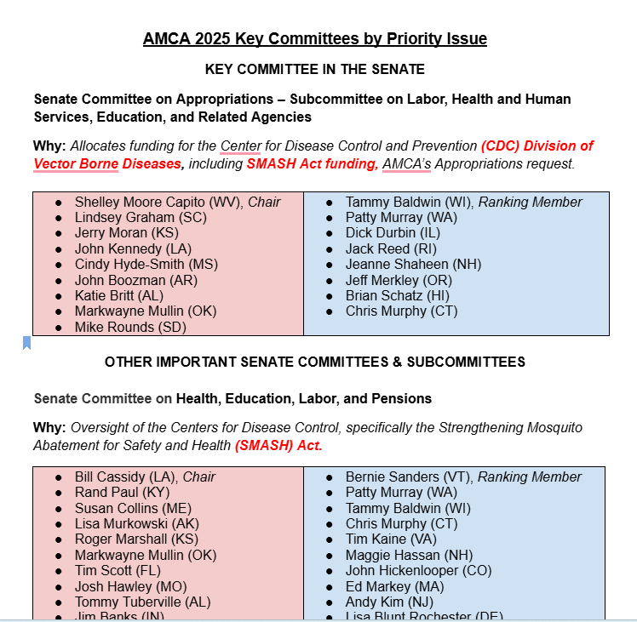
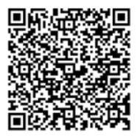
Use this guide to target members of Congress to maximize our impact. We are small, but mighty!
Before you request a meeting with a key member of Congress,
Check the meeting spreadsheet to see if the Normandy Group has already requested a meeting.

Slide 4
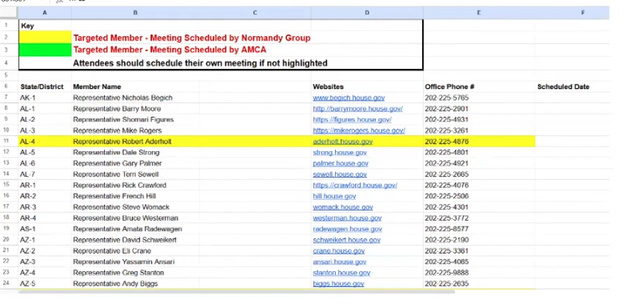
Hill Visit Meeting Master Spreadsheet
If it’s yellow; be mellow.
Then, coordinate with Katherine.
kschmitz@thenormandygrp.com

Slide 5
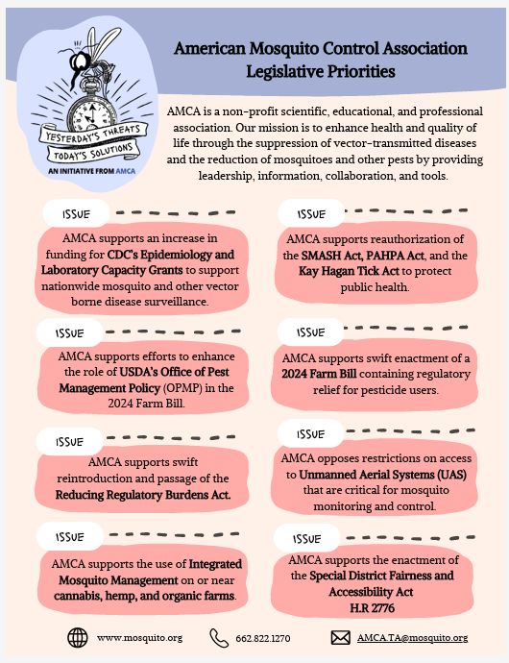
This is your conversation starter
You will have a packet with all the materials to leave behind in each office
You will choose your message
Changes with each member of Congress
Based on party and committee appointments
Based on their values
Depends on your personal experience, passion, and comfort level

Slide 6
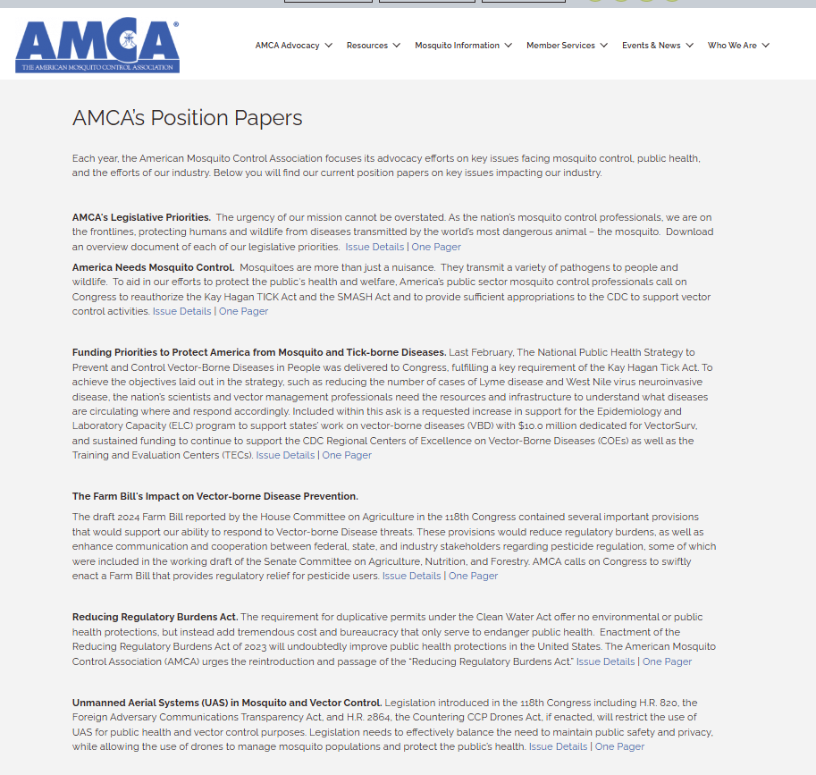
Tools
The position papers are online
Along with a detailed webpage for each issue with more details
The detailed page will change as bills move through the legislative session

Slide 7
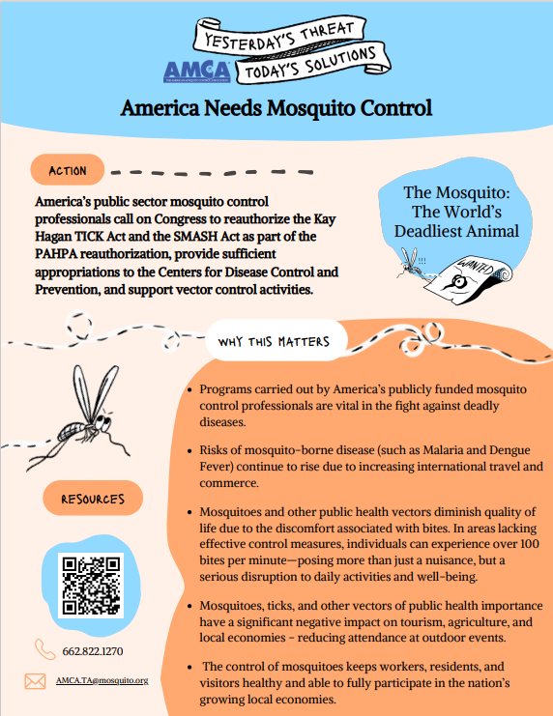
America Needs Mosquito Control
Globalization, climate change, and urbanization have contributed to an increase in the number of vector-borne disease cases in the United States.
Vector-borne diseases can affect many aspects of society: human health, quality of life, pets, agriculture, native wildlife, and the economy can all be negatively impacted.
It is widely expected that these risks will only grow worse.
Mosquito and vector control organizations are the frontline of this battle, yet many of us are underprepared.
ASK: Mitigate the threat by supporting the specific legislative asks of the AMCA.

Slide 8
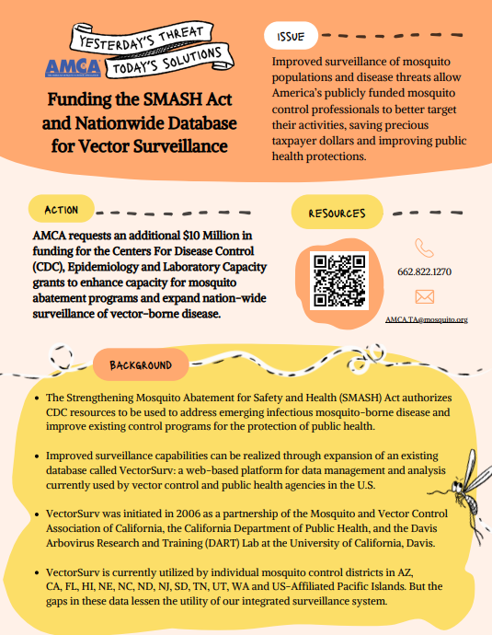
Support the AMCA’s Appropriations Request to Increase ELC Funding
AMCA members submitted an appropriations request earlier this year to increase Epidemiology and Laboratory Capacity (ELC) funding grant monies to $50 million.
The current funding level of $40 million would be increased by $10 million to support surveillance, early detection, and rapid response through nationwide participation in VectorSurv
VectorSurv is a computer program that allows for rapid data sharing about mosquito populations, viruses, mosquito resistance, and other information.
Timely and easy sharing of vector-borne disease information will improve the ability of vector control organizations to respond in a coordinated fashion.
VectorSurv is currently used by many Mosquito Control Districts in over 20 states, but wide gaps in data exist, which increase risks to public health.
ASK for Labor, Health and Human Services (LHHS), Education Appropriations Bill: Please support $698,272,000 for the Emerging and Zoonotic Infectious Diseases account to include $50 million for epidemiology and lab capacity, of which $10 million is to be directed to the support of VectorSurv.

Slide 9
Support the continued funding of the CDC’s Division of Vector-Borne Diseases (DVBD)
The CDC’s DVBD is critical in supporting the country’s surveillance and testing for all states.
Speak to how your program works with the State Lab for surveillance and testing.
The DVBD is the central hub to support and coordinate with the COE and the TEC
These centers demonstrate the value of collaboration and coordination between states, local Districts, and the academic community
The vector control community is small but very connected. A potential lack of resources to investigate new and emerging diseases would be devastating to the long-term protection of public health. (Zika, Oropouche, Dengue, West Nile)
The DVBD provides expertise and support where established Districts are not available due to a lack of resources (resistance testing)
The DVBD is necessary for the investigation of new and emerging techniques to allow for more efficient control of vectors (SIT) and to communicate the real-time status of diseases across the country (VectorSurv)
ASK: Please support the continued funding of the Centers of Disease Control and Prevention, Division of Vector Borne Disease

Slide 10
Support the SMASH Act language in the Pandemic and All-Hazards Preparedness Act (PAHPA)
The SMASH Act, first authorized in 2019, reinforces Congress’s support of a comprehensive effort to combat vector-borne diseases.
Congress has continued to support the SMASH Act language over the years.
A new version of the SMASH Act needs to be introduced & authorized this summer (SMASH 2.0 Act)
Although funding has not been appropriated directly for the SMASH Act, the CDC utilizes these authorities for vector-borne disease preparedness (i.e., Zika, Eastern Equine Encephalitis, Dengue, Malaria, West Nile Virus, Oropouche)
Some highlights of SMASH 2.0 include authorization for innovative new research programs with a focus on new pesticides, SIT techniques, non-pesticide control methods, nano-formulations, and biopesticides.
Additionally, SMASH 2.0 authorizes funding for a national vector surveillance database (VectorSurv)
ASK: Please support SMASH 2.0, as part of PAHPA.

Slide 11
Support the Kay Hagan Tick Act
Sens. Smith and Collins renamed the bill in honor of former Senator Kay Hagan, who passed away due to complications from the tick-borne disease known as the Powassan virus.
Using a three-pronged approach, the Tick Act:
1. Required the Department of Health and Human Services (HHS) to develop a National Strategy. This helped expand research, improve testing and treatment, and coordinate common efforts with DOD, USDA, EPA, the VA, and the Departments of Interior and Homeland Security.
2. Reauthorized the Regional Centers of Excellence in Vector-Borne Disease for five years at $10 million per year. Funding for these centers, which was allotted in 2017, expired in 2021. These Centers have led the scientific response against tick-borne diseases, which now make up 75 percent of vector-borne diseases in the U.S.
3. Authorized CDC Grants at $20 million per year awarded to State Health Departments to improve data collection and analysis, support early detection and diagnosis, improve treatment, and raise awareness. These awards would help states build a public health infrastructure for Lyme and other tick and vector-borne diseases and amplify their initiatives through public-private partnerships.

Slide 12
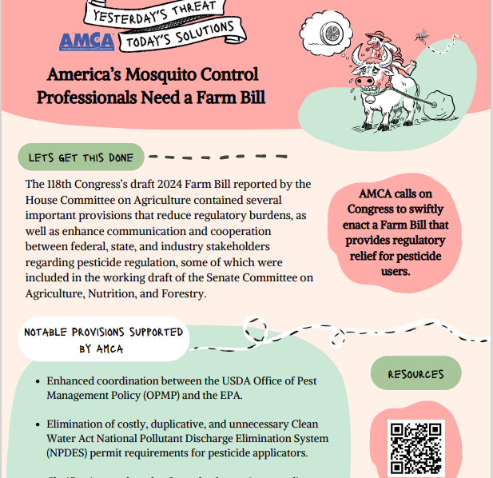
The AMCA supports pesticide preemption in the Farm Bill to ensure that pesticide regulation remains under the authority of the EPA
Pesticides are an essential tool used by vector control organizations to safeguard human health, agriculture, pets, and the economy.
Some local jurisdictions are independently regulating pesticides based on misconceptions and without input from the EPA.
Many vector control organizations operate across multiple local jurisdictions. A patchwork of local pesticide regulations would complicate our responsibilities, potentially remove a vital tool from our vector control toolbox, and hinder our ability to respond effectively to disease outbreaks.
Supporting pesticide preemption ensures that local vector control can continue to protect public health.

Slide 13
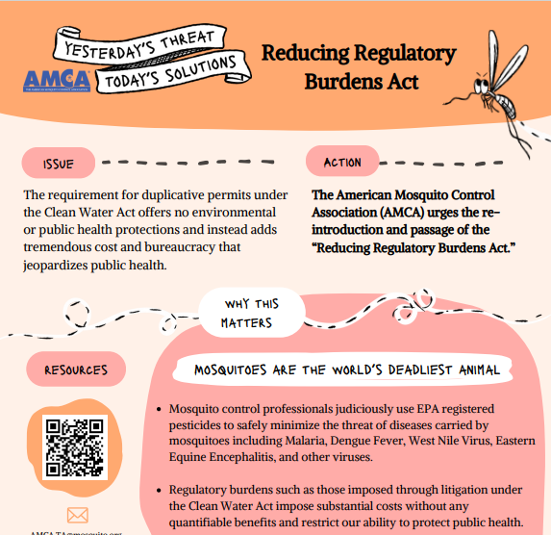
We urge Congress to reintroduce and pass the Reducing Regulatory Burdens Act
AMCA has strongly supported the “Reducing Regulatory Burdens Act” in each Congress since 2011.
NPDES pesticide general permits (PGPs) do not add any environmental benefits.
The burden PGPs impose on Mosquito Control Districts does, however, add significant costs, which in turn increase the risk of mosquito-borne diseases, including Malaria, Dengue, Zika, Eastern Equine Encephalitis, West Nile Virus, and Chikungunya.
This legislation would eliminate costly, duplicative, and unnecessary Clean Water Act National Pollutant Discharge Elimination System (NPDES) permit requirements for pesticide applicators.

Slide 14
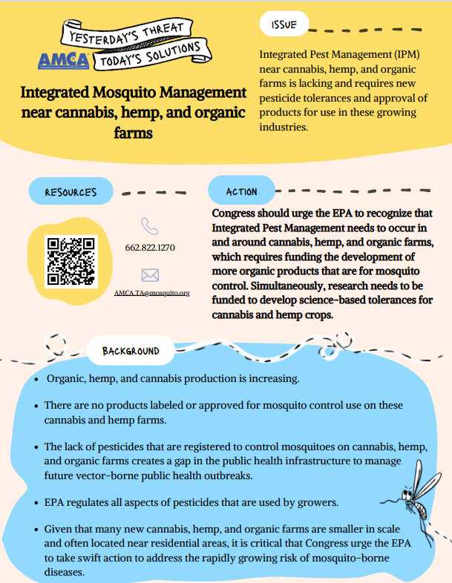
Organic farming, hemp, and cannabis production are increasing
Mosquito control products have not been labelled for use around these farming practices.
The lack of suitable products creates a gap in our ability to respond.
Ask your legislator to direct the EPA to develop tolerances for mosquito control products.

Slide 15
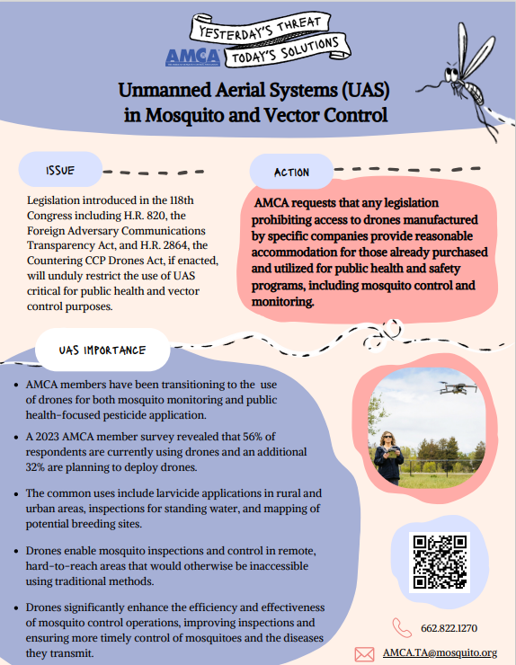
UASs are used to conduct applications in otherwise inaccessible areas and improve worker safety
Some states are restricting the use of UASs based on their country of origin over concerns about data acquisition and the ability of foreign governments to access this data
UAS used for application purposes do not collect images, visuals, or conversations; nor do they transmit and store this data
Public agencies have made significant investments in this equipment. Causing them to ground this aircraft and purchase anew would strain already limited resources.
Recognize in any legislation that may arise that UASs have legitimate and important uses in protecting public health, and limiting their use will negatively affect mosquito control.
Share with your legislator that AMCA is working closely with regulators at the FAA and EPA to provide guidance and training to AMCA members who use UAS to make safe, effective, and efficient applications that protect the environment, wildlife, and public health.

Slide 16
Ask your legislator to support the Special District Fairness and Accessibility Act (H.R. 2766), which would define “special district” in federal law
This Act would drive federal understanding of the Special District as a form of local government across the nation
The Act would also require the Office of Management and Budget (OMB) to issue guidance to federal agencies that clarifies and reinforces that special districts are local governments
Special districts altogether employ 890,000 Americans and provide about one-fifth of the local critical infrastructure and essential (non-education) community services across the country, including mosquito control districts
If federally recognized, Mosquito Control Districts would have access to direct or pass-through federal programs to supplement local governmental infrastructure and other essential services.

Slide 17
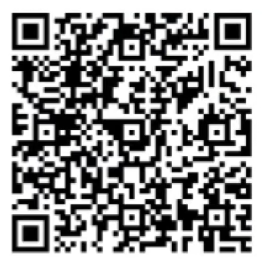
Hill Visit Meeting Master Spreadsheet

Slide 18
Last Minute things
Group your Hill visits – House side together, Senate together
Check the weather – umbrella, coat
Packing – comfortable shoes, a bag for packets
Plan some touristy time
Fill your Hill day
If you have connections in other states, fill in as needed

Slide 19
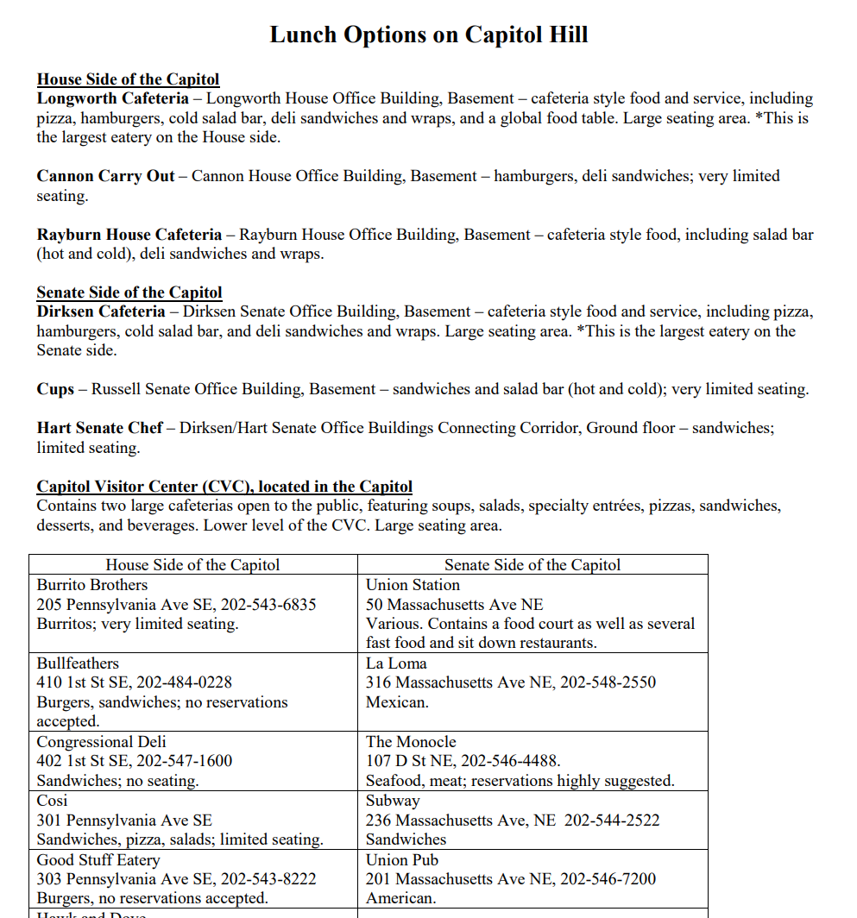
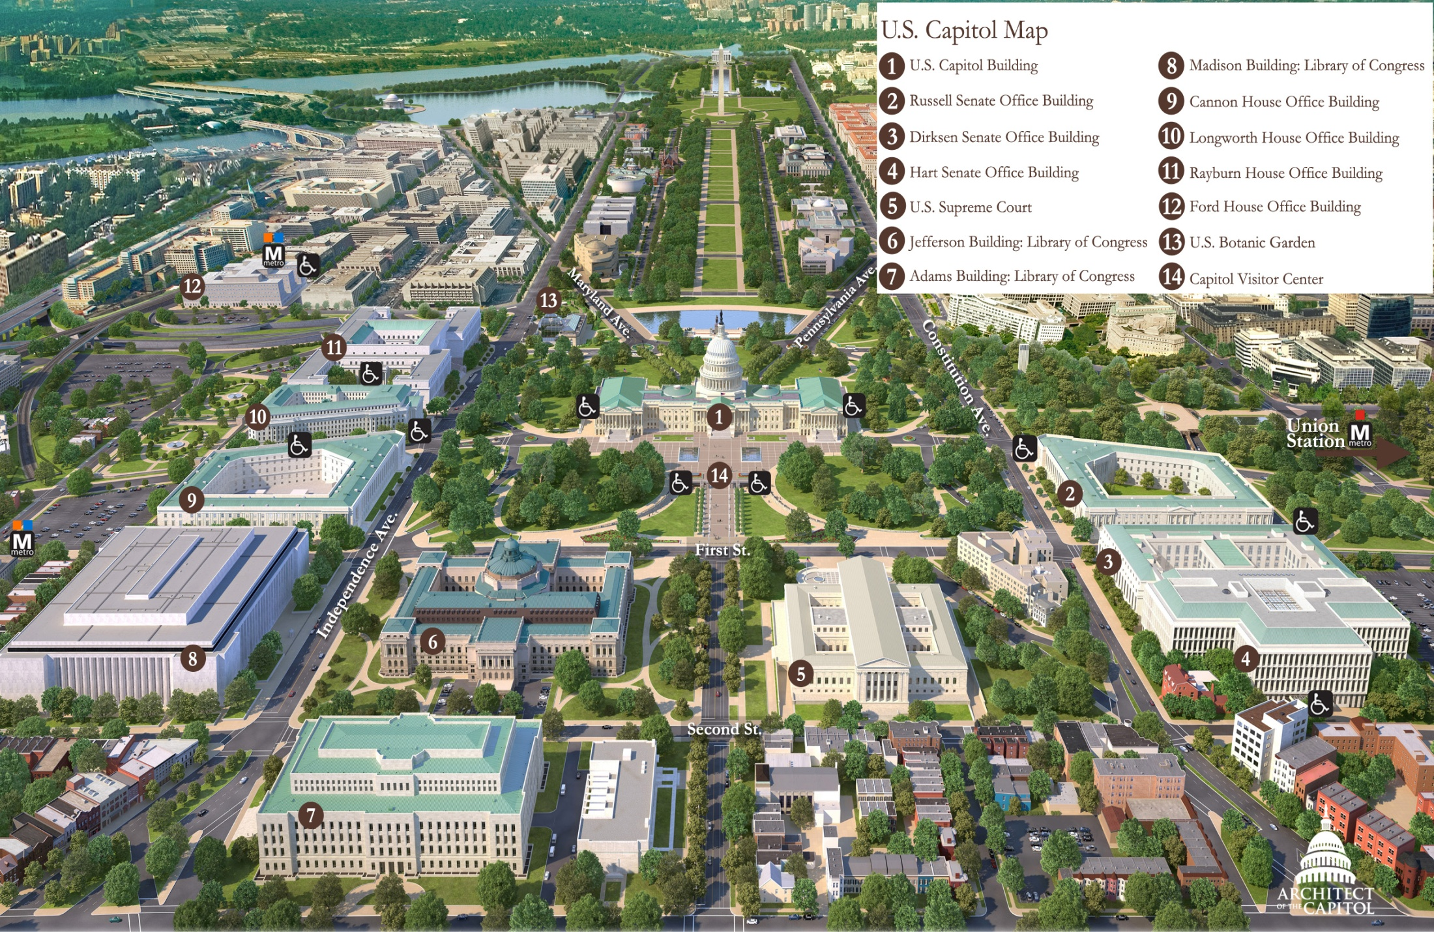

Slide 20
Breakfast will be served Wed. morning
Team up with others to go to the Hill
Allow yourself enough time – >45 minutes before your 1st mtg.
<$15 there and back
Ask for a “buddy” at any time, and we will help you every step of the way.
Now, at the conference, ask a stranger at the station
Notes:
Mark

Slide 21
Questions
Position Papers
Daniel Markowski, PhD
AMCA.TA@mosquito.org
(662) 822-1270
Mentorship Program
Angela Beehler
Angela@MosquitoControl.org
(509) 572-7864
Congressional Visits
Dr. John Goldberg
jgoldberg@thenormandygrp.com
(703) 244-0275
Meeting Info and Registration
Natalie Perry
nperry@amgroup.us
(888) 260-0630

