Slide 1
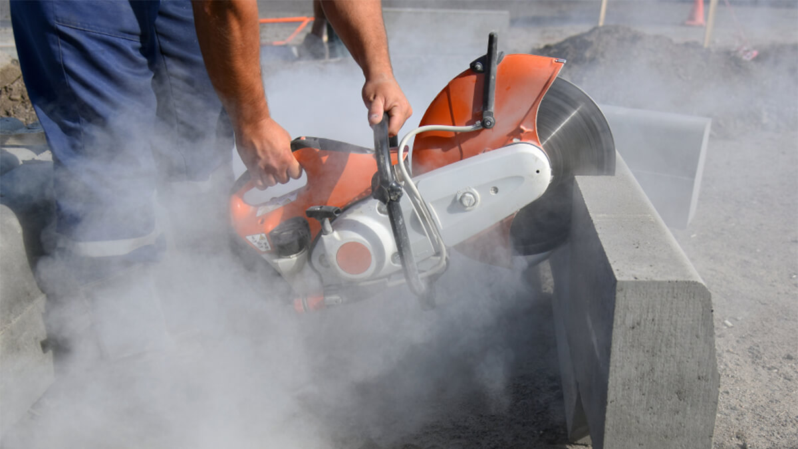

CRYSTALLINE SILICA
HBACA SAFETY COMMITTEE PRESENTATION
-Rubon Caldwell Hirschi Masonry
-Michael Abbott D.R. Horton

Slide 2
What is Crystalline Silica?
What is Silica?
Crystalline silica is a naturally occurring mineral. It is one of the most common minerals found on Earth.
Found in:
  Sand
  Stone
  Rock
  Concrete
  Brick
  Mortar
  Block
  Granite
  Quartz
Why is it dangerous?
When these materials are cut, drilled, ground, or demolished, very small dust particles become airborne.
These particles are called Respirable Crystalline Silica (RCS) because they are small enough to enter deep into the lungs.

Slide 3
Where Does Silica Exposure Occur?
Workers may be exposed while:
Cutting CMU block
Saw cutting concrete
Grinding mortar joints
Jackhammering
Demolition work
Drilling concrete
Mixing dry mortar
Sweeping silica dust
Chipping masonry
Using abrasive blasting equipment
Reminder:
You cannot see the smallest dangerous silica particles.

Slide 4
Health Hazards
Long-Term Exposure Can Cause:
Silicosis
Lung Cancer
Chronic Obstructive Pulmonary Disease (COPD)
Kidney Disease
Reduced Lung Function
Permanent Scarring of the Lungs
Symptoms
Shortness of breath
Persistent cough
Fatigue
Chest pain

Slide 5
OSHA Silica Standard – 29 CFR 1926.1153
OSHA requires employers to:
Limit employee exposure
Use engineering controls
Provide respiratory protection when needed
Restrict housekeeping practices that create dust
Train employees
Offer medical surveillance for qualifying employees
Maintain written exposure control plans

Slide 6
OSHA Exposure Limits
Permissible Exposure Limit (PEL)
OSHA's PEL is:
50 micrograms per cubic meter (50 µg/m³)
Average over an 8-hour workday (TWA).
Action Level
25 µg/m³
When exposures reach the Action Level, employers must begin monitoring and implement additional protective measures.

Slide 7
Engineering Controls
OSHA requires employers to control dust at the source whenever possible.
Examples:
Wet cutting
Wet drilling
Water suppression
Vacuum dust collection systems
HEPA-filter vacuums
Local exhaust ventilation
Engineering controls must be used before relying on respirators.

Slide 8
Respiratory Protection & PPE
Workers may need:
N95 Respirator
Half-face respirator
Full-face respirator (depending on exposure)
Additional PPE:
Safety glasses
Face Shield
Hearing protection
Gloves
Protective clothing when necessary

Slide 9
Required Respiratory Protection
If a company requires their employees to wear an N95 respirator, half-face respirator or full-face respirator, they must have:
A medical evaluation to determine they are physically able to wear a respirator.
An initial fit test before using the respirator.
Annual fit testing thereafter.
Respirator training before first use and at least annually.
A clean-shaven face where the respirator seals against the skin.
These requirements are covered under 29 CFR 1910.134

Slide 10
Voluntarily Use of Respiratory Protection
If employees are voluntarily wearing a filtering facepiece respirator (such as an N95) and it is not required by the employer or OSHA, then:
A fit test is generally not required.
The employer must provide the employee with Appendix D of OSHA's Respiratory Protection Standard, which explains the limitations and proper use of voluntary respirator use.
Respirators are used only when engineering controls cannot adequately reduce silica exposure.

Slide 11
Employee Responsibilities
Every employee should:
Follow safe work procedures
Use water suppression whenever required
Use dust collection equipment
Wear appropriate PPE
Never remove or disable dust controls
Report damaged equipment immediately
Attend silica training
Ask questions if unsure

