Slide 1
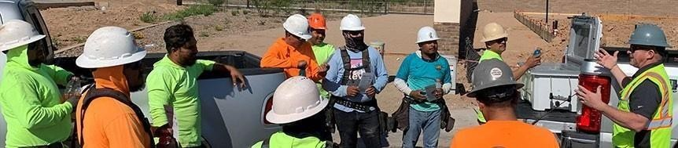

HBACA Builder Safety Committee
Ladder Safety Awareness
November 2025
Initiative & Stand Down Kit
The HBACA is excited to announce that November is Ladder Safety Awareness Month. All builders and trade partners
are asked to join us in our valley wide Safety Stand Down in the month of November. In addition, feel free to break out the training topics throughout the month.
Distribution Network
HBACA members field employees and at the discretion of each builder and their trade partners. Builders are encouraged to distribute these accordingly and organize brief safety meetings/discussion sessions throughout their communities.
Elements of theKit:
Tool Box Talk #1 – Ladder Safety Checklists
Tool Box Talk #2 – Selecting the Right Ladder for the Job (English and Spanish)
Tool Box Talk #3 – Ordering Replacement Stickers
Tool Box Talk #4- Step Stool
Learn more at www.hbaca.org

Slide 2
Ladder Safety DOs and DON’Ts
To prevent workers from being injured due to falls from various types of ladders, including extension ladders and stepladders, employers are encouraged to adopt the following practices:
Safe Extension Ladder Use—DO:
Maintain a 3-point contact (two hands and a foot, or two feet and a hand) when climbing/descending a ladder.
Face the ladder when climbing or descending.
Keep the body inside the side rails.
Use extra care when getting on or off the ladder at the top or bottom.
Avoid tipping the ladder over sideways or causing the ladder base to slide out.
Carry tools in a tool belt or raise tools up using a hand line. Never carry tools in your hands while climbing up/down a ladder.
Extend the top of the ladder three feet above the landing.
Keep ladders free of any slippery materials.
Safe Extension Ladder Use—DON’T:
Place a ladder on boxes, barrels, or unstable bases.
Use a ladder on soft ground or unstable footing.
Exceed the ladder’s maximum load rating.
Tie two ladders together to make them longer.
Ignore nearby overhead power lines.
Move or shift a ladder with a person or equipment on the ladder.
Lean out beyond the ladder’s side rails.
Use an extension ladder horizontally like a platform.
Safe Stepladder Use—DO:
Read and follow all the manufacturer’s instructions and labels on the stepladder.
Look for overhead power lines before handling or climbing a ladder.
Maintain a 3-point contact (two hands and a foot, or two feet and a hand) when climbing/descending a ladder.
Stay near the middle of the ladder and face the ladder while climbing up/down.
Use a barricade to keep traffic away from the ladder.
Keep ladders free of any slippery materials.
Only put ladders on a stable and level surface that is not slippery.
Safe Stepladder Use—DON’T:
Use stepladders for a purpose other than that for which they were designed.
Use a stepladder with spreaders unlocked.
Use the top step or cap as a step.
Place a ladder on boxes, barrels or other unstable bases.
Move or shift a ladder with a person or equipment on the ladder.
Use cross bracing on the rear of stepladders for climbing.
Paint a ladder with opaque coatings.
Use a damaged ladder.
Leave tools/materials/equipment on stepladder.
Use a stepladder horizontally like a platform.
Use a metal stepladder near power lines or electrical equipment.
For more information, see the OSHA Safe Use of Extension Ladders – Fact Sheet or the OSHA Safe Use of Stepladders – Fact Sheet. Upcoming courses held in-person and on ZOOM:
OSHA #3115 Fall Protection Classes
OSHA #510 OSHA Standards for the Construction Industry Classes
OSHA #511 OSHA Standards for General Industry Classes
October 21, 2025|Fall Prevention, Ladders|

Slide 3
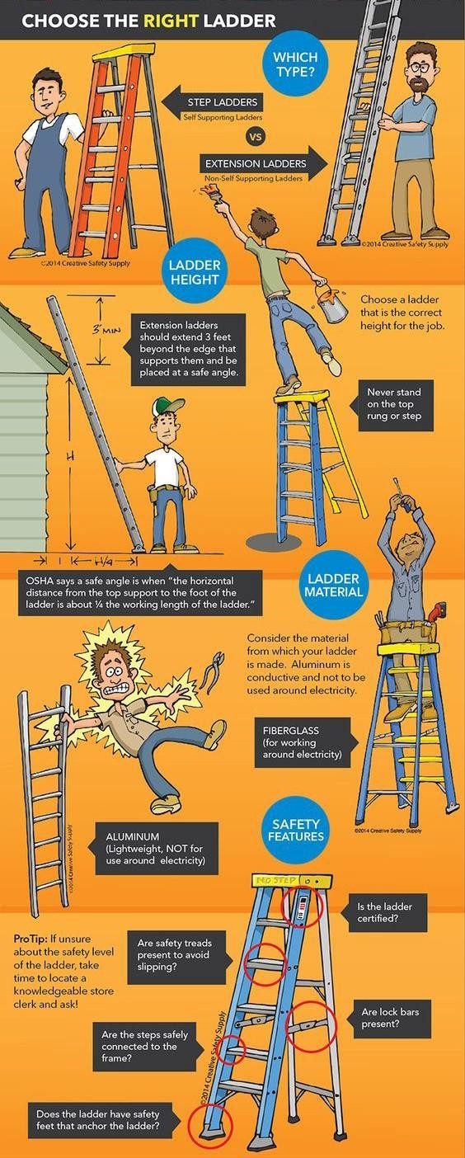

Slide 4

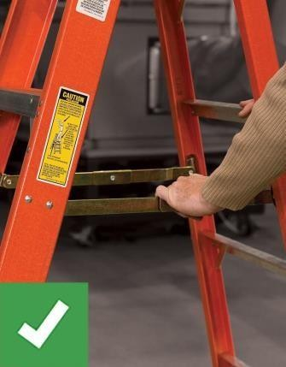
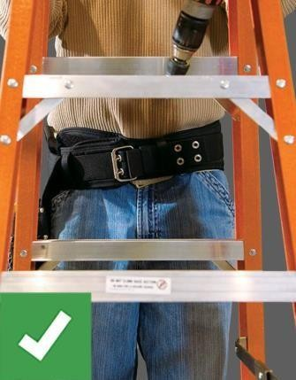
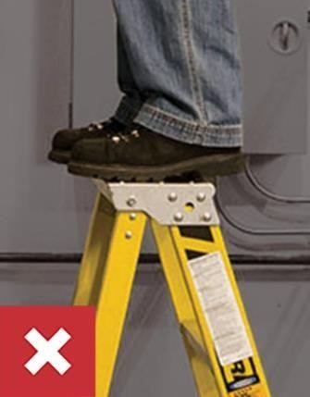
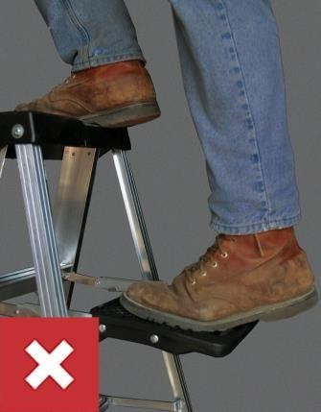
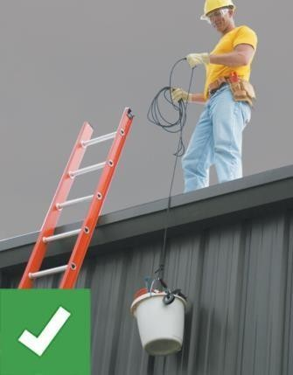
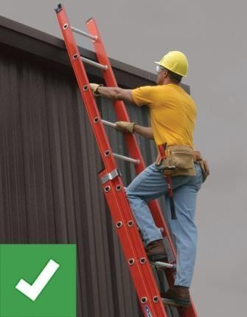
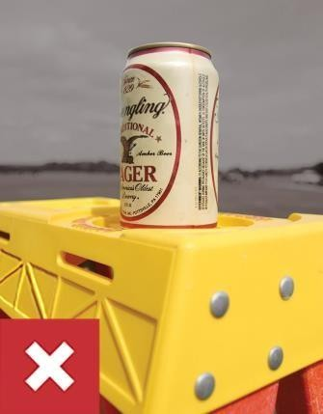
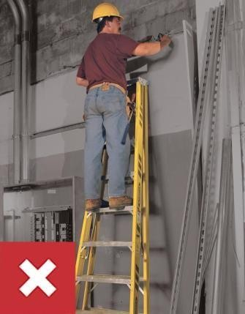

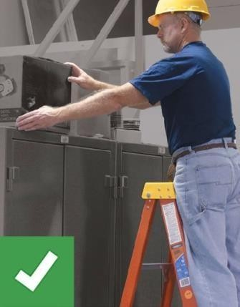
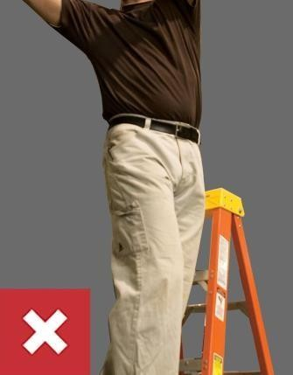
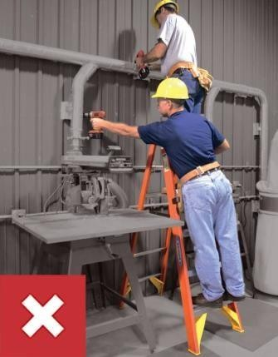
LADDER SAFETY TIPS
Ladders are common everyday tools that many workers take for granted. As you read the safety guidelines, you may say: “I know that, that’s just plain common sense.” You can avoid a ladder injury if you think before you act and use ladders correctly. Your work will be easier and more productive, too. Most ladder related injuries are preventable, if you think before you climb.
THE "RIGHT" WAY TO USE A LADDER THE "WRONG" WAY TO USE A LADDER
RIGHT
Properly set-up and use the ladder in accordance with safety instructions and warnings. Wear shoes with non-slip soles.
RIGHT
Center body on the ladder and keep belt buckle between the rails while maintaining a rm grip.
WRONG
DON'T stand above the second step from the top of a stepladder or the fourth rung from the top of an extension ladder.
WRONG
DON'T climb on the back of a stepladder. DON'T stand or sit on a stepladder top or pail shelf.
RIGHT
Haul materials with a line rather than carry them up an extension ladder. Use extra caution when carrying anything on a ladder.
RIGHT
Climb facing the ladder, move one step at a time and rmly set one foot before moving the other.
WRONG
DON'T climb a ladder if you are not physically and mentally up to the task.
WRONG
DON'T climb a closed ladder, it may slip out from under you.
RIGHT
Have another person help with a heavy ladder. Have another person hold the ladder while you are working onit.
RIGHT
Move materials with extreme caution. Be careful pushing or pulling anything while on a ladder. You may lose your balance or tip the
WRONG
DON'T over-reach, lean to one side or try to move a ladder while on it. Climb down and then re-position the ladder closer to your work.
WRONG
DON'T exceed the maximum load capacity or duty rating of a ladder. DON’T permit more than one person on a single-sided stepladder
WernerCo. Support/Training/Safety Instructions, "Ladder Safety Tips" 2022, https://www.wernerco.com/us/support/training/safety-instructions.

Slide 5


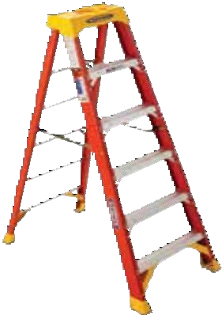
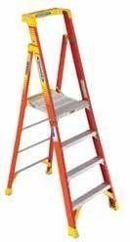
LADDER INSPECTION CHECKLISTS
All ladders should be thoroughly inspected from top to bottom before every use. Ladders can be damaged while in transit or storage, and through misuse and abuse.
Examine the ladders carefully for damaged or missing parts. Never use a bent or damaged ladder or one that has been exposed to excessive heat or acid.
STEPLADDER Size: ft. Fiberglass Aluminum Wood Circle Areas of Damage ⁶²⁰⁶ |  | PODIUM Size: ft. Fiberglass Aluminum Circle Areas of Damage ^{PD6204}
YES | NO | YES NO Steps:
Steps:
Loose, cracked, bent, or missing |  | Loose, cracked, bent, or missing
Rails: Cracked, bent, split or frayed rail shields |  | Rails: Cracked, bent, split or frayed rail shields
Labels: Missing or not readable |  | Labels: Missing or not readable
Pail Shelf: Loose, bent, missing, or broken |  | Top: Cracked, loose, or missing
Top: Cracked, loose, or missing |  | Spreader: Loose, bent, or broken
Spreader: Loose, bent, or broken |  | Platform: Cracked or bent
General: Rust, corrosion, or loose |  | General: Rust, corrosion, or loose
Other: Bracing, shoes, or rivets ACTIONS: Ladder tagged as damaged and removed from use Ladder is in good condition |  | Other: Bracing, shoes, or rivets ACTIONS: Ladder tagged as damaged and removed from use Ladder is in good condition
WernerCo. Support/Training/Climbing Pro, "Climbing Pro" 8/2020, https://www.wernerco.com/us/support/training/climbing-pro.

Slide 6
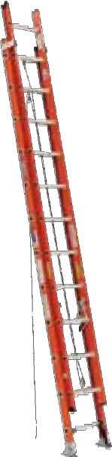
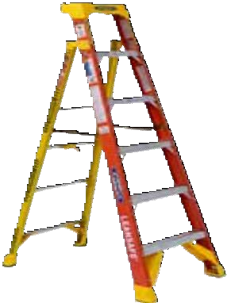
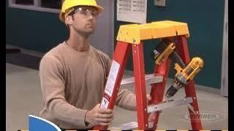
EXTENSION LADDER
Size: ft.
LEANSAFE
Size: ft.
Fiberglass
Fiberglass
Aluminum
Aluminum
Circle Areas of Damage
D6224
Circle Areas of Damage
L6206
Rungs:
Loose, cracked, bent, or missing
Rails:
Cracked, bent, split, or frayed
Labels:
Missing or not readable
Rung Locks:
Loose, bent, missing, or broken
Hardware:
Damaged, loose, or missing
Shoes:
Worn, broken, or missing
Rope / Pulley:
Loose, bent, or broken
General:
Rust, corrosion, or loose
Other:
Bracing rivets
YES NO
Steps:
Loose, cracked, bent, or missing
Rails:
Cracked, bent, split or frayed rail shields
Labels:
Missing or not readable
Hinge Mechanism:
Loose, bent, missing, or broken
Top:
Cracked, loose, or missing
Spreader:
Loose, bent, or broken
General:
Rust, corrosion, or loose
Other:
Bracing, shoes, or rivets
YES NO
ACTIONS:
ACTIONS:
Ladder tagged as damaged and removed from use
Ladder is in good condition
Ladder tagged as damaged and removed from use
Ladder is in good condition
We rner La dder - Segu ridad co n las es caleras
Al nalizar es te cu rso, podrá selec cionar la esc alera ap ropiad a pa ra su traba jo, insp eccionarla correctam ente, man ipularla y transp ortarla pa ra evitar
►
dañ os y conoce r las maneras ade cu ad as de utilizar la esc alera de man era segura.
WernerCo. Support/Training/Ladder Safety Videos, "Ladder Safety Videos" 2022, https://www.wernerco.com/us/support/training/safety-videos.

Slide 7
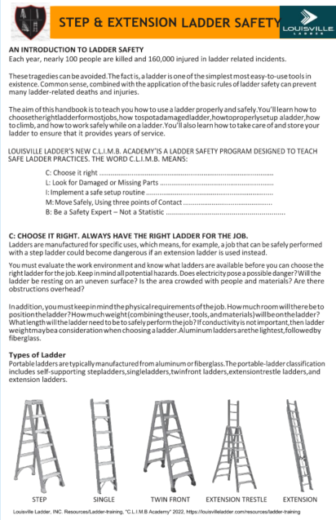


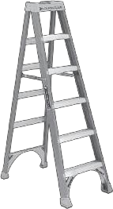

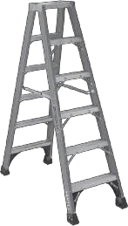
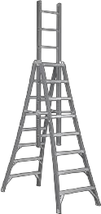

STEP & EXTENSION LADDER SAFETY
AN INTRODUCTION TO LADDER SAFETY
Each year, nearly 100 people are killed and 160,000 injured in ladder related incidents.
Thesetragedies can be avoided.The factis, a ladder is one of the simplest most easy-to-use tools in existence. Common sense, combined with the application of the basic rules of ladder safety can prevent many ladder-related deaths and injuries.
The aim of this handbook is to teach you how to use a ladder properly and safely.You’ll learn how to choosetherightladderformostjobs,how tospotadamagedladder,howtoproperlysetup aladder,how to climb, and how to work safely while on a ladder.You’ll also learn how to take care of and store your ladder to ensure that it provides years of service.
LOUISVILLE LADDER’S NEW C.L.I.M.B. ACADEMY®IS A LADDER SAFETY PROGRAM DESIGNED TO TEACH SAFE LADDER PRACTICES. THE WORD C.L.I.M.B. MEANS:
C: Choose it right ............................................................................................ L: Look for Damaged or Missing Parts ............................................................
I: Implement a safe setup routine ...................................................................
M: Move Safely, Using three points of Contact ...............................................
B: Be a Safety Expert – Not a Statistic ............................................................
C: CHOOSE IT RIGHT. ALWAYS HAVE THE RIGHT LADDER FOR THE JOB.
Ladders are manufactured for specific uses, which means, for example, a job that can be safely performed with a step ladder could become dangerous if an extension ladder is used instead.
You must evaluate the work environment and know what ladders are available before you can choose the right ladder for the job. Keep inmind all potential hazards.Does electricity pose a possible danger?Will the ladder be resting on an uneven surface? Is the area crowded with people and materials? Are there obstructions overhead?
Inaddition,youmustkeepinmindthephysicalrequirements ofthejob.Howmuchroomwilltherebeto positiontheladder?Howmuchweight(combiningtheuser,tools,andmaterials)willbeontheladder? Whatlength willtheladder need to be to safely perform thejob? If conductivity is not important,then ladder weightmaybea consideration when choosing aladder.Aluminum laddersarethe lightest,followedby fiberglass.
Types of Ladder
Portableladders are typically manufactured from aluminum or fiberglass.The portable-ladder classification includes self-supporting stepladders,singleladders,twinfront ladders,extensiontrestle ladders,and extension ladders.
STEP SINGLE TWIN FRONT EXTENSION TRESTLE EXTENSION
Louisville Ladder, INC. Resources/Ladder-training, "C.L.I.M.B Academy" 2022, https://louisvilleladder.com/resources/ladder-training

Slide 8
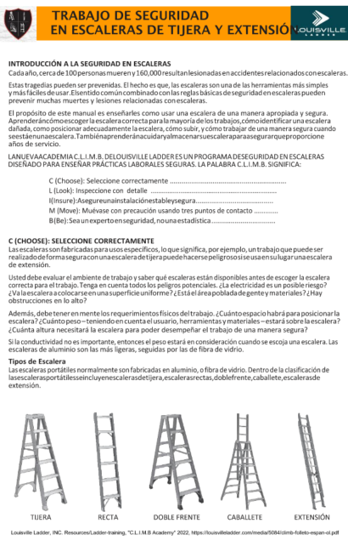


TRABAJO DE SEGURIDAD
EN ESCALERAS DE TIJERA Y EXTENSIÓN
INTRODUCCIÓN A LA SEGURIDAD EN ESCALERAS
Cadaaño, cercade100personasmuereny160,000resultanlesionadas enaccidentesrelacionados conescaleras.
Estas tragedias pueden ser prevenidas. El hecho es que, las escaleras son una de las herramientas más simples y más fáciles deusar.Elsentido comúncombinado con las reglas básicas deseguridad en escaleras pueden prevenir muchas muertes y lesiones relacionadas con escaleras.
El propósito de este manual es enseñarles como usar una escalera de una manera apropiada y segura. Aprenderáncómoescoger la escaleracorrecta parala mayoría delos trabajos,cómoidentificar una escalera dañada, como posicionar adecuadamente la escalera, cómo subir, y cómo trabajar de una manera segura cuando seestáenunaescalera.Tambiénaprenderánacuidaryalmacenarsuescaleraparaasegurarqueproporcione años de servicio.
LANUEVAACADEMIA C.L.I.M.B. DELOUISVILLE LADDER ES UN PROGRAMA DESEGURIDAD EN ESCALERAS DISEÑADO PARA ENSEÑAR PRÁCTICAS LABORALES SEGURAS. LA PALABRA C.L.I.M.B. SIGNIFICA:
C (Choose): Seleccione correctamente ............................................................
L (Look): Inspeccione con detalle ....................................................................
I(Insure):Asegureunainstalaciónestableysegura........................................ M (Move): Muévase con precaución usando tres puntos de contacto ............. B(Be):Seaunexpertoenseguridad, nounaestadística.................................
C (CHOOSE): SELECCIONE CORRECTAMENTE
Las escaleras son fabricadas para usos específicos, lo que significa, por ejemplo, un trabajo que puede ser realizadodeformaseguraconunaescaleradetijerapuedehacersepeligrososiseusaensulugarunaescalera de extensión.
Usted debe evaluar el ambiente de trabajo y saber qué escaleras están disponibles antes de escoger la escalera correcta para el trabajo. Tenga en cuenta todos los peligros potenciales. ¿La electricidad es un posible riesgo?
¿Valaescaleraacolocarseen unasuperficieuniforme? ¿Estáel áreapobladadegentey materiales?¿Hay obstrucciones en lo alto?
Además, debe tener en mentelos requerimientos físicos deltrabajo. ¿Cuánto espacio habrá para posicionar la escalera? ¿Cuánto peso – teniendo en cuenta el usuario, herramientas y materiales – estará sobre la escalera?
¿Cuánta altura necesitará la escalera para poder desempeñar el trabajo de una manera segura?
Si la conductividad no es importante, entonces el peso estará en consideración cuando se escoja una escalera. Las escaleras de aluminio son las más ligeras, seguidas por las de fibra de vidrio.
Tipos de Escalera
Las escaleras portátiles normalmente son fabricadas en aluminio, o fibra de vidrio. Dentro de la clasificación de lasescalerasportátilesseincluyenescalerasdetijera,escalerasrectas,doblefrente,caballete,escalerasde extensión.
TIJERA RECTA DOBLE FRENTE CABALLETE EXTENSIÓN
Louisville Ladder, INC. Resources/Ladder-training, "C.L.I.M.B Academy" 2022, https://louisvilleladder.com/media/5084/climb-folleto-espan-ol.pdf

Slide 9
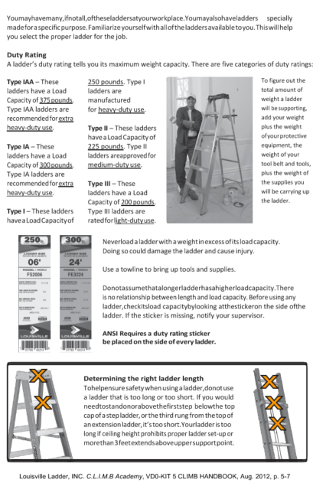
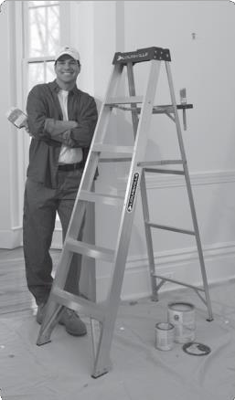


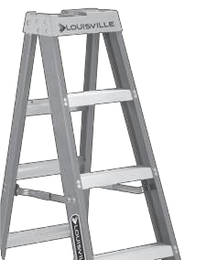
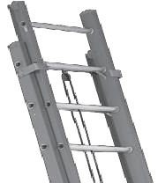

Youmayhavemany,ifnotall,oftheseladdersatyourworkplace.Youmayalsohaveladders specially madeforaspecificpurpose.Familiarize yourselfwithalloftheladdersavailabletoyou.Thiswillhelp you select the proper ladder for the job.
Duty Rating
A ladder’s duty rating tells you its maximum weight capacity. There are five categories of duty ratings:
Type IAA – These ladders have a Load Capacity of 375 pounds. Type IAA ladders are recommended for extra heavy-duty use.
250 pounds. Type I ladders are manufactured
for heavy-duty use.
To figure out the total amount of weight a ladder will be supporting, add your weight plus the weight of yourprotective equipment, the weight of your
tool belt and tools, plus the weight of the supplies you will be carrying up the ladder.
Type II – These ladders have a Load Capacity of 225 pounds. Type II ladders areapproved for medium-duty use.
Type IA – These ladders have a Load Capacity of 300 pounds. Type IA ladders are recommended for extra heavy-duty use.
Type III – These ladders have a Load Capacity of 200 pounds. Type III ladders are ratedforlight-dutyuse.
Type I – These ladders havea Load Capacityof
Neverload a ladder with a weightinexcess ofitsload capacity. Doing so could damage the ladder and cause injury.
Use a towline to bring up tools and supplies.
Donotassumethatalongerladderhasahigherloadcapacity.There is no relationship between length and load capacity. Before using any
ladder,checkitsload capacitybylooking atthestickeron the side ofthe ladder. If the sticker is missing, notify your supervisor.
ANSI Requires a duty rating sticker be placed on the side of every ladder.
Determining the right ladder length Tohelpensure safety when using a ladder,donotuse a ladder that is too long or too short. If you would needtostandonorabovethefirststep belowthe top cap of a step ladder,or the third rung from the top of anextension ladder,it’s too short.Yourladder is too long if ceiling height prohibits proper ladder set-up or morethan3feetextendsaboveuppersupportpoint.
Louisville Ladder, INC. C.L.I.M.B Academy, VD0-KIT 5 CLIMB HANDBOOK, Aug. 2012, p. 5-7

Slide 10
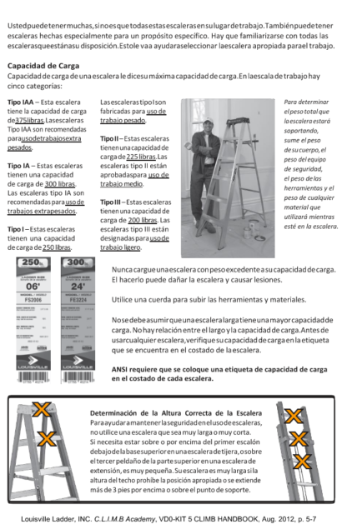
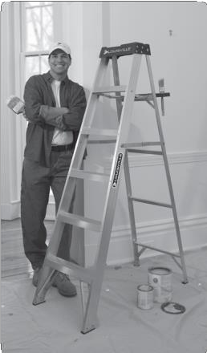
Ustedpuedetenermuchas,sinoesquetodasestasescalerasensulugardetrabajo.Tambiénpuedetener escaleras hechas especialmente para un propósito específico. Hay que familiarizarse con todas las escalerasqueestánasu disposición.Estole vaa ayudaraseleccionar laescalera apropiada parael trabajo.
Capacidad de Carga
Capacidad de carga de una escalera le dicesu máxima capacidad de carga.En laescala de trabajo hay cinco categorías:
Tipo IAA – Esta escalera tiene la capacidad de carga de375libras.Lasescaleras Tipo IAA son recomendadas parausodetrabajosextra pesados.
LasescalerastipoIson fabricadas para uso de trabajo pesado.
Para determinar el peso total que la escalera estará soportando, sume el peso
de sucuerpo, el peso del equipo de seguridad, el peso de las
herramientas y el peso de cualquier material que utilizará mientras esté en la escalera.
Tipo II – Estas escaleras tienenunacapacidad de carga de 225 libras.Las escaleras tipo II están aprobadaspara uso de trabajo medio.
Tipo IA – Estas escaleras tienen una capacidad de carga de 300 libras.
Las escaleras tipo IA son recomendadas para uso de trabajos extrapesados.
Tipo III – Estas escaleras tienen una capacidad de carga de 200 libras. Las escaleras tipo III están designadas parausode trabajo ligero.
Tipo I – Estas escaleras tienen una capacidad de carga de 250 libras.
Nunca cargueunaescalera con pesoexcedenteasu capacidaddecarga. El hacerlo puede dañar la escalera y causar lesiones.
Utilice una cuerda para subir las herramientas y materiales.
Nosedebeasumirqueunaescaleralargatieneunamayorcapacidadde carga. No hay relación entre el largo y la capacidad de carga.Antes de usarcualquier escalera,verifique su capacidad decarga en la etiqueta que se encuentra en el costado de laescalera.
ANSI requiere que se coloque una etiqueta de capacidad de carga en el costado de cada escalera.
Determinación de la Altura Correcta de la Escalera Paraayudaramantenerlaseguridadenelusodeescaleras, no utilice una escalera que sea muy larga o muy corta.
Si necesita estar sobre o por encima del primer escalón debajodelabasesuperiorenunaescaleradetijera,osobre el tercer peldaño de la partesuperior en una escalera de extensión, es muy pequeña. Su escalera es muy largasila altura del techo prohíbe la posición apropiada o se extiende más de 3 pies por encima o sobre el punto de soporte.
Louisville Ladder, INC. C.L.I.M.B Academy, VD0-KIT 5 CLIMB HANDBOOK, Aug. 2012, p. 5-7

Slide 11
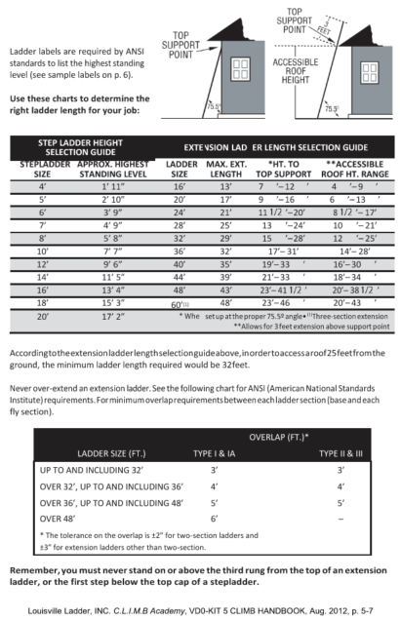
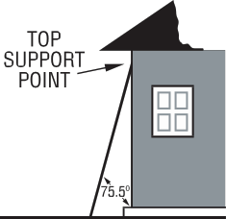
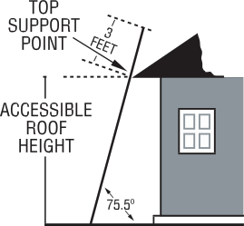
Ladder labels are required by ANSI standards to list the highest standing level (see sample labels on p. 6).
Use these charts to determine the right ladder length for your job:
STEP LADDER HEIGHT SELECTION GUIDE |  | EXTE | NSION LAD | ER LENGTH SELECTION GUIDE
STEPLADDER | APPROX. HIGHEST | LADDER | MAX. EXT. | *HT. TO | **ACCESSIBLE
SIZE | STANDING LEVEL | SIZE | LENGTH | TOP SUPPORT | ROOF HT. RANGE
4’ | 1’ 11” | 16’ | 13’ | 7 ’– 12 ’ | 4 ’– 9 ’
5’ | 2’ 10” | 20’ | 17’ | 9 ’– 16 ’ | 6 ’– 13 ’
6’ | 3’ 9” | 24’ | 21’ | 11 ’–20’ | 8 ’– 17’
7’ | 4’ 9” | 28’ | 25’ | 13 ’–24’ | 10 ’– 21’
8’ | 5’ 8” | 32’ | 29’ | 15 ’–28’ | 12 ’– 25’
10’ | 7’ 7” | 36’ | 32’ | 17’– 31’ | 14’– 28’
12’ | 9’ 6” | 40’ | 35’ | 19’– 33 ’ | 16’– 30 ’
14’ | 11’ 5” | 44’ | 39’ | 21’– 33 ’ | 18’– 34 ’
16’ | 13’ 4” | 48’ | 43’ | 23’– 41 ’ | 20’– 38 ’
18’ | 15’ 3” | _{60’}(1) | 48’ | 23’– 46 ’ | 20’– 43 ’
20’ 17’ 2” |  | * Whe | set up at the proper 75.5º angle• ⁽¹⁾Three-section extension **Allows for 3 feet extension above support point
n
Accordingtotheextensionladderlengthselectionguideabove,inordertoaccessaroof25feetfromthe ground, the minimum ladder length required would be 32feet.
Never over-extend an extension ladder. See the following chart for ANSI (American National Standards Institute) requirements.For minimum overlaprequirements between eachladder section (base and each fly section).
OVERLAP (FT.)*
LADDER SIZE (FT.) | TYPE I & IA | TYPE II & III
UP TO AND INCLUDING 32’ | 3’ | 3’
OVER 32’, UP TO AND INCLUDING 36’ | 4’ | 4’
OVER 36’, UP TO AND INCLUDING 48’ | 5’ | 5’
OVER 48’ | 6’ | –
* The tolerance on the overlap is ±2” for two-section ladders and ±3” for extension ladders other than two-section.
Remember, you must never stand on or above the third rung from the top of an extension ladder, or the first step below the top cap of a stepladder.
Louisville Ladder, INC. C.L.I.M.B Academy, VD0-KIT 5 CLIMB HANDBOOK, Aug. 2012, p. 5-7

Slide 12
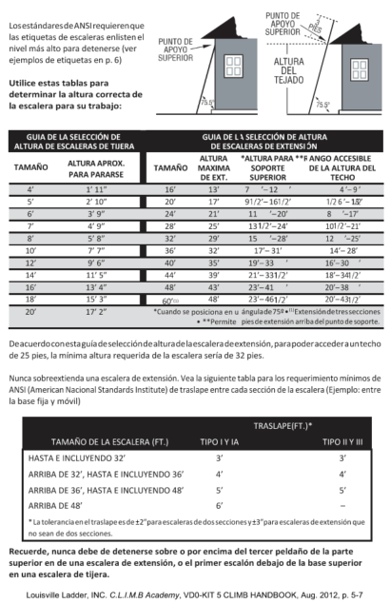


LosestándaresdeANSIrequierenque las etiquetas de escaleras enlisten el nivel más alto para detenerse (ver ejemplos de etiquetas en p. 6)
Utilice estas tablas para determinar la altura correcta de la escalera para su trabajo:
GUIA DE LA SELECCIÓN DE ALTURA DE ESCALERAS DE TIJERA _{TAMAÑO} ALTURA APROX. PARA PARARSE |  | TAMAÑO | GUIA DE L DE ESCA ALTURA MAXIMA DE EXT. | A SELECCIÓN DE AL LERAS DE EXTENSI *ALTURA PARA **R SOPORTE SUPERIOR | TURA ÓN ANGO ACCESIBLE DE LA ALTURA DEL TECHO
4’ | 1’ 11” | 16’ | 13’ | 7 ’– 12 ’ | 4 ’– 9 ’
5’ | 2’ 10” | 20’ | 17’ | 9 ’– 16 ’ | 6 ’– 13 ’
6’ | 3’ 9” | 24’ | 21’ | 11 ’– 20’ | 8 ’–17’
7’ | 4’ 9” | 28’ | 25’ | 13 ’– 24’ | 10 ’–21’
8’ | 5’ 8” | 32’ | 29’ | 15 ’– 28’ | 12 ’–25’
10’ | 7’ 7” | 36’ | 32’ | 17’– 31’ | 14’– 28’
12’ | 9’ 6” | 40’ | 35’ | 19’– 33 ’ | 16’– 30 ’
14’ | 11’ 5” | 44’ | 39’ | 21’– 33 ’ | 18’– 34 ’
16’ | 13’ 4” | 48’ | 43’ | 23’– 41 ’ | 20’– 38 ’
18’ | 15’ 3” | _{60’}(1) | 48’ | 23’– 46 ’ | 20’– 43 ’
20’ 17’ 2” |  | *Cuando se | posiciona en u **Permite | ángulade75º•⁽¹⁾Extensióndetressecciones pies de extensión arriba del punto de soporte.
n
3
Deacuerdoconestaguíadeseleccióndealturadelaescaleradeextensión,parapoderaccederauntecho de 25 pies, la mínima altura requerida de la escalera sería de 32 pies.
Nunca sobreextienda una escalera de extensión. Vea la siguiente tabla para los requerimiento mínimos de ANSI (American Nacional Standards Institute) de traslape entre cada sección de la escalera (Ejemplo: entre la base fija y móvil)
TRASLAPE(FT.)*
TAMAÑO DE LA ESCALERA (FT.) | TIPO I Y IA | TIPO II Y III
HASTA E INCLUYENDO 32’ | 3’ | 3’
ARRIBA DE 32’, HASTA E INCLUYENDO 36’ | 4’ | 4’
ARRIBA DE 36’, HASTA E INCLUYENDO 48’ | 5’ | 5’
ARRIBA DE 48’ | 6’ | –
* La tolerancia en el traslape es de ±2”para escaleras de dos secciones y±3”para escaleras de extensión que no sean de dos secciones.
Recuerde, nunca debe de detenerse sobre o por encima del tercer peldaño de la parte superior en de una escalera de extensión, o el primer escalón debajo de la base superior en una escalera de tijera.
Louisville Ladder, INC. C.L.I.M.B Academy, VD0-KIT 5 CLIMB HANDBOOK, Aug. 2012, p. 5-7

Slide 13





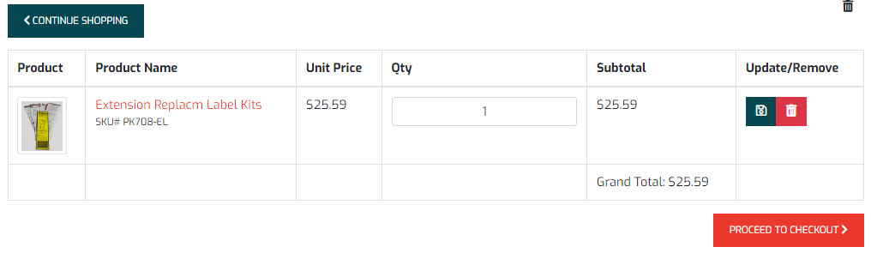
Tool Box #3 How to order Replacement Stickers for Louisville Ladders
Reminder: Werner & Louisville are the parent companies of several other ladder brands. Look at the bottom of the safety instructions for manufacturer.
1.
Order replacement stickers by entering the model #
in the search box at the top right corner of the Louisville
Ladder Website:
Search | Louisville Ladder
Select your ladder in the list of ladders. Scroll to the bottom of the page and find the section
labeled…
Beneath this section is a list of parts for that ladder, use the arrows underneath the parts until you find (Type of Ladder) …REPLACM LAB
Select ADD TO CART. Then select the quantity (QTY) of stickers you need and PROCEED TO CHECKOUT to pay for stickers.
EL KITS”
5. You can check out as a Guest. Stickers will be shipped to your
address with free ground shipping in the Continental US.

Slide 14


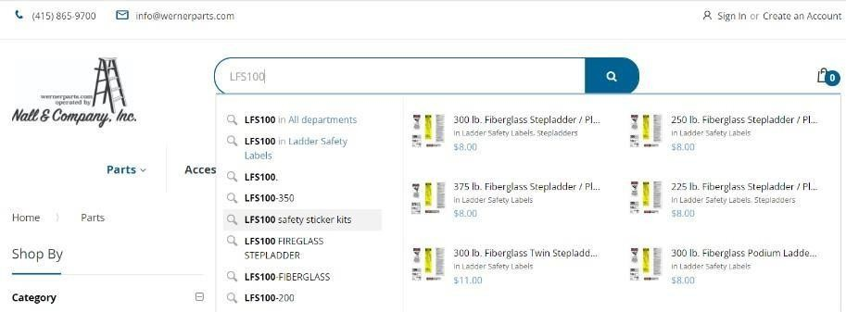
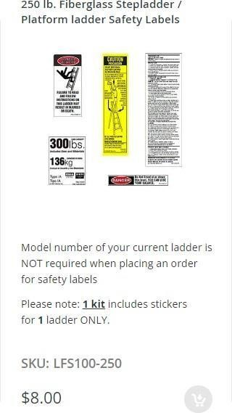
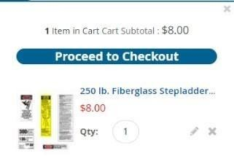
How to order Replacement Stickers for Werner Ladders
1. Order replacement stickers by entering the model # in the search box at the top center of the Werner Co. authorized part distributor (Nall & Company, Inc) website: https://www.wernerparts.com/parts.html
Look for your Ladder’s model # “Safety Sticker kits” and select it. For example
Find the weight rating of the ladder (the 3 digits after the dash) or you can enter it directly in the search box above.
Select the “Add to Cart” button to purchase
the replacement stickers.
A green bar will appear at the top of the page to let you know it has been added to your shopping cart.
When ready to checkout and pay for the stickers, select the check out button at the top right of the page to pay.
Fill out the shipping information, you can check out as a guest to pay for items.
NOTE:
Werner/Nall & Co. Inc., charges a flat $10.00 shipping fee.

Slide 15
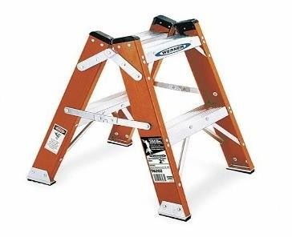
OSHA’s definition of a step stool:
The Federal OSHA standard at 29 CFR 1926.1050(b) defines a step stool which is the equipment you refer to as a self-supporting, foldable, portable ladder, nonadjustable in length, 32 inches or less in overall size, with flat steps and without a pail shelf, designed to be climbed on the ladder top cap as well as all the steps.
Step stools are suitable only for use on floors with a flat surface and are not usable on those with irregular surfaces. They can be used as a ladder, but they have the advantage of being more comfortable to be able to stand on its wider platform. For small heights they are safer than a normal ladder.
Always inspect the step stool prior to each use, or at minimum before the first use on each shift. During the step stool inspection, you are checking that all parts of the step stool are in good working condition, including:
all four anti-slip feet
climbing/gripping surfaces on each step
step-to-side rail connections
working parts, bolts, rivets
Always set up and use the step stool according to the manufacturer’s instructions. Before using any step stool for the first time, review all warning labels and instructions on the step stool and read the owner’s manual for guidance on proper use and safety precautions.
Ensure that the step stool you are planning to use is sturdy and able to support the intended weight of the task. The maximum intended load includes the weight of the employee as well as the PPE worn, and all tools, equipment and materials being carried.
To be used safely, a step stool must be placed on level ground with solid floor support for all four feet. The step stool should be set up close to the work being performed or the area that needs to be accessed. If you begin to climb and feel like the step stool is not balanced properly, climb down and reposition.
Climb and use the step stool in a way that allows your body to be near the middle of the steps to prevent tipping or fall hazards. Avoid over-reaching when on a step stool. Always face the step stool when climbing up or down. Step stools are intended to be used by only one person at a time.

Slide 16
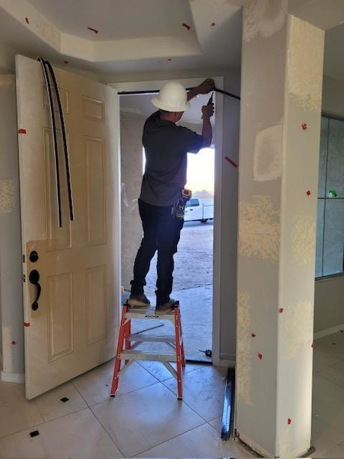
Every time a step stool is used, the base must be spread fully open with the spreaders locked. Always ensure the locking mechanism is engaged before climbing. Never attempt to move the step stool while standing on it, or by standing on something else (like a shelf) and pushing the step stool with your foot.
Additional ladder safety training videos &
Documents: Werner Co.
Ladder Safety Videos | Werner US (wernerco.com)
National Association of Home Builders
Ladder Safety - NAHB
Podium Ladders - English and Spanish (nahb.org) Job-made Ladders - English and Spanish (nahb.org)
Extension Ladder Safety - English and Spanish (nahb.org) Stepladders - English and Spanish (nahb.org)
American Ladder Institute’s Ladder Safety Training: Online Certificate Training
American Ladder Institute

