Slide 1

SILICA
Health Risks, Safety Measures, and Regulations
Home Builders Association of Central Arizona - HBACA

Slide 2



Topic Overview
What is Silica?
Silica in Construction
Health Risks
Safety Measures
Regulations & Standards
Call to Action
Stay Informed

Slide 3

What is Silica?
Silica is a natural mineral found in various forms
  Types:
        Crystalline Silica: Includes quartz, cristobalite, and tridymite; most dangerous in dust form
        Amorphous Silica: Includes diatomaceous earth and some other forms; less hazardous
Forms in Construction:
      Quartz: Common in concrete, granite & sand
      Sand: Used in mixing concrete & plaster

Slide 4
Silica in Construction
Materials:
Concrete: Silica sand is a primary ingredient
Mortar: Contains sand and other silica compounds
Brick and Tile: Made with silica as a binder
Applications:
Cutting & Grinding: Tasks that generate silica dust
Blasting: Using sand in abrasive blasting processes
Demolition: Dust creation from breaking down materials

Slide 5
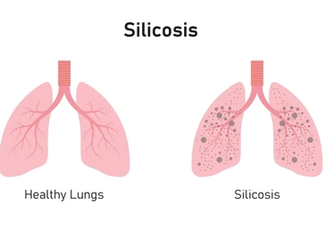
Health Risks
Respiratory Issues:
  Silicosis: A lung disease cause by inhaling silica dust, leading to scarring and breathing difficulties
  Lung Cancer: Increased risk from long-term exposure to respirable crystalline silica
  Chronic Obstructive Pulmonary Disease (COPD): Potentially exacerbated by silica dust
Symptoms:
  Early Signs: Coughing, shortness of breath, chest pain
  Long-Term Effects: Progressive lung damage & reduced lung function

Slide 6

Safety Measures
Personal Protective Equipment (PPE)
Respirators:
Type: Use NIOSH-approved respirators, ex: N95 masks
Fit: Ensure proper fit with a tight seal to prevent dust ingress
Maintenance: Regularly inspect & replace filters/cartridges/masks
Protective Clothing
Long-sleeve shirts & gloves to reduce dust contact
Eye Protection
Use safety glasses or goggles to prevent dust from getting into eyes

Slide 7
Safety Measures
Engineering Controls:
Ventilation – Ensure good airflow in work areas to disperse dust & improve air quality
Water Suppression
Wet cutting & grinding: Use water to reduce dust emissions during cutting, grinding, drilling operations
Water spraying: Apply water to work surfaces or during demolition to minimize dust
Work Practices:
Use wet methods & avoid dry sweeping (hose integrated systems & vacuums)

Slide 8
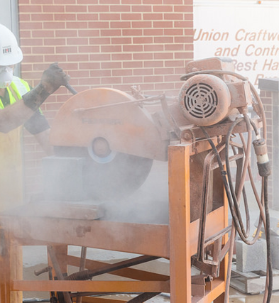
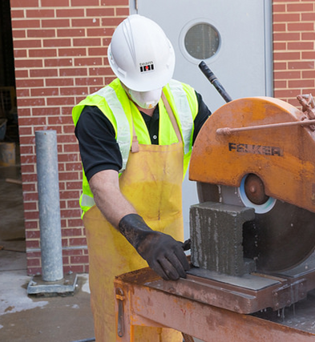

Slide 9
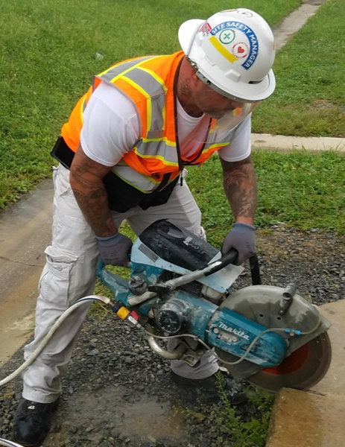
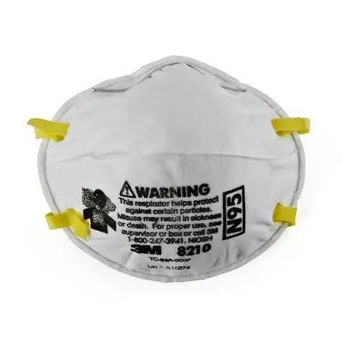
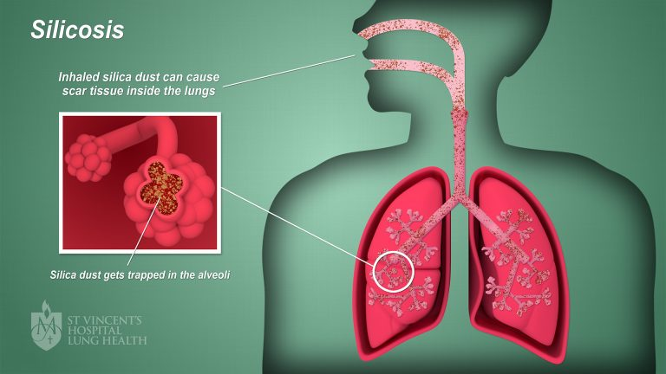
Safety Measures
Worker Training:
  Silica Awareness: Educate employees on silica hazards, health, & importance of protective measures
  Proper use of PPE: Train employees how use, maintenance & disposal of PPE

Slide 10
Regulations & Standards
OSHA Standard 29 CFR 1926.1153
Permissible Exposure Limits (PEL): Ensure silica exposure levels are maintained below OSHA’s PEL
General Duty Clause: Employer responsibility to provide a safe work environment
Exposure Control Plan: Develop and implement a written silica exposure control plan as required by OSHA

Slide 11
Summary
Silica – mineral commonly found in various construction materials
Health Risks –
Silicosis, Lung Cancer, COPD
Safety Measures:
Engineering Controls – Ventilation systems & water suppression
PPE – Protective clothing, respirators, & eye protection
Work Practices – Wet methods, housekeeping, safe work procedures
Regulatory Compliance:
Permissible exposure limits & exposure control plans

Slide 12

Call to Action
Implement Best Practices:
  Review & Update – Regularly review & update safety procedures/equipment to ensure they meet current standards
  Engage Workers - Involve workers in safety planning & encourage voicing concerns & suggestions

Slide 13
Stay Informed
Ongoing Education
Stay informed of new regulations & best practices related to silica safety
Safety Audits
Conduct regular safety audits to assess effectiveness of implemented measures & identify areas for improvement

Slide 14
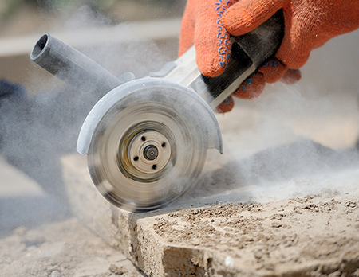
References
1926.1153 - Respirable crystalline silica. | Occupational Safety and Health Administration (osha.gov)
Silica, Crystalline - Construction | Occupational Safety and Health Administration (osha.gov)
V2-53M-Silica-Dust.pdf
V1-64M-Silica-Dust.pdf
Additional resources for further information: OSHA Guidelines & NIOSH Publications

