Slide 1

New Employee Safety Initiatives in the Construction Industry
Enhancing Safety cultures and reducing risks
By: Karl McIntyre and Ashton Woods

Slide 2
Introduction
Karl McIntyre
EH&S Compliance Manager
Ashton Woods & Starlight Homes
17 years in the Safety Industry
12 years commercial
3 years consulting
3 year residential

Slide 3

COMMUNICATION

Slide 4




LEADERSHIP

Slide 5

POSITIVE
CULTURE

Slide 6
WHAT IS A POSITIVE CULTURE
SHARED BELIEFS, PRACTICES AND ATTITUDES TOWARD THOSE BELEIFS AND PRACTICES
COMPLIANCE VS OWNERSHIP
DRIVEN LEADERSHIP, SUPPORTED BY EVERYONE FROM TOP TO BOTTOM

Slide 7


COMMONLY PROMOTED NEGATIVE SAFETY CULTURE EXAMPLES

Slide 8
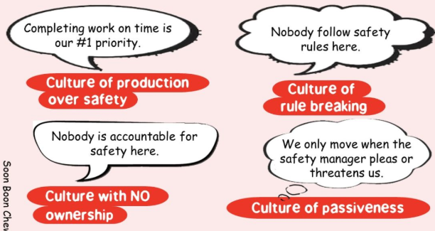

Slide 9
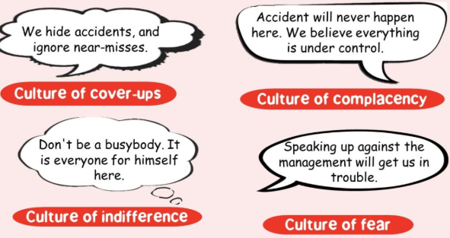

Slide 10

TRAINING

Slide 11
Training comes in MANY forms
Orientation programs
On-the-Job (OJT) Training
Scheduled / Regulated Drills
Toolbox Talks
Mentorship programs
Personal conversations about past experiences

Slide 12

STATISTICS

Slide 13
OSHA Failure to TRAIN
How Often
Occur in nearly every CFR 1926 standard
Max
Max penalty of $15,625.00 per serious violation
Max
Max penalty of $156,259 for willful or repeated violations
Average
Average WC payout in 2020-2021 was $41,757

Slide 14
Frequent OSHA citations issued for failure to comply with training requirements
Failure to educate employees on their job requirements
Failure to provide proper safety equipment (free of charge)
Failure to provide adequate supervision
Failure to provide sufficient posting and explanation of safety codes
Failure to provide complete risk information
Failure to train employees to safely handle and dispose of chemicals and bloodborne pathogens
Failure to diligently screen new hires
Failure to have an emergency action plan in place and inform workers of such plan

Slide 15
Common Injuries attributed to inadequate training
Falls from scaffolds, ladders or other equipment leading to head injuries, spinal cord injuries and broken bones are common when there is insufficient training to use the equipment properly.
Soft tissue injuries, including back injuries, are common when there is inadequate training in manual handling of heavy items.
Skin burns from chemicals or hot objects frequently result from inadequate training on how dangerous substances must be handled.
Electrical shocks can occur when there is inadequate training on the proper use of equipment or machines.
Repetitive stress injuries and other musculoskeletal injuries can occur when workers aren’t trained on proper ergonomics and other techniques to avoid these injuries.
Crush injuries, head and spinal cord injuries, and even amputations can occur when there is inadequate training on the safe operation of heavy machinery, equipment and tools.

Slide 16
May result in…
Lost Productivity
Legal fees for the injured
Increased Insurance Premiums
Workers Comp payments
Reputation damage
Impact on direct and indirect costs

Slide 17
BENEFITS of Safety Training
Engaging leadership support
Continuous Education
Reduction of incidents and injuries
Enhanced employee morale and retention
Legal protection
Adoption of best practices
Increased productivity and efficiency
Meeting compliance and regulation
Lower insurance costs
Raised awareness in hazard recognition
Promotion of a positive Safety Culture

Slide 18
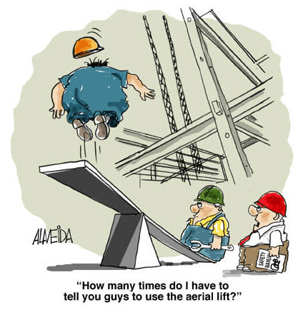
A negative impact to your SAFETY CULTURE!

Slide 19


