Slide 1
Overview to Fall Protection
Scott W. Hayes
AMERICA ROOFING

Slide 3
Historical Stats
OSHA reports a 20% decline in fatal falls in construction it investigated in the past fiscal year, for a total of 189 in 2024.
The majority of fatal falls in construction (2023) — 260 or 64.4% — were from a height between 6 feet and 30 feet. Portable ladders and stairs were the primary source of 109 construction fatalities

Slide 4
Most Cited
1. Duty to have fall protection – 6,557 citations, $48 million penalties.
2. Ladders – 2,681 citations, $9.5 million penalties.
7. Head protection – 766 citations, $2.4 million penalties.

Slide 5
29 CFR 1926 - Subpart M
1926.500(a)(1) This subpart sets forth requirements and criteria for fall protection in construction workplaces covered under 29 CFR part 1926.
Scope and Applications
1926.501(a)(1)This section sets forth requirements for employers to provide fall protection systems.
Duty to have Fall Protection
1926.502(a)(1)Fall protection systems required by this part shall comply with the applicable provisions of this section.
Fall Protection Systems and Criteria

Slide 6
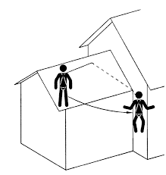
Fall Protection
Required at 6 feet and higher in Construction (4ft general industry)
No more than 30-degree deviation left or right – Swing Fall
Anchor and PFAS must support 5,000lbs
Guardrails and scaffolding

Slide 7
Swing Fall
Greater the angle of Deviation, the greater the risk
Can pose an even greater risk

