Slide 1
INTRODUCTION TO INVERSION & PERSPECTIVE-BASED SAFETY

Slide 2
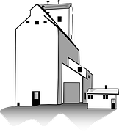
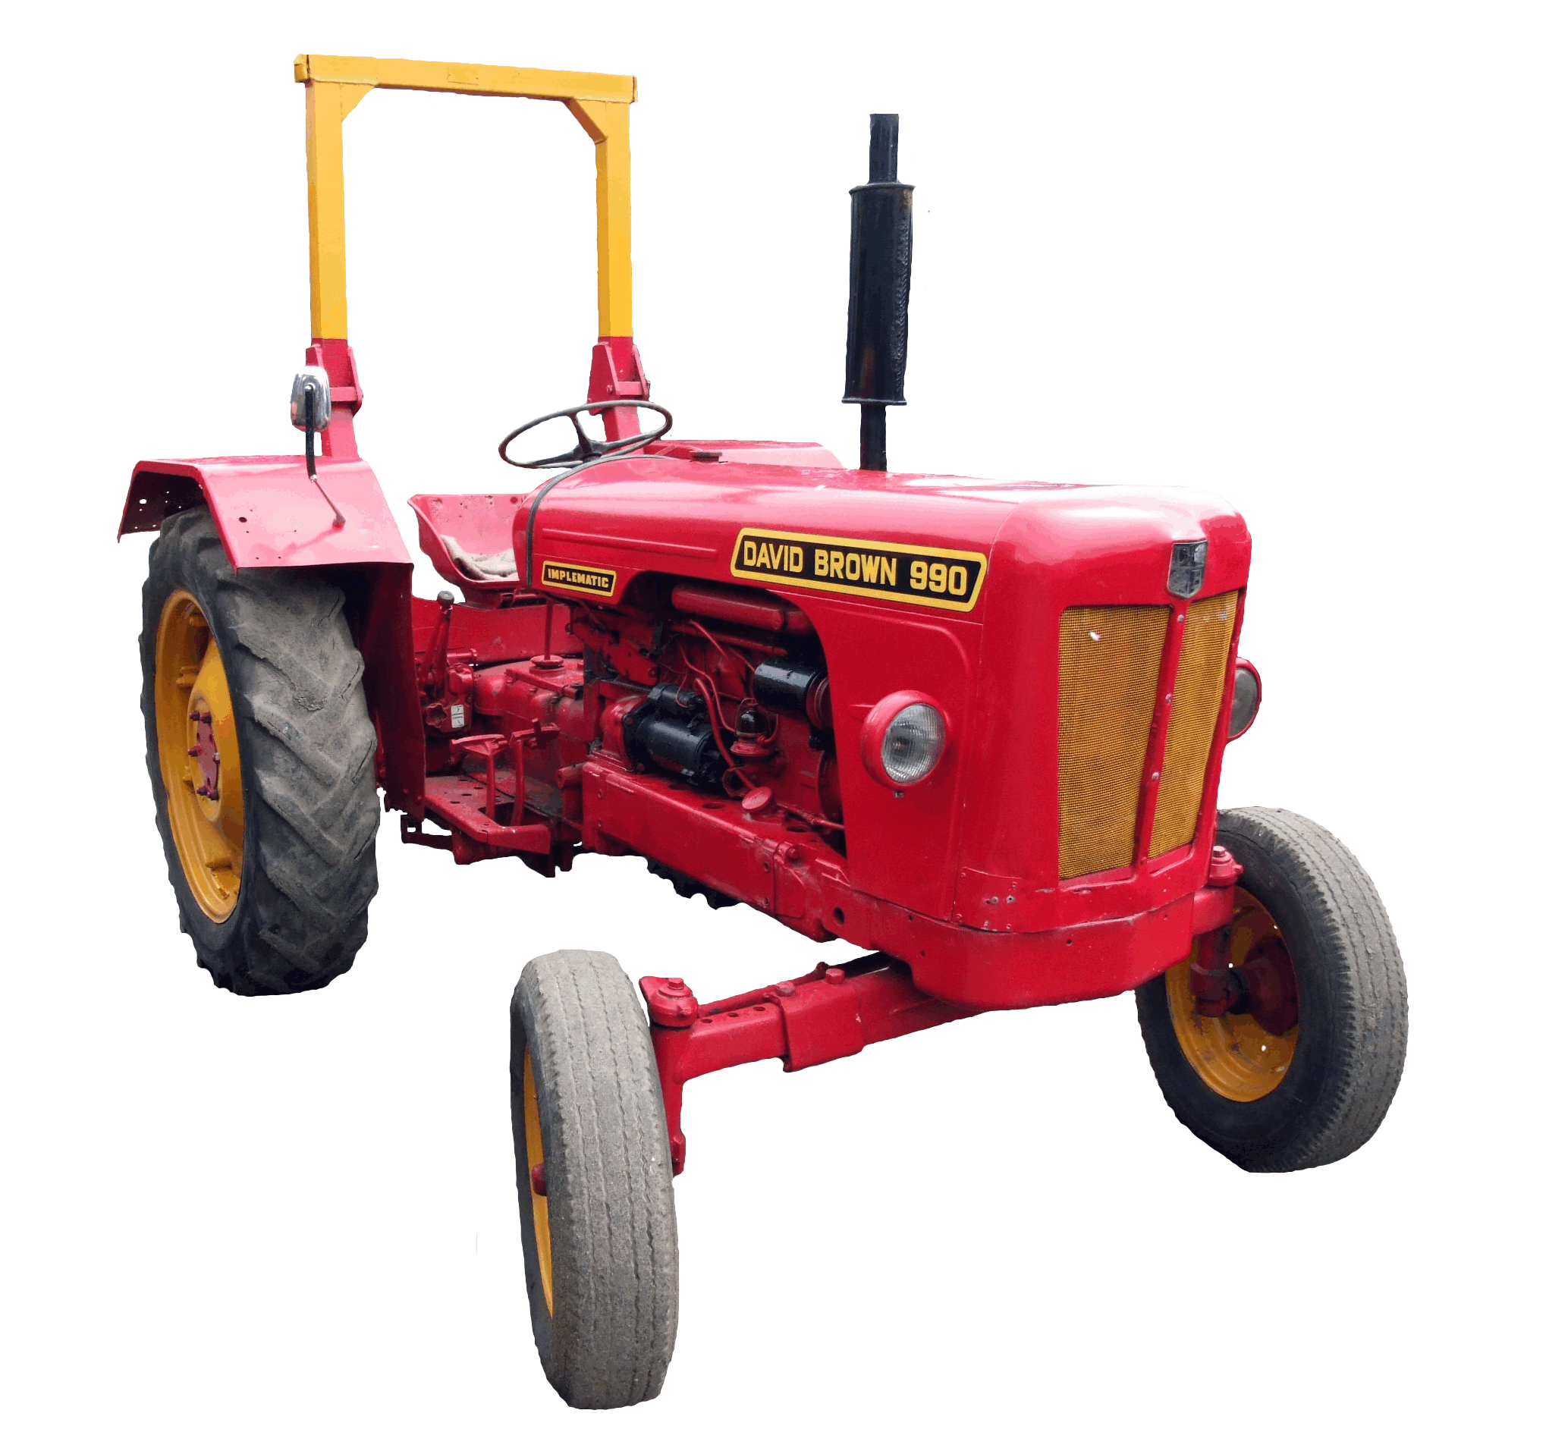
CULTURE
CULTURE
BEHAVIOR
AWARENESS
KPI’S
BEST PRACTICES
MITIGATION
CONTROL

Slide 3
WHAT MAKES AN ORCHARD SUCCESSFUL…
Healthy fruit-bearing trees
Good Soil/Water/Sunlight/Fertilizer
Space and room to grow
Invested Farmers
Knowledgeable about their product and harvesting processes
Caretaking of the trees, including removal of toxic trees when necessary.

Slide 4
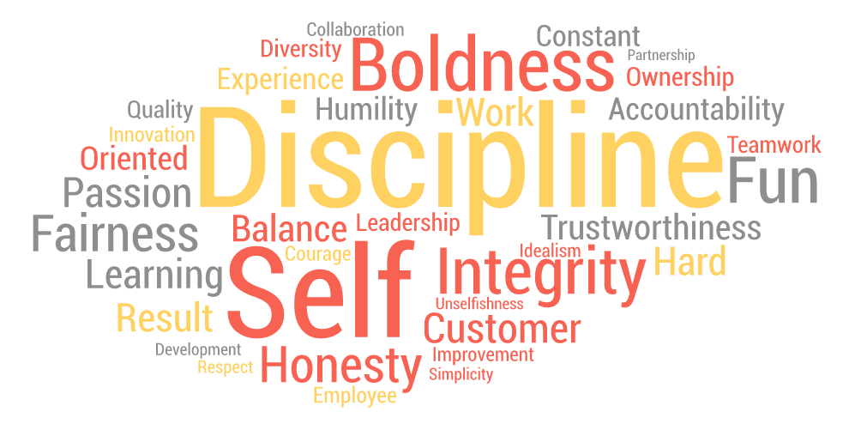
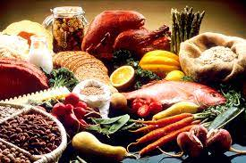
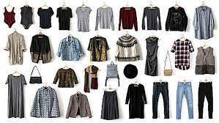
VALUES
FOOD
C U L T U R E
MUSIC
TRADITIONS
CLOTHING

Slide 5
BEHAVIOR DEFINED…
“The manner in which one acts or behaves.”
- The American Heritage Dictionary of the English Language
“The way in which one acts or conducts oneself, especially towards others.”
- Oxford Dictionary
“A response of an individual or group to an action, environment, person, or stimulus.”
- The Business Dictionary

Slide 6
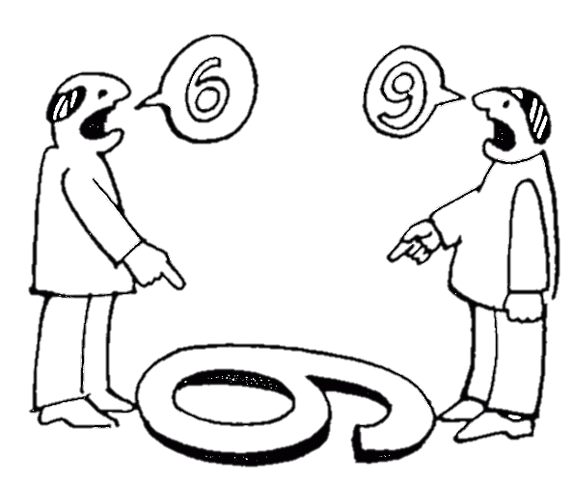
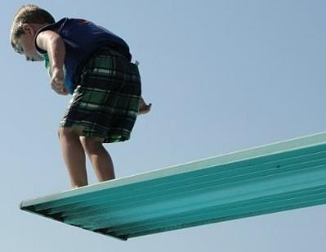
Employee
Behavior
Exposure
Influence
Perception
Thought
Belief

Slide 7
THE BEHAVIOR FORMULA
Exposure
Behavior
Behavior
Behavior
Behavior
Behavior
Behavior
Behavior
Influence
Perception
CULTURE
Thought
Behavior
Behavior
Behavior
Behavior
Behavior
Behavior
Belief

Slide 8
MUSIC
Hazard Recognition
Risk Taking
Personal Safety
FOOD

Slide 9
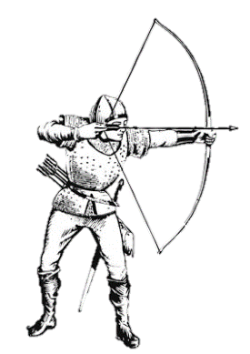

Slide 11
EXPOSURE
INFLUENCE
PERCEPTION
THOUGHT
BELIEF
BEHAVIOR
P E R S P E C T I V E

Slide 12
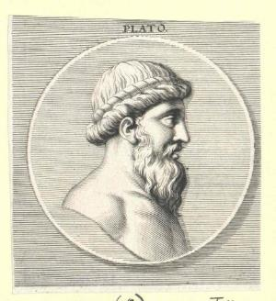
WHY PERSPECTIVE?

Slide 13
“We see the world not as it is, but as we are.”
-Steven Covey

Slide 14
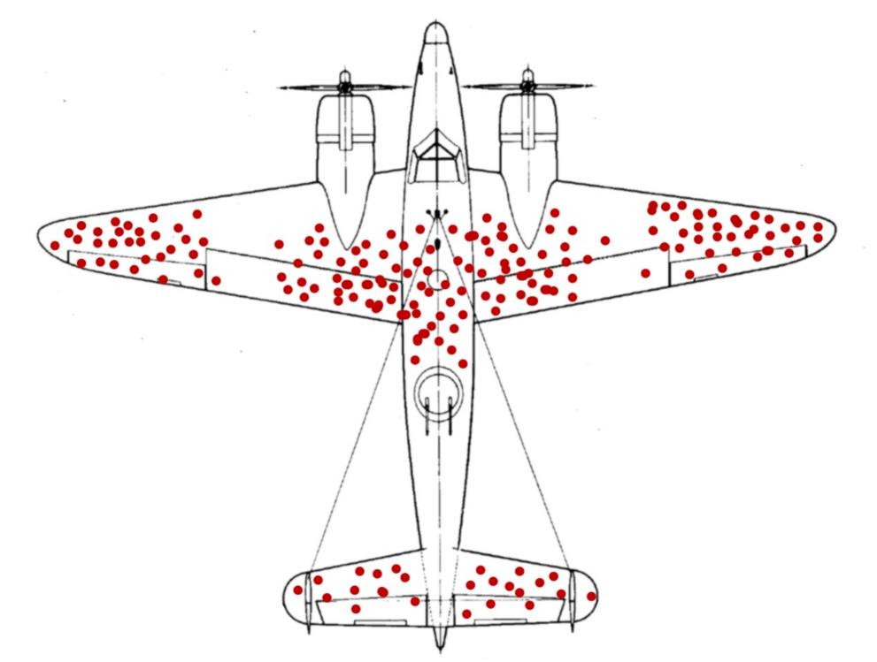
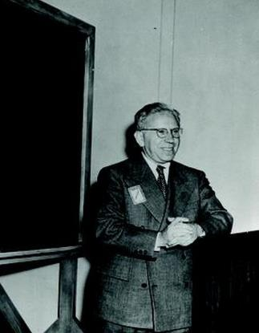
PERSPECTIVE & SAFETY -

Slide 15
EXPOSURE
INFLUENCE
PERCEPTION
THOUGHT
BELIEF
BEHAVIOR
CAVE DWELLING
P E R S P E C T I V E
SURFACE LIVING

Slide 16
THINK TIME

Slide 17
You have taken a risk at work and have
become fatally injured.
Help will not arrive to you in time.
You have 3 minutes left to live.
Write out your last words to the person or people
you would want to read them.

