Slide 1
SCAFFOLD SAFETY
WWW.SFICOMPLIANCE.COM
800-727-5051
CUSTOMERSERVICE@SFICOMPLIANCE.COM
Notes:
BASED ON §1926.450 SUBPART L SCAFFOLDS
This training complies with OSHA requirements as described on CFR1926.450 Subpart L – Scaffolds
This standard applies to all construction employees and employers who work on, under, or in close proximity to scaffolding and aerial lifts. Employees erecting and dismantling scaffolds also are covered.

Slide 2
WHAT IS A SCAFFOLD?
Scaffold means any temporary elevated platform (supported or suspended) and its supporting structure (including points of anchorage), used for supporting employees or materials or both.
1926 Subpart L Scaffolds 1926.450(b)
Notes:
Scaffold is: any temporary elevated work platform (supported or suspended) and its supporting structure (including points of anchorage), used for supporting employees or materials or both.
Supported scaffold - one or more platforms supported by outrigger beams, brackets, poles, legs, uprights, posts, frames, or similar rigid support.
Suspended scaffold - one or more platforms suspended by ropes or other non-rigid means from an overhead structure(s)
Aerial lifts – Vehicle-mounted devices used to get a worker to an elevated position, — referred to as “cherry pickers” or “boom trucks”

Slide 3
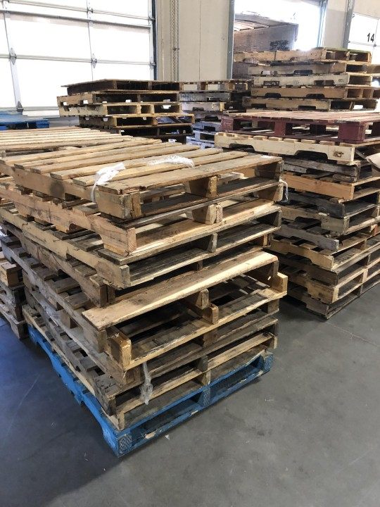
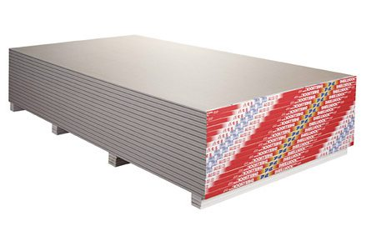
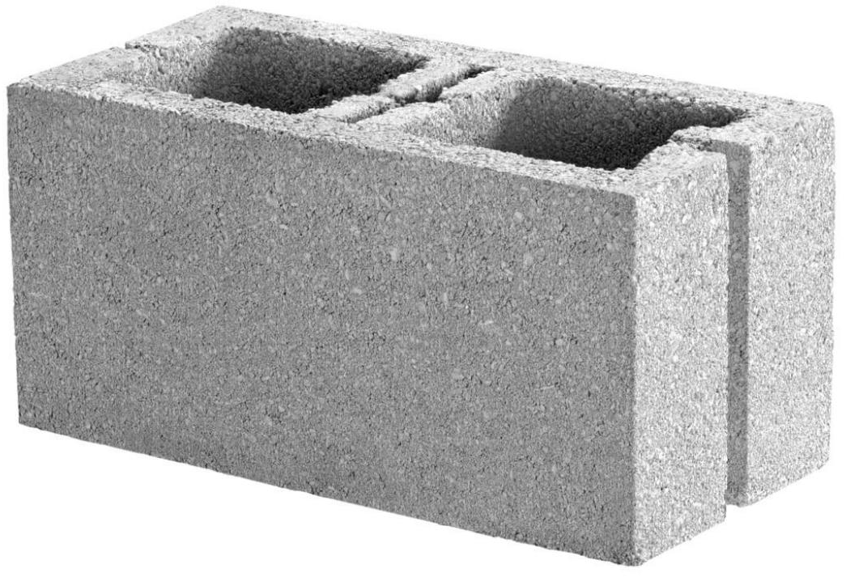
KNOWLEDGE CHECK: IS THIS AN ACCEPTABLE SCAFFOLD?

Slide 4
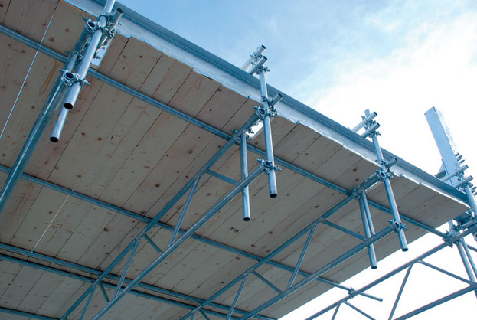
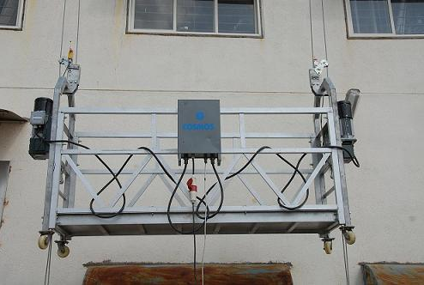
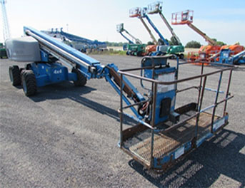
COMMON TYPES OF SCAFFOLD
Supported
Suspended
Aerial Lift
Aerial lift
One or more platforms supported by outrigger beams, brackets, poles, legs, uprights, posts, frames, or similar rigid support.
One or more platforms suspended by ropes or other non-rigid means from an overhead structure(s).
Any vehicle-mounted device used to elevate personnel.

Slide 5
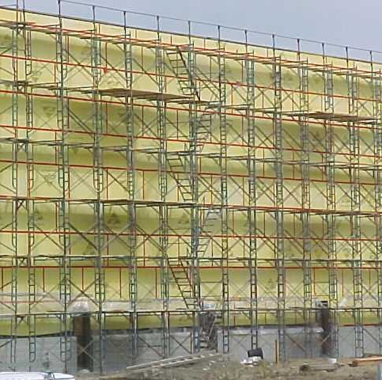
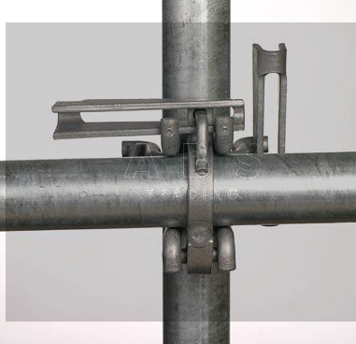
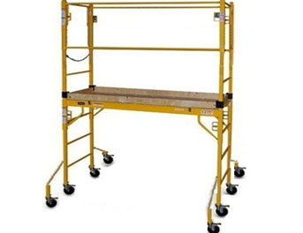
SUPPORTED SCAFFOLDS
Frame
Tube and Clamp
System
Mobile
Notes:
There are 3 main types of Supported Scaffolds:
Frame scaffolds: Used in the construction Industry.
Tube and Clamp: Used in industrial plants, refineries and offshore. More flexible, can be configured to work on odd shaped buildings
System: Used in commercial construction and maintenance applications. Pre-engineered components that connect together. EX: Stair tower
MUST BE FULLY PLANKED
SCAFFOLD PLATFORM AT LEAST 18 INCHES WIDE
TYPICAL PLANK IS 2X10, SO AT LEAST TWO PLANKS MINIMUM
ALSO MOBILE SCAFFOLD

Slide 6
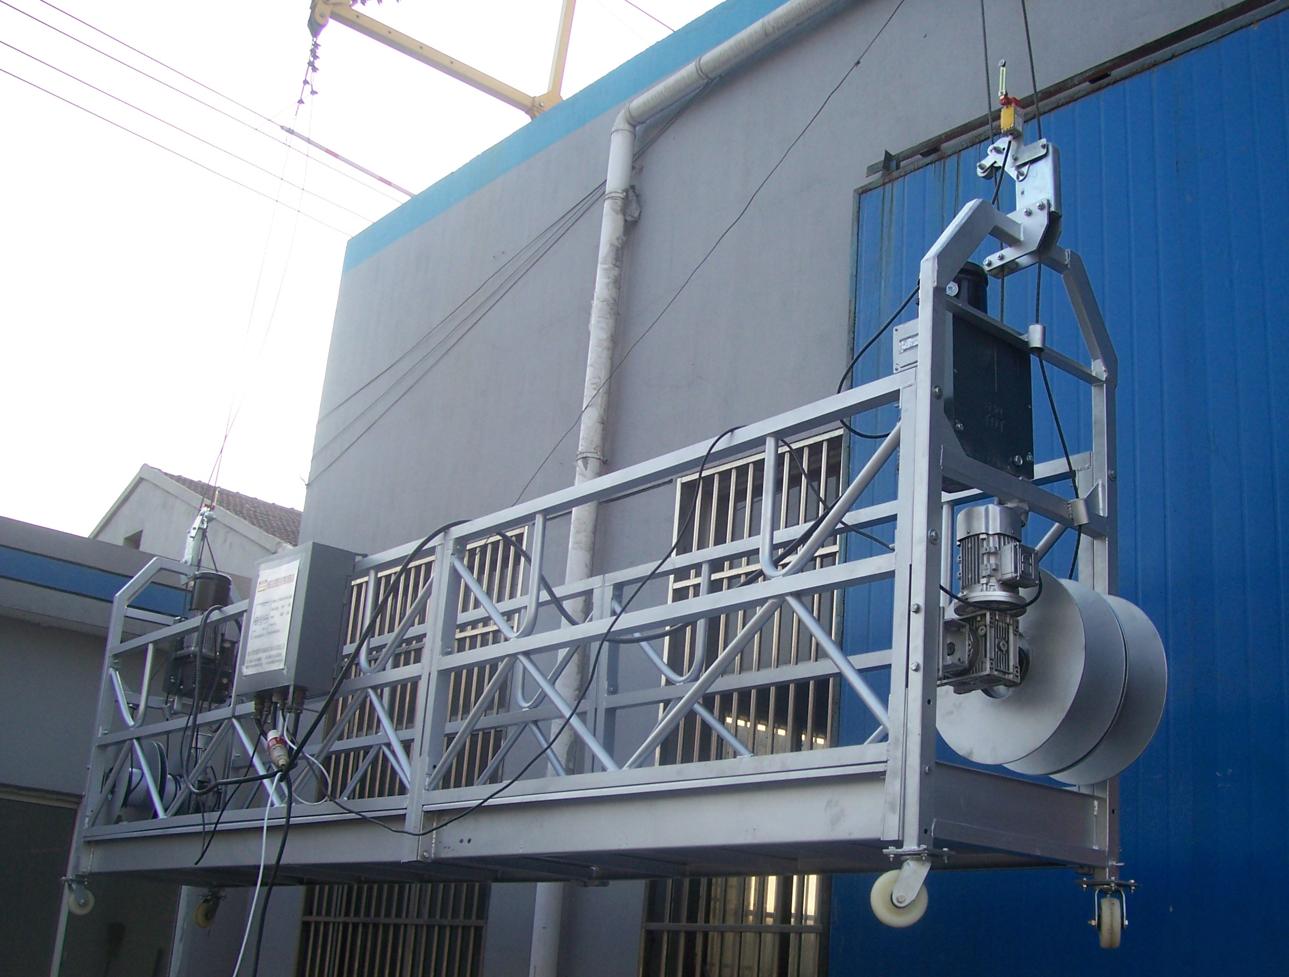
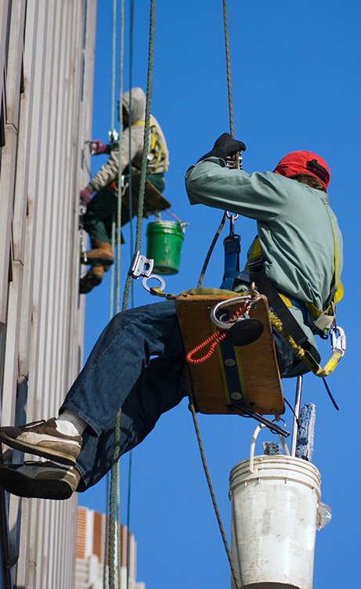
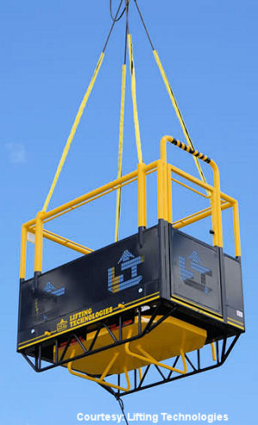
SUSPENDED SCAFFOLD
Hanging Platform
Single and Two-Point
Notes:
There are 3 main types of unsupported scaffolds:
Hanging platform: Used by window cleaning crews.
Single Point: Used in repair or maintenance jobs
Aerial Lifts: Including cherry pickers and boom trucks.

Slide 7
INSPECTIONS
Scaffolds and scaffold components must be inspected for visible defects before each shift by a competent person, and after each occurrence that could affect a scaffold's integrity (such as being struck by a crane).
Any part of a scaffold that has been damaged or weakened so that it no longer meets OSHA strength requirements must either be repaired, replaced, braced, or removed from service.
Attractive Nuisance
Must inspections be recorded and documented?
1926 Subpart L Scaffolds 1926.451(f)(3); 1926 Subpart L Scaffolds 1926.451(f)(4)

Slide 8
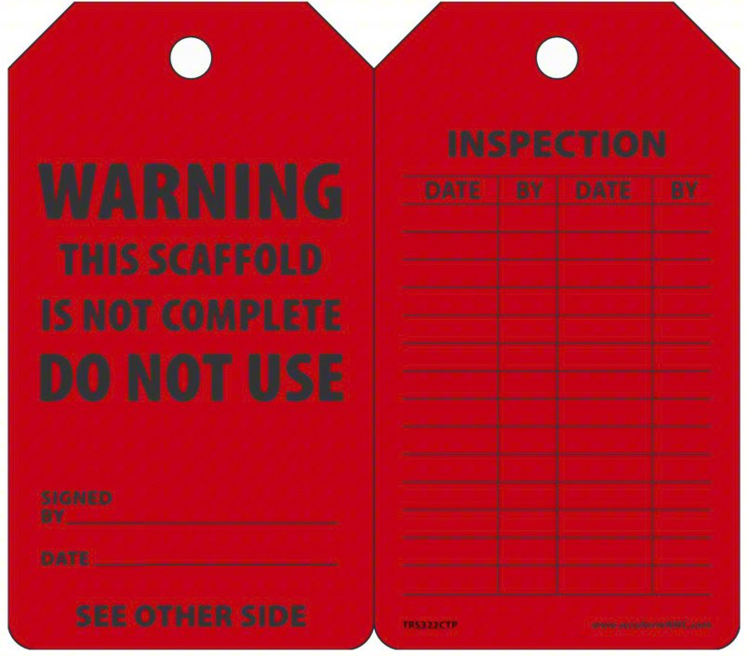
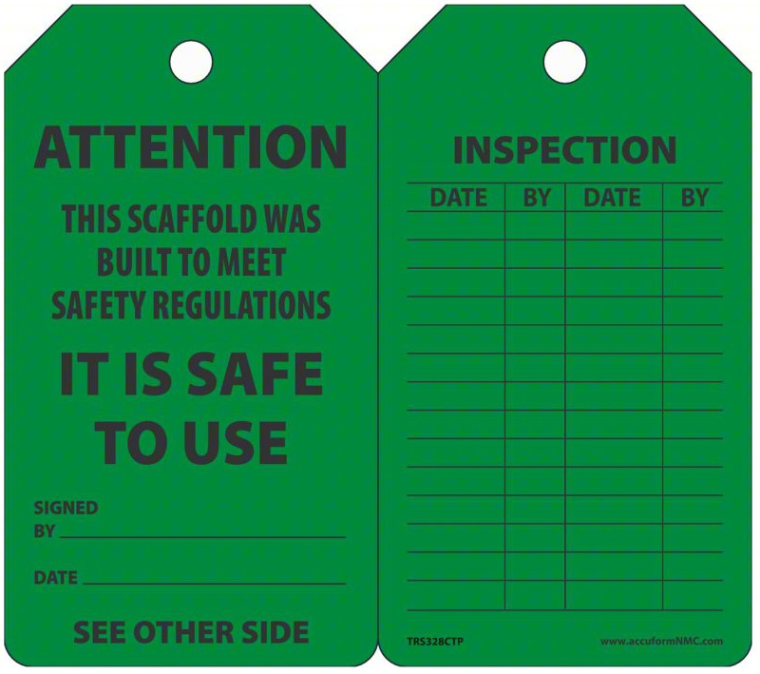
IF WE CAN RECORD INSPECTIONS, WE SHOULD

Slide 9
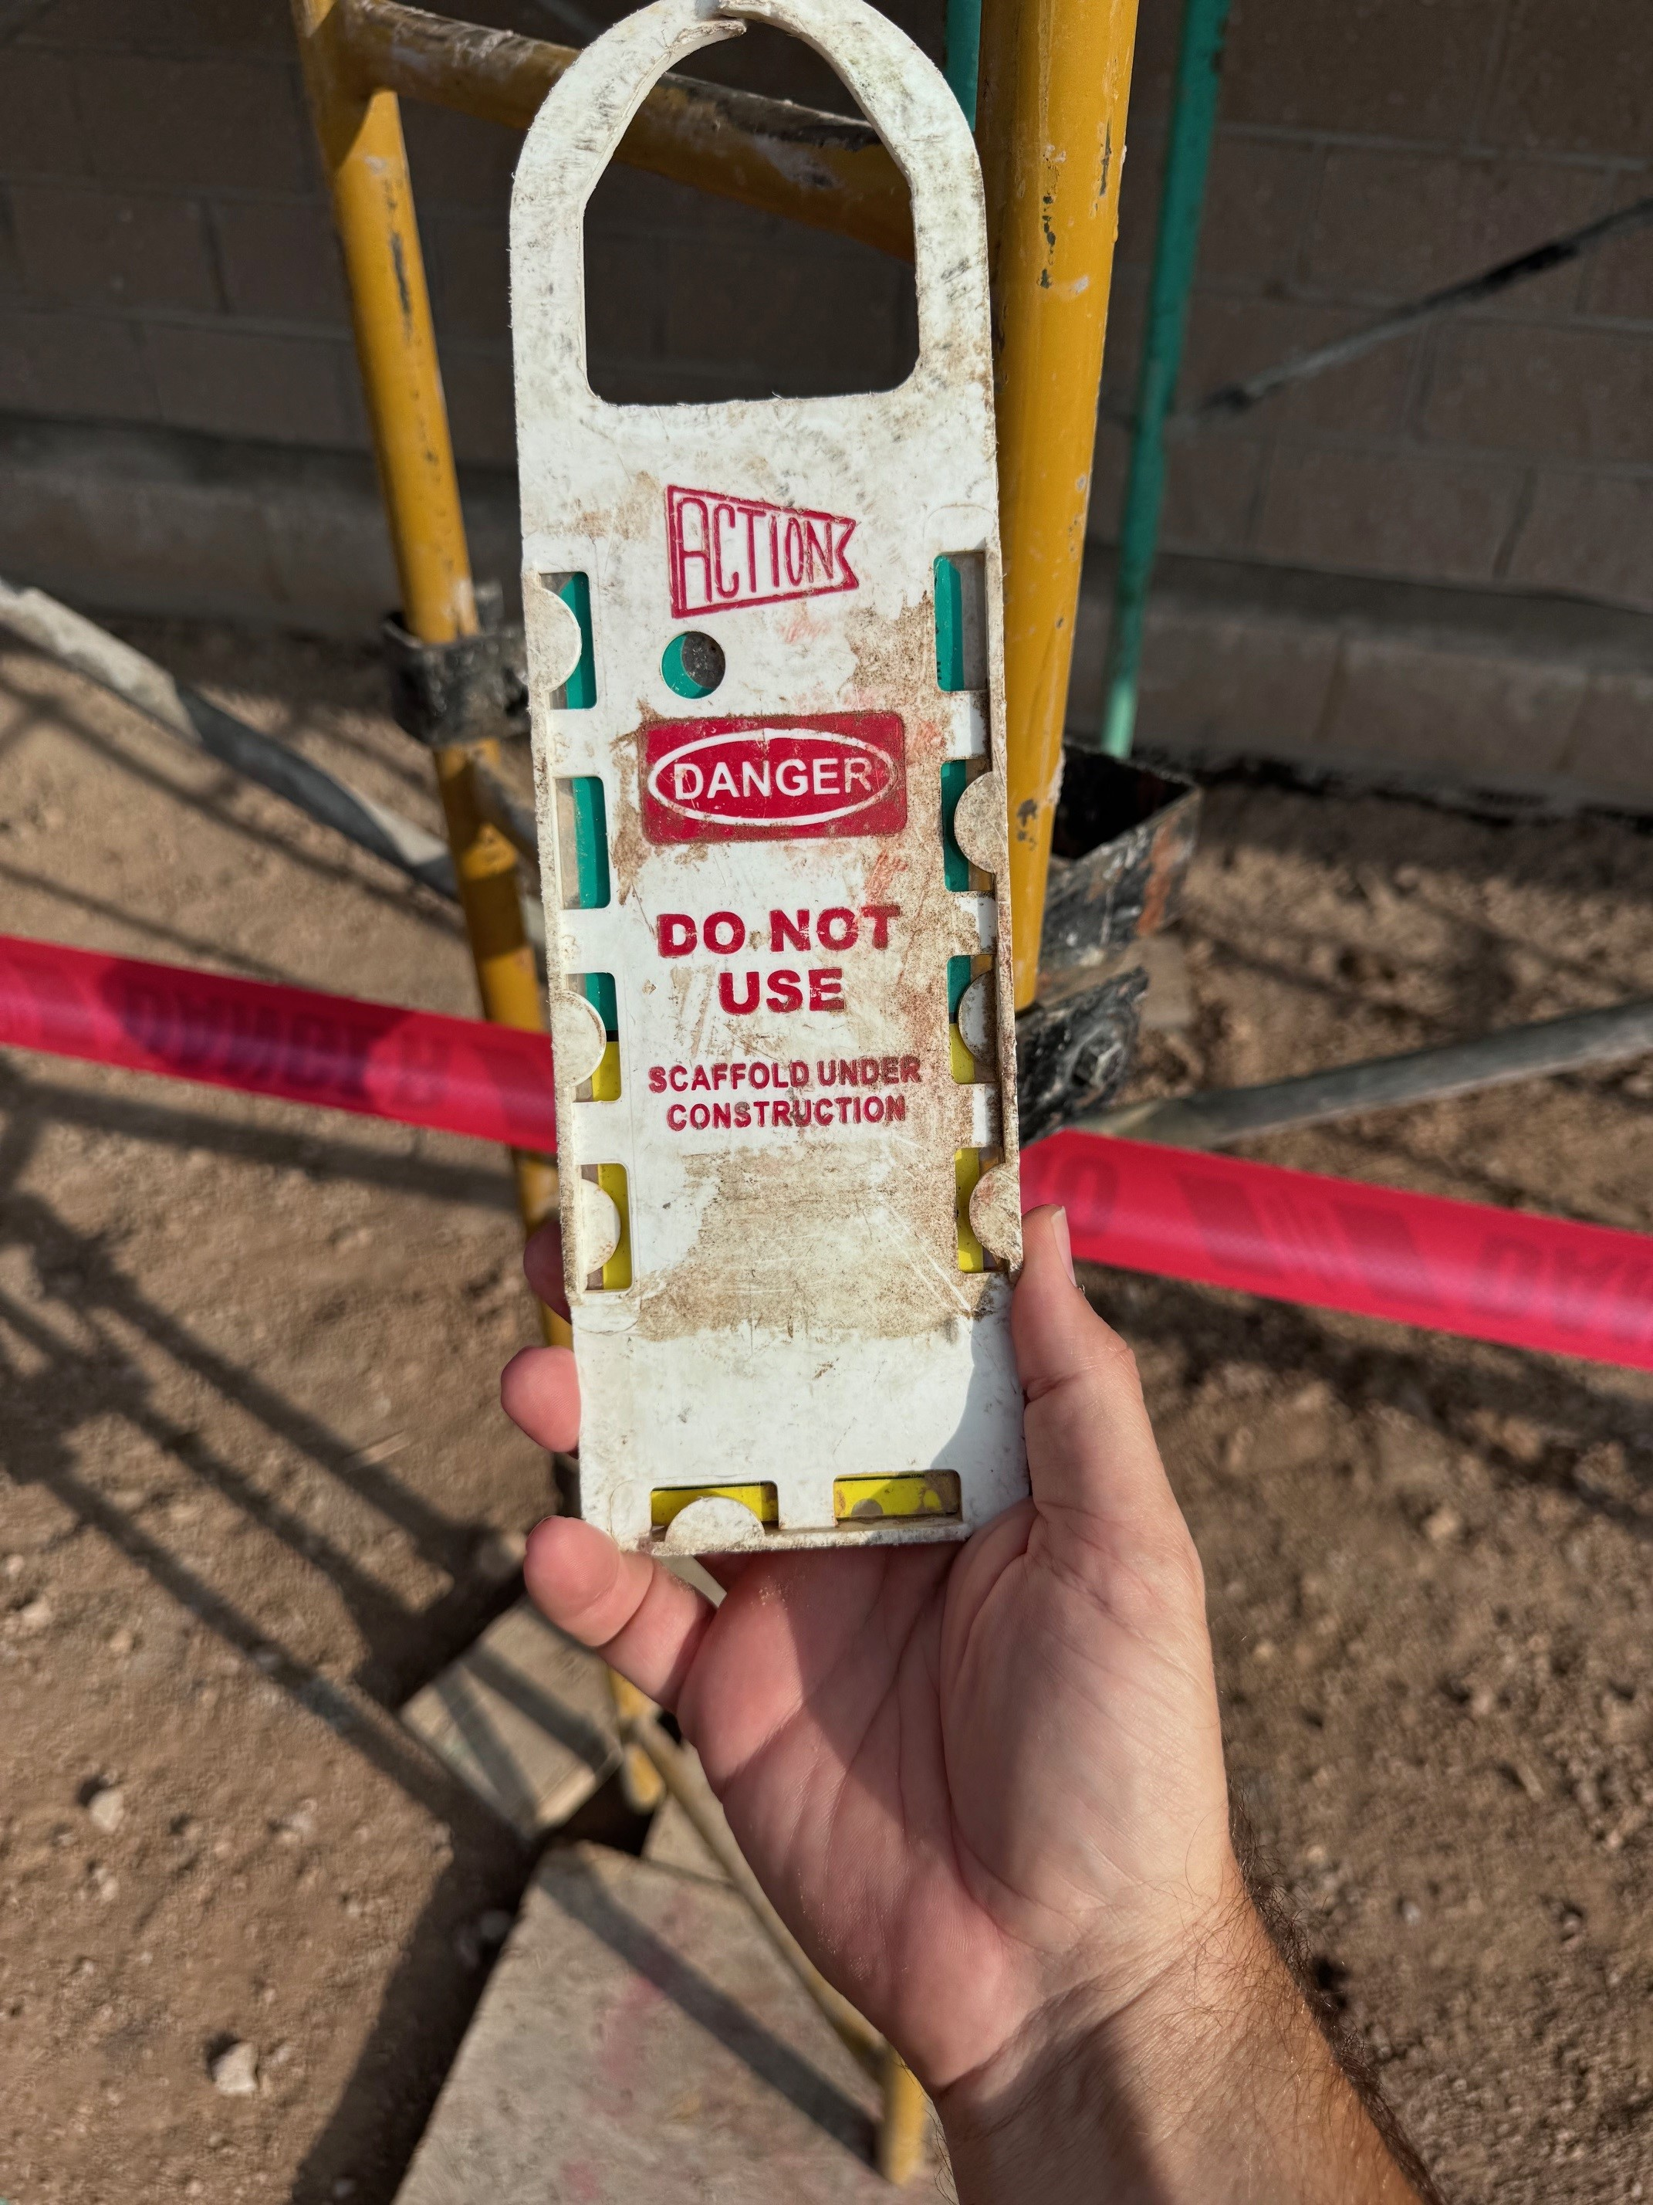
PAY ATTENTION TO WHAT IS DISPLAYED

Slide 10
INSPECTIONS

Slide 11
INCIDENT COST: DIRECT VS INDIRECT
Direct Cost – expenses covered by insurance
Medical Expenses
Wage and Death/Dependent Benefits
Legal Fees
Claim Investigation Costs
Indirect Cost – unexpected costs NOT covered by insurance
Temporary Labor and Overtime
Recruiting, Hiring, and Training Replacement Workers
Hazard Mitigation
OSHA Fines
Insurance Premiums
Negative impact to Culture, Goodwill, and Reputation

Slide 12
WHO SHOULD INSPECT: COMPETENT PERSON
A competent person is an individual designated by the EMPLOYER, who:
Has knowledge/experience to identify hazardous conditions
Has the authority to stop work until hazardous conditions are corrected
Determines if scaffold is safe for use:
After erection
After modification
After conditions that may impact safety of scaffolding
Point of Contact on site for OSHA inquiries
Notes:
Competent Person:
One who is capable of identifying existing and predictable hazards in the surrounding or working areas that are unsanitary, hazardous or dangerous to employees and who has authorization to take prompt corrective measures to eliminate them.

Slide 13
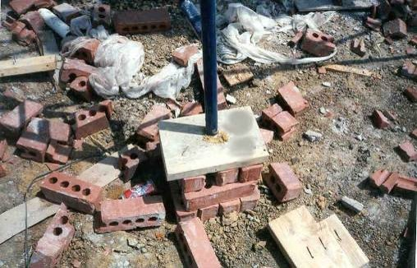
FOUNDATION AND STABILITY
A stable scaffold is solid and plumb.
In order to assure stability, supported scaffolds must be set on:
Base plates
Mud sills
Or other adequate firm foundation
Footings must be capable of supporting the loaded scaffold without settling or displacement.
Unstable objects may not be used to support scaffolds or platform units.

Slide 14
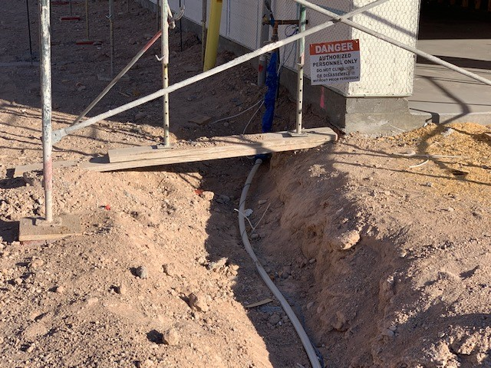
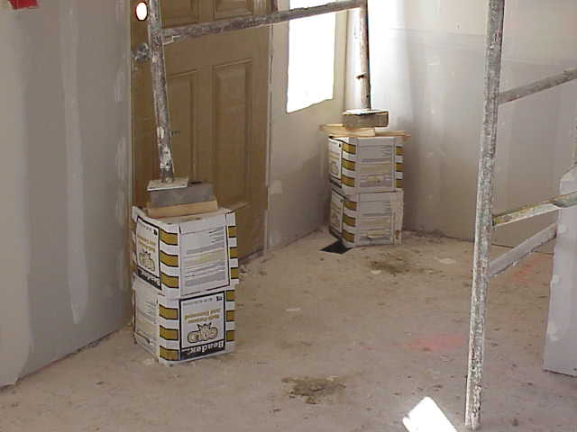
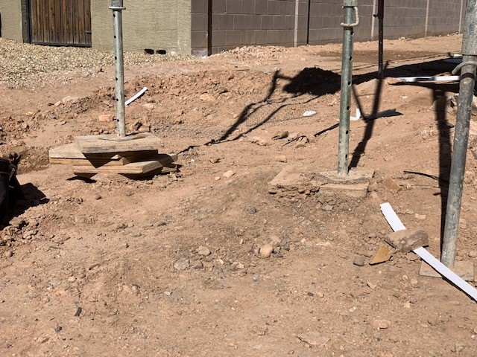
IDENTIFY THE HAZARDS

Slide 15
STABILITY: BRACING
Frames must be connected by cross, horizontal, or diagonal braces
Depending on configuration, it may be possible to leave every other bay open
Bracing required at interior and exterior of platform
Should never be removed when work is being performed on the scaffold
Could compromise the structural integrity of the scaffolding and make it easy to overload
Should not be used as access

Slide 16
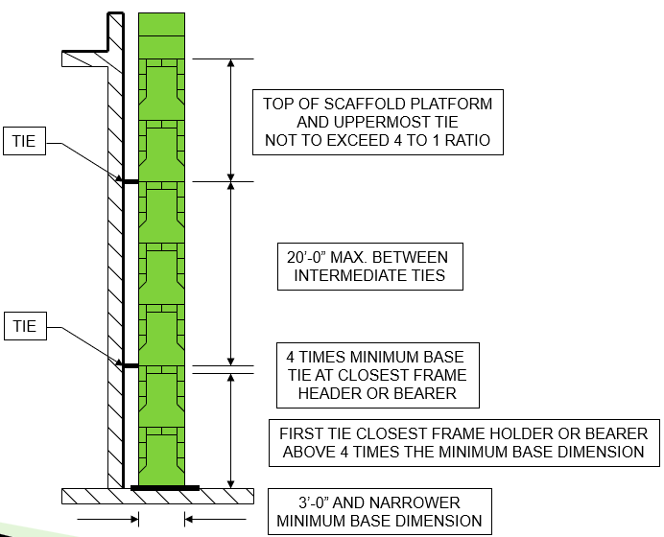
STABILITY: TIE BACK TO STRUCTURE
First tie at 4x Minimum Base Dimension
Maximum distance between intermediate ties 20’ or 26’
At least every 30’ horizontally

Slide 17
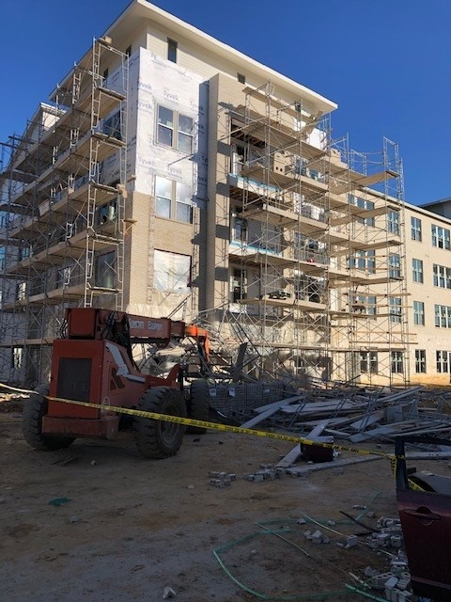
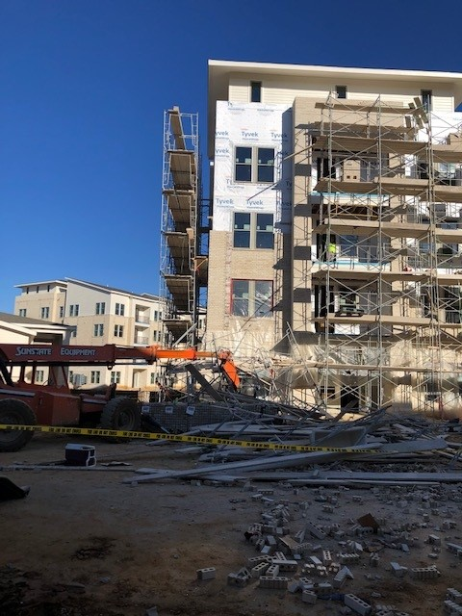
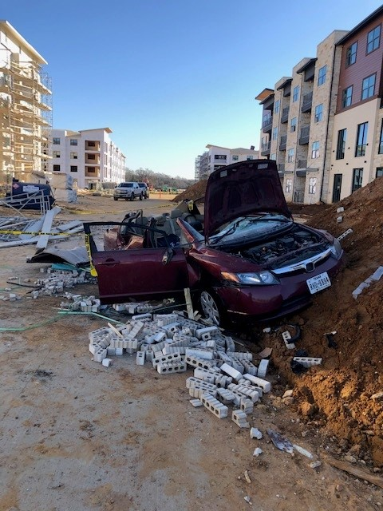
STABILITY: TIE BACKS REMOVED
Tie backs removed at end of previous work day.
Attempted to reposition scaffold using forklift.
Scaffold tipped onto passing car.

Slide 18
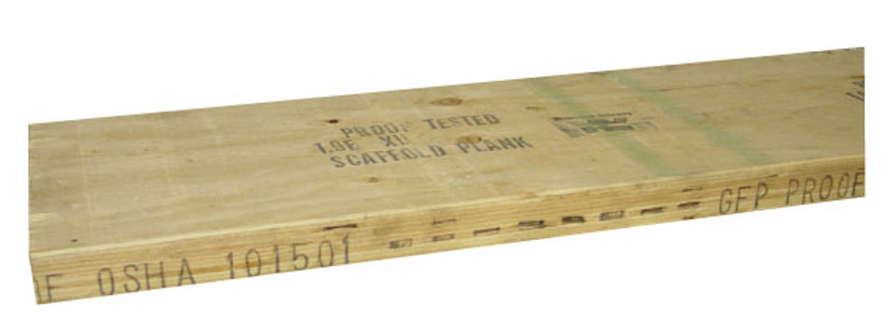
PLANKING AND DECKING
Each platform must be fully planked or decked between the front uprights and guardrail supports.
No gaps greater than 1”
Unless employer can show it is necessary
Must use scaffold-grade planks
Must be at least 18”wide
Clean and free of debris
Inspect and remove damaged planks
Maintain 14” from wall to scaffold
18” for lathing and plastering

Slide 19
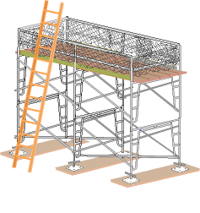
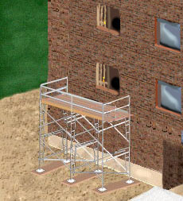
ACCESS
Ladders
Positioned so as not to tip the scaffold
Uniform spacing between rungs (Max 16.75”)
Minimum rung length of 11.5”
Extend 3’ past the platform
Integral (built-in) Access
Specifically designed and constructed for use as ladder rungs.
Uniform spacing between rungs (Max 16.75”)
Minimum of 8” in length
Direct Access
Permitted when scaffold is no more than 14” horizontally, and no more than 24” vertically from the other surface

Slide 20
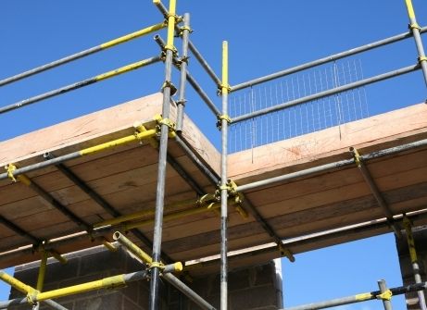
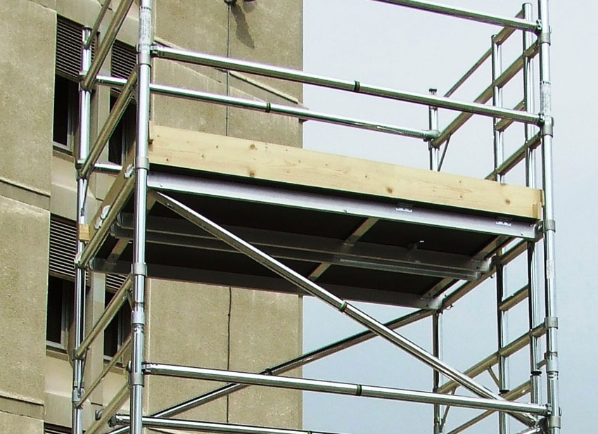
GUARDRAILS AND OVERHEAD
36-38 in at top
Can use cross bracing
36-48 for top rail
20-30 for midrail
Overhead Protection
Toe boards on platforms greater than 10’
3.5” in height
Maximum ¼” above platform
Screens, mesh, catch platforms and canopies
When material stacked above toe board
Barricade
1926.451(h)(2)(i)The area below the scaffold to which objects can fall shall be barricaded, and employees shall not be permitted to enter the hazard area.
Notes:
38 inch minimum guardrail height where guardrail is primary fall protection.
36 inch minimum guardrail height where fall arrest systems are primary fall protection.
Top rails - 36-48 inches tall when using the crossbracing as the top rail
When crossbracing is used as a midrail, it must be between 20 and 30 inches above the work platform.
Guardrails are not required:
• when the front end of all platforms is less than 14 inches from the face of the work
• when outrigger scaffolds are three inches or less from the front edge
• when employees are plastering and lathing 18 inches or less from the front edge
TOE BOARDS should be at least 3 ½” , they must protect the whole edge.

Slide 21
STANDARD INTERPRETATION
“Applicability of scaffold fall protection requirements to guardrails near ladder access areas on scaffolds; toe boards across ladder access areas”
Addresses two questions:
Can there be gaps in guardrails for access?
No. Fall protection standard still applies.
Use gates, removable rails, or chains
Are toe boards required at access points?
Yes, but…
If material is kept away from the access point, and the competent person determines there is no danger of tools or material falling onto workers below, then no.

Slide 22
TOE BOARDS OVER ACCESS

Slide 23
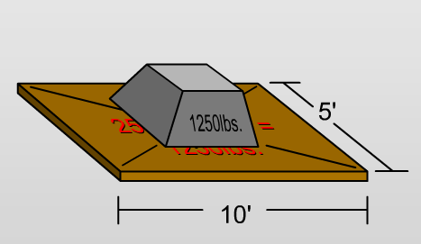
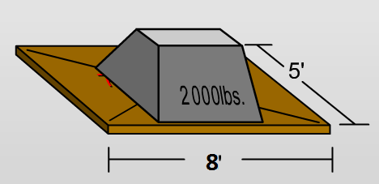
LOAD CAPACITIES
Scaffolds and scaffold components must be capable of supporting, without failure, their own weight and at least 4 times their maximum intended load
Light Trade Medium Trade Heavy Trade
Notes:
CALCULATE LOAD FOR 5 FT WIDE SCAFFOLD
LIGHT DUTY – 25LBS/SQ FT
10FT BETWEEN BEARERS –
5X10=50SQ FT
25X50=1250 MAX LOAD
HEAVY DUTY – 75LB/SQ FT
6FT BETWEEN BEARERS
6X5=30SQ FT
75X30=2250 MAX LOAD
Scaffolds and scaffold components must be capable of supporting, without failure, their own weight and at least 4 times their maximum intended load. (Figure 4) [29 CFR 1926.451(a)]
Each suspension rope, including connecting hardware, must be capable of supporting, without failure, at least 6 times the maximum intended load applied to that rope while the scaffold is operating at the greater of either [29 CFR 1926.451(a)(4)]:
The rated load of the hoist.
Or 2 times the stall load of the hoist.

Slide 24
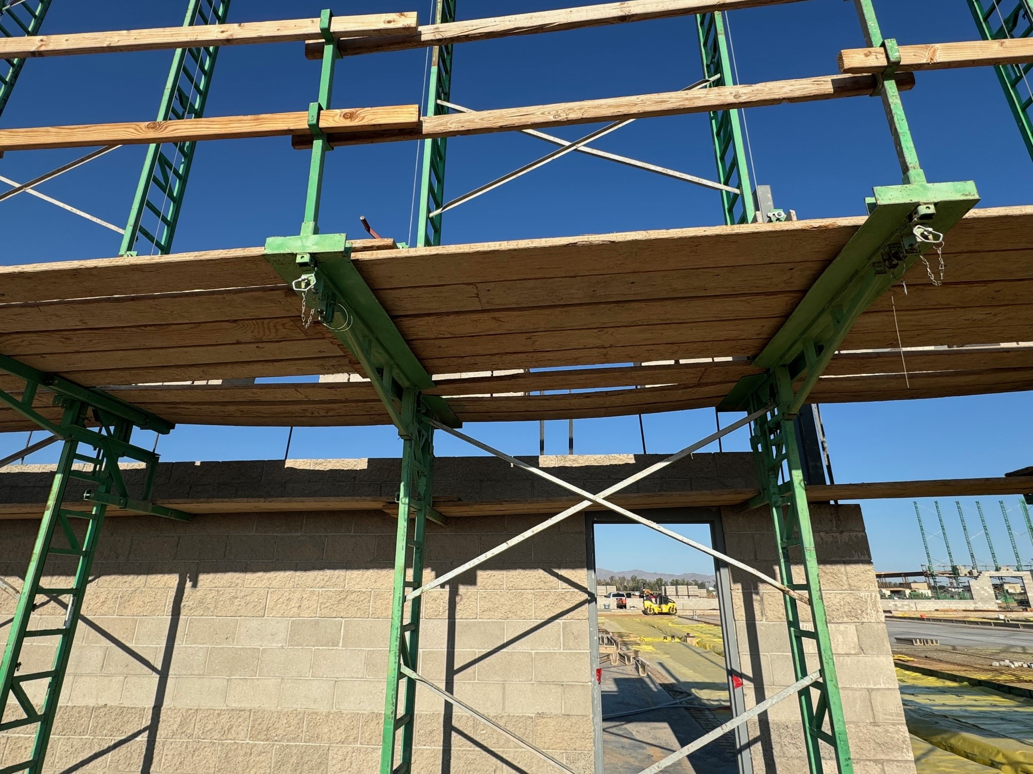
LOAD CAPACITIES
Platforms shall not deflect more than 1/60 of the span when loaded.

Slide 25
LOAD CAPACITIES
Notes:
DO WE TYPICALLY NEED FALL PROTECTION IN SCISSOR LIFT? NO
CAN WE STAND ON GUARDAILS? NO. SCAFFOLDS AND SCAFFOLD COMPONENT MUST BE CAPABLE OF SUPPORTING OWN WEIGHT + 4X INTENDED LOAD
ALSO GUARDRAIL IS NOT SCAFFOLD PLATFORM
Reference 1926.451(g)
Personal fall arrest system - a system used to arrest an employee’s fall. It consists of an anchorage, connectors, a body belt or body harness and may include a lanyard, deceleration device, lifeline, or combinations of these.
The type of fall protection required depends on the kind of scaffold being used.
Reference 1926.451(g)
What fall protection will I need when working on scaffolds?
Boatswains’ chair, catenary scaffold, float scaffold, needle beam scaffold, ladder jack scaffold – personal fall arrest system.
Single-point or two-point adjustable scaffold – personal fall arrest system and a guardrail system.
Crawling board (chicken ladder) – personal fall arrest system, a guardrail system or by a three-fourth inch diameter grabline or equivalent handhold securely fastened beside each crawling board.
On a walkway within a scaffold – guardrail system installed within 9 ½ inches of and along at least one side of the walkway
On a supported scaffold when performing overhand bricklaying operations – personal fall arrest system or guardrail system on all open sides and ends of the scaffold.
For all other scaffolds, a personal fall arrest system or a guardrail system

Slide 26
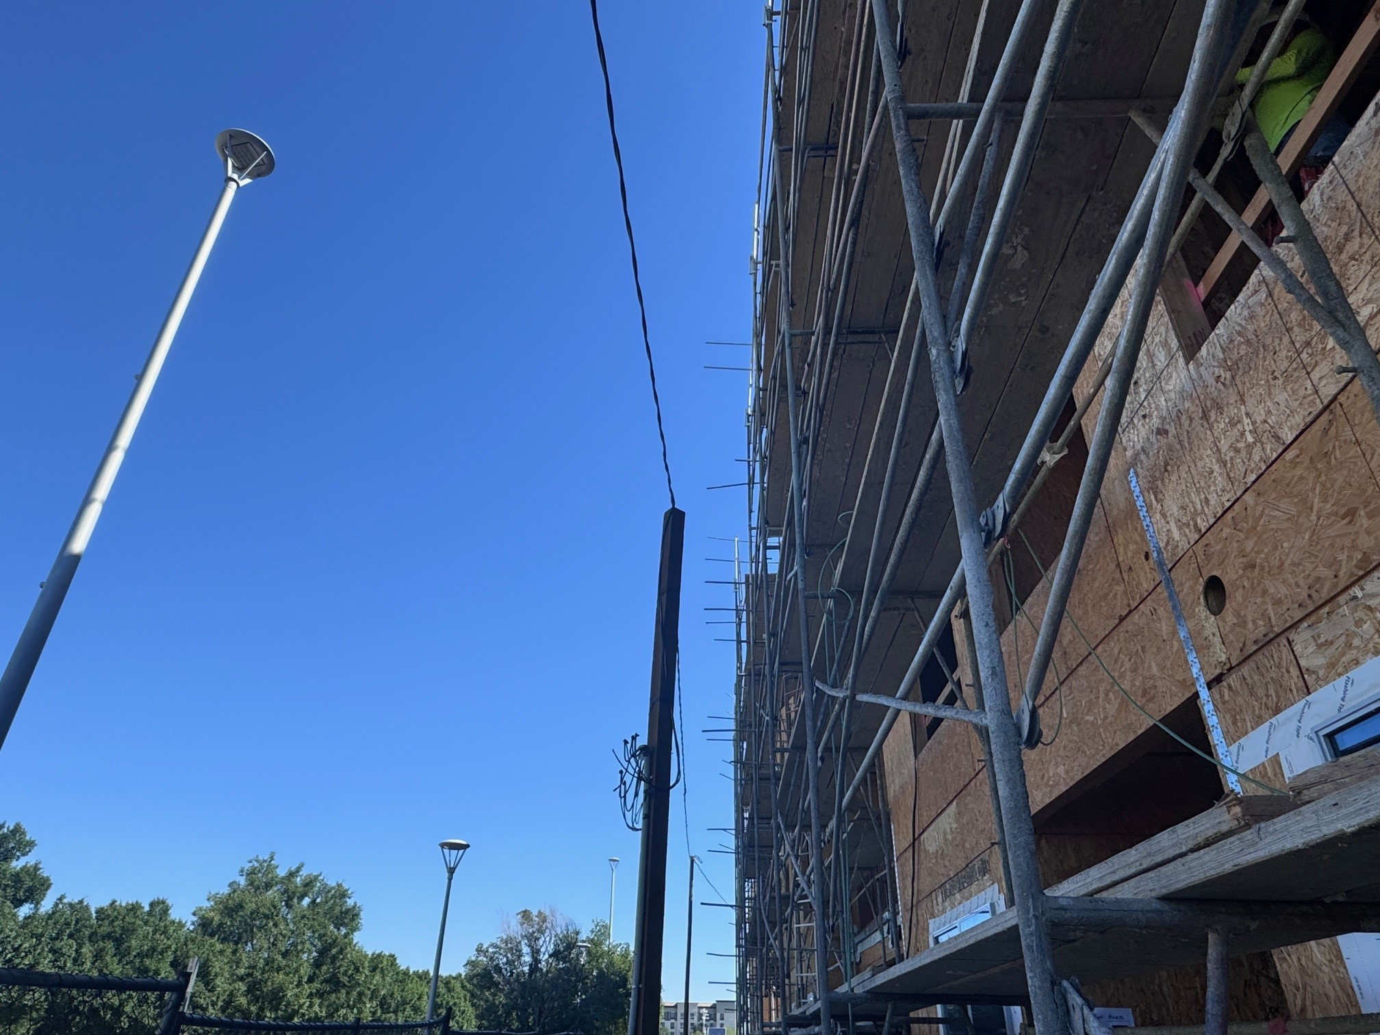
ELECTRICAL CLEARANCES
Scaffolds must not be close enough to overhead power lines that they, or any conductive materials (e.g. building materials, paint roller extensions, scaffold components) that may be handled on them, come closer than 10 feet to the power line.
To be closer than 10 feet:
De-energize the lines.
Relocate the lines.
Install protective coverings to prevent accidental contact with the lines
Because it may be difficult to determine if a power line is insulated, or what its exact voltage is, the 10 foot rule should always be applied.

Slide 27
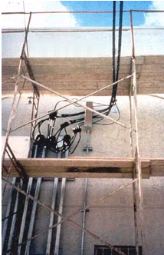
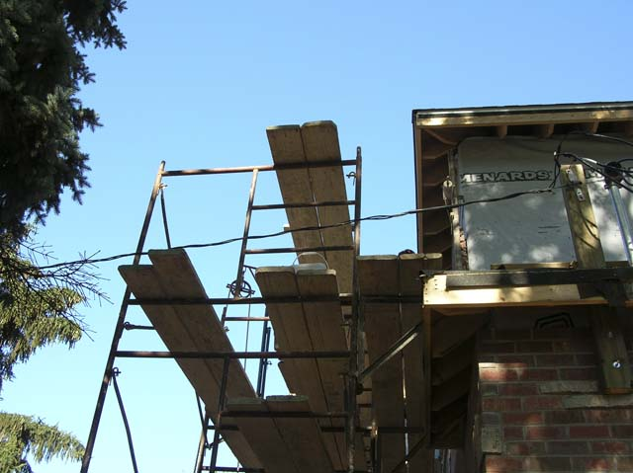
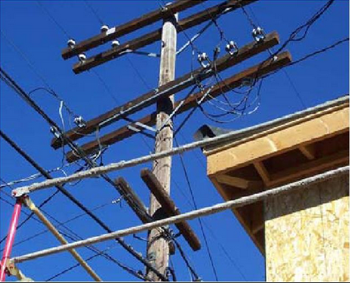
ELECTRICAL CLEARANCES
Notes:
Because they may be built in proximity to overhead power lines, and because they are often made of metal, scaffolds can put workers at risk of electrocution. This risk can be removed through proper clearance and maintenance.

Slide 28
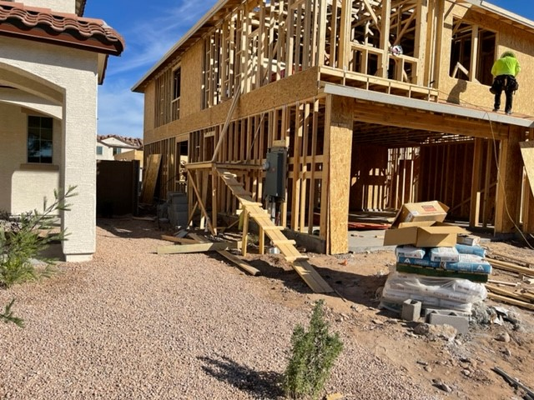
IDENTIFY THE HAZARDS
Notes:
There are two kinds of falling object hazards associated with scaffolds. One concerns the employees on the scaffold itself, and the other concerns employees who may work in or enter the area below the scaffold. Scaffolds that have no toeboards are unprotected from objects falling off to the sides. Employees with no hardhats expose themselves to unexpected falling objects or head bumps.
Reference 1926.451(h)(1) & (2) & (3)
How am I protected from falling objects when I am working on a scaffold?
The major protection is to always wear a hardhat. In addition, when there is the danger of falling hand tools, debris, and other small objects, the employer must install toeboards, screens or guardrail systems above the worker on a scaffold, or through the erection of debris nets, catch platforms, or canopy structures that contain or deflect the falling objects.
When the potential falling objects are too large to be held by toeboards, screens or guardrail systems, the employer must place such objects away from the edge of the surface from which they could fall, and must secure those materials as necessary to prevent their falling.
Workers on scaffolds must be aware of employees working below them, who are in danger from objects falling from the scaffold. Where this danger exists, the employer must erect a barricade to keep employees from working below the scaffold, or must place a toeboard or an edging along the edge of the platform.

Slide 29
Steve Mullen, CSP, ARM, CRIS steve@sficompliance.com 602-316-9038 sficompliance.com
Notes:
$865 million in restoration and rebuild costs (direct costs)
At one point, estimated $2 million lost daily in tourist revenue (indirect costs)
Construction at cathedral suspected to be a cause since the fire started
In every picture there is a TREMENDOUS AMOUNT OF SCAFFOLDING
Recently new theory has come forward blaming electric bells installed 15 years ago – frayed wires
Who is publicizing this theory – scaffold owner

