Slide 1
Scaffolding Training
Insure Compliance

Slide 2
Scaffold Definition
Means any temporary elevated platform (supported or suspended) and its supporting structure (including points of anchorage), used for supporting employees or materials or both.

Slide 3
Competent person
Knowledgeable and authorized to determine needs of scaffolding work.
Inspect scaffolding and components prior to each work shift
Determine feasibility of providing fall protection and access
Evaluate connections to support load and prevent swaying
Determine structural soundness when intermixing components manufacturer
Train erectors and dismantlers to recognize work hazards
Notes:
Hazard: Employees working on improperly constructed scaffolding system.
Corrective Action: Install proper scaffold system

Slide 4
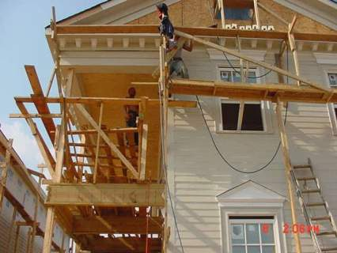
Capacity of Scaffolds
Non-Adjustable
Support its own weight and 4 x maximum intended load
Suspension rope and connecting hardware support 6 x maximum intended load
Adjustable
Stall load of scaffold hoist not to exceed 3 x rated load
Designed by a qualified person and built to loaded design
1926.451(a)
Notes:
Hazard: Employees working on an improperly constructed scaffold.

Slide 5
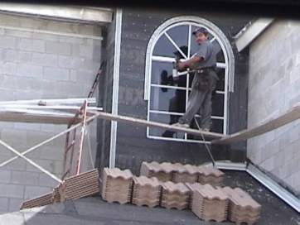
Platform construction
Fully planked and decked
No more than 1” gap between adjacent units and platform and uprights
Max openings between platform and uprights 9 -1/2”
Platform and walkways at least 18” wide
1926.451(b)
Notes:
Description: (1) Platform consists of only one plank; (2) Plank is supported by another plank that is supported by a window sill; (3) No fall protection.
Corrective Action: Provide adequate support for planks. Fully plank Platform. Provide fall protection

Slide 6
Platform Construction
Fully planked and decked
Ladder jack, top plate bracket, roof bracket, and pump jack scaffold at least 12” wide
Guardrails and/or personal fall arrest systems for platforms and runways not 18’ wide

Slide 7
Platform Construction
No paint on wood platforms, except edges that may be marked for identification
Fully planked between from upright and guardrail
No mixed components, unless compatible and integrity maintained
No modification of mixed components unless approved by competent person
No components or dissimilar metals unless competent person determines galvanic action will not reduce strength

Slide 8
Supported scaffolds
Restrained from tipping by guys, ties, or equivalent when higher than 4:1 ratio
Support installed per recommendations or at closest horizontal member to the 4:1 height
Notes:
When working on scaffolding at heights of 10 feet or more above a lower level, guardrails must be installed. The guardrails will provide a physical barrier to prevent you from falling. The guardrail system must be installed along all open sides and ends of the platforms.
The guardrail system must be installed before the scaffold can be used by workers.

Slide 9
Supported scaffolds
Never use scaffolds that do not have proper guardrails installed
Notes:
Guardrails are required for your protection. Never use a scaffold that does not have proper guardrails installed. Many workers will use a scaffold without guardrails because they think nothing will happen to them and the guardrails are not really needed. The guardrails may be the only thing between you and a fall to your death.
In this photograph the worker is on the third level of the scaffold and working unsafely. There are no guardrails in place to prevent him from falling.

Slide 10
Supported scaffolds
Must bear on adequate foundations
Unstable objects will not be used as working platforms
Plumbed and braced
Notes:
To avoid falls and other hazardous conditions, you should only work from scaffolds that are properly constructed and supported. If the scaffold does not have a stable foundation, then the scaffold may move or shift causing either the scaffold or you to fall.
This scaffold has a base plate but it is not resting on a firm foundation. The base plate is resting on blocks, uneven timbers and planking over uneven ground.

Slide 11
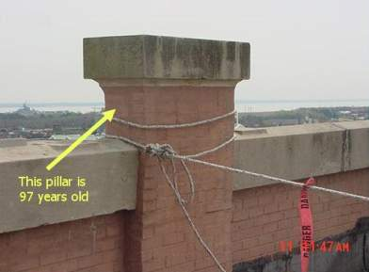
Suspension scaffolds
Support devices must support 4 x imposed load
Outrigger beams, metal or equivalent material, and restrained
Outrigger beams stabilized to floor or roof deck
Direct connection evaluated by competent person
1926.451(b)
Anchor point for lifeline rope not
evaluated prior to use

Slide 12
Access
Must have safe access
Cross-braces prohibited as means of access
Bottom rung no more than 24’ high
Rest platforms required at 35’ intervals
Slip-resistant treads on all steps and landings
September 2, 1997, sets access for erectors and dismantlers
Can use end frames for access
1926.451(e)

Slide 13
Access
Hook-on attachable ladders
Specifically designed for type of scaffold
Lowest rung no more than 24 inches above level on which scaffold is supported
Rest platforms at 35 foot intervals when more than 35 feet high
Minimum rung length 11 ½ inches, and a maximum space between rungs 16 ¾ inches
Notes:
When scaffold platforms are more than 2 feet above or below a point of access, portable ladders, hook-on ladders, attachable ladders, or other means of safe access must be provided. Other types of access may include stair towers, ramps, or walkways.
When using portable hook-on ladders, they must be positioned so they do not tip the scaffold over.
Additionally, the spacing of the ladder rungs must be 16 ¾ inches or less and have a minimum length of 11 ½ inches.
Following these guidelines will allow you to safely access scaffolding and reduce your risk of falls.

Slide 14
Use
Never overloaded
Erected, moved, dismantled and altered near power lines
Repair in place or replace damaged components
Restrict horizontal movement with employees unless designed by registered P.E.
Prohibit work activities during high winds unless authorized by C.P.
Remove whole scaffold from service until repaired
1926.451(f)
Notes:
Description: This scaffold was within 10 feet of the overhead power line with 300 volts to 50KV.
Corrective Action: The scaffold should not be erected, dismantled, used or altered near energized power lines.

Slide 15
Use
Proper clearance near overhead lines
Keep 10 foot minimum unless de-energized,
Relocated, or installed protective covering installed!
Notes:
Description: This scaffold was within 10 feet of the overhead power line with 300 volts to 50KV.
Corrective Action: The scaffold should not be erected, dismantled, used or altered near energized power lines.

Slide 16
Tube and Coupler
When platforms are being moved to the next level, the existing platform must be left undisturbed until the new bearers have been braced and set in place
Couplers must be made of a structural metal
Couplers made from gray cast iron is prohibited
Designed by P.E. if over 125 feet
Notes:
Tube and coupler scaffolds are so-named because they are built from tubing connected by coupling devices. Due to their strength, they are frequently used where heavy loads need to be carried, or where multiple platforms must reach several stories high. Their versatility, which enables them to be assembled in multiple directions in a variety of settings, also makes them hard to build correctly.

Slide 17
Tube and Coupler (cont’d)
Transverse bracing forming an "X" across the width of the scaffold must be installed at the scaffold ends, and at least at:
Every third set of posts horizontally (measured from only one end)
Every fourth runner vertically
Bracing must extend upward diagonally to opposite sides of the scaffold
Where length is greater than their height, longitudinal bracing must be repeated beginning at least at every fifth post
On outside posts, tube and coupler guardrails and midrails may be used in lieu of outside runners

Slide 18
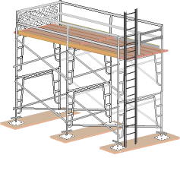
Fabricated frame
Existing platforms remain until the frames are set / braced
Joined with stack pin
Must be designed by registered engineer when over 125 ft.
Notes:
Fabricated frame scaffolds are the most common type of scaffold because they are versatile, economical, and easy to use. They are frequently used in one or two tiers by residential contractors, painters, etc., but their modular frames can also be stacked several stories high for use on large-scale construction jobs.

Slide 19
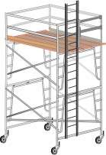
Mobile
Plumb, level and squared
Braced to prevent collapse
Casters and wheels locked to prevent movement while in a stationary position
Platforms must not extend beyond the base supports of the scaffold, unless stability is ensured
Notes:
Mobile scaffolds are a type of supported scaffold set on wheels or casters. They are designed to be easily moved and are commonly used for things like painting and plastering, where workers must frequently change position.

Slide 20
1926.454 Training
Employees must receive training from qualified person that covers:
Nature of hazards, electrical, falls, and falling items
Use of scaffold / handling
Maximum intended load and load carrying capabilities of scaffold
Procedures for setup, dismantling or moving the system
Requirements of subpart “L”

Slide 21
Retraining
When the employer has reason to believe an employee lacks the skill or understanding needed for safe work involving scaffolds, retraining shall be performed until proficiency is established
Retraining is also required when:
Additional or new hazards exists
Changes occur in the type of scaffold and fall protection exist
Where there are inadequacies in an employee’s work

Slide 22
Common OSHA Citations
451(g)(1) Fall protection at 10 feet
453(b)(2)(v) Aerial lifts – Body belt and lanyard
451(e)(1) Scaffold access
451(b)(1) Scaffold platform construction
454(a) Scaffold user training

Slide 23
Resources
www.osha.gov
29 CFR 1926.451
NSHA-OSHA Job Site Safety Handbook
http://www.osha.gov/publications/osha2202.html
Construction Industry Digest
Scaffolding Industry Association
http://www.scaffold.org
American National Standards Institute
A92 (SIA): Scaffolds and other elevating devices

