Slide 1
Brewer Companies
Trench Safety

Slide 2
This Training will provide information about basic Trenching Operations to help you ensure a Safe Working Environment.
It will include a basic overview of Soil Hazards, Protective Systems, and Soil Classifications.
Incorporating and applying these standards to your daily work regimen will increase worker protection and help reduce the frequency of accidents.

Slide 3
Trenching and Excavation is dangerous work that construction workers face daily.
Depending on the task at hand, there are different risks involved.
Let's dig into the differences between trenching and excavation, the hazards involved, and how to mitigate risks while working.

Slide 4
Excavation vs. Trench
An excavation is defined as any man-made cut, cavity, trench, or depression in the Earth’s surface formed by earth removal.
A trench is defined as a narrow excavation (in relation to its length) made below the surface of the ground.
In general, the depth of a trench is greater than its width, but the width of a trench (measured at the bottom) is not greater than 15 feet

Slide 5
Brewer Policy
No employee is permitted to enter a trench that is over 5' in depth. If you
encounter a trench deeper than 5'. Immediately notify your Super, Director,
and/or Safety Team
Brewer pays additional money – outside of the soil task – for connections
that need to be made inside of a shoring box.
If you need Caution Tape, please reach out to your Super, Director, and /or
Safety Team

Slide 6
Trench Hazards
Trenching and Excavation tasks can be deadly if they are not performed using the controls outlined in this training.
Always take Trenching and Excavation Hazards Seriously, as even a 3-foot cave-in can cause a fatality.

Slide 7
Hazards of Trench and Excavation Work
Workers who dig, excavate, or work around and in trenches are at risk of death if they enter an unprotected trench and the walls collapse.
The lack of a protective system is the leading cause of the trench-related fatalities.
Hazards associated with trench work and excavation are recognized and preventable, yet injuries and fatalities associated with these hazards continue to occur.
Engineering controls, protective equipment, and safe work practices to minimize worker’s hazards during trench work and excavations are required.
The OSHA Standards outline the specific requirements for excavations (1926.651) and requirements for protective systems (1926.652).

Slide 8
Requirements for Protective Systems
Trenches 5 feet deep or greater require a protective system unless the excavation is made entirely in stable rock.
If less than 5 feet deep, a competent person may determine that a protective system is not required.
Trenches 20 feet deep or greater require that the protective system be designed by a registered professional engineer or be based on data approved by a registered professional engineer.

Slide 9
Types of Protective Systems
The following are types of protective systems that are used to prevent cave-ins.
Designing a protective system can be complex. Considerations include soil classification, depth of cut, the soil's water content, changes caused by weather, surcharge loads (e.g., spoil, other materials to be used in the trench), and other operations in the area.

Slide 10
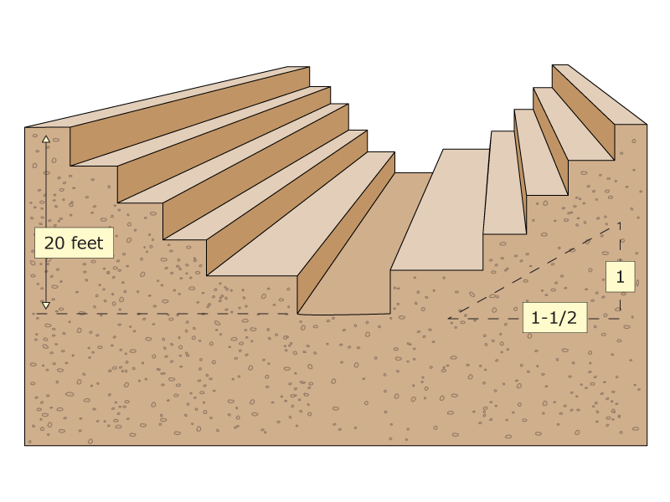
Benching
Means a method of protecting workers from cave-ins by excavating the sides of an excavation to form one or a series of horizontal levels or steps, usually with vertical or near-vertical surfaces between levels. Benching cannot be done in Type C soil. Type C soil is classified as the least stable type of soil, and examples include gravel and sand.

Slide 11
Sloping
Involves cutting back the trench wall at an angle inclined away from the excavation.

Slide 12
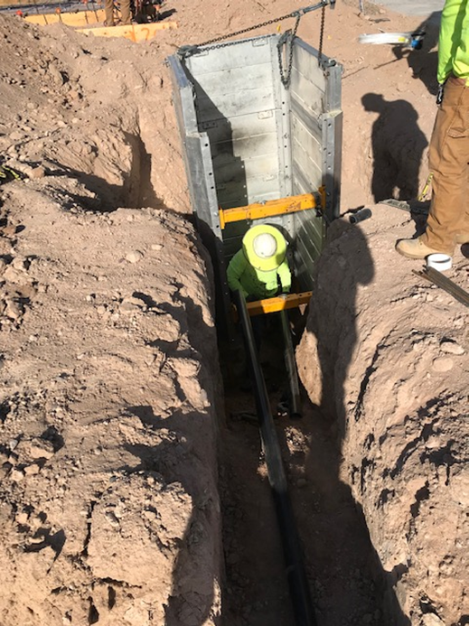
Shielding
Protects workers by using trench boxes or other types of supports to prevent soil cave-ins and must remain 2 feet above the top of the Trench

Slide 13
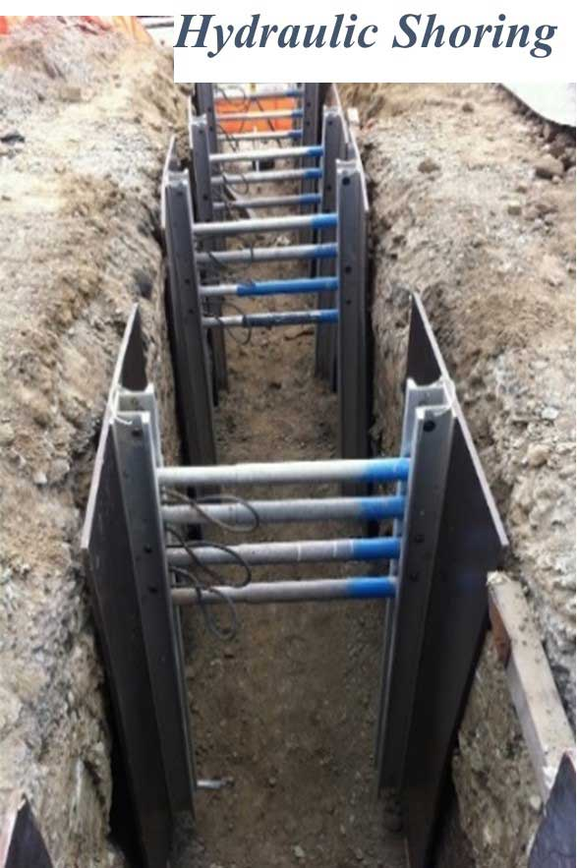
Shoring
Requires installing aluminum hydraulic or other types of supports to prevent soil movement and cave-ins.

Slide 14
Soil Definitions
Cohesive Soil
Means clay (fine grained soil), or soil with a high clay content, which has cohesive strength. Cohesive soil does not crumble, can be excavated with vertical side slopes, and is plastic when moist. Cohesive soil is hard to break up when dry and exhibits significant cohesion when submerged. Cohesive soils include clayey silt, sandy clay, silty clay, clay and organic clay.
Dry Soil
Means soil that does not exhibit visible signs of moisture content.
Fissured
Means a soil material that has a tendency to break along definite planes of fracture with little resistance, or a material that exhibits open cracks, such as tension cracks, in an exposed surface.
Granular Soil
Means gravel, sand, or silt, (coarse grained soil) with little or no clay content. Granular soil has no cohesive strength. Some moist granular soils exhibit apparent cohesion. Granular soil cannot be molded when moist and crumbles easily when dry.

Slide 15
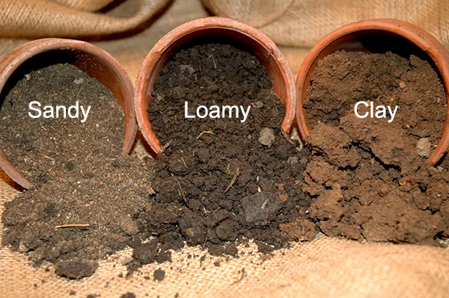
Different Types of Soil
Type A Soil
Is cohesive soils with an unconfined compressive strength of 1.5 ton per square foot (tsf) (144 kPa) or greater.
Examples of cohesive soils are clay, silty clay, sandy clay, clay loam and, in some cases, silty clay loam and sandy clay loam.
Cemented soils such as caliche and hardpan are also considered Type A.

Slide 16
Different Types of Soil
Type B Soil
Cohesive soil with an unconfined compressive strength greater than 0.5 tsf (48 kPa) but less than 1.5 tsf (144 kPa); or
Granular cohesionless soils including angular gravel (similar to crushed rock), silt, silt loam, sandy loam and, in some cases, silty clay loam and sandy clay loam.
Previously disturbed soils except those which would otherwise be classified as Type C soil.
Soil that meets the unconfined compressive strength or cementation requirements for Type A, but is fissured or subject to vibration; or
Dry rock that is not stable; or
Material that is part of a sloped, layered system where the layers dip into the excavation on a slope less steep than four horizontal to one vertical (4H:1V), but only if the material would otherwise be classified as Type B.

Slide 17
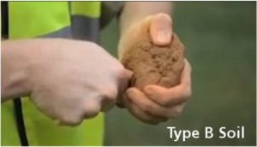

Slide 18
Different Types of Soil
Type C Soil
Cohesive soil with an unconfined compressive strength of 0.5 tsf (48 kPa) or less; or
Granular soils including gravel, sand, and loamy sand; or
Submerged soil or soil from which water is freely seeping; or
Submerged rock that is not stable; or
Material in a sloped, layered system where the layers dip into the excavation on a slope of four horizontal to one vertical (4H:1V) or steeper.

Slide 19
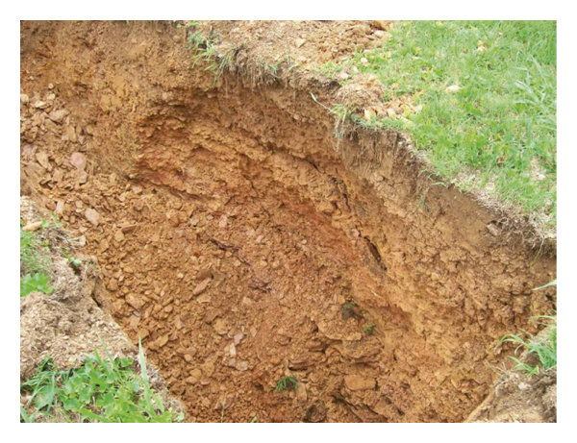

Slide 20
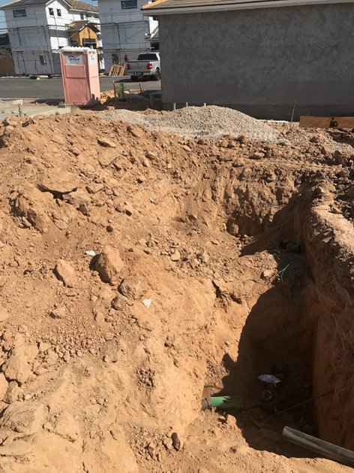
How much does a cubic yard of dirt weigh?
200 Pounds?
500 Pounds or 1000 Pounds?
A DRY Cubic Yard of Dirt Weighs 2000 Pounds!
A WET Cubic Yard of Dirt can weigh up to 3000 Pounds!
That’s like a Toyota Prius falling on you if a trench collapses and only one cubic yard falls in...
Think about that!

Slide 21
Safe Work Practices for Trench Safety
The Best Practices outlined below are critical elements to keeping you Safe when working in a Trench or around an Excavation.
Plan the job before starting by laying out a safe locations away from the trench for spoil piles and heavy equipment routes
heavy equipment can cause stability problems of the trench
Keep excavated soil (also known as spoils) and other materials at least 2 feet from the trench's edge
Know where underground utilities are located before digging. Always call 811 so that utility lines can be marked
Do not work under suspended loads
Ensure that all personnel working in or around the trench wear high visibility vests or shirts
Ladders should never be more than 25 feet from any worker in the trench over 4' in depth for access and egress.
A-frame ladders are ok to use so long as they extend 3' above the trench.
Remember the deepest part of the trench needs to have double row of Caution Tape around the trench top to call attention to the Hazard

Slide 22
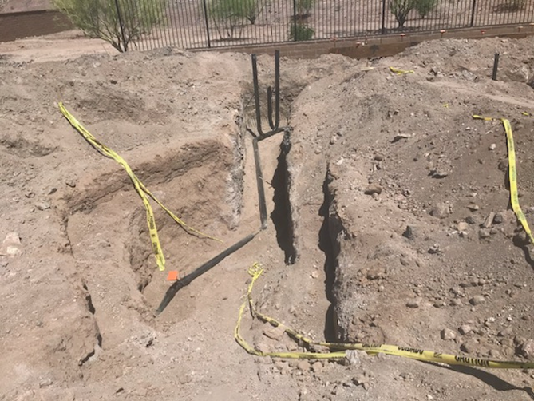
Safe or Unsafe
Unsafe
Why is it Unsafe?

Slide 23
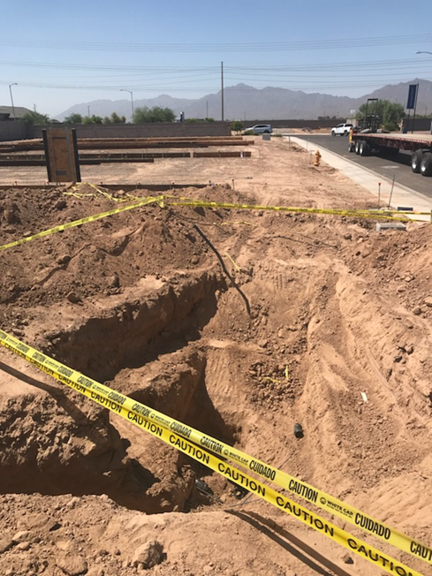
Safe or Unsafe
Unsafe
Why is it Unsafe?

Slide 24
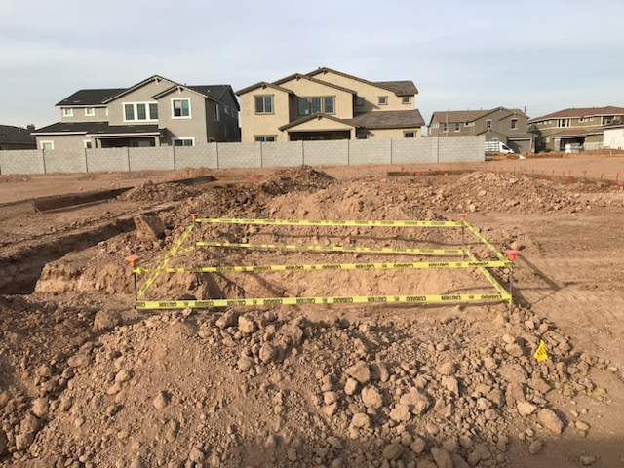
Brewer Policy
Double Row Caution Tape should be installed around the deepest part
of the excavation, most often at the tap location to protect other
Workers and the General Public.
If you are using rebar for your stakes, they must have Protective Caps installed

Slide 25
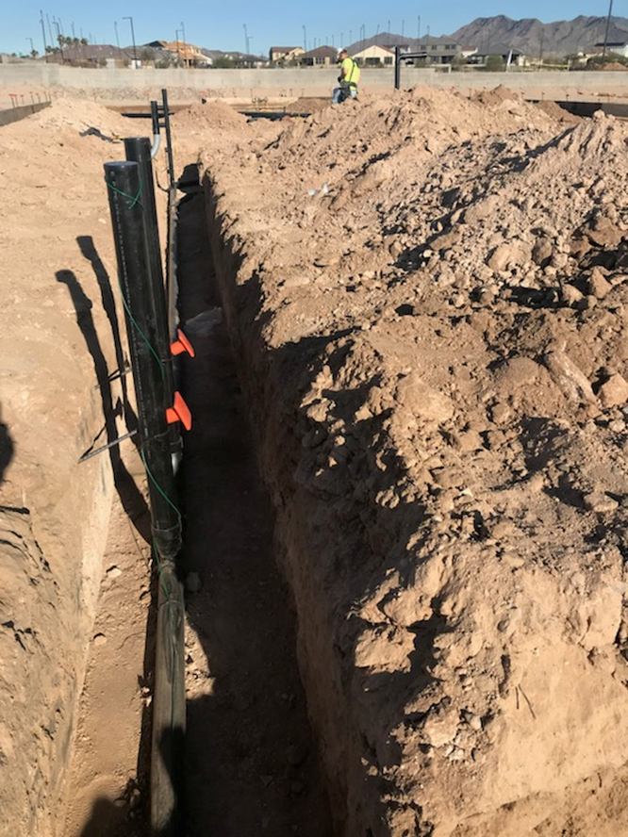
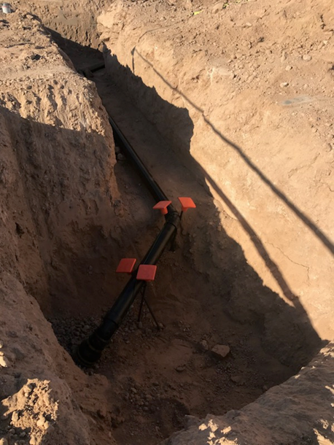
Some Good Work Practices
The use of Rebar Caps inside the Trench on rebar to eliminate Impalement Hazards

Slide 26
Brewer Policy
No employee is permitted to enter a trench that is over 5' in depth. If you
encounter a trench deeper than 5'. Immediately notify your Super, Director,
and/or Safety Team
Brewer pays additional money – outside of the soil task – for connections
that need to be made inside of a shoring box.
If you need Caution Tape, please reach out to your Super, Director, and /or
Safety Team

Slide 29
SP Video

