Slide 1
Kittitas Residential Insurance Town Hall
Impacting Homeowners & Realtors

Slide 2
Residential Nonrenewals and Cancellation
Availability of insurance is based on perception of risk.
Affordability of insurance is based on cost of claims and cost of reinsurance.

Slide 3
Residential Nonrenewals and Cancellation
Nonrenewal means the policy is not extended into a new policy term.
Cancellation means the policy was stopped during the policy term.
Year | C- Policyholder Initiated | C- Policyholder Nonpayment of Premium | C- Insurer Initiated | NR- Policyholder Initiated | NR- Insurer Initiated
2021 | 182,094 | 21,328 | 13,996 | 22,145 | 11,763
2022 | 165,440 | 22,233 | 13,014 | 23,403 | 14,258
2023 | 139,697 | 19,624 | 14,821 | 23,779 | 18,823
2024 | 175,408 | 20,834 | 8,733 | 22,764 | 24,109

Slide 4
Residential Nonrenewals and Cancellation
Let’s look at 98922 and 98940 areas:
98922 | C- Insurer Initiated | NR- Insurer Initiated
2021 | 40 | 55
2022 | 23 | 63
2023 | 38 | 311
2024 | 201 | 92
98940 | C- Insurer Initiated | NR- Insurer Initiated
2021 | 12 | 10
2022 | 8 | 21
2023 | 15 | 85
2024 | 41 | 30

Slide 5
WA FAIR Plan- Insurer of last resort
Provides basic property insurance on dwellings and commercial buildings when owner unable to find coverage in normal market.
Insurance companies are required to include the name and telephone number of the FAIR Plan in all property cancellation and non-renewal notices.

Slide 6
WA FAIR Plan- Insurer of last resort
State | Florida | California | Louisiana | Oregon | Washington
Number of policies in effect | 1,000,000+ | 450,000+ | 120,000+ | 2300+ | 405

Slide 7
WA FAIR Plan- expand coverage?
Current coverage offerings:
$1.5 million policy limits, Actual Cash Value
Fire (includes lightning); extended coverage (wind, hail, vandalism, explosion, volcanic, etc.)
Does NOT cover: theft, liability, water damage
Dwelling coverage: Owner/occupied; Rental properties of single family homes and condominium units; Multi-family rental property up to 4 units.
Commercial coverage: Any non-residential commercial structure; building has mixed commercial and residential space; and multi-family rental property of five or more units.

Slide 8
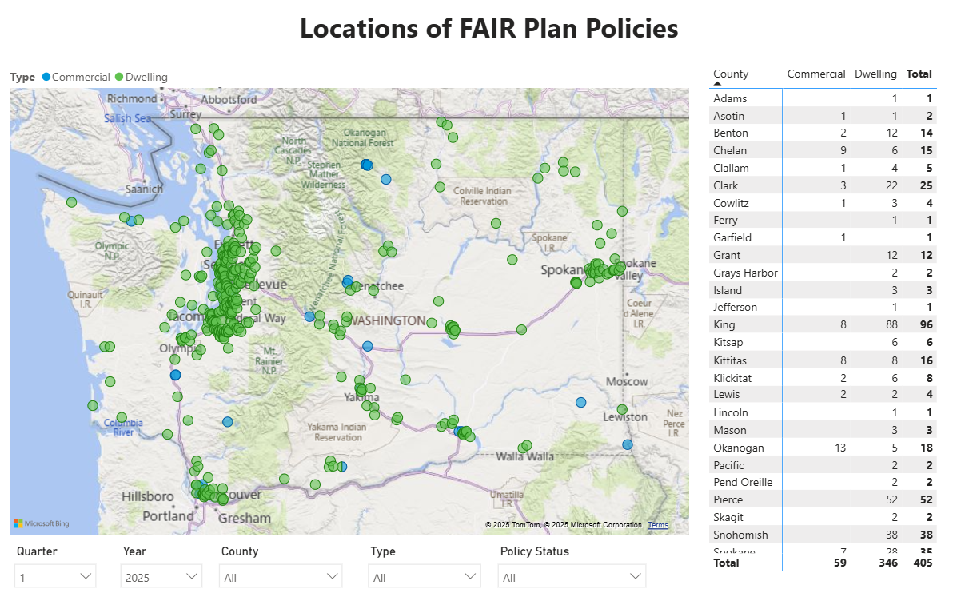
WA FAIR Plan

Slide 9
Mitigation is the key for insurability
Community mitigation- Firewise and NFPA standards
Home mitigation- Insurance Institute for Business & Home Safety Wildfire Prepared Homes is the insurance industry’s upcoming standard.

Slide 10
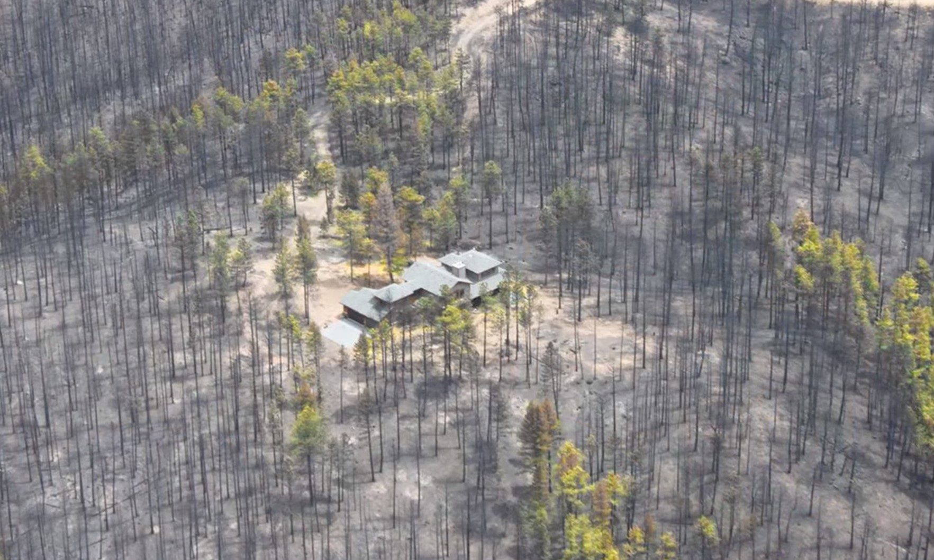
Mitigation is saving homes

Slide 11
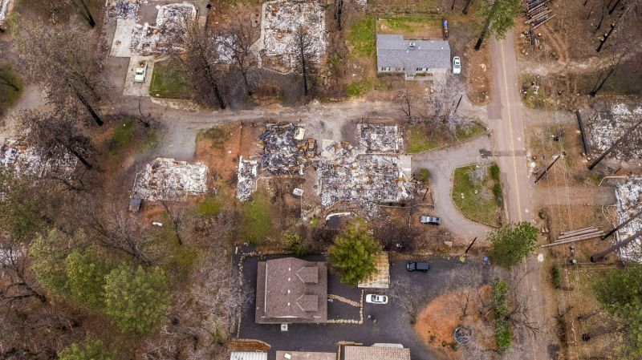
Mitigation is saving homes

Slide 12
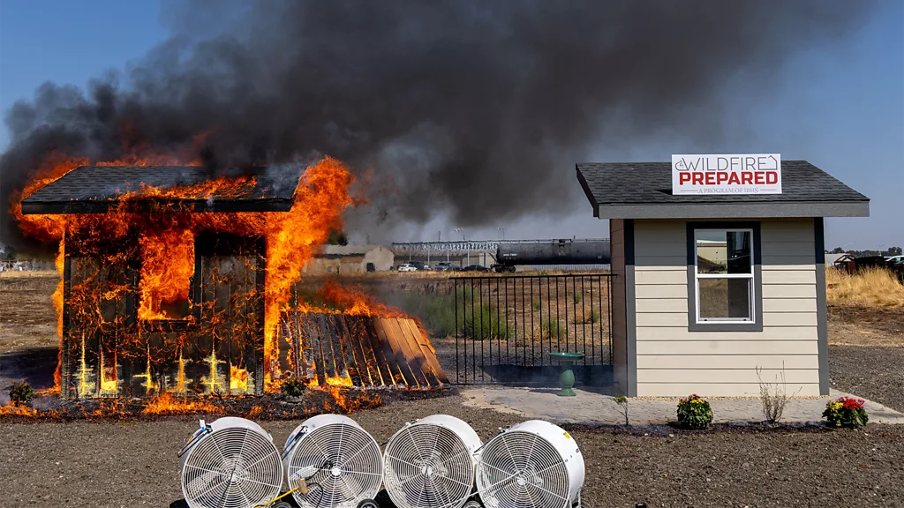
IBHS Wildfire Prepared Home

Slide 13
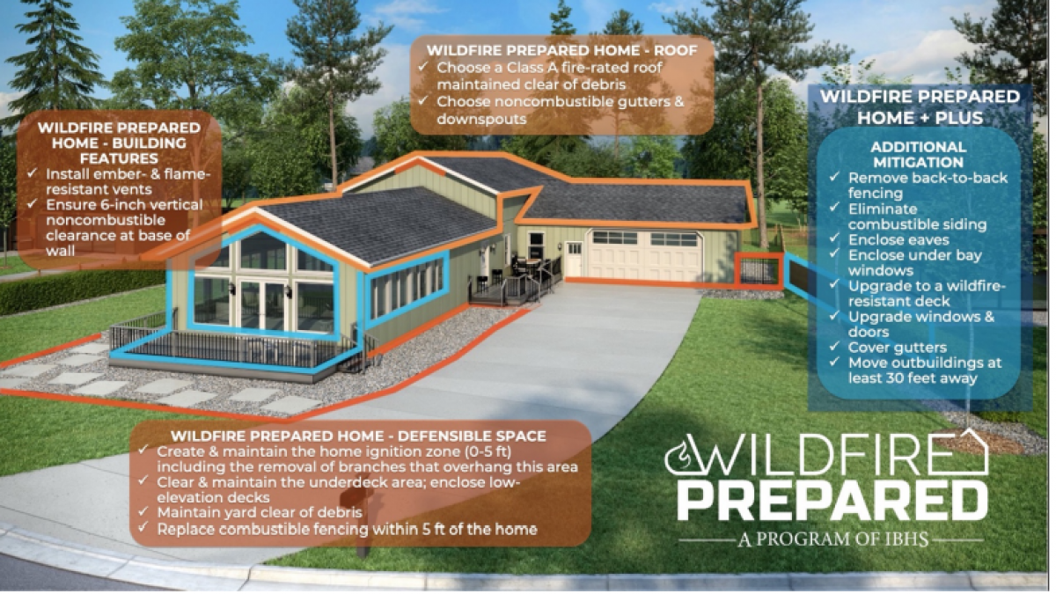
IBHS Wildfire Prepared Home

Slide 14
Questions?
David Forte
Senior Policy Advisor, Property & Casualty
david.forte@oic.wa.gov / 360-725-7268
Connect with us!
Facebook: https://www.facebook.com/WSOIC
Bluesky: https://bsky.app/profile/oicwa.bsky.social
Blog: https://wa-oic.medium.com/
Website: www.insurance.wa.gov

