Slide 1
AUSTIN PEREZ
NAR SENIOR POLICY REPRESENTATIVE

Slide 2
THE PROBLEM

Slide 3
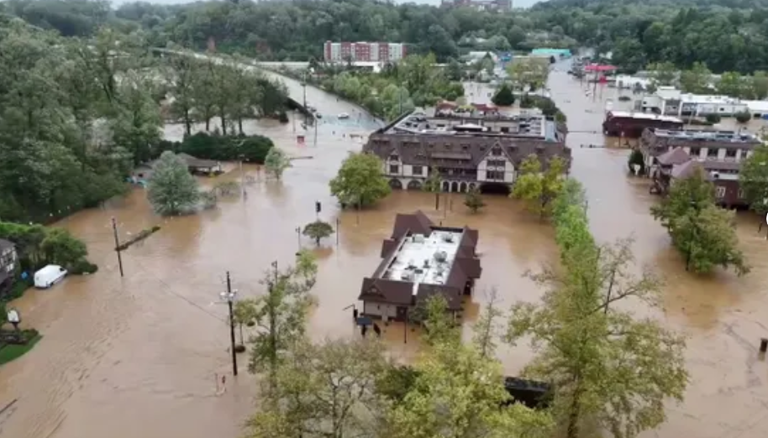
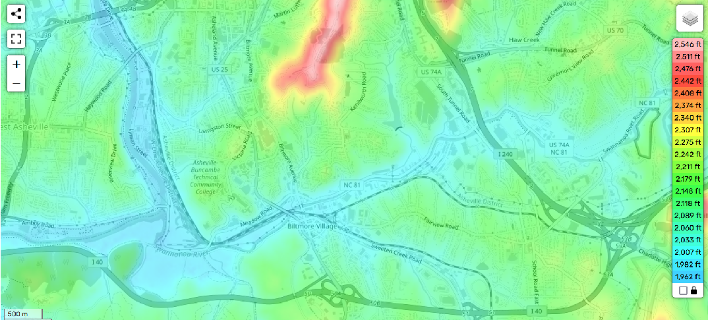
INSURANCE IS A RISKY BUSINESS
“IOU” from an insurer to cover a lump sum in exchange for smaller policyholder payments
Insurers will take the risk IF:
Meet all contractual obligations
Cover expenses in the long run
Use all tools to manage exposure
BUT disaster risk is rising and becoming less predictable and measurable due to:
Escalating natural disasters
Continued high-risk construction
High inflation driving up rebuilding costs
Low reinsurance availability and cost
State insurance rate & land use policies

Slide 4
SECTION BREAK

Slide 5
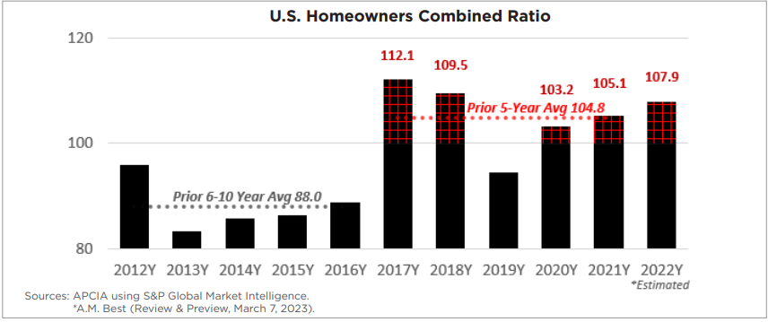
SECTION BREAK

Slide 6
WHAT’S THE SOLUTION?

Slide 7
OPTION 1: STATE INSURANCE REGULATIONS
ADAPTABILITY
INCONSISTENCY
State regulation can be tailored to address the specific risks and needs of each state, such as hurricanes in Florida or earthquakes in California.
Different states may have varying regulations, leading to inconsistencies and complexities for insurers operating in multiple states.
CONSUMER PROTECTION
LIMITED RESOURCES
Local oversight ensures that insurance rates are controlled, and companies are financially stable and able to pay claims
Some state regulatory bodies may lack the resources and expertise to oversee complex insurance markets.
RESPONSIVENESS
FRAGMENTATION
State regulators can quickly address local issues and adapt regulations to meet the changing needs of residents.
The lack of a unified national approach can lead to gaps in oversight, leaving some risks unaddressed.

Slide 8
OPTION 1: STATE INSURANCE REGULATIONS
ADAPTABILITY
INCONSISTENCY
State regulation can be tailored to address the specific risks and needs of each state, such as hurricanes in Florida or earthquakes in California.
Different states may have varying regulations, leading to inconsistencies and complexities for insurers operating in multiple states.
CONSUMER PROTECTION
LIMITED RESOURCES
Local oversight ensures that insurance rates are controlled, and companies are financially stable and able to pay claims
Some state regulatory bodies may lack the resources and expertise to oversee complex insurance markets.
RESPONSIVENESS
FRAGMENTATION
State regulators can quickly address local issues and adapt regulations to meet the changing needs of residents.
The lack of a unified national approach can lead to gaps in oversight, leaving some risks unaddressed.

Slide 9
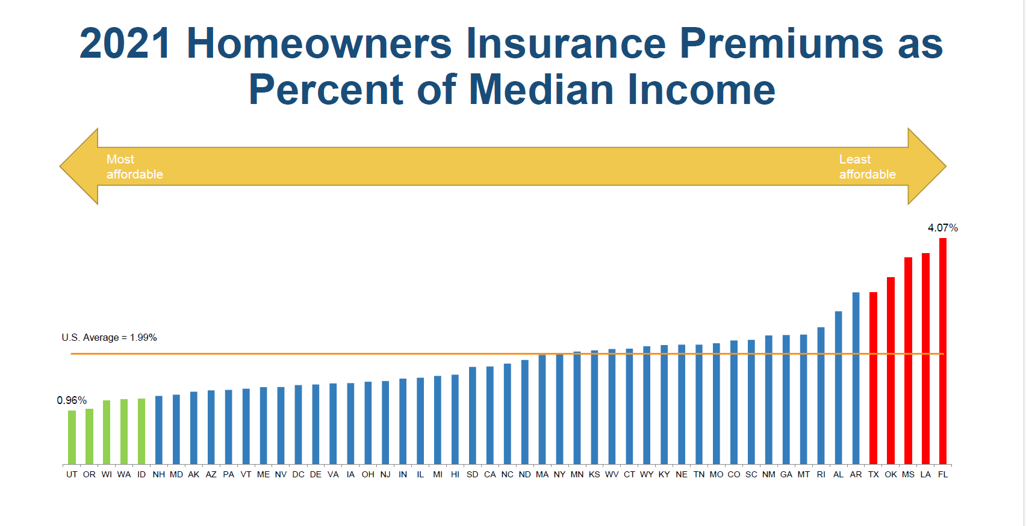
OPTION 1: STATE INSURANCE REGULATIONS
ADAPTABILITY
INCONSISTENCY
State regulation can be tailored to address the specific risks and needs of each state, such as hurricanes in Florida or earthquakes in California.
Different states may have varying regulations, leading to inconsistencies and complexities for insurers operating in multiple states.
CONSUMER PROTECTION
LIMITED RESOURCES
Local oversight ensures that insurance rates are controlled, and companies are financially stable and able to pay claims
Some state regulatory bodies may lack the resources and expertise to oversee complex insurance markets.
RESPONSIVENESS
FRAGMENTATION
State regulators can quickly address local issues and adapt regulations to meet the changing needs of residents.
The lack of a unified national approach can lead to gaps in oversight, leaving some risks unaddressed.

Slide 10
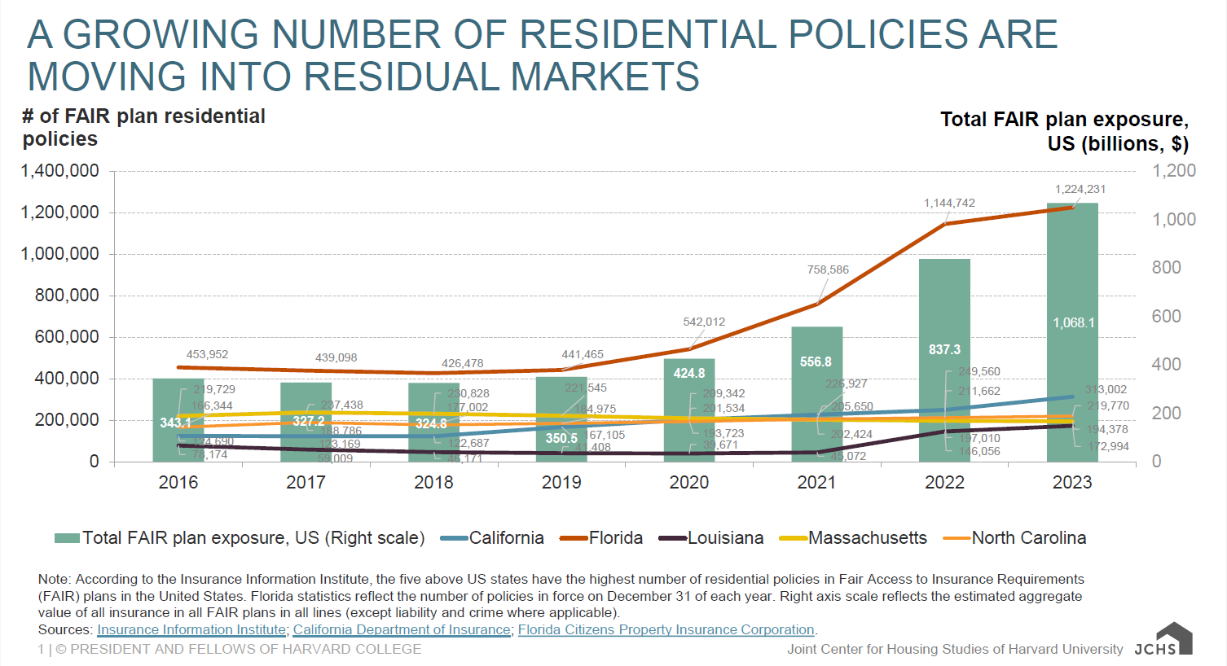
OPTION 1: STATE INSURANCE REGULATIONS
ADAPTABILITY
INCONSISTENCY
State regulation can be tailored to address the specific risks and needs of each state, such as hurricanes in Florida or earthquakes in California.
Different states may have varying regulations, leading to inconsistencies and complexities for insurers operating in multiple states.
CONSUMER PROTECTION
LIMITED RESOURCES
Local oversight ensures that insurance rates are controlled, and companies are financially stable and able to pay claims
Some state regulatory bodies may lack the resources and expertise to oversee complex insurance markets.
RESPONSIVENESS
FRAGMENTATION
State regulators can quickly address local issues and adapt regulations to meet the changing needs of residents.
The lack of a unified national approach can lead to gaps in oversight, leaving some risks unaddressed.

Slide 11
OPTION 2: NATIONAL DISASTER INSURANCE PROGRAM
AVAILABILITY
RATE HIKES
Ensures home insurance coverage for floods, earthquakes, windstorms, and wildfires nationwide.
Raises the average home insurance cost in all 48 states included in the study.
COST REDUCTION FOR SOME
INCREASED COST FOR MOST
Reduces insurance costs for 2% of homeowners by expanding federal mandatory purchase requirement.
Requires 98% of homeowners to pay more for insurance.
LESS FEDERAL AID
RISKY DEVELOPMENT
May reduce federal disaster spending IF more homes are insured and a program is self sustaining.
May encourage more homeowners to build or stay in high-risk areas, as their decisions are subsidized by others.

Slide 12
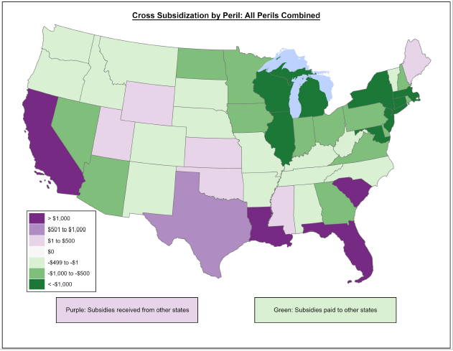
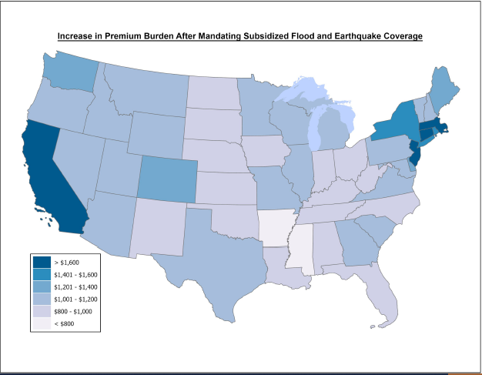
RESULTS OF 2024 MILLIMAN STUDY FOR NAR
$120Bil National Disaster Insurance Fund for floods, earthquakes, wildfires, tornados, and hurricanes.
Some states receive large subsidies, but insurance costs would rise in 48 states.
Requires expanding federal mandatory purchase requirement to flood and EQ.

Slide 13
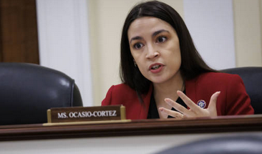
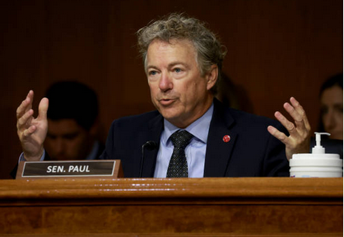
CLINK?
Rep. Alexandria Ocasio-Cortez (AOC):
Progressive Policies: Green New Deal, Medicare for All, tuition-free college.
Social Justice: Supports criminal justice reform and immigration rights.
Economic Equality: Advocates for higher minimum wage and wealth tax.
Senator Rand Paul:
Libertarian Views: Advocates for limited government and individual liberties.
Healthcare Reform: Critic of Affordable Care Act; supports free-market solutions.
Foreign Policy: Opposes military interventions.

Slide 14
OPTION 3: MITIGATION GRANT PROGRAMS
RISK REDUCTION
LOCAL BURDENS
Building stronger reduces the overall risk and impact of natural disasters and can also help with risk-based insurance rates.
Managing multiple grants from different federal agencies can create significant administrative and planning burdens for local governments.
ECONOMIC BENEFITS
ACCESSIBILITY CHALLENGES
Studies show that every $1 invested in mitigation saves an average $6 dollars in avoided future disaster recovery cost.
Some communities may face difficulties navigating the complex application processes and managing the grants effectively
EQUITY/INCLUSION
INEFFICIENCIES
Ensures support for disadvantaged and underserved communities to enhance resilience against natural disasters.
Overlapping and duplicative federal programs can lead to waste, fraud and abuse.

Slide 15
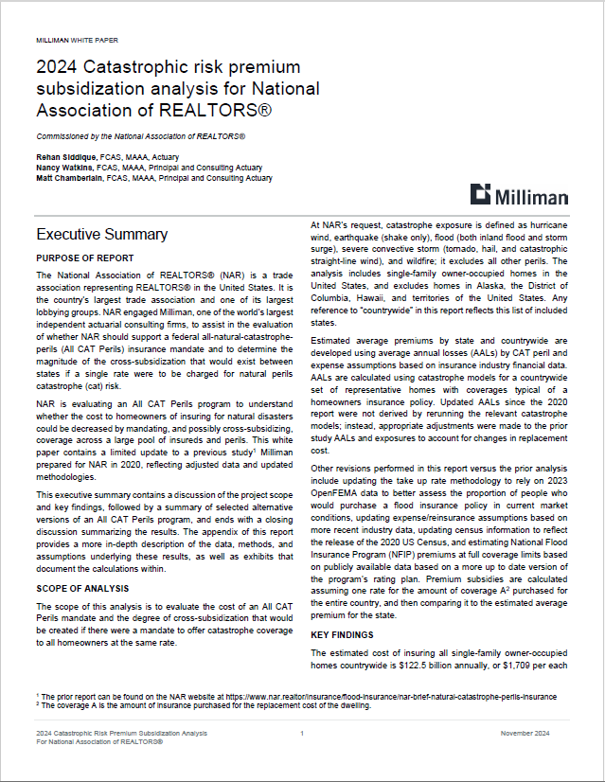
NAR RESOURCES FOR YOU
NAR Brief: Natural Disaster Insurance Program Analysis
10/8 Build Strong America Disaster Risk Mitigation Briefing
8/13 Milliman CA Wildfire Insurance Briefing
NAR-Triple-I Homebuyers Insurance Handbook (nar.realtor)
FEMA-NAR Toolkit: Flood Preparedness Resources
Natural Disaster Policy (nar.realtor)
Flood Insurance (nar.realtor)
Insert image here

