Slide 1
AUSTIN PEREZ
SENIOR POLICY REPRESENTATIVE, INSURANCE ISSUES

Slide 2
In the news…

Slide 3
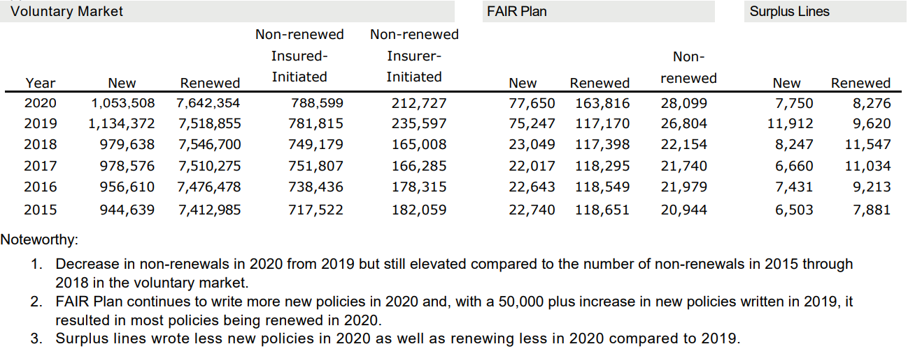
What does the data show?

Slide 4
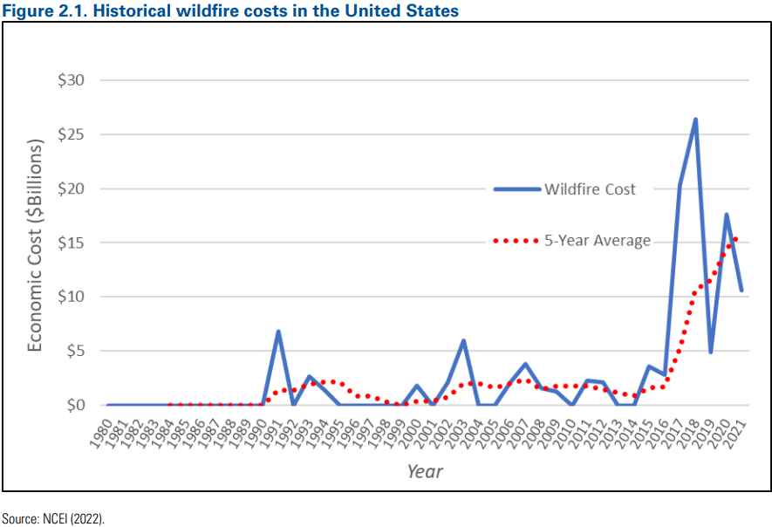
Insurance is a risky business
Insurance policy is an “IOU” to pay a lump sum before knowing true risk
Insurers will take risks that are measurable and predictable IF:
Can meet all contractual obligations
Cover expenses in the long run
Use all tools to manage exposure
Risk-management tools include:
Rate Adequacy
Catastrophe Models
Reinsurance
Bond Investments
Capital & Surplus
New Policies/Renewals

Slide 5
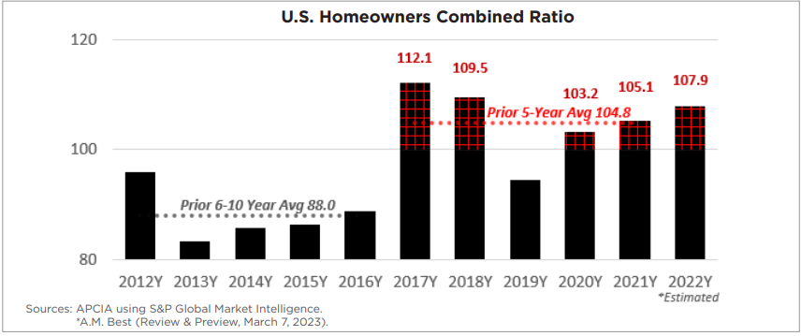
Insurance companies are losing money
Ratio = [Claims + Expenses] / Premiums

Slide 6
How can REALTORS help clients?
Property Resource
Not a Risk Expert
Please use FEMA’s facts like “wherever it rains, it can flood” or “an inch of flooding can cause $25,000 of building damage.”
Please don’t discourage the use of alternative flood risk maps and always avoid statements outside your license or training.
Credible Contacts
People Connectors
Make sure you have knowledgeable insurance advisors on your team; also, surveyors and your floodplain manager.
Be ready with contact information for a short list of expert contacts to help clients answer questions.

Slide 7
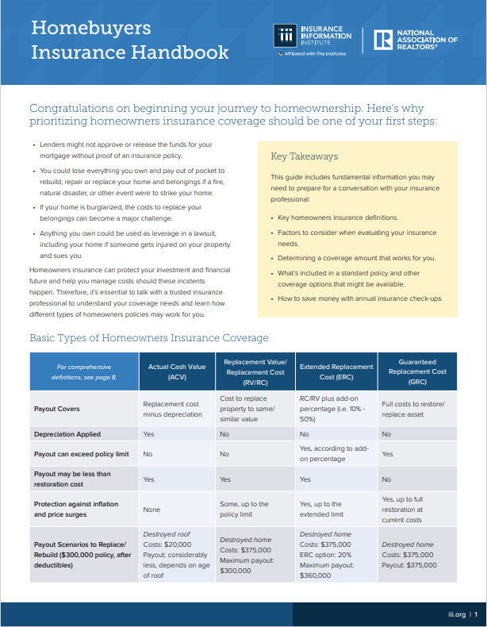
Insert image here
NAR Resources for You
Triple-I, National Association of Realtors® Release Homebuyers Handbook (nar.realtor)
Disaster Preparation Resources (nar.realtor)
Transaction Guidance After Natural Disaster (nar.realtor)
Window to the Law: Create a Disaster Preparedness Plan (nar.realtor)
FEMA-NAR Toolkit: Flood Preparedness Resources
NAR Brief: Natural Catastrophe Perils Insurance
Natural Disaster Policy (nar.realtor)
Flood Insurance (nar.realtor)
Insert image here
7

