Slide 1

NY-GEO 2026
March 24-25, 2026 | Brooklyn, NY
Bridging the Financing Gap
Moderator:
Panel:
Jack DiEnna / GEO NII
Andrea Lee / NY Green Bank
Adam Serbert / Good Carbon
Larry Campana / CT Green Bank
HannahZoe Chua-Reyes / City of New Haven
BUSINESS MODELS • Salon D • 11:45-12:45

Slide 2
Unlocking Residential Geothermal Through ITC Transferability Bridge Lending
NY-GEO | March 25, 2026
Andrea Lee

Slide 3
Who we are

Slide 4
ABOUT NY GREEN BANK
Investment fund dedicated to bridging financial gaps and mobilizing capital towards clean energy projects in New York State, primarily through debt.
Largest
  state green bank
  in the nation
Over $2.9 billion
  in capital committed to clean energy projects in New York State
$5–50 million
  typical investment size
50%
  of capital commitments to date benefitting NYS Disadvantaged Communities
GOAL
Transform financing markets in ways that accelerate New York’s clean energy transition to support a healthier and thriving future for all New Yorker's.

Slide 5





Priority Market Segments
Building Decarbonization
Energy Storage
Clean Transportation
Clean Energy Generation
Community Lenders

Slide 6
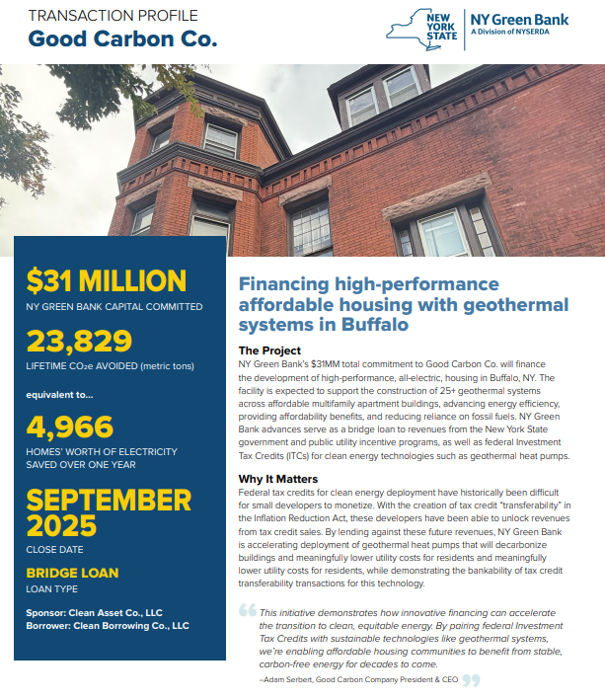
Transaction Snapshot: Good Carbon Co. ITC Transfer Bridge Facility

Slide 7



Investment considerations
General underwriting parameters for investment tax credit transferability bridge lending:
Project Execution
Ability to complete construction on time and on budget to generate an eligible ITC Developer track record, liquidity, construction schedule, and third-party reviews Structural features: Step-in rights, contractor replacement rights, draw schedule, collateral package
Generating marketable ITCs is the primary repayment pathway Factors that enhance marketability: prior experience, cost segregation estimates, tax credit insurance, other third-party reviews Structural features: conservative advance rates and basis estimation, tailored funding conditions precedent (CPs), mandatory prepayment triggers tied to ITC generation and sale timelines
ITC marketability
Sponsor considerations
Holistic assessment of Sponsor’s: Track record, execution capability, and project delivery experience Financial strength Management team and business model
OTHER GENERAL TRANSACTION INFORMATION Typically secured and based on flexible, market-based commercial terms Interest and fees based on risk profile and market conditions Typical transaction expenses including legal, IE, appraisal, and insurance costs

Slide 9
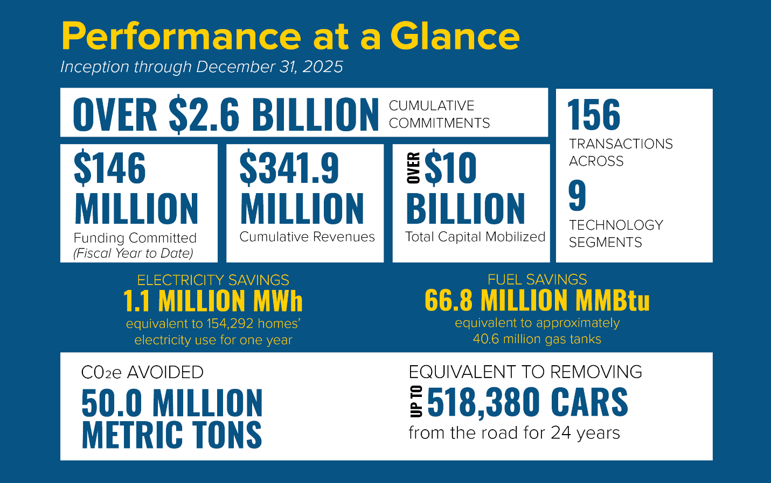

Slide 10


Slide 11
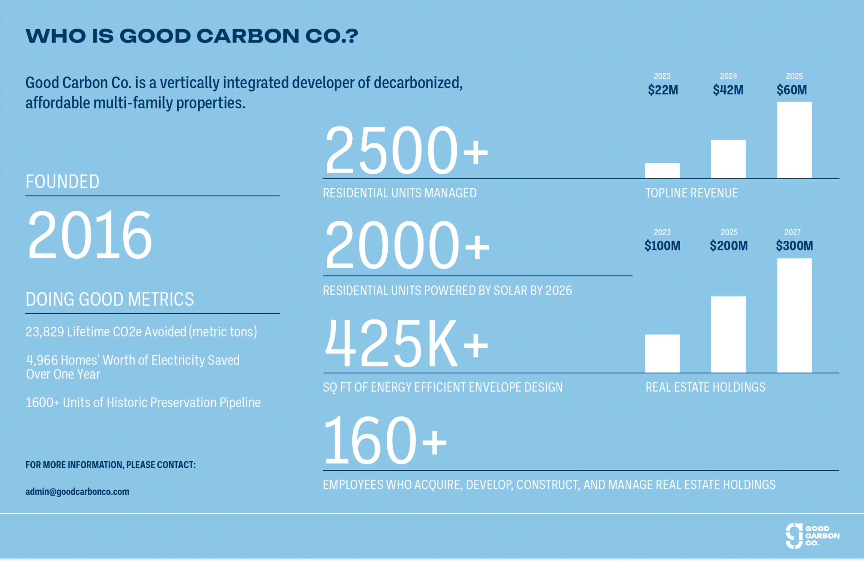

Slide 12
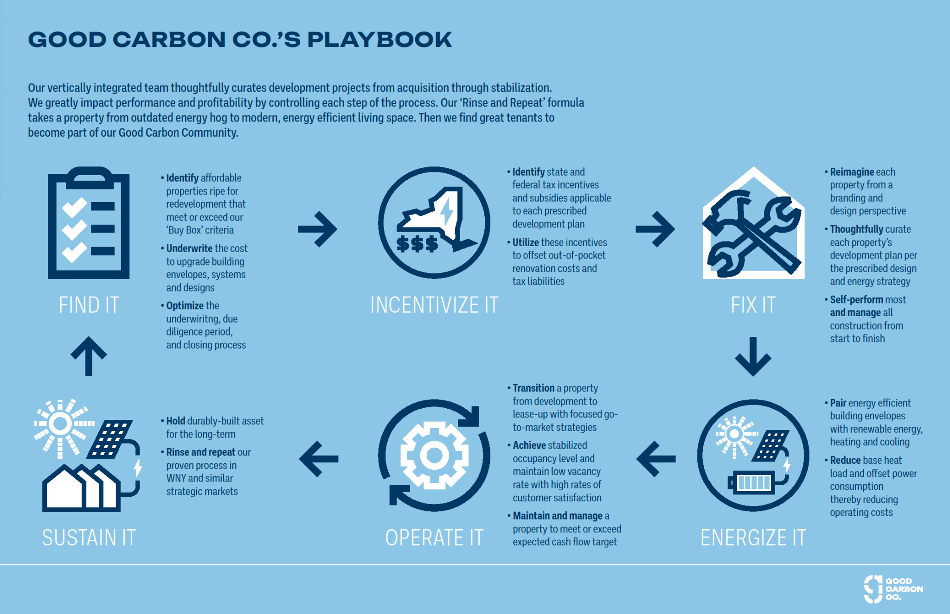

Slide 13
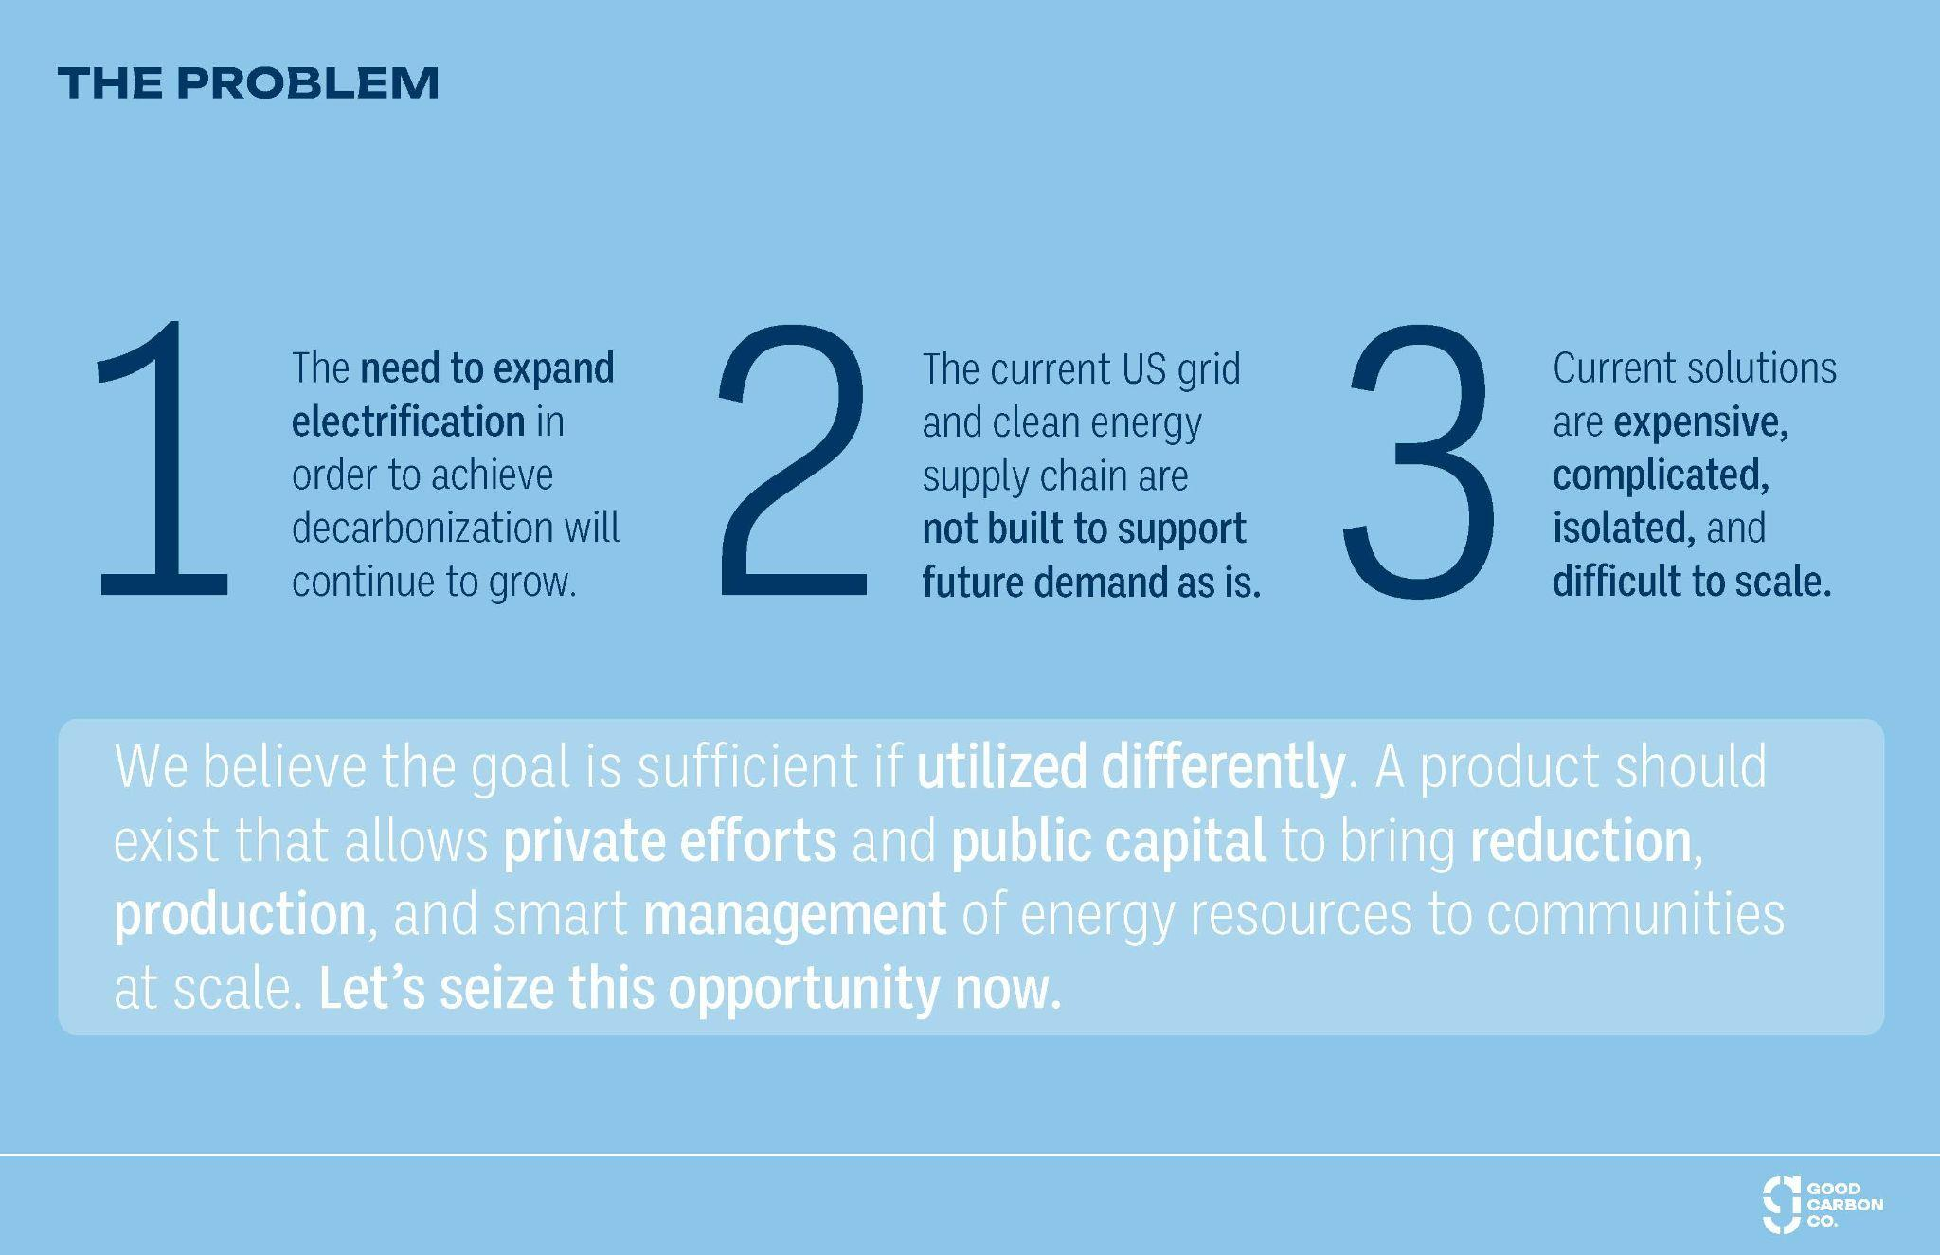

Slide 14
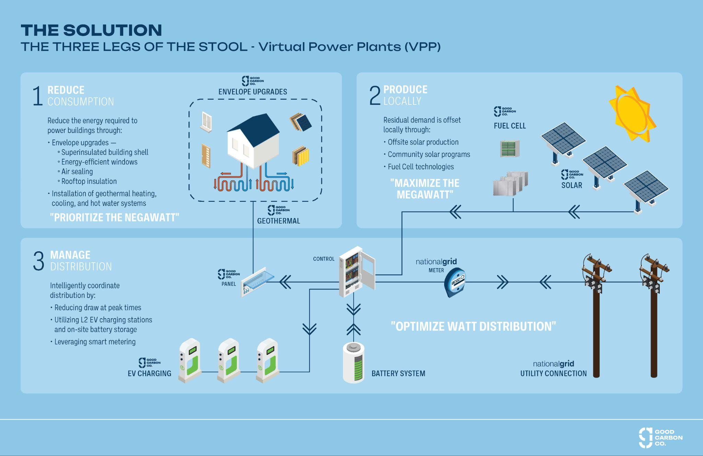

Slide 15
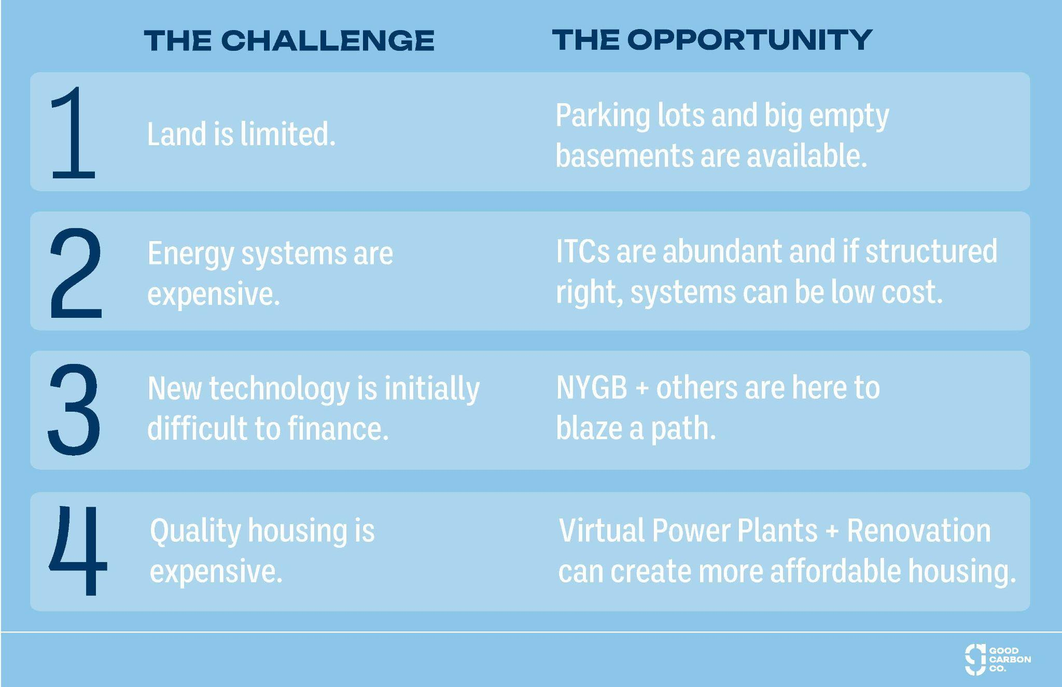

Slide 16
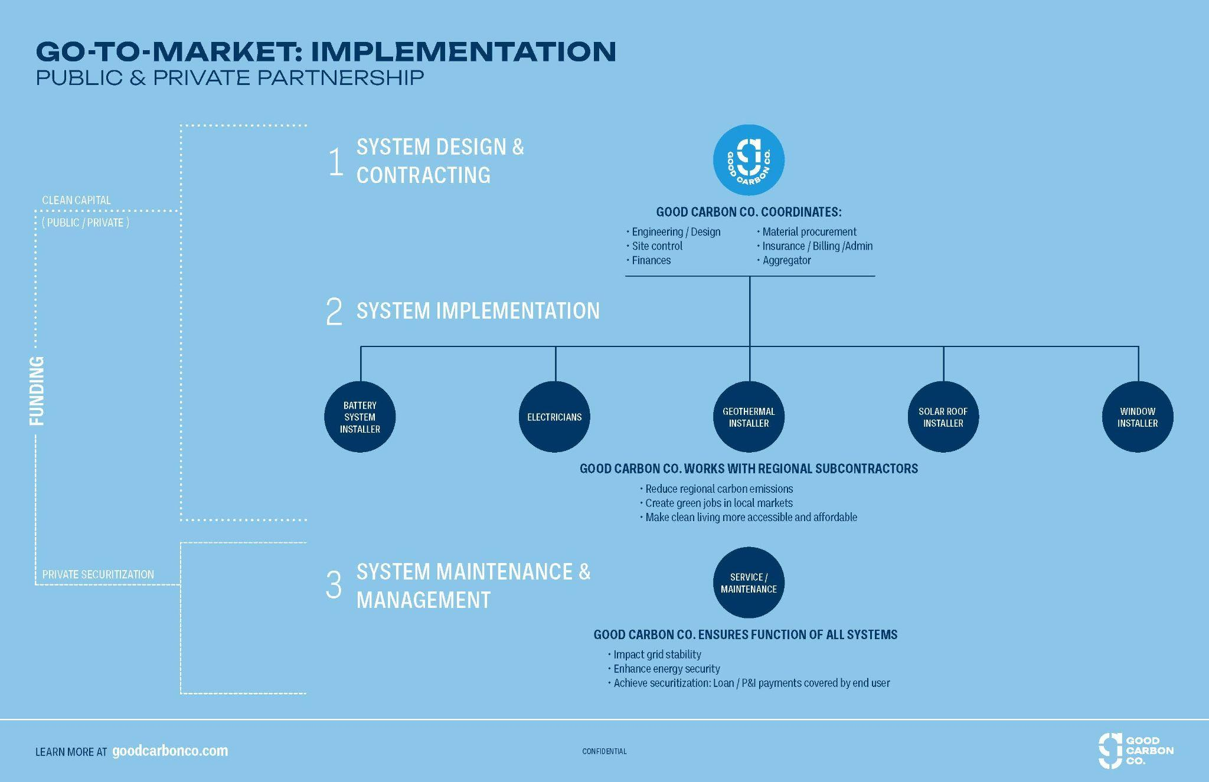

Slide 17
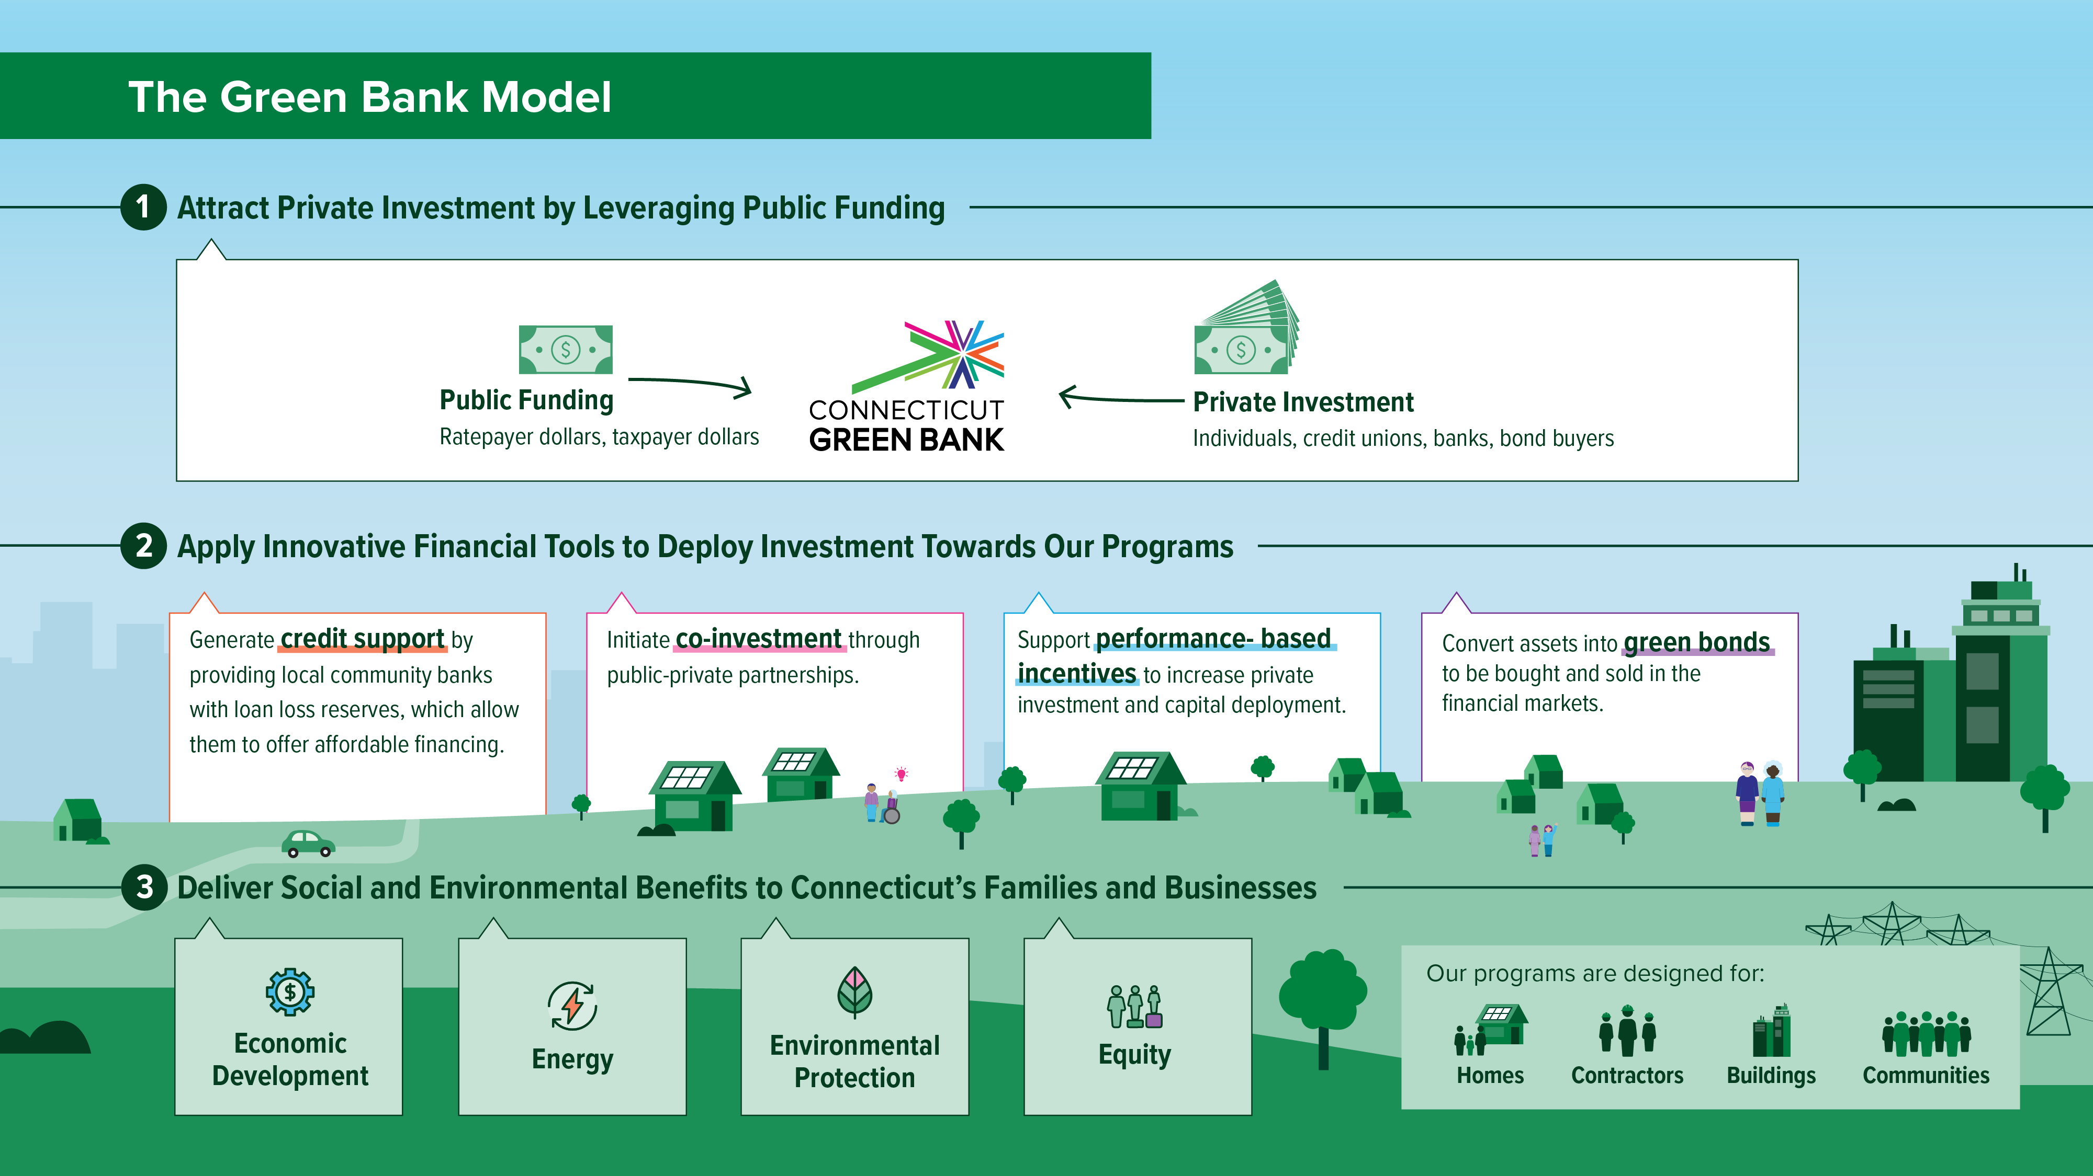

Slide 18




Slide 19
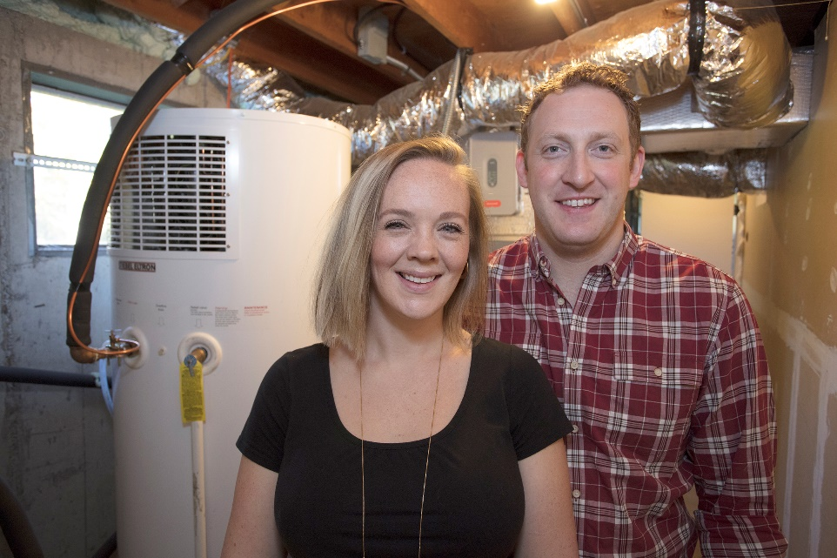
Customer Story
Solar and geothermal systems cut Dan & Sarah’s energy bills to just $630.
When Dan and Sarah bought their home and planned renovations, the large old, existing oil heating system had to go. They insulated the attic and windows to improve energy efficiency, and added a geothermal system as well as solar panels. Using a Smart-E Loan, they were able to access low interest rate financing to cover these costs.
Thanks to these renewable and energy efficiency upgrades, Dan and Sarah’s yearly electric and heating expenses were only $630.
Location
Redding, CT
Energy Upgrade
Solar Panels and Geothermal System
Total Loan Amount*
$25,000
Projected Energy Savings
$630 annually
“When we first moved into the house, we knew this was a fixer-upper and that we wanted to make renovations. There would be no way to do this without the Smart-E Loan. It was a pretty easy process.”
Dan

Slide 20



The Green Bank is helping Connecticut to thrive and create stronger, more resilient communities by offering green solutions for buildings of all types – from businesses and nonprofits to multifamily housing and local government. Leverage Green Bank financing to save money and realize the benefits of more modern, sustainable buildings.

Slide 21

Commercial Property Assessed Clean Energy
Commercial Financing
Low-cost, long-term funding (up to 25 years)
Owner repays over time through a senior assessment placed on the property
Assessment stays with the property regardless of ownership
Financing available to commercial properties for GREEN solutions
+ EV Charging Infrastructure
& Resilience

Slide 22



Access financing for your unique project or business. The Green Bank is committed to investing in the clean economy through our extensive financing products, but some projects don’t quite fit the mold. If you have a project plan that needs an investment boost, the Green Bank may be able to help.
© 2026 CT Green Bank. All Rights Reserved
Notes:
Access financing for your unique project or business. The Green Bank is committed to investing in the clean economy through our extensive financing products, but some projects don’t quite fit the mold. If you have a project plan that needs an investment boost, the Green Bank may be able to help.

Slide 23
How does it work? Through its open Request for Proposals for Green Bank Capital Solutions, the Green Bank provides access to capital to Connecticut projects that catalyze clean energy deployment and energy efficiency, reduction of greenhouse gasses, environmental infrastructure, improved public health outcomes, job creation and economic development.
The RFP is open to technologies that have already proven to be commercially viable or
have demonstrated clear potential for commercial viability through well-documented
feasibility studies or pilot programs with clear evidence of a viable business model
and path to sustainable impact.
True to the green bank model, this open RFP allows the Green Bank
to leverage public dollars to bring in private investment and
potentially other investment partners.
© 2026 CT Green Bank. All Rights Reserved
Notes:
How does it work? Through its open Request for Proposals for Green Bank Capital Solutions, the Green Bank provides access to capital to Connecticut projects that catalyze clean energy deployment and energy efficiency, reduction of greenhouse gasses, environmental infrastructure, improved public health outcomes, job creation and economic development.
The RFP is open to technologies that have already proven to be commercially viable or
have demonstrated clear potential for commercial viability through well-documented
feasibility studies or pilot programs with clear evidence of a viable business model
and path to sustainable impact.
True to the green bank model, this open RFP allows the Green Bank
to leverage public dollars to bring in private investment and
potentially other investment partners.

Slide 24

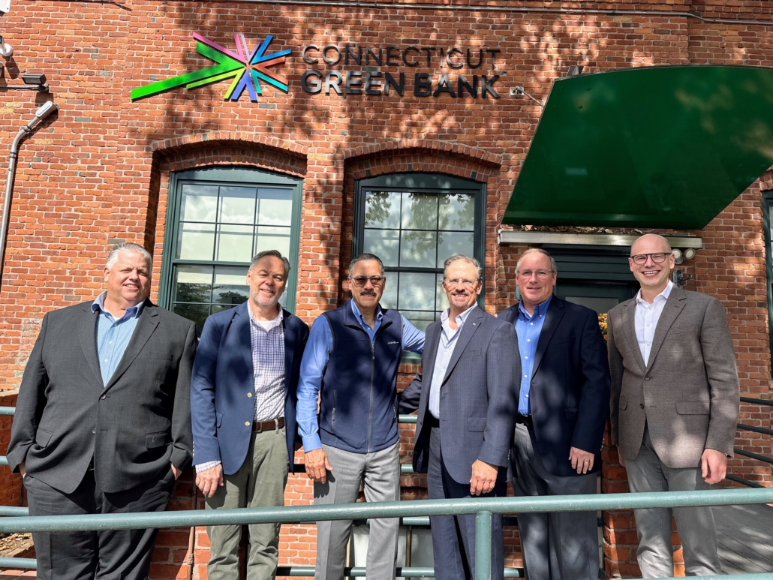
Customer Story
Budderfly expands its mission with the help of Green Bank financing.
What happens if we change how businesses use energy? This question drives Budderfly to provide a unique energy and cost saving model to businesses ranging from quick service restaurants to healthcare facilities. Using their energy-as-a-service approach, they have helped Connecticut businesses save 24,729 MWh through new equipment, technology, and innovation while simultaneously reducing their energy costs and emissions.
In 2022, seeking to expand their customer base in Connecticut, Budderfly turned to Green Bank’s Capital Solutions Open RFP, which helped open the door to other investment. Now, their services continue to make a large impact on businesses in Connecticut and beyond looking to become more energy efficient, and their growth is earning recognition from Inc 5000 and others.
“Financing from the Connecticut Green Bank has been hugely supportive in our efforts to grow and scale our impact across the state. We're proud to help our customers drive impactful change, including Ryders Health Management, YMCA, Chabaso Breads, UConn Health Center and countless restaurant franchises, like McDonalds, Dunkin' and more."
Al Subbloie, Budderfly Founder & CEO
Headquarters
Shelton, CT
Capital Solutions Financing
$5 million over 6 years
Greenhouse Gas Avoided
22,745 cumulative metric tons

Slide 25

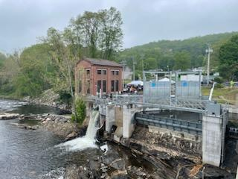
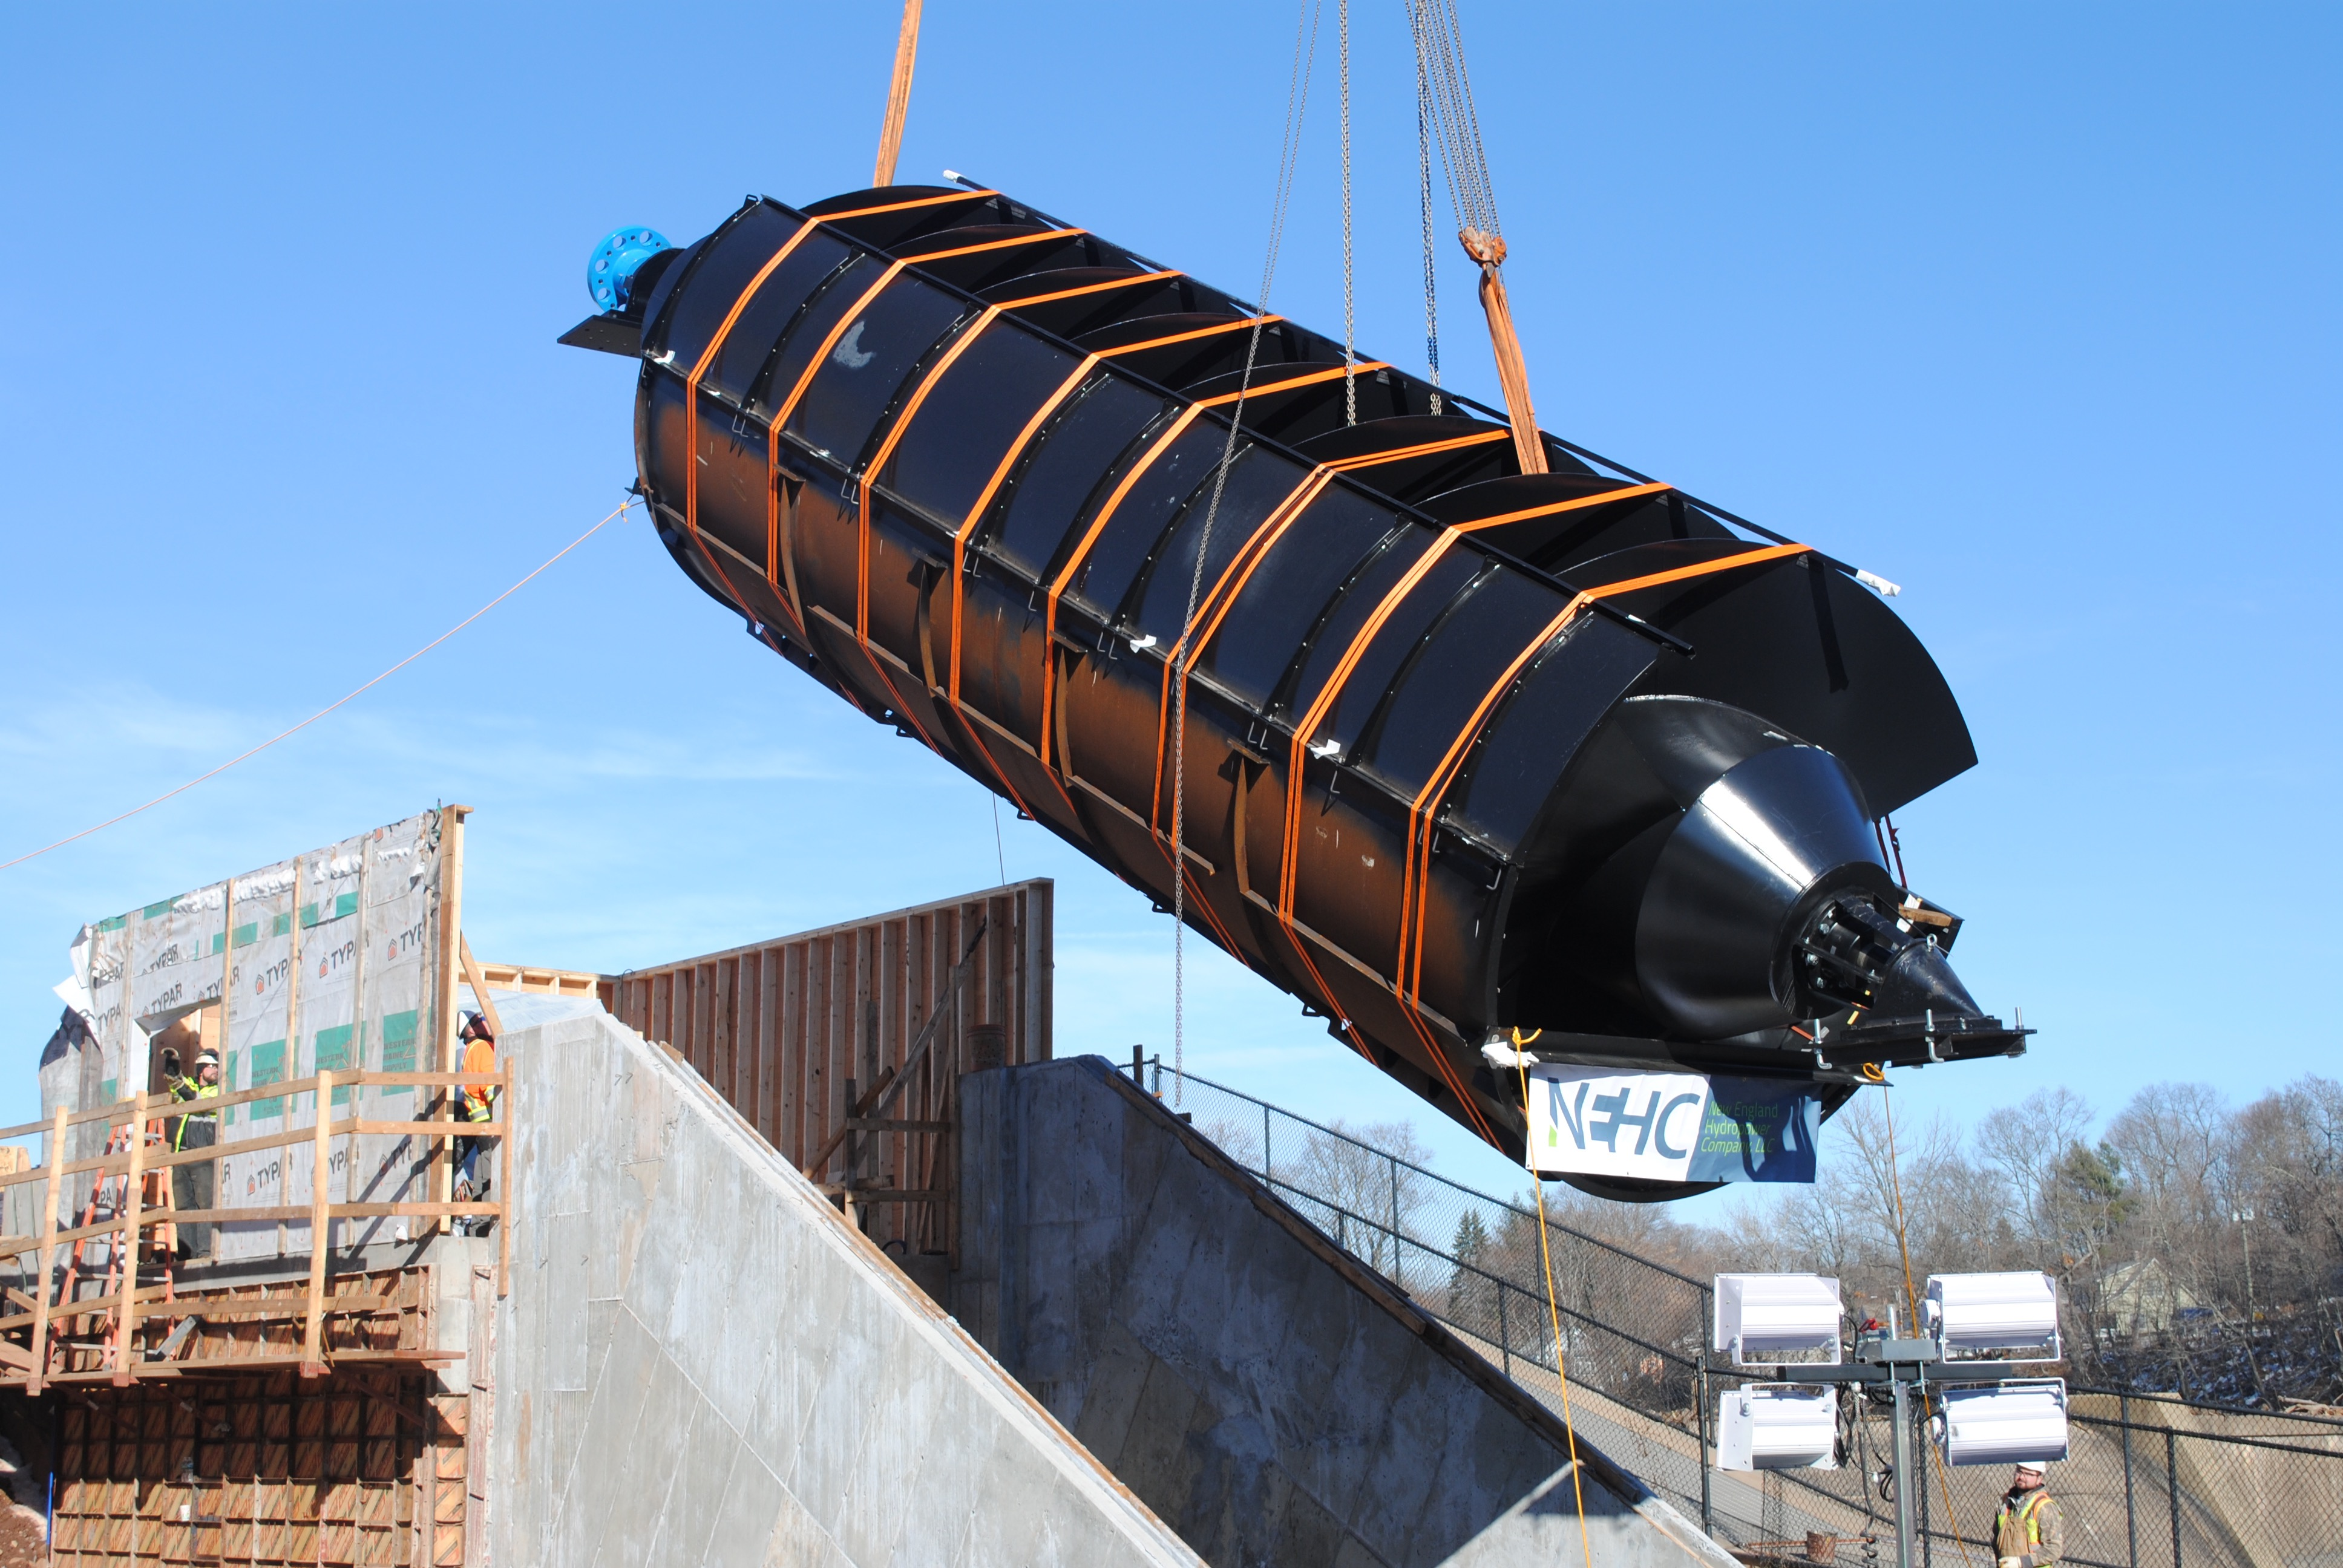
Capital Solutions Project Types
Geothermal, Solar, Fuel cell, Microgrids, Battery storage, Hydropower
Canton Hydropower
Meriden Hydropower

Slide 26
Union Station Area Thermal Energy Network (USATEN)
Bridging the Financing Gap
US EPA Climate Pollution Reduction Grants Program - Implementation Grants

Slide 27

EPA Climate Pollution Reduction Grants Program
$5 billion in Inflation Reduction Act funding for grants to states, local governments, tribes, and territories to (Phase 1) develop and (Phase 2) implement ambitious plans for reducing greenhouse gas emissions and other harmful air pollution
Phase 2: $4.6 billion for competitive Implementation Grants

Slide 28

USATEN: Generational Investment in Clean Energy
Partnership between the City, Elm City Communities (ECC), New Haven Parking Authority, and CT Department of Transportation to reduce fossil fuel use at one of New Haven’s most important buildings – historic Union Station – and provide clean, affordable heating and cooling to the new Union Square development.
Reduce climate and air pollution
Build shared platform for affordable, neighborhood-level decarbonization
Create high-quality jobs/apprenticeship opportunities

Slide 29
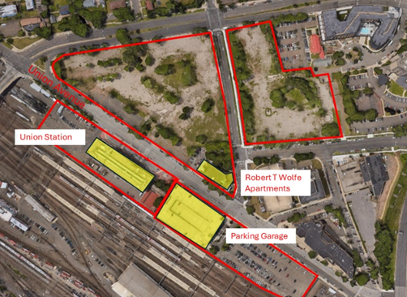
Project Overview
Union Station – historic structure, 12th busiest Amtrak station (2025)
Residential + public plaza redevelopment planned adjacent to the station

Slide 30
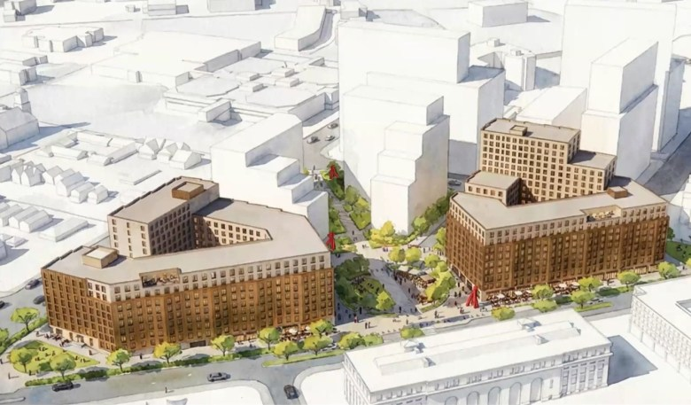
Project Overview
New construction - 541 units of housing + first floor commercial
Union Station retrofit

Slide 31
Sources of Funding
Total Cost of Project: $16.5 million
Green Bank Bridge Loan
CPRG Funding: $9.42 million
City Funding: $7.08 million
EnergizeCT Rebate: $800,000
40% Inflation Reduction Act Direct Payment: $6.6 million

Slide 32
Investment Tax Credit Considerations
Direct Pay: City to own ground loop and in-building heat pump
Domestic content requirement: begin construction 2027 55% of manufactured product costs
Brownfield Adder – site contains asbestos containing pipe, petroleum plume
Notes:
Lack of safe harbor table – specialized tax advisor

Slide 33
Advantages of CT Green Bank Loan
Interest rate (3% GGRF, 4.25% Conventional) close to City bonding rate
Avoid 15% reduction in direct payment
Reduction in payment ~$1M vs increased carrying cost of $.25M >
Notes:
Unusual for a City to obtain a loan

Slide 34
Conditions of Initial Funding
Easement for pump station and other geothermal components on ECC property
Thermal offtake agreements
Tax advisor ITC eligibility opinion
Notes:
Unusual for a City to obtain a loan

Slide 35
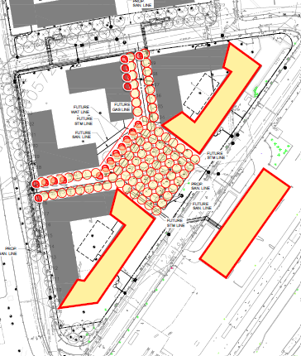
Project Status
Nearing completion of ground loop 90% design
Beginning schematic design options for Union Station
Closing on Green Bank financing (June)
Developing utility rate structure
Notes:
Unusual for a City to obtain a loan

Slide 36
Project Timeline
Network Installation
Drilling and lateral piping
Ongoing Operation
General system management, billing and performance testing
2027
2029
2026
2028
Ground Loop Design/Procurement
Union Station Design Development
System Completion
Pump house, commissioining
Union Station Heat Pump Installation
In-building construction

Slide 37
THANK YOU
HannahZoe Chua-Reyes
HChuaReyes@newhavenct.gov
Steven Winter
SWinter@newhavenct.gov
City of New Haven

Slide 38
NY-GEO 2026
March 24-25, 2026 | Brooklyn, NY
Bridging the Financing Gap
Moderator:
Panel:
Jack DiEnna / GEO NII
HannahZoe Chua-Reyes / City of New Haven
Larry Campana / CT Green Bank
Adam Serbert / Good Carbon
Andrea Lee / NY Green Bank
BUSINESS MODELS • Salon D • 11:45-12:45

