Slide 1
P-12 Schools - Clean Green Schools Initiative
PON 4924 Modification
Hannah Morgan, Senior Project Manager
Efficiency Planning & Engineering Team
3-8-24

Slide 2
Budget:
$160 M
$100M of Clean Water, Clean Air and Green Jobs Environmental Bond Act funding
$60M of CEF/RGGI funding
Program Goal:
The goal of the program is to help under-resourced public schools decarbonize their building portfolio and improve indoor air quality (IAQ) across their buildings.
Eligibility:
Track I: All public school districts across NYS that are designated as High-Needs by the New York State Education Department or have at least one building which is located in a disadvantaged community.
Track II: All public school districts across NYS that are designated as High-Needs by the New York State Education Department or school buildings which are located in a disadvantaged community.
Track I and Track II provide support for existing buildings, not new construction projects.
Overview of Clean Green Schools Initiative

Slide 3
PON modifications include, but are not limited to:
An expanded school eligibility list.
Higher funding caps in Track I and Track II.
A second round of Track II (e.g. implementation/construction funding).
PON Modifications

Slide 4
This program provides funding in two tracks to support a school's pathway towards decarbonization.
Track I Planning: Open Enrollment (accepting apps until 12/30/25)
Provides funding for services which will help schools evaluate, plan for and facilitate energy reduction projects, clean energy projects and indoor air quality projects.
Track II Installation: Competitive (proposals due 6/6/24)
Provides funding to implement construction projects which will help schools decarbonize their buildings.
Clean Energy Educational and Professional Development Opportunities:
NYSERDA will provide funding to support a range of workforce development and student educational activities for P-12 students that explore, support or promote decarbonization efforts in their schools and communities. This is an optional service in Track I and Track II.
Participation in Track I is not a requirement to participate in Track II, but Applicants must have an energy study or equivalent analysis completed at the time of a Track II application.
Program Structure

Slide 5
Eligible services include, but are not limited to:
Engineering & Architecture Services
Energy Benchmarking
Energy Studies
Energy Efficiency and Clean Heating and Cooling Design Services
Eligible design projects include, but are not limited to, GSHP, ASHP, and VRF system designs. Other projects demonstrating space and/or water heating or cooling without the use of fossil fuels may be eligible. Eligible project activities include, but are not limited to, the development of heating and cooling load calculations, equipment schedules, drawings, mechanical plans, and test boreholes.
Energy Master Planning and Decarbonization Roadmaps
Clean Transportation Studies
Indoor Air Quality Evaluation and Management
On-Site Energy Manager
District level or across districts
Services Associated with Clean Energy Projects
Grant Writer
Fiscal Advisor
Clean Energy Educational and Professional Development Activities
This must be paired with an above bullet and is ineligible as a standalone project.
Track I Planning: Eligible Projects

Slide 6
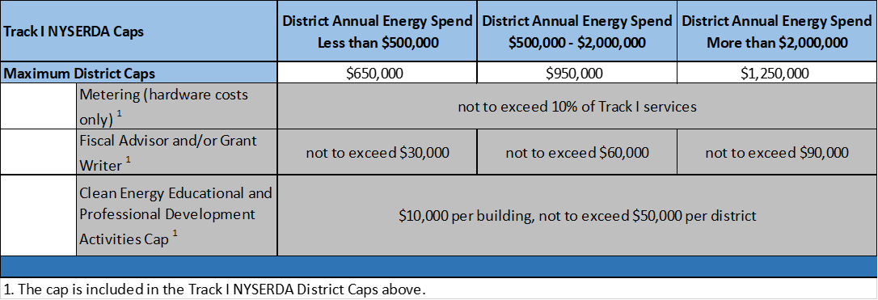
Track I Planning: Funding
NYSERDA’s funding ranges from $650,000 - $1,250,000 per district depending on the district’s annual energy spend.
School districts are not required to contribute funding to a Track I project unless the project cost exceeds the cap in the table above.

Slide 7
A complete application package includes the following:
Track I Program Application
Scope of Work
Budget
Applicants may be either the school or an authorized representative of the school.
Applicants may include one or more Track I services in their Scope of Work.
Applicants may submit one application on behalf of multiple buildings within a district.
Template documents are available on the Clean Green Schools Initiative documents and resources website.
Track I Planning: Application Requirements

Slide 8
Clean Heating and Cooling Projects:
Ground Source Heat Pump
Air Source Heat Pump
Variable Refrigerant Flow System
Capital Projects to Move Towards Decarbonization:
Comprehensive retrofits that impact energy consumption and overall building load
Electrification of building systems (e.g., kitchen equipment & domestic hot water heaters)
Building electrification readiness projects:
High performance building envelope (e.g., air sealing, insulation, window film)
Heating/cooling projects
Conversion of distribution systems (e.g., steam to hot water) to support potential future electrification
Track II Installation:
Eligible Projects

Slide 9
The following supporting upgrades/efforts are eligible when completed in combination with any eligible activities shown above:
• Building ventilation system and filtration system capital projects
• Resiliency measures
• Building Automation Systems
• Energy storage systems
• Renewable energy technologies
• Clean electricity purchase with emphasis on the use of community solar or “Green” energy service provider
• Window replacement
• Upgrading existing electrical infrastructure (e.g., electrical panel upgrades & equipment service infrastructure
• Lighting upgrades
All Track II projects must have an energy study or equivalent analysis completed at the time of application.
For projects that include the installation of refrigerant containing equipment (such as chillers and heat pumps):
The feasibility of utilizing equipment that contains a natural or other refrigerant with a global warming potential (GWP) of less than 10 shall be studied and installed if deemed feasible.
Track II Installation:
Eligible Projects Continued

Slide 10
One Building:
$500,000 - $5,000,000 for eligible project types
Up to $30,000 for Clean Energy Educational and Professional Development Activities
Total max funding per school building is $5,030,000
Multiple Buildings:
$500,000 - $10,000,000 for eligible project types
Up to $100,000 for Clean Energy Educational and Professional Development Activities
Total max funding per multiple buildings is $10,100,000
Additional Incentives:
Additional incentives may be available through your local utility.
Track II Installation:
Funding
*Maximum funding awarded from NYSERDA may not exceed 100% of the project cost. Additional funded sources are encouraged such as State Aid and your local utility.

Slide 11
A complete Track II Proposal package includes the following:
Completion of the series of questions presented in NYSERDA’s online portal submission platform
School Authorization Form, if applicable (Attachment B)
Track II Proposal Template (Attachment D)
Track II Building Impacts Table (Attachment E)
Track II Milestone Payment Schedule (Attachment F)
Energy study or equivalent analysis used to select the Track II project components
The Proposer may be either the school or an authorized representative of the school.
Work completed prior to NYSERDA’s receipt of a completed Track II application is ineligible for funding.
First Round: Proposals are due on 6/6/24 by 3:00 pm EST.
Read the PON and ask questions!
Track II Installation: Proposal Requirements

Slide 12
Proposals will be evaluated by a Scoring Committee based on their overall responsiveness and specifically based on the Evaluation Criteria below, which are listed in order of importance:
Project Impact (65 points)
Clarity of Budget (15 points)
Project Team and Stakeholder Commitment (10 points)
Project Implementation and Schedule (10 points)
Projects will be evaluated in two separate categories: Clean Heating and Cooling projects and Capital Projects to Move Towards Decarbonization. If a project includes measures from both categories, it will be evaluated under the Clean Heating and Cooling project category.
Evaluation and scoring of each proposal will ultimately be determined in comparison with and relative to the other proposals submitted in each category.
Track II Installation: Proposal Evaluation

Slide 13
Project Impact (65 points):
Project includes installation of clean heating and cooling system(s) that will supply a portion of the schools heating and cooling load (Clean Heating and Cooling category) OR
Project includes installation of Capital Projects to Move Towards Decarbonization.
Reduces schools greenhouse gas emissions related to energy consumption (proposals will be grouped in to tiers).
Stage of proposed project.
Appropriate ventilation and filtration as a result of the decarbonization project.
Resiliency components of proposed project.
Expanded use of the school(s) to support the community.
Track II Installation: Proposal Evaluation

Slide 14
Clarity of Budget (15 points)
Budget completed and appears reasonable.
Project leverages additional funding from federal funding, utility incentives or grant opportunities.
Funding secured covering the entire proposed cost of the project, net the NYSERDA funding requested.
Track II Installation: Proposal Evaluation

Slide 15
Project Team and Stakeholder Commitment (10 points)
Project Team includes relevant parties with the necessary background and experience to ensure project success and likelihood of installation of project as proposed.
Preference will be given to projects implemented by contractors that are participating in New York State Department of Labor (NYS DOL) recognized pre-apprenticeship programs or NYS DOL registered apprenticeship programs.
Track II Installation: Proposal Evaluation

Slide 16
Project Implementation and Schedule (10 points)
Includes a detailed description for the proposed school building upgrades and provides dates for the Project Stage and Schedule (see Attachment D - Section Ib and Section III). The dates included in the anticipated schedule demonstrate a realistic understanding of how the proposed project will proceed through implementation.
Track II Installation: Proposal Evaluation

Slide 17
NYSERDA will provide funding to support a range of workforce development and student educational activities for P-12 students that explore, support or promote decarbonization efforts in their schools and communities.
The Educational and Professional Development Activities Pathway document, which is located on the Clean and Green Schools Initiative documents and resources website:
Should be consulted for assistance in designing these activities
Includes existing programs, tools, and resources
Eligible activity costs include, but are not limited to:
Curriculum development, program/license fees, software subscription fees, project supplies/tools/equipment, field trips, promotional material, speakers, teacher stipends, internship wages, textbooks, signage, clean energy toolkits, registration/entrance fees (conferences, camps, workshops), space rental, consultants/trainers fees, professional development fees, food, travel and lodging.
Clean Energy Educational and Professional Development Opportunities

Slide 18
Clean Energy Educational and Professional Development Opportunities:
Additional Funding
Track I Planning:
Per Building – Up to $10,000
Per District – Up to $50,000
Track II Installation :
One Building – Up to $30,000
Multiple Buildings – Up to $100,000

Slide 19
Track II Proposals Due:
Thursday (6/6/24) by 3:00 pm EST
Clean Green Schools Initiative Website:
Visit the Clean Green Schools Initiative website to see the most current list of Program resources, specific to eligibility, template documents, guidance documents and more.
Link - nyserda.ny.gov/P-12-Clean-Green-Schools
Contact Information:
E-mail Hannah.Morgan@nyserda.ny.gov
Important Dates and Resources

Slide 20
Questions
Hannah.Morgan@nyserda.ny.gov

