Slide 1


FROM ROOTS TO ROCKETS
THE NEXT ECONOMY OF THE MID-WILLAMETTE VALLEY
Cara Turano, Oregon Entrepreneurs Network
SEDCOR Mid-Valley Economic Summit 2026

Slide 2



Slide 3
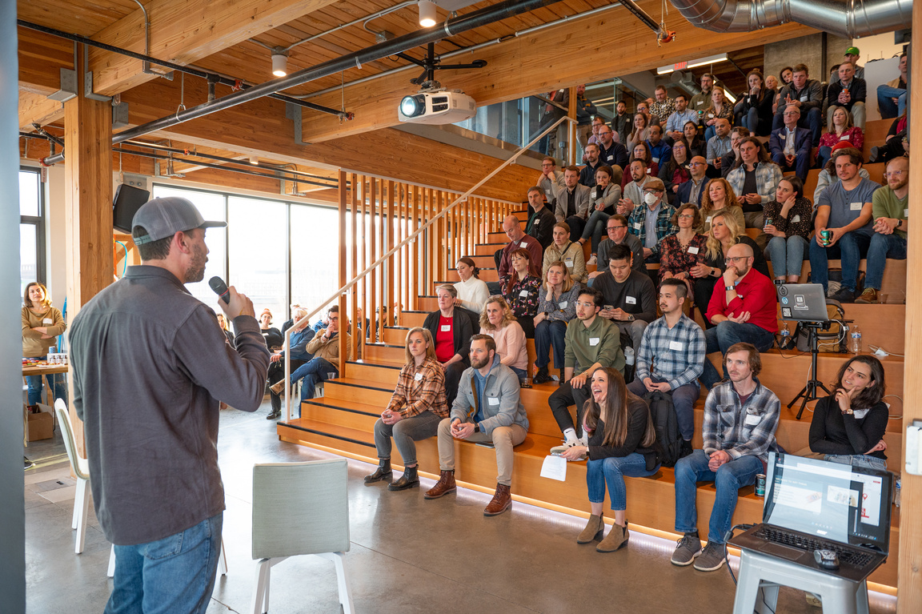
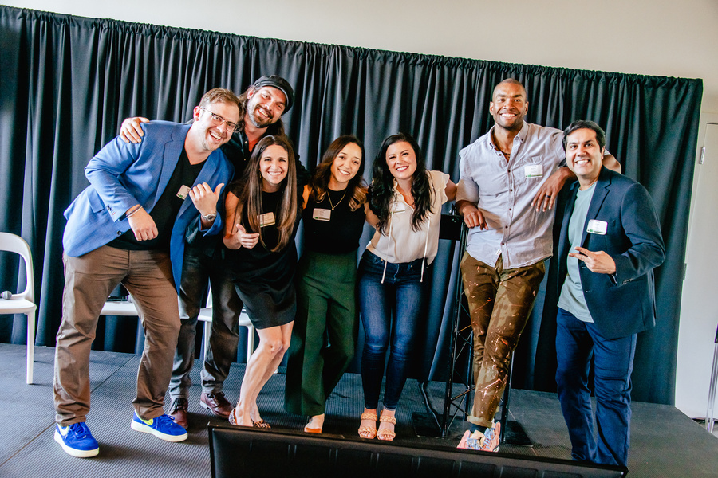
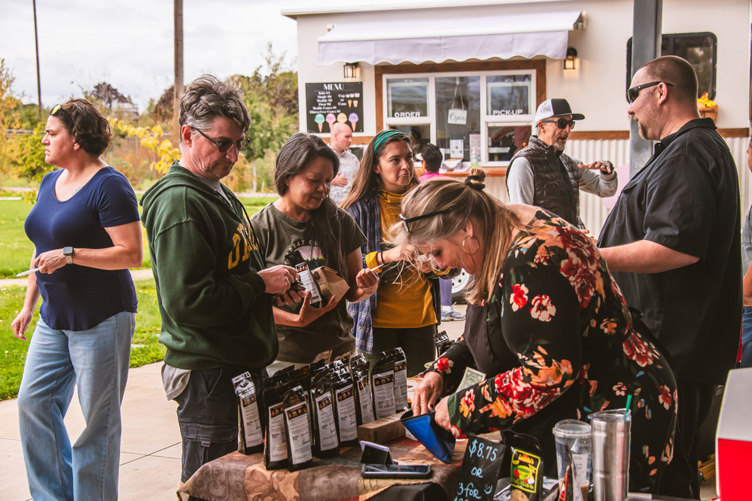
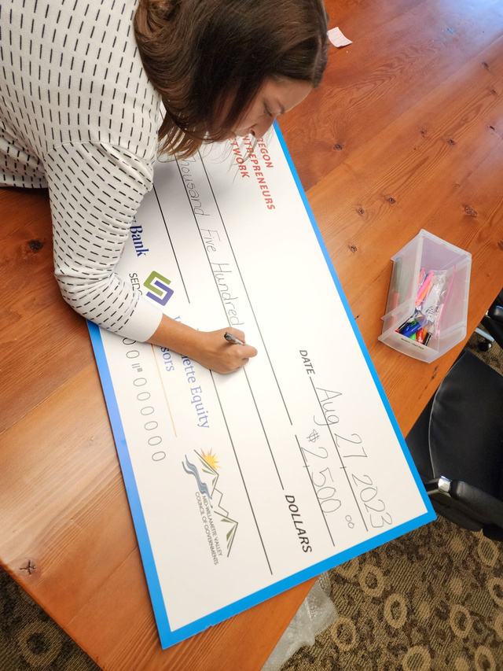


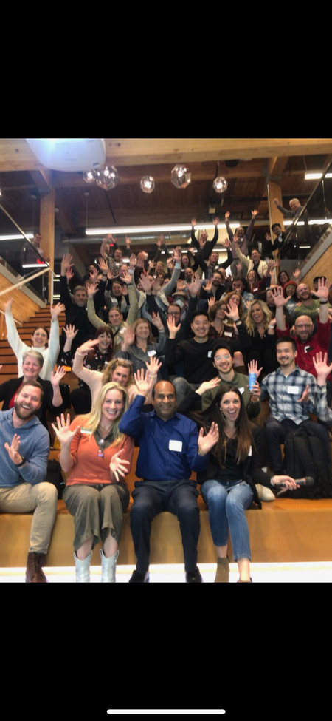
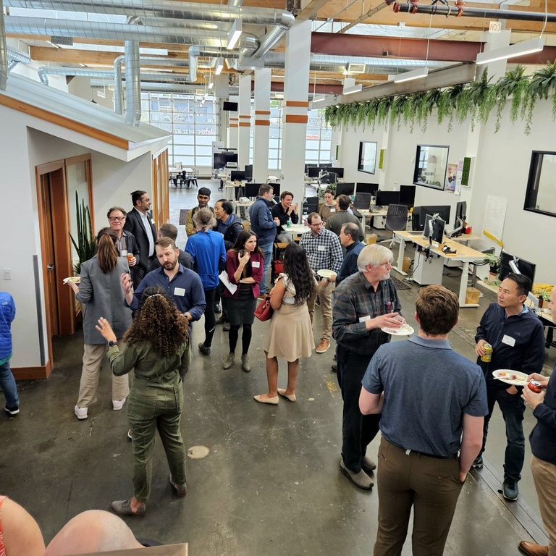
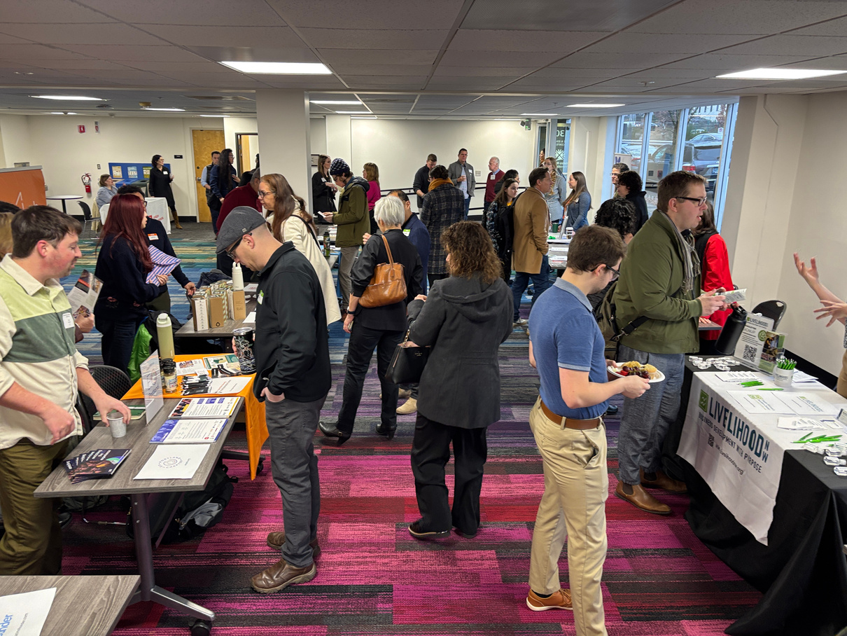

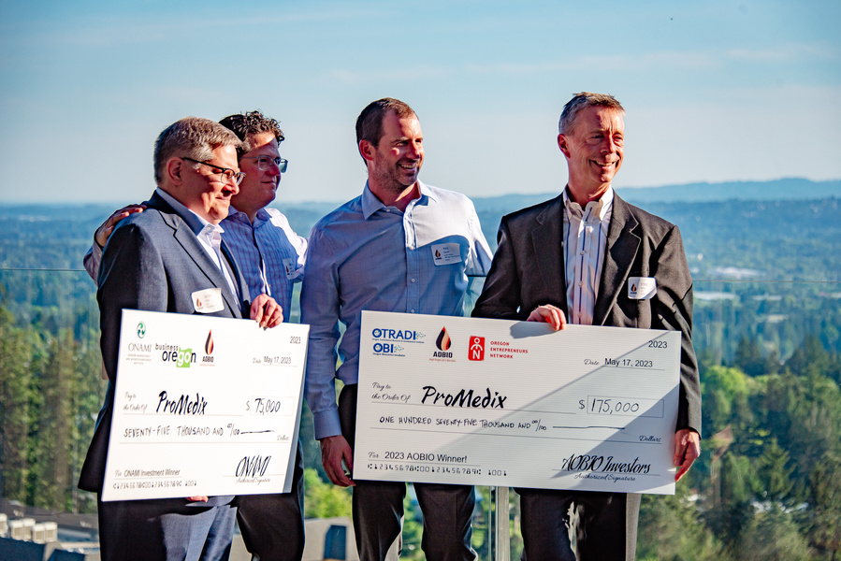
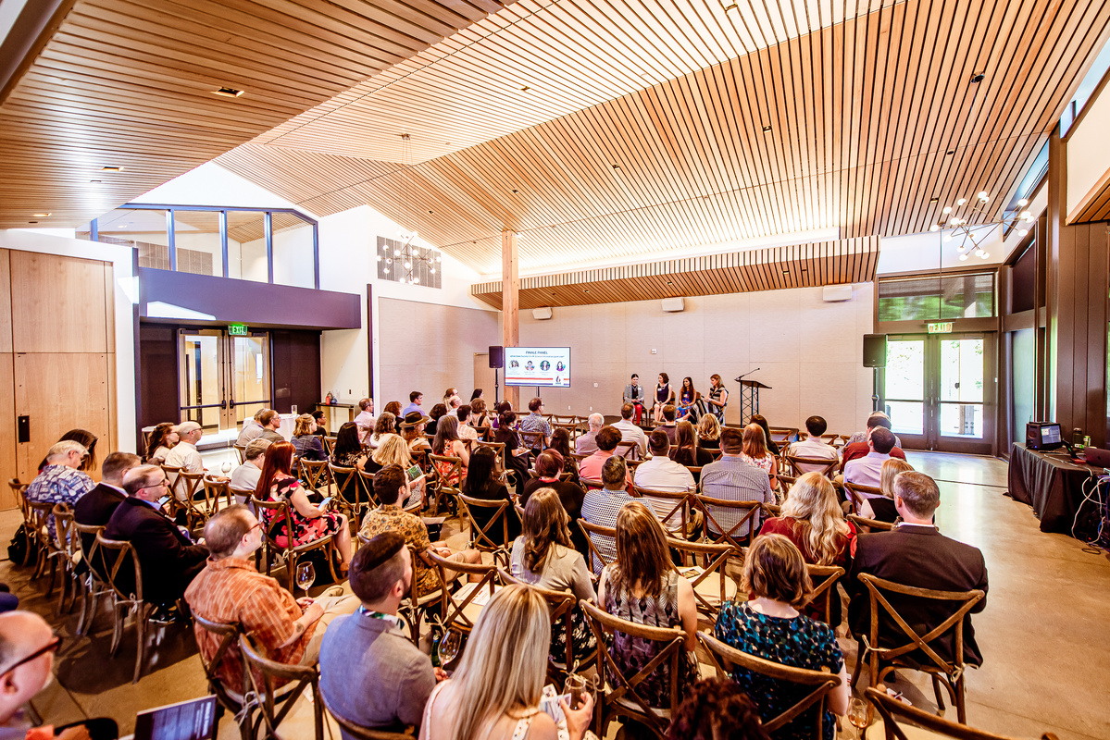

Slide 4

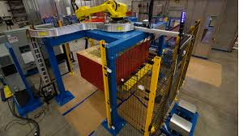
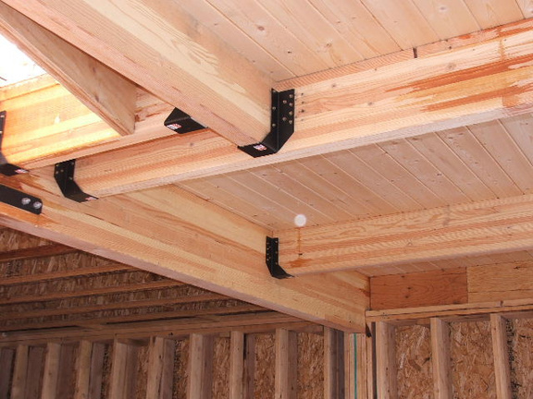
FOUNDATIONAL INDUSTRIES
AGRICULTURE
FOOD & BEVERAGE
ADVANCED
MANUFACTURING
NATUAL RESOURCES
& WOOD PRODUCTS

Slide 5
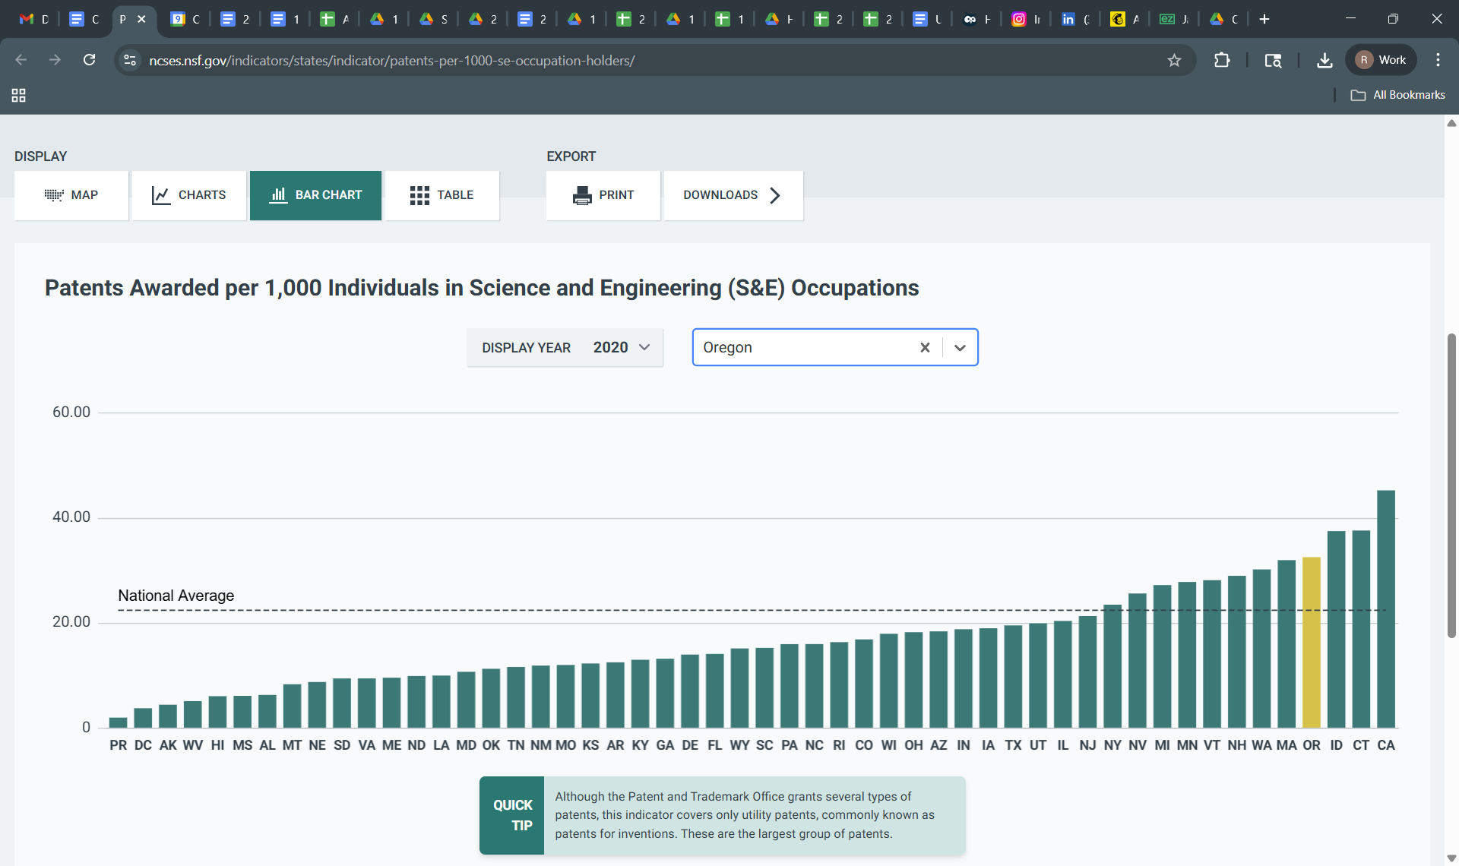

Slide 6

TENSION
WAGE PRESSURE
VS. INDUSTRY MIX
TALENT &
WORKFORCE GAPS
INNOVATION
ACCESS

Slide 7

ECONOMIC TRANSITION PRESSURE
NATURAL RESOURCES
TECH ENABLED
ECONOMY
MANUFACTURING

Slide 8

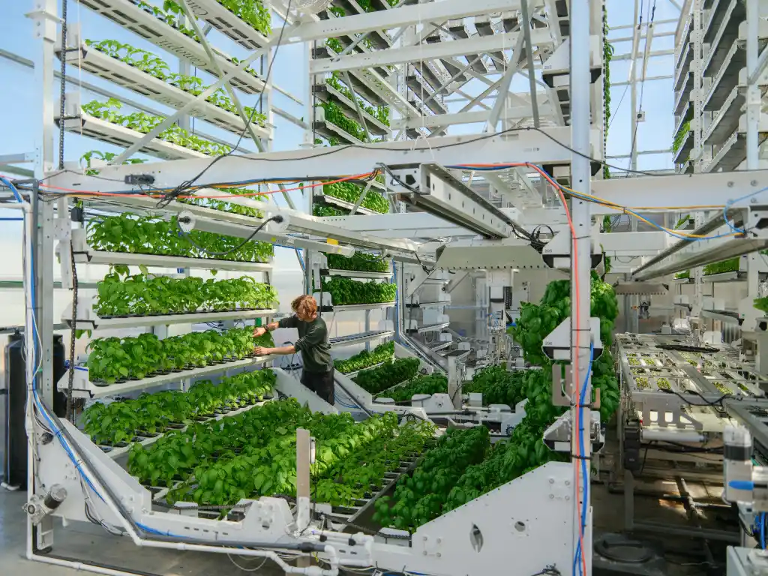

Slide 9
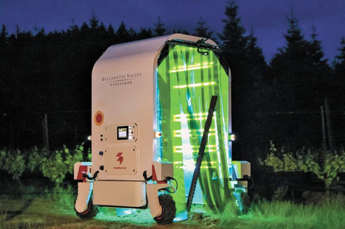
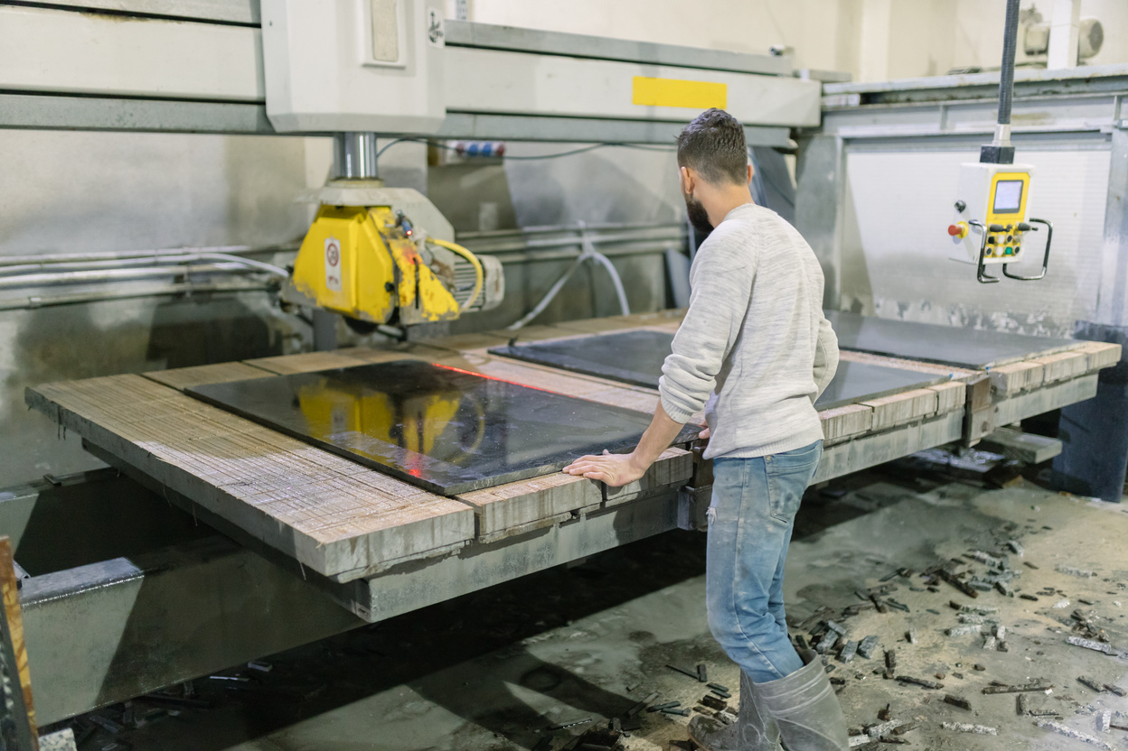
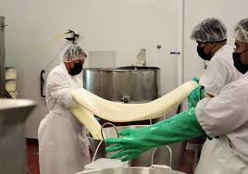

AGRICULTURE BECOMES A TECHNOLOGY PLATFORM
MANUFACTURING BECOMES DIGITALLY INTEGRATED
CLIMATE & SUSTAINABILITY BECOME ECONOMIC DRIVERS
THE RISE OF
THE “RURAL INNOVATOR”

Slide 10
BUILD BRIDGES
AGRICULTURE
TECH
MANUFACTURING
AI
LOGISTICS
DATA

Slide 11
INVEST
IN ENTREPRENEURIAL INFRASTRUCTURE
DOUBLE DOWN
ON WORKFORCE EVOLUTION
TELL A NEW
REGIONAL STORY

Slide 12
