Slide 1
Restoring Oregon’s Competitiveness An Economic Imperative
Strategic Economic Development Corporation
April 23, 2026

Slide 2



About OBI
250,000
Employees
All Industry
Sectors
All 36
Counties
Oregon’s Affiliate for:

Slide 3
A healthy, robust
private sector
is necessary for
WAGES & INCOME
GOVERNMENT
SERVICES
PHILANTHROPY

Slide 4
Oregon has lost its competitive mojo.
mojo
noun
: a magic spell, hex, or charm
also : magical power
Taxes vs. Outcomes
High Costs
Reputation & Desirability
Regulatory Burdens
Outlying
Policies

Slide 5
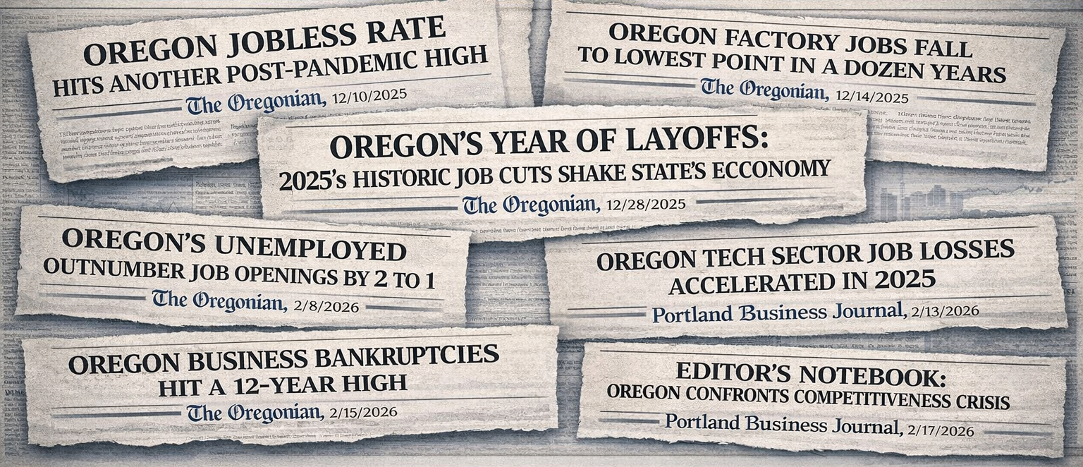

Slide 6
Three Problems We Need to Address
Oregon is an expensive place in which to live and operate a business.
Oregon creates unnecessary obstacles to success.
Oregon’s political culture undervalues the private sector.

Slide 7
Prioritize economic and business development.
Acknowledge,
accept and
own the problem
Do no
more harm.

Slide 8

Acknowledge The Problem
39th in the 2025 Top States for Business Ranking
47th for Business Friendliness
7th Most Regulated
3rd Highest Unemployment Rate Among States
35th for Tax Competitiveness
45th for Cost of Living (1st → most affordable)
4% YOY Decline Manufacturing Jobs
33% Increase in State Business Tax Burden Between ‘19-’23

Slide 9
Do No More Harm
Avoid laws and regulations that make Oregon a policy outlier and harm the state’s competitiveness.
Evaluate and modernize existing polices to reduce harm and increase growth.
Examples:
Unemployment insurance for striking workers
Climate Protection Program
Recycling Modernization Act
Land use restrictions
Single-payer health care
✗
✗
The First Test
SB 1507 – Tax Code Disconnect
Accelerated depreciation
Qualified small business stock exemption
Auto loan interest

Slide 10
Prioritize Economic and Business Development
Make Oregon a more affordable place to live, work and run a business.
Modernize the Corporate Activity Tax
Replace the Climate Protection Program
Fix the Recycling Modernization Act
Index personal income tax rates
Reform prevailing wage laws
Expand access to child care through credits and employer incentives
Reconnect to key sections of federal tax code
Streamline permitting and regulatory barriers, including housing
Eliminate the estate tax
Preempt local income taxes

Slide 11
Establish a culture of “yes” rather than “no” and reduce Oregon’s overall regulatory burden while modernizing rulemaking processes and outcomes.
Reduce regulations in Oregon by 20% by 2030
Require legislative review of agency rules, viability analysis of new regulations and thorough fiscal and economic impact studies
Improve Oregon’s occupational licensing requirements (currently the nation’s most onerous) to better align with national norms
Streamline complex regulatory programs, such as Cleaner Air Oregon
Improve permitting for new applications, renewals and modifications

Slide 12
Prioritize business and economic development through competitive retention, recruitment and long-term planning efforts in critical areas.
Establish, fund and routinely refresh statewide economic development strategy.
Create a statewide energy strategy that balances demand, storage and transmission with a focus on affordability and reliability.
Make Enterprise Zone policy permanent and ensure Opportunity Zones are statewide so that communities across the state may benefit.
Establish permanent tax credits and investment opportunities, including expanded R&D, capital equipment credits and exemptions, job tax credits.

Slide 13
We know the problems and we have the solutions.
We need policymakers to act.

Slide 14

Thank you!
Preston Mann
Vice President, External Affairs
prestonmann@oregonbusinessindustry.com

