Slide 1
US Economic Outlook
Created for SEDCOR April 23, 2026

Slide 2
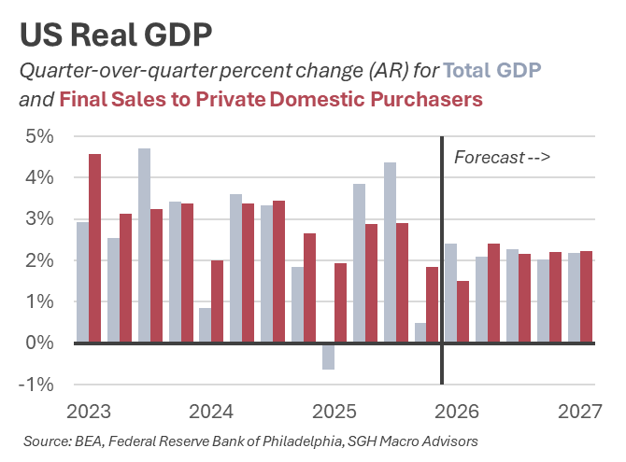
Resilient Economy Despite Turbulence
2025 growth was expected to be 2.1%, ended up being 2.0%
Growth due to broad-based consumer spending and narrow AI business investment
Near-term changes
  Federal shutdown subtracted ~1% from Q4, will boost Q1
  Larger tax refunds expected to boost Q2 consumer spending

Slide 3
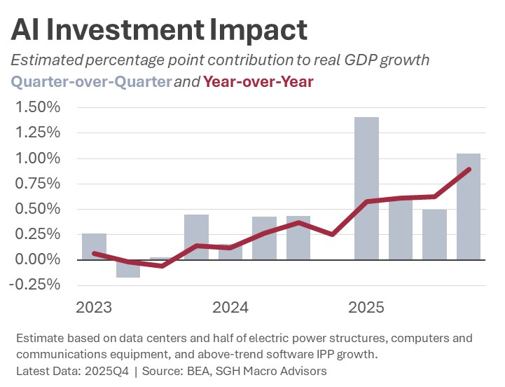
AI Boosts Growth But Crowds Out Other Economic Activity
2024 Q4 to 2025 Q4
  Real GDP 2.0%
  AI-Related GDP 36%
  Net AI Contribution ~0.5ppt
    50-60% of the AI-related GDP is imported computer equip.
AI Crowding Out Effect
  Uses inputs (capital, labor, land, electricity etc) that could be used for other projects
  Stronger economy and demand for capital keeps interest rates higher

Slide 4
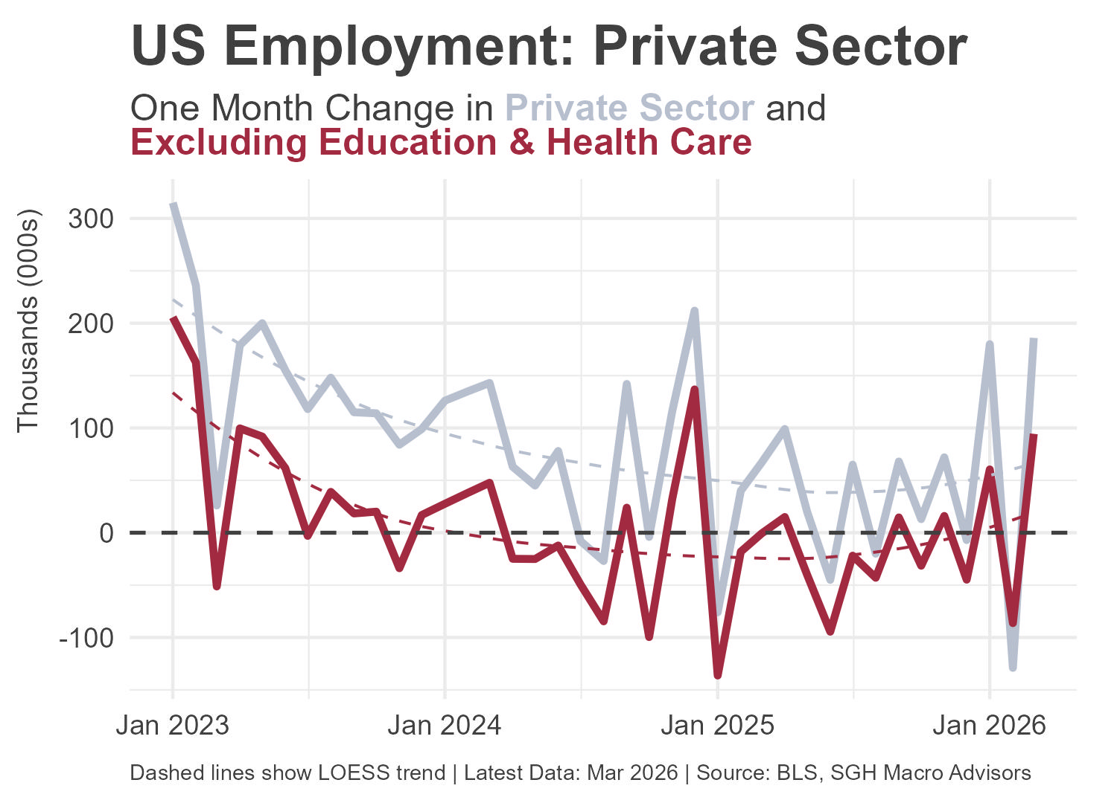
US Labor Market Strengthening

Slide 5
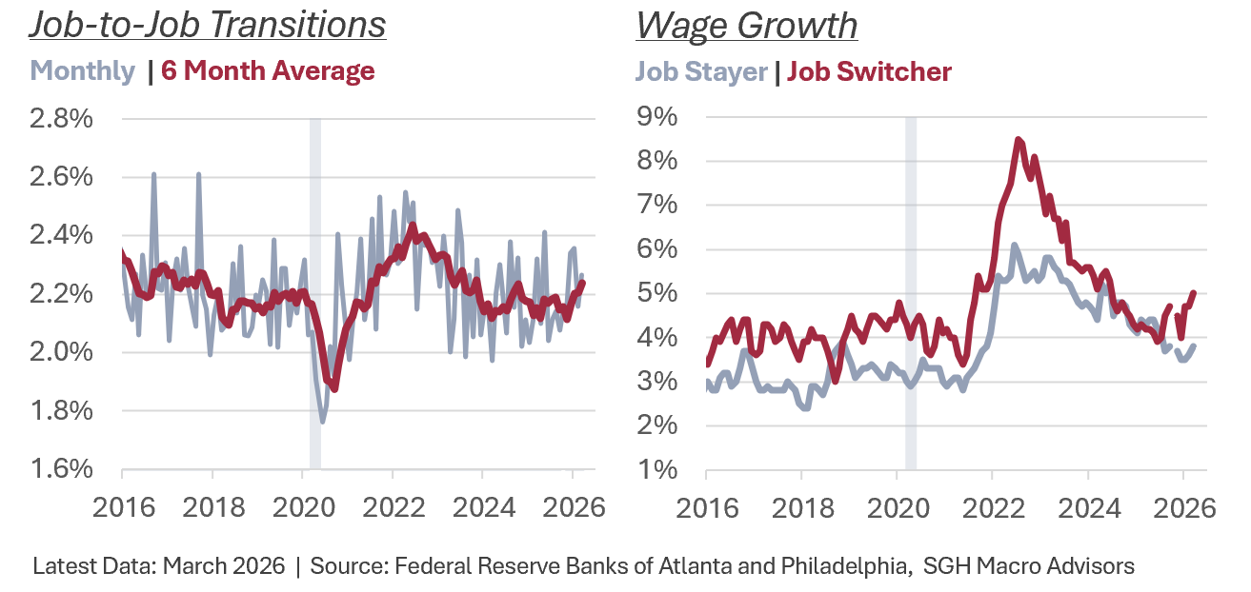
US Labor Market Strengthening

Slide 6
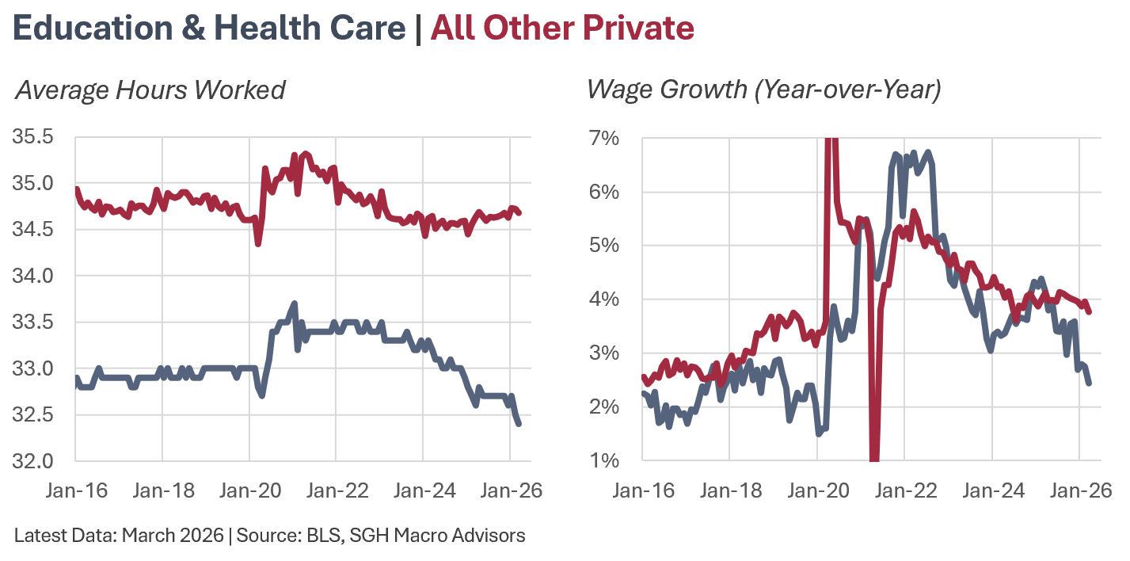
US Labor Market Strengthening

Slide 7
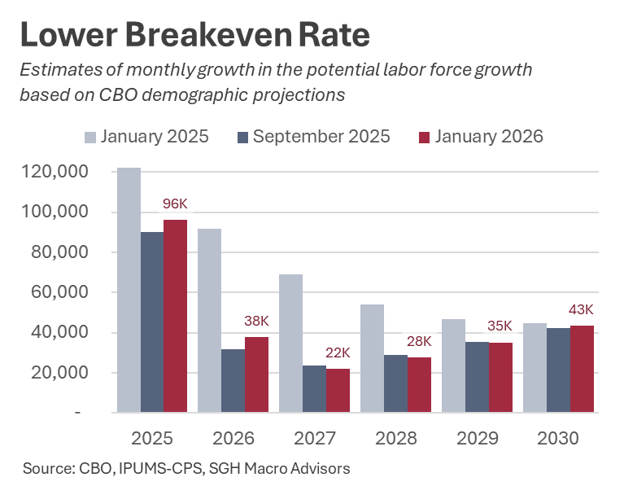
Breakeven Job Growth Near Zero
US version

Slide 8
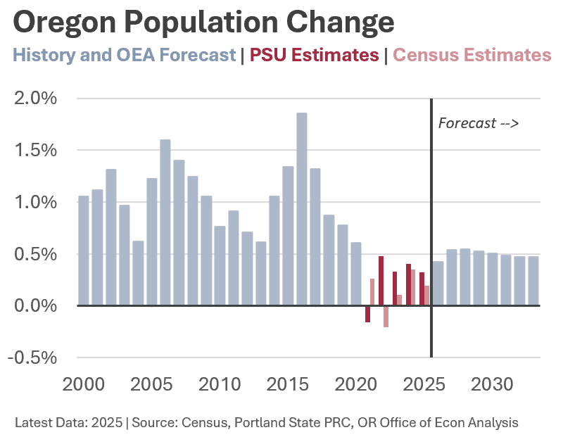
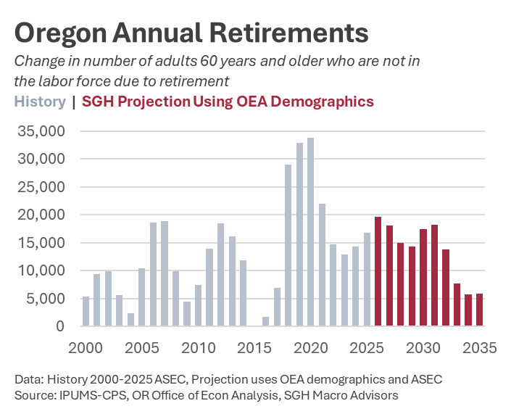
Breakeven Job Growth Near Zero
Oregon version
Notes:
Beveridge: near kink in curve
Working age pop 4K 2025, 8K 2026

Slide 9
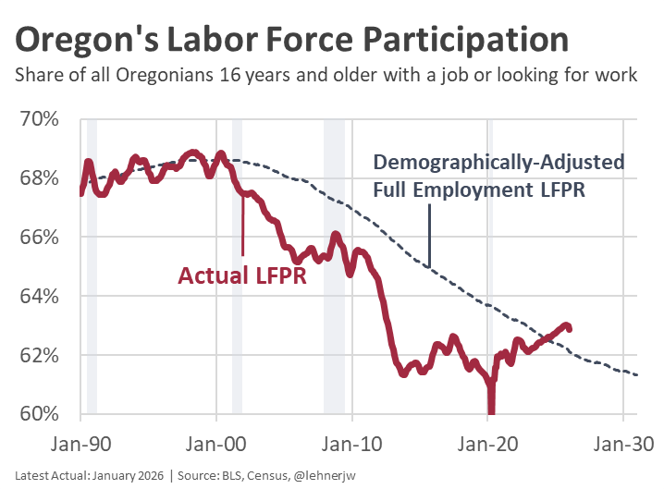
Labor Supply is Elevated
Using Oregon version here
Oregon #1 LFPR increase since pre-pandemic
Labor Force Participation (LFPR) measured as share of population 16 years and older
  Structural: Aging demographics lower participation as retirements rise
  Cyclical: Variation around long-run potential

Slide 10
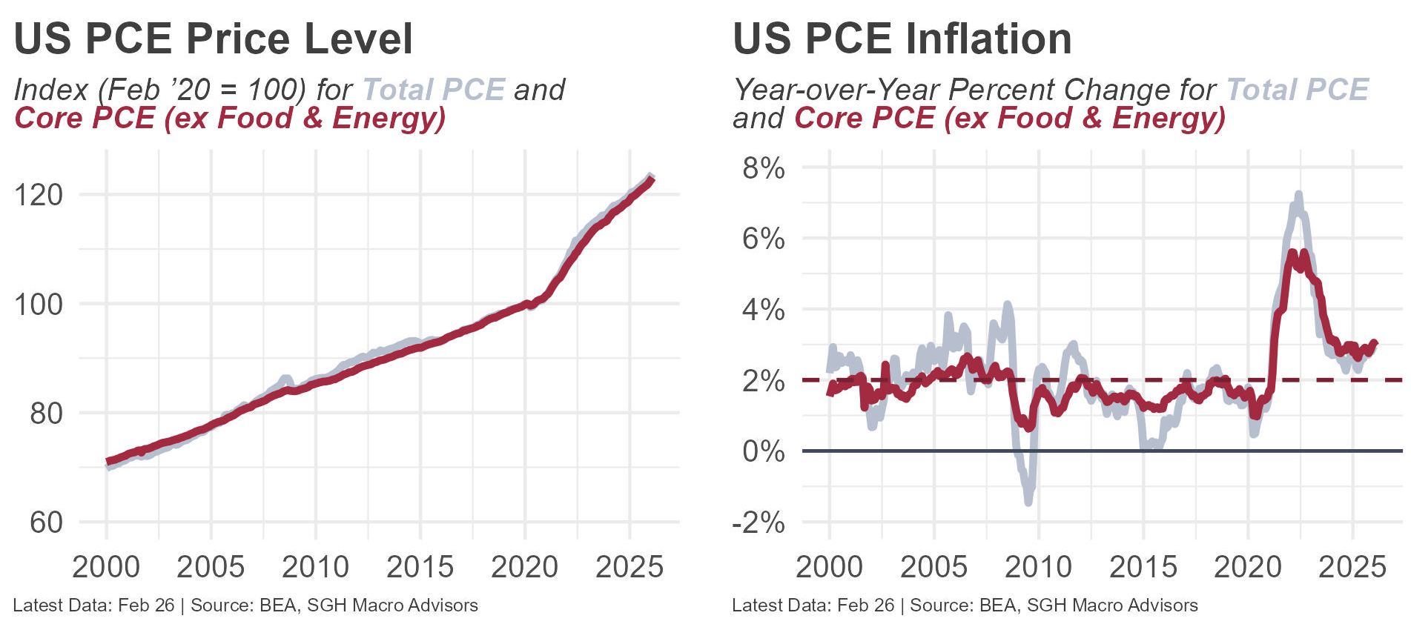
Cost of Living Permanently Higher

Slide 11
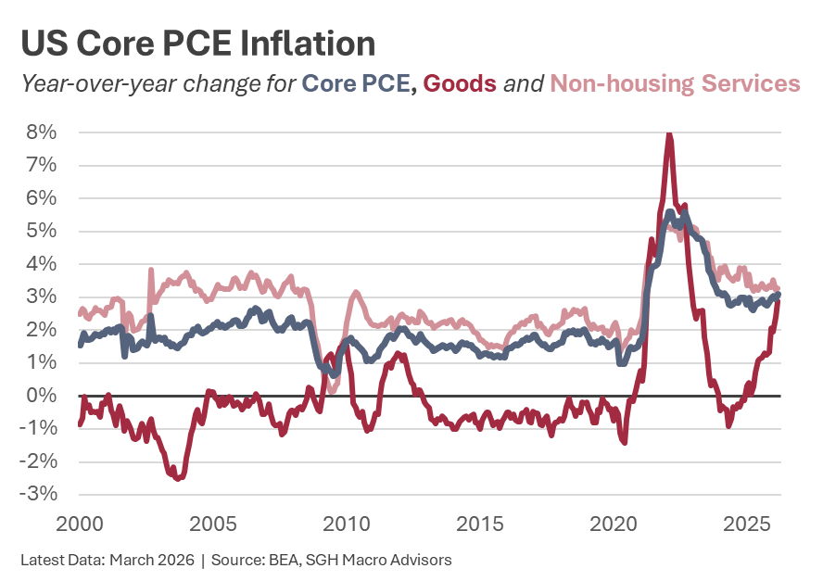
Above-Target Inflation

Slide 12
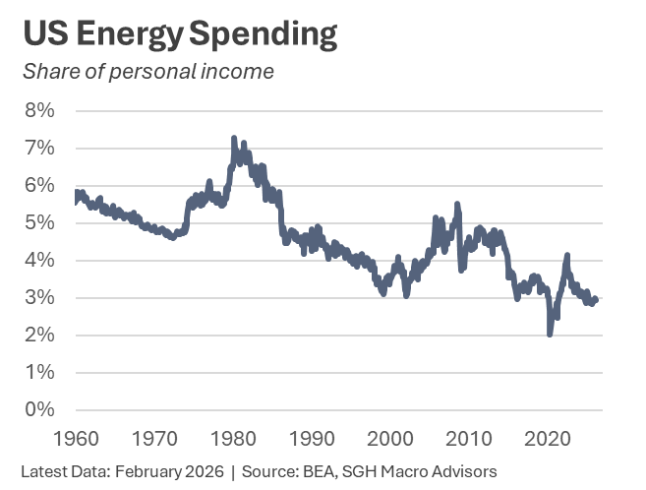
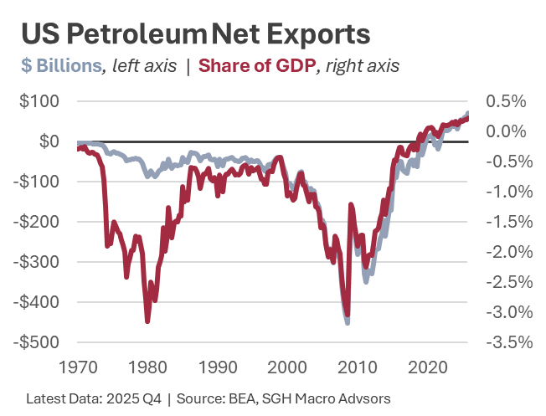
Oil Shock Impact Differs Today

Slide 13
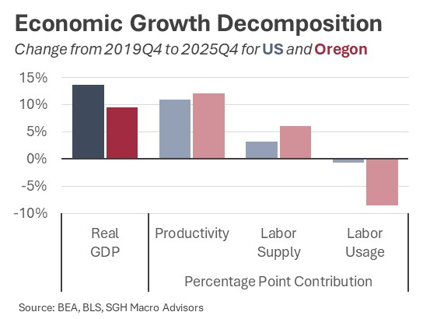
Drivers of Economic Growth
Notes:
GDP US 14%, OR 10%
Prod US 11%, OR 12%
Supp US 3%, OR 6%
Use US -1%, OR -9%

Slide 14
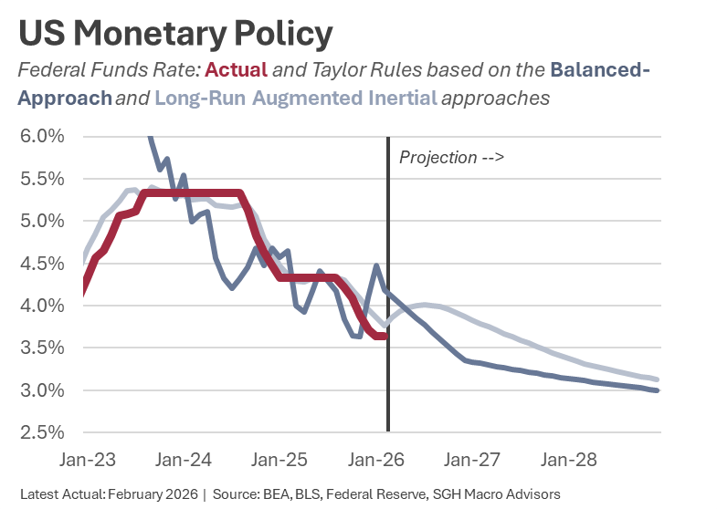
Interest Rates
FFR vs Taylor Rule?
Yield Curve?

Slide 15
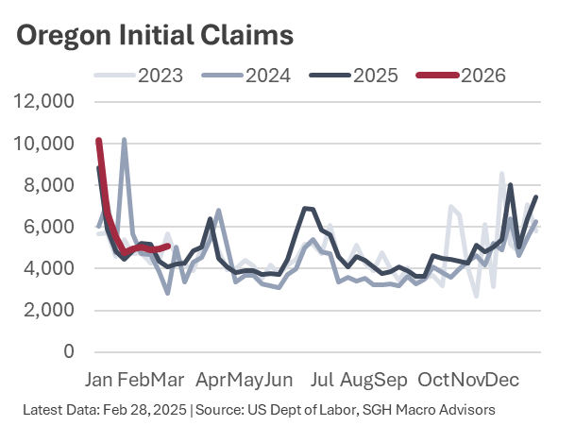
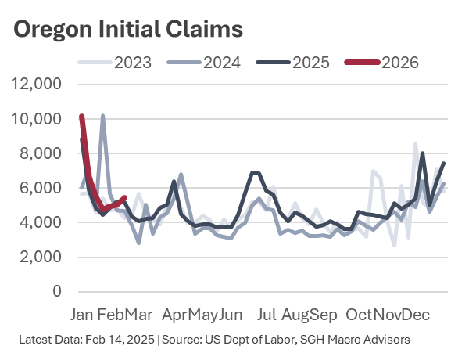
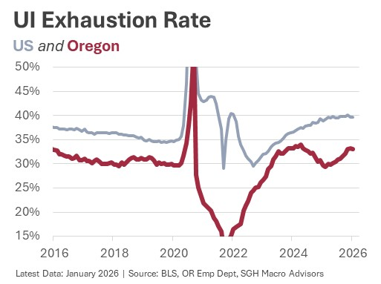
Low-Hire, Low-Fire Equilibrium
Can update if needed…

Slide 16
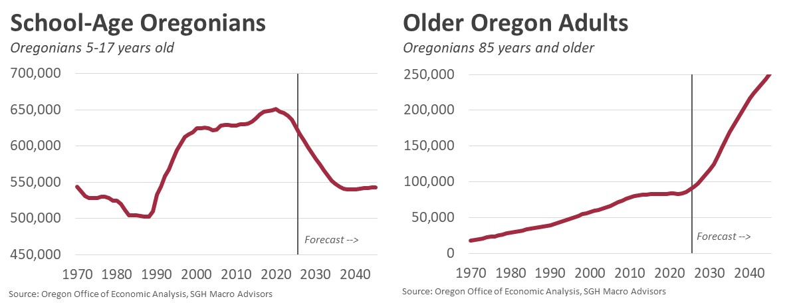
Demographics Shift Society, Economy, and Demand for Public Services
No one has come to grips with what this means, or is going to mean
Notes:
K12 decline by over 100K

Slide 17
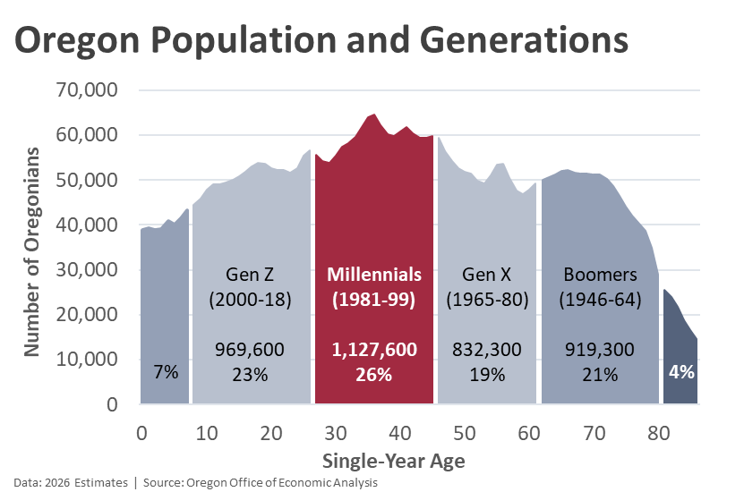

Slide 18
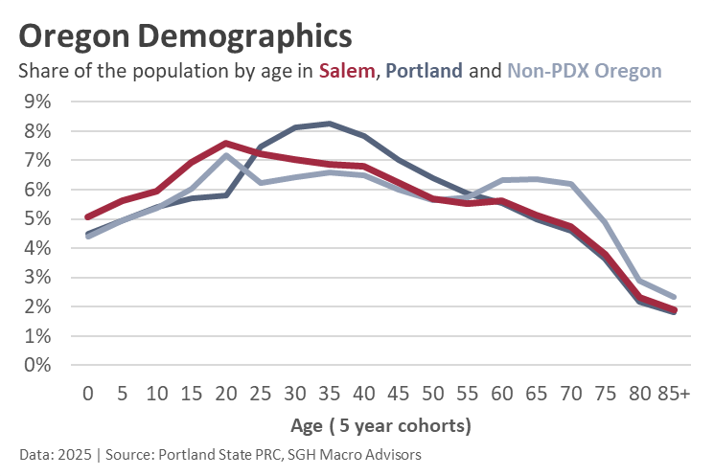
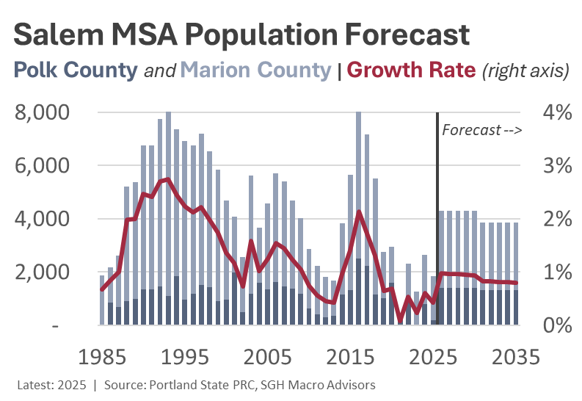
Salem is Oregon’s Demographic Future

Slide 19

Contact
Tim Duy
tduy@sghmacro.com
@TimDuy

