Slide 1



Energy Cost Crisis – 2026
“Facts, Fiction and Your Options”
Hosted by

Slide 2
Facts
Energy Rates have increased since 2022 by 62%
From $0.091per kWh in April 2026 to $0.147 per kWh as of April 2026
Electricity & Natural Gas costs have outpaced inflation, increasing by 42% since 2019
While overall Consumer Price Index (CPI) has only risen by 29%.

Slide 3
Facts
Root Causes:
Ukraine War – Natural Gas Exports
Maryland 2022 Energy Legislation
Re-regulation of Residential Accounts in 2024
PJM Regulatory Rate Increase June 2025
Transition from Renewables
Mid-East War 2026
Lack of an overall energy policy and plan

Slide 4
Key Issue Impacting Increased Energy Costs
Capacity and transmission fee increases:
For the June 2024 to May 2025 year, the capacity auction price was $28.92 per megawatt day.
The auction price starting June 2025 to May 2026 soared to $269.92 per megawatt day for all Potomac Edison, Delmarva and PEPCO accounts.
The auction price starting June 2025 to May 2026 soared to $466.35 per megawatt day for all BGE accounts.
The June 2026 to May 2027 price came in at the FERC-approved cap, $329.17 per megawatt day for the entire PJM footprint.
June 2027 to May 2028 to be announced within 60 days
THIS INCREASE HAS ADDED $.03 TO $.04 PER KWH SIGNIFICANTLY INCREASING SUPPLY COSTS

Slide 5
Issues Impacting Increased Energy Costs
Transition from fossil fuels to electricity – electrification
Lack of an infrastructure and power plant upgrade plan
Planned shutdown of coal burning plants
Maryland imports 60% of the energy requirements from out of state
Increased demand on transmission line due to renewable energy and electric vehicle charging capacity

Slide 6
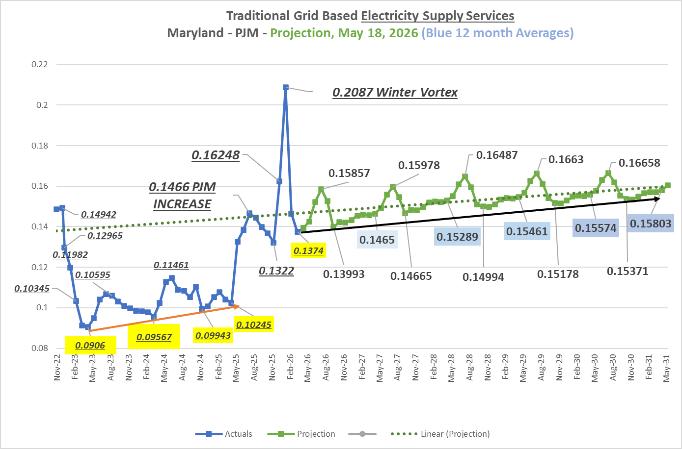

Slide 7
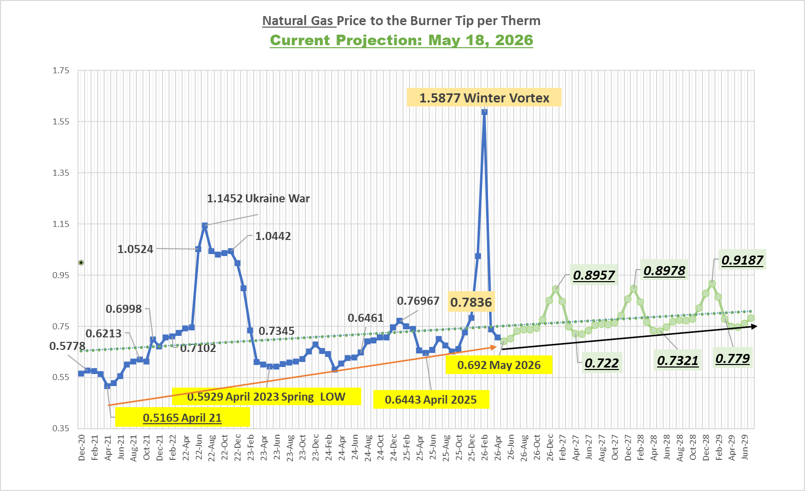

Slide 8
Fiction
AI is the primary reason
Oil price increase has a direct impact
Maryland Legislature will fix the problem
Infrastructure improvements will fix the problem in the short term
I can not do anything to control my costs

Slide 9
Energy Bill Components
Energy Supply Services
Generated Energy or Power – De-Regulated
Contract with a licensed third-party supplier
Service provided by the Chamber Energy Purchasing Program
Delivery & Distribution Services
Franchised Distribution Providers – Regulated
You continue to have a relationship with existing distribution service provider
  BGE, PEPCO, Delmarva, Potomac Edison
Fees and Taxes – Regulated
Excise Fee
Empower Maryland Fee
Sales Tax – Verify Exception Certificate is Current

Slide 10
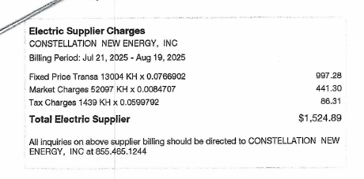
Energy Only Recent Bill Example BGE ($0.0339/kWh)
Market Charge is the Indexed Cost Shown Below
The kW for Market Charges is 4 times the fixed rate kW
Market Charges are based on each accounts peak demand kW consumption with Type Two – Time of Use Accounts the Highest

Slide 11
Pricing Options:
All in Fixed Price
  Includes capacity and transmission pricing composites
Energy Only Fixed
  Capacity and transmission pricing composites as a pass-thru cost
  Option to convert to all-in-fixed
  CQI will conduct quarterly reviews
  Capacity & Transmission Fee are reset every May to go into effect in June. Next transition is June 2028

Slide 12
Pricing Options:
Full indexed with current supplier
  Monthly – Indexed Market Based Rates
  Summer Peak will be highest potential pricing
Return or Remain with the Utility
  SOS Rates – Quarterly Based Rates
  Now published until September 30, 2026
  On-Peak rates are very high $0.17567 per kWh

Slide 13
How to Evaluate Pricing
Know the utility “Price to Compare” for your rate class
Electricity: to September 2026
BGE: G $0.13179, GL $0.13962 and GL Hourly $014592 per kWh
Potomac Edison: $0.12550 to $0.13810 per kWh
DEMARVA: $0.13237 to $0.14620 per kWh
Natural Gas:
Reported daily on News Feeds as NYMEX rate from Huston
Today: $2.68 per Deca-therm ($0.268 per therm)
Add $4.00 per Deca-therm = $6.68 per Deca-therm
$0.668 per therm Summer
$0.8787 per therm Winter (Add $2.00 per Deca-therm)

Slide 14
How to Evaluate Pricing
Do the calculation to know the unit price on the current invoice
Total Supply Cost less sales tax divided by kWh or therm on invoice:
Electricity:
$4,455 - $250 tax = $4,205 divided by 32,854 kWh Used = $0.1356 per kWh
Natural Gas:
$1,471 - $74 tax = $1,397 divided by 2,715 therm Used = $0.5145 per therm

Slide 15
How to Evaluate Pricing
Compare:
Current Rate__________
Utility Rate_________
Third Party Supplier Rate___________
Compare Terms:
12, 18, 24, 30 and 36 months
Determine your risk tolerance:
Short Term
Long Term
When in drought do nothing

Slide 16
Last Thoughts
The Chaos will continue and is not really a factor
Could rates change?
Key factors:
  Mid-East War
  Legislative Regulatory Changes
  Developing AI Legislation and Cost Allocation
  Mid Term Election
If you see an offer that is equal to or better than the utility rates – lock in 12 to 18 months
If the offer is below $0.125 per kWh or $0.68 per therm consider signing a contract.

Slide 17
QUESTIONS?
Thank You
Richard Anderson
richard@cqiassociates.com
443-864-7293

