Slide 1
Maryland Small Business Development Center (SBDC):
Accredited to provide technology commercialization assistance

Slide 2
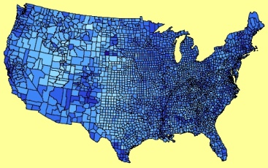
What is SBDC?
A national network of centers that –
Delivers assistance to strengthen
small- & medium- sized businesses
Contributes to the growth
of local, state and national economies
Partners with private enterprise,
gov’t, higher education and local economic
development organizations
development organizations
Notes:
Some of our funding and resource partners include: SBA, State of MD, Department of Commerce, Universities, economic development organizations

Slide 3
About the Maryland SBDC

Slide 4
SBDC’s Purpose
Assist in Small Business Development
Primary Services:
Counseling/Technical Assistance
Business Plan Development
Strategic and Marketing Plan Development
Export Assistance
Loan and Financing Assistance
Resource Research
Government Procurement
Commercialization of Technology

Slide 5
MDSBDC’s Purpose
Assist in Small Business Development
Primary Services:
Training:
Marketing
Human Resource
Financial Literacy
Investment Channels
Business Plans
International Business
Bookkeeping/Accounting
Executive Training
Minority Certification
Social Media
Search Engine Optimization

Slide 6
Business Plan Basics
Why do you need a plan?
What the plan should include?
Executive Summary
Products/Services
Industry/ Target Customer
Marketing Plan
Competitor Analysis
Operations/ Team
Financial Plan
This is a LIVING document

Slide 7
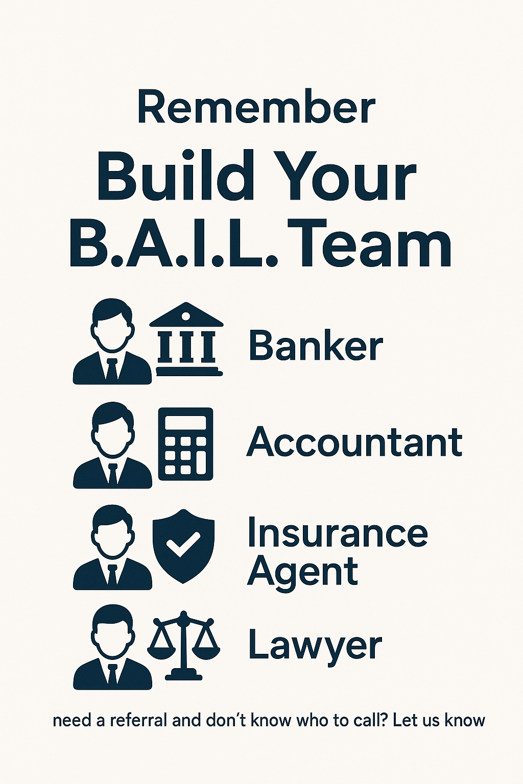

Slide 8
Picking a legal structure

Slide 9
Loan package assistance Questions a Lender will Ask:
How much money are you looking for?
What will you do will the funds?
Why is borrowing money a good thing for the business?
How long have you been in business? If you are a start up, do you have a business plan?
How much capital do have you put into or do you have to put into the business?
What type of experience you and your management team have in your industry?
Who are the direct competitors in the market?
Over what time period are you looking to pay the loan back?
What were your revenues last year? Was the business profitable?
Can you tell me about your sales cycle and how you get paid?
What happens if the business can’t pay back the money?

Slide 10
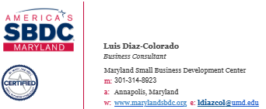
Thank You

