Slide 1
Housing Study Overview
Economic Development
Sherburne County
2025

Slide 2
Overview
Key Points
Demographic Analysis
Employment Trends
Housing Characteristics
Rental Housing
Senior Housing
Special Needs Housing
Planned & Pending Housing Developments
Housing Affordability
Housing Demand Analysis
Conclusions and Recommendations

Slide 3
Key points
Entire housing study projects through 2030 (no further).
Identifies demand for 5,200 new housing units.
Age-restricted senior housing- 2,205 units
All other housing- 2,995 units
Growth from 2020-2030 projected at 10%.
62% of county workforce commute out of the county.

Slide 4
Key points continued
Young seniors (ages 65-74) to grow by 14%; older seniors (ages 75-84) to grow by 34% by 2030.
Overall rental vacancy rate at 3.1% (well below market equilibrium). Medium rent is $1,053.
Median resale price has jumped from $199K in 2015 to $370K in 2022 (due mostly to limited housing stock).
Current lot supply is less than two year supply (3-5 year recommended).

Slide 5
Demographics analysis

Slide 6
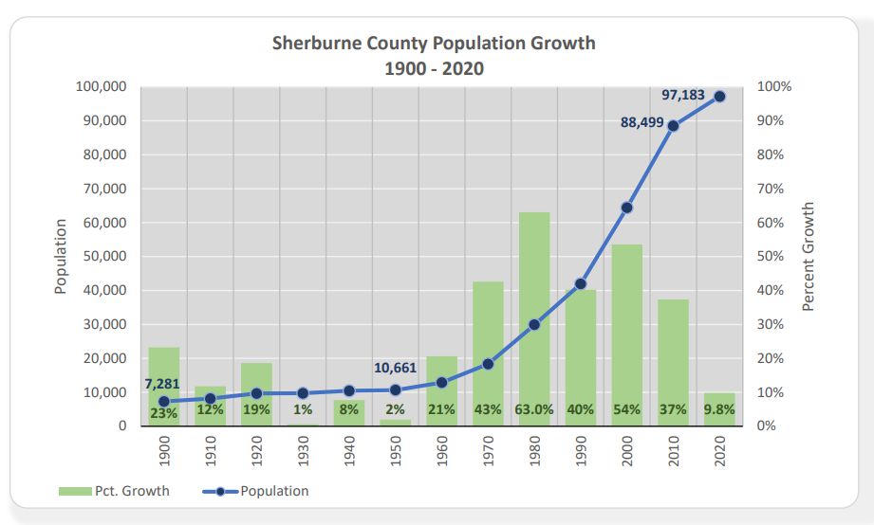
Demographics analysis

Slide 7
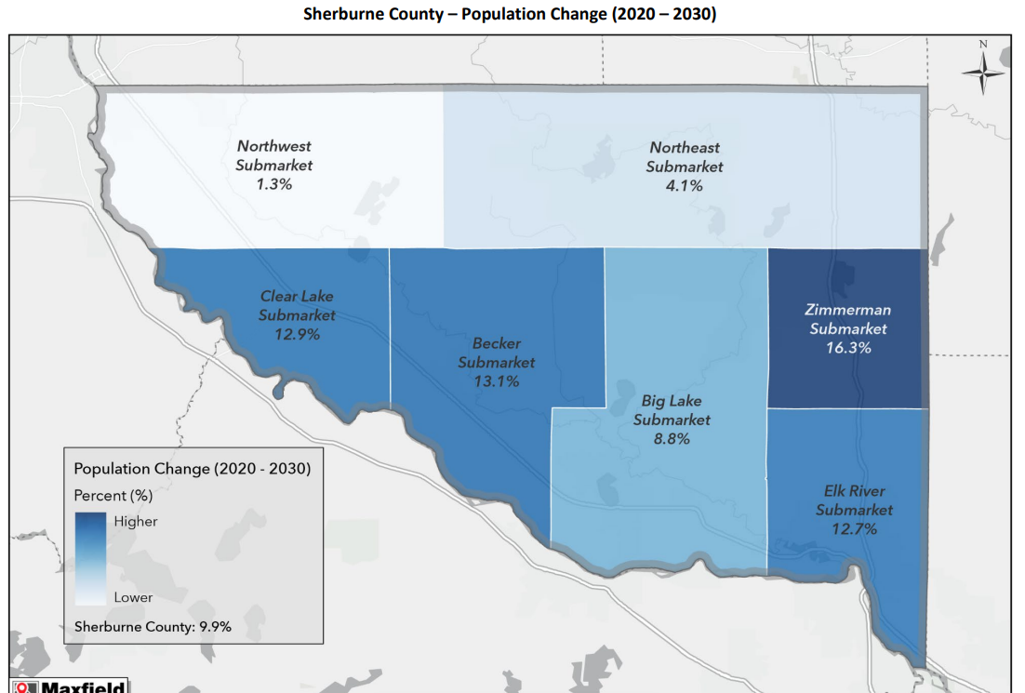
Demographics analysis

Slide 8
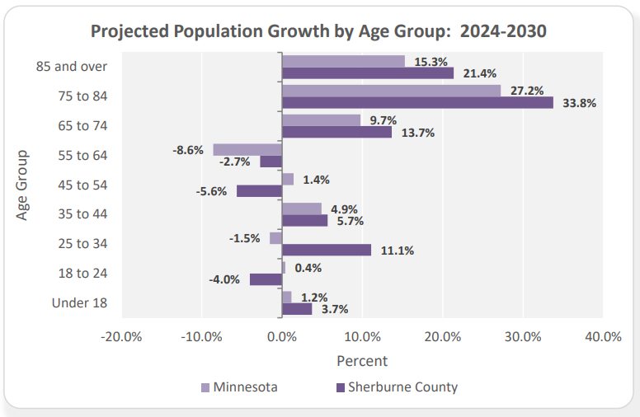
Demographics analysis

Slide 9
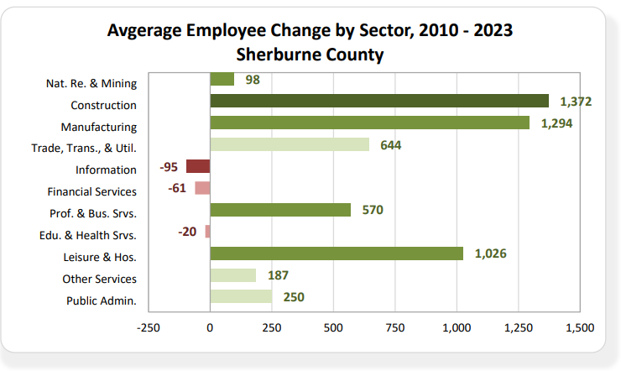
Employment trends

Slide 10
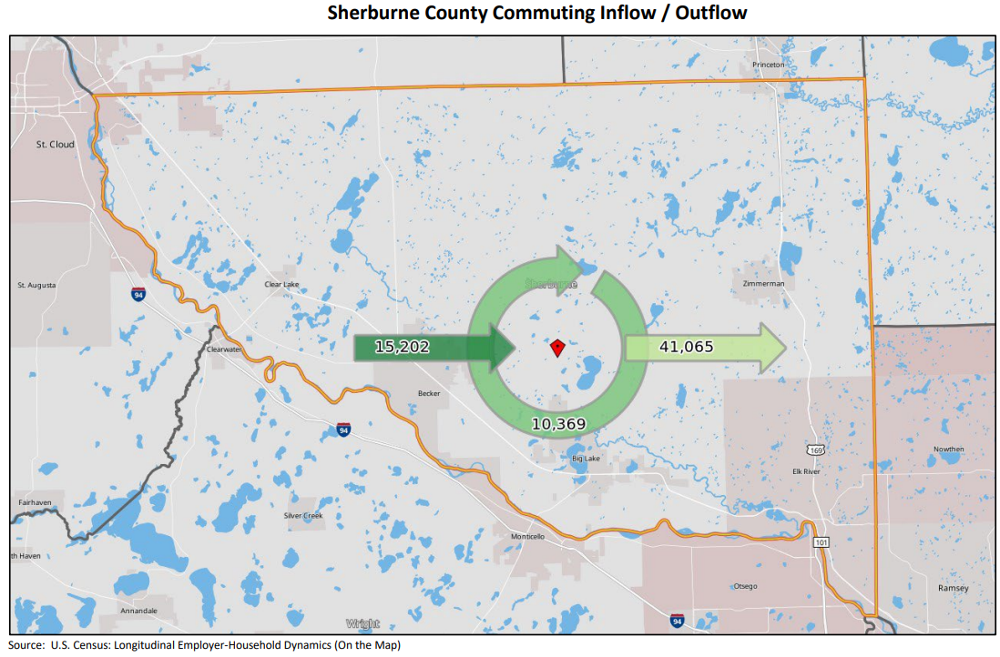
Employment trends

Slide 11
Housing Characteristics
Average Percentages of Sherburne County Housing Built in Each Decade:
<1940 – 1950s- 9.025%
1960s - 6.125%
1970s - 12.875%
1980s - 12.125%
1990s - 22%
2000 - 28.25%
2010+ - 9.6%
*Nearly 60% of all housing stock built after 1990.

Slide 12
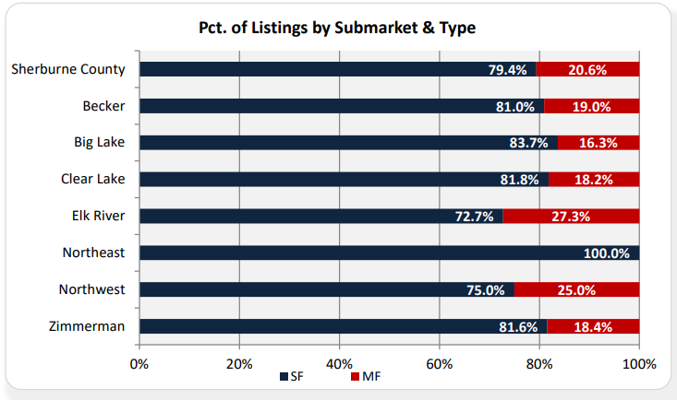
Housing Characteristics

Slide 13
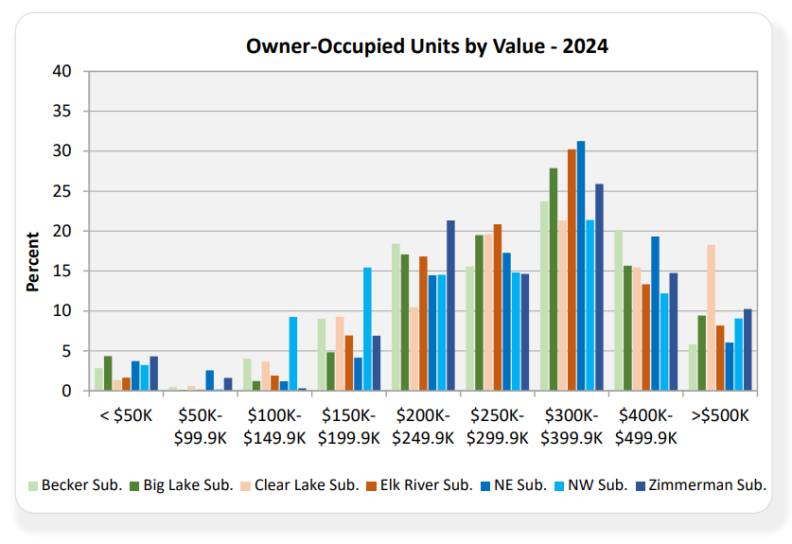
Housing Characteristics

Slide 14
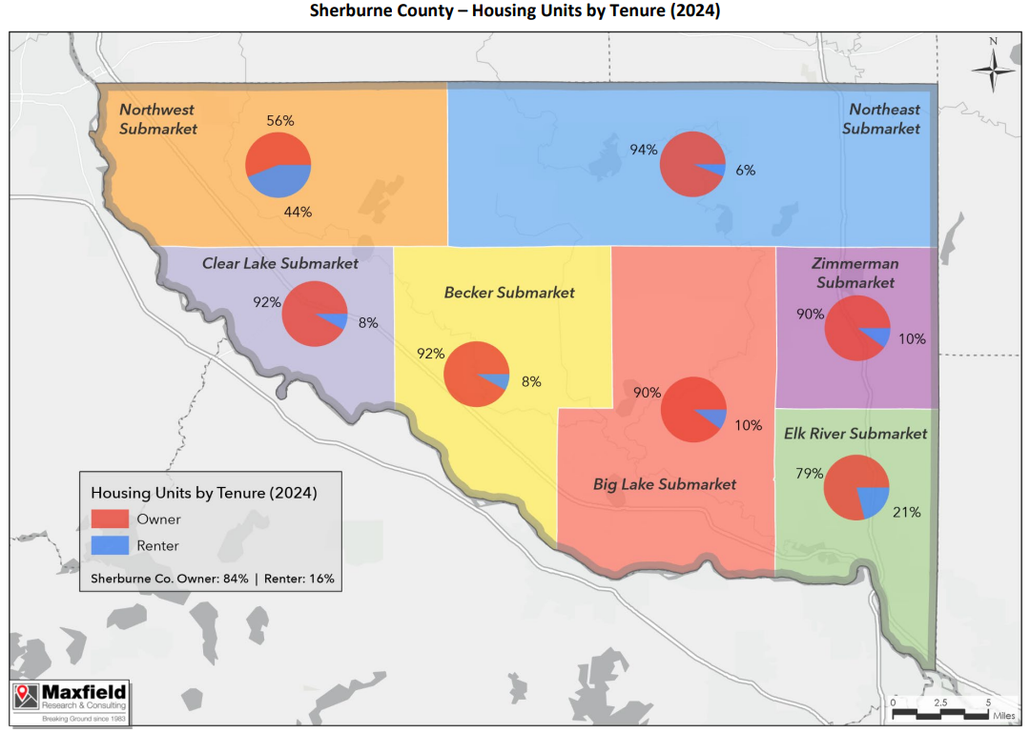
Housing Characteristics

Slide 15
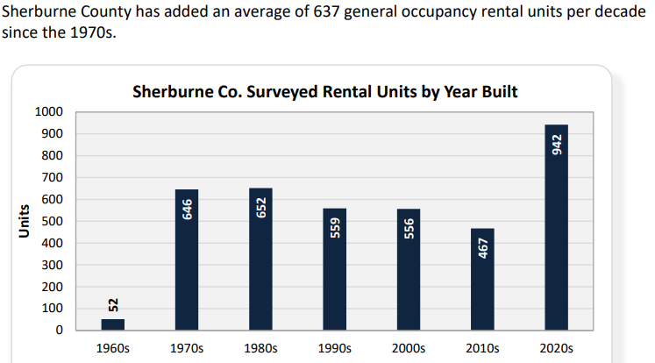
Rental housing

Slide 16
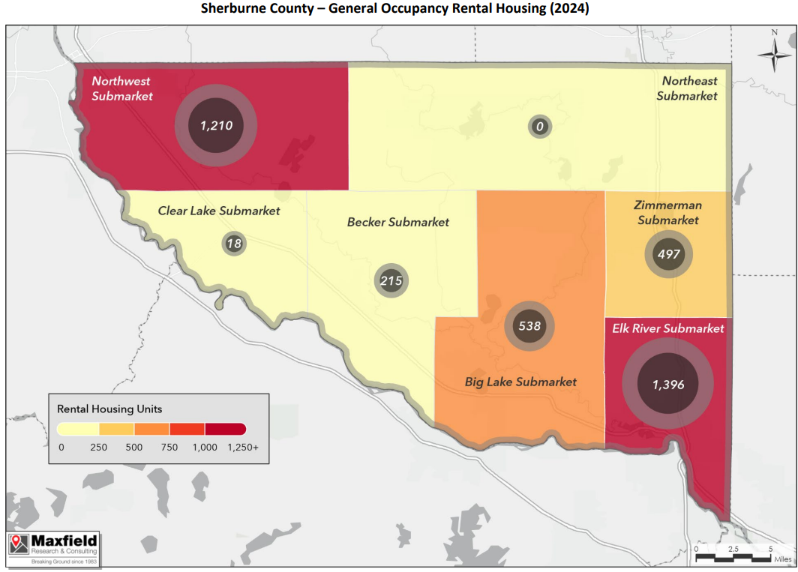
Rental housing

Slide 17
Senior housing

Slide 18
Senior housing

Slide 19
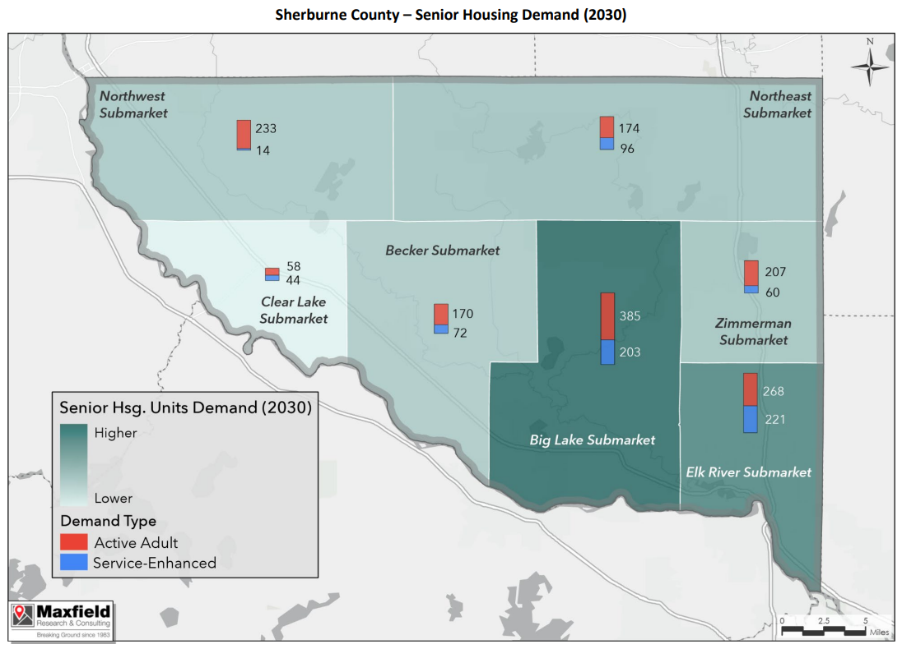
Senior housing

Slide 20
special needs housing

Slide 21
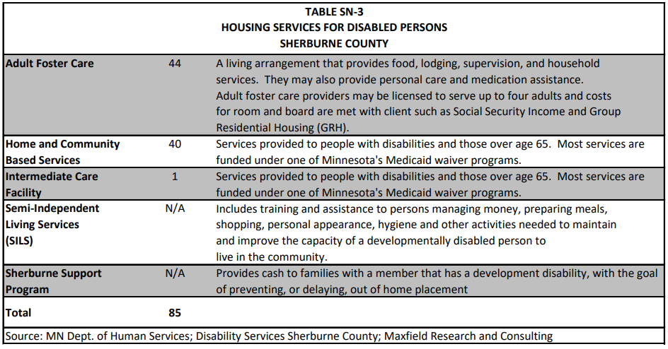
special needs housing

Slide 22
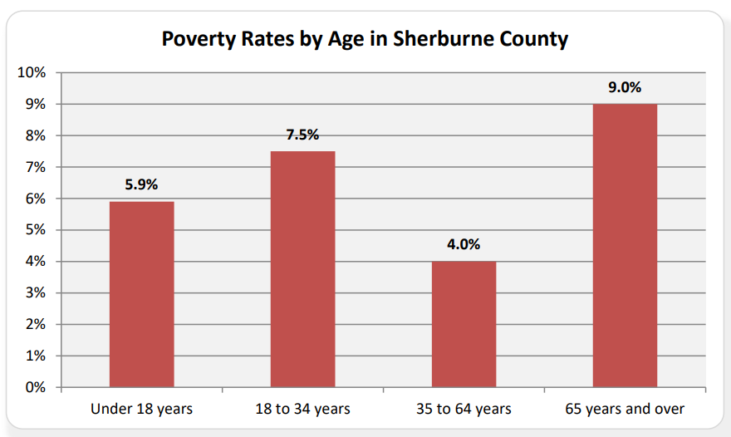
special needs housing

Slide 23
Planned & pending housing developments

Slide 24
Planned & pending housing developments

Slide 25
Housing affordability

Slide 26
Housing affordability

Slide 27
Housing demand Analysis

Slide 28
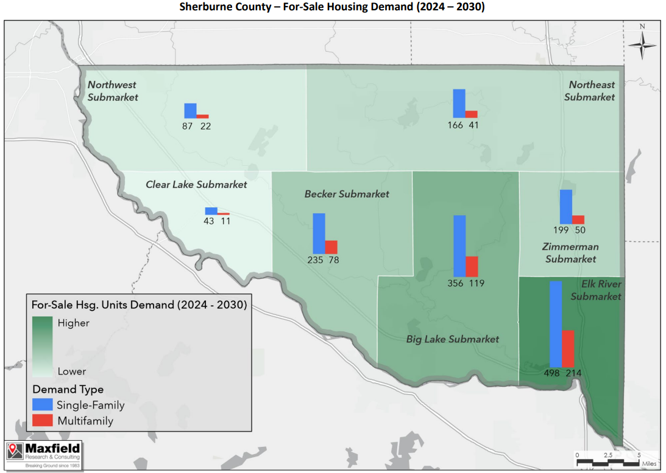
Housing demand Analysis

Slide 29
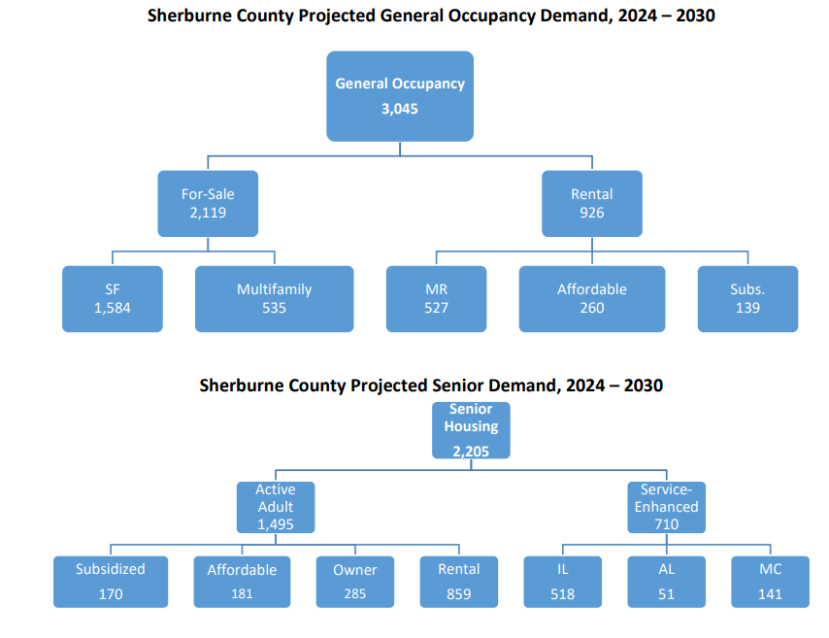
conclusions & recommendations

Slide 30
conclusions & recommendations
New platted lots are a critical need (only at 2 yr. Supply, 3-5 yrs. Recommended).
Development of entry-level homes may require a private-public partnership or other incentives to stimulate lower priced new home construction.
Growing need for patio home, one-level, and/or ground level main bedroom homes (both single and multifamily housing).
Strong need for market rate and affordable/subsidized rental housing.
Senior housing (independent living) is a strong need.

