Slide 1
Minnesota Employment Law Updates 2023
Kristin Kingsbury, Shareholder Attorney, Bassford Remele
McKenzie Tompt, Sr. Human Resource Specialist, Insperity
November 2, 2023

Slide 2
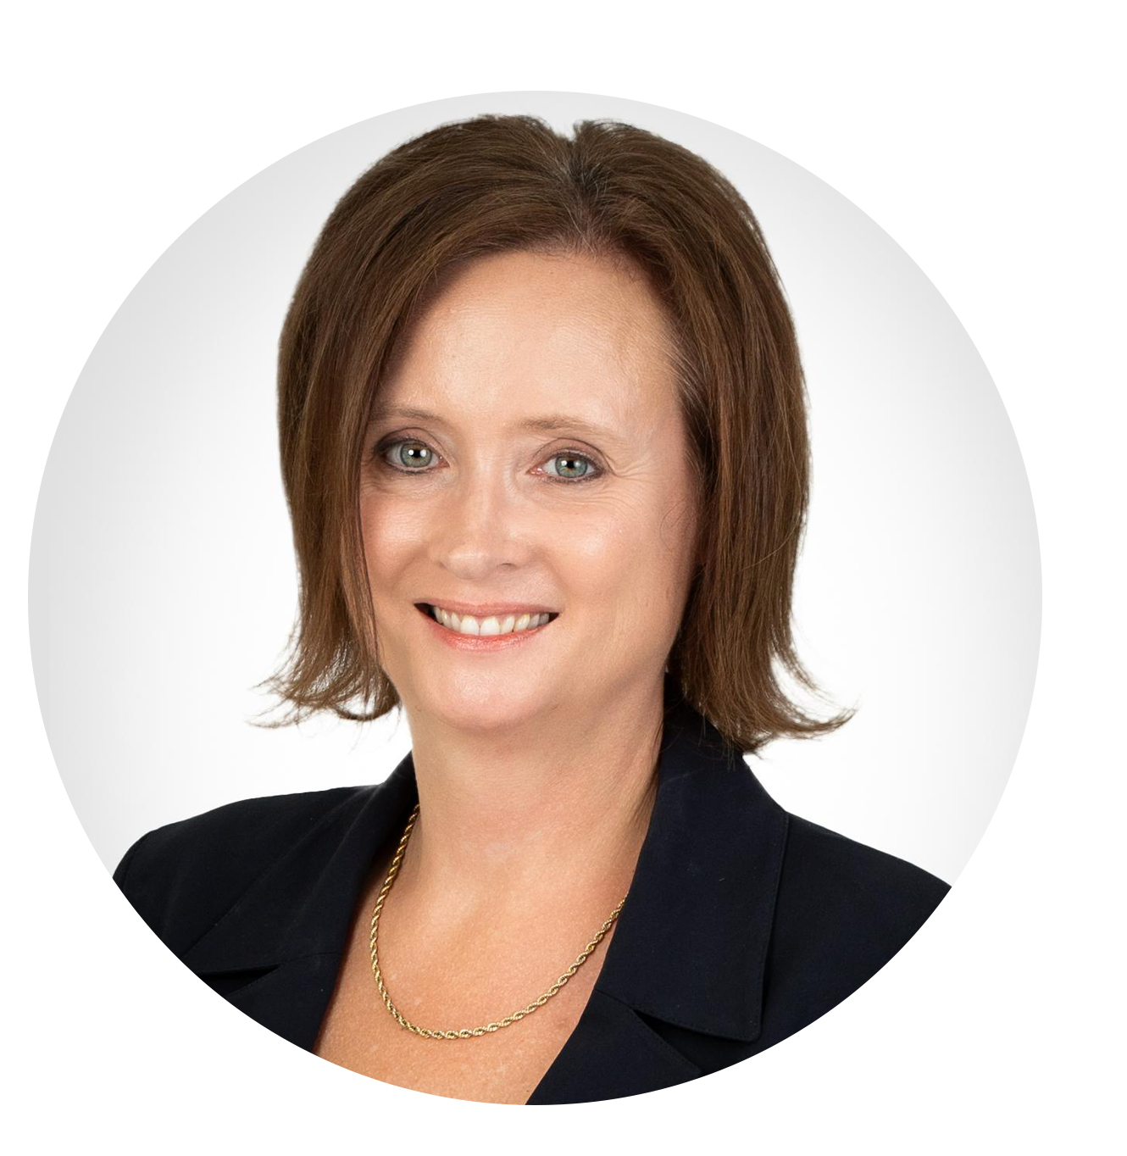
Presenters
Kristin Kingsbury
Shareholder Attorney,
Bassford Remele
McKenzie Tompt
Sr. Human Resource Specialist, Insperity

Slide 3
Disclaimer
Nothing in these materials or the presentation is be relied upon as legal advice from either Insperity or Bassford Remele. In addition, nothing herein creates an attorney-client relationship between Bassford Remele, P.A., and any reader of these materials or viewer of the presentation.

Slide 4
January 1, 2024
January 1, 2026
Minnesota Earned Sick and Safe Leave
Affects all employers with at least 1 employee in Minnesota
1 hour of sick and safe time for every 30 hours worked
Paid Family and Medical Leave
Partial Wage Replacement for 12-20 (max) weeks of leave
Can include pregnancy or recovery from childbirth (12 weeks)
All other types of leave (12 weeks).
Up to 12 weeks for care of other family members
20 week cap for self and family members

Slide 5
Minnesota Omnibus Jobs Bill
January 1, 2024
Minnesota Earned Sick and Safe Leave
Affects all employers with at least 1 employee in Minnesota
1 hour of sick and safe time for every 30 hours worked
48 hours minimum per year

Slide 6
Minnesota Earned Sick and Safe Leave (ESSL)
Accrual vs Frontload
Accrual
Frontload
1 hour for every 30 hours worked (.0334 per hour worked)
Carryover required
Can add a balance cap of 80 hours (minimum)
48 hours upon hire and 80 hours every year there after
Can choose to frontload 48 hours every year and pay out any unused ESSL from the previous year
Carryover not required

Slide 7
Accrual scenario
Employee begins accruing when hired
60 hours by the end of the year
Carries over to next year
Stops accruing at 80 hours
Employee takes 40 hours off, leaving a balance of 40 hours
Accruals begin again until they reach 80 hours for year 2
80 hours carries into the 3rd year
Essentially a “continual bucket” of sick time

Slide 8
Accrual scenario #2
Michelle accrued 30 hours by the end of year 1 – which carryover
Michelle accrued another 48 hours year 2
She did not use any hours and now has 78 hours (30+48), which carryover again
Michelle accrues an additional 2 hours before stopping at the limit of 80 hours (30+48+2=80)
Since her employer caps at 80 hours, she must use time before she continues to accrue in her third year.

Slide 9
Frontload scenario
Employee immediately credited 48 hours of sick time upon hire
They use 8 hours, leaving a balance of 40 hours
On December 31st, they lose unused 40 hours
On January 1st, employer frontloads 80 hours
Employee leaves company on January 5
Employer does not have to pay out the 80 hours
Rehired within 120 days, and employer reinstates their 80-hour balance

Slide 10
Minnesota Earned Sick and Safe Leave (ESSL)
Not required to payout upon termination
If rehired within 120 days, must reinstate any previously accrued balance

Slide 11
MN Paid Family and Medical Leave
January 1, 2026
Partial wage replacement for 12-20 (max) weeks of leave
Medical for employee (up to 12 weeks)
Medical care for other family members (up to 12 weeks).
Capped at 20 weeks

Slide 12
January 1, 2024
January 1, 2026
Minnesota Earned Sick and Safe Leave
Affects all employers with at least 1 employee in Minnesota
1 hour of sick and safe time for every 30 hours worked
Paid Family and Medical Leave
Partial Wage Replacement for 12-20 (max) weeks of leave
Can include pregnancy or recovery from childbirth (12 weeks)
All other types of leave (12 weeks).
Up to 12 weeks for care of other family members
20 week cap for self and family members

Slide 13
Q & A

