Slide 1
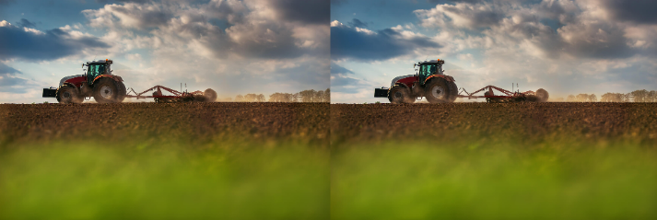
Welcome to the
SOUTHEAST WELD COUNTY CHAMBER
Networking Luncheon

Slide 2
BENEFITS OF PARTNERING WITH THE
WELD CENTRAL HIGH SCHOOL
WORK-BASED LEARNING PROGRAM
with thanks to our presenters

Slide 3
thank you to
for their continued partnership and support!

Slide 4
ANNOUNCING the FINAL session of our
LEADERSHIP DEVELOPMENT PROGRAM
Friday, March 28th with many THANKS to
our PRESENTING HOST
your SUPPORT of our EFFORTS is truly APPRECIATED!

Slide 5
Introducing your
2025 BOARD OF DIRECTORS
MARC ARNUSCH, President
Marc Arnusch Farms LLC
MAGGIE MUÑOZ, Past President
Platte Valley Hospital
MARK KINNEAR, Vice President
Kinnear Insurance
SAM RIBLETT, Secretary
United Power
ADRIENNE SANDOVAL, Treasurer
High Plains Landscapes Inc.
TAMI CROSSEN
Hudson Public Library
KRISTA GIBSON
High Plains Bank
BRYCE LANGE
Town of Hudson
Amy McFarland
Aims Community College
TERRY YOUNG
Brighton Tactical
BRITTANY STEINMAN
Wolf & Honey Coffee Bar

Slide 6
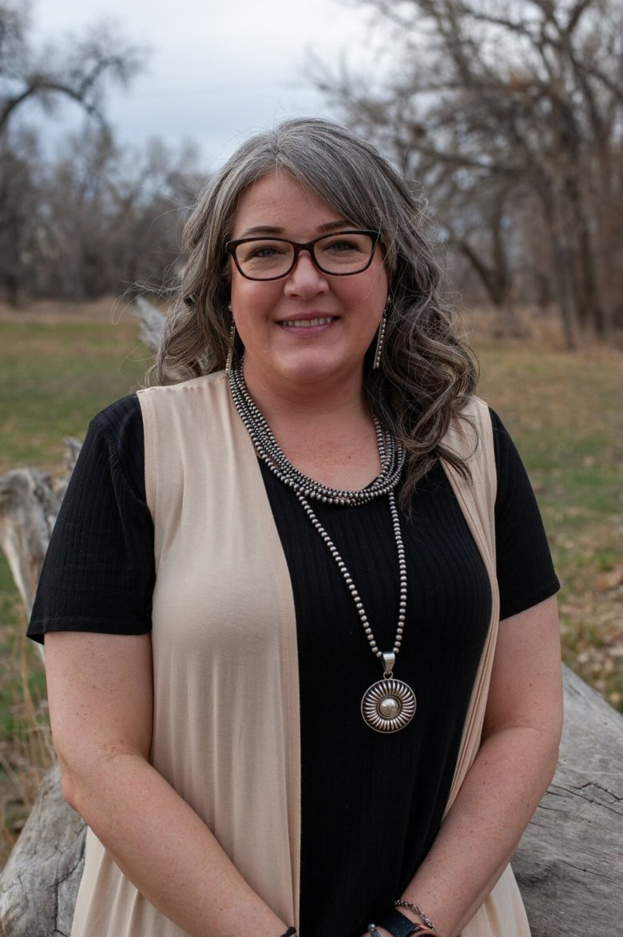
and welcoming
ADRIENNE SANDOVAL
High Plains Landscapes Inc.
your 2025
Southeast Weld County Chamber
Board
TREASURER

Slide 7
announcing an OPPORTUNITY for your VOICE to be HEARD…
100 Beech Street, Hudson
Chamber Member Focus Group
Thursday, April 3^{rd,} 11:30am – 12:30pm
lunch will be served

Slide 8
TWO NEW MEMBERS in March!
welcome to
RENTED RELIEF
LOST CREEK SENTINEL LLC
…together we’ll make it!

Slide 9
!! 2025 NEW MEMBERS !!
City of Fort Lupton
Loan Goddess Mortgage Group
MSP Companies
Schrader Real Estate & Auction
Bandimere Speedway
Copper Kettle Restaurant & Catering
Warner Ranch
High Plains Landscapes, Inc.
Rented Relief
Lost Creek Sentinel LLC
…together we’ll make it!

Slide 10
SAVE THE DATE
Wednesday, April 30, 2025
BUSINESS MATTERS NETWORKING LUNCHEON
@ Ben’s Brick Oven Pizza
Thursday, May 1, 2025
MULTI-CHAMBER AFTER HOURS – DERBY DAYS
@ location TBD
Saturday, November 8, 2025
REGIONAL MILITARY & 1ST RESPONDER
APPRECIATION LUNCHEON
in partnership with
HUDSON, KEENESBURG & LOCHBUIE

Slide 11
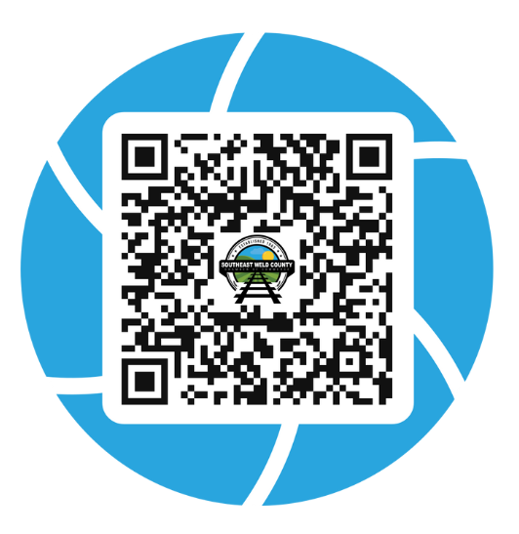
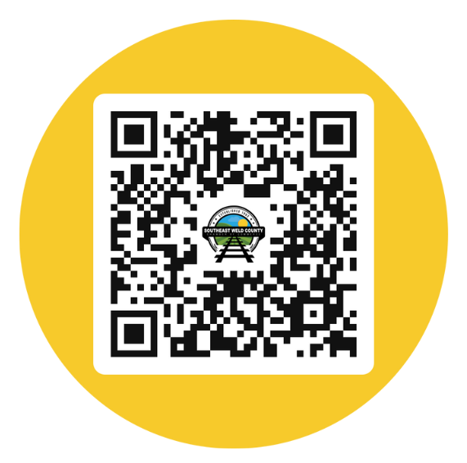
LIKE - SHARE - FOLLOW
check out all the happenings
for the Chamber & Chamber Members
on the Event Calendar at
southeastweldchamber.org/event-calendar
check out the
Chamber FACEBOOK page
and please
LIKE – SHARE - FOLLOW

Slide 12
PLEASE
GIVE US YOUR
Paper survey available today…electronic version will be posted by the end of the week!
THANK YOU for providing your thoughts!
This Photo by Unknown Author is licensed under CC BY-NC-ND

