Slide 1
Fraud Prevention
Avoiding Financial Scams

Slide 2
Cybersecurity is key
Do not open emails from people you don’t know.
Be careful with links and new website addresses.
Secure your personal information.
Stay informed on the latest cyber threats.
Use strong passwords.
Keep your software up to date and maintain preventative software programs.
Update the operating systems on your electronic devices.
When cybersecurity is inadequate it can lead to stolen identity and financial loss. Maintaining cybersecurity is very important.

Slide 3
Trending scams to be aware of
Money Mules – Scammers use people to receive or move money obtained from victims of fraudulent activities. Be very cautious of strangers asking you open accounts or to receive packages or goods.
Online Dating – Romance scammers create fake profiles and try to develop relationships with targeted victims through online dating apps, social media websites or apps, or email.
Impostors – Scammers pretend to be someone you know or trust to convince you to send them money. Examples include check endorsements, bankruptcy forms, stock or investment confirmations.
Mortgage and Foreclosure Scams – Watch out for scammers who falsely claim to be lenders, loan servicers, counselors who can help with your mortgage. They prey on vulnerable, desperate homeowners.
Ransomware – A type of malware created to lock or encrypt files on a device.

Slide 4
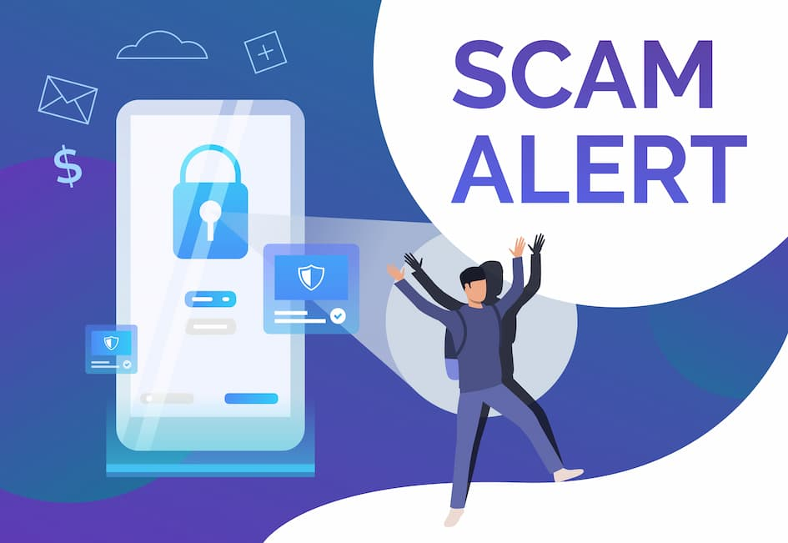
Spot the Scammer
Things only scammers will say:
“Act Now!”
“Only say what I tell you to say”
“Don’t trust anyone, they’re in on it”
“Do (this) or you’ll be arrested”
“Don’t hang up!”
“Move your money to protect it”
“Withdraw cash and take it to (someone)”
“Buy these particular gift cards”
“Go to a Bitcoin ATM”
Instead of doing what they say, STOP! Hang up. Delete the email. Stop texting with them. Block their number. Report the scam.

Slide 5
Telephone Fraud
Scammers often try to get you to click on links by promising you something. Scammers might:
Promise free prizes, gift cards, or coupons
Offer you a low or no interest credit card
Promise to help you pay off student loans
Scammers also send fake messages that say they have information about your account/transaction. Scammers might:
Say they’ve noticed some suspicious activity on your account
Claim there’s a problem with your payment information
Send you a fake invoice to tell you to contact them if you didn’t authorize a purchase
Send you a package delivery notification
Beware of callers asking for money or information. To reduce the number of telemarketing calls you receive, consider signing up for the national Do Not Call Registry at www.donotcall.gov.
If you are on this list, be suspicious of calls from an organization that you have reason to believe is not eligible to contact you under the registry’s rules.
If you have a cell phone, you probably use it to text people you know. But have you ever gotten a text message from an unknown sender? It could be a scammer trying to steal your personal and financial information.

Slide 6
What to do about spam text messages
If you receive a message asking you for personal or financial info do not click on any links.
To find out if the message is real, contact the company using a phone number or website you know is real, not the info from the text message.
Your phone may have an option to filter and block spam or messages from unknown senders.
Some call-blocking apps let you block unwanted texts. Go to ctia.org for a list of call-blocking apps. Check out the features, user ratings, and expert reviews.

Slide 7
What in the world are these scams?
Phishing – A scam commonly used by criminals using email to ask you to provide personal financial information through links, often sending urgent-sounding or threatening messages, trying to trick you
Smishing – Similar to phishing, but instead of using email, the criminals use text messaging to reach you, pretending they are from an organization you might trust
Vishing – Scammers use phone services (live phone call or voicemail) to try and trick you into providing your personal information by sounding like a legitimate business or government official

Slide 8
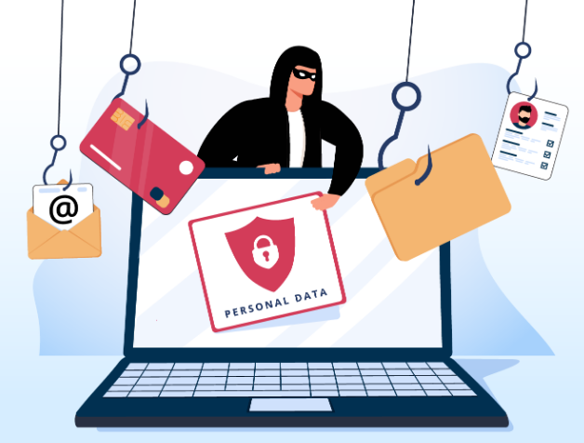
How to recognize & avoid Phishing
Phishing = when a scammer uses fraudulent emails, texts, phone calls, or copycat websites to get you to share valuable personal financial information – such as account numbers, Social Security numbers, or login credentials.
When you receive an email, never assume it’s safe. Take a moment to analyze the email or text before clicking on any links or opening attachments.
Ask yourself:
Do I recognize the sender’s email address?
Are they asking for personal info?
Is there bad grammar or spelling errors in the message?
Does the subject line match the message content?
Was the message sent at an unusual time?
Do I feel pressured to respond?
Follow your gut instinct, but when in doubt, try calling the sender to
verify they actually sent the message. If you feel uncomfortable, there
is probably a good reason.

Slide 9
Why NOT to click on the link
Malicious email links and attachments make up over 50% of the top tactics used by threat actors to gain access to unauthorized information.
Some links might take you to a spoofed website that looks real, but isn’t. If you log in the scammers then might steal your username and password.
Clicking on other links might install harmful malware on your phone that steals your personal or financial information without you realizing it.
To identify a bad link, hover over it with your mouse – don’t click the link. The real web address will show up. It’s generally obvious that something isn’t right. The domain might be different, the end of the URL might look strange other than .com or .org, or there might be misspelling for common company names

Slide 10
Three ways to protect yourself from Phishing
Protect your devices by using security software. Set the software to update automatically so it will deal with any new security threats
Protect your data by backing it up. Back up the data on your devices to an external hard drive or in the cloud. This will help in the case of theft or fraud.
3. Protect your accounts by using multi-factor authentication. Some apps or accounts offer extra security by requiring two or more credentials to log into your account. This makes is harder for scammers to log into your accounts if they do happen to get your username and password.

Slide 11
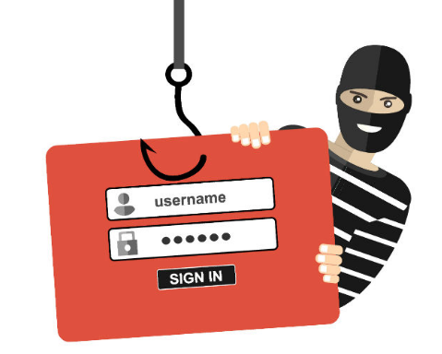
How to report Phishing
If you get a phishing email, forward it to the Anti-Phishing Working Group at reportphishing@apwg.org
If you get a smishing text message, forward it to SPAM (7726)
Report the phishing attempt to the Federal Trade Commission at ReportFraud.ftc.gov.
Your report makes a difference and can help law enforcers spot problems

Slide 12
Tech Support Scams
Never call a number on a security pop-up warning. Pop-ups that tell you to call tech support are always scams.
Never move or transfer your money to “protect it.” Only a scammer will tell you to do that.
Never give someone a verification code to log in to your account. Scammers want it to get into your account.
Call your real bank, broker, or investment advisor if you’re worried. Use a number that you know is real.

Slide 13
Identity Theft is a crime against YOU
Warning Signs of Identity Theft
Withdrawals you didn’t make
Missing bills or statements
Merchants refusing your checks
Credit card transactions declined
Letters about accounts you didn’t open
Emails about purchases you didn’t make
Debt collectors calling about debts that aren’t yours
Usernames or passwords not working
Medical bills for services you didn’t receive
Unfamiliar accounts on your credit report
Your identity is an asset
Identity Theft - a crime that happens when someone uses your personal information, finances, or impersonates you without your authority
Credit Card fraud was the most common type of identity theft reported in 2023, using phishing as the most common cybercrime

Slide 14
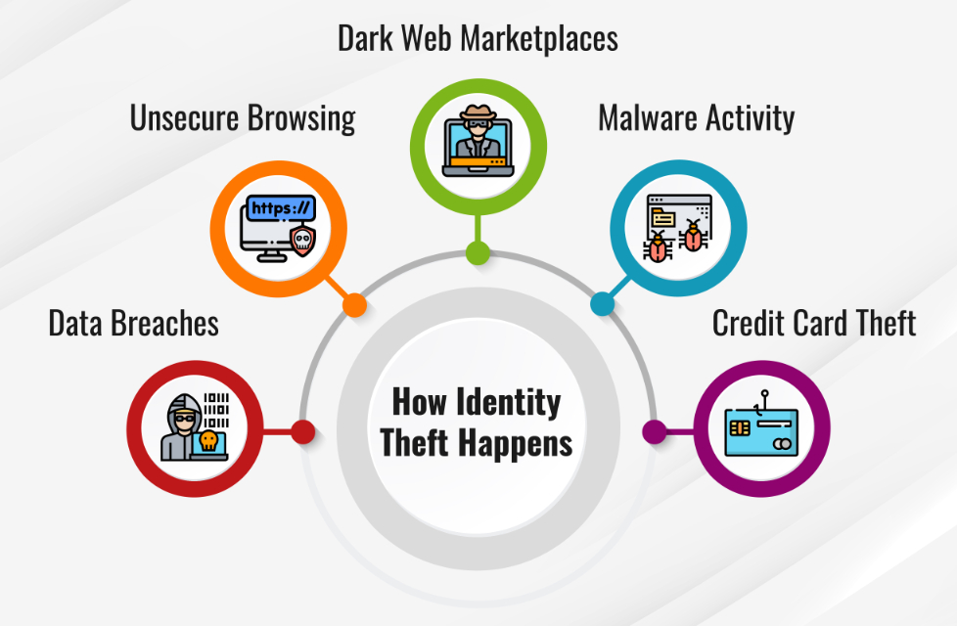
Steps to minimize Identity Theft
Did you know that Americans lost over $10 billion to identity fraud in 2023?
Steps to minimize identity theft:
Guard your personal information
Don’t respond to unsolicited requests
Protect your mail
Sign up for Direct Deposit
Review your financial accounts regularly and carefully
Beware of identity theft on the Internet
Protect your devices
Review your credit report at least once every 12 months
Keep your important documents secure
Beware of disaster-related scams
Read scam alerts

Slide 15
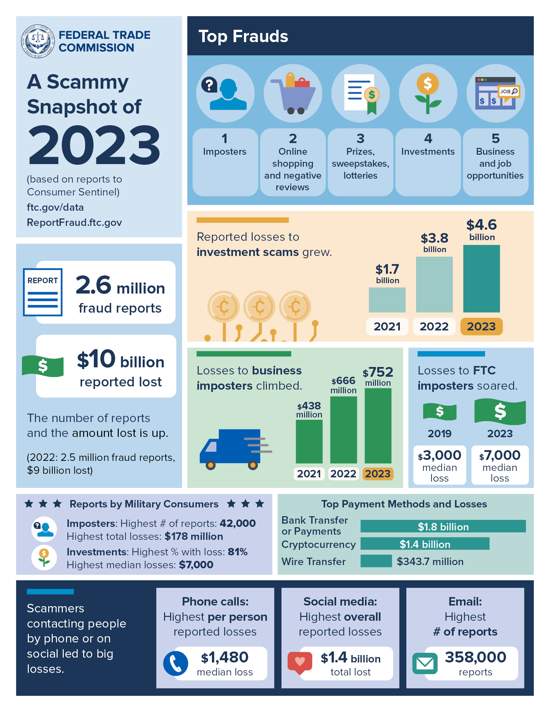
The Federal Trade Commission (FTC) is a great source of information on identity theft and fraud. Their site at IdentityTheft.gov lets you know how to take action if your identity has been stolen.
If your identity has been stolen, the FTC also advises you to work with credit reporting agencies to respond to the identity theft.
The FTC also advises you to communicate with your creditors and debt collectors to alert them about and to dispute fraudulent accounts.

