Slide 1
Small Business Bookkeeping 101
Getting started with QuickBooks Online
Sarah Gluckstein, QuickBooks ProAdvisor Lucky Stone Bookkeeping sarah@luckystone.biz

Slide 2
Agenda
1. Basics
GAAP: Generally Accepted Accounting Principles
The Accounting Equation
Double-Entry Bookkeeping
2. QuickBooks Online
Chart of Accounts
Making sales: Products, Invoices, and Sales Receipts
Paying: Expenses and Bills
Linking your bank and connecting transactions
Creating reports

Slide 3
Basics: GAAP
Generally Accepted Accounting Principles:
Issued by Federal Accounting Standards Board (FASB)
Ensures reports are complete, consistent, and comparable to one another
Adherence is required by US federal law for publicly-traded companies
Economic Entity Principle: business separate from the owner
Monetary Unit Principle: always working in the same currency
Time Period Principle: activities are dated and reports cover specific periods of time
Cost Principle: items are recorded at their original price
Full Disclosure Principle: complete information is always recorded
Going Concern Principle: the business intends to carry on its operations into the future
Matching Principle: for accrual basis accounting, income and expenses in a given period are matched to one another
Revenue Recognition Principle: for accrual basis accounting, income is recorded at the time the sale is made, whether or not cash is received at that time
Materiality principle: small errors may be disregarded as insignificant
Conservatism principle: always err on the unfavorable side
See also: FASB.org/standards agiled.app/hub/accounting/gaap-principles/#principles-of-gaap

Slide 4
Basics: The Accounting Equation
Assets = Liabilities + Equity
Profit = Income - Expenses

Slide 5
Basics: Double-Entry Bookkeeping
Why do we record everything twice?
Money came from somewhere, and went to somewhere else
We need to know exactly what happened, every time
Record a credit (minus) in the from account, and a debit (plus) in the to account
*for certain types of accounts, credit/debit may be opposite the usual convention
Example: I paid the monthly phone bill for $10.21
Account | Debit (plus) | Credit (minus)
Checking |  | $10.21
Utilities: Phone | $10.21

Slide 6
Part 2: QuickBooks Online
What is it?
Bookkeeping software: helps to automate the bookkeeping process, and generate useful reports
How much does it cost?
Depends on the features you want – Simple Start is $30/month base price
Are there alternatives?
Yes! QuickBooks is the most popular in the United States, but there are lots of others. Xero is popular internationally, and Wave is a simple free system.
They all work in similar ways.

Slide 7
QBO: Chart of Accounts
Account # | Full name | Account type
1000 | Cash on hand | Bank
1020 | Checking Account | Bank
1110 | Accounts Receivable (A/R) | Accounts receivable (A/R)
1310 | Prepaid Expenses | Other Current Assets
1340 | Undeposited Funds | Other Current Assets
1490 | Accumulated Depreciation | Fixed Assets
1410 | Furniture & Fixtures | Fixed Assets
1420 | Phone | Fixed Assets
1520 | Organization Costs | Other Assets
2110 | Accounts Payable (A/P) | Accounts payable (A/P)
2210 | Credit Card | Credit Card
3310 | Opening Balance Equity | Equity
3020 | Owner Distributions | Equity
3010 | Owner's Equity | Equity
3510 | Retained Earnings | Equity
4010 | Bookkeeping Revenue | Income
4030 | Other Income | Income
5010 | Client Subscription Cost | Cost of Goods Sold
6150 | Advertising/Promotional | Expenses
6170 | Bank Charges | Expenses
6210 | Dues & Subscriptions | Expenses
6230 | Insurance - E&O | Expenses
6310 | Legal & Professional Fees | Expenses
6311 | Licenses | Expenses
6450 | Taxes - Other than Income | Expenses
6490 | Utilities | Expenses
8210 | Depreciation Expense | Other Expense
8410 | Penalties | Other Expense
-- | Reconciliation Discrepancies | Other Expense
Needs vary by industry and from business to business
Numbering is usually standardized
QBO supports sub-accounts
Can find examples online (or in QBO) and adjust them as needed

Slide 8
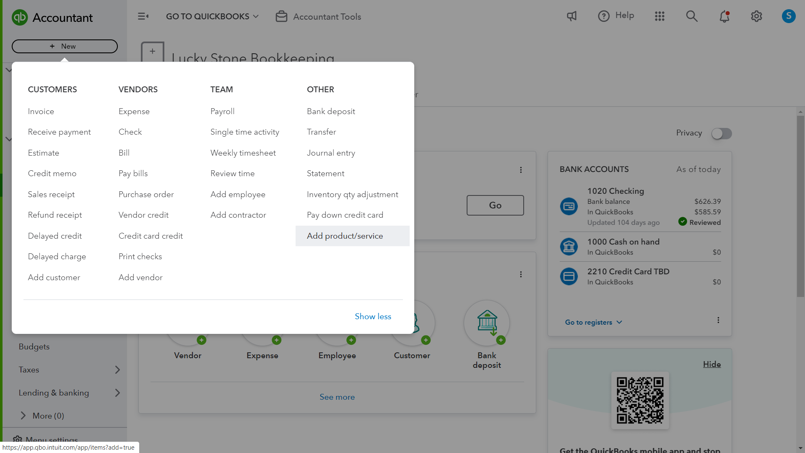
Making Sales: Products & Services

Slide 9
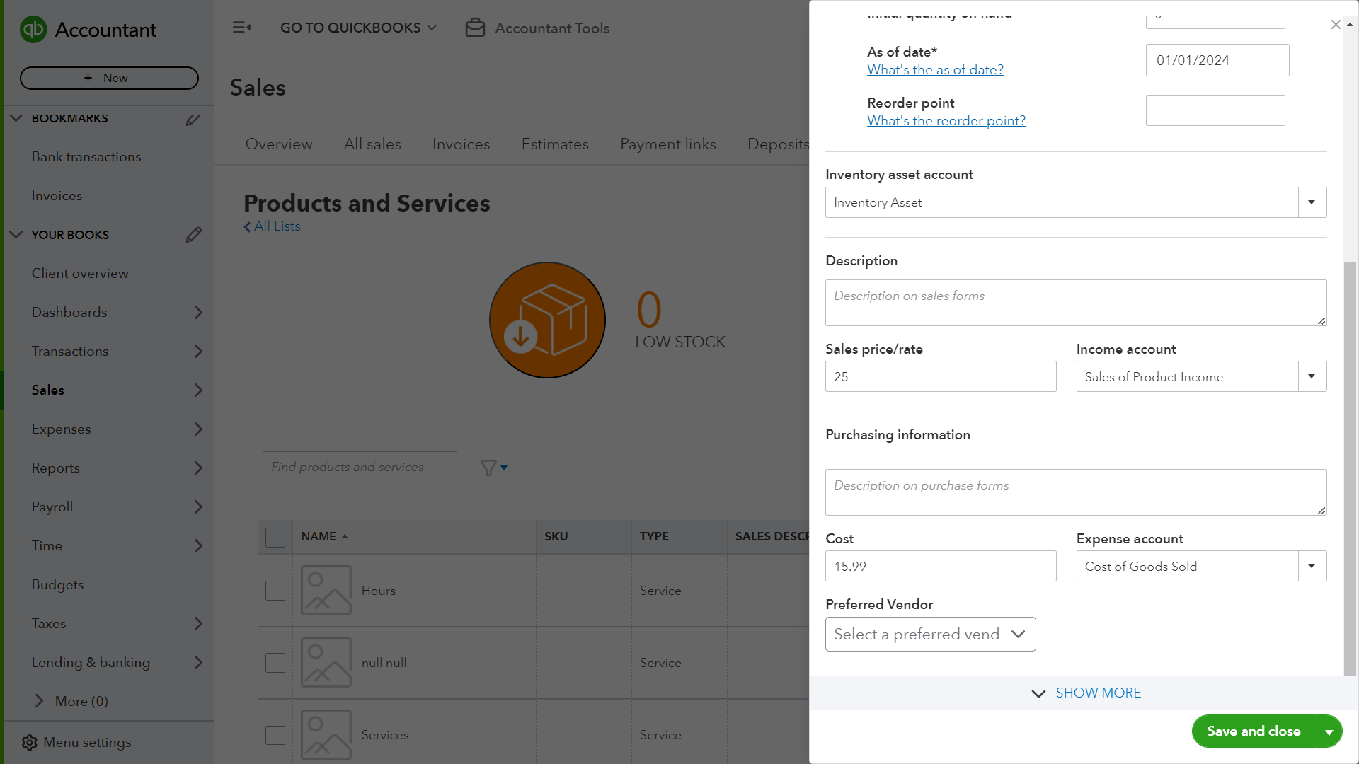
Making Sales: Products & Services

Slide 10
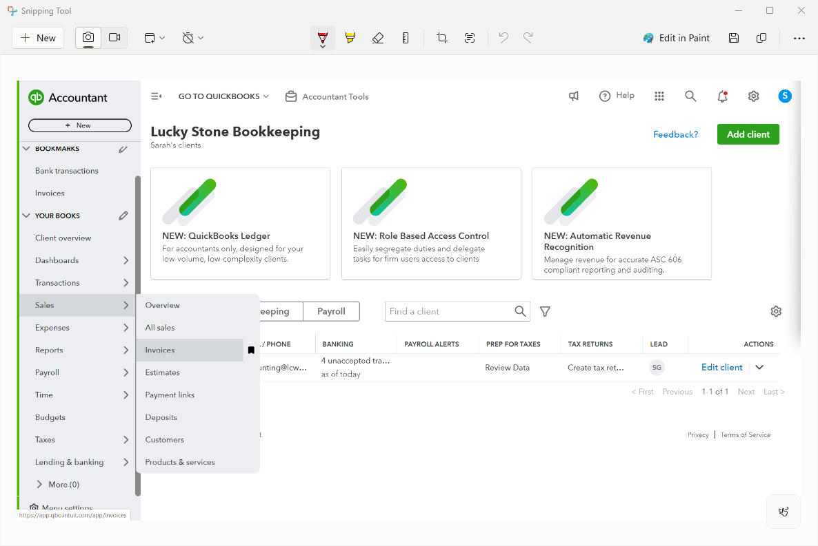
Making Sales: Invoices

Slide 11
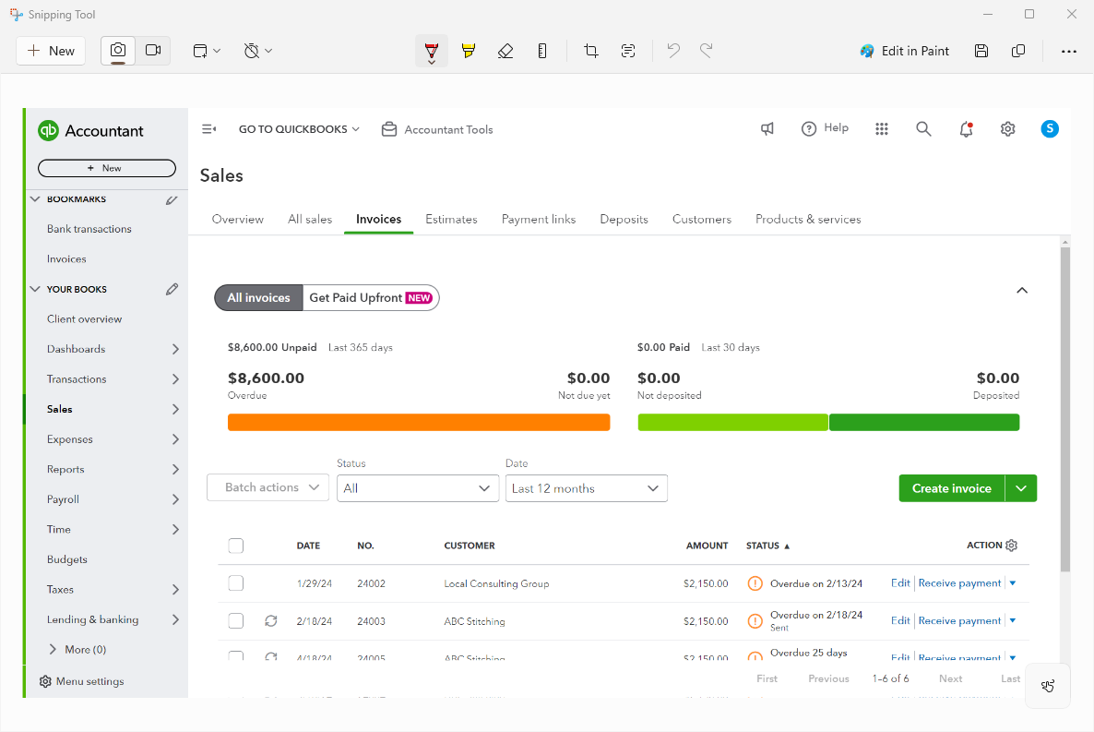
Making Sales: Invoices

Slide 12
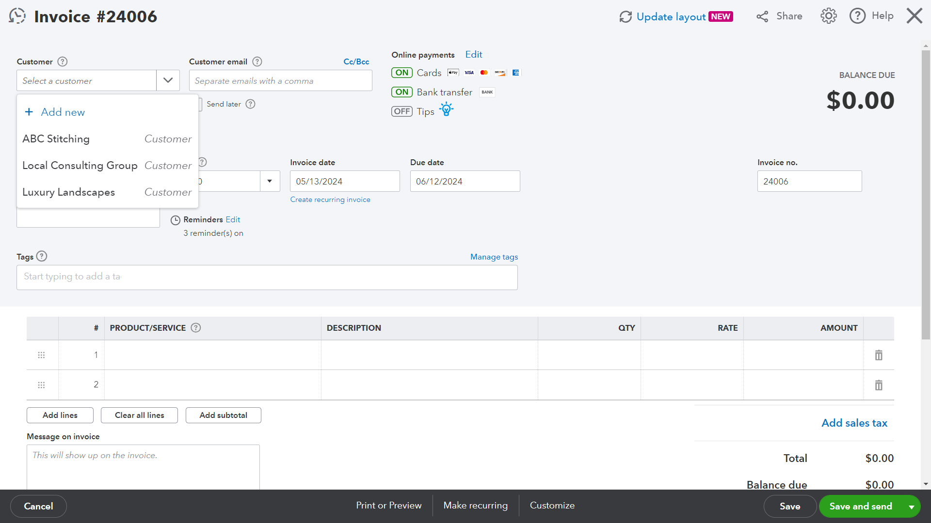
Making Sales: Invoices

Slide 13
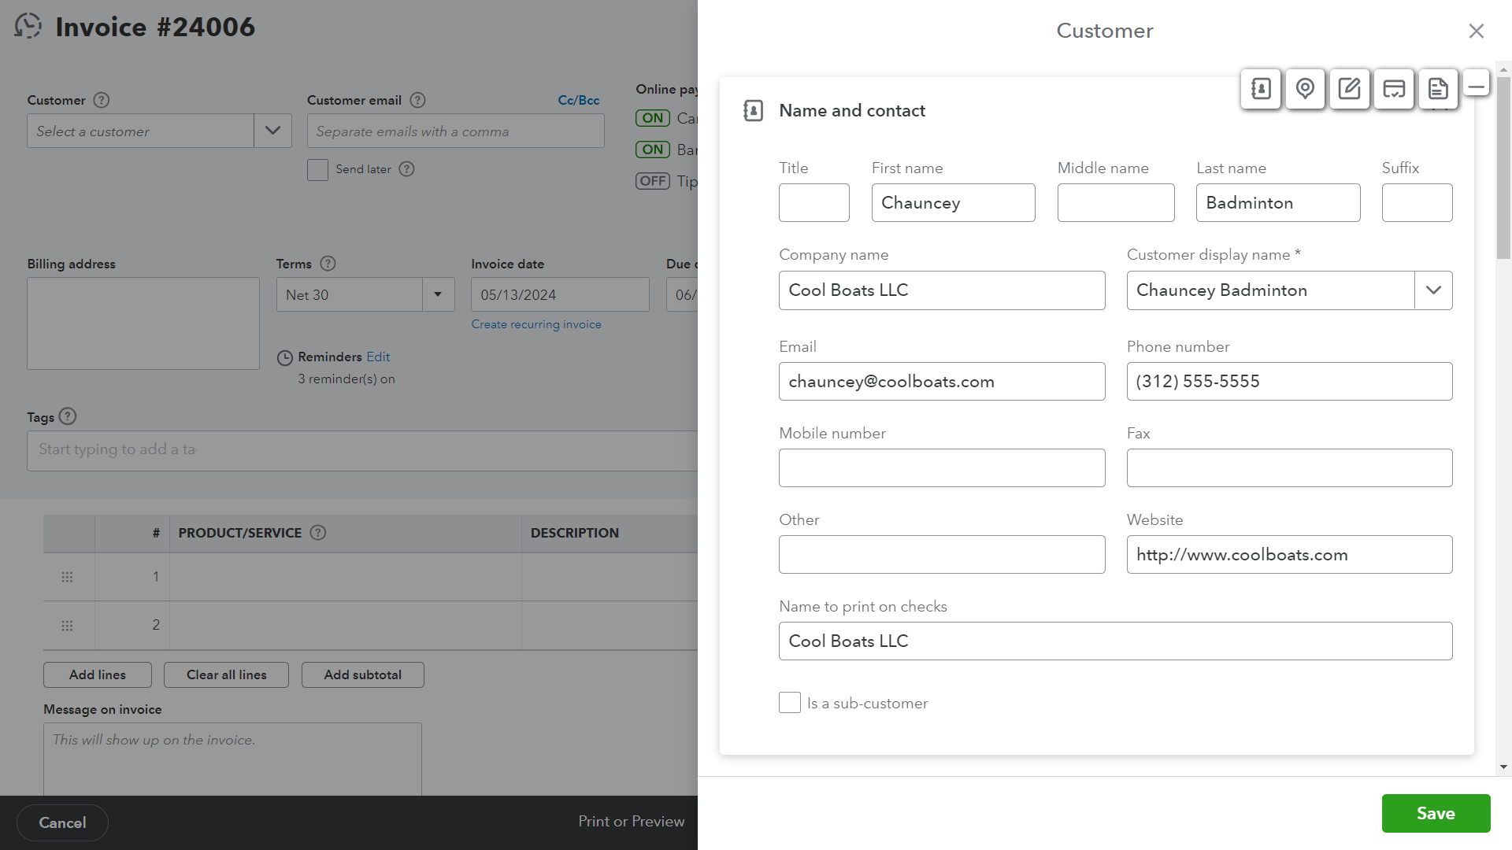
Making Sales: Invoices

Slide 14
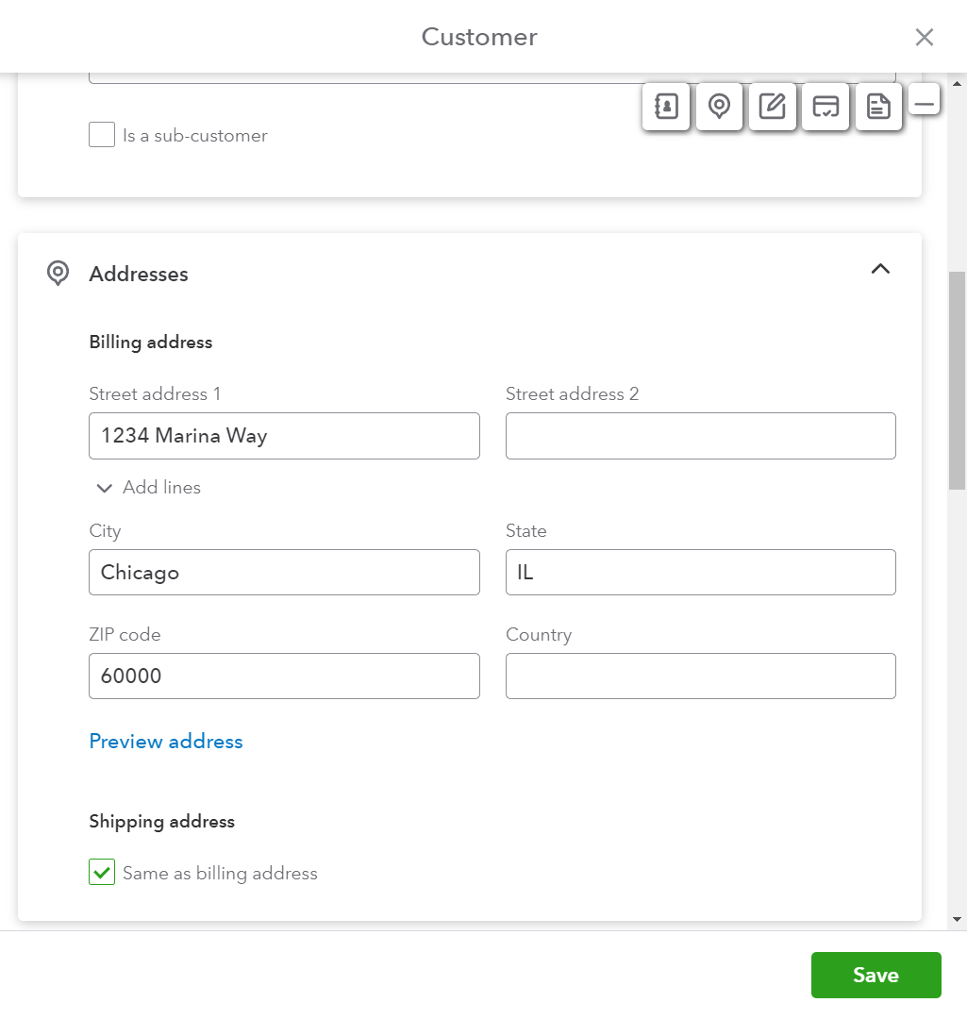
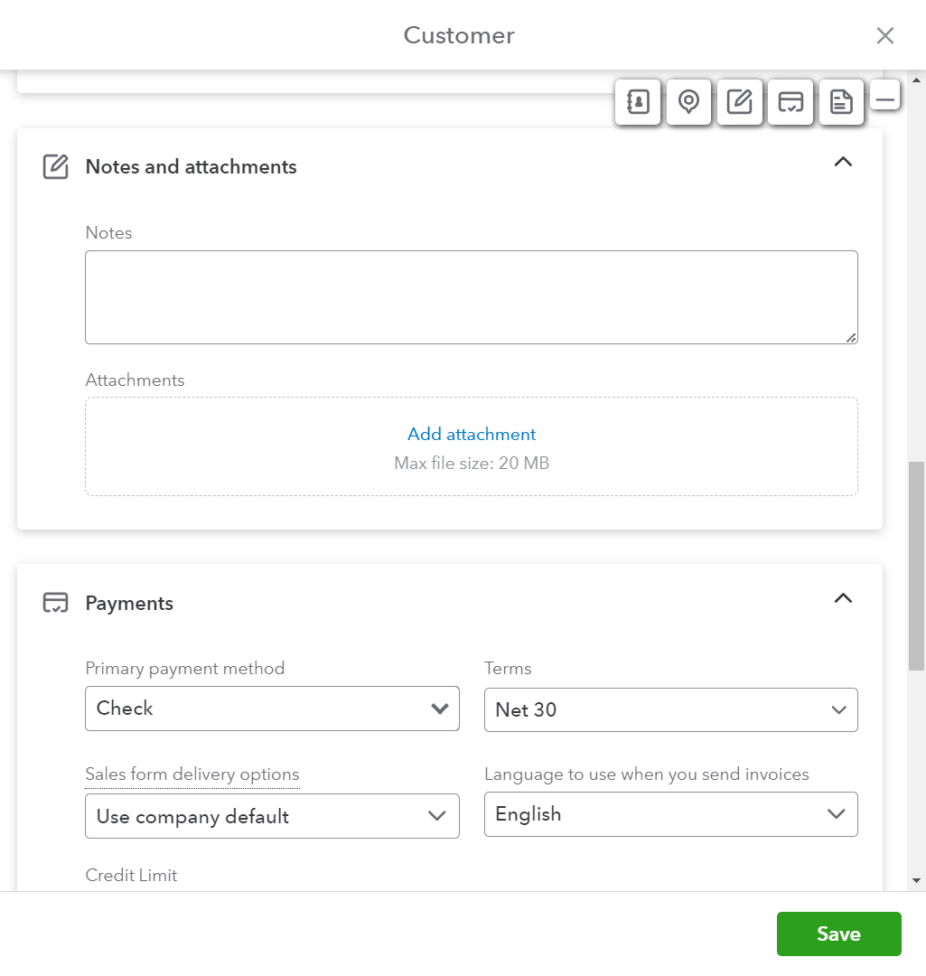
Making Sales: Invoices

Slide 15
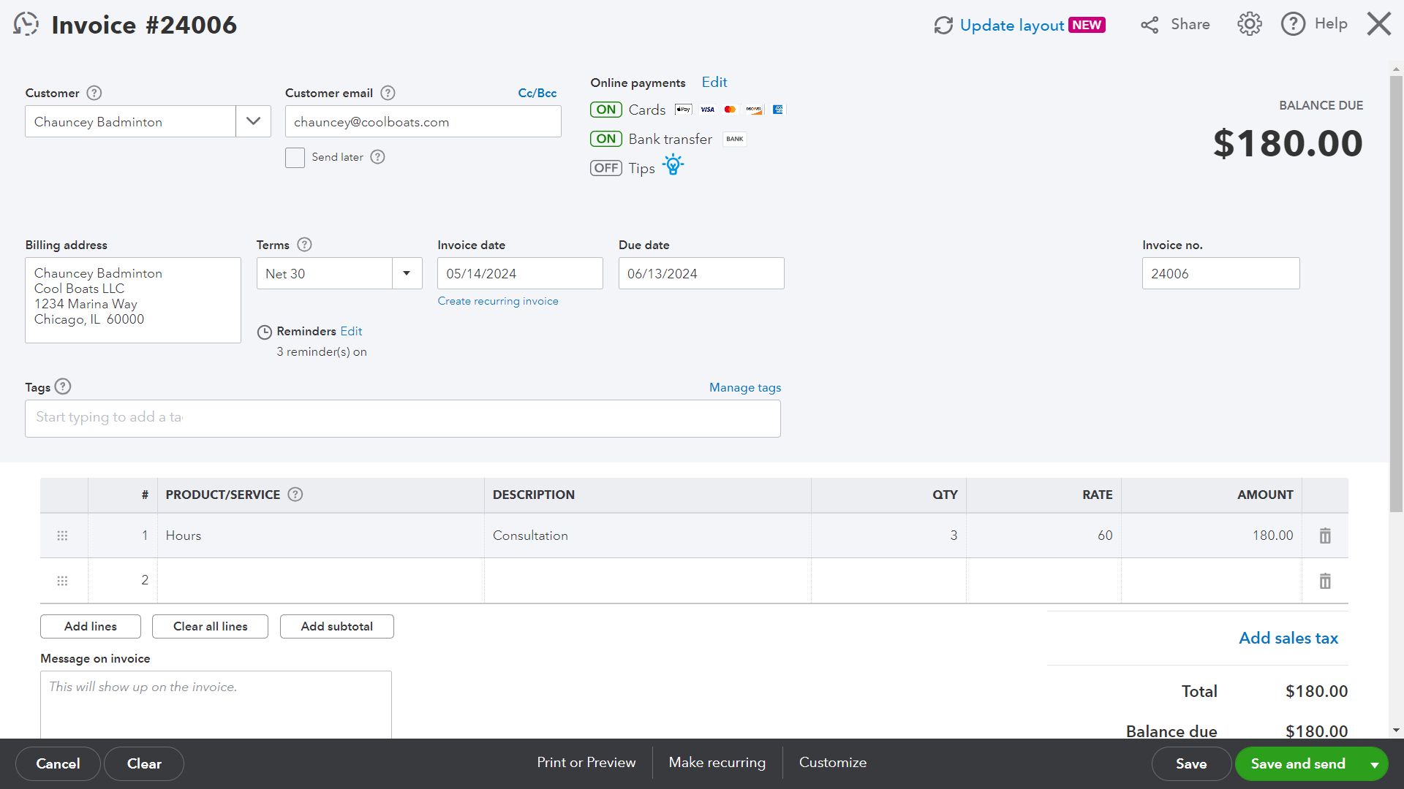
Making Sales: Invoices

Slide 16
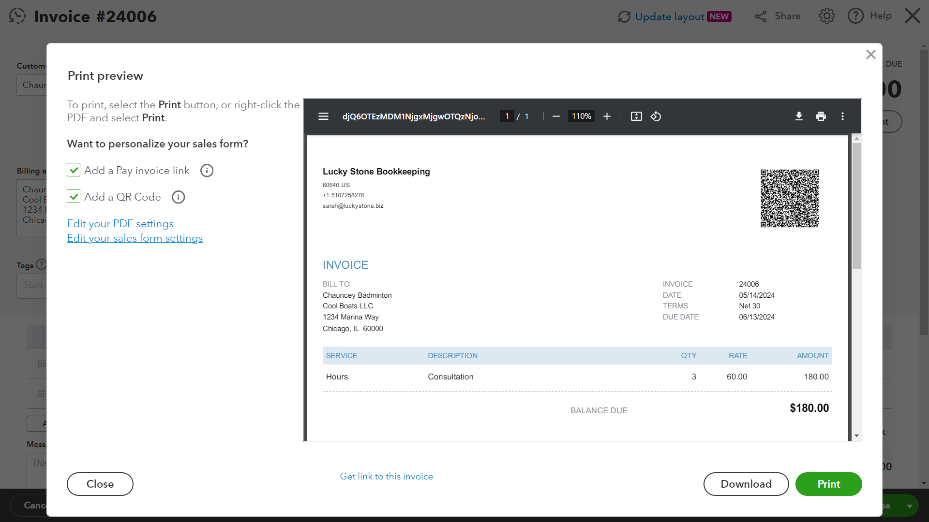
Making Sales: Invoices

Slide 17
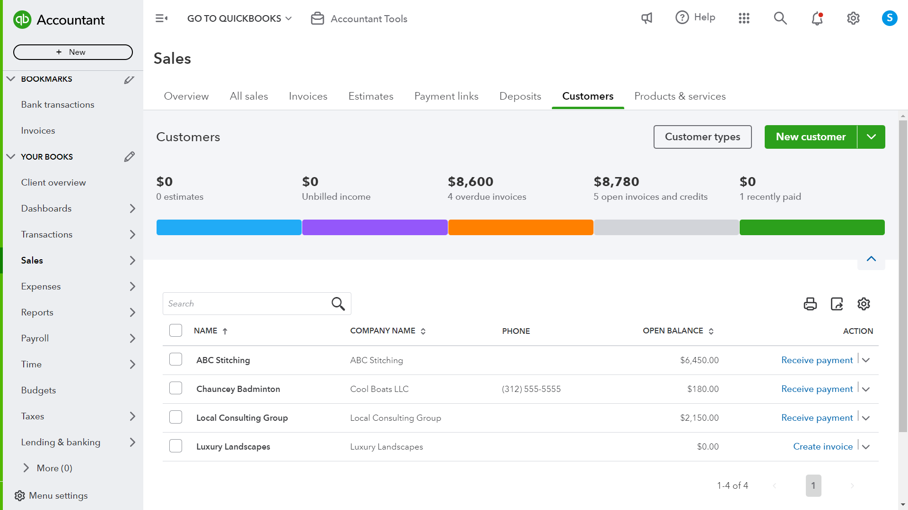
Making Sales: Invoices

Slide 18
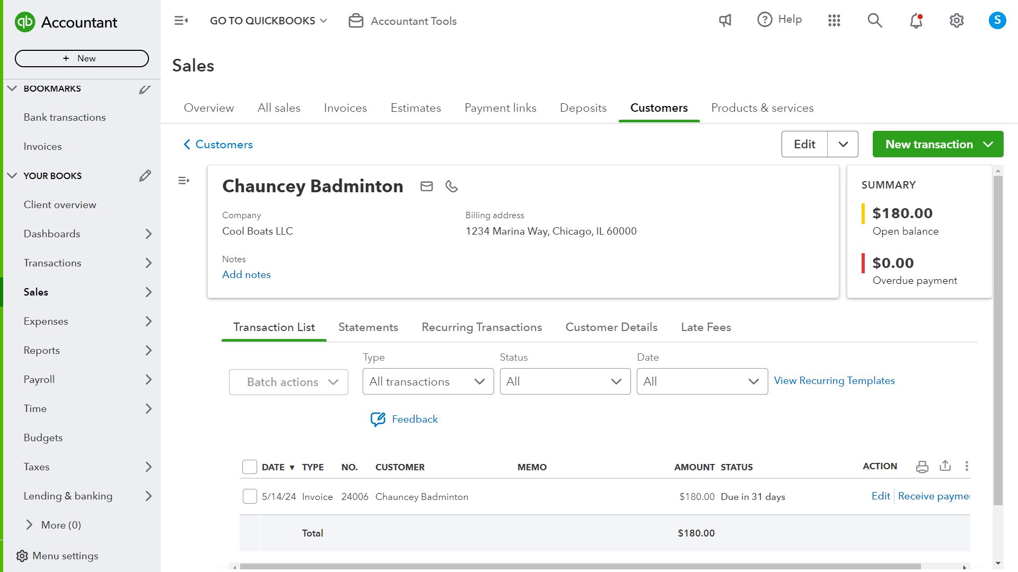
Making Sales: Invoices

Slide 19
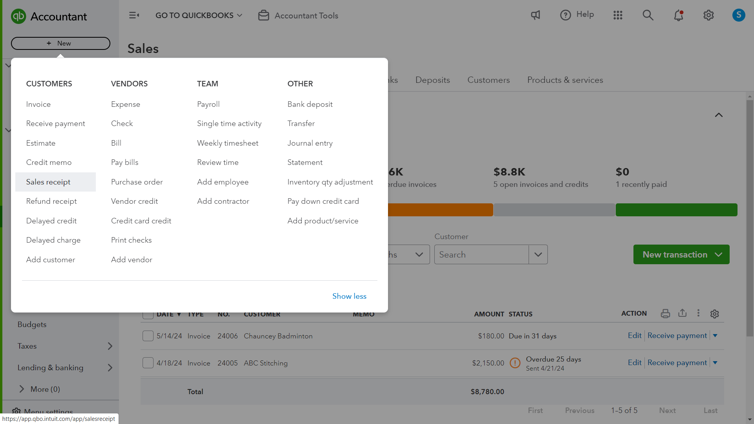
Making Sales: Receipts

Slide 20
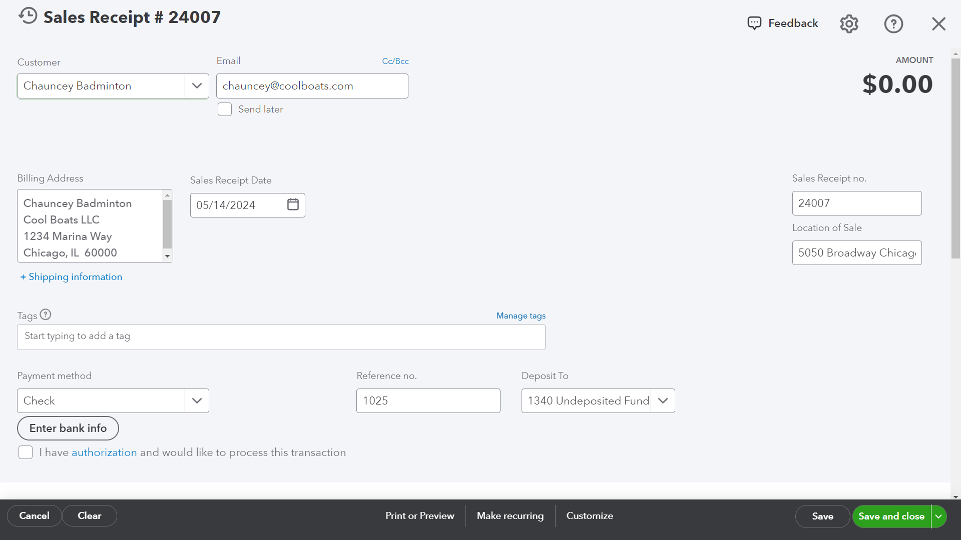
Making Sales: Receipts

Slide 21
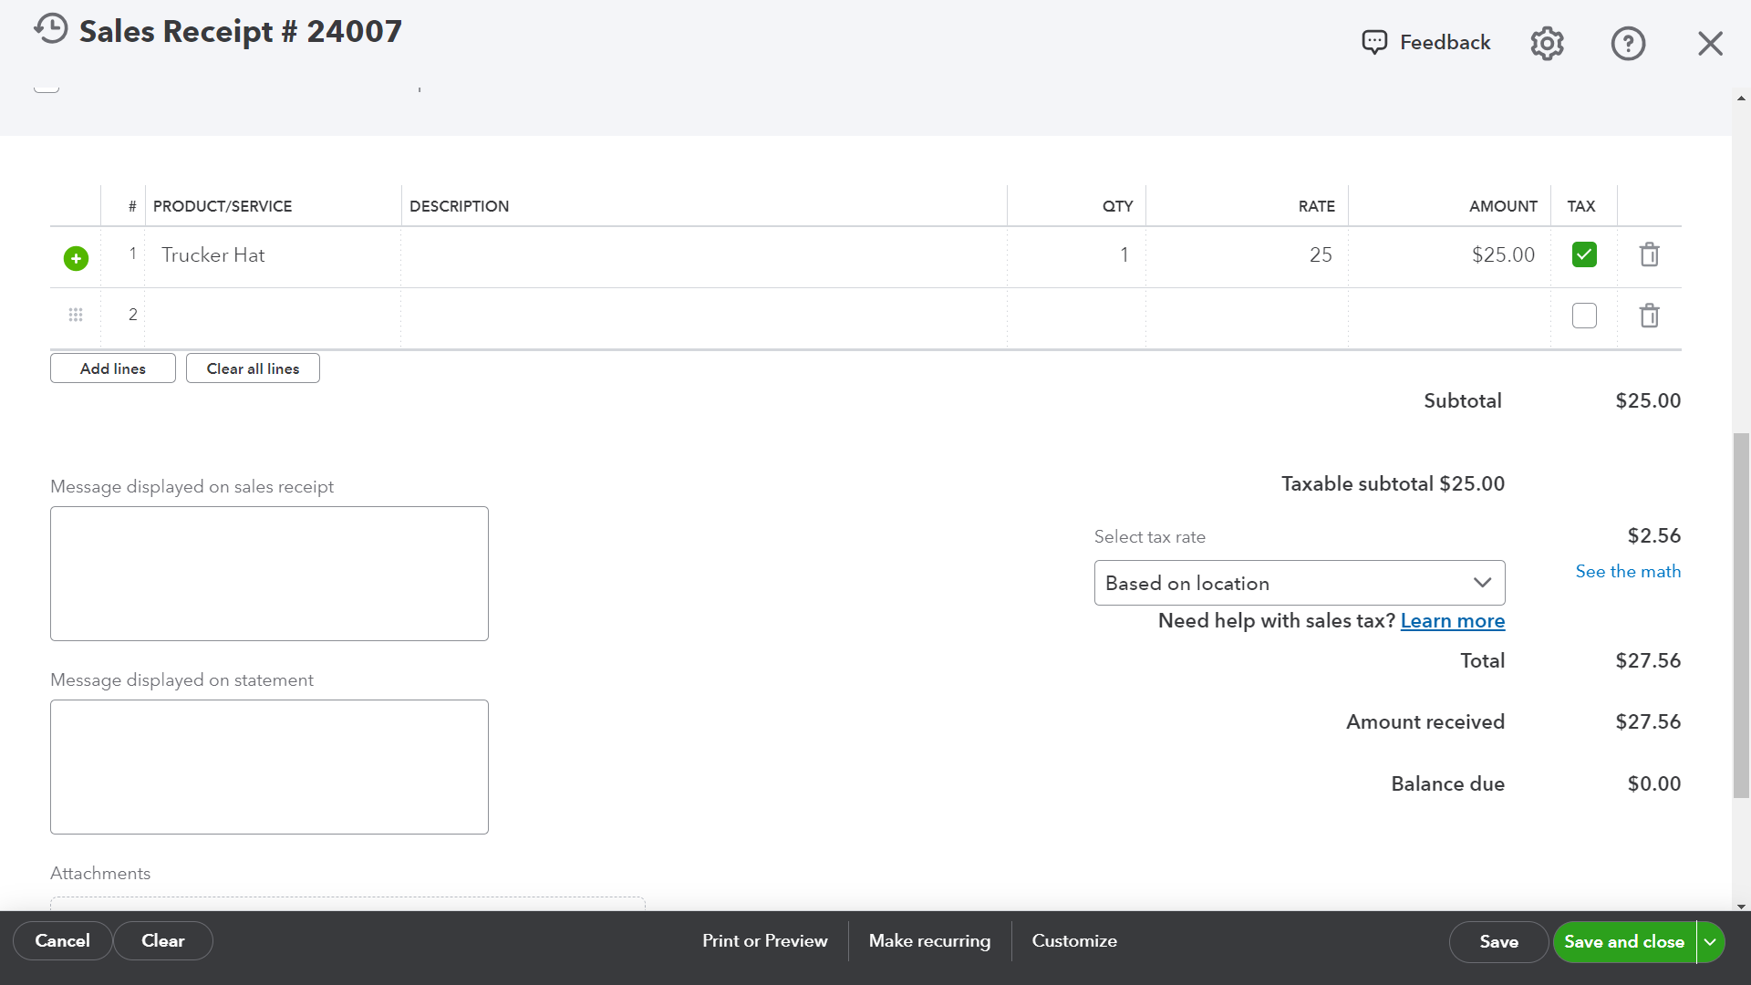
Making Sales: Receipts

Slide 22
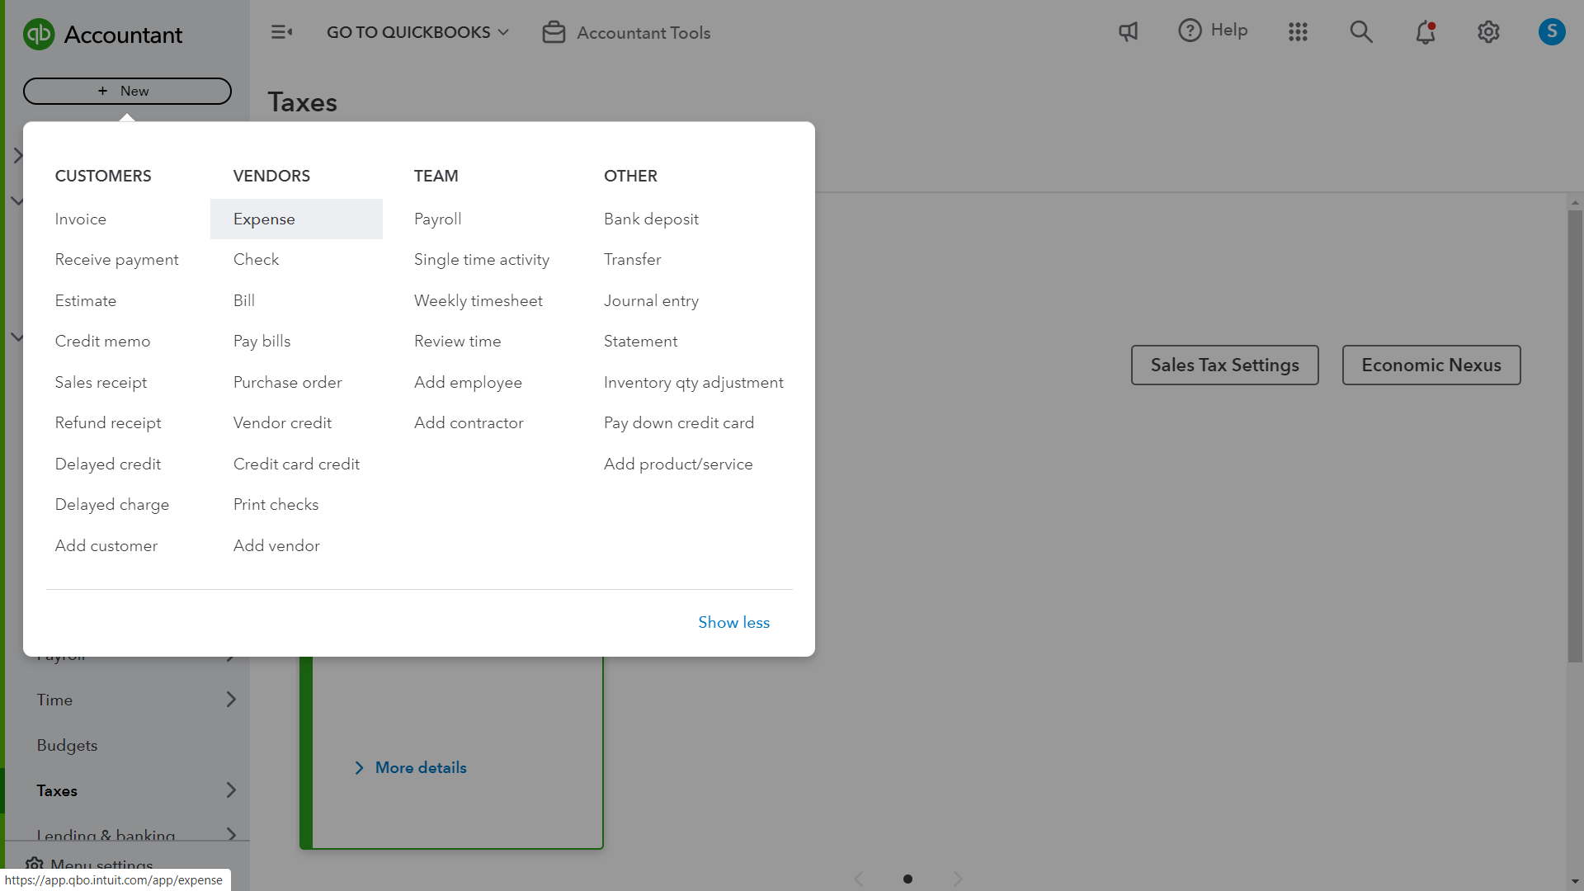
Paying: Expenses

Slide 23
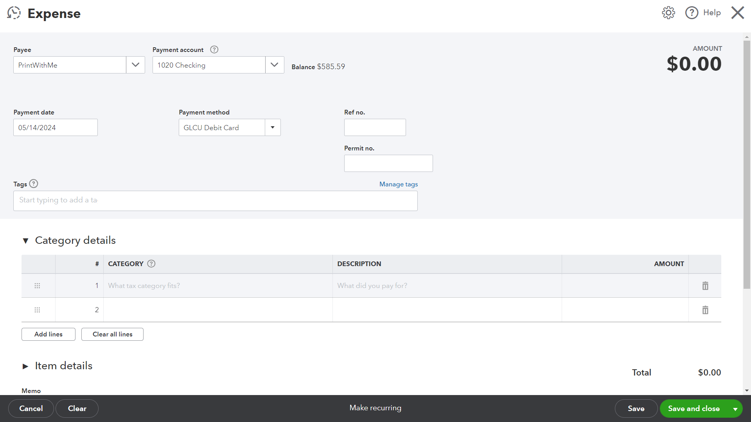
Paying: Expenses

Slide 24
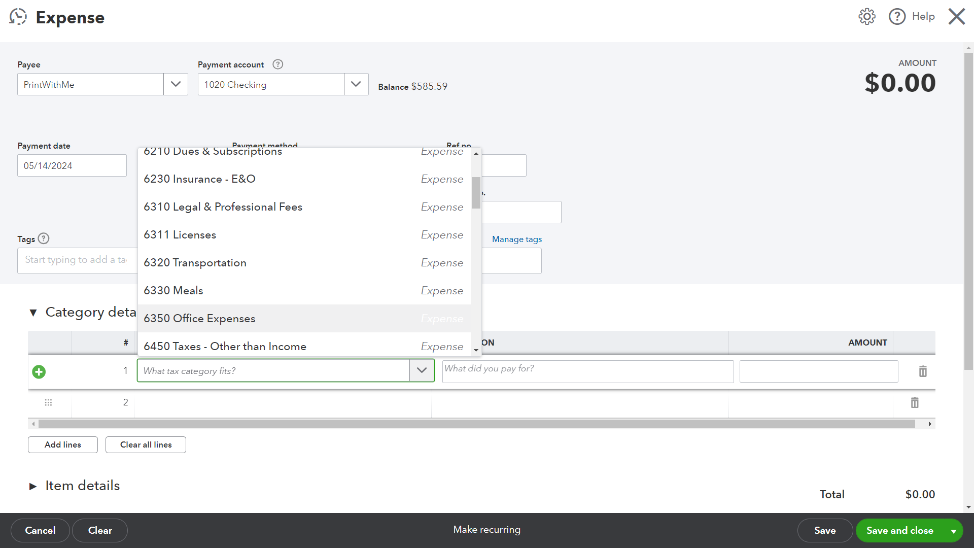
Paying: Expenses

Slide 25
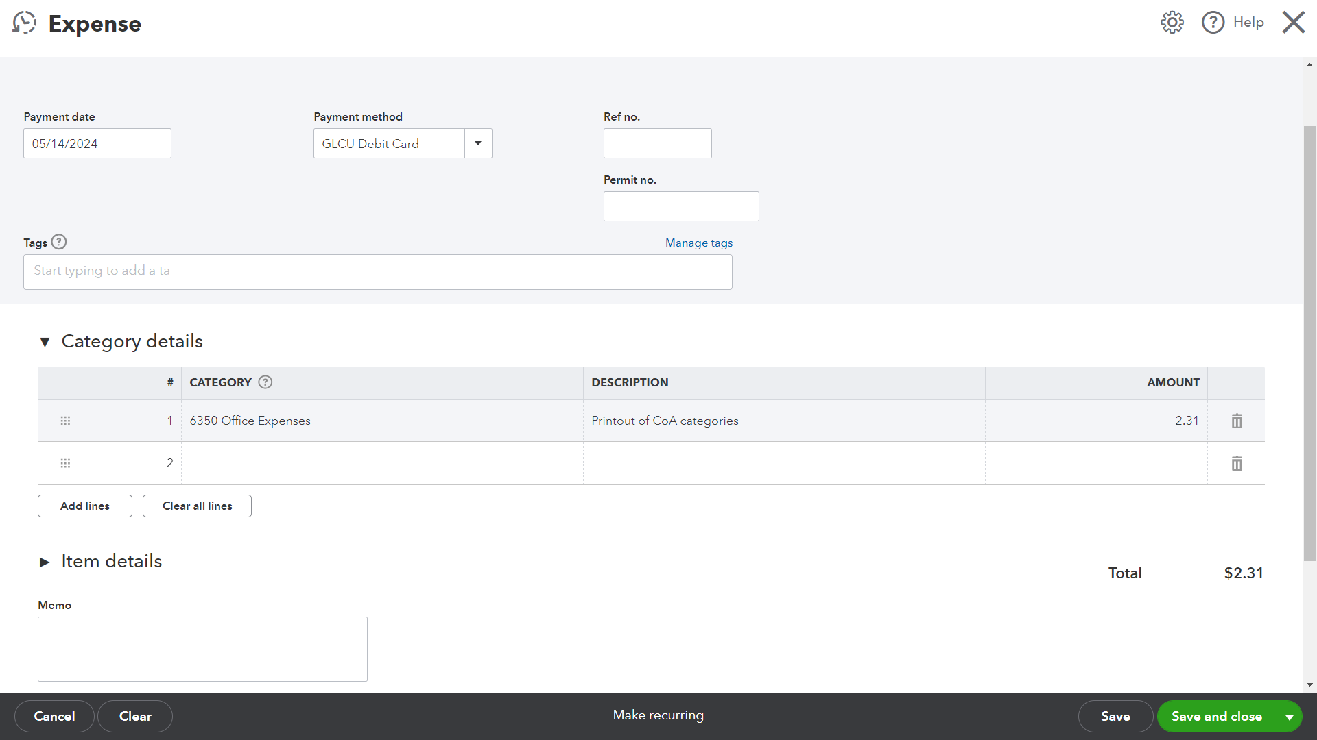
Paying: Expenses

Slide 26
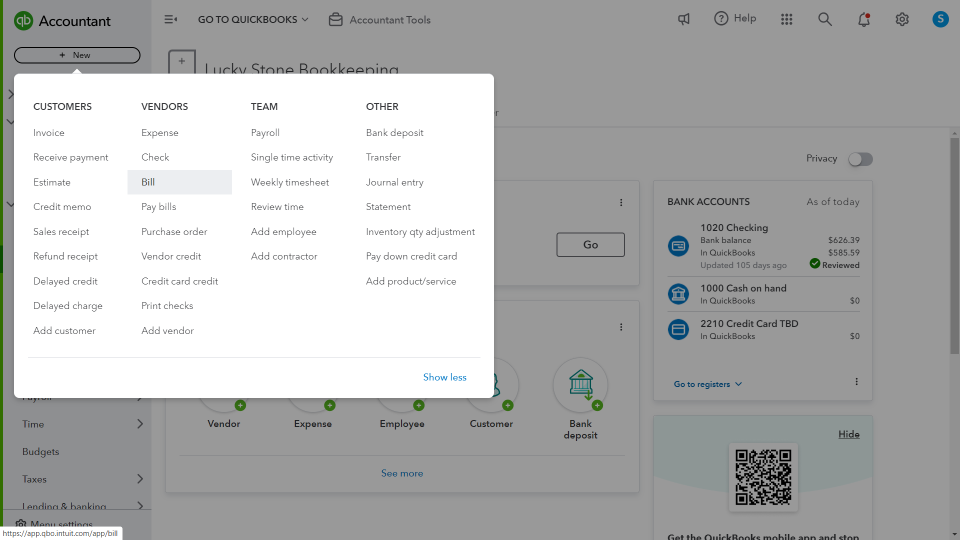
Paying: Bills

Slide 27
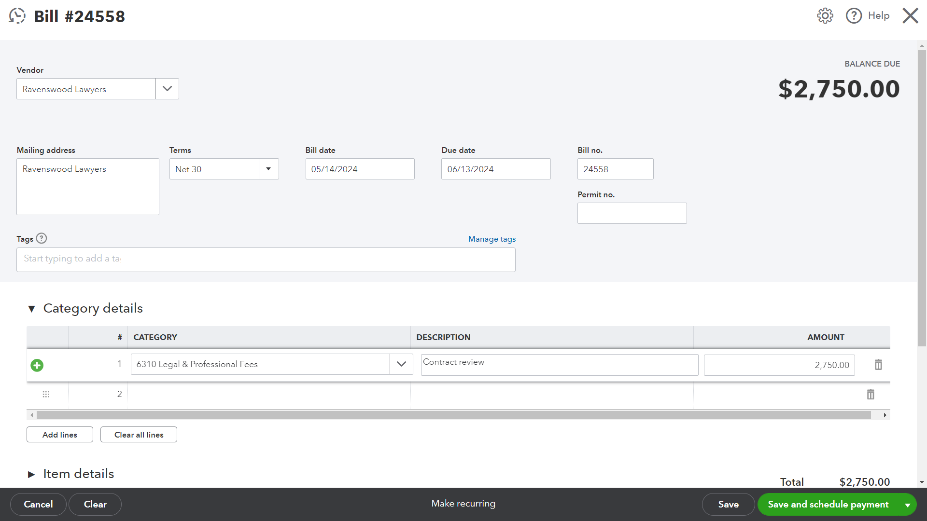
Paying: Bills

Slide 28
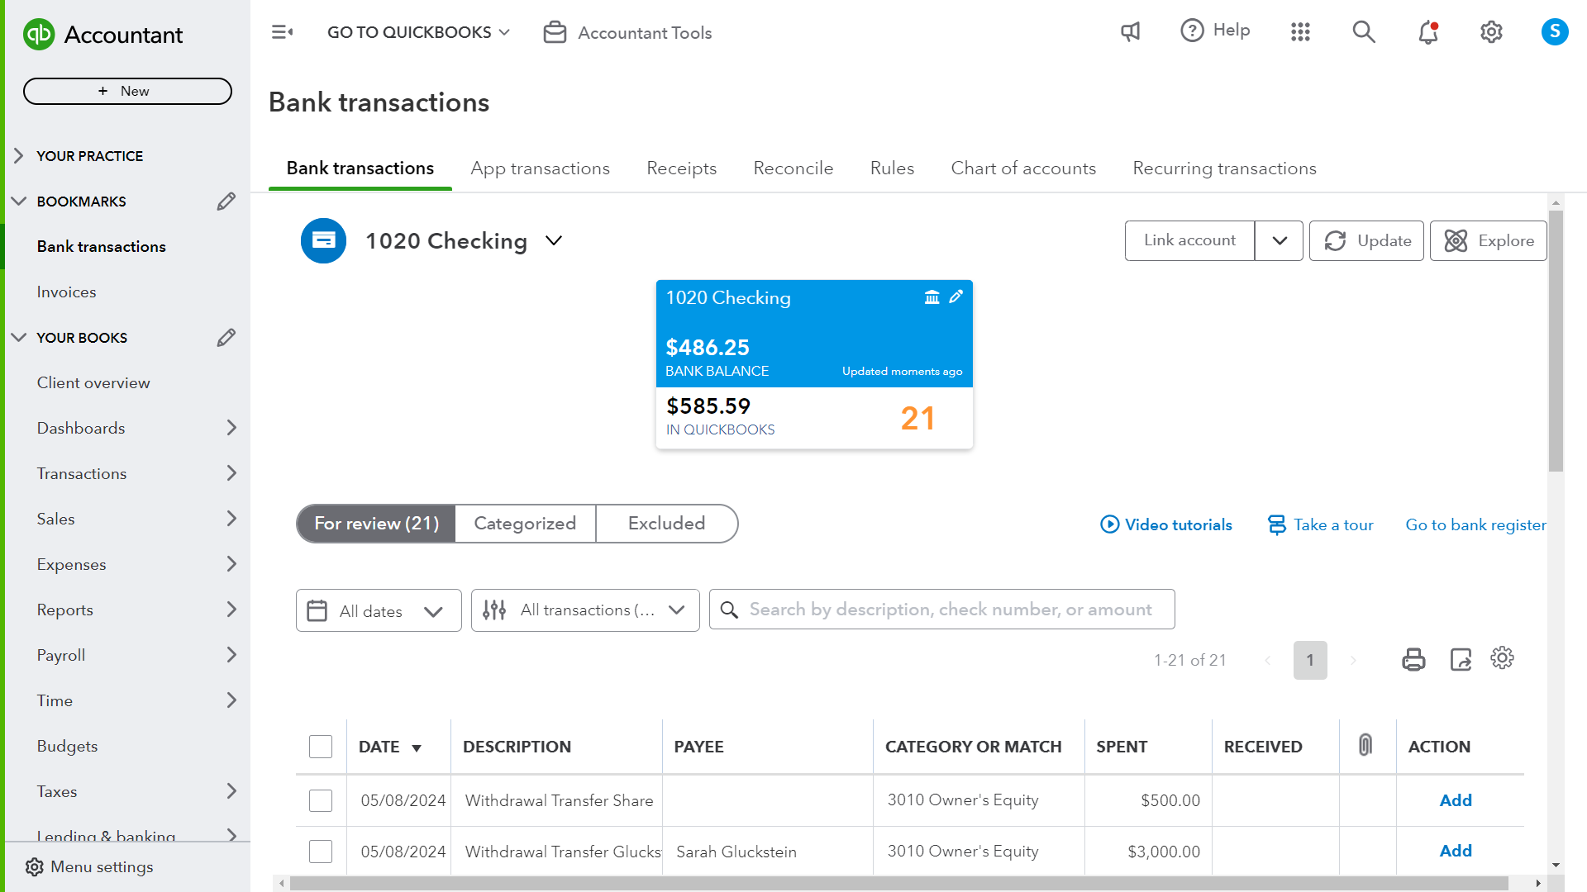
Bank Transactions

Slide 29
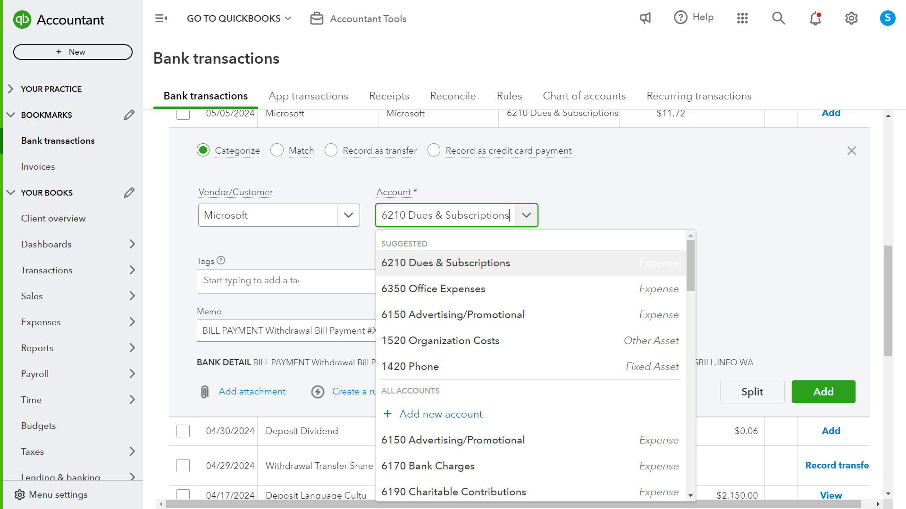
Bank Transactions: Categorizing

Slide 30
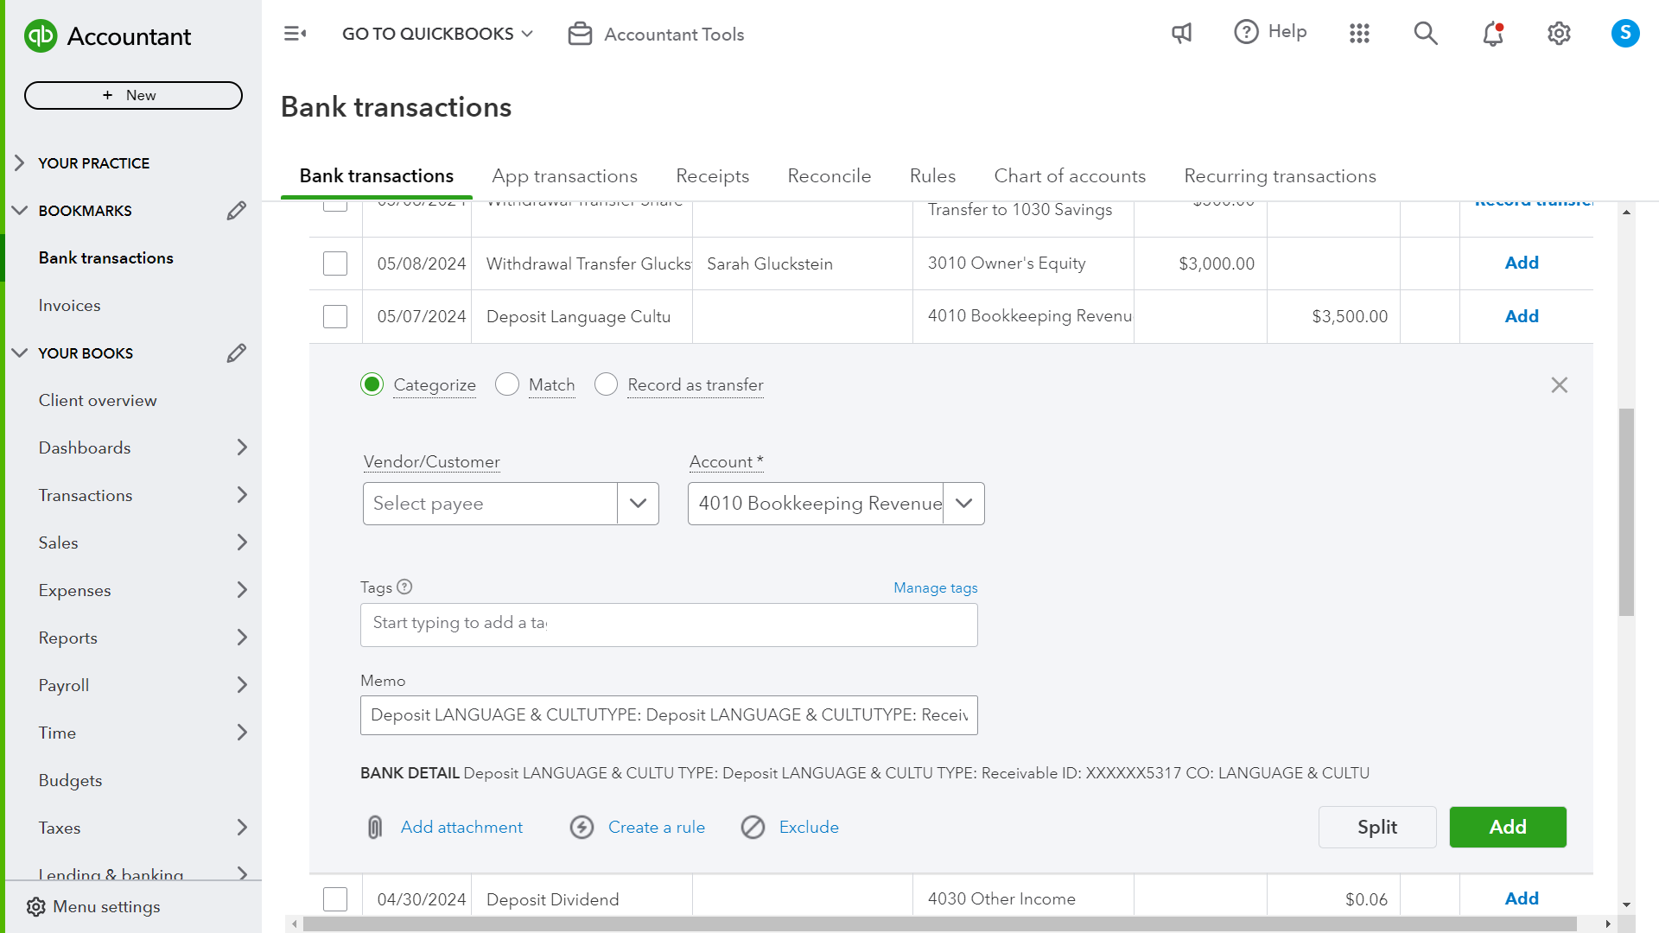
Bank Transactions: Matching

Slide 31
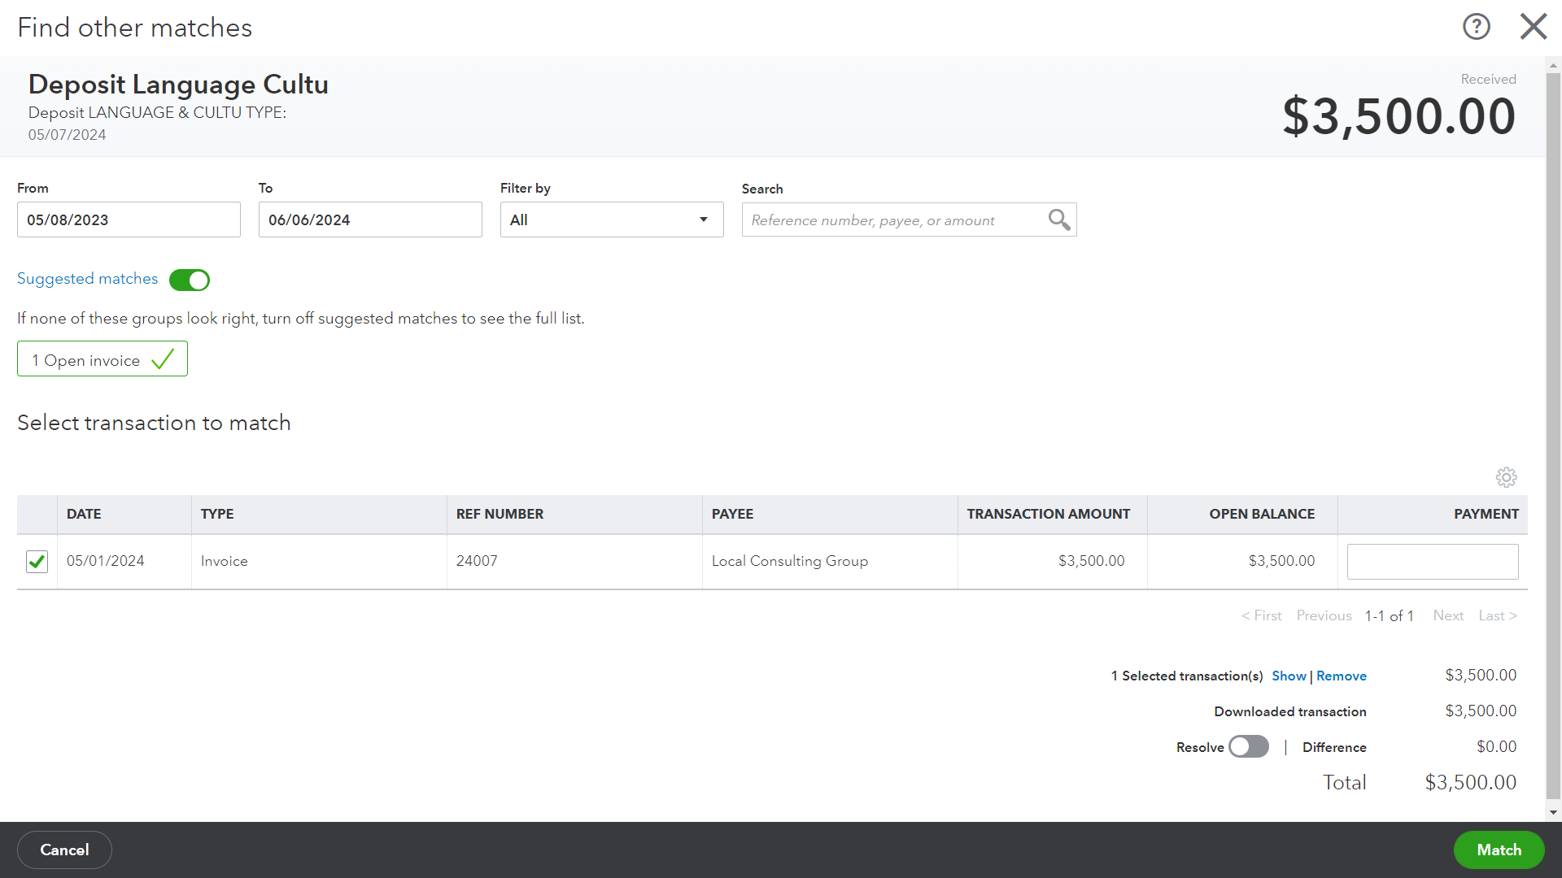
Bank Transactions: Matching

Slide 32
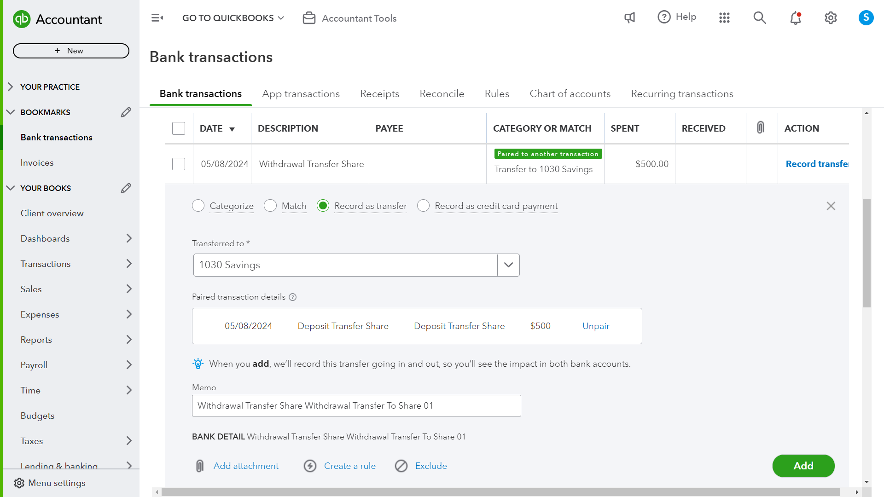
Bank Transactions: Transfers

Slide 33
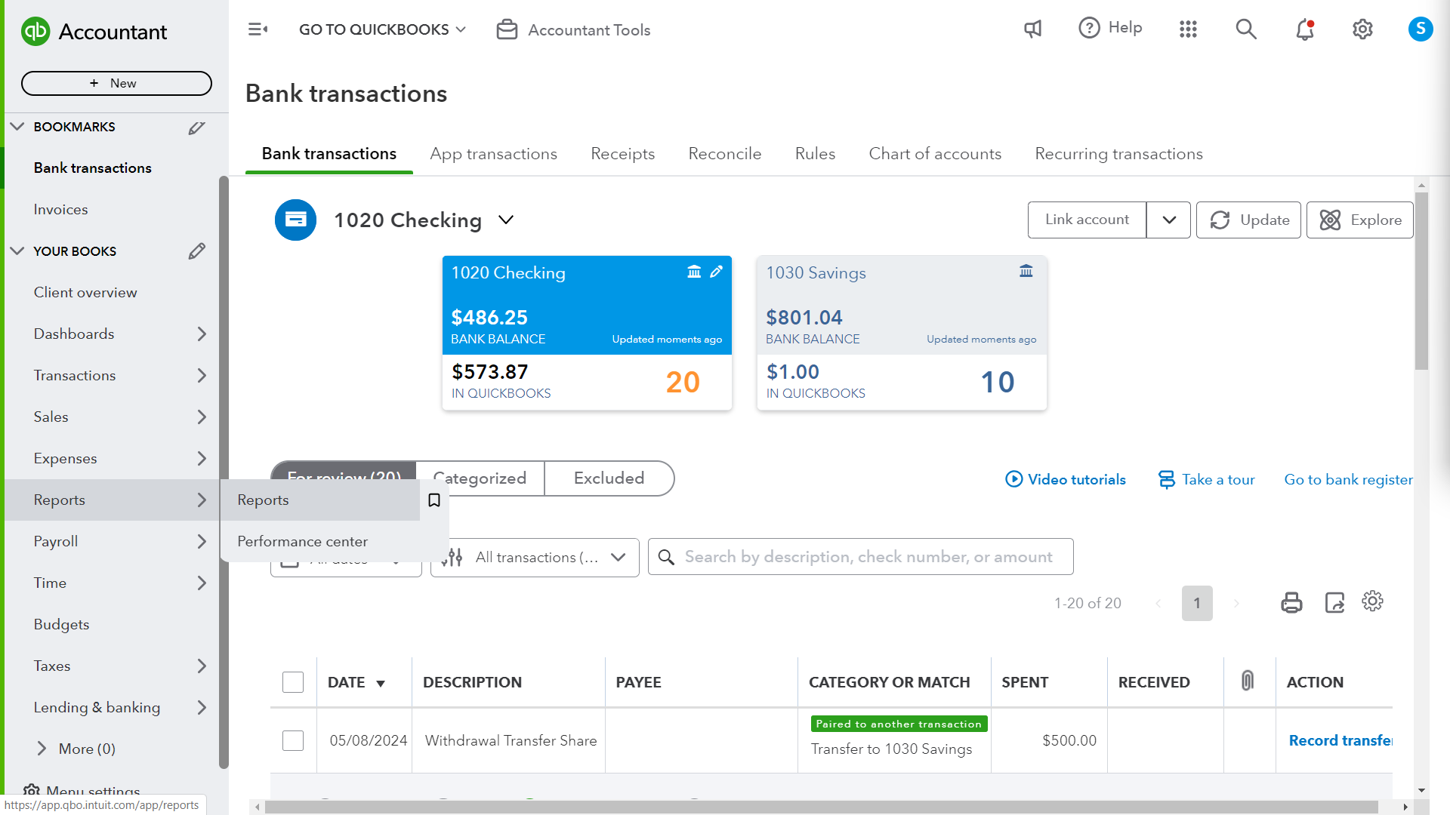
Reports

Slide 34
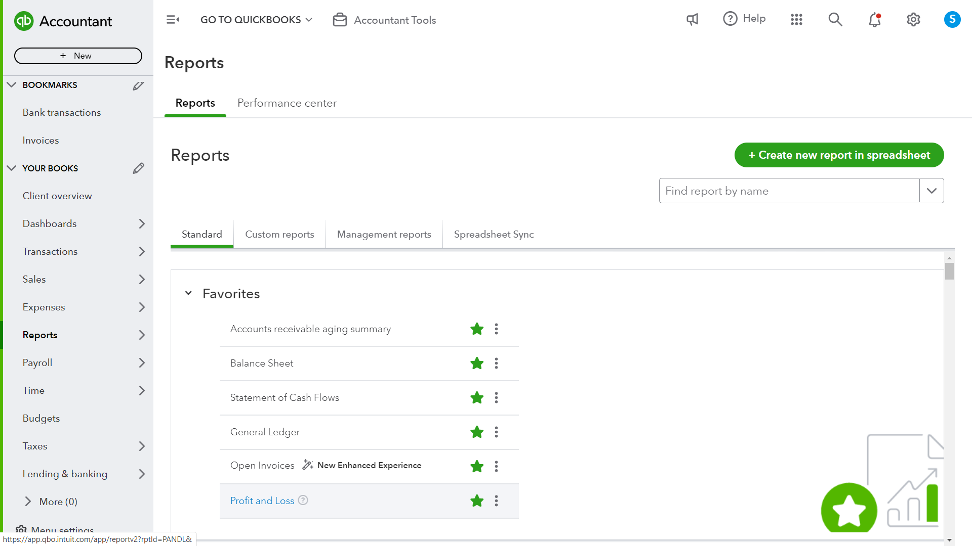
Reports

Slide 35
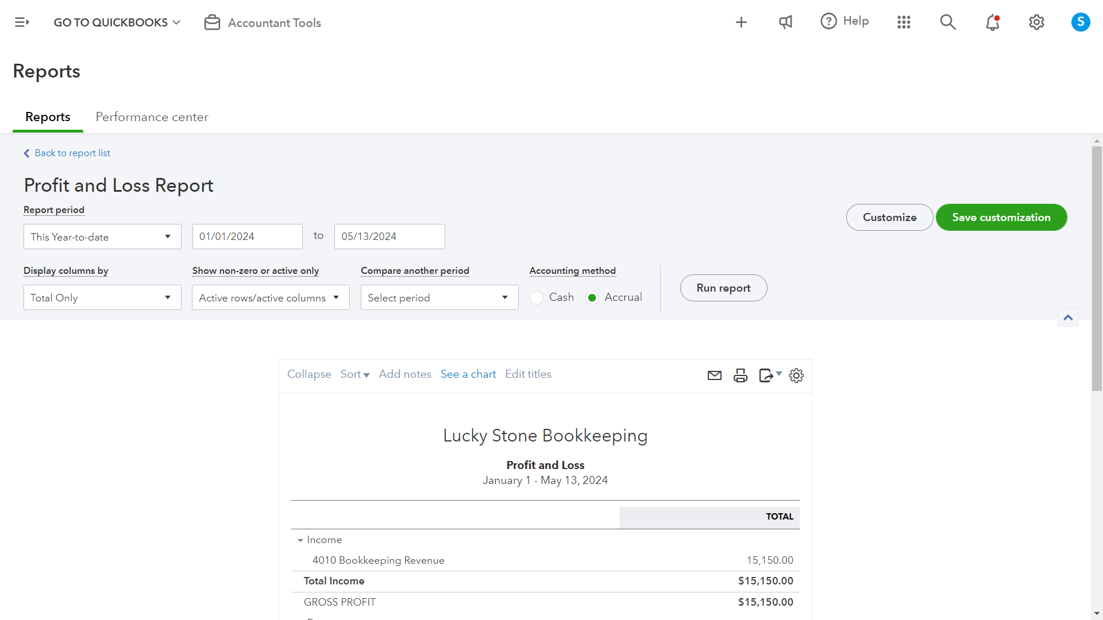
Reports

Slide 36
Thank you Uptown Chamber!
Record your finances
Make sales and pay vendors
Let me know if you have any questions!
There are lots of tutorials online, this is just a starter.
QBO has a built-in help function too.
Consult your bookkeeper or accountant for information about taxes and compliance.
QBO changes frequently, so positions and functions may change from what’s shown.
QuickBooks has an online directory of ProAdvisors that you can hire to help.
I am also available: sarah@luckystone.biz
Know what your business needs
Number go up!

