Slide 1
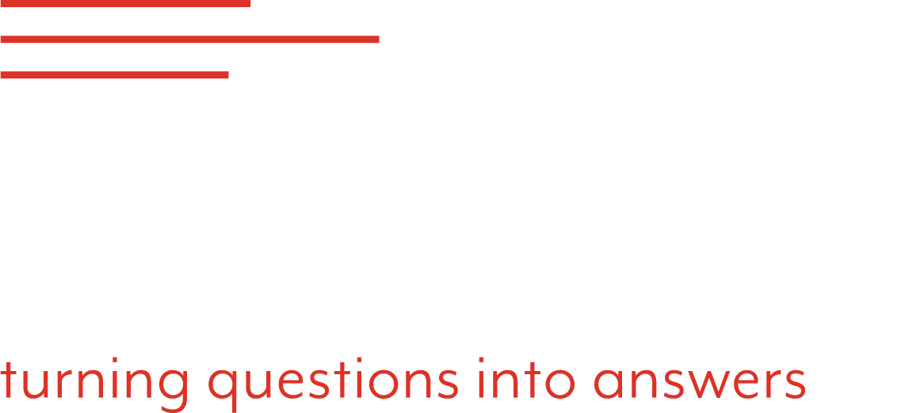


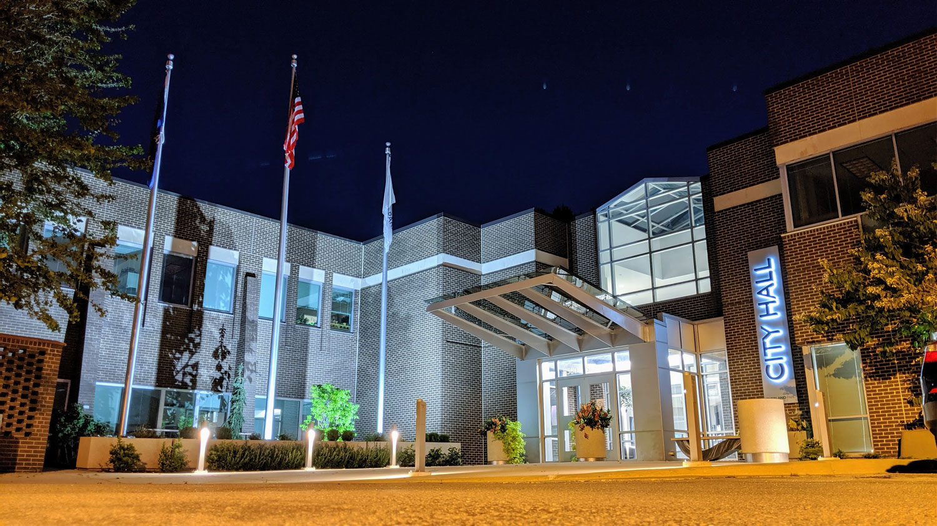
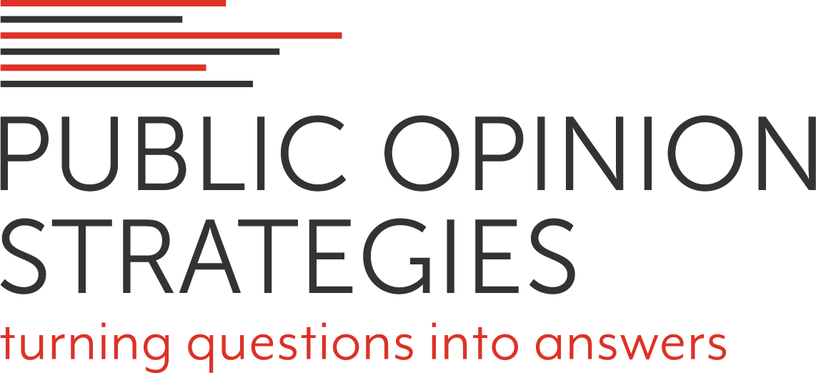
A Poll of 500
Overland Park Voters
September 21, 2021
PREPARED BY:
Neil Newhouse, Partner

Slide 2

METHODOLOGY
On behalf of Overland Park Chamber Foundation and the Home Builders Association of Greater Kansas City, Public Opinion Strategies completed a survey of 500 registered voters in Overland Park, Kansas.
One hundred eighteen respondents were contacted via landline and 382 via cell phone.
The survey was conducted May 22-25, 2021 and has a margin of error of +4.38%.

Slide 3
Take-Aways

Slide 4
KEY FINDINGS
Make no mistake, the mood of voters in Overland Park is extremely positive. Not only do they give the outgoing mayor very positive marks, but voters here rate the city government as responsive to their needs and as doing a good job handling their tax dollars. Further, nearly 90% of those interviewed agree that Overland Park is a welcoming community.

Slide 5
KEY FINDINGS
Reinforcing the general positive mood in the city is the finding that there are no dominant issues or concerns that voters are focused on. No single issue or concern is mentioned by more than 18% of Overland Park residents (crime/drugs), and 15% say there are no issues they are most concerned about or simply don’t know how to answer the question.
The city’s growth is really a focal point among residents, with 72% saying the city is “growing at about the right speed.” Those more likely to believe the city is growing too fast tend to be older, long-term residents.

Slide 6
KEY FINDINGS
Voters’ top priorities for their elected officials revolve around quality of life issues – K-12 schools, crime/public safety, economic development/jobs and access to quality health and mental health care. Interestingly, “keeping the mill levy low” falls toward the bottom of the list of priorities.
The discussion of taxes in the poll is illuminating. Fully 72% of residents polled said they believe that for the services they receive, the city taxes they pay are “about right,” with just 26% saying they are too high. But, there is little awareness that their local property taxes are significantly lower than their neighboring cities – just 11% say they believe they pay less than their neighbors. Even more surprising is the finding that 55% of respondents say that “it’s not all that important to them that Overland Park has the lowest property taxes in the area.”

Slide 7
KEY FINDINGS
These Overland Park voters are not as viscerally opposed to higher taxes as one might expect, especially if the taxes are viewed as enabling and facilitating their quality of life. In fact, a majority of voters support raising taxes for eleven of the fifteen priorities tested, led by support for mental health services, K-12 education and infrastructure – highways and city/neighborhood streets.

Slide 8
KEY FINDINGS
  Overland Park voters are truly divided on another key aspect of the growth of their city – housing options, specifically the construction of apartment complexes. Fully 40% of voters say they believe that the choice of housing options in the city is too limited, 50% believe that more apartment complexes are needed, and 64% say they support policies that ensure that lower cost residences can be built throughout the city.
  But, attitudes on this issue vary greatly based on the length of residency and age of the respondent. Clearly, some Overland Park voters fear that this new construction will negatively change the complexion of their city.

Slide 9
KEY FINDINGS
Finally, it’s clear that the images and reputations of Johnson County Community College and KU Edwards campus are strong and valued by local residents.

Slide 10
BOTTOM LINE
While Overland Park voters are overwhelmingly positive about the direction of the city, their quality of life and political leadership, the major concerns raised by voters revolve around how to manage the growth of the city. From traffic congestion to road repairs, from tax rates to the construction of apartment complexes, longer term residents fear the changes will disrupt their quality of life, while younger and shorter-term residents want to share in the glow of Overland Park.
No doubt, low tax rates are important and an attractive benefit of living in Overland Park. But, they are not the end-all and be-all. Overland Park voters don’t even recognize that their property tax rates are lower than their neighbors and, just as importantly, they really don’t seem to care that much.

Slide 11
BOTTOM LINE
Residents simply don’t want to feel like they are being gouged, they want city government to watch their tax dollars carefully, and they want to maintain their quality of life. This is not to say that there won’t be significant push-back from voter groups opposed to higher taxes. Of course, there will be, and it could be strong. But if higher taxes are linked directly to solving issues like congestion, schools, teachers or mental health, they are likely to be embraced.
The bottom line here is that Overland Park’s political leadership is faced with the same issues that it has managed pretty effectively over the last 30-40 years – how to manage the growth of an appealing community that is a magnet for area residents because of its high quality of life.

Slide 12
Key Poll Findings

Slide 13
As we found nearly a decade ago, Overland Park voters overwhelmingly believe the city is headed in the right direction.
+43
+59
+52
+62
+65
Generally speaking, would you say that things in Overland Park are going in the right direction, or have they pretty seriously gotten off on the wrong track?

Slide 14
That optimism clearly cuts across geography.
+58
+71
+54
+58
+58
+50
Generally speaking, would you say that things in Overland Park are going in the right direction, or have they pretty seriously gotten off on the wrong track?

Slide 15
There isn’t a single issue that dominates voters’ concerns, but crime/drugs tops the list.
%Most Concerned
Crime/Drugs
Education
Economic
Growth/Transportation
Taxes
State/Local Government
Health Issues
Other/Local Issues
Energy/Environment
No Problems/Don’t Know
And, what would you say is the most important priority facing Overland Park's political leaders, that is the issue that you're most concerned about?

Slide 16
Overland Park voters overwhelmingly approve of the job Mayor Gerlach has done.
+55
+56
+50
+60
24%
Strongly
19%
Strongly
17%
Strongly
14%
Strongly
And, do you approve or disapprove of the job Carl Gerlach has done as the Mayor of Overland Park?

Slide 17
Voters agree that city government is responsive to its citizens and approve of the job city council is doing handling their tax dollars.
Overland Park city government is responsive to its citizens
Do you generally approve or disapprove of the job that the Overland Park City Council is doing in handling your tax dollars?
+59
+51
26%
Strongly
17%
Strongly
Do you agree or disagree with the following statement: Overland Park city government is responsive to its citizens./Do you generally approve or disapprove of the job that the Overland Park City Council is doing in handling your tax dollars?

Slide 18
Voters are also very positive toward Johnson County government.
+67
19%
Strongly
Do you agree or disagree with the following statement: Johnson County government is responsive to its citizens.

Slide 19
But, that positivity doesn’t extend to the state legislature.
+5
+9
-0-
-28
41%
Strongly
27%
Strongly
22%
Strongly
19%
Strongly
10%
Strongly
14%
Strongly
12%
Strongly
And, do you agree or disagree with the following statement: The Kansas State Legislature is responsive to its citizens.

Slide 20
Fully 72% of Overland Park voters rate the city extremely positively as a place to live.
72%
Generally speaking, how would you rate Overland Park as a place to live?

Slide 21
Voters are nearly unanimous in describing Overland Park as a “welcoming community.”
+80
+81
+77
+78
And, do you agree or disagree with the following statement: Overland Park is a welcoming community?

Slide 22
Most Overland Park residents believe the city is growing “at about the right speed,” though concern about growing too quickly increases with age.
 | 18-34 (19%) | 35-44 (24%) | 45-54 (17%) | 55-64 (19%) | 65+ (21%)
Too quickly | 8% | 16% | 32% | 32% | 31%
At about the right speed | 90% | 80% | 63% | 67% | 67%
Generally speaking, do you believe that Overland Park is growing too quickly, too slowly, or at about the right speed?

Slide 23
Issue Priorities for Overland Park Elected Officials

Slide 24
When voters were asked the importance of each of the following issues for the city’s elected officials…
Addressing poverty in Overland Park
Economic development and job growth
Pre-K through 12th grade schools
Having a variety of affordable housing options
Arts and cultural amenities
Crime and public safety
Public libraries
Creating community gathering and entertainment spaces in Overland Park
Keeping the city mill levy as low as possible
Improving access to mental health care
Bringing more diversity to city government
Improving access to quality health care
Expanding environmental sustainability policies
Higher education
Public transportation systems
Parks and recreation, bike and hike trails
Traffic congestion on city streets, that is, not US 69 or I-435
Traffic congestion on US 69

Slide 25
K-12 education, public safety, economic development and health care top the list.
%High Issue Priority
Pre-K through 12th grade schools
Crime and public safety
Improving access to mental health care (B)
Economic development and job growth
Improving access to quality health care (A)
Having a variety of affordable housing options
Addressing poverty in Overland Park
Bringing more diversity to city government (A)
Now, I'd like to read you a list of priorities that some people have suggested for Overland Park's political leaders. Given the need to prioritize limited taxpayer resources, please tell me whether you believe each one should be a top priority, a very high priority, a somewhat high priority…

Slide 26
Surprisingly, traffic/congestion issues and cultural amenities rank toward the bottom of the list.
%High Issue Priority
Higher education
Traffic congestion on city streets, that is, not US 69 or I-435
Expanding environmental sustainability policies
Creating community gathering and entertainment spaces in Overland Park
Traffic congestion on US 69
Arts and cultural amenities
Public libraries
Keeping the city mill levy as low as possible
Parks and recreation, bike and hike trails
Public transportation systems
Now, I'd like to read you a list of priorities that some people have suggested for Overland Park's political leaders. Given the need to prioritize limited taxpayer resources, please tell me whether you believe each one should be a top priority, a very high priority, a somewhat high priority…

Slide 27
On Other Issues…

Slide 28
When voters are asked about “chip seal”…
On the topic of repairing and resurfacing neighborhood streets…
Some people are against the resurfacing process known as chip seal because they say it is messy, and can pose a safety hazard to kids and bike riders.
Other people favor chip seal because they say it is the most cost-efficient maintenance process, provides quickest access for residents to use streets after application and lasts seven to nine years.
How about you? Do you favor or oppose using chip seal to resurface neighborhood roads, or isn't this an issue you care about?

Slide 29
Residents are evenly divided, with over one-quarter saying it’s an issue they don’t care about.
23%
Strongly
12%
Strongly
Do you favor or oppose using chip seal to resurface neighborhood roads, or isn't this an issue you care about?

Slide 30
The “chip seal” issue doesn’t appear to be driven by partisanship or political ideology.
-7
-9
+1
+1
-11
-5
27%
Strg
27%
Strg
23%
Strg
21%
Strg
23%
Strg
17%
Strg
18%
Strg
18%
Strg
10%
Strg
Do you favor or oppose using chip seal to resurface neighborhood roads, or isn't this an issue you care about?

Slide 31
There is a division of opinion regarding whether housing options in the city are “too limited.”
+16
+37
+22
-19
Do you believe that Overland Park residents have an appropriate variety of housing options, or do you believe the choice is too limited?

Slide 32
Shorter-term residents are more likely to believe that housing options are more limited.
+9
+26
+13
Do you believe that Overland Park residents have an appropriate variety of housing options, or do you believe the choice is too limited?

Slide 33
Voter opinion is divided on whether the city is allowing too many apartment complexes to be built.
-5
-36
-22
+4
+14
+16
And, do you think the city is allowing too many apartment complexes to be built, or do you believe that these apartment complexes are needed to provide lower cost housing alternatives in the city?

Slide 34

Again, this is an issue that divides voters by partisanship and length of residency.
+24
-17
-35
-25
-2
+8
And, do you think the city is allowing too many apartment complexes to be built, or do you believe that these apartment complexes are needed to provide lower cost housing alternatives in the city?

Slide 35
There is significant support for policies to ensure smaller, lower cost residences can be built throughout the city.
+29
+58
+28
+12
+21
+56
+48
On a different topic, do you support or oppose policies to ensure that smaller, lower cost homes like duplexes, townhouses and garden apartments can be built throughout the city?

Slide 36
On the issue of taxes, there is a general consensus that city taxes are “about right.”
26%
32%
28%
17%
Thinking about the city taxes you pay… do you believe that for the services you receive from Overland Park, that the city taxes you pay are too high, or are they about right?

Slide 37
Attitudes on taxes varies by political ideology, education level and income.
+10
+55
+67
+25
+55
+37
+50
+49
Thinking about the city taxes you pay… do you believe that for the services you receive from Overland Park, that the city taxes you pay are too high, or are they about right?

Slide 38
When Overland Park voters are asked about the level of property taxes they pay compared to their neighbors…
Generally speaking, do you believe that Overland Park's property taxes are higher than, less than or about the same as its neighboring cities such as Lenexa, Olathe, Shawnee, Prairie Village and Leawood?

Slide 39
Only 11% (!) believe their property taxes are less than neighboring cities.
Generally speaking, do you believe that Overland Park's property taxes are higher than, less than or about the same as its neighboring cities such as Lenexa, Olathe, Shawnee, Prairie Village and Leawood?

Slide 40
And, fewer than half say that it’s important (very/extremely) that OP’s property taxes are significantly lower than their neighbors.
-12
+17
-13
-41
39%
Not Very
26%
Not Very
29%
Extremely
28%
Not Very
19%
Extremely
18%
Extremely
13%
Not Very
As you may know, Overland Park's property taxes are significantly lower than any of its neighbors. How important is it to you that Overland Park have the lowest property tax rates in the area...

Slide 41
Attitudes don’t differ all that much by age or income level.
-15
-10
-6
-27
-7
-2
-18
-12
31%
Not
Very
31%
Not
Very
25%
Ext
27%
Not
Very
27%
Not
Very
27%
Not
Very
22%
Not
Very
23%
Not
Very
21%
Ext
23%
Ext
19%
Not
Very
15%
Ext
19%
Ext
17%
Ext
19%
Ext
13%
Ext
As you may know, Overland Park's property taxes are significantly lower than any of its neighbors. How important is it to you that Overland Park have the lowest property tax rates in the area...

Slide 42
There is strong support across party lines for renewing the 1/8th cent sales tax.
+73
+67
+68
+86
57%
Strongly
47%
Strongly
45%
Strongly
41%
Strongly
%
Strongly
%
Strongly
%
Strongly
10%
Strongly
As you may know, Overland Park has a one-eighth of a cent sales tax dedicated to neighborhood and city street reconstruction which is up for renewal in 2023. Do you support or oppose renewal of this sales tax?

Slide 43
Willingness to Pay Higher Taxes?

Slide 44
While no one wants to pay higher taxes, these Overland Park Voters were asked whether they would be willing to pay increased taxes if the money were to be used solely for this purpose…
Providing mental health education and services
Expanding broadband access and capacity
Expanding higher education offerings in the county to include more trade and tech certifications and Bachelor's, Master's and PhD programs.
Improving pre-K through 12 education through lower class sizes and all-day kindergarten
Improving public transportation
Providing funding for Johnson County Community College to expand its offerings
Maintaining and improving city thoroughfares and neighborhood streets
Improving arts and cultural amenities
Increasing teacher salaries in local schools
Building a new city hall
Creating engaging, sustainable public gathering and entertainment spaces
Eliminating chip seal as the method to maintain neighborhood streets
Expanding and improving local parks, hike and bike trails
Improving highway infrastructure
Making city government more environmentally sustainable

Slide 45
Mental health services, K-12 schools and teacher salaries top the list of priorities that voters would be willing to pay higher taxes for, closely followed by infrastructure needs.
+68
+65
+54
+53
+44
+28
+26
Providing mental health education and services (B)
Improving pre-K through 12 education through lower class sizes and all-day kindergarten (A)
Increasing teacher salaries in local schools
Maintaining and improving city thoroughfares and neighborhood streets (A)
Improving highway infrastructure (B)
Expanding higher education offerings in the county to include more trade and tech certifications and Bachelor's, Master's and PhD programs. (B)
Providing funding for Johnson County Community College to expand its offerings (A)
Now, I'd like to ask you a few questions about tax increases… No one likes to pay higher taxes, but please tell me for each of the following if you would be willing to pay higher local taxes if the money were to be used solely for this purpose…

Slide 46
Creating new public gathering spaces and building a new city hall fall at the bottom of the “willing to pay for” list.
+21
+17
+13
+6
-7
-16
-35
-79
Expanding and improving local parks, hike and bike trails (A)
Making city government more environmentally sustainable (A)
Expanding broadband access and capacity (A)
Improving public transportation (B)
Improving arts and cultural amenities (A)
Eliminating chip seal as the method to maintain neighborhood streets (A)
Creating engaging, sustainable public gathering and entertainment spaces (B)
Building a new city hall (B)
Now, I'd like to ask you a few questions about tax increases… No one likes to pay higher taxes, but please tell me for each of the following if you would be willing to pay higher local taxes if the money were to be used solely for this purpose…

Slide 47
One Key Take-Away:
Of the fifteen issues tested, only four issues failed to hit the 50% mark for raising taxes. This seems to indicate that the city’s political leaders have latitude in judiciously raising taxes to address some of these priorities.
(A majority of Republicans supported raising taxes for seven of these priorities, while Independents and Democrats supported raising taxes for twelve of them.)

Slide 48
JCCC has an overwhelmingly favorable image in the community, with three-quarters of voters agreeing it is critical for economic development.
Do you have a favorable or unfavorable impression of Johnson County Community College?
And, do you agree or disagree with the following statement: Higher education at Johnson County Community College is critical for economic development.
+94
+57
50%
Strongly

Slide 49
KU’s Edwards campus also scores well on these measures, though a couple of notches below JCCC.
Do you have a favorable or unfavorable impression of the University of Kansas Edwards Campus?
And, do you agree or disagree with the following statement: Higher education at the University of Kansas Edwards Campus is critical for economic development.
+68
+25
32%
Strongly

Slide 50
JCCC also has an advantage on “preparing a workforce that is ready for the jobs and careers of today and in the future.”
Johnson County Community
College is preparing a workforce that is ready for the jobs and careers of today and in the future.
The University of Kansas Edwards
Campus is preparing a workforce that is ready for the jobs and careers of today and in the future.
+79
+52
48%
Strongly
23%
Strongly
And, do you agree or disagree with the following statement:

Slide 51

Neil Newhouse
Partner
Phone: (703) 836-7655
Email: neil@pos.org
Twitter: @KCkid

