Slide 1
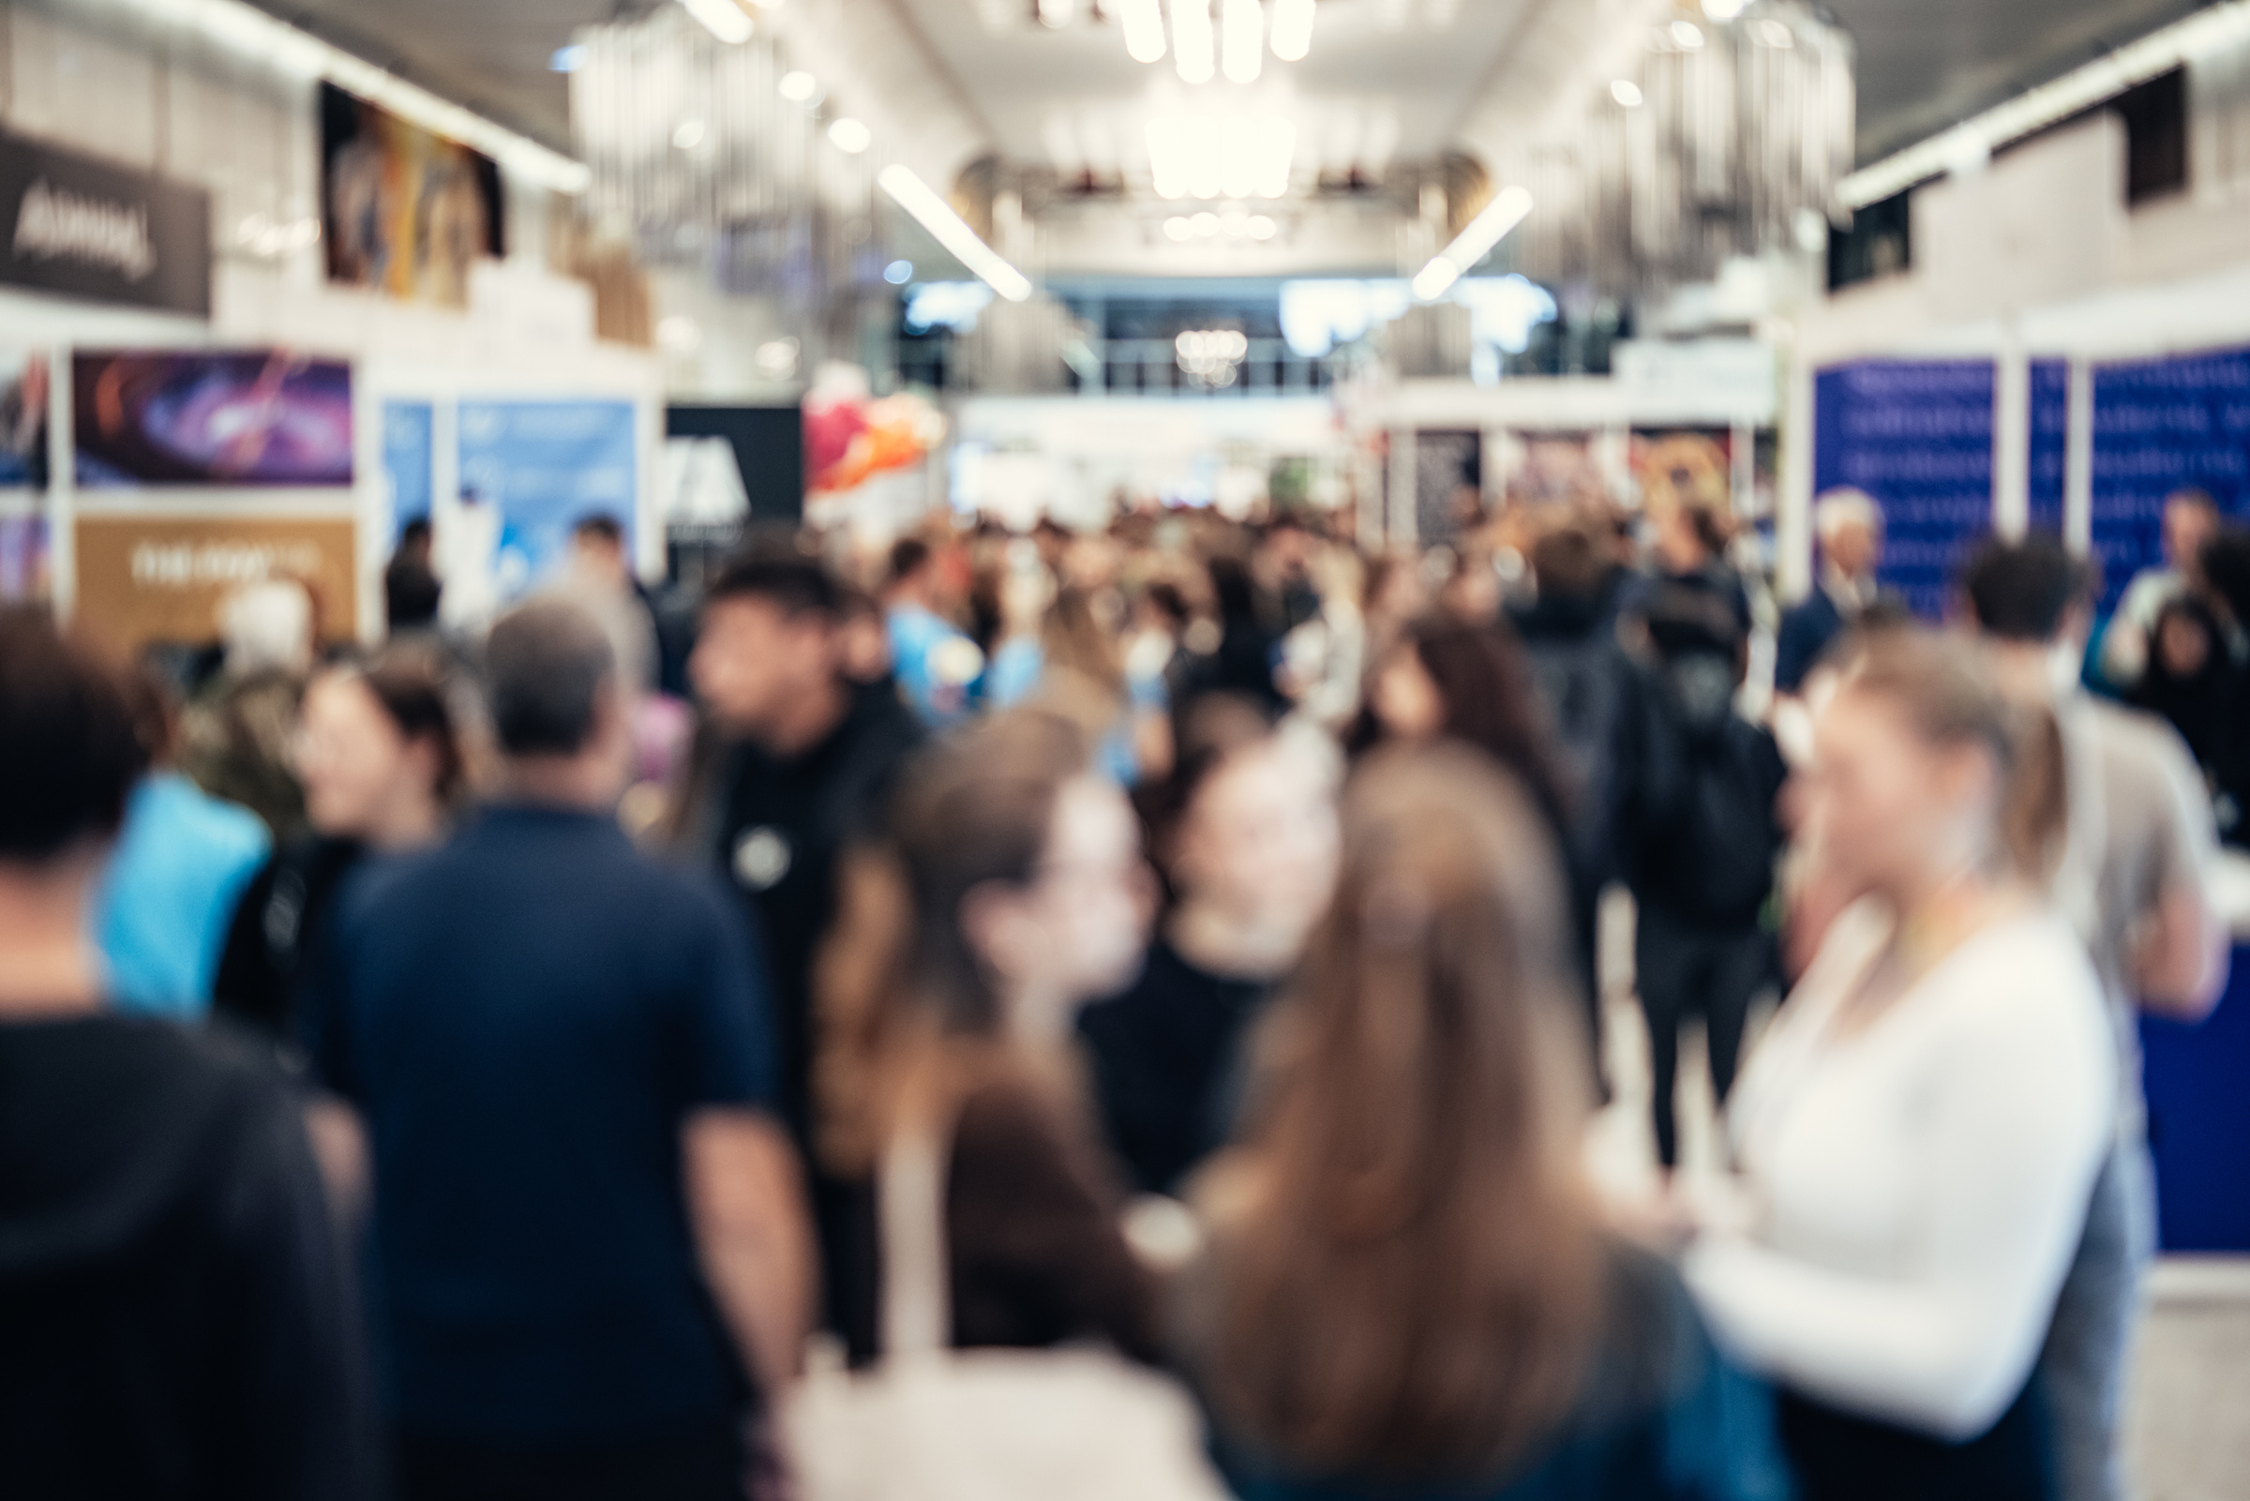




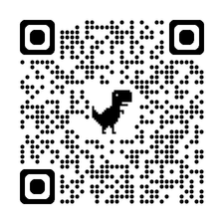
Thank You to Our
Exclusive Sponsors!
EXPO
Managed By:
Insert
Logo
Here
Proud Distributor Partner
  View over 200+ booths of industry products/services.
  PDH offering on all seminars.
  19 presentations by industry subject matter experts.
  IAEI-Eastern Missouri “Analysis of 2026 NEC *fulfills City of St. Louis Licensing REquirements for this code cycle.
  Register before August 1st AND attend the Expo-to be eligible for gift cards, Big Green Egg, Blackstone Grill, or Nintendo Switch.
  New Product Showcase featuring cutting -edge industry products and services.
Register
Today!
St. Charles Convention Center | St. Charles, MO | electricalboard.org

