Slide 1


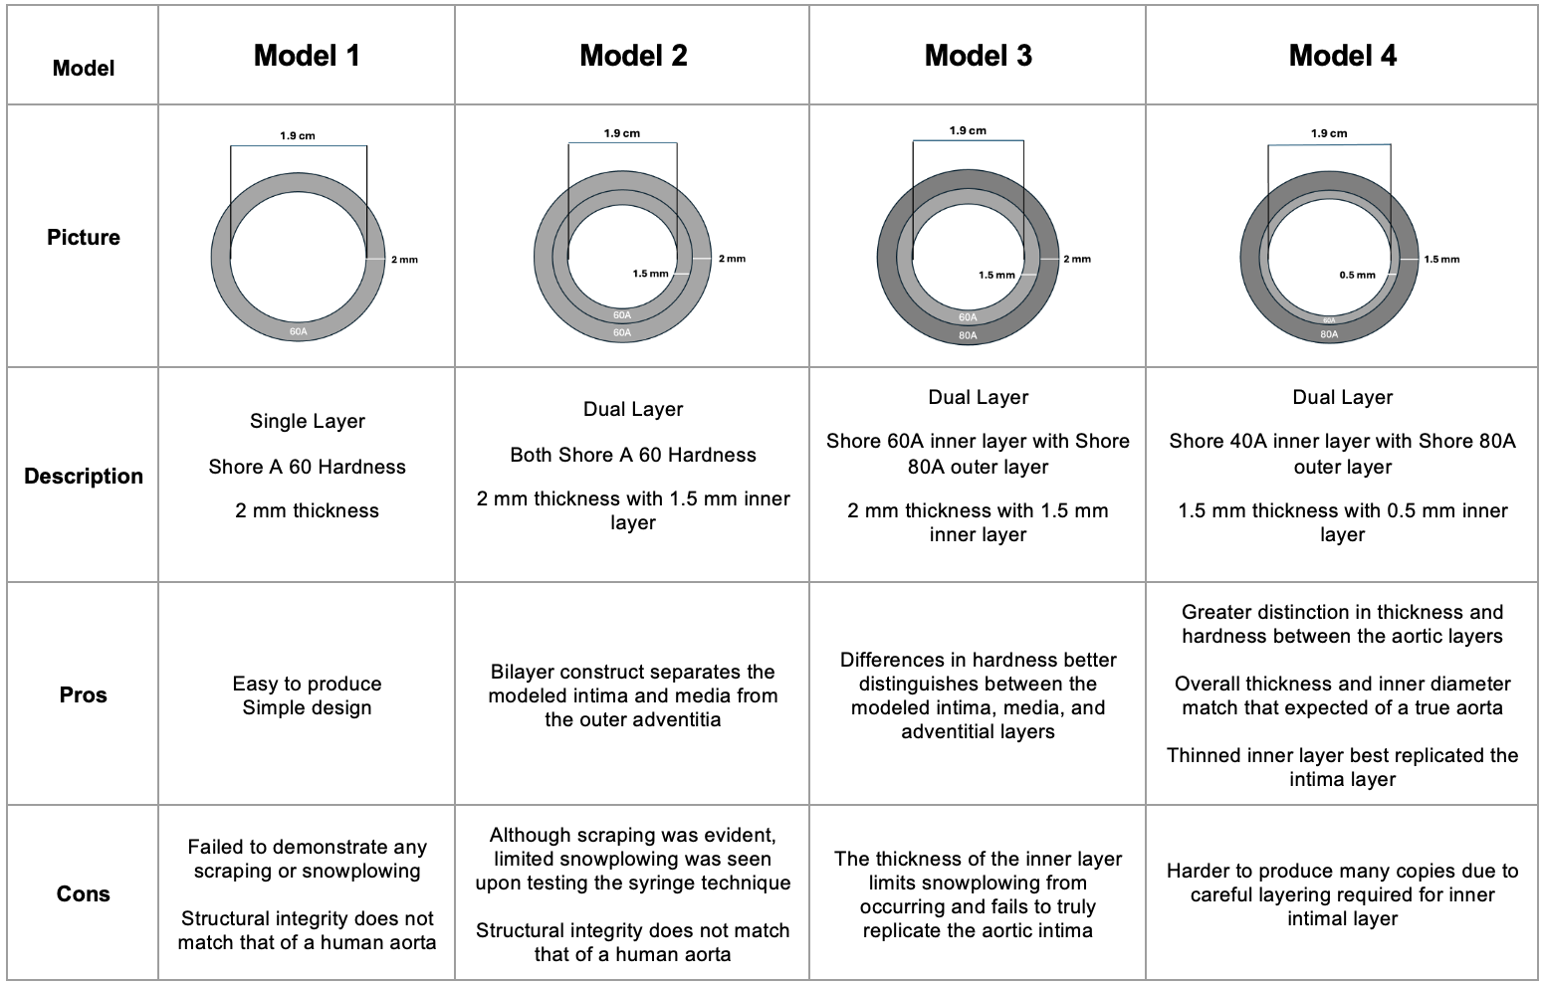
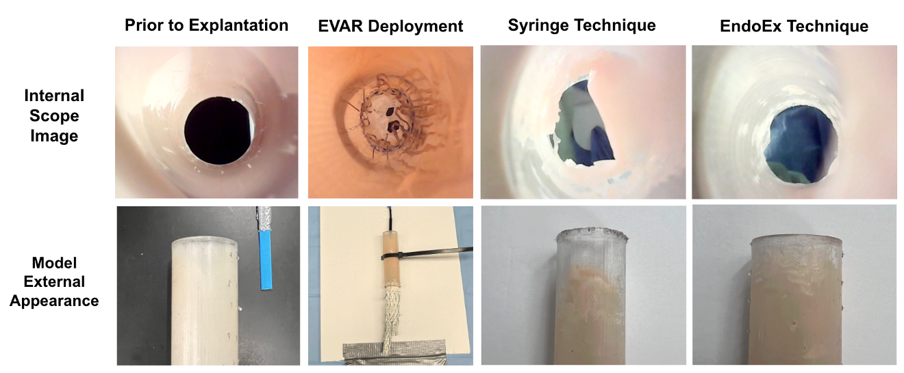
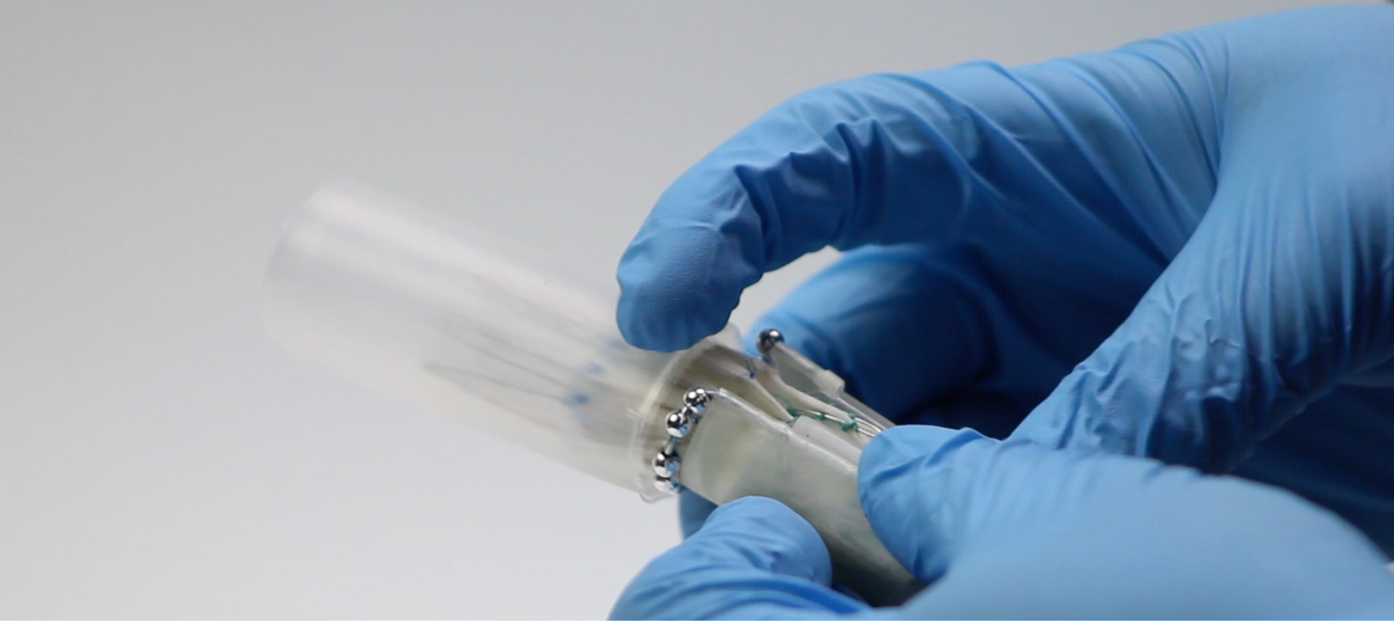
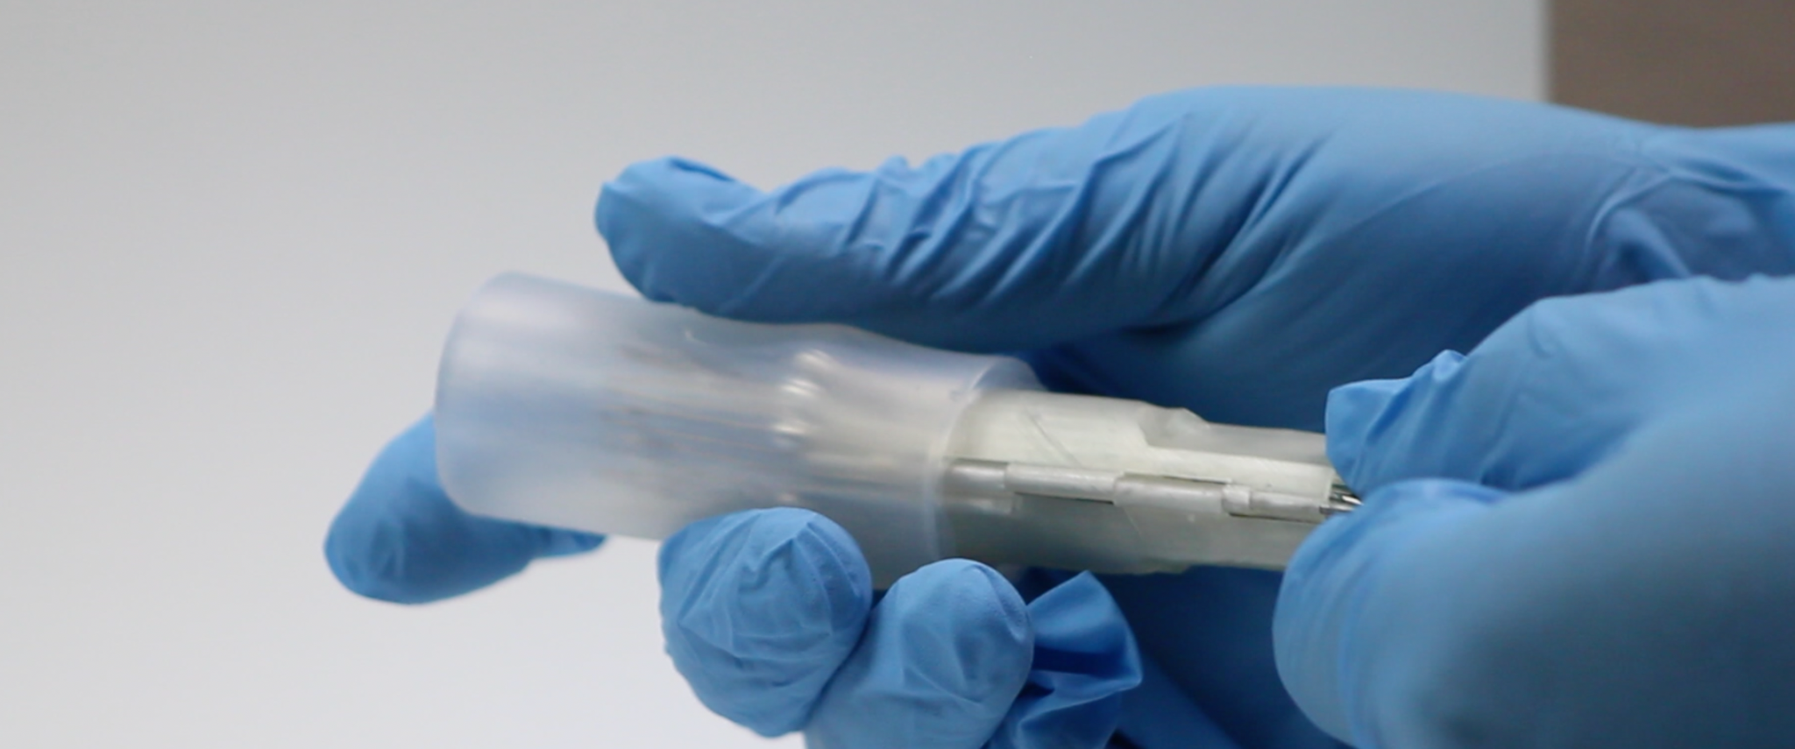
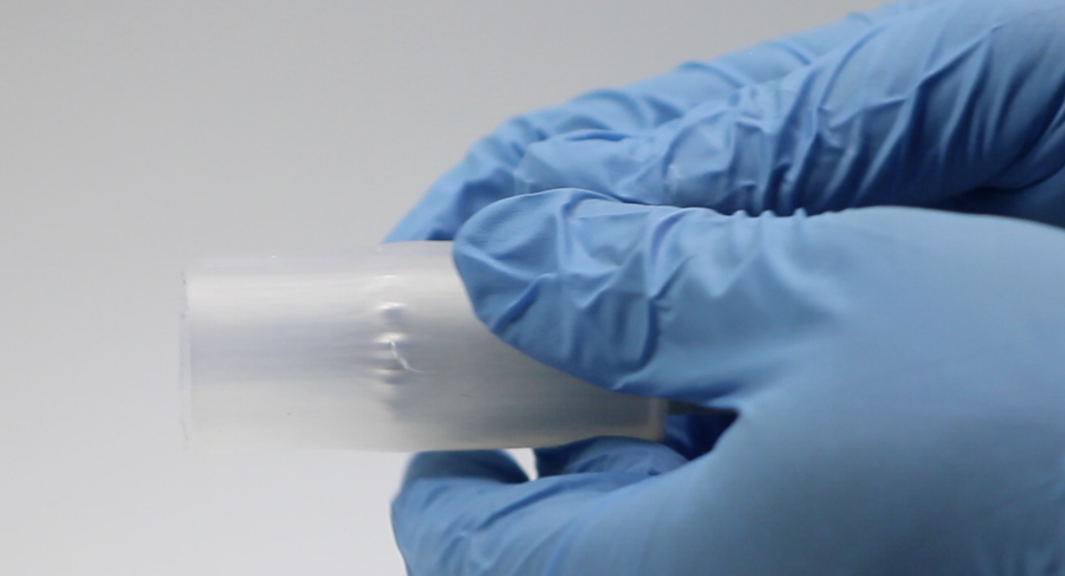
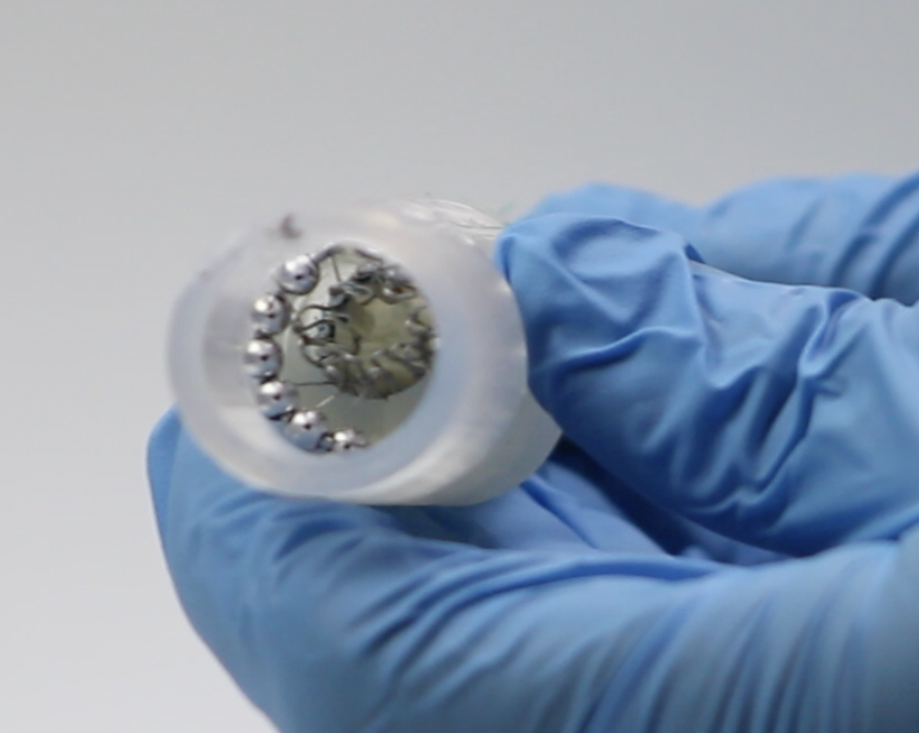
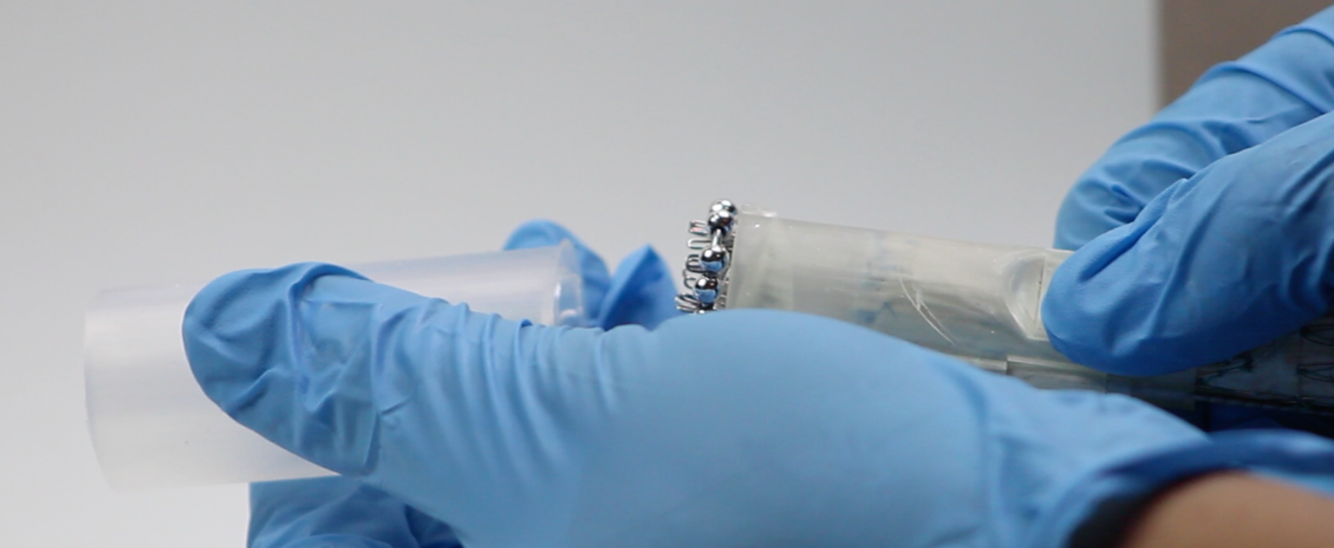
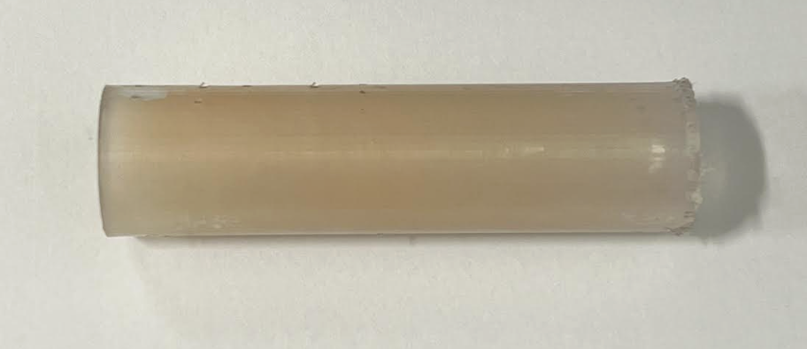
Development of a Reproducible Aortic Model for Intraluminal Device Benchtop Evaluation
Zain Moin^{[1]}, Alayne Morrel^{[1]}, , Maham Rahimi MD PhD^{[2]}
^{[1]}School of Engineering Medicine, Texas A&M University, Houston, TX 77030
^{[2]} Department of Cardiovascular Surgery, Houston Methodist Hospital, Houston TX 77030
Correspondence: zainmoin@tamu.edu
Objectives
Model Iterations
Results and EndoEx Testing
Endovascular Aortic Repair (EVAR) reduces mortality and morbidity compared to open repair. However, it is associated with long term complication including graft infection (10%) and endoleaks with sac expansion (68%)¹
With the development of novel explantation devices like the EndoEx, there remains a limited number of modeling tools available for evaluating their safety and effectiveness.
This study involved the iterative development of an aortic model for the future evaluation of intraluminal aortic devices
Figure 3: Evaluation of the EndoEx on Final Model
The final model was able to effectively replicate the endothelial scraping and snowplow effect associated with the syringe technique and there was a marked improvement when the EndoEx device was used
We have confidence that this model can be used for evaluating other intraluminal or aortic devices.
Attachment
Advancement
Figure 2: Aortic Model Progressive Iterations
Capture
The final Model was constructed using a dual-layer, dual hardness approach through a Stratasys J55 printer.
This allowed us to guarantee that our model’s structural metrics matched those of a true aorta.
Further evaluation of the model involved conducting experimental analysis, mechanical testing, and eventually conducting a usability study over the EndoEx device.
Conclusion
Retraction
Clinical Significance
The final model was found to replicate both the endothelial scraping and snowplow effects associated with the syringe technique.
The model’s overall strength and structural integrity was very close to that expected of a real aorta, suggesting that future results using this model should match those expected in true clinical settings
Future testing and usability analysis will involve using a dual layer approach for assessing the extent of snowplowing and scraping incurred by devices like the EndoEx.
Figure 1. EndoEx Device in Action
Methods
A cylindrical base was used to serve as an aortic model our study
Progressive alterations to the base were performed in order to optimize the base toward the structural integrity of the tunica intima, media, and adventitia.
Alterations involved using a Stratasys J55 printer with customizable hardness, thickness, and overall material
Since the syringe technique has been found across many instances to produce a snow plowing effect when in contact with the aortic wall, the ability of each model to reproduce this effect was used to gauge model effectiveness.
Figure 3: Final Aortic Model
REFERENCES
1. de Boer, M., Qasabian, R., Dubenec, S. & Shiraev, T. The failing endograft-A systematic review of aortic graft explants and associated outcomes. Vascular, 17085381221082370 (2022).
Special thanks to: Brandon Look-Fong, Rishik Puppala, Solyman Hatami, Shannon Lu, Alwin Mathew, and Vamsi Maturi for their guidance and previous contributions towards the project

