Slide 1
ISVMA Master Class
Radiology

Slide 2
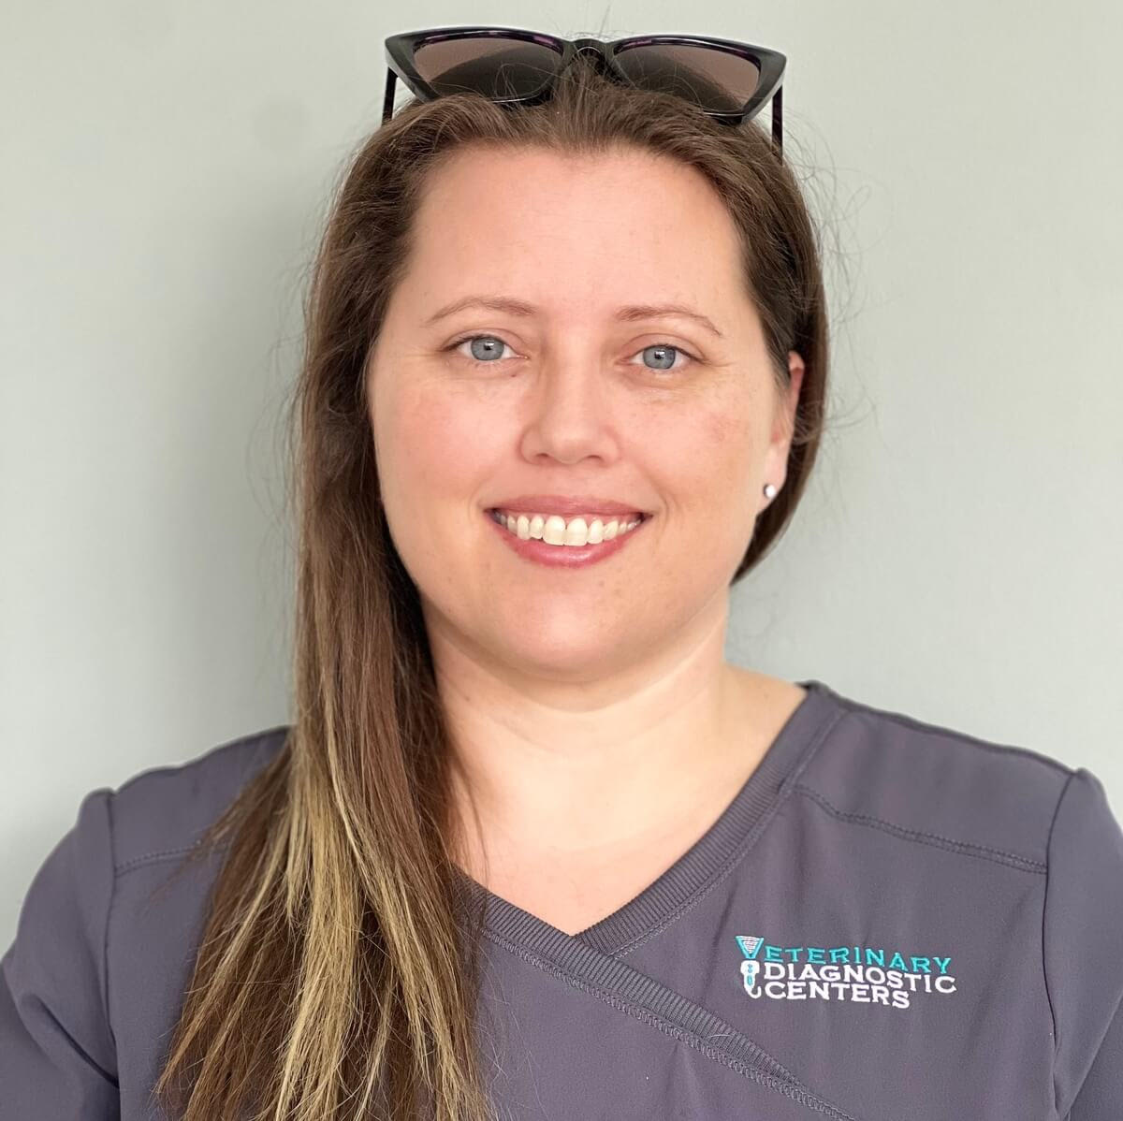
Kimberly King CVT
A little about me
Bachelors of Science: Biology
Associate of Veterinary Technology
CVT for 7 years
GP for 14 years
Current position: Lead Tech Veterinary Diagnostic Centers
Passed the VTNE in 2019

Slide 3
What scares you about VTNE?
Radiology Questions (lets really use that chat feature here)
BE HONEST!!! ITS SCARY!!!
Remember the basics. They do not change.
Keep it simple. If you remember the basic principles the rest will follow

Slide 4
AGENDA
Understand radiation safety
Master image production basics
Recognize common positioning & artifacts
Prepare for VTNE-style questions

Slide 5
Safety First, as it should be
ALARA principle
Distance, time, & shielding
Inverse square law
Occupational dose limits
Who can restrain patients
PPE: lead apron, gloves, thyroid shield, eye protection

Slide 6
ALARA principle
As Low As Reasonably Achievable
Protect yourself and your patient
Always use a collimator and use the smallest possible aperture that will cover the anatomic area of interest
Never permit any part of your body to be in the path of the primary x-ray beam
Positioning is key
Premedication for patient (hands free radiology)

Slide 7
Distance, Time, Shielding
Distance: Maximize the distance from the radiation source, as intensity decreases with distance.
Time: Minimize the duration of exposure to reduce total dosage.
Shielding: Use appropriate barriers (e.g., lead aprons, concrete walls) to block or absorb radiation.

Slide 8
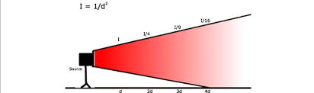
Inverse square law
Radiation intensity decreases the farther you get away from it.
Doubling distance= ¼ exposure
Stand as far away as possible

Slide 9
Occupational dose limits
Legal Records (hint)
What needs to be displayed on a radiograph?
Name, Date, Signalment, Clinic information
Radiation exposure is cumulative
Dosimeter badges are required
Report sent to you quarterly
Bring your totals with you between jobs

Slide 10
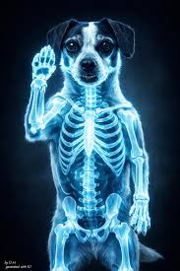
Occupational dose limits
It's okay to say NO…..
If you are on your 9th radiograph of the day and need to switch out its okay.
Remember this is the WRONG type of GLOWING
Advocate for yourself and for your patients

Slide 11
Restrain Patients
Who can restrain patients
Only those who have been trained should be restraining
Must always where the correct size of PPE
Never hold the tube (dental) or cassette (xray table) in place.
If its broken get it fixed and in the meantime DO NOT USE IT.
Pregnancy precautions
Should avoid exposure
When able never manually restrain if sedation is possible (Hands Free Radiology)

Slide 12
Personal Protective Equipment (PPE)
PPE MUST BE at least 0.5mm lead equivalent
Apron / Vest & Skirt: Protects the chest, abdomen, and pelvis from scatter radiation.
Thyroid Shield / Collar: Wraps around the neck to protect the thyroid gland, very sensitive to radiation.
Lead Gloves: Barrier for the hands during procedures where hands may be in close proximity to the beam.
Lead Glasses: Protects the lenses of the eyes from scatter exposure.
Eye Protection: Most sensitive part of the body to radiation exposure.

Slide 13
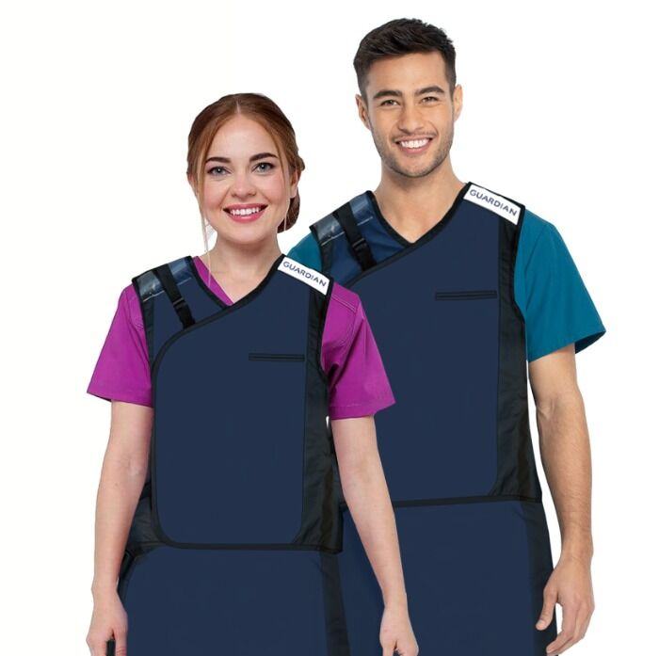
What is missing from this picture??
Where is the thyroid guard?
Where is the eye protection?
Where are the gloves?
Where are their dosimeter badges?

Slide 14
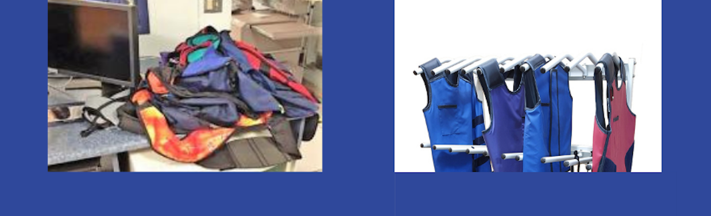
Keep your equipment in the best condition
Check it regularly
Any cracks or wear replace immediately
Don’t drop them on the table or floor
Always hang them up
If its broken do not use it

Slide 15
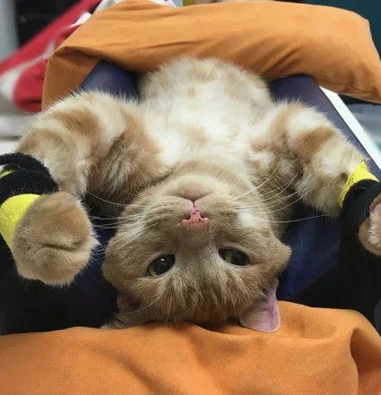
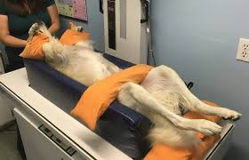
Hands Free Radiology (real life exposure)
Reduce time, Increase distance, and minimize radiation exposure
Great resource VETgirl (Great poster with guidelines)
What every practice should be striving for the safety of the staff and their patience
Its not just a diagnostic tool, it’s a procedure. Treat it as such.
Premedication, sedation as needed

Slide 16
1st radiology VTNE question
True or False: Sedated animals can be manually restrained.
Answer: True
Sedation level does not affect manually restrain.

Slide 17
Which PPE is required when personnel must be in the radiography room?
A. Lead apron only
B. Lead gloves only
C. Thyroid shield only
D. Lead apron, gloves, and thyroid shield
Answer: D

Slide 18
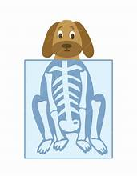
Let's produce the best radiograph
KVP vs mAs a VTNE favorite

Slide 19
KVP (beam energy)
Kilovolt Peak
X-rays penetrate tissue more easily
More photons reach the detector
What happens when you increase kVP?
Image becomes darker (more exposure)
Quality of image not as good
Image looks less black and white
Higher kvp for thicker or dense body parts (abd, pelvis)
Lower kvp for tinner parts (limbs, digits)

Slide 20
mAs (beam quantity)
Milliampere-seconds
The number of X-ray photons produced
mAs= mA x exposure time
What happens when you increase mAs
More photons are produced
Image becomes darker
Contrast stays roughly the same
Patient dose increases proportionally

Slide 21
Easy Comparison Guide
Factor | kVp | mAs
Controls | Beam energy | Beam quantity
Affects penetration? | Yes | No
Affects contrast? | Yes (higher kVp = lower contrast) | Minimal
Affects image darkness? | Yes | Yes
Affects patient dose? | Yes | Yes (directly proportional)

Slide 22
15% rule
The 15% rule describes the relationship between kVp and image receptor exposure.
Increasing the kVp by 15% (doubles image receptor exposure)
Decreasing the kVp by 15% (halves image receptor exposure)
Compensate with mAs
(Increase your kVp, Decrease you mAs)
(Decrease you kVp, Increase you mAs)

Slide 23
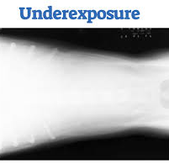
How do we make this radiograph better?
Effects of underexposure
mAs too low
kVP too low

Slide 24
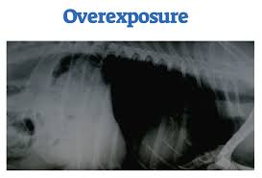
How do we make this radiograph better?
Effects of overexposure
mAs too high
kVP too high

Slide 25
VTNE QUESTION (a form of this question will be on the test)
Which setting control image density?
kVP
mAs
Collimation
Grid
Answer: B

Slide 26
Positioning Essentials
Positioning is key for the best image and for limiting exposure
Collimating a radiograph properly
Having the proper positioning tools will help produce the best pictures

Slide 27
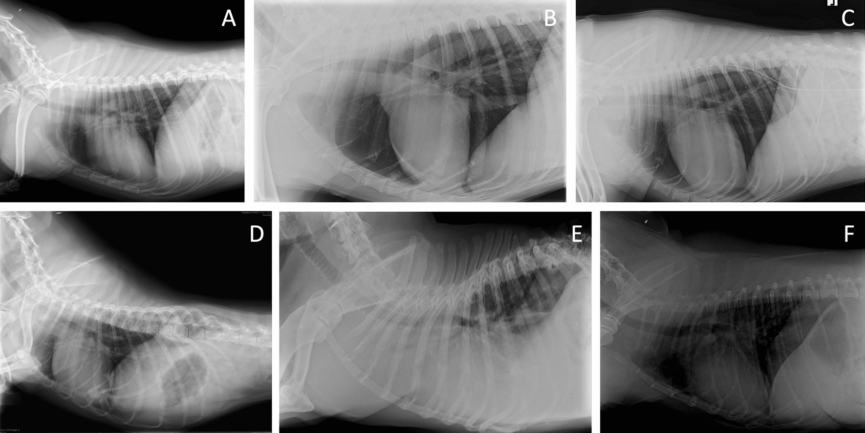
Thorax views
3 views
Right lateral
Left lateral
VD or DV (when should you use the DV view?)
Thoracic radiographs taken on inspiration
How does air look on radiograph?
Thorax landmarking
Caudal scapula

Slide 28
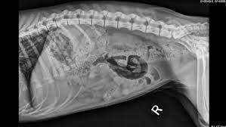
Abdominal Views
3 views
Right lateral
Left lateral
VD
Abdominal radiogrpahs taken on expiration
Abdomen landmarks
Last rib

Slide 29
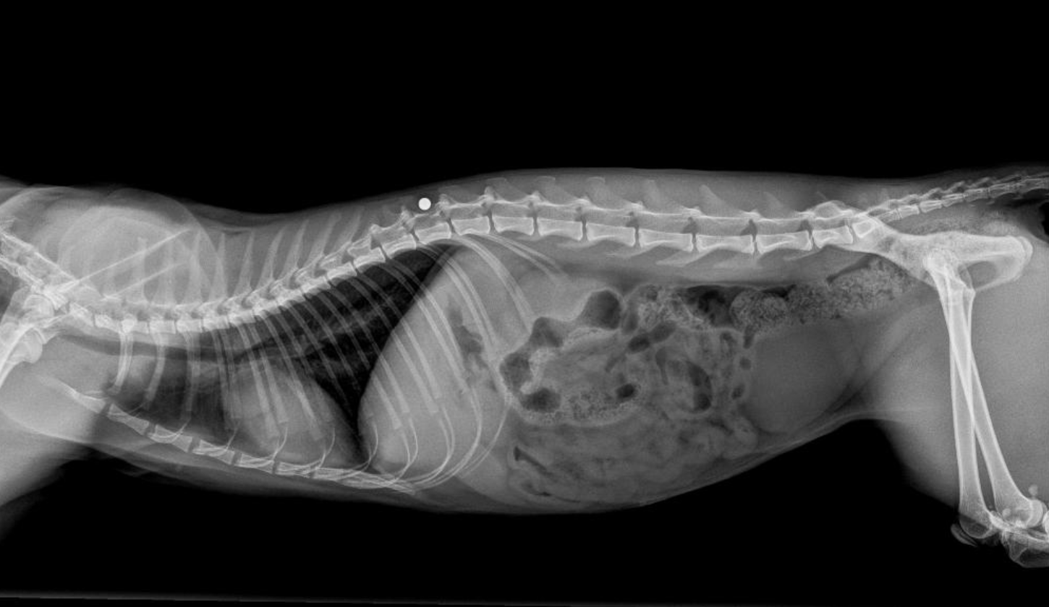
Whole Body Radiographs
Don’t do them.
You will lose the fine detail
Collimation is key
Use the tools in your tool box, to get the best answers

Slide 30
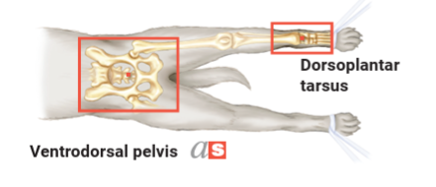
Pelvic views
Hip dysplasia positioning
Ventrodorsal view
Hind limbs extended
Femurs parallel
Pelvis straight
Landmarking basics
Joints: joint space

Slide 31
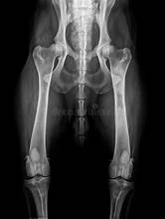
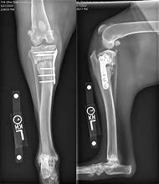
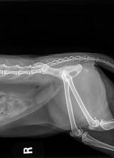
Pelvic Views

Slide 32
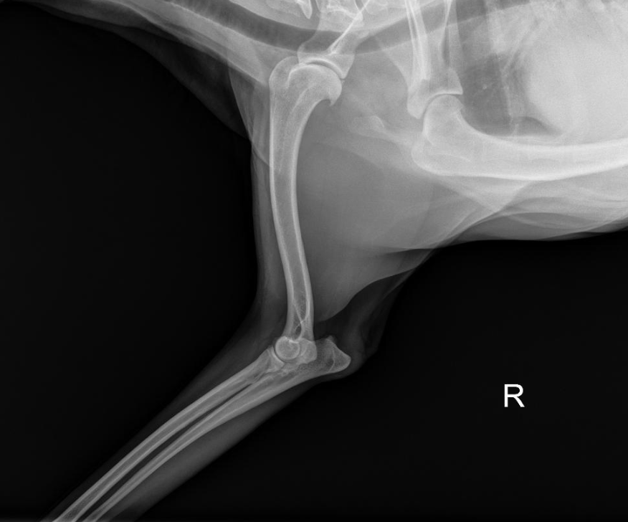
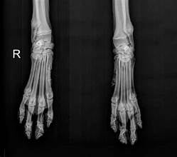
Orthopedic Limb Images
Centering your pointing of interest
Collimating is key
Compare both limbs when able

Slide 33
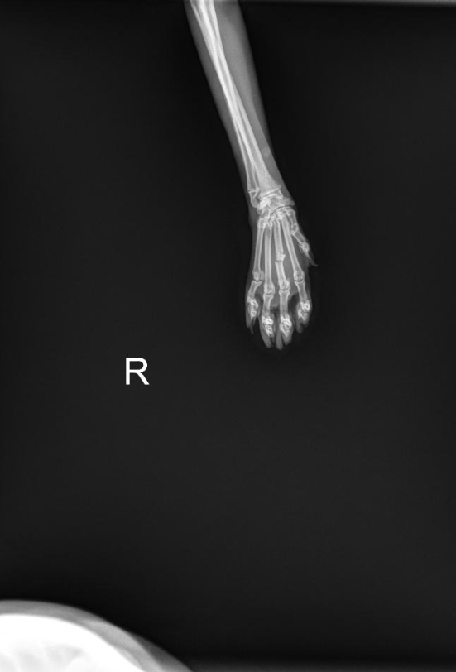
What's wrong with this image??
It is to far out.
What else is in that image?
There is only one limb for comparison.

Slide 34
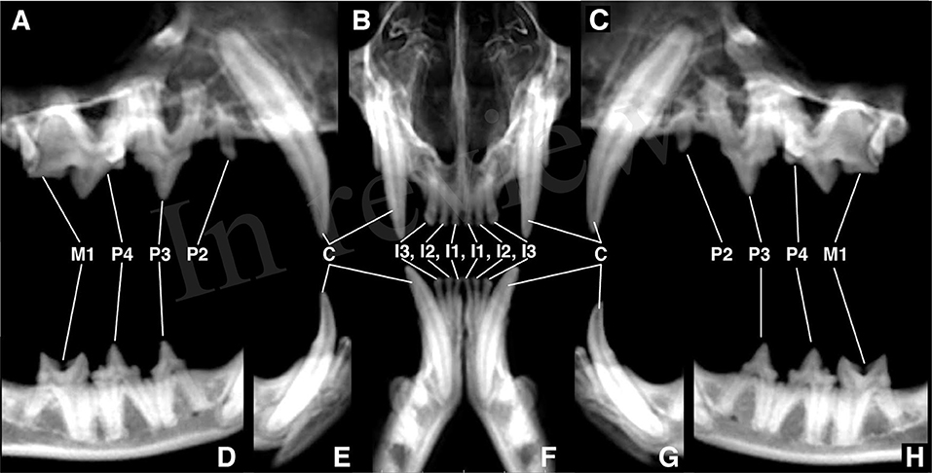
Dental Radiology
All the same basics apply, just on a much smaller scale.
Positioning is key
Enlongating vs shorting
Practice is key

Slide 35
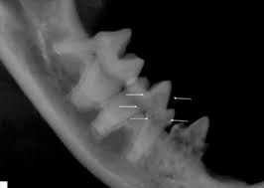
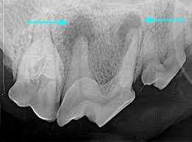
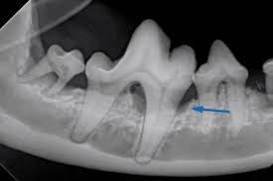
Dental Radiograph Importances
Dental disease is often below the gumline
Periodontal disease stages
Tooth root abscesses
Resorptive lesions

Slide 36
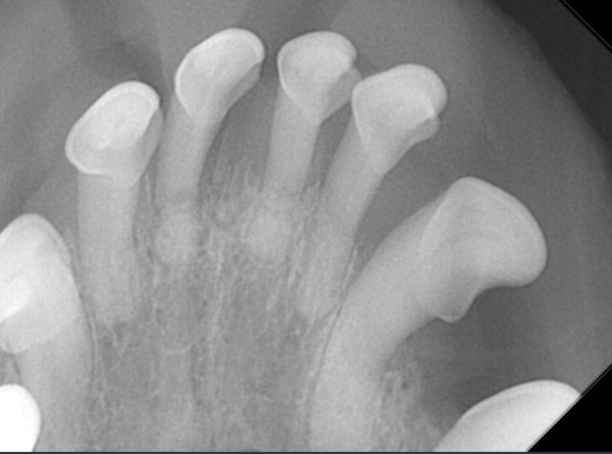
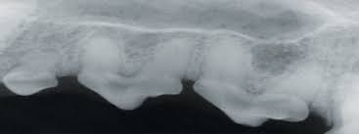
Elongating vs Shortening Dental Radiographs
Elongating
Caused by the x-ray head being too parallel
Shortening
Caused by the x-ray head being too perpendicular

Slide 37
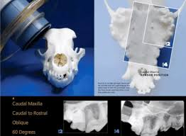
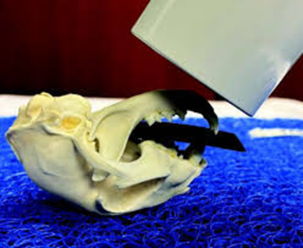
60, 45, 90 repeat
Postion is key to any dental radiograph
Once you get that tooth on image you can always adjust your kvp or mAs to get the image you need

Slide 38
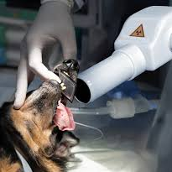
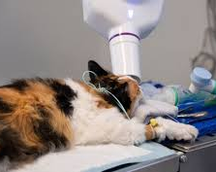
Bad Practices
Take your hands out of the radiographs
Safety first
Should be wearing all the same PPE
Hands Free Radiology skills still apply

Slide 39
Break it down..hehe
Back in 5 minutes

Slide 40
Key problems
Motion artifact
Improper collimation
Light vs dark images
Common artifacts (motion, grid lines, debris)

Slide 41
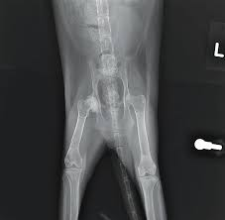
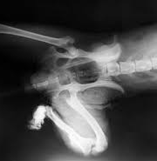
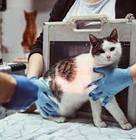
Motion Artifact
Burly image
Sedation
Hands free radiology

Slide 42
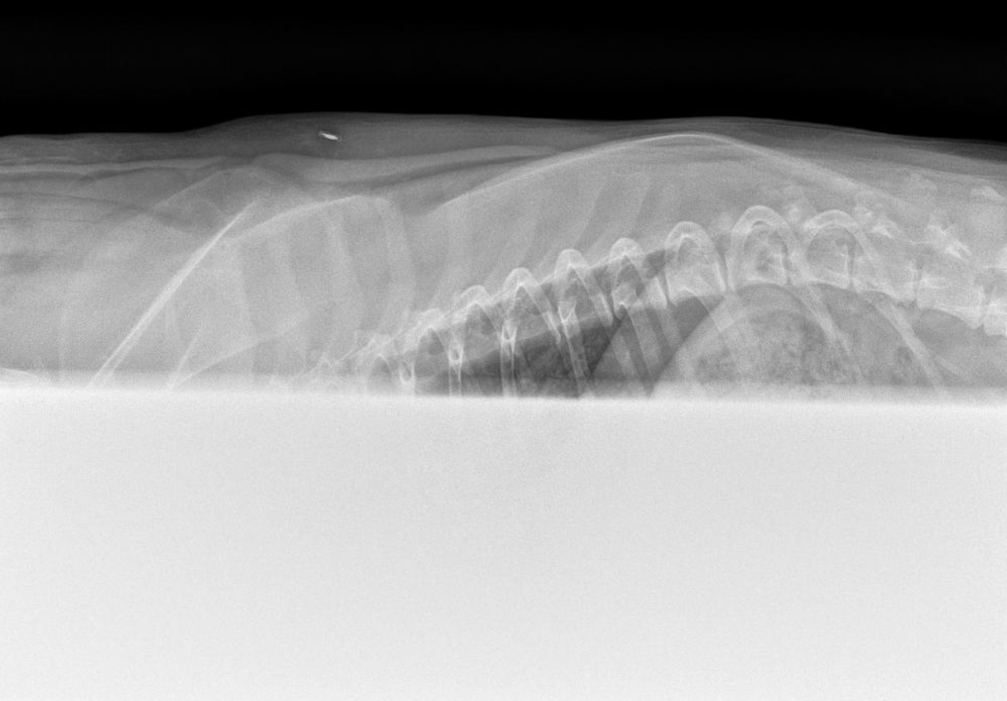
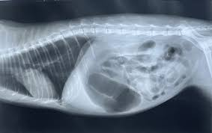
Improper Collimation
Loss of detail
Loss of correlation
Grid lines

Slide 43
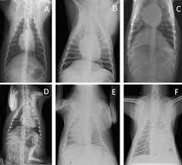
Image to dark vs light
Most machines will adjust based on weight.
Body habitus, Fluid, etc.
Remember your Kvp or Mas if needed to adjust

Slide 44
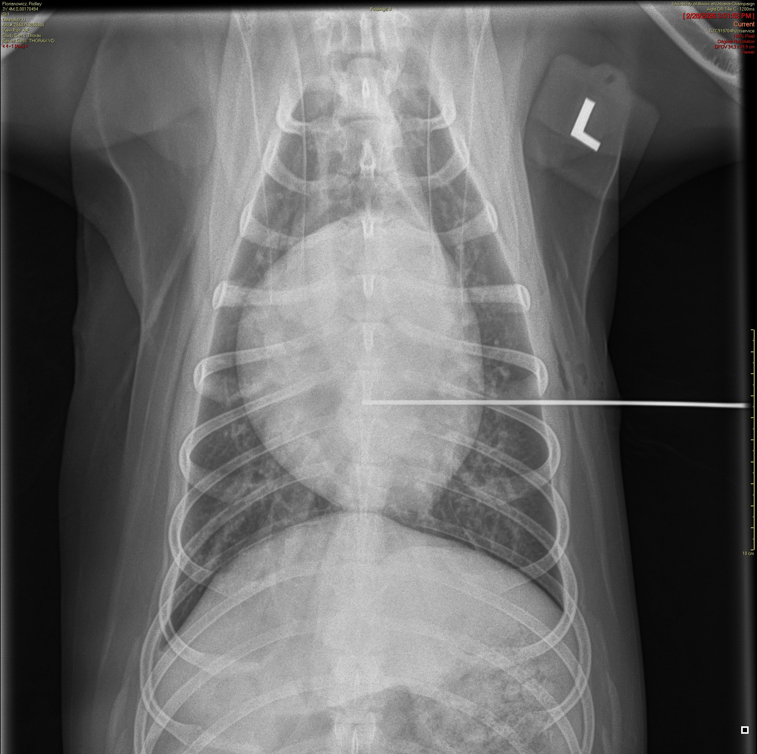
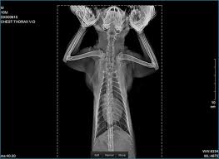
Artifacts in image
What is the metal line??
Superimposed object or a concern
Hands in the radiograph

Slide 45
Contrast Studies
Barium vs iodinated contrast
When barium is contraindicated
Cystograms
Myelograms
Double-contrast studies

Slide 46
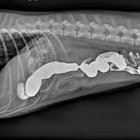
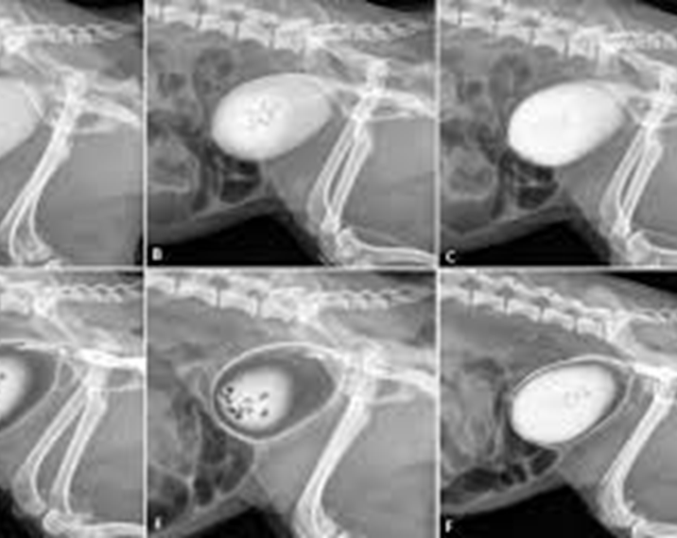
Barium vs Iodine
Barium
GI studies
Contraindicate with perforation
Iodine
Safer if rupture suspected
Used for urinary and spinal studies

Slide 47
Other forms of Digital Imaging
Ultrasound
CT
MRI

Slide 48
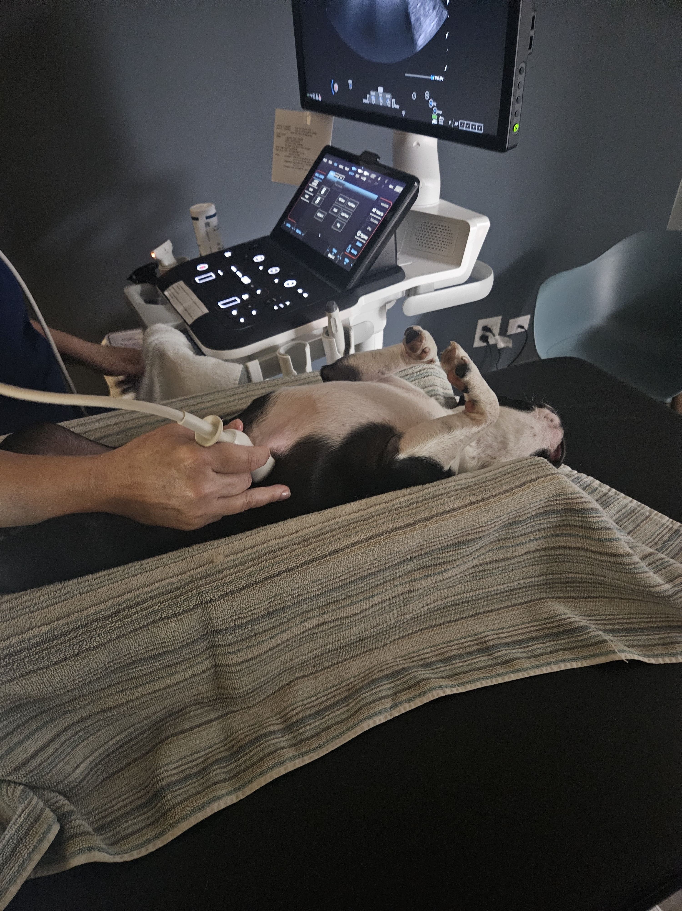
Ultrasound
My new favorite diagnostic tool
Sound waves
Echocardiograms and Abdominal ultrasounds
Fine detail on organs
No sedation required

Slide 49
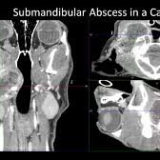
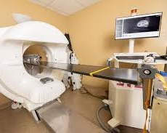
CT
Computed Tomography
cross-section (“slice”) images of your pet’s body
CT scan = best for structure (bones, lungs, tumors)
Very fast (seconds to minutes) compared to MRI
Sedation Required

Slide 50
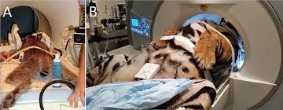
MRI
Magnetic Resonance Imaging
MRI = best for soft tissue (brain, nerves)
powerful magnets and radio waves (not X-rays)
MRI scans can take 30–90 minutes
Sedation Required

Slide 51

Lets put our knowledge to the test…just for fun
8 possible VTNE questions.
All multiple choice
Remember this is just for fun to see watch knowledge you have retained.
Let’s talk test anxiety

Slide 52
Increasing mAs will result in:
A. Decreased image density
B. Increased image density
C. Increased contrast
D. Decreased distortion
Answer: B

Slide 53
Which factor has the greatest effect on radiographic contrast?
A. mA
B. Exposure time
C. kVp
D. SID
Answer: C
Kvp VS MaS WILL BE ON THE TEST IN SOME FASHION.

Slide 54
The primary purpose of collimation during radiography is to:
A. Increase image density
B. Reduce scatter radiation
C. Shorten exposure time
D. Increase contrast resolution
Answer: B

Slide 55
Which imaging technique uses sound waves?
A. X-ray
B. CT
C. MRI
D. Ultrasound
Answer: D

Slide 56
Which of the following is the most effective way to reduce radiation exposure?
A. Increase exposure time B. Stand closer to the beam C. Use proper shielding D. Hold the patient manually
Answer: C

Slide 57
A radiograph appears too light. What is the most likely cause?
A. Overexposure B. Excessive kVp C. Underexposure D. Too much scatter
Answer: C

Slide 58
Which structure is best evaluated on a right lateral thoracic view?
A. Left lung inflation B. Cardiac silhouette only C. Sternum D. Pelvis
Answer: A

Slide 59
Which term describes sharpness of an image?
A. Contrast B. Density C. Detail D. Distortion
Answer: C

Slide 60
Key Takeaways
Safety first, always
Know kVp and mAs
Proper positioning is critical
Artifacts are common VTNE questions
Digital doesn’t always mean safer exposure

Slide 61
Resources for more information
IDEXX positioning guides (free PDFs)
https://www.idexx.com/files/radiography-positioning-guide.pdf
VIN (Veterinary Information Network)
Veterinary Oral Health Council
https://vohc.org/

Slide 62
Thank you again
If you have additional questions. Please reach out.
www.linkedin.com/in/kimberly-king-589485b9
Any questions?

