Slide 1
Exploring Neurodiversity in veterinary medicine
Presented by Alyssa Brown, CVT LATg for the ISVMA

Slide 2

Credentials, etc.
Bachelor’s degree in English 2010
2015 graduate of the Joliet Junior College Veterinary Medical Technology program.
Working as a CVT in academic research in Chicago
2015-present
Pronouns: they/she
Neurodivergent

Slide 3
Presentation Overview
Discuss what neurodiversity is, as well as common types of neurodivergence
Common traits that may be relevant in a workplace
Strategies that do and don’t work for neurodivergent colleagues
Easy workplace accommodations
Advantages to having a neurodiverse team
Notes:
As we move through this presentation, we will talk about different forms of neurodivergence, attributes that may be relevant in the veterinary setting, as well as discuss strategies to make the clinical setting a safe and inclusive environment for every type of brain.

Slide 4

What is neurodiversity?
The idea of neurodiversity was first developed in autistic self-advocacy groups as a way to reframe autism as a natural occurrence instead of a defect that needs to be fixed.
Notes:
The words “neurodiversity,” or “neurological diversity” first appeared in online Autism groups in the mid 1990s, and is alleged to have come from one called Independent Living on the Autism Spectrum. The term is intended to describe the way people with cognitive disabilities interact with the world in a more neutral, non-pathologizing way than the traditional medical model of disability.
Autism Network International was one of the first organizations that was run by and for autistic people, and sought to support each other through difficulties and share coping strategies they had developed in their own lives. It also hosted annual retreats that were tailored to autistic sensibilities, such as interaction badges, a ban on strong odors or noises, and presentations on self-advocacy.

Slide 5
What is “normal” anyway?
The NIH estimates that 15-20 percent of the world’s population exhibits some form of neurodivergence.
“Neurodivergent conditions, including attention deficit disorder (ADHD) and autism spectrum disorder (ASD) are overrepresented in STEM fields.”
https://dceg.cancer.gov/about/diversity-inclusion/inclusivity-minute/2022/neurodiversity

Slide 6
A note on terminology
An individual is “neurodivergent.”
“I am neurodivergent because I have ADHD.”
A group of people is “neurodiverse.”
“I like Star Trek because the characters are neurodiverse.”
https://neuroqueer.com/neurodiversity-terms-and-definitions/
Notes:
Neurodiverse indicates a group of people who are differently neurodivergent, so next we will go through some common flavors of neurodiversity.

Slide 7

Putting the diversity in neurodiversity
Since its origin, the concept has been applied more broadly to encompass a constellation of neurocognitive differences.
Autism
Attention deficit disorder
Dyslexia
Dyscalculia
Psychiatric disorders
Acquired neurodiversity
"Neurodiversity Crowd 1" by MissLunaRose12
is licensed under CC BY-SA 4.0.
Notes:
This is a by no means exhaustive list of conditions that fall under the neurodiversity umbrella. Many of them can overlap or occur concurrently in the same individual, so after we run through some definitions we will pick out some common traits to discuss in more depth. Some of these conditions may be new to you, or more discussed as of late, but you will find that neurodiversity has always existed, we just didn't always have the terminology to describe it.

Slide 8
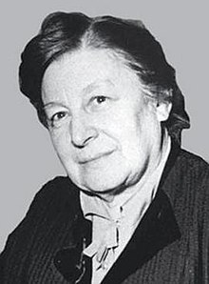

Putting the diversity in neurodiversity
Since its origin, the concept has been applied more broadly to encompass a constellation of neurocognitive differences.
Autism
Attention deficit disorder
Dyslexia
Dyscalculia
Psychiatric disorders
Acquired neurodiversity
Autism infinity symbol – becoming more common due to many Autistic people being uncomfortable with the history of the puzzle piece ribbon.
Grunya Sukhareva
Photo credit: A.V. Goriunov, published in Jewish News, 2017
Notes:
Autism was first described by Grunya Sukhareva in 1926, when she published a paper about six boys with autistic characteristics. Autism is a neurological and developmental disorder that affects how people interact with others, communicate, learn, and behave. The DSM-5 criteria include difficulty with communication and interaction with other people, restricted interests and repetitive behaviors, and symptoms that affect their ability to function in school, work, and other areas of life. (NIMH)

Slide 9
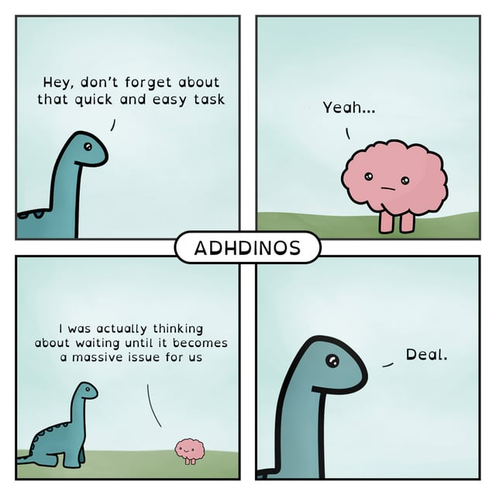
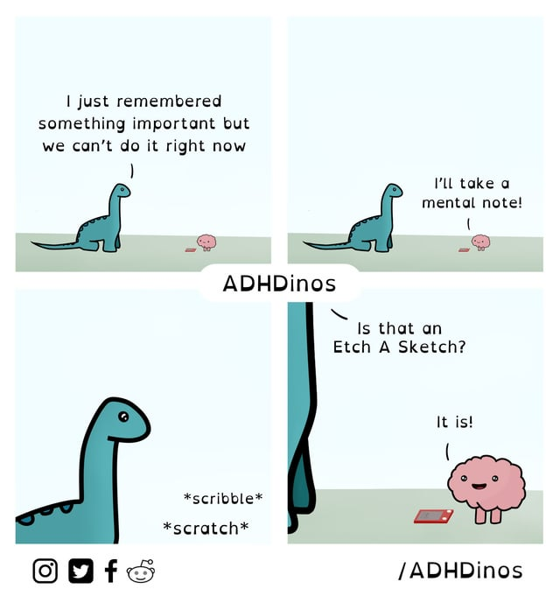
Putting the diversity in neurodiversity
Since its origin, the concept has been applied more broadly to encompass a constellation of neurocognitive differences.
Autism
Attention deficit disorder
Dyslexia
Dyscalculia
Psychiatric disorders
Acquired neurodiversity
https://add.org/adhd-dsm-5-criteria/
Comics from @adhdinos on Instagram
Notes:
Attention deficit disorder has three subtypes – predominantly-hyperactive, predominantly-inattentive, and combined. Hyperactive is the one that most people think of first – interrupting people and situations, leaving their seat during class and meetings, restless energy, fidgeting, etc. Inattentive includes lack of attention to detail, difficulty focusing, losing important items, forgetfulness, and so forth. Combined is exactly what it sounds like – a mix of both types, which can’t be explained by another disorder or condition.

Slide 10

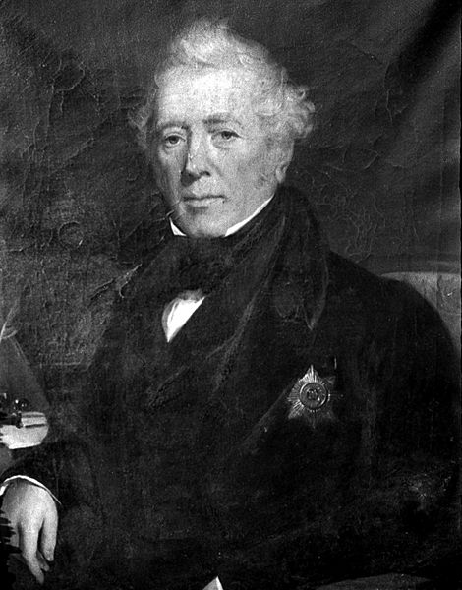
Putting the diversity in neurodiversity
Since its origin, the concept has been applied more broadly to encompass a constellation of neurocognitive differences.
Autism
Attention deficit disorder
Dyslexia
Dyscalculia
Psychiatric disorders
Acquired neurodiversity
Portrait of Sir Alexander Crichton First page of Zappel-Phillipp
Notes:
Sir Alexander Crichton first described a condition he called “the incapacity of attending with a necessary degree of constancy to any one object” in 1798, and in 1844 Heinrich Hoffmann published a children’s story called “Zappel-Philipp” – or Fidgety Phil – about a child who is restless and fidgety.

Slide 11
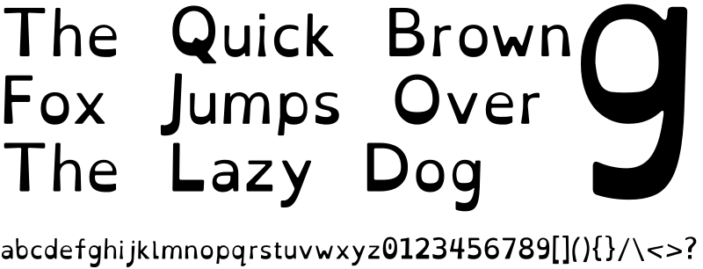
Putting the diversity in neurodiversity
Since its origin, the concept has been applied more broadly to encompass a constellation of neurocognitive differences.
Autism
Attention deficit disorder
Dyslexia
Dyscalculia
Psychiatric disorders
Acquired neurodiversity
An example of the “OpenDyslexic” font designed by Abbie Gonzalez
https://dyslexiaida.org/definition-of-dyslexia/
Notes:
Dyslexia was first described in 1877, called word-blindness. It presents as difficulties with accurate or fluent word recognition, and by poor spelling. This may create problems in reading comprehension and impeded vocabulary acquisition. There are several computer fonts meant to be easier for dyslexic people to read, however there is no evidence that they are any easier to read than a standard font. The good people of r/Dyslexia attest that Arial, Helvetica, and Verdana are generally considered readable.

Slide 12
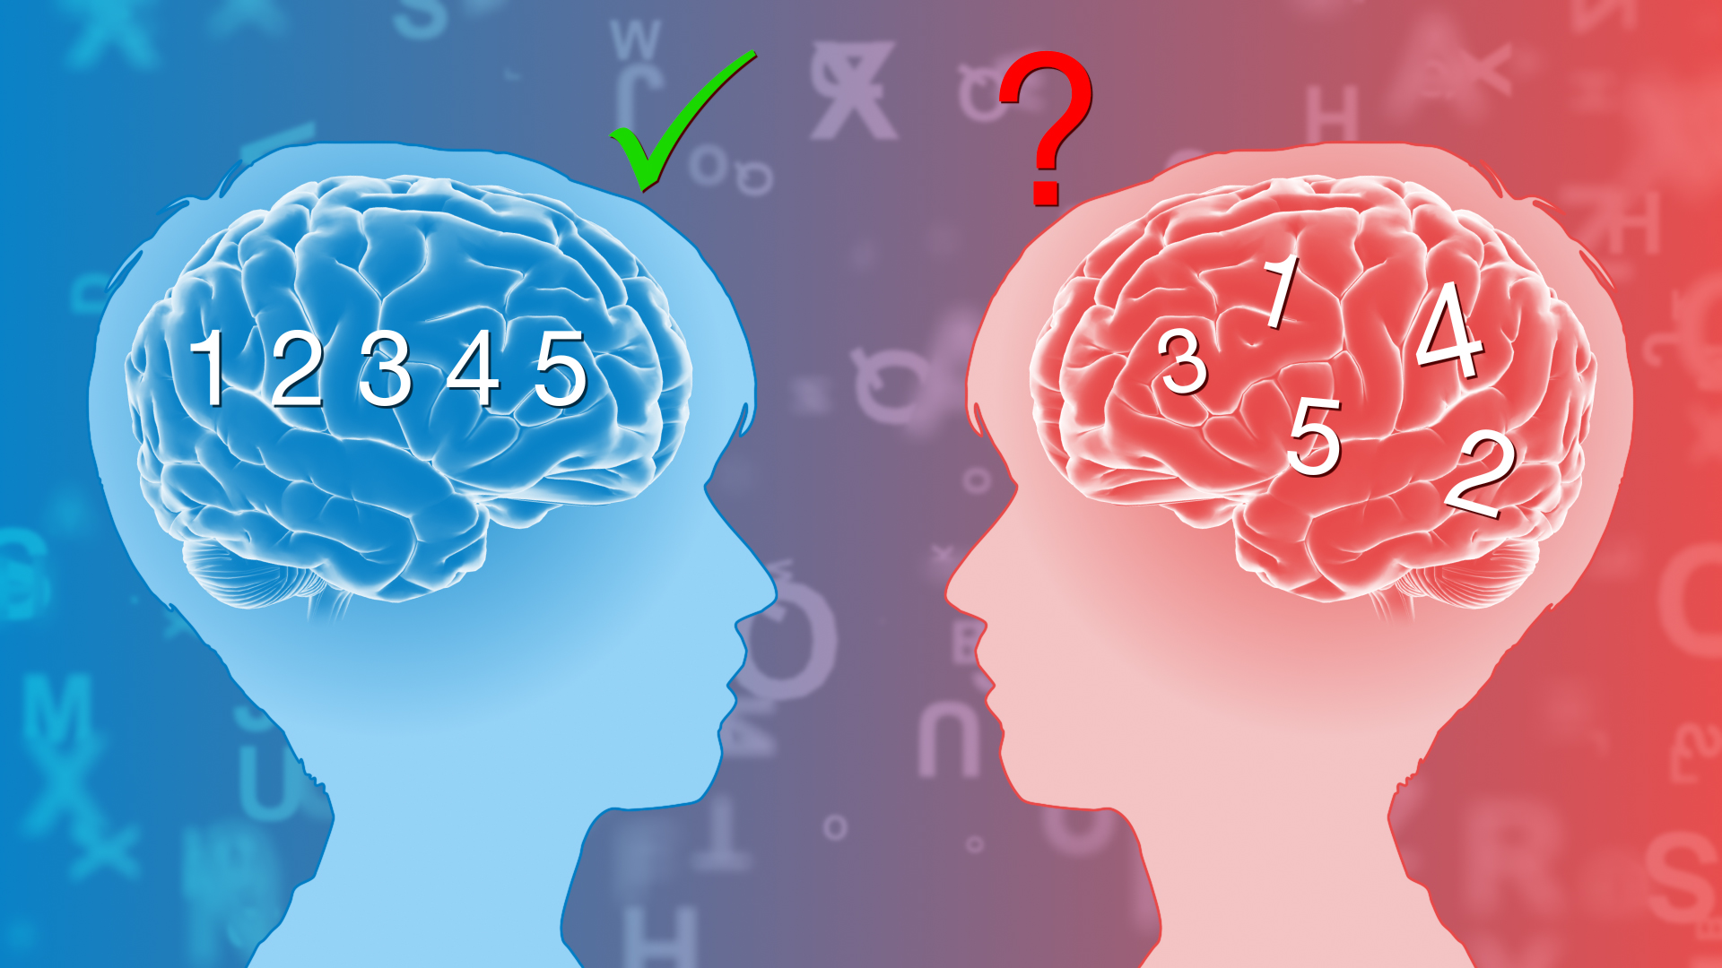
Putting the diversity in neurodiversity
Since its origin, the concept has been applied more broadly to encompass a constellation of neurocognitive differences.
Autism
Attention deficit disorder
Dyslexia
Dyscalculia
Psychiatric disorders
Acquired neurodiversity
"Dyslexia" by http://www.scientificanimations.com is licensed under CC BY-SA 4.0.
Notes:
Dyscalculia was first described in 1919 by Swiss neurologist Salomon Henschen, and was referred to as “number blindness.” It refers to difficulties in understanding the association between a number and the quantity it represents, understanding aspects of counting and its use in addition and subtraction, and/or remembering and recalling of arithmetic facts and skills required for solving algebra and geometry. People with dyscalculia are generally of high intelligence otherwise, but struggle with math.

Slide 13
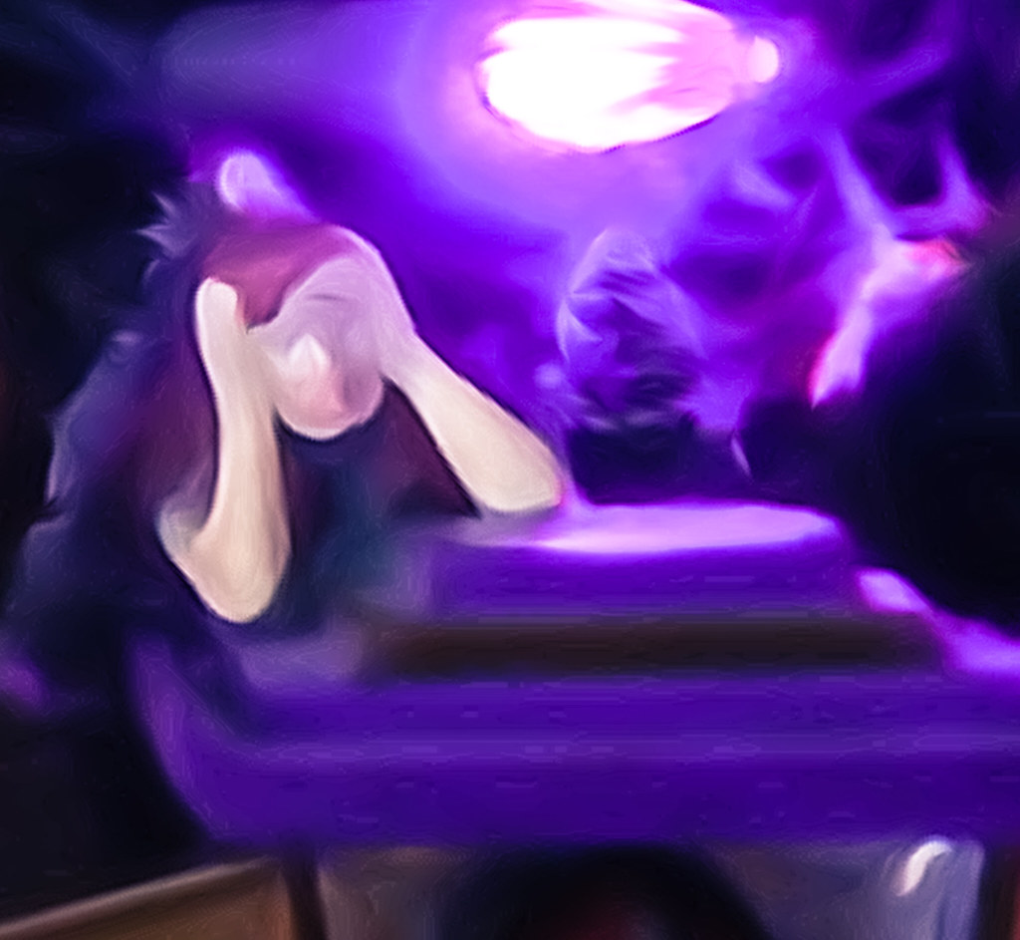
Putting the diversity in neurodiversity
Since its origin, the concept has been applied more broadly to encompass a constellation of neurocognitive differences.
Autism
Attention deficit disorder
Dyslexia
Dyscalculia
Psychiatric disorders
Acquired neurodiversity
"Anxiety" by kevin dooley is licensed under CC BY 2.0.
Notes:
Psychiatric disorders include major depressive disorder, generalized anxiety, schizophrenia, bipolar disorder, and many others.

Slide 14
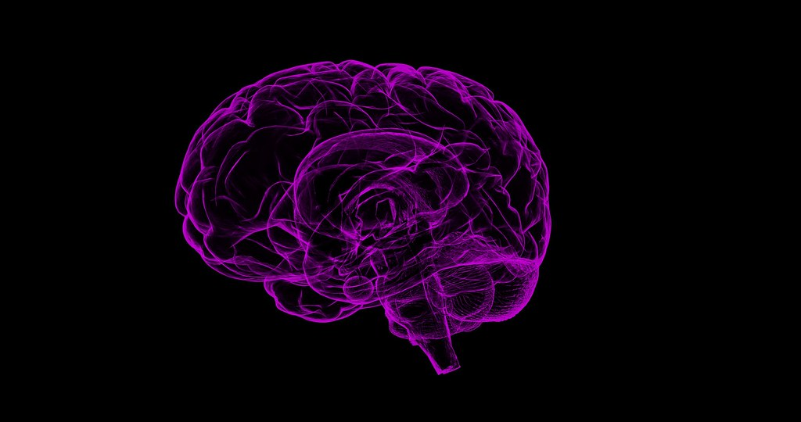
Putting the diversity in neurodiversity
Since its origin, the concept has been applied more broadly to encompass a constellation of neurocognitive differences.
Autism
Attention deficit disorder
Dyslexia
Dyscalculia
Psychiatric disorders
Acquired neurodiversity
"Brain Image" by SciTechTrend is marked with Public Domain Mark 1.0.
Notes:
Acquired neurodiversity refers to changes that were not present at birth, such as PTSD, acquired brain injury, and Alzheimer’s disease. Psychiatric disorders also often fall under this category as well, since they tend to present in adolescence or beyond.
Note that some of these conditions have medical treatments or interventions, and some do not. Neurodivergent people may or may not want to seek treatment for a variety of reasons, and those reasons are their own unless they wish to share them with you. There is no correct way to be neurodivergent, and in general neurodivergent people do not want to be told they can or should be cured.

Slide 15
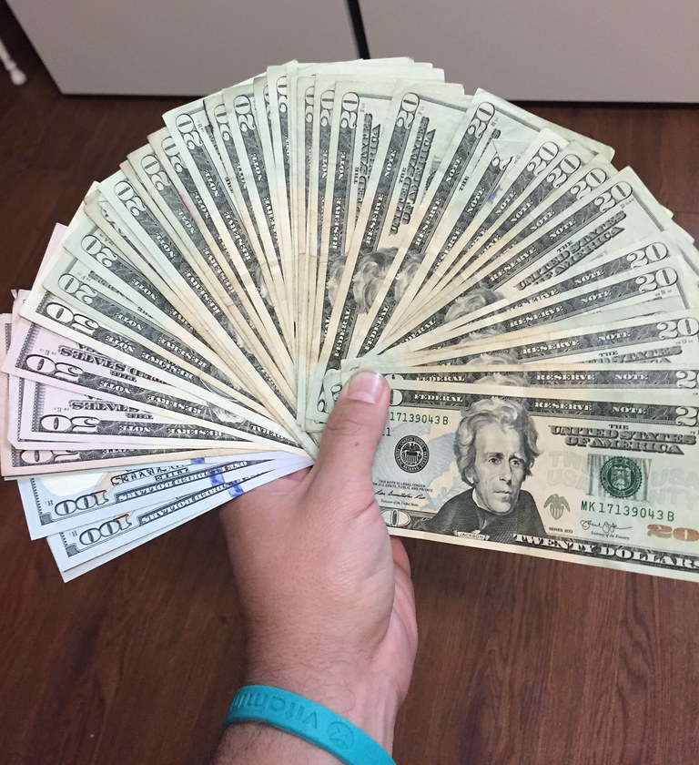
Diagnosis, or lack thereof
Barriers to diagnosis
Cost of testing
Lack of access to health care
Concern for being “labeled”
Gender/cultural disparity
Lack of knowledge
"Money - US Currency" by joncutrer is marked with CC0 1.0.
Notes:
Even though neurodivergence has a long history and we have a better understanding and better labels for these conditions, there are still barriers to receiving these diagnoses. Self-diagnosis is somewhat common in neurodiverse circles, mainly due to the difficulty (or lack of desire) of accessing formal diagnosis. There are few – if any – types of neurodivergence that can be diagnosed based on a blood test or an x-ray. There are also systemic barriers to diagnosis, such as the high cost of testing, whether or not you have health insurance, and whether or not that health insurance even covers assessments.

Slide 16
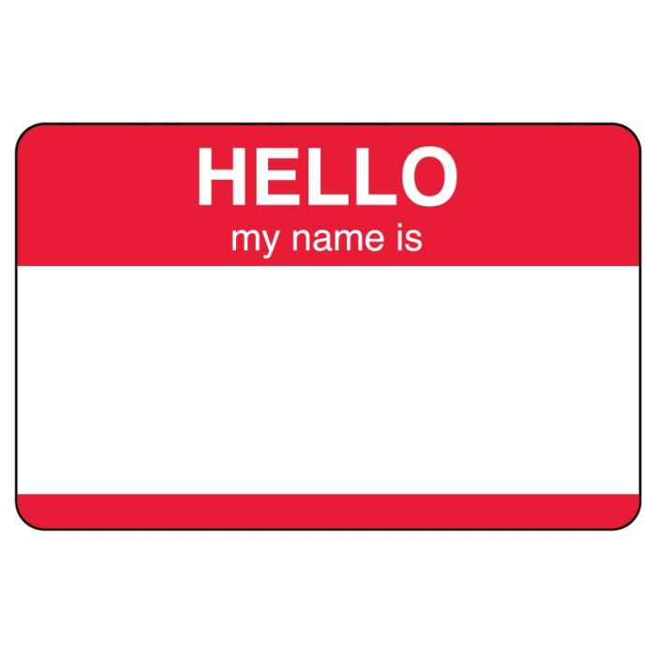
Diagnosis, or lack thereof
Barriers to diagnosis
Cost of testing
Lack of access to health care
Concern for being “labeled”
Gender/cultural disparity
Lack of knowledge
“disruptive in class”
“problem child”
“just needs to focus”
Notes:
I grew up in the era of “don’t label my child,” so unless something was extremely apparent and detrimental, it was ignored. There are many, many people finding out in adulthood that they are neurodivergent because of the stigma of neurodiversity, and previous generations not wanting them to be labeled a problem child. This is especially relevant in the current political climate, where earlier this year the Health and Human Services Secretary floated the idea of creating a registry to track Americans with autism.

Slide 17

Diagnosis, or lack thereof
Barriers to diagnosis
Cost of testing
Lack of access to health care
Concern for being “labeled”
Gender/cultural disparity
Lack of knowledge
"Gov. Inslee and First Lady Trudi Inslee visited a kindergarten class at Fort Stevens Elementary in Yelm" by WaStateGov is licensed under CC BY-ND 2.0.
Bussing et al. in Barriers to Detection, Help-Seeking, and Service Use for Children with ADHD Symptoms (2003)
Guerrero et al. in Understanding the Barriers to Receiving Autism Diagnoses for Hispanic and Latinx Families (2022)
Notes:
An ADHD study in kindergarteners found that boys are more than 5 times more likely to be evaluated, diagnosed, and treated than girls, and white children are more than twice as likely to be evaluated, diagnosed, and treated than Black children, even when they show equal indicators of ADHD.
There is evidence that first generation American born Latinx children are less likely to be diagnosed with Autism, and that language and cultural differences are a significant barrier to diagnosis.

Slide 18
Diagnosis, or lack thereof
Barriers to diagnosis
Cost of testing
Lack of access to health care
Concern for being “labeled”
Gender/cultural disparity
Lack of knowledge
Notes:
One of the reasons behind this presentation is to combat this lack of knowledge. We don’t know what we don’t know. I spent many years thinking I was broken in some way because I struggled with things other people had no trouble completing. My grades suffered, my confidence suffered, and my relationships suffered because I didn’t have any strategies to improve them. It wasn’t until relatively recently that I realized I am not in fact broken, my brain is just running a different operating system than many of my peers. Now, I have resources to communicate with fellow neurodivergent people across the world and share tips and tricks for getting through a world that wasn’t set up for us.

Slide 19
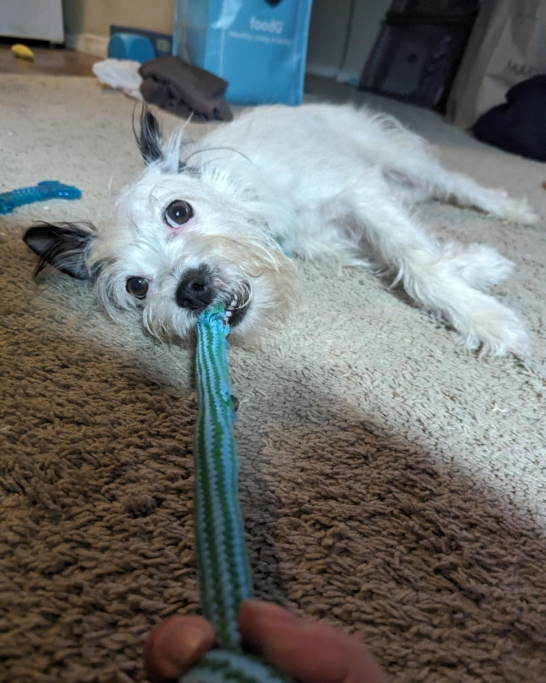
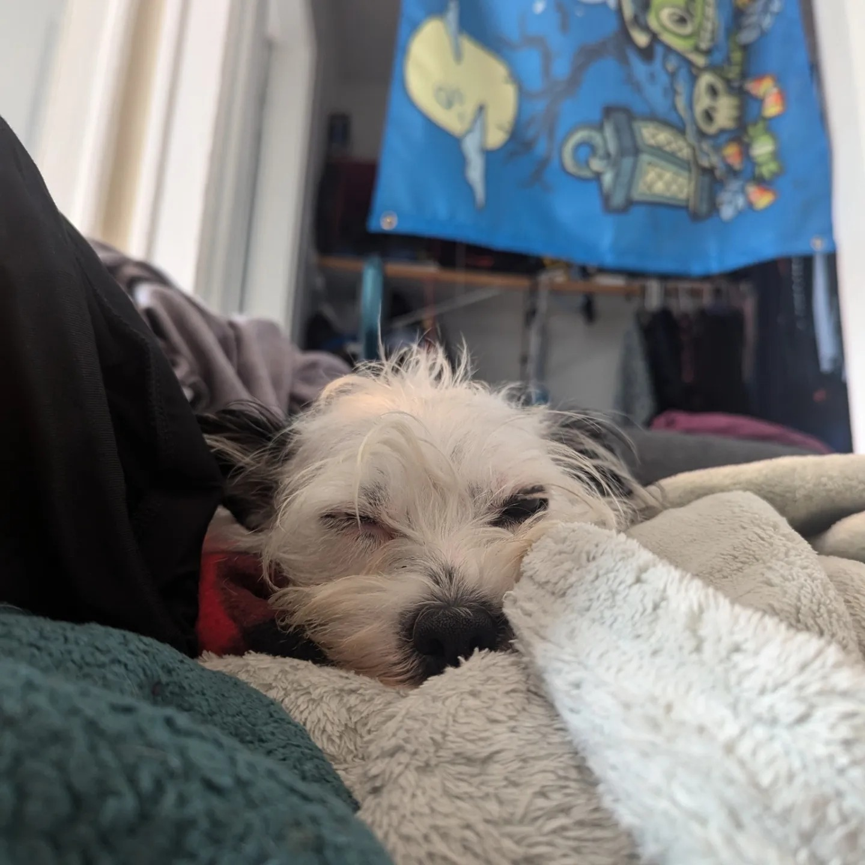
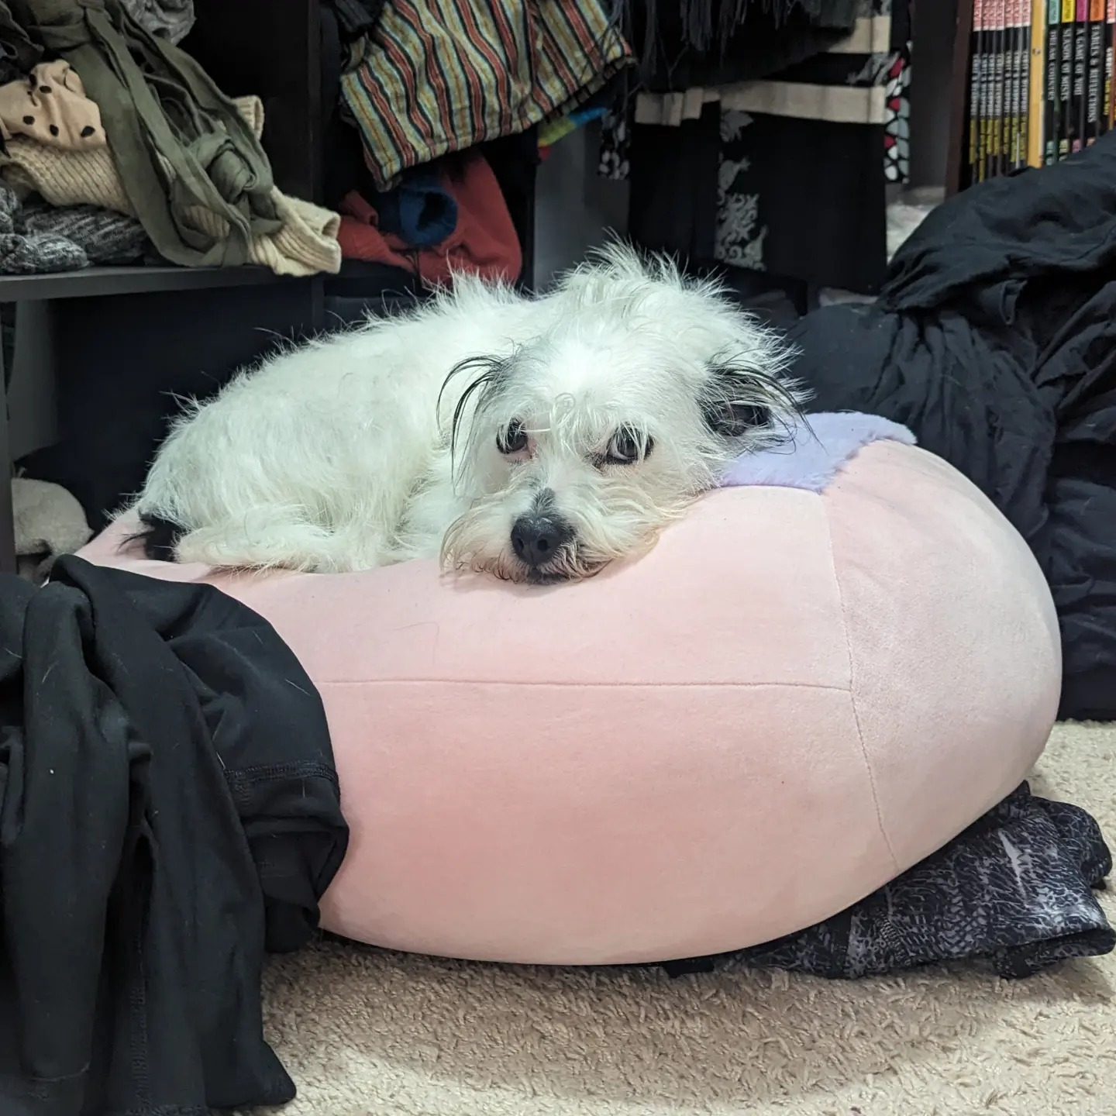
Time for a brain break!
Notes:
We’ve gotten through the basics, so I invite everyone to take the opportunity to stretch, drink some water, and ask any questions you may have thus far. If no questions, I'll count to 5 and then we'll move on to some common experiences of neurodivergent people, and what they mean in a larger sense.

Slide 20
Common facets of neurodivergence
(a non-exhaustive list)
Notes:
These are all very different diagnoses, but there are some commonalities that are shared amongst several. We are now going to go over some facets of neurodivergence that are relevant to the workplace, and particularly to a clinical setting.

Slide 21
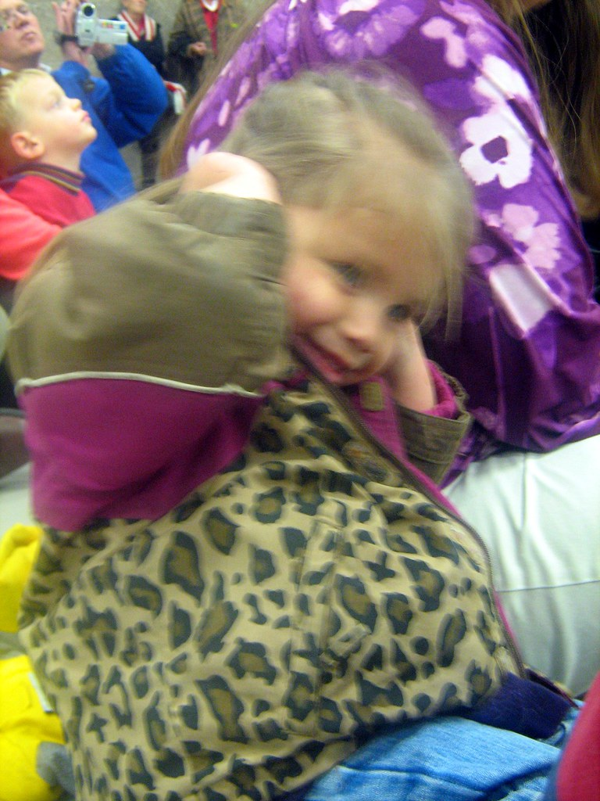
Sensory processing disorder
Studies estimate that 5-16.5% of the population have symptoms of sensory processing disorders, with higher concentration in Autism and ADHD.
Sensory overload
Symptoms of sensory overload include
Extreme irritability
Urge to block incoming sensory signals
A sense of panic or desire to escape
Feeling stressed/stimming
Fatigue
Restlessness and discomfort
"Maria covering her ears" by oddharmonic is licensed under CC BY-SA 2.0.
https://neurodivergentinsights.com/blog/sensory-overload-in-adhd
Notes:
Sensory overload – think about everything going on at a veterinary practice. You walk into the building and you hear barking dogs, the washer and dryer running on heavy soil, and the chatter of your colleagues and clients. The radio is playing classical music in the cat room. You see that one of the overhead lights is flickering, and another has just been replaced so it’s much brighter in one area than another. You realize that your scrub top has a tag that is going to be scratching your side the whole day. You smell Feliway, disinfectant, and – if you’re unlucky – yeasty ears and Parvo puppies. That is a lot of sensory input, and for someone who can’t block any of that out it can be overwhelming.

Slide 22
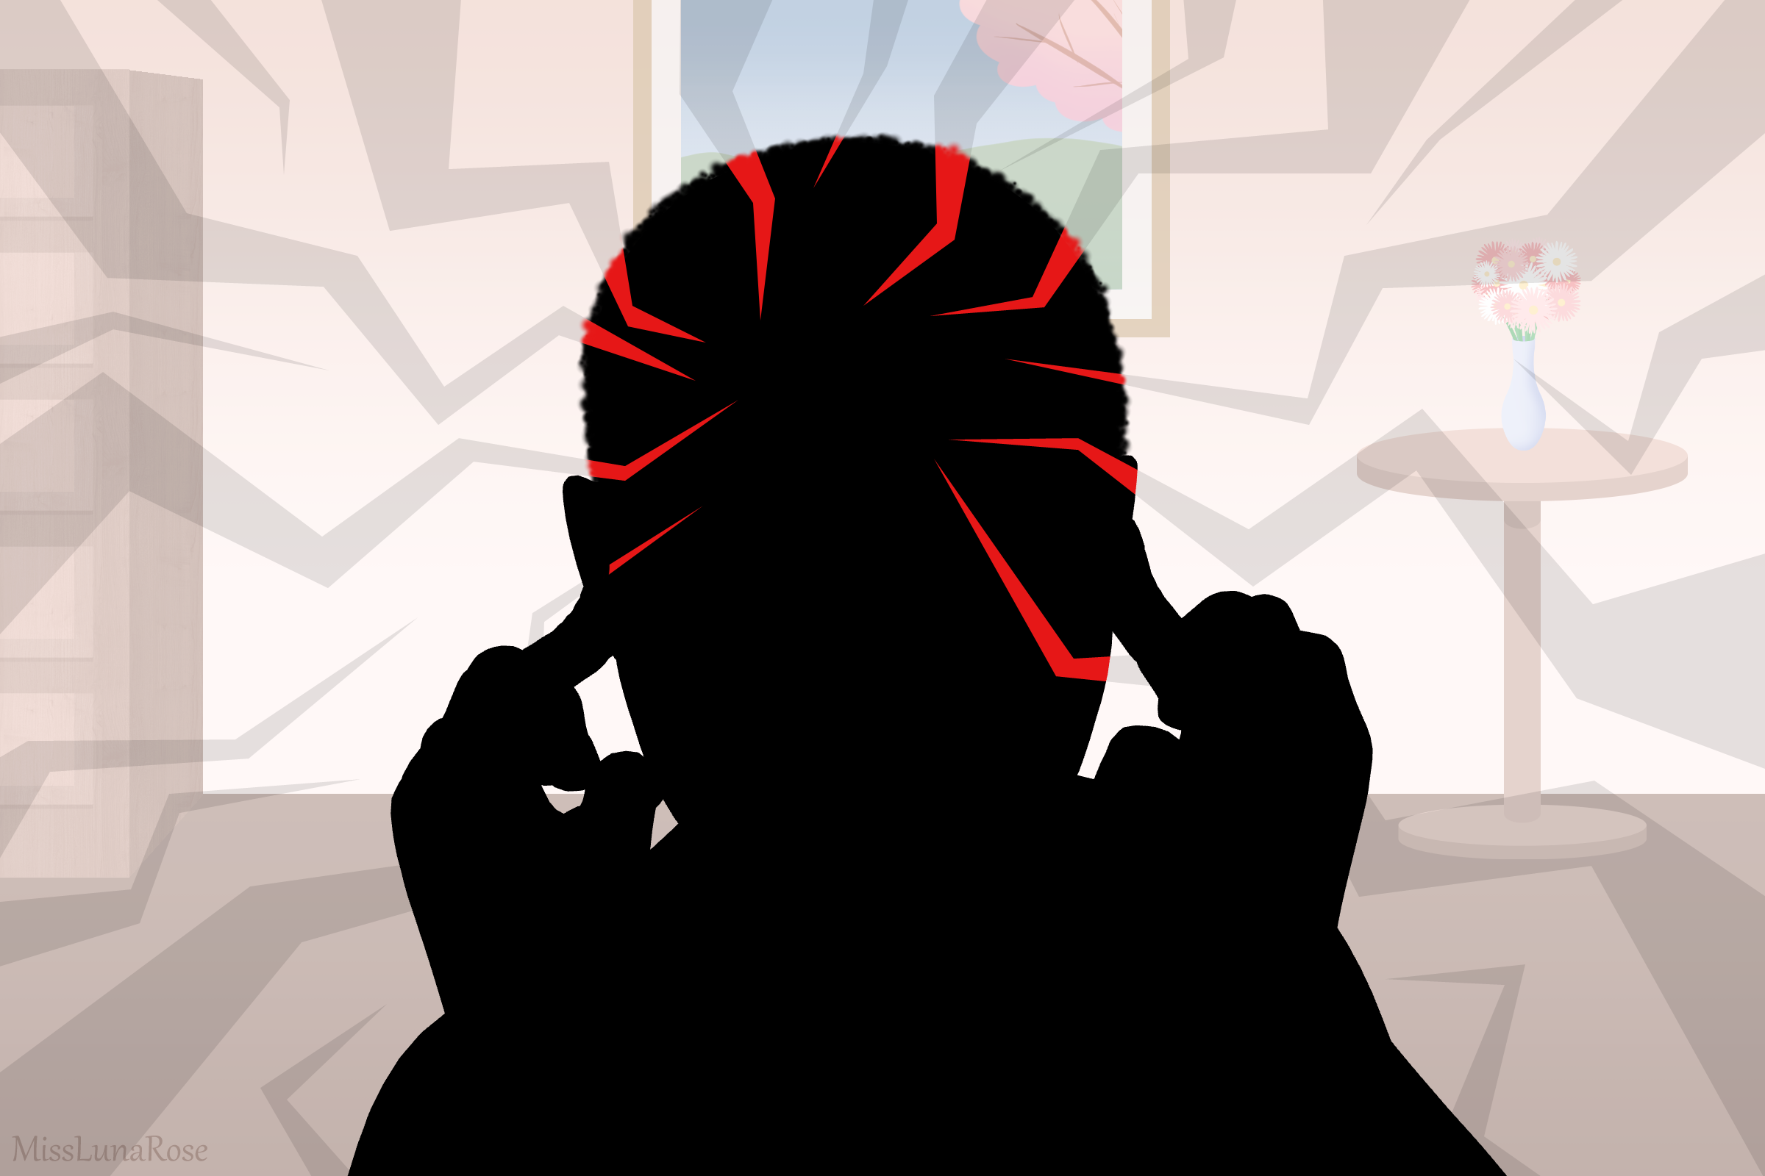
Auditory sensitivity/overload
Physiological and psychological internal states of an individual that increase the degree of reactivity to noise in general.
Think barking dogs, beeping monitors, ultrasonic cleaners/scalers
Common in (but not exclusive to) anxiety disorder, autism, major depressive disorder, schizophrenia, and traumatic brain injury.
Notes:
This person may not be able to focus on a conversation at a dinner party where several are happening, or prefers to use noise canceling headphones when they work on a project. For example, I work in an office with five other people, plus veterinarians and other staff coming in to discuss cases. If two conversations are happening concurrently, I can’t focus on either of them. This is especially bad when the speakers are on opposite sides of the room, talking over my head. We also have some surgeons who like to play music in the OR – I have turned down the volume once they’re scrubbed in to a level I can tolerate.

Slide 23
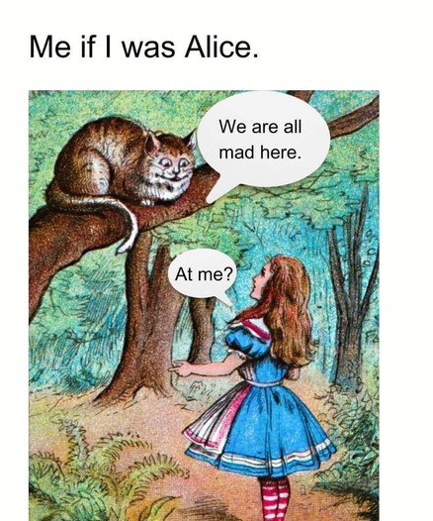
Rejection sensitive dysphoria
Overwhelming emotional pain triggered by rejection (or perceived rejection)
Commonly linked to ADHD
Not an officially recognized diagnosis/symptom (yet)
https://my.clevelandclinic.org/health/diseases/24099-rejection-sensitive-dysphoria-rsd
Notes:
A generally favorable performance review with one suggestion for improvement might cause this person to burst into tears, become suddenly withdrawn, or become uncharacteristically angry.

Slide 24
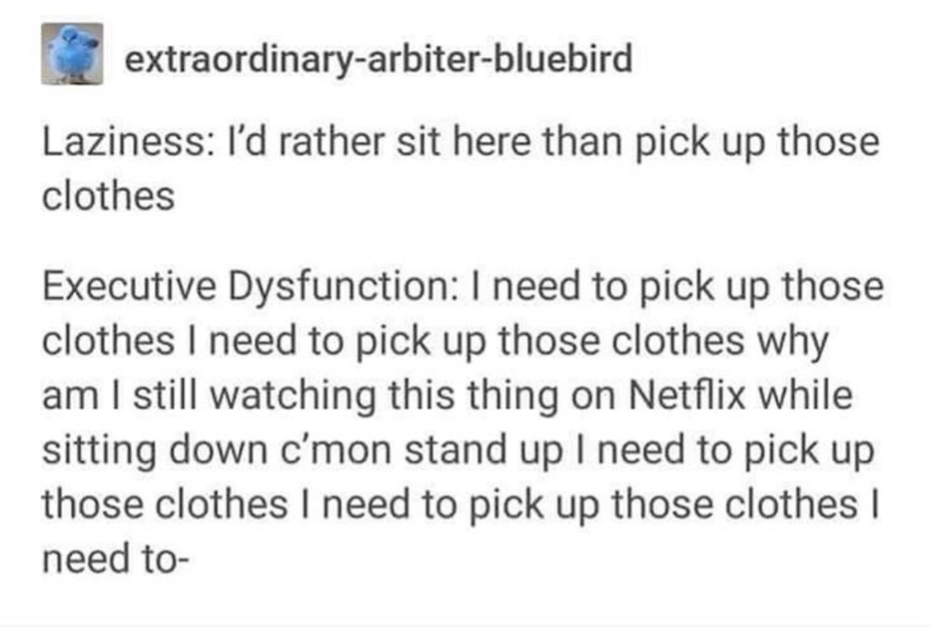
Executive dysfunction
Difficulty planning, initiating, and completing goal-directed activities.
Common in (but not exclusive to) major depressive disorder, Autism, ADHD, OCD, and bipolar disorder.
Notes:
This one gets a lot of people into trouble at work if they don’t have a handle on it. You know there are things you need or want to do, but actually doing them feels insurmountable. You need to fold the towels and put them away, but doing it at this moment seems impossible. This isn’t limited to things that NEED to be done. Hobbies can be waylaid by executive dysfunction just as easily as daily work tasks. Executive dysfunction can come and go in waves – sometimes all of my laundry is washed, folded, and put away all in the same day. Sometimes it isn’t. Sometimes I can knock out an hour long powerpoint presentation in two weeks. Sometimes it takes two months.

Slide 25
Masking
“When an Autistic person is not given resources […] and when they are told their stigmatized traits are just signs that they’re a disruptive, overly sensitive, or annoying kid, they have no choice but to develop a neurotypical façade. Maintaining that neurotypical mask feels deeply inauthentic and it’s extremely exhausting to maintain.”
Devon Price PhD, “Unmasking Autism”
Notes:
Now we’re going to talk about masking. I’m going to share a few passages from Unmasking Autism by Dr. Devon Price. Though the book is primarily written through an Autistic lens, many of the chapters can be more widely applied to neurodivergence in general. The book is, overall, a great resource for understanding neurodivergence.

Slide 26
Masking
“Conforming to neurotypical standards can earn us tentative acceptance, but it comes at a heavy existential cost. Masking is an exhausting performance that contributes to physical exhaustion, psychological burnout, depression, anxiety, and even suicidal ideation.”
Devon Price PhD, “Unmasking Autism”
Notes:
Masking refers to a neurodivergent person suppressing their natural behaviors to fit into society’s definition of “normal.”
Think of an event you were forced to attend, or your least favorite cousin’s wedding, and how excruciating it was to pretend you were happy to be there, that you were enjoying yourself as much as everyone else, and that you weren’t ready to leave the minute you walked in. You have to plaster on a smile for photos you don’t want to take, with people you don’t like, at an event you don’t want to attend. It sucks, right? Hiding your true self is exhausting, and especially so in a job field where we are already at a higher risk of burnout and suicidal ideation.

Slide 27
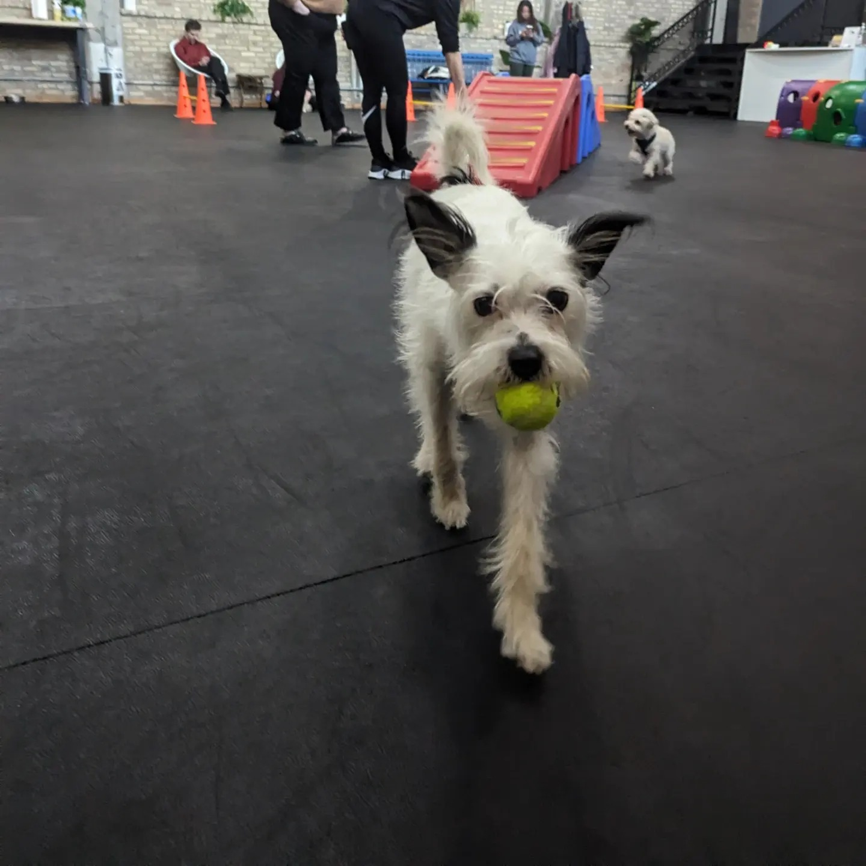
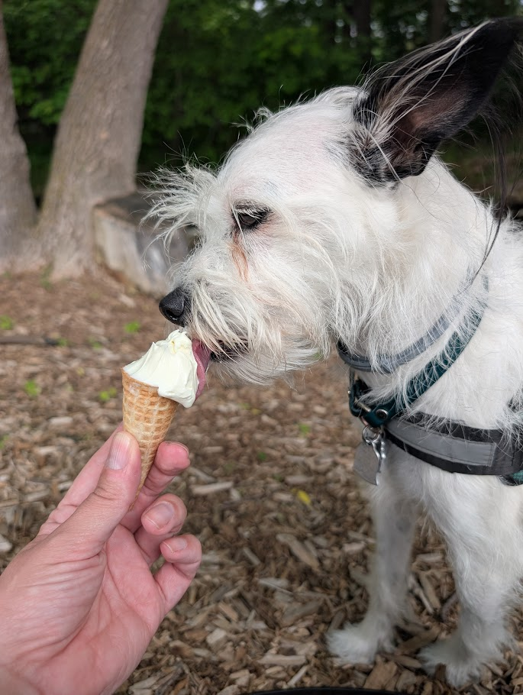
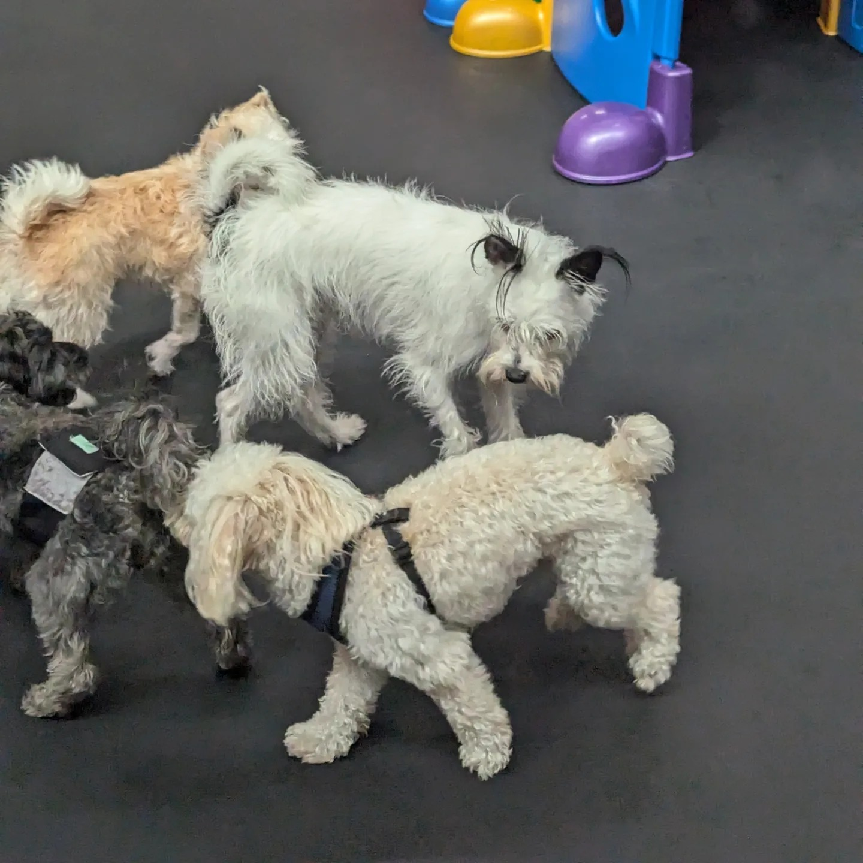
Time for a brain break!
Notes:
We’re done with the research portion of the presentation, and I think now is a good time for another stretch, water refill, and any questions about the previous material before we get into strategies and accommodations for a more inclusive workplace.

Slide 28
Okay, so what do we do about all this?
Strategies for working as, with, or for neurodivergent people
Notes:
For this presentation, I had a conversation with a colleague who is diagnosed with ADHD and suspects she is Autistic. I asked her what she wished more people understood that would make a big difference in her work life. All of these strategies are things that have worked for us, or for neurodivergent people in my life who had suggestions. Some of these strategies may be helpful for communicating with neurodivergent colleagues, and others may be helpful tools for neurodivergent people to manage themselves in the workplace.

Slide 29
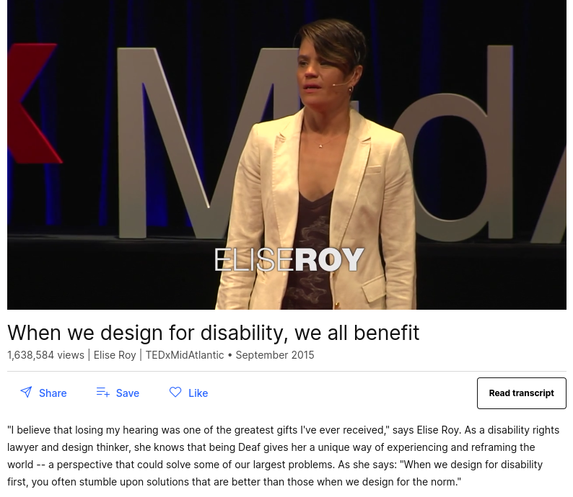
Notes:
There is an excellent TEDtalk, pictured here, called When we design for disability, we all benefit, by Elise Roy. She discusses how innovation intended to help disabled people often turns out to benefit the larger group. Text messaging, originally designed for people who are Deaf, is now used universally. Potato peelers, designed for people with arthritis, are in pretty much every kitchen. You will find as we move through this part of the talk, that a lot of these strategies are not exclusively helpful to neurodivergent people. Implementing these strategies in your life, in your practice, could end up being a net good for every single employee even though they are originally designed for neurodiverse groups.

Slide 30
Workplace strategies
Address issues right away
“If I messed something up in the room, tell me once we have exited the room. Not tomorrow, as chances are the problem is long forgotten.”
Be patient
“[People with ADHD] ask so many questions and think of outside of the box way[s] to do things because that’s just how our brains function. We may just need to talk it out to realize ‘oh, that won’t work’ or physically test something first.”
“If we say something that comes across wrong we might not mean it that way or have misunderstood the situation. Very blunt and honest literal thinking on social aspects.”
Notes:
If you have annual reviews, this may be familiar. Being told “you need to work on your attitude” or “you’re folding the surgical packs wrong” is not helpful without specific incidents, or so far in the future that you don’t remember what they’re referencing. Correction is best done right away, or as soon as possible without causing a public scene.
Remember that nobody’s brain works exactly like yours. Something that might be obvious to you may not be obvious to someone else. They may have seen a new bandaging trick on Tiktok and want to try it out on the next happy tail injury. Even if you’re pretty sure it’s not going to work, let them get it out of their system so they can let go of the thought.
If you think someone is being out-of-nowhere rude, question what they mean by that. They may not know it came out sounding worse than it was intended.
Conversely, being naturally blunt and honest is not a free pass to be rude. If a client says they’re having difficulty paying for Vetsulin, there’s a difference between “insulin is super important, we can see if there’s a less expensive formulation we can script out” and “Fluffy will die if you don’t give her insulin.” The latter may be true, but it isn’t particularly helpful right now.

Slide 31
Workplace strategies
“Know that rejection/criticism of any sort
is taken very deeply to heart.”
Notes:
This is not to say that you shouldn’t criticize neurodivergent people. This is to say that if you snap at someone and they avoid you for the rest of the day, this is probably why. Additionally, excessive criticism with no praise will drive a perfectly competent CVT to quit your clinic. Criticism can be much better received when it comes along with appreciation for the quite often difficult job we are all doing. Be direct, but be kind.
“I appreciate that you always get the laundry done, but when you fold the towels this way they’re difficult to unfold easily into a kennel. Let me show you what I mean with this next load of laundry.”
“I know you enjoy running lab work but once you make the slides can you come back to the exam room to finish up? You can read them later when we have a break in appointments.”

Slide 32
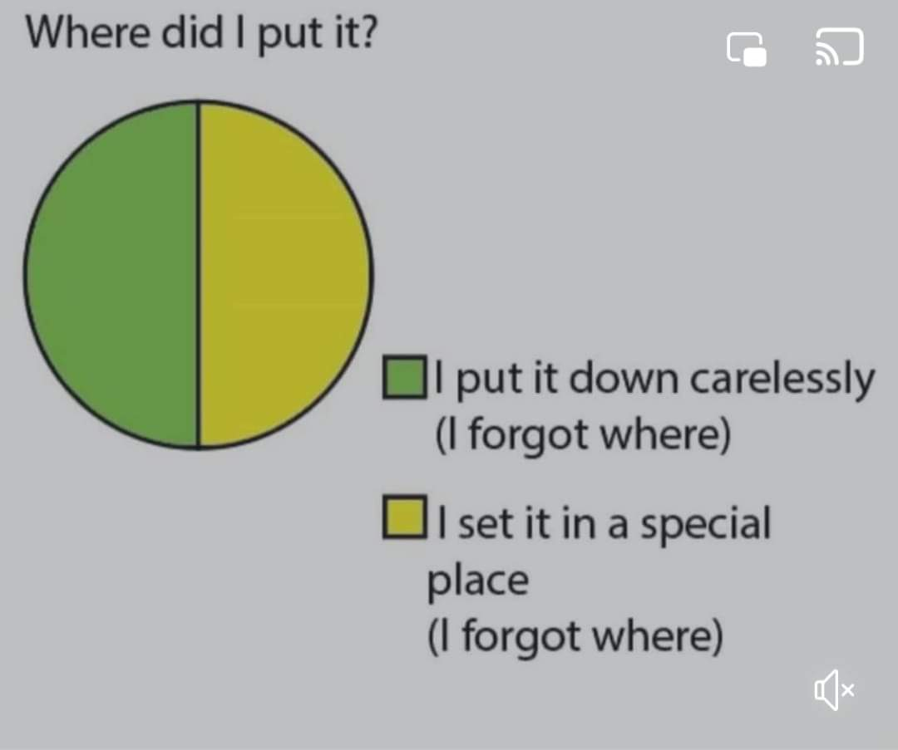
Workplace strategies
Do not put things down until you’re done with them.
One of my colleagues has referred to me as “Gretel” because of my habit of leaving a trail of misplaced objections in my wake.
If I am transporting a piece of equipment from one room to another, or taking a box of syringes to restock a room, I do not take my hands off that piece of equipment until it has reached its destination.
Have a math buddy
If you have dyscalculia, have a trusted colleague check your calculations. Making a list of common formulae and what it means may also be helpful.
Notes:
While I was assembling the slides for this presentation, my officemate came into the office holding my jacket and work keys. I’d left the keys in a door, and the jacket on top of the rack of oxygen tanks. I’d been using the keys to open the door, and I’d taken my jacket off because the hallway was warm, and as soon as those two objects left my hands they ceased to exist.
Cold saline story
Tape measure!

Slide 33
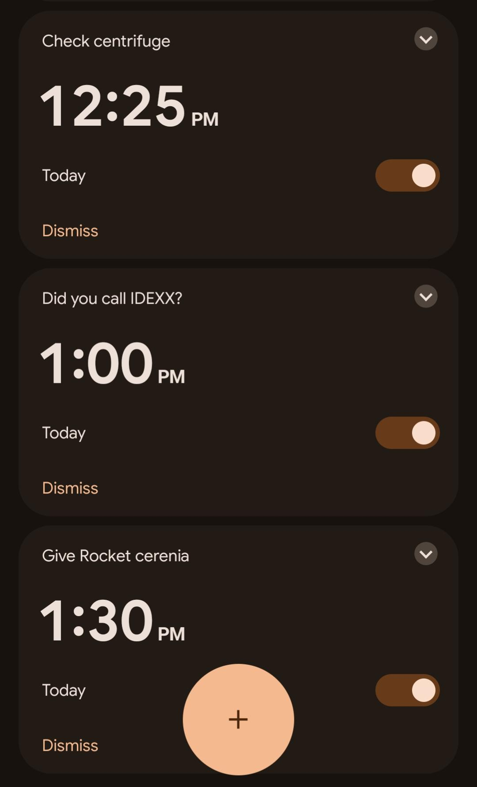
Workplace strategies
Set alarms
It can be really difficult to pull yourself away from something (e.g. looking at really cool pathology under the microscope), so setting a 5 minute timer for yourself can break the focus long enough to move on to the next thing.
Also helpful for reminding oneself to do something – this animal needs medication at 1:30 p.m., so I set an alarm to make sure it gets done.
Notes:
Time blindness and hyperfixation can be tough for neurodivergent people, and in turn for their colleagues who don’t know how to tell them they need to move on from a task.
Your reminders might look like this – you just put a blood sample into the centrifuge, and need to remember to go back and take it out at 12:25 to finish processing. And, in case you get distracted during this process, you set a reminder alarm asking yourself if you called IDEXX for a pick up. One of the vets also asked you right at the start of your shift to give Rocket another dose of Cerenia at 1:30, so you set another reminder alarm to make sure Rocket gets his meds on time.

Slide 34
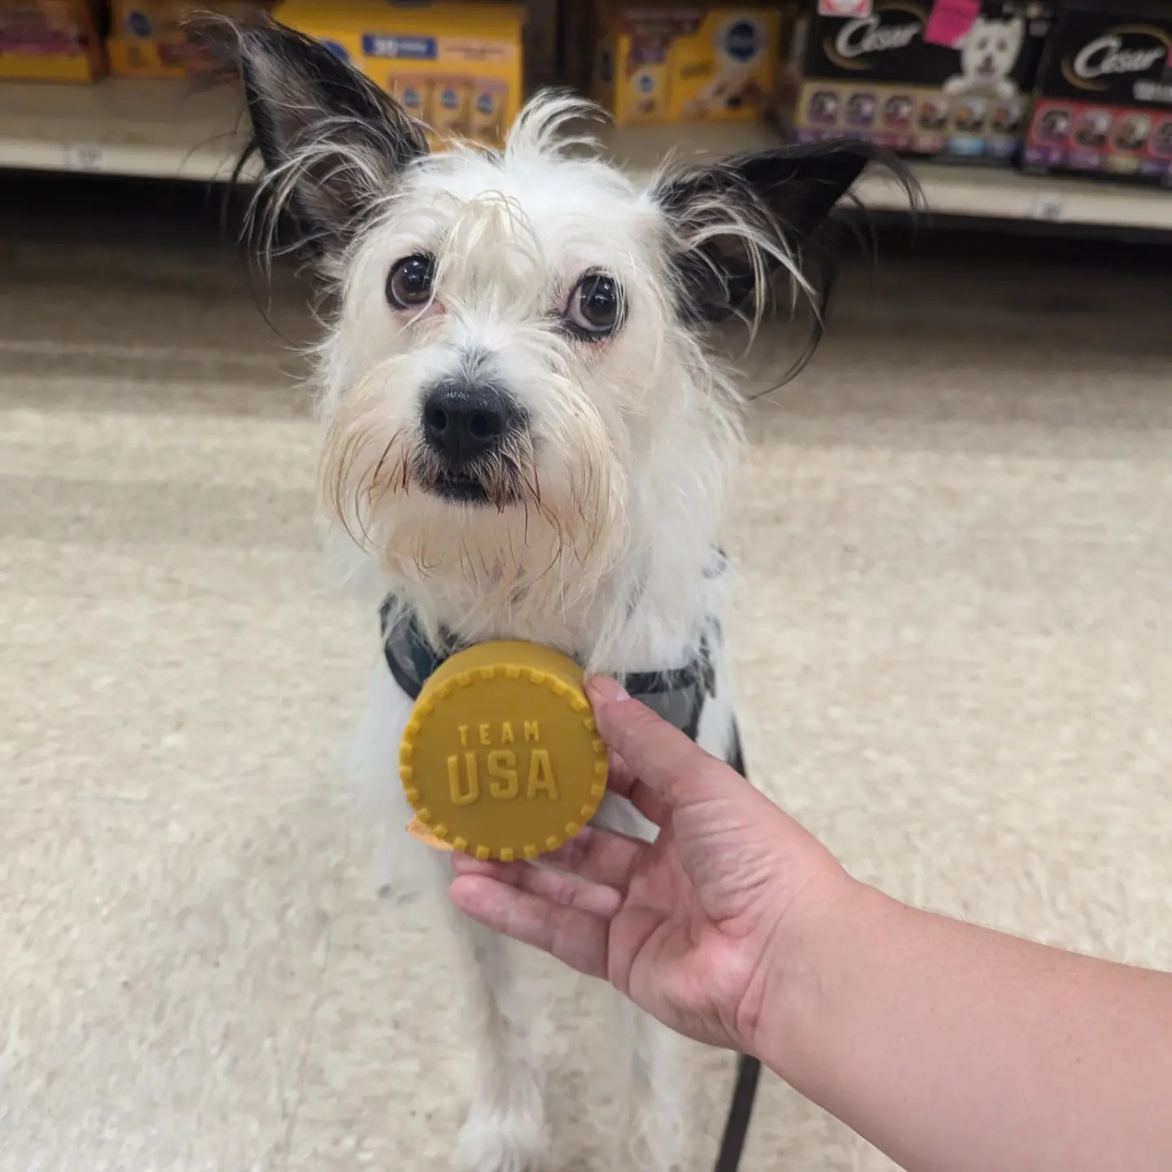

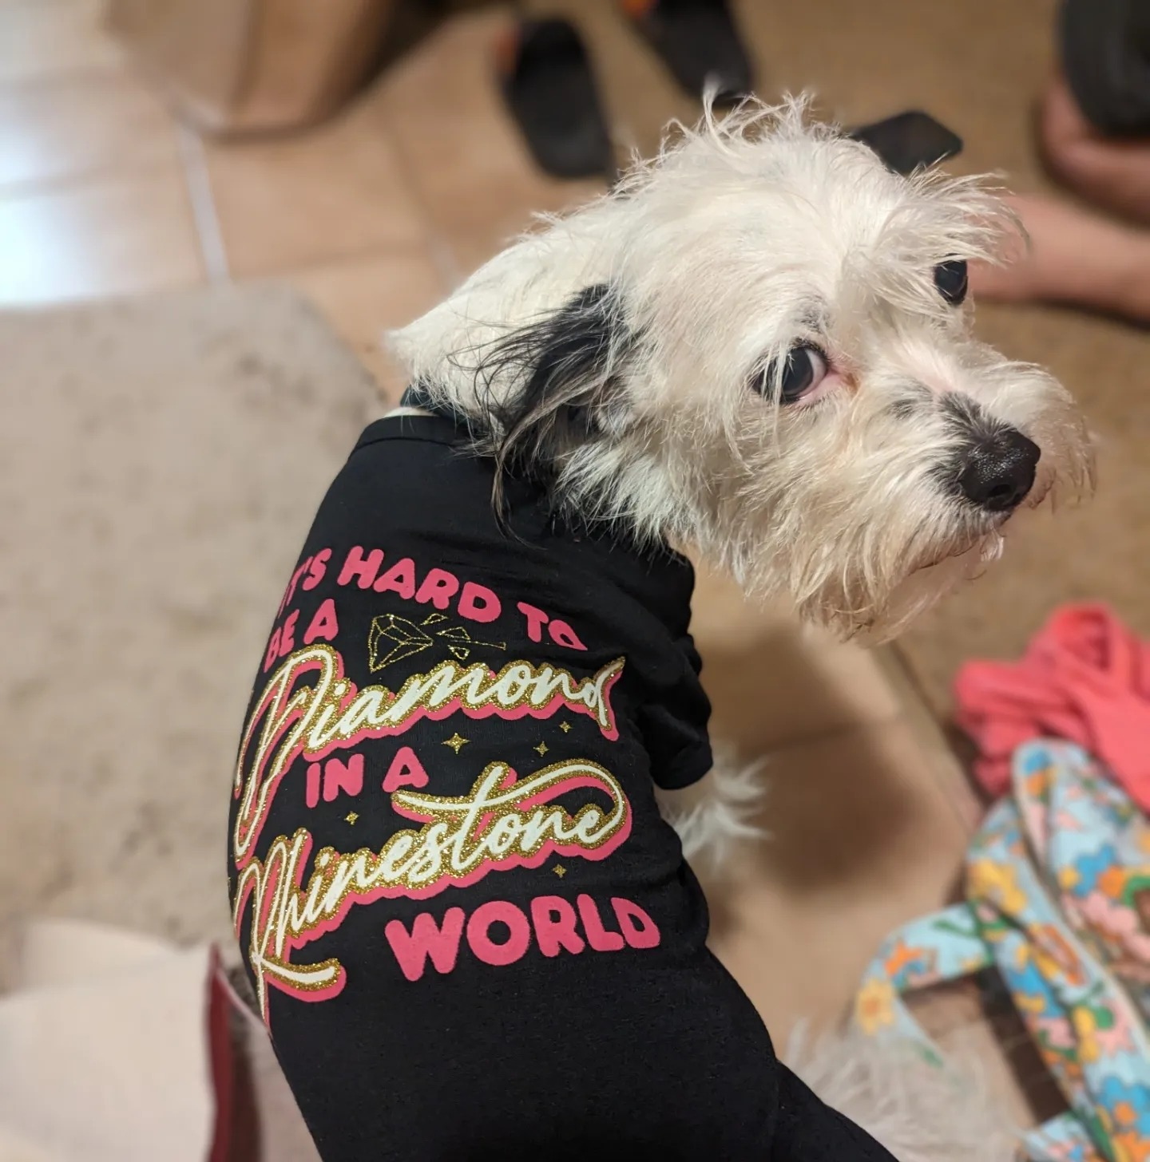
Time for a brain break!
Notes:
Next, we’re going to talk about some very easy - and usually cheap or free – accommodations that can be implemented in a veterinary clinic to improve the quality of life for your neurodivergent employees. Remember again, that when we design for disability, we all benefit. Even if you’re neurotypical, quite a few of these might sound like a good idea anyway.

Slide 35
Easy Accommodations
Getting some alone time on lunch
Important to have some quiet time to rest and recharge for the afternoon.
Reminder: Illinois employees must receive a lunch break of at least 20 minutes if you are working 7.5 continuous hours, no later than 5 hours after the start of your shift.
Ear plugs/ear muffs (auditory sensitivity, sensory processing disorder)
Noise aversion is very common, especially barking dogs, beeping machines, and the sound of the ultrasonic scaler.
Consistent scheduling
“I suck at keeping and making my own routine, but thrive if one is in place.”
https://www.who.int/news-room/questions-and-answers/item/deafness-and-hearing-loss-safe-listening
Notes:
Time alone example: Marek bothering Jenny while she’s trying to read on lunch
The noise level of barking dogs in a kennel can range from 85-122 decibels. At levels greater than 85, hearing loss can occur from regular exposure. Hearing protection, like ear plugs or ear muffs, will go a long way toward you keeping your hearing through retirement. I have Loop earplugs at my desk. If you haven’t heard of them before, their purpose is to filter background noise enough – about 16 dB – that you are less distracted by extraneous noise but can still hear people speaking to you. I like these because I can still do my job, but I can get some relief from conversations happening down the hall from me, or the sound of the refrigerator in the next room, or the HVAC kicking on. Paired with over-ear headphones, I can block out almost anything.
This one is not just for neurodivergent people. Does the clinic’s work schedule have to be set only 2 weeks in advance? Is it possible to have set shifts for each person instead? One of the best perks of my job is that we have a standard rotation where I work every fourth weekend, and have weekdays off on the same schedule. I can plan dental appointments months in advance and don’t have to put in a time off request because I know that in March I’ll have Friday the 28th off. At a recent technician career fair, one of the biggest selling points was that we had a set schedule.

Slide 36
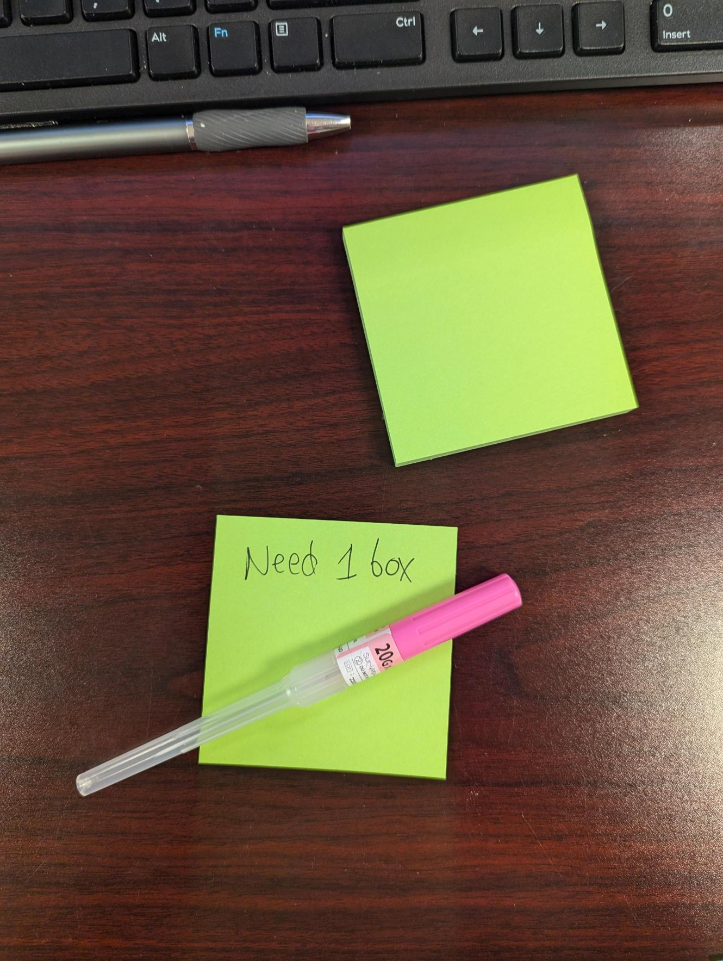
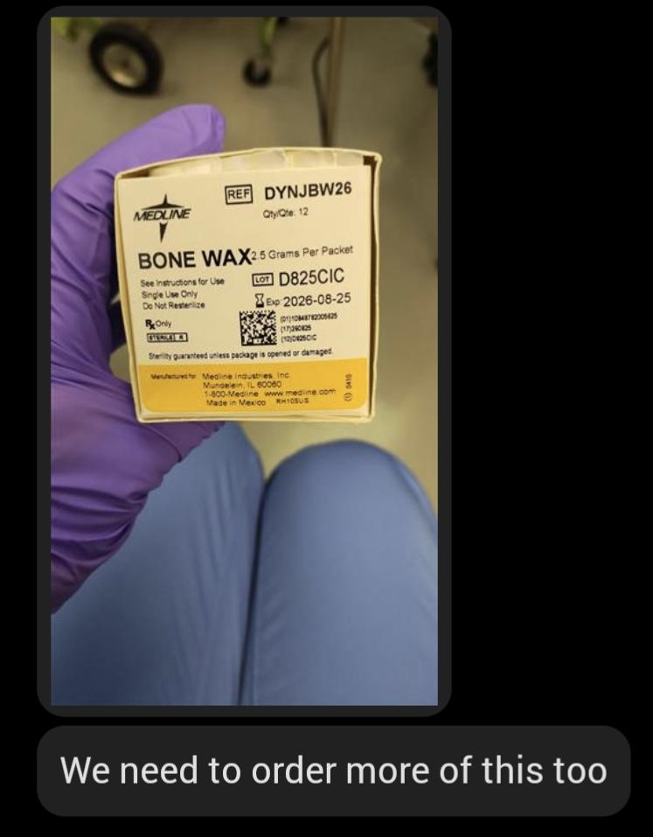
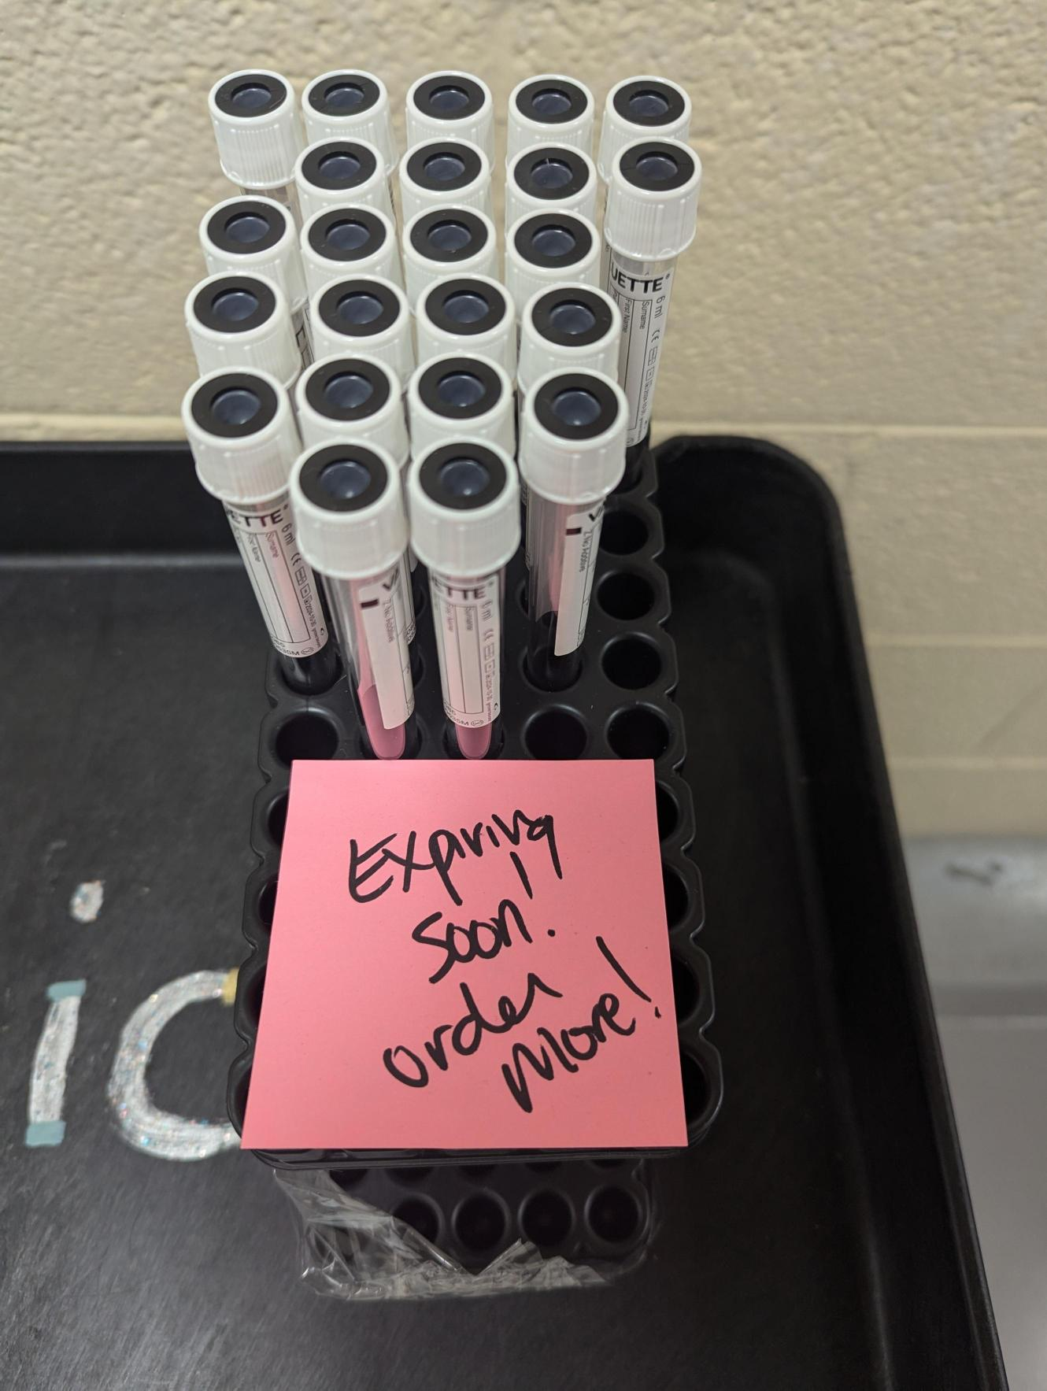
Easy Accommodations
Putting it in writing
Use sticky notes, email, Microsoft Teams, or Slack – whatever works
Notes:
I have two bosses, and both are great. However, there are days when both of them will be asking for something to be done, often at the same time. My brain isn’t great at holding two things in my head at once, so making two requests at the same time means that (at best) only one of them is getting done. After some time of me feeling like a miserable failure and my bosses feeling like I’m purposely refusing to do work, they finally brought it up during a review. They explained that they felt like I was neglecting to do certain tasks because I didn’t want to do them. I explained that I absolutely didn’t mean for it to come across that way, and went into some detail about how my brain processes multiple pieces of information. Our solution for this is that, if I’m not at my desk, they leave a sticky note with the requested task. If neither of us are near my desk, they send me a Teams message about the task. If it’s a specific item that needs to be reordered, they will put a “reorder this” note on my desk along with one example item so I know exactly what I’m looking for. Give me a physical, visual reminder that I have a task to complete, and it will be done.

Slide 37
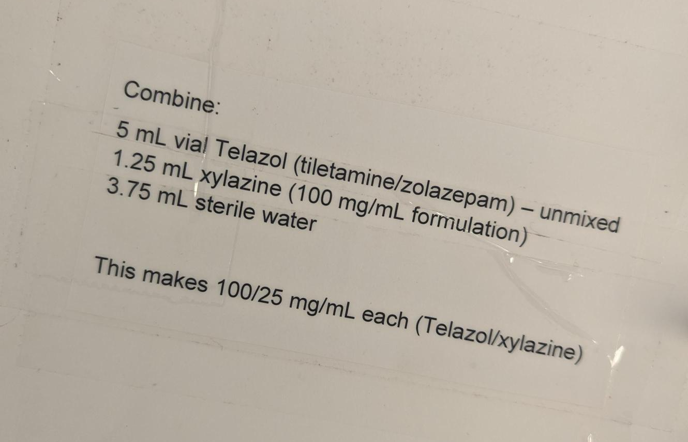
Easy Accommodations
Make (and maintain) important information where it’s needed
Instructions for drug dilutions where the drugs are kept
Notes:
This is a photo from our controlled substance log book, specifically the divider page facing our Telazol logsheets. For years, everyone either kept a sticky note of this dilution at their desk, or had them memorized. This worked, but if the sticky note went missing, that information was lost until someone who had it memorized could be asked for a new one. So, we printed it up and put it in the log book where the “bad at numbers” crew could always have it ready when they needed it.

Slide 38
Easy Accommodations
If you don’t know, ask!
If someone discloses to you that they are neurodivergent, the best next step is to ask what they need from you. What adaptations would help you work together more effectively?
Notes:
The second inspiration behind this presentation is a conversation I had with a fellow CVT who had recently left a clinic. They were working with a new veterinarian who told them they were a particular flavor of neurodivergent, and this CVT had never encountered such a person before. They didn’t have any strategies for communicating well with this person, who didn’t provide any strategies either, and they ended up having so much stress and friction as a result that they quit. I wonder what difference there could have been if these two people had a discussion about what this diagnosis would mean for their working relationship, and what steps each of them could take to improve the situation.
There is a slogan borrowed from the disability rights movement, "nothing about us without us." If you are trying to make accommodations in your workplace, consult with the people who you are trying to help with the result. They will have insight that you may not have considered, and including your neurodivergent staff members in decisions that will affect their lives will show them that you are acting in good faith and that you value them as employees and colleagues.

Slide 39
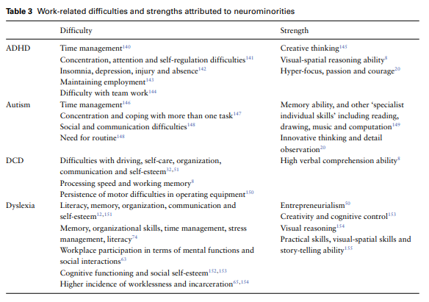
The benefit of a neurodiverse veterinary team
In a 1998 issue of The Atlantic, Harvey Blume wrote:
“Neurodiversity may be every bit as crucial for the human race as biodiversity is for life in general. Who can say what form of wiring will prove best at any given moment?”
https://www.theatlantic.com/magazine/archive/1998/09/neurodiversity/305909/
Notes:
One good example is… me! I am often the culprit when a medical record has gaps, or when a piece of equipment is found in a location that makes no sense. However, I am the go-to person for technology and troubleshooting issues with various machines. I have, on many occasions, forgotten to put the bottle of meloxicam back in the pharmacy and instead left it and a giant tub of strawberry yogurt in the food prep area for an hour until someone else put it away. But, I have also on many occasions, been messaged when I’m not at work so I can figure out a confusing calculation, or explain it clearly to someone whose brain doesn’t make the strange jumps mine does. Teaching new hires in person tends to scramble my brain, but I’ve put together a whole handbook of all of our processes, surgical set ups, and so forth so I can refer them to that instead.
One of my colleagues is an extremely good teacher but has what is likely undiagnosed dyscalculia. She is a very skilled technician, but freely admits she seems to repel technology and can't hold numbers in her head. She trained me in how to intubate a rabbit, and I have walked her through how to use an Engler ventilator just about every time we have to use it. She tends to be the person putting the meloxicam and yogurt away for me, and I tend to be the person to use the back of a junk mail envelope to jot down my calculations for diluting morphine for a CRI on a marmoset on my day off. We work well together because our weaknesses complement each other, and because we are flexible in finding ways to be accommodating. I have often joked that we are two halves of one great veterinary technician.
I also want to thank the neurotypical colleagues who are picking up the slack where their neurodiverse colleagues are perhaps falling short. I am fully aware that my brain is wired to forget any task I'm interrupted during, and that can mean that my colleagues end up doing that last 20 percent for me. I am also exploring strategies to improve my working memory, or find workarounds to reduce how often my colleagues have to pick up after me, and I make sure they are aware of that. Make sure your neurotypical, or differently-neurodivergent, colleagues know that you are (a) aware your particular wiring may be creating extra work for them, and (b) that you appreciate them for doing it. Because the alternative is that they begin to resent you, or even refuse to help you at all anymore because they feel used.
We all know that the shelf life of a CVT is often very short, so many of us leave practice within 10 years of graduation because we’re burned out. I truly believe that if people get better at asking for and giving support where it’s needed, technician retention will improve greatly. If you are working with someone who is neurodivergent, ask what they need from you to be more successful. If you ARE neurodivergent, don’t be afraid to ask for what you need to be more successful. And, if you’re coming away from this talk thinking “wow, some of this really sounds like me,” there are tons and tons of resources online to learn more.

Slide 40
Sources
Bussing, R., Zima, B.T., Gary, F.A. et al. (2003). Barriers to detection, help-seeking, and service use for children with ADHD symptoms. The Journal of Behavioral Health Services & Research 30, 176–189. https://doi.org/10.1007/BF02289806
DCEG Staff. (2022) Neurodiversity. NIH Division of Cancer Epidemiology & Genetics. 2022 Apr. https://dceg.cancer.gov/about/diversity-inclusion/inclusivity-minute/2022/neurodiversity
DeBattista, C. (2005). Executive dysfunction in major depressive disorder. Expert Review of Neurotherapeutics, 5(1), 79–83. https://doi.org/10.1586/14737175.5.1.79
Doyle, N. (2020). Neurodiversity at work: a biopsychosocial model and the impact on working adults. British medical bulletin 135(1): 108-125.
Guerrero MGB, Sobotka SA. (2022). Understanding the Barriers to Receiving Autism Diagnoses for Hispanic and Latinx Families. Pediatr Ann. 2022 Apr;51(4):e167-e171. doi: 10.3928/19382359-20220322-03. Epub 2022 Apr 1. PMID: 35417307; PMCID: PMC9584143.
Goldberg, H. (2023). "Unraveling Neurodiversity: Insights from Neuroscientific Perspectives." Encyclopedia 3(3): 972-980.
Lange, K.W., Reichl, S., Lange, K.M. et al. (2010). The history of attention deficit hyperactivity disorder. ADHD Atten Def Hyp Disord 2, 241–255. https://doi.org/10.1007/s12402-010-0045-8
Miller LJ, Schoen SA, Mulligan S, Sullivan J. (2017). Identification of Sensory Processing and Integration Symptom Clusters: A Preliminary Study. Occup Ther Int. 2017 Nov 16;2017:2876080. doi: 10.1155/2017/2876080. PMID: 29348739; PMCID: PMC5733937.
National Institute of Mental Health. (2024). “Autism Spectrum Disorder.” Accessed 2024 Sept. https://www.nimh.nih.gov/health/topics/autism-spectrum-disorders-asd
Posar, A. and P. Visconti (2017). "Tribute to Grunya Efimovna Sukhareva, the Woman who First Described Infantile Autism." Journal of Pediatric Neurosciences 12(3): 300-301.

Slide 41
sources
13. Price, D. (2022). Unmasking Autism. National Geographic Books.
14. Roy, E. (2015, Sept.) "When we design for disability, we all benefit" [Video]. TED Conferences. https://www.ted.com/talks/elise_roy_when_we_design_for_disability_we_all_benefit?subtitle=en
15. Sadasivan, A. (2013). 8 - Neuropsychological Intervention for Specific Learning Disorder: An Innovative Approach. Neuropsychological Rehabilitation. J. Rajeswaran. Oxford, Elsevier: 155-175.
16. Shepherd D, Heinonen-Guzejev M, Hautus MJ, Heikkilä K. (2015). Elucidating the relationship between noise sensitivity and personality. Noise Health. 2015 May-Jun;17(76):165-71. doi: 10.4103/1463-1741.155850. PMID: 25913556; PMCID: PMC4918655.

Slide 42
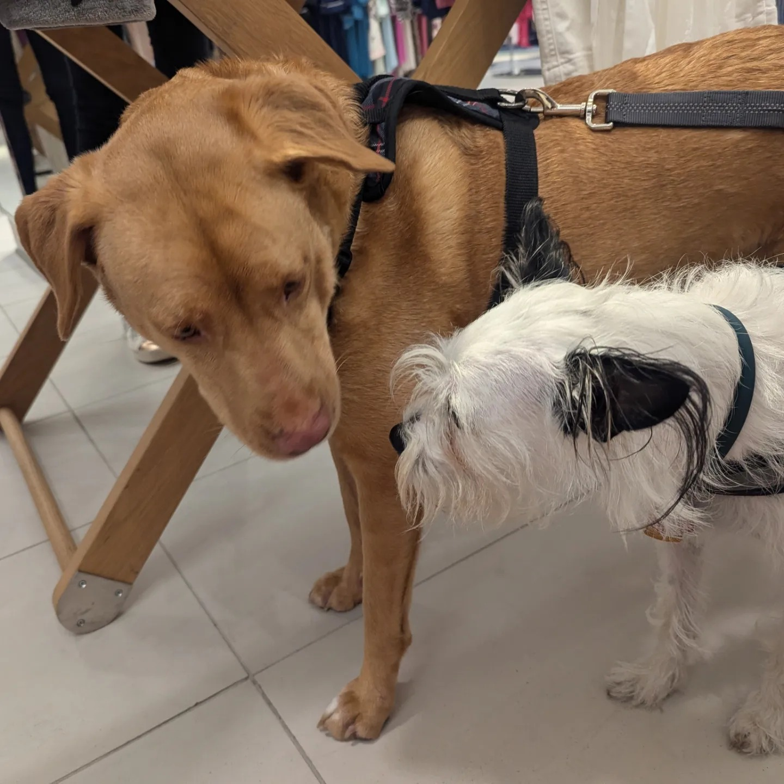
Questions, comments, anecdotes?
???
???

