Slide 1
Beyond pizza parties
What CVTs actually want from their jobs
Presented to the ISVMA 2025 annual meeting
By Alyssa Brown, BA CVT RLATg

Slide 2
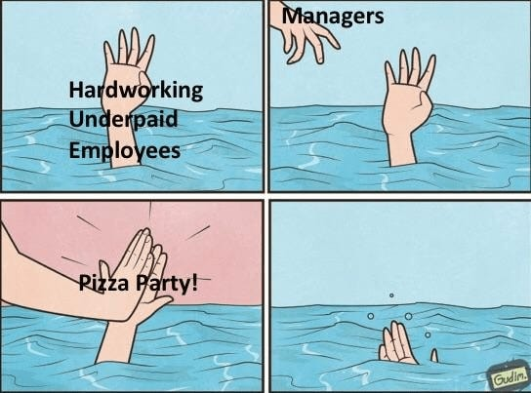
Notes:
The idea for this presentation started, like all good things, with a meme.

Slide 3
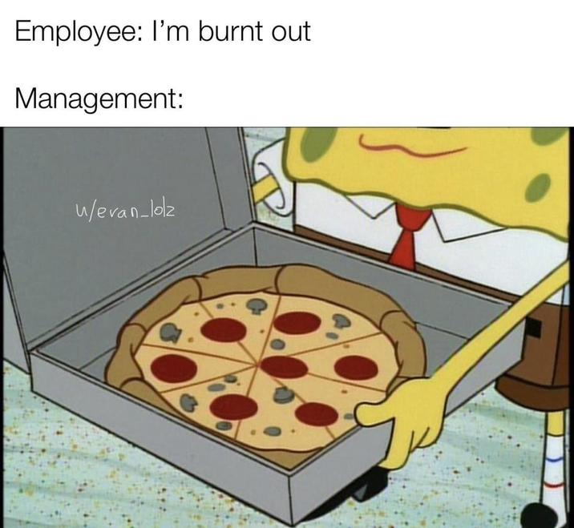
Notes:
There are a million of them. They’ve become something of a joke about the disconnect between management and employees.

Slide 4
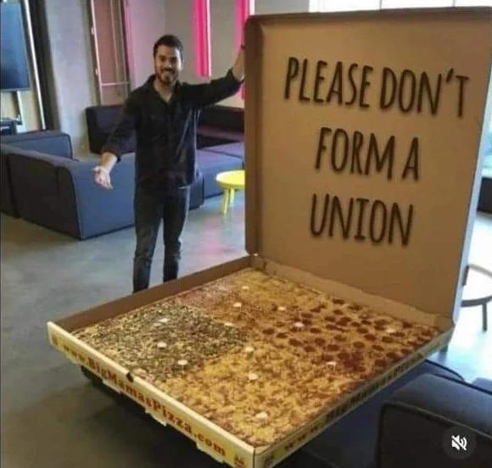
Notes:
That, instead of staffing appropriately, giving raises, or treating their employees better, management defaults to an office pizza party as the best and only way to retain employees.

Slide 5
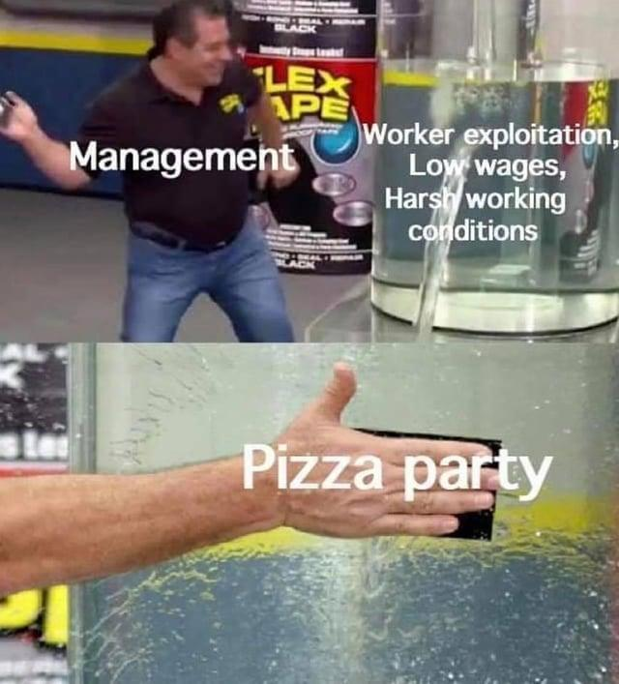
Notes:
Don’t get me wrong, everyone loves free food. I’m not going to turn down free pizza. But pizza is easy. Pizza is cheap. Pizza doesn’t require forethought, consideration, or – heaven forbid – compromise. This isn’t a problem exclusive to veterinary medicine, either, it crops up in just about every field there is. Hence the abundance of memes.

Slide 6
Session overview
Background and definitions
What are we talking about, here?
Historical view
What are CVTs getting right now? What do they think about it?
Ideal view
What would CVTs like to have? How could our job satisfaction and retention rate be improved?
Big takeaways
Okay, so now what?
Notes:
We are going to start with some background, . Why am I here, and what am I talking about? We’re going to talk about perks vs benefits, job satisfaction, quality of life, and work-life balance, and it was pretty hard to find solid definitions of some of those terms so I’ll do my best. Then we’ll get into the really interesting stuff. I ran a survey online for CVTs asking about job satisfaction and the barriers they encounter, and what their ideal CVT job would include. First we’ll look at the historical view – what are CVTs getting right now? What do they think about it? Are they happy with their current situation? Then the ideal view – what would a perfect clinic look like? How could our current states be improved to more align with the ideal? Then finally, we’ll talk about what all of this information means, and how you can take it back to your clinic to hopefully boost employee retention and attract more quality applicants.

Slide 7
How did we get here?
Notes:
For several years now, I have wondered what a survey like this would reveal. Since tech school, I have been told I’ll rarely get to eat lunch or drink water, I’ll barely get paid, and I’ll be treated terribly by pet parents and toxic coworkers alike. It’s a wonder any of us stay if that’s what we deal with. So, I had two big questions. First, I wanted to know if this is actually true. Are we paid and treated as poorly as we say? Do we really not get a chance to sit down? What do we actually have right now? Second, if it was really as bad as it sounds, what can we do to fix it? What would make us happier in our careers, and how can we achieve that? What could our employers do that would keep us working for them?

Slide 8
Qualifications (such as they are)
a.k.a., why should you listen to me, anyway?
Notes:
I’ve been a certified veterinary technician since 2015, and over that time have had my share of technician appreciation week pizza, staff meeting cookies from Costco, and five dollar Starbucks gift cards at Christmas. I worked at a clinic that scheduled after hours not-exactly-mandatory bowling parties, and volunteered for weekend events that were, of course, off the clock. I’m also a chronically online millennial, so I’ve absorbed the many Facebook, Instagram, and Reddit posts discussing the dissatisfaction with veterinary medicine and the disconnect between ground-level employees and their managers. I also believe that we should be the change we want to see in the world, and that if we don’t talk about our problems then they’ll never be solved.

Slide 9
Survey questions
Do you currently work in the veterinary field?
How long have you been in practice?
Which monetary benefits are provided to you?
Do you use all of your paid days off each year?
Have you experienced a time when you were discouraged from using your paid time off?
How far ahead do you know which days you’ll be working?
How many times a week do you get a 30 minute lunch break?
In an average week, how often is your practice short staffed?
Which of the following monetary benefits would contribute to your job satisfaction?
How important are the listed monetary benefits in your consideration of a job offer?
Which of the following quality of life perks would contribute to your job satisfaction?
Are there any other benefits, monetary or otherwise, that your ideal job would include?
Do you have any other comments you’d like to make about perks, benefits, or job satisfaction that were not covered in other items?
Notes:
In service of this, and because the ISVMA convinced me I should actually do it instead of just talking about doing it for years, I made an online survey asking these 13 questions about the working conditions and benefits technicians have at their clinics and where those clinics could improve. The first part of the survey asked respondents about their current job, or more recent job if they have left the field. I asked what perks and benefits they get, and how important they are. I asked some quality of life questions, such as how often they get lunch or are short staffed, to see the current state of the field.

Slide 10
Survey questions
Do you currently work in the veterinary field?
How long have you been in practice?
Which monetary benefits are provided to you?
Do you use all of your paid days off each year?
Have you experienced a time when you were discouraged from using your paid time off?
How far ahead do you know which days you’ll be working?
How many times a week do you get a 30 minute lunch break?
In an average week, how often is your practice short staffed?
Which of the following monetary benefits would contribute to your job satisfaction?
How important are the listed monetary benefits in your consideration of a job offer?
Which of the following quality of life perks would contribute to your job satisfaction?
Are there any other benefits, monetary or otherwise, that your ideal job would include?
Do you have any other comments you’d like to make about perks, benefits, or job satisfaction that were not covered in other items?
Notes:
The second part of the survey covers what we would like to have in our careers. Which rewards matter the most to us, and what more would we like to see? What keeps us at the jobs we have, or makes us leave them? What do we wish our clinics would do – or not do – to make us value our jobs more?

Slide 11
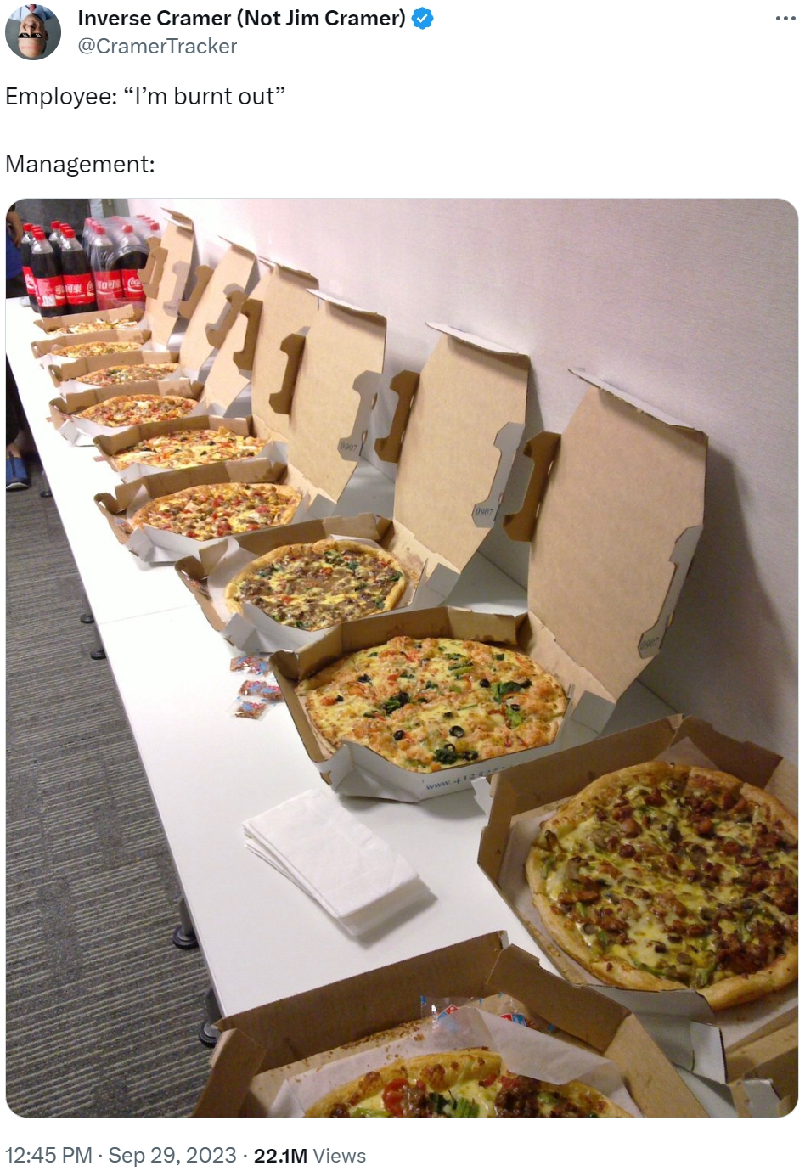

Slide 12
Benefits vs. perks
Benefits – non-wage compensation that supplements salary, usually to offset costs an employee would otherwise have to pay.
Paid time off, health insurance, employee discount, uniform allowance
Perks – something a company can do to improve worker’s lives and business productivity, non-monetary rewards
Free lunch, break room snacks, skill advancement opportunities, gifts, etc.

Slide 13
Other definitions
Job satisfaction
The degree to which a worker feels pleasure or happiness in their job
Notes:
Do you enjoy going to work? Do you feel like the work you do is important? Or do you dread going back to work after your lunch break?

Slide 14
Other definitions
Job satisfaction
The degree to which a worker feels pleasure or happiness in their job
Quality of life
The degree to which a person enjoys the important possibilities of their lives
Notes:
Quality of life is one we’re all familiar with, at least as regards animals. For humans, we’re talking about whether you’re able to enjoy your days off? Are you able to get out of bed in the morning, or is it a struggle every day? Do you enjoy your hobbies, friendships, meals, and so forth?

Slide 15
Other definitions
Job satisfaction
The degree to which a worker feels pleasure or happiness in their job
Quality of life
The degree to which a person enjoys the important possibilities of their lives
Work-life balance
The amount of time you spend doing your job versus the amount of time you spend doing what’s important to you
Notes:
When you leave work, are you expected to respond to messages about work? Are you on call every weekend? If your child or pet is sick, are you able to take time off to take care of them? Do you have to justify every hour of PTO you take?
These three items are what this survey tries to capture. Are CVTs satisfied with their jobs, do they enjoy a good quality of life, and do they have some kind of work-life balance.

Slide 16
Breakdown of respondents
54 respondents to survey
Notes:
I had 54 respondents to my survey, which was posted both in my tech school’s alumni Facebook group as well as in 3 large veterinary technician focused Facebook groups with more than 40k members. I limited the survey pool like this because unfortunately, despite its limitations, Facebook continues to be the simplest forum for targeting a specific group such as veterinary technicians.
I didn’t take too many demographics because, in my mind, job satisfaction and quality of life shouldn’t be dependent on age, race, gender, or part of the country. I’m not going to suggest that Gen X deserves better perks than Gen Z, or that technicians in Chicago should have better benefits than technicians in Peoria. We all deserve good wages and non-toxic work environments.

Slide 17
Breakdown of respondents
54 respondents to survey
Currently working?
Currently working in the veterinary field – 89%
Not working in the veterinary field – 11%
Years in practice
1-5 years – 7%
6-10 years – 35%
11-15 years – 29%
16-20 years – 11%
Greater than 20 years – 14%
Notes:
I recorded whether they were or weren’t currently working in the field, and how many years they’d worked in practice. I wasn’t surprised that the largest segment was 6-10 years, as I’ve often heard that 10 years is the average shelf life of a CVT. I was surprised at the greater than 20 year segment, which included someone who had been working in veterinary medicine since age 18 in 1972. They spent 8 years in clinics, then 35 years as a CVT in shelter medicine. They are now retired, but still work part time in private practice.
One demographic I did /not/ collect but realized afterward would have been an interesting addition is which part of the veterinary field they work in. I assume mainly private practice based because it tends to be the norm, but I didn’t think to collect that until my boss asked me about it later.

Slide 18
At your current practice…
…what monetary benefits are provided to you?
Pet care discount
Health insurance
Paid vacation time
401K matching
Vision/dental insurance
CE allowance
Uniform allowance
Paid sick time
Flex holidays (separate from vacation time)
Pet insurance
Notes:
We’re going to start with the reality. What do we have right now? It’s raise-your-hand time, so let’s go through the list.

Slide 19
At your current practice…
…what monetary benefits are provided to you?
Pet care discount – 89%
Health insurance – 89%
Paid vacation time – 87%
401K matching – 80%
Vision/dental insurance – 72%
CE allowance – 67%
Uniform allowance – 65%
Paid sick time – 61%
Flex holidays (separate from vacation time) – 31%
Pet insurance – 6%
Notes:
Here are the numbers from the survey respondents. I was surprised to see that 11% of respondents don’t have a pet care discount. We work in veterinary medicine, it’s almost always going to be the technician pet owner doing the work anyway, so why charge them for their own labor? I’m not saying to charge them nothing, but what about drugs at cost? Lab work at cost?
I am glad to see that health insurance and paid vacation time are so high on the list. When I was starting out over a decade ago, these two were much less common. I know I didn’t have health insurance in private practice, and if I had paid time off nobody ever mentioned it to me or encouraged me to utilize it.

Slide 20
At your current practice…
…how important to you are the listed monetary benefits?
Paid vacation time – 4.38/5
Health insurance – 4.38/5
Vision/dental insurance – 4.1/5
Paid sick time – 4.08/5
Pet care discount – 4.02/5
CE allowance – 3.92/5
401K matching – 3.79/5
Personal holidays (separate from vacation time) – 3.44/5
Uniform allowance – 2.83/5
Pet insurance – 2.31/5
Notes:
This was scored on a five point scale, with 1 being least important and 5 being most. I wasn’t very surprised about the spread on this question. Paid vacation and health insurance are two of the most important things to me as well, so it makes sense they’re at the top. If you’re part of the 89% who have a pet care discount, then you probably don’t need to also pay for pet insurance way down in dead last. CE allowances are middle of the road. I could see that go either way since there’s so much free CE for technicians out there now.

Slide 21
At your current practice…
…what monetary benefits are provided to you?
Pet care discount – 89%
Health insurance – 89%
Paid vacation time – 87%
401K matching – 80%
Vision/dental insurance – 72%
CE allowance – 67%
Uniform allowance – 65%
Paid sick time – 61%
Personal holidays (separate from vacation time) – 31%
Pet insurance – 6%
…how important to you are the listed monetary benefits?
Paid vacation time – 4.38/5
Health insurance – 4.38/5
Vision/dental insurance – 4.1/5
Paid sick time – 4.08/5
Pet care discount – 4.02/5
CE allowance – 3.92/5
401K matching – 3.79/5
Personal holidays (separate from vacation time) – 3.44/5
Uniform allowance – 2.83/5
Pet insurance – 2.31/5
Notes:
I also wanted to compare how the order changed between what we have and how important it is to us.

Slide 22
At your current practice…
…what monetary benefits are provided to you?
Pet care discount – 89%
Health insurance – 89%
Paid vacation time – 87%
401K matching – 80%
Vision/dental insurance – 72%
CE allowance – 67%
Uniform allowance – 65%
Paid sick time – 61%
Personal holidays (separate from vacation time) – 31%
Pet insurance – 6%
…how important to you are the listed monetary benefits?
Paid vacation time – 4.38/5
Health insurance – 4.38/5
Vision/dental insurance – 4.1/5
Paid sick time – 4.08/5
Pet care discount – 4.02/5
CE allowance – 3.92/5
401K matching – 3.79/5
Personal holidays (separate from vacation time) – 3.44/5
Uniform allowance – 2.83/5
Pet insurance – 2.31/5
Notes:
89% of respondents have a pet care discount, but it’s almost halfway down on importance. It’s still over a 4/5, but there are things more important now. Paid sick time, which 61% have, comes up to the fourth spot for importance. This is not to say stop giving pet care discounts, but consider giving sick days. If there’s one thing we’ve learned from COVID, it’s that people who come in to work sick are less productive, and if they infect their coworkers then those coworkers, in turn, become less productive and then you have a whole shift that’s sick but still coming in because they don’t have sick days and can’t afford to stay home.

Slide 23
At your current practice…
…what monetary benefits are provided to you?
Pet care discount – 89%
Health insurance – 89%
Paid vacation time – 87%
401K matching – 80%
Vision/dental insurance – 72%
CE allowance – 67%
Uniform allowance – 65%
Paid sick time – 61%
Personal holidays (separate from vacation time) – 31%
Pet insurance – 6%
…how important to you are the listed monetary benefits?
Paid vacation time – 4.38/5
Health insurance – 4.38/5
Vision/dental insurance – 4.1/5
Paid sick time – 4.08/5
Pet care discount – 4.02/5
CE allowance – 3.92/5
401K matching – 3.79/5
Personal holidays (separate from vacation time) – 3.44/5
Uniform allowance – 2.83/5
Pet insurance – 2.31/5
Notes:
Uniform allowance dropped to the bottom two, though still well ahead of pet insurance. My theory is that everyone has enough scrubs already and don’t need to repurchase them every year, so the promise of a uniform allowance isn’t as helpful as it might seem at first.

Slide 24
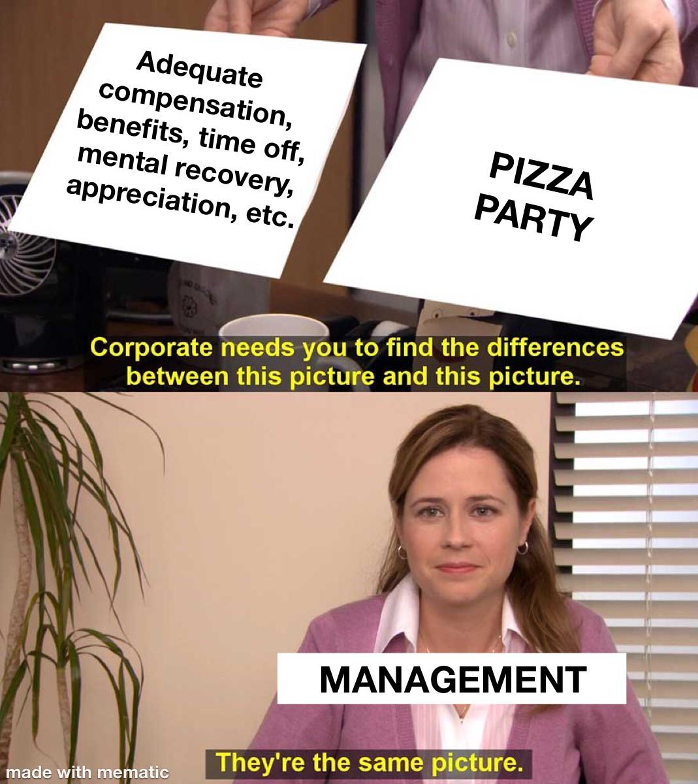

Slide 25
Are we getting what we want?
Paid vacation time – 4.38/5 – 87%
Health insurance – 4.38/5 – 89%
Vision/dental insurance – 4.1/5 – 72%
Paid sick time – 4.08/5 – 61%
Pet care discount – 4.02/5 – 89%
CE allowance – 3.92/5 – 67%
401K matching – 3.79/5 – 80%
Personal holidays – 3.44/5 – 31%
Uniform allowance – 2.83/5 – 65%
Pet insurance – 2.31/5 – 6%
Notes:
So, are we getting what we want? Well, kind of. Paid vacation and health insurance are the top two both by ranking and by how many respondents had access to them. Paid sick time is desired, more than the much more common pet care discount and 401K match, but only 2/3 of technicians have it available. Pet insurance was universally lowest. Nobody’s got it, and nobody is particularly bothered about that fact.

Slide 26
At your current practice…
…do you use all of your paid days off each year?
Yes
No
I do not have paid days off

Slide 27
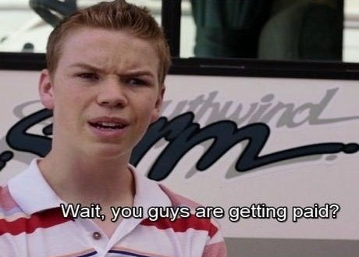
At your current practice…
…do you use all of your paid days off each year?
Yes – 59%
No – 33%
I do not have paid days off – 7%
Notes:
Over half of the respondents use all of their paid time off each year, which is great! That said, though…

Slide 28
At your current practice…
…have you experienced a time when you were discouraged from using your allotted time off?
Yes – 44%
At a previous job – 5%
Sometimes – 4%
No – 47%
Notes:
I’m not going to ask for hands on this one, I don’t want to put anyone in a weird spot if their colleagues are here with them. I can also include myself in the yes and at a previous job category. Luckily for me, the people who were notorious for discouraging and guilting people about taking time off have left my current practice and I am now free to take my time off whenever I want to do so. I’d like to emphasize, though…

Slide 29
At your current practice…
…have you experienced a time when you were discouraged from using your allotted time off?
Yes – 44%
At a previous job – 5%
Sometimes – 4%
No – 47%
Over half of the respondents have been discouraged from taking their PTO at some point in their career
Notes:
This can take many forms. Being denied PTO because someone else already requested it off, being asked to come in on your day off because of short staffing, being asked if you can reschedule your time off, or just being told no with no explanation. I’ve gotten the “well, we have a lot of appointments that day…” or “why do you need a day off?” or even the strong implication that because someone else doesn’t use their PTO, you shouldn’t either.

Slide 30
“I’ve never worked at a clinic that was always fully staffed. So taking time off has always been difficult.”
“Yes, pm always trying to make me change my vacation. Even though I have seniority.”
“Yes, or guilted to feel bad about taking time off.”
“If another tech is off at the same time.”
“Yes. Due to short staffing.”
Notes:
Here are some of the comments people left about their experience being discouraged to take PTO.
And speaking of short staffing…

Slide 31
At your current practice…
…how many days per week are you short staffed, on average?
0 days
1-2 days
3-4 days
Every day

Slide 32
At your current practice…
…how many days per week are you short staffed, on average?
0 days – 4%
1-2 days – 52%
3-4 days – 15%
Every day – 26%
Notes:
Short staffing comes up a lot when talking about veterinary medicine. Reducing short staffing may be why you’re here listening to me yap for an hour. There wasn’t a great way for me to differentiate between understaffed by turnover or understaffed by design, because what practice is going to tell their technicians that they’re not hiring enough people simply because they don’t want to? We’ll be charitable and say it’s turnover. What I can say for certain, though, is that it’s a nearly universal problem. Only 4% of us don’t experience short staffing in an average week, and a quarter of us are understaffed every single day.

Slide 33
At your current practice…
…how far ahead do you know which days you’ll be working?
One week – 7%
Two weeks – 11%
One month – 37%
My work schedule never changes, or changes on a consistent rotation – 44%
Notes:
I was pleasantly surprised by this one. Almost half of us have a steady work schedule, and most of us have at least a month’s notice. That said…

Slide 34
At your current practice…
…how far ahead do you know which days you’ll be working?
One week – 7%
Two weeks – 11%
One month – 37%
My work schedule never changes, or changes on a consistent rotation – 44%
Notes:
If you make the schedule for your practice and you’re one of these two? I beg you to please, please give your staff more time to plan their lives. One of the biggest perks, which we always mention at job fairs, is that the technicians’ schedule is fixed. I work every fourth weekend, and have weekdays off to make up for that time on the same schedule in perpetuity, or at least until someone quits or is hired on. I very, very rarely have to request time off for doctor’s appointments because I can schedule a 6 month follow up at the dentist and know exactly which day I’m going to be available.

Slide 35
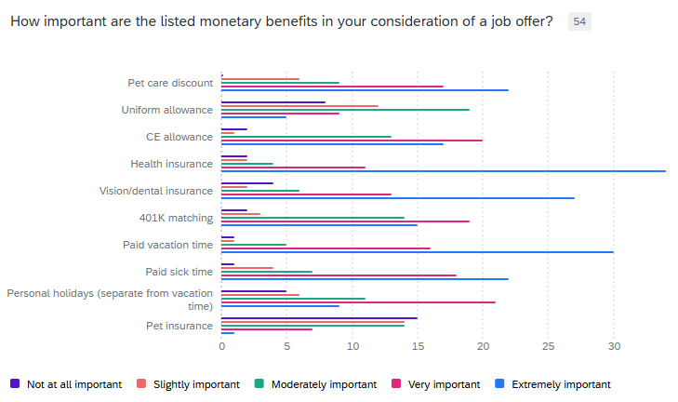
Notes:
Now, let’s talk about job postings. What attracts a potential candidate to your clinic over the one down the street? Here, respondents were asked how important these benefits are in their consideration of a job offer. What would make them more likely to accept a job, and what would have little to no impact on their decision. Nobody ranked a pet care discount as not at all important, and only one person rated paid vacation and sick time as not at all important. Health insurance got more extremely important votes than any other option, though paid vacation time was more important overall.

Slide 36
Let’s get theoretical!
…what monetary benefits are provided to you?
Pet care discount – 89%
Health insurance – 89%
Paid vacation time – 87%
401K matching – 80%
Vision/dental insurance – 72%
CE allowance – 67%
Uniform allowance – 65%
Paid sick time – 61%
Personal holidays (separate from vacation time) – 31%
Pet insurance – 6%
…how important to you are the listed monetary benefits?
Paid vacation time – 4.38/5
Health insurance – 4.38/5
Vision/dental insurance – 4.1/5
Paid sick time – 4.08/5
Pet care discount – 4.02/5
CE allowance – 3.92/5
401K matching – 3.79/5
Personal holidays (separate from vacation time) – 3.44/5
Uniform allowance – 2.83/5
Pet insurance – 2.31/5
Notes:
So, where does that leave us? Getting theoretical for a minute, let’s imagine a clinic that offers the top 20% of benefits – anything over 80% of clinics offer - and a candidate who wants anything ranked over a 4 – very important. So, the top fifth of each category. Then we cross reference.

Slide 37
Let’s get theoretical!
…what monetary benefits are provided to you?
Pet care discount – 89%
Health insurance – 89%
Paid vacation time – 87%
401K matching – 80%
Vision/dental insurance – 72%
CE allowance – 67%
Uniform allowance – 65%
Paid sick time – 61%
Personal holidays (separate from vacation time) – 31%
Pet insurance – 6%
…how important to you are the listed monetary benefits?
Paid vacation time – 4.38/5
Health insurance – 4.38/5
Vision/dental insurance – 4.1/5
Paid sick time – 4.08/5
Pet care discount – 4.02/5
CE allowance – 3.92/5
401K matching – 3.79/5
Personal holidays (separate from vacation time) – 3.44/5
Uniform allowance – 2.83/5
Pet insurance – 2.31/5
Notes:
We have a pet care discount, health insurance, paid vacation, and 401K matching, which is nice, but not vision and dental insurance or paid sick time. Are we taking this job that offers 3/5 of what we want? Depends on how much I need a job, I guess.

Slide 38
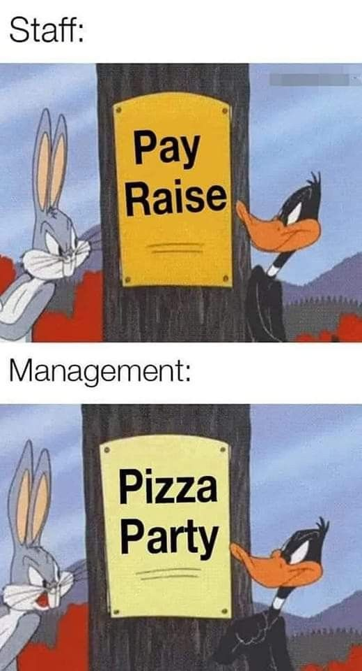

Slide 39
At your ideal practice…
…rank the following rewards based on how much they would contribute to your job satisfaction.
Pizza party/free lunch
Scrubs/clothing with company branding
An extra day off
A $5 gift card
An after work group event
A handwritten thank you card
Free product (e.g. Heartgard+)
Employee spotlight on social media
$0.25/hour raise
Baked goods in the break room

Slide 40
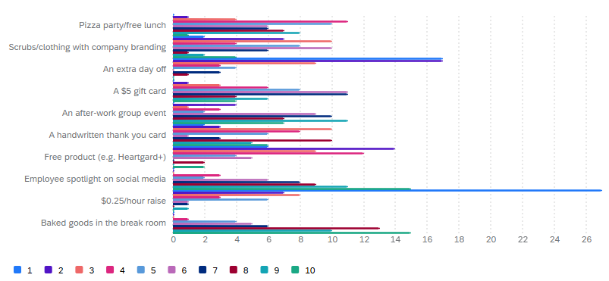
At your ideal practice…
Rank the following rewards based on how much they would contribute to your job satisfaction.
Notes:
This graph came out very pretty, but also very overwhelming to read. You can probably guess which reward this gigantic blue line is for, though, right? I can tell you it’s not the employee spotlight.

Slide 41
At your ideal practice…
…rank the following rewards based on how much they would contribute to your job satisfaction.
$0.25/hour raise
An extra day off
Free product (e.g. Heartgard+)
Scrubs/clothing with company branding
A handwritten thank you card
Pizza party/free lunch
A $5 gift card
An after work group event
Employee spotlight on social media
Baked goods in the break room
Notes:
This is a little more coherent. Here are the rewards based on how highly they were ranked overall by respondents. Responses were weighted based on how often each rank was chosen. You will not be at all surprised to know that a 25 cent per hour raise was the highest ranked benefit. 27 respondents ranked it first, and nobody ranked it last. A 25 cent raise comes out to ten bucks a week per full time technician, by the way.

Slide 42
At your ideal practice…
…rank the following rewards based on how much they would contribute to your job satisfaction.
$0.25/hour raise
An extra day off
Free product (e.g. Heartgard+)
Scrubs/clothing with company branding
A handwritten thank you card
Pizza party/free lunch
A $5 gift card
An after work group event
Employee spotlight on social media
Baked goods in the break room
Notes:
An extra day off came in a close second. Again, not a big surprise. 17 people ranked it first, and a total of 24 ranked it in their top two.

Slide 43
At your ideal practice…
…rank the following rewards based on how much they would contribute to your job satisfaction.
$0.25/hour raise
An extra day off
Free product (e.g. Heartgard+)
Scrubs/clothing with company branding
A handwritten thank you card
Pizza party/free lunch
A $5 gift card
An after work group event
Employee spotlight on social media
Baked goods in the break room
Notes:
Neither an employee spotlight nor baked goods in the break room ranked in anyone’s top three, and both were most often ranked lowest. For each of these two, 15 people put them at the bottom of the list.

Slide 44
At your ideal practice…
…rank the following rewards based on how much they would contribute to your job satisfaction.
$0.25/hour raise
An extra day off
Free product (e.g. Heartgard+)
Scrubs/clothing with company branding
A handwritten thank you card
Pizza party/free lunch
A $5 gift card
An after work group event
Employee spotlight on social media
Baked goods in the break room
Notes:
Nobody chose any of these five as the best for job satisfaction.

Slide 45
At your ideal practice…
…rank the following “quality of life” perks based on how much they would contribute to your job satisfaction.
Adequate staffing
Genuine acknowledgement for a job well done
Consistent work schedule
Encouragement to take vacation time
Learning a new skill (e.g. ultrasound, central line placement)
Encouragement to pursue specialization/further certifications
30 continuous minutes of lunch break
Notes:
Now we’re talking about quality of life perks. Non-monetary things that contribute to a person’s ability to enjoy their life and career. While better staffing does technically cost the practice money, not a single other one of these costs the practice a dime. Genuine acknowledgement. Consistent work schedule. Encouragement to take vacation time and pursue further certifications. Making technicians feel supported and appreciated.

Slide 46
At your ideal practice…
…rank the following “quality of life” perks based on how much they would contribute to your job satisfaction.
Adequate staffing
Genuine acknowledgement for a job well done
Consistent work schedule
Encouragement to take vacation time
Learning a new skill (e.g. ultrasound, central line placement)
Encouragement to pursue specialization/further certifications
30 continuous minutes of lunch break
Notes:
Staffing is, again and again, the biggest problem for CVTs. 21 respondents ranked adequate staffing first, and 41 of the 54 respondents ranked it in their top three. If you’re looking to make the biggest impact on the well being of your technicians, this is it.

Slide 47
At your ideal practice…
…rank the following “quality of life” perks based on how much they would contribute to your job satisfaction.
Adequate staffing
Genuine acknowledgement for a job well done
Consistent work schedule
Encouragement to take vacation time
Learning a new skill (e.g. ultrasound, central line placement)
Encouragement to pursue specialization/further certifications
30 continuous minutes of lunch break
Notes:
Nobody ranked encouragement to pursue specialization as number one.

Slide 48
At your ideal practice…
…rank the following “quality of life” perks based on how much they would contribute to your job satisfaction.
Adequate staffing
Genuine acknowledgement for a job well done
Consistent work schedule
Encouragement to take vacation time
Learning a new skill (e.g. ultrasound, central line placement)
Encouragement to pursue specialization/further certifications
30 continuous minutes of lunch break
Notes:
This one genuinely shocked me. A 30 minute lunch break ranked lowest under quality of life perks. One of the constant refrains in vet med is not having time to eat, having to work through lunch, only having time to eat while charting or looking at slides, and so forth, so I expected this one to rank at least a little higher. Almost every time we hire a new technician at my job, they’re surprised when we tell them to take a full 30 minute break because it’s so uncommon. However!

Slide 49
At your ideal practice…
…rank the following “quality of life” perks based on how much they would contribute to your job satisfaction.
Adequate staffing
Genuine acknowledgement for a job well done
Consistent work schedule
Encouragement to take vacation time
Learning a new skill (e.g. ultrasound, central line placement)
Encouragement to pursue specialization/further certifications
30 continuous minutes of lunch break
0 days a week – 19%
1-2 days a week – 19%
3-4 days a week – 19%
Every day - 44%
Notes:
Maybe this is starting to change for the better. 44 percent of the respondents said they get a full lunch break every shift. That still leaves 54% of us hungry at least one shift a week, but overall this is a much brighter picture than I expected to see. I hope this continues to move in the direction of technicians getting to sit down and rest every shift. You need to be nourished and hydrated to feel your best and do your best work, so please take care of yourselves and make sure your colleagues do the same.

Slide 50
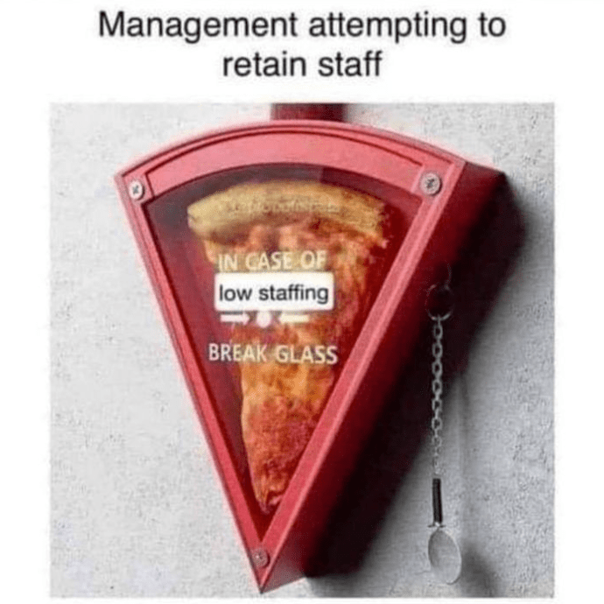

Slide 51
Are there any other benefits, monetary or otherwise, that your ideal job would include?
Notes:
This was a free writing question, so I want to share their answers in their own words.

Slide 52
“Holiday bonus would be nice, especially since many of us don’t make a lot of money and anything extra around the holidays would be greatly appreciated.”

Slide 53
“Adequate raises, and bonuses for actual tech appointments and stuff that each tech does. Shavedowns, nail trims, injections, not [being] lumped together with other techs that do nothing, clients requesting you personal for tech appointments.”

Slide 54
“Livable wages. Can’t even make 3x the rent.”
“Fairness with how all employees are treated.”
“More breaks during a 12 hour day.”

Slide 55
“Having a head tech who wasn’t constantly having to hide to do her managerial job duties, leaving our already short staffed floor shorter would be great.
They have her spread too thin and the consequences are pouring down not up. We are also on call, but do not receive any sort of “pager” fee. We do get extended pay when we get called in, but only if we get called in. I do more on calls than anyone else in the practice and even if it was $5 for an entire night, the acknowledgement that I am giving up the opportunity to spend quality time, have a drink, take my dogs for a hike would be nice.”

Slide 56
“A livable wage.”
“Listen to what we suggest and discuss. Most of the time management won’t discuss new ideas or needs. Thank you, great job, appreciated.“
“Dental/vision, paid holidays, full 40 hours/week.”

Slide 57
“More time off.”
“Pay a decent wage to afford to live.”
“No personal contact from employer on days off asking to work. If working holidays, paid floating day off to make up for holiday worked. Alternating holidays worked with other staff.”

Slide 58
“No weekends or holidays, better pay if licensed vs not licensed.”
“Profit sharing or equity in the company.”
“Title protection and defined scope of practice as a credentialed tech.”

Slide 59
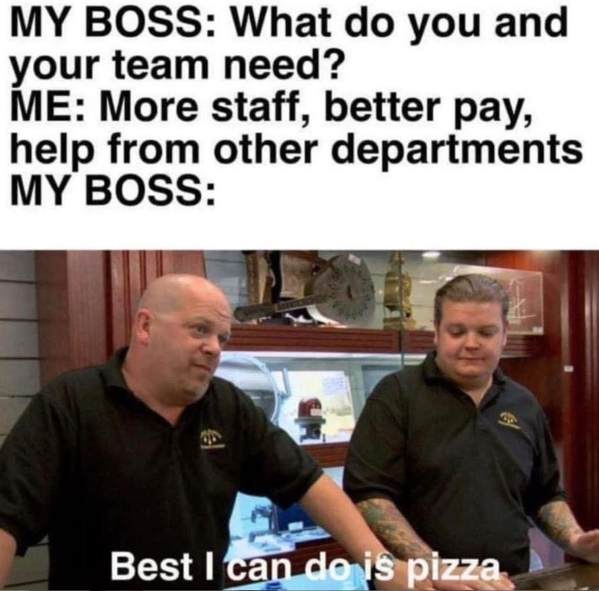
Notes:
(water break) Okay, so we’ve gone over what we have and what we want, but what are you supposed to do with all of these graphs and percentages? What can we take away from this?

Slide 60
Why do CVTs leave the field?
“Looking for a new job due to allergies.”
“Taking a break due to pregnancy.”
“Low pay.”
“No longer working due to pay.”
“Burnout, low pay, poor management and coworkers.”
Notes:
Low pay, low pay, low pay. I’ve said it a lot in this presentation, and I’m going to say it more, sorry. But it is a big component in technicians leaving vet med. If I find a desk job where I’m not on my feet all day, not wrestling pugs that don’t want their nails trimmed, or being yelled at by owners who think the pyometra surgery is too expensive, what’s my motivation for staying here? Money. But Alyssa, you might be saying, how do you even quantify what counts as low pay?

Slide 61
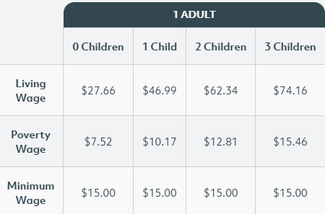
Why do CVTs leave the field?
https://livingwage.mit.edu/counties/17043
Notes:
Luckily, someone has done the work for us. MIT has a living wage calculator for every county, which shows how much money per hour a full-time employee requires to cover the costs of their basic needs where they live, including food, health care, housing, transportation, and so forth. This chart shows the living wage for DuPage County, where we are right now. A single person with no kids in DuPage County, in order to cover their basic needs, should be making $27.66 per hour.

Slide 62
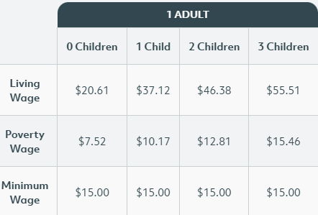
Why do CVTs leave the field?
https://livingwage.mit.edu/metros/44100
Notes:
Here’s Springfield, in case anyone is panicking about not being able to afford paying Naperville wages. If your practice is in a different county, you can look it up to see the livable wage for your area and see what your target should be. Of course, if you’re paying above these minimums then that’s great! Pay your techs what they’re worth! But if you’re trying to hire in Naperville and only willing to pay minimum wage, this is probably why you’re not getting many applicants.

Slide 63
What can we take away from this?
Technician needs are not being met.
Notes:
I want to revisit the free writing portion and pull out some themes that show up again and again across respondents.

Slide 64
“Holiday bonus would be nice, especially since many of us don’t make a lot of money and anything extra around the holidays would be greatly appreciated.”
“Adequate raises, and bonuses for actual tech appointments and stuff that each tech does. Shavedowns, nail trims, injections, not [being] lumped together with other techs that do nothing, clients requesting you personal for tech appointments.”
“Livable wages. Can’t even make 3x the rent.”
“Fairness with how all employees are treated.”

Slide 65
“Holiday bonus would be nice, especially since many of us don’t make a lot of money and anything extra around the holidays would be greatly appreciated.”
“Adequate raises, and bonuses for actual tech appointments and stuff that each tech does. Shavedowns, nail trims, injections, not [being] lumped together with other techs that do nothing, clients requesting you personal for tech appointments.”
“Livable wages. Can’t even make 3x the rent.”
“Fairness with how all employees are treated.”
Notes:
Adequate raises, livable wages. By now, nobody should be surprised at this. Fairness, equal treatment for all employees.

Slide 66
Having a head tech who wasn’t constantly having to hide to do her managerial job duties, leaving our already short staffed floor shorter would be great.
They have her spread too thin and the consequences are pouring down not up. We are also on call, but do not receive any sort of “pager” fee. We do get extended pay when we get called in, but only if we get called in. I do more on calls than anyone else in the practice and even if it was $5 for an entire night, the acknowledgement that I am giving up the opportunity to spend quality time, have a drink, take my dogs for a hike would be nice.

Slide 67
Having a head tech who wasn’t constantly having to hide to do her managerial job duties, leaving our already short staffed floor shorter would be great.
They have her spread too thin and the consequences are pouring down not up. We are also on call, but do not receive any sort of “pager” fee. We do get extended pay when we get called in, but only if we get called in. I do more on calls than anyone else in the practice and even if it was $5 for an entire night, the acknowledgement that I am giving up the opportunity to spend quality time, have a drink, take my dogs for a hike would be nice.
Notes:
A remedy for short staffing so people can do their jobs. Acknowledgement that technicians are giving up their personal time for you.

Slide 68
Listen to what we suggest and discuss. Most of the time management won’t discuss new ideas or needs. Thank you, great job, appreciated.
More breaks during the 12 hour day
Pay a decent wage to afford to live
Title protection and defined scope of practice as a credentialed tech
Dental/vision, paid holidays, full 40 hours a week

Slide 69
Listen to what we suggest and discuss. Most of the time management won’t discuss new ideas or needs. Thank you, great job, appreciated.
More breaks during the 12 hour day
Pay a decent wage to afford to live
Title protection and defined scope of practice as a credentialed tech
Dental/vision, paid holidays, full 40 hours a week
Notes:
Listen to your technicians. Acknowledge their hard work, and listen to their suggestions for new processes or procedures that might improve the flow of the clinic. Pay a decent wage.

Slide 70
“More time off.”
“No personal contact from employer on days off asking to work. If working holidays, paid floating day off to make up for holiday worked. Alternating holidays worked with other staff.”
“No weekends or holidays, better pay if licensed vs not licensed.”
“Profit sharing or equity in the company.”

Slide 71
“More time off.”
“No personal contact from employer on days off asking to work. If working holidays, paid floating day off to make up for holiday worked. Alternating holidays worked with other staff.”
“No weekends or holidays, better pay if licensed vs not licensed.”
“Profit sharing or equity in the company.”
Notes:
Vacation time, floating holidays, and not being contacted by your employer when you’re not at work. Better pay.

Slide 72
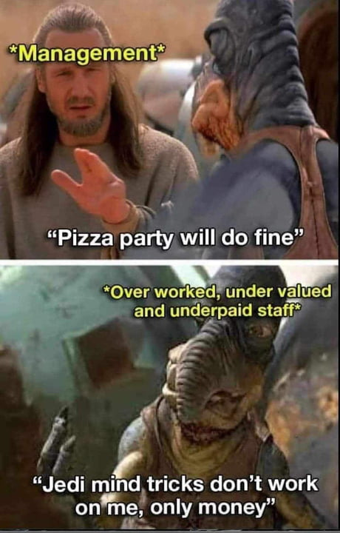

Slide 73
What can we take away from this?
Technician needs are not being met.
Low pay
Short staffing
Notes:
Low pay and short staffing come up again and again in this survey. I know vets are cheap, but personnel is not the place to cut costs. When you lose an employee, you lose their knowledge of processes and procedures. Hiring a new technician requires time, labor, and money to find, hire, and train, and new employees are more prone to mistakes that can be costly. They may also turn out to be a poor fit for the clinic, versus a current employee with a known temperament. And, if a lost employee was well loved by their colleagues, group morale will take a big hit as well.

Slide 74
What can we take away from this?
Technician needs are not being met.
Low pay
Short staffing
Notes:
Okay, you might be thinking, but I can’t afford to raise wages and I’ve had two open job postings for three months without any viable candidates so what do you want from me?

Slide 75
What else can you do?
Fulfill non-monetary needs
Notes:
Okay, so you can’t afford to pay more and can’t find anyone to hire. What else can you do to improve the culture at your clinic?

Slide 76
What else can you do?
Fulfill non-monetary needs
Show your appreciation
“Thanks for your help on this surgery, you’re a great sterile assist.”
“You always know how to fix the fluid pumps, I appreciate it.”
“I know that code was harrowing but you really held it together.”
Notes:
Make sure your technicians know they are valued. Don’t overdo it and constantly thank them and tell them they did a good job, because it will feel false and make them nervous, but when you have a positive thought, tell them. It doesn’t have to be big or grand, just honest.

Slide 77
What else can you do?
Fulfill non-monetary needs
Show your appreciation
“Thanks for your help on this surgery, you’re a great sterile assist.”
“You always know how to fix the fluid pumps, I appreciate it.”
“I know that code was harrowing but you really held it together.”
Let them use their PTO
Notes:
To doctors, practice managers, and fellow technicians. Nobody should have to justify their time off. There is no big reward at retirement for the person who took the fewest days off, and there should be no shame or moral judgement involved in using time off that is considered part of your overall benefits package. As long as it’s not going to tank a shift, like leaving one technician for three doctors with a double booked schedule, it doesn’t matter why they want to take time. It doesn’t have to be an important enough reason for you, it’s important enough to them to use PTO on it.

Slide 78
What else can you do?
Fulfill non-monetary needs
Show your appreciation
“Thanks for your help on this surgery, you’re a great sterile assist.”
“You always know how to fix the fluid pumps, I appreciate it.”
“I know that code was harrowing but you really held it together.”
Let them use their PTO
You are not their boss when they’re off the clock.
Notes:
Unless there are on-call arrangements being made, time spent away from work is away from work. Technicians do not sit in stasis at home until they’re needed, they have lives they want to enjoy. I am lucky in that my boss encourages us to log out of Teams when we’re taking vacation time, and even booted one of the other veterinarians from the group chat because she was responding while on maternity leave. Whenever she does contact me out of work hours, she is apologetic and I know that she exhausted all in-clinic options before asking me for help with something.

Slide 79
What else can you do?
Fulfill non-monetary needs
Show your appreciation
“Thanks for your help on this surgery, you’re a great sterile assist.”
“You always know how to fix the fluid pumps, I appreciate it.”
“I know that code was harrowing but you really held it together.”
Let them use their PTO
You are not their boss when they’re off the clock.
Help them when they’re swamped
Notes:
I have a personal policy, formed after years of customer service and veterinary medicine, of never working for someone who thinks they’re too good to mop the floor. If there’s vomit in the treatment room and everyone has their hands full, wipe it up. If it’s the end of a hectic shift and technicians are running around the clinic trying to get all of the closing duties finished by the time they’re supposed to leave… ask if there’s anything you can do. They may turn down your offer of help, but it’s still important to show that you are aware their job is difficult and that you are willing to help shoulder the load if needed.

Slide 80
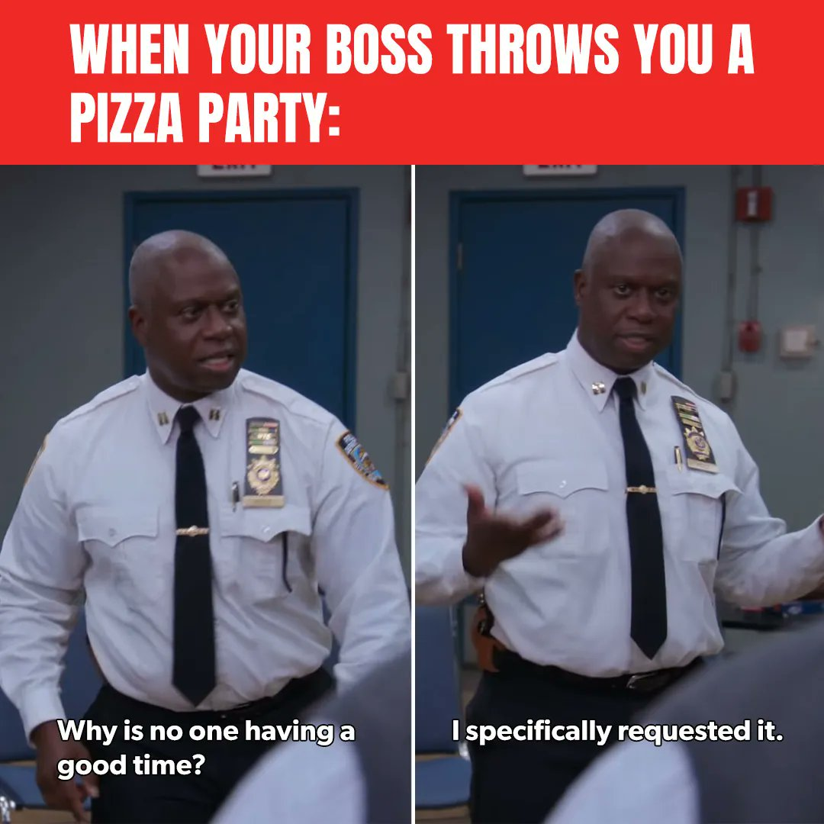

Slide 81
This goes for you, too!
Your non-monetary needs matter, too
Notes:
Veterinarians! Practice managers! All of these quality of life changes go for y'all as well. Just as the clinic suffers when its technicians have poor job satisfaction and work life balance, so too does it suffer when the higher ups do. Remember to take care of your own needs as well.

Slide 82
This goes for you, too!
Your non-monetary needs matter, too
Use your PTO!
Notes:
Y'all should also use your PTO, by the way. This field can be so busy and so stressful, and you need to be able to get away and recharge your batteries every so often as well.

Slide 83
This goes for you, too!
Your non-monetary needs matter, too
Use your PTO!
You are not the boss when you're off the clock
Notes:
This one applies to y'all, too. You shouldn't be obligated to communicate, answer questions, or do work when you're not at the clinic. Leave the work at work and enjoy the time you have with your family, friends, pets, or Netflix. Work will always be waiting for you tomorrow, when you clock back in.

Slide 84
What else can you do?
Find out why you’re short staffed
Notes:
Let’s talk about short staffing. Why are you short staffed all the time? Does your clinic have a lot of turnover? If so, find out why.

Slide 85
What else can you do?
Find out why you’re short staffed
One-on-one meetings
Notes:
Consider implementing one-on-one meetings. These don’t have to be super formal, and be clear it isn’t a performance review, but find a way to touch base with employees outside of staff meetings so they can ask questions and share concerns privately. This is not a place to accuse or dig for information. Just ask them what they want from their career, and how you can help them achieve that. Maybe they’re always in surgery but what they really love is dentistry and would be much happier at the dental table every day. Maybe they absolutely hate working with cats, but really enjoy pocket pets and exotics and would like to get more experience with them. Things like that. Give them some measure of control over their workplace, and they will be happier for it.

Slide 86
What else can you do?
Find out why you’re short staffed
One-on-one meetings
Exit interviews
Notes:
When a technician quits, do an exit interview with them. Ask them why they’re leaving, ask them what (if anything) would make them stay – even if it’s something you can’t provide – and what ways you can improve the climate at YOUR clinic to make it better for the next technician you hire. You may find out some interesting things, like that the last three exit interviews have mentioned the technician manager as a reason for leaving, or the same employee keeps being cited as a toxic personality. You might hear that there’s an abusive client who keeps berating your front desk staff, and the front desk staff feel that management doesn’t back them up. Which brings me to…

Slide 87
What else can you do?
Find out why you’re short staffed
One-on-one meetings
Exit interviews
Stop allowing toxic clinic cultures

Slide 88
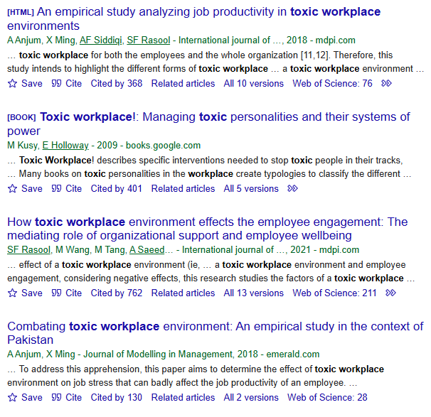
What else can you do?
Find out why you’re short staffed
One-on-one meetings
Exit interviews
Stop allowing toxic clinic cultures
Notes:
This goes for everyone, not just the managers. There have been plenty of studies done about toxic workplaces and their negative effects on employees. Toxicity will spread and ruin an entire clinic if it’s left unchecked. Everyone will be burnt out, stressed, and snippy, and work will suffer. Patient care will suffer.

Slide 89
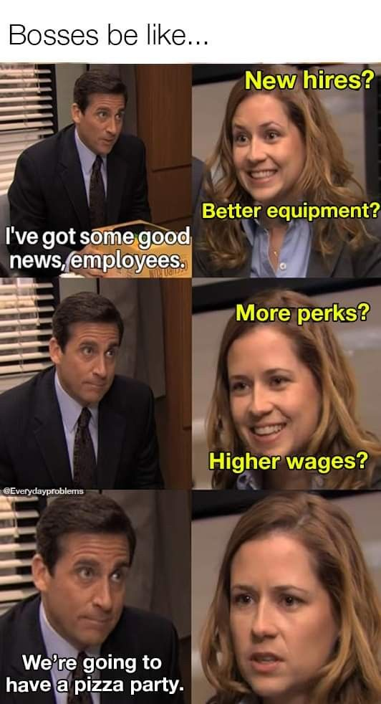

Slide 90
What else can you do?
Listen to your technicians.
Notes:
There was one more free writing section of the survey, asking for any other comments the respondents wanted to include about perks, benefits, or job satisfaction.

Slide 91
Listen to your technicians
“We currently get $2000/year for services. We get medications at cost. Vaccines are cost plus 30%. We don’t get charged for exams. An employer shouldn’t try to make money from their employees. Employees are the backbone of the company.”

Slide 92
Listen to your technicians
“We currently get $2000/year for services. We get medications at cost. Vaccines are cost plus 30%. We don’t get charged for exams. An employer shouldn’t try to make money from their employees. Employees are the backbone of the company.”
“Adequate pay for years of experience and certifications.”

Slide 93
Listen to your technicians
“We currently get $2000/year for services. We get medications at cost. Vaccines are cost plus 30%. We don’t get charged for exams. An employer shouldn’t try to make money from their employees. Employees are the backbone of the company.”
“Adequate pay for years of experience and certifications.”
“My answers are money driven. I’m 27 and still live at home because I can’t afford to live on my own and make 3x the rent.”

Slide 94
Listen to your technicians
“Regular praise is the most valuable raise.”

Slide 95
Listen to your technicians
“Regular praise is the most valuable raise.”
“Staff members [should be] all working on the same team. Stop allowing toxic work environments.”

Slide 96
Listen to your technicians
“Regular praise is the most valuable raise.”
“Staff members [should be] all working on the same team. Stop allowing toxic work environments.”
“Having great doctors that are knowledgeable, trustworthy, reliable, and respected. This also applies to managers and lead technicians.”

Slide 97
Listen to your technicians
“This is the second job where there’s a work communication group and they expect people to see and follow it even on days off, so separating that boundary would be nice.”

Slide 98
Listen to your technicians
“This is the second job where there’s a work communication group and they expect people to see and follow it even on days off, so separating that boundary would be nice.”
“All the personal life perks are super important to me.”

Slide 99
Listen to your technicians
“This is the second job where there’s a work communication group and they expect people to see and follow it even on days off, so separating that boundary would be nice.”
“All the personal life perks are super important to me.”
“More pay!”

Slide 100
Listen to your technicians
“My ideal clinic would not do cosmetic procedures (ear crops, tail docks, neonatal dewclaw removals, declaws, debarking) and would not tolerate abuse from clients.”

Slide 101
Listen to your technicians
“My ideal clinic would not do cosmetic procedures (ear crops, tail docks, neonatal dewclaw removals, declaws, debarking) and would not tolerate abuse from clients.”
“I just want to be treated like a human being that has a life outside of work. I don’t want to be penalized for the one time I put my child first. Employees should be encouraged to take care of themselves and their families above all. If those things are both taken care of, employees are able to be better employees.”

Slide 102


Slide 103
What can we take away from this?
Technician needs are not being met.
Low pay
Short staffing
Technicians are not a monolith
Notes:
All of these things said, technicians are not a monolith.

Slide 104
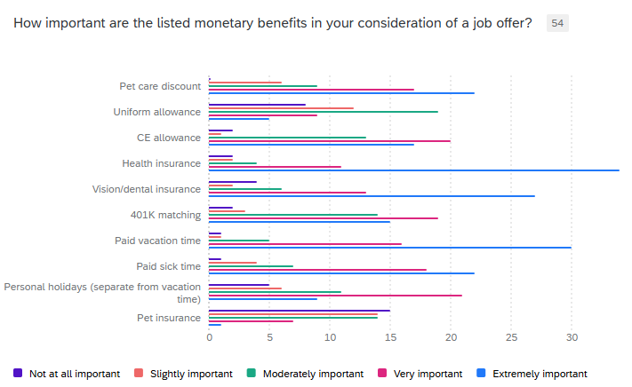
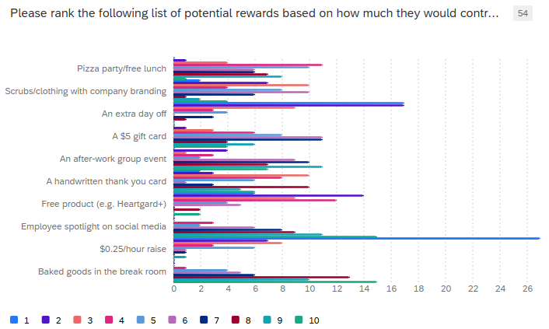
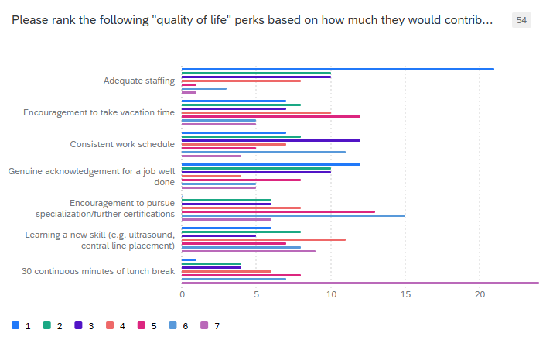
What can we take away from this?
Notes:
As evidenced by the spread of responses I received to all of these questions, each of us has different preferences and priorities regarding perks and benefits in our workplace. There is no one-size-fits-all solution, much as I would love to be able to give one to you all. My biggest takeaway from doing this survey is that, with a few notable exceptions, different technicians have different priorities. That’s okay. Not every technician will be a good fit for every clinic. That said, knowing what YOUR technicians want is what’s important. Ask them. If you can do it anonymously, fantastic. If you can do it in a one-on-one, great. If it’s during a staff meeting, good, but just ask them. Involve them in decisions that will affect them, and listen to what they tell you.

Slide 105
In summary…
Are CVTs as poorly paid as we say?
Notes:
So! At the beginning of this presentation, I had some questions I was trying to get answered. Are we really paid as poorly as we say?

Slide 106
In summary…
Are CVTs as poorly paid as we say?
Yes
Notes:
Based on the responses to this survey, yes. With some exceptions, like the one person who ranked a 25 cent raise as second to the bottom, higher wages are one of the things we can all agree on. We want to be able to afford to move out of our parents’ houses, and we can’t do that if we can’t make 3x the cost of rent. We want to be able to enjoy our lives, our families, our hobbies, and we can’t do that if we’re scrabbling for every penny we can find.

Slide 107
In summary…
Are CVTs as poorly paid as we say?
Yes
Are we constantly moving with no chance to sit down?
Notes:
Do we really not get a chance to sit down?

Slide 108
In summary…
Are CVTs as poorly paid as we say?
Yes
Are we constantly moving with no chance to sit down?
Surprisingly, no!
Notes:
Well, no, apparently. I was sure this would have been a yes, but 44% of the respondents said they get to sit down for their full lunch break every day. Another 19% only miss one or two lunches per week. It’s not perfect, but it’s a far cry from the eat-on-the-run stereotype.

Slide 109
In summary…
Are CVTs as poorly paid as we say?
Yes
Are we constantly moving with no chance to sit down?
Surprisingly, no!
What do we actually have right now?
Notes:
What benefits do we actually have right now? What do the majority of clinics offer to their technicians?

Slide 110
In summary…
Are CVTs as poorly paid as we say?
Yes
Are we constantly moving with no chance to sit down?
Surprisingly, no!
What do we actually have right now?
Health insurance, pet care discounts, vacation time
Notes:
Most of us have health insurance, pet care discounts, and paid vacation time. Whether or not we’re able to use said paid vacation time is another question entirely – over half of us have trouble actually using it.

Slide 111
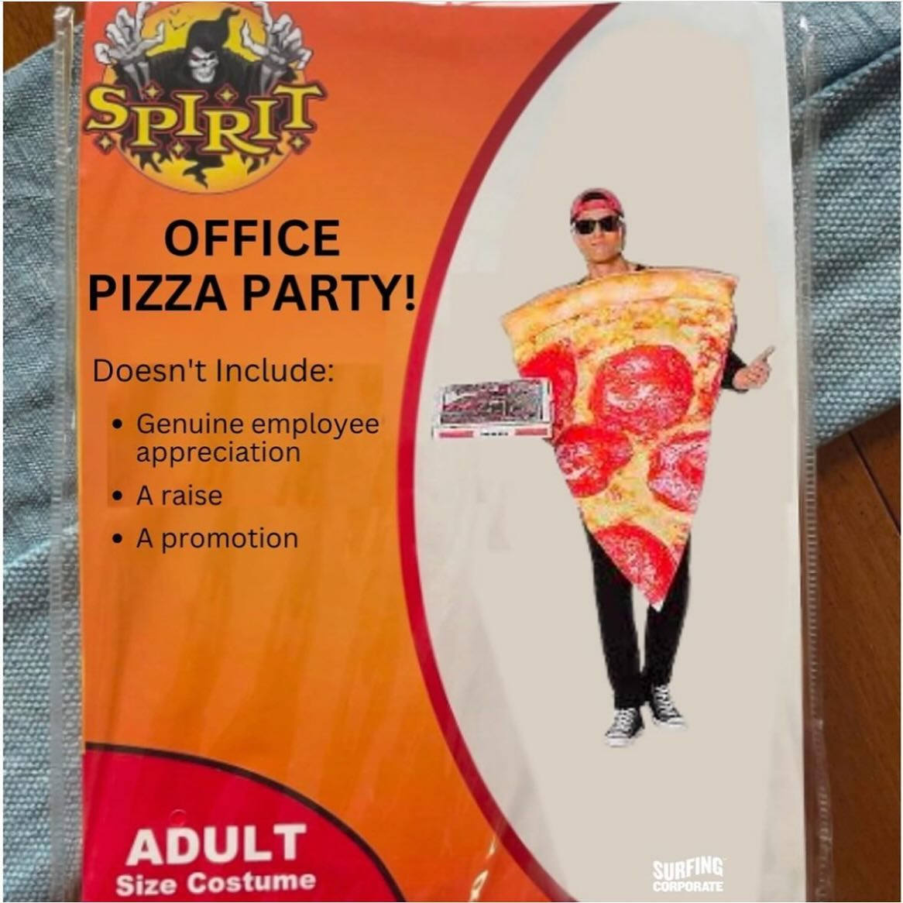

Slide 112
In summary…
What would make us happier?
Notes:
What are some things that can be done to make veterinary technicians happier?

Slide 113
In summary…
What would make us happier?
More money
Notes:
Surprise. More money. Financial insecurity is on everyone’s mind these days, as you all know. Being able to afford to feed, clothe, and house oneself is the most basic set of needs, and if these aren’t met then there’s no way to move forward. Someone who is worried about not being able to make rent this month doesn’t have their whole focus on the job at hand, and that leaves them more open to errors. Speaking as someone who has mental health issues, when I’m really struggling and all up in my own head I’m much more likely to make a mistake at work. It’s unfortunate, but it’s true.

Slide 114
In summary…
What would make us happier?
More money
Better staffing
Notes:
Staff your clinic appropriately for the number of appointments you have, and take the number of appointments you can reasonably do with the staff you have. There are days that will totally get away from you, sure. But an example from my own experience – if there’s a day coming up that looks like it’s going to be extra busy and go into overtime, my boss will come to us in advance and ask for volunteers to stay late. She will add that OT is always voluntary, and that if none of us are available then one of the veterinarians will stay to take care of it. I don’t think she’s ever not gotten a volunteer. Earlier there was a respondent who mentioned taking on call shifts at their clinic. You could rotate through who is on call that week to come in if the schedule really gets away from you, just make sure to compensate them appropriately.

Slide 115
In summary…
What would make us happier?
More money
Better staffing
Support
Notes:
Support each other. Support your CVTs. Support them physically, when they’re trying to lift a sedated great dane, but also mentally and emotionally. Show them that they are appreciated. That you see them and the work they’re doing, and that you recognize their efforts. If they come to you with a concern, listen to them and take their concerns seriously.

Slide 116
“I just want to be treated like a human being that has a life outside of work. I don’t want to be penalized for the one time I put my child first. Employees should be encouraged to take care of themselves and their families above all. If those things are both taken care of, employees are able to be better employees.”

Slide 117
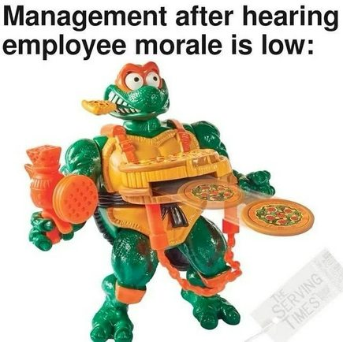

Slide 118
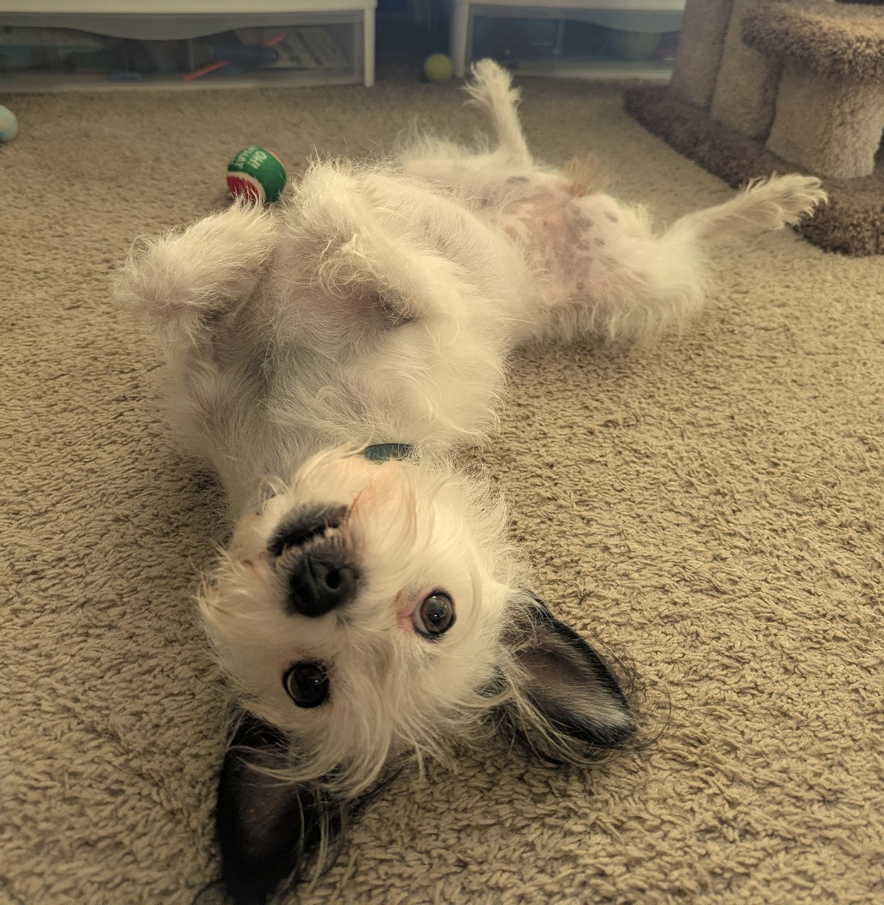
Questions, comments, anecdotes?

