Slide 1
Webinar for Tribal Historic Preservationists and Tribal Emergency Responders March 13, 2017
Emergency Preparedness in Indian Country and Tribal Preservation Planning Needs: Recommendations for Tribes and Other Stakeholders

Slide 2
Presenters
Bambi Kraus, President, National Association of Historic Preservation Officers
Jen Wellock, Architectural Historian, National Park Service, U.S. Department of Interior
Cathleen Carlisle, Hazard Mitigation Planner, National Mitigation Planning Program, Federal Insurance and Mitigation Administration, Federal Emergency Management Agency, U.S. Department of Homeland Security
Monte Fronk, Emergency Management Coordinator with the Tribal Police Department at Mille Lacs Band of Ojibwe
Katherine Brodie, Consultant, NATHPO

Slide 3
Outline of Discussion
Purpose and Scope of Report – NATHPO and NPS
FEMA Tribal Mitigation Overview
Key Report Definitions & Principles
Recommendations for Tribal Governments
Recommendations for Other Stakeholders
Resources for Tribes and Other Stakeholders
Next Steps

Slide 4
Purpose and Scope of Report
Developed with the assistance of NPS grant
Purpose: to provide stakeholders with best practices recommendations to better integrate cultural resource protection into emergency preparedness and response
Identify current status and resources
Develop Tribal Case Studies to inform best practices
Identify Gaps and Make Recommendations for Future Planning
Provide templates and resources for tribes of all sizes and planning capacities

Slide 5
Tribal Mitigation Planning - Overview
Laws, Regulations, and Policies
Cultural and Sacred Sites
Mitigation Planning Resources and Training
Tribal Multi-Hazard Mitigation Planning Guidance Update - Second Consultation and Outreach Period (Ends April 9, 2017)
Planning Information Exchange (PIE)
Contacts

Slide 6
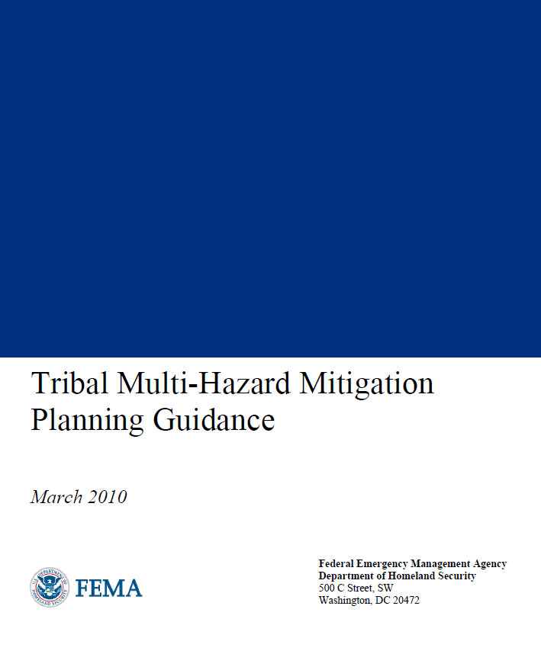
Laws, Regulations, and Policies
Laws, Regulations and Policies webpage: https://www.fema.gov/hazard-mitigation-planning-laws-regulations-policies
Robert T. Stafford Act, as amended by the Disaster Mitigation Act of 2000
Title 44 Code of Federal Regulations §201.7 Tribal Mitigation Plans: http://www.ecfr.gov/cgi-bin/text-idx?SID=6d1824de306391d5c9c6a655fc47feb2&mc=true&node=se44.1.201_17&rgn=div8
Tribal Multi-Hazard Mitigation Planning Guidance (2010): http://www.fema.gov/media-library/assets/documents/18355
Notes:
Hazard mitigation: Any action taken to reduce or eliminate long term risk to people and property from natural disasters.
Hazard mitigation planning is a process used by State, tribal, and local governments to identify risks and vulnerabilities associated with natural disasters and develop mitigation strategies to reduce or eliminate long term risks.
Tribal governments develop and adopt hazard mitigation plans that are approved by FEMA as a condition for receiving certain types of assistance, including funding for mitigation projects.
To remain eligible, Tribal governments must update their hazard mitigation plans and re-submit them for FEMA approval every five years.
As of December 31, 2016, 149 Federally-recognized tribal governments have mitigation plans that are FEMA-approved or approvable-pending-adoption

Slide 7
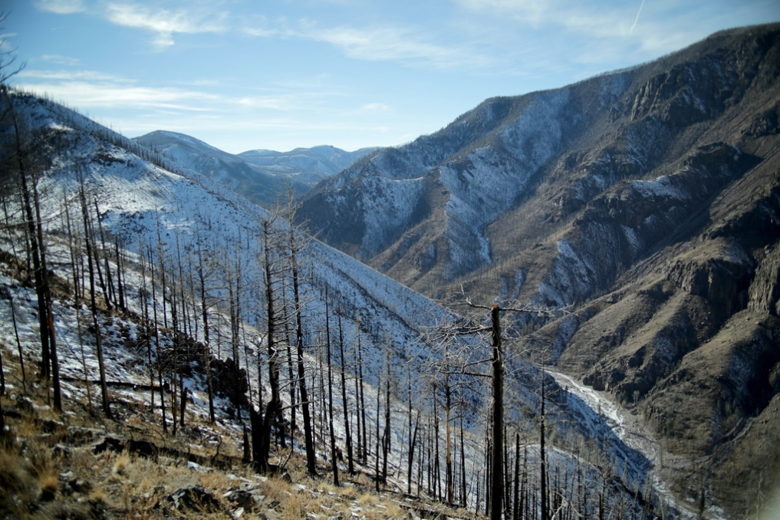
Cultural and Sacred Sites
44 CFR Section 201.7(c)(2)(ii) “The plan should describe vulnerability in terms of:
(D) Cultural and sacred sites that are significant, even if they cannot be valued in monetary terms.” http://www.ecfr.gov/cgi-bin/text-idx?SID=6d1824de306391d5c9c6a655fc47feb2&mc=true&node=se44.1.201_17&rgn=div8
Tribal Multi-Hazard Mitigation Planning Guidance (2010), page 40-41: https://www.fema.gov/media-library/assets/documents/4317
Integrating Historic Property and Cultural Resource Considerations into Hazard Mitigation Planning (2005), "How-To" Guide #6 (FEMA 386-6): http://www.fema.gov/media-library/assets/documents/18355
Photo: FEMA/Adam DuBrowa, Santa Clara, NM, 12/15/14
Notes:
FEMA Media Library, https://www.fema.gov/media-library/assets/images/89395: “Santa Clara, Sacred Mountain, N.M., December 16, 2013 -- The Pueblo Tribe's ancient sacred lands were damaged after recent fires scorched the topography stripping the vegetation while creating a slick runoff during rain events that devastate the ruins, hunting grounds and the Native American spiritual grounds downstream. Adam DuBrowa/ FEMA Photo by Adam DuBrowa - Dec 15, 2013 - Location: Santa Clara, NM”

Slide 8
Mitigation Planning Resources and Training
FEMA’s Hazard Mitigation Planning Resources webpage: https://www.fema.gov/hazard-mitigation-planning-resources
Tribal Mitigation Planning Fact Sheet (2016), https://www.fema.gov/media-library/assets/documents/18375
Mitigation Ideas: A Resource for Reducing Risk to Natural Hazards (2013), https://www.fema.gov/media-library/assets/documents/30627
FEMA’s Hazard Mitigation Planning Training webpage: https://www.fema.gov/hazard-mitigation-planning-training
IS-318 Mitigation Planning for Local and Tribal Communities, https://training.fema.gov/is/courseoverview.aspx?code=IS-318
G-318: Mitigation Planning Workshop

Slide 9
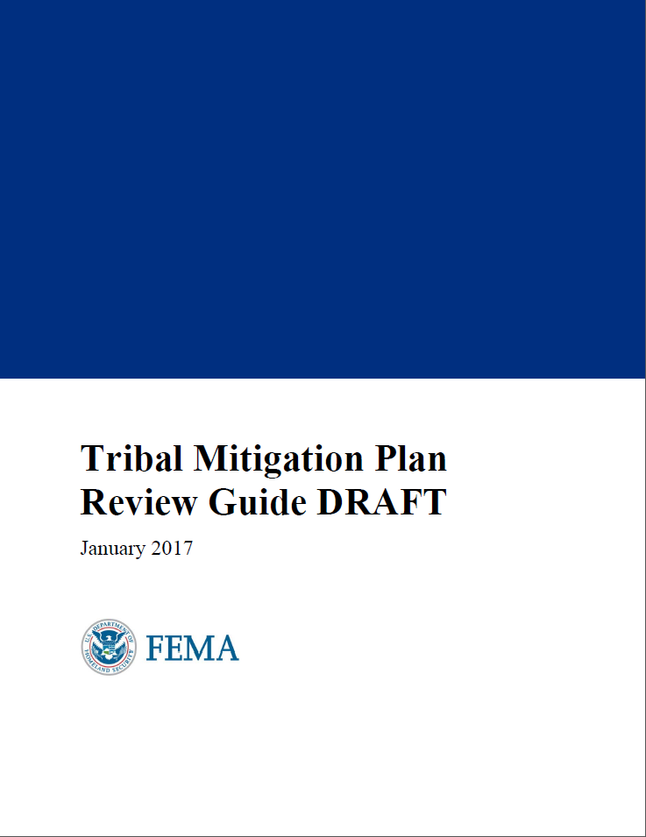
Tribal Multi-Hazard Mitigation Planning Guidance Update – Second Consultation and Outreach Period
Consultation and Outreach Period: February 8 – April 9, 2017
Draft Tribal Mitigation Plan Review Guide: https://www.fema.gov/tribal-consultation
National Webinar: March 13, 2017 3:30-4:30 pm ET
Adobe Connect: https://fema.connectsolutions.com/r53m98fb1oa/
Conference #: 800-320-4330; Code: 905506

Slide 10
Tribal Multi-Hazard Mitigation Planning Guidance Update – Second Outreach and Consultation Period
Submit comments via email to tribalconsultation@fema.dhs.gov or by mail:
ATTN: National Mitigation Planning Program Federal Insurance and Mitigation Administration (FIMA), DHS/FEMA, 400 C Street SW, Suite 313, Washington, DC 20472-3020
Photo: FEMA/Ruth Kennedy, Rainsville, AL, 8/22/11
Notes:
FEMA Media Library, https://www.fema.gov/media-library/assets/images/60896: “Rainsville, Ala., August 22, 2011 -- Rainsville citizens share their ideas for rebuilding their community during a meeting at the Tom Bevill Enrichment Center in Rainsville. Three tornadoes destroyed a large portion of Rainsville on April 27th. Currently the FEMA ESF#14 team is working closely with Rainsville to rebuild the community to be better and stronger than before. FEMA Photo/Ruth Kennedy Photo by Ruth Kennedy - Aug 21, 2011 - Location: Rainsville, AL”

Slide 11
Planning Information Exchange (PIE)
FEMA’s Hazard Mitigation Planning News and Events webpage: https://www.fema.gov/hazard-mitigation-planning-news-events
In partnership with the American Planning Association (APA) and the Association of State Floodplain Managers (ASFPM) – the Planning Information Exchange (PIE) is a series of free, quarterly webinars to encourage peer-to-peer learning
Next webinar: March 23, 2017, 2pm ET
To register or view past webinars, visit the APA website, https://www.planning.org/nationalcenters/hazards/planninginformationexchange/

Slide 12
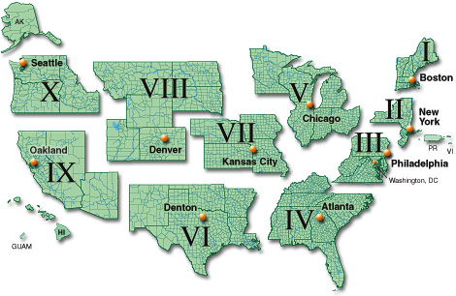
FEMA Contacts
For more information as well as requests for training and technical assistance, Tribal officials can contact FEMA’s:
National Tribal Affairs Advisor, https://www.fema.gov/tribal-contacts
Regional Tribal Liaisons, https://www.fema.gov/tribal-contacts
Senior Mitigation Planner in the Mitigation Division, Risk Analysis Branch of the appropriate FEMA Regional Office, https://www.fema.gov/fema-regional-contacts

Slide 13
Key Definitions
“Stakeholders” -
Tribal Historic Preservation Officers and other tribal cultural resource experts
Tribal emergency responders
Federal agencies with jurisdiction over emergency response and cultural resource protection
State and local officials including emergency responders, State Historic Preservation Officers, and others who interact with tribes
Nongovernmental tribal and non-tribal cultural and emergency response organizations

Slide 14
Key Definitions
Cultural Resources:
Aspects of cultural systems that are valued by or significantly representative of a culture or that contain significant information about a culture. A cultural resource may be a tangible entity or a cultural practice. Tangible cultural resources are characterized by structures, archeological resources, cultural landscapes, museum collections, archival documents and photographs, sacred sites, and ethnographic resources. Also included are cultural items as defined in the Native American Graves Protection and Repatriation Act (25 U.S.C. § 3001).

Slide 15
Key Definitions
Historic Properties:
Any prehistoric or historic district, site, building, structure, or object included in, or eligible for inclusion in, the National Register of Historic Places, including artifacts, records, and material remains which are related to such district, site, building, structure or object. (16 U.S.C. § 470)

Slide 16
Key Definitions
Natural Resources:
Includes terrestrial and aquatic ecosystems, biological resources, including fish and wildlife, threatened and endangered species, and migratory birds, mapping and geospatial data, geology, hydrology, including real time water flow data, earthquakes and other natural hazards, on- and off-shore minerals, energy and coal mining.

Slide 17
Key Definitions
For convenience, the Report uses the term “cultural resources” to refer to any cultural resource, cultural heritage, sacred site, natural resource or historic property that a tribe would seek to protect in event of emergency.

Slide 18
Key Definitions
Emergency:
An incident, whether natural or man-made, that requires responsive action to protect life or property.

Slide 19
Key Definitions
Hazard Mitigation Plan:
State, Tribal and local governments are required to develop a hazard mitigation plan as a condition for receiving certain types of Federal non-emergency disaster assistance, including funding for mitigation projects. State, Tribal and local governments engage in the mitigation planning process to identify risks and vulnerabilities associated with natural disasters and establish a long-term strategy for protecting people and property in future hazards events. A Mitigation Plan is a community-driven, living document that communities use to reduce their vulnerability to hazards. The hazard and risk assessment process provides the foundation for the rest of the mitigation planning process.

Slide 20
Key Definitions
Mitigation:
Action intended to eliminate or reduce the effect of an actual or potential emergency. Example: Providing the public with information for eliminating or reducing risk (staying off roadways during a storm), implementing environmental and safety regulations, or monitoring and inspecting potential high-risk areas. Seeks to fix the cycle of disaster damage, reconstruction and repeat damage.

Slide 21
Key Definitions
Preparedness:A continuous cycle of planning, organizing, training, equipping, exercising, evaluating and taking corrective action in an effort to build and sustain the capabilities necessary to prevent, protect against, mitigate the effects of, respond to and recover from the threats that post the greatest risk. Includes planning, procedures and protocols, training and exercises, personnel qualification and certification, and equipment certification.

Slide 22
Key Definitions
Prevention: Involves taking action to avoid, prevent or stop an incident before it occurs. Example: Turning gas off to a neighborhood in which there is an odor of gas or acting on observed suspicious behavior by calling the police.

Slide 23
Key Definitions
Protection:Taking deliberate steps to ensure an effective response. Example: Developing an Emergency Operations Plan, activating weather forecasting and warning systems.

Slide 24
Key Definitions
Response:Occurs immediately after an emergency strikes. Activity that addresses the short-term, direct effects of an incident, specifically the immediate actions to save lives, protect property and meet basic human needs. Example: Activating an Emergency Operations Plan and Emergency Operations Center, providing support to and coordinating first responders and the impacted community. An effective response can reduce the extent of potential subsequent damage.

Slide 25
Key Definitions
Recovery:Begins during and continues following response efforts. Involves the development, coordination and execution of service and site restoration plans and the reconstruction of government operations and services, including lessons learned and initiatives to prevent re-occurrence. Example: Performing a damage assessment, conducting debris removal, returning systems and facilities to normal or “new normal.”

Slide 26
Risk Mitigation Risk mitigation principles articulated by the Federal Emergency Management Agency (FEMA) in Hazard Mitigation Planning for Tribal Governments include …

Slide 27
1. Organize Resources
At the start, an Indian tribal government can focus on assembling the resources, partners, and technical expertise needed for a successful mitigation planning process. In the context of cultural resources, this means having the right individuals at the table, such as the THPO or other cultural steward, to integrate cultural issues throughout the planning process.

Slide 28
2. Assess Risks
Next, the Indian tribal government needs to identify the characteristics and potential consequences of hazards. It is important to understand what geographic areas different hazards might impact and what people, property, or other assets might be vulnerable. In the context of cultural resources, this means that the THPO or other cultural steward is at the table to help assess hazards and risks through the cultural resource perspective.

Slide 29
3. Develop a Hazard Mitigation Plan
Based on an understanding of risk, the Indian tribal government then needs to set priorities and develop long-term strategies for avoiding or minimizing the undesired effects of disasters. A written Hazard Mitigation Plan is the outcome, one ideally approved by the Tribe and then by FEMA to gain access to non-emergency federal aid, and can be the focus of the Tribes’ emergency management implementation efforts. In the context of cultural resources, this means having the right individuals at the table, such as the THPO or other cultural steward, to integrate cultural issues throughout the required areas of the HMP drafting

Slide 30
4. Implement Plan and Monitor Progress
The Indian tribal government can bring the mitigation plan to life in a variety of ways, from implementing specific mitigation projects to changing aspects of day-to-day tribal operations. To ensure success in ongoing implementation, the plan must remain relevant. Thus, the Indian tribal government can conduct periodic evaluations to assess changing risks and priorities and make revisions as needed. In the context of cultural resources, this means that the THPO or other cultural steward is actively engaged in activities, plans, programs, training and other areas designed to push forward implementing the HMP.

Slide 31
Action Item One: Identify Stakeholders and Organize Resources
The THPO can focus on assembling a Cultural Resources Working Group with participants that represent the resources, partners, and technical expertise needed for a successful hazard mitigation planning process that includes cultural resources.
This means having the right individuals at the table, such as the THPO or other cultural steward, to integrate cultural issues throughout the planning process

Slide 32
Action Item Two: Assess Risks to Cultural Resources.
The Cultural Resources Working Group, led by the THPO or other tribal designee, can work to identify the characteristics and potential consequences of hazards.
It is important to understand what geographic areas different hazards might impact and what people, property, or other assets might be vulnerable.
In the context of cultural resources, this means that the THPO is at the table to help assess hazards and risks through the cultural resource perspective.

Slide 33
Action Item Three: Develop a Hazard Mitigation Plan.
Based on an understanding of risk, the THPO must set priorities and develop long-term strategies for avoiding or minimizing the undesired effects of disasters on cultural resources.
A written Hazard Mitigation Plan is the outcome, one ideally approved by the Tribe and then by FEMA to gain access to non-emergency federal aid, can serve as the focus of the Tribe’s emergency management implementation efforts.
In the context of cultural resources, this means having the right individuals at the table, such as the THPO or other cultural steward, to integrate cultural issues throughout HMP drafting

Slide 34
Action Item Four: Implement Plan and Monitor Progress.
The THPO can implement the cultural resource aspects of the HMP through specific mitigation projects.
The THPO can conduct periodic evaluations to assess changing risks and priorities and make revisions as needed.
In the context of cultural resources, this means that the THPO or other cultural steward is actively engaged in activities, plans, programs, training and other areas designed to push forward implementing the HMP.

Slide 35
Action Item One: Identify Stakeholders and Organize Resources.

Slide 36
Stakeholders may include:
Tribal Council or leadership
Tribal Historic Preservation Officer
Cultural, natural and historic resource experts at the Tribe including museum or cultural center personnel, archeologists, and academics
Historic preservation, cultural resources, natural resources, land use or other committees of the Tribe’s executive and legislative bodies
Tribal community, including Elders
Transportation and public works department personnel
Emergency management experts including the Tribe’s emergency manager, emergency management department
First responders including fire and police, foresters, wildfire management experts, public affairs officers
Other Tribes in the locality or region with knowledge to assist the Tribe
The Tribe’s education department including youth programs

Slide 37
Non-Tribal Stakeholders might include:
The State Historic Preservation Officer
Federal agency representatives including Bureau of Indian Affairs (BIA), Forest Service, Coast Guard, FEMA (including the Heritage Emergency National Task Force), National Park Service, Fish and Wildlife Service, and any other federal agencies with jurisdiction to interact with the Tribe for purposes of emergency response or resource management or protection
State and local government officials that interact with the Tribe for purposes of emergency response or resource management through mutual aid agreements or otherwise

Slide 38
Recommended actions
Identify and create a working group of identified stakeholders (“Cultural Resources Working Group”) by maintaining a list of the names, titles, affiliations, phone numbers and email addresses for all stakeholders that, in the Tribe’s or the THPO’s judgment, are integral to the preparedness, mitigation, response and recovery efforts regarding cultural and historic resources and the execution of an HMP incorporating cultural resources.
Put the THPO or other designated tribal cultural resource expert in the lead to communicate with these stakeholders in advising the Tribe on the incorporation of cultural resources into the Tribe’s emergency planning, through an EOP, HMP or other plan.
Utilize this working group as the basis for the THPO to strengthen the Tribe’s partnership with Tribal, federal, state and local planning and emergency preparedness officials to ensure that cultural resources are integrated into the tribe’s emergency plan as adopted and implemented over time.
Tribal Emergency Response Committee (TERC) Model

Slide 39
Action Item Two: Assess Risks to Cultural Resources.

Slide 40
1. Hazard Identification
Recent local events impacting the reservation such as a fire or flood, including man-made events such as train derailments
Trends such as drought conditions raising fire risk or rising water creating a flooding threat
Hazards identified in State or Local Hazard Mitigation Plans that are relevant to the Tribe’s reservation or bordering land
Rare but severe events: Earthquakes, hurricanes, tornados
Slow moving but consequential events such as climate change
Information gathered from Cultural Resources Working Group

Slide 41
2. Risk Identification
What is a cultural resource?
Risk identification involves the THPO and Cultural Resources Working Group determining, based on identified hazards, what cultural resources are at risk, and prioritizing the incorporation of those resources into an HMP. The analysis of the cultural resources “at risk” is limited only by what the Tribe considers to be naturally, culturally or historically significant to the Tribe.
As stated in Getting Ready in Indian Country: Emergency Preparedness and Response for Native American Cultural Resources, the terms “cultural heritage,” “cultural resources,” “cultural properties” and similar terms:
“are defined by each Tribe and include the people, places, objects, and traditions integral to the community and way of life. All Tribal cultural heritage is at risk [in an emergency] – not only material objects and structures, but also landscapes, archeological sites, natural resources, native language, traditions and customs. All of these expressions of Native American cultural heritage should be considered in emergency planning”

Slide 42
3. Creating an inventory of cultural resources
The Tribe cannot identify cultural resources at risk from hazards without a working inventory of cultural resources. For this purpose, if it does not have one, the Tribe could put in place an ongoing program of cultural resource inventory and assessment supported by the THPO (or other cultural resource designee) ideally utilizing GIS mapping software to develop a data base of all known locations of cultural resources within and outside of the Tribe’s reservation, which is continually updated as the THPO and others identify new cultural resource sites and maintains confidentiality of information.

Slide 43
Action Item Three: Develop a Hazard Mitigation Plan.

Slide 44
HMP Development
With a starting template, utilize the resources and talents of the Cultural Resources Working Group to review each component required in an HMP to determine:
where cultural resource issues can be added to the History, Hazards, Structures, Asset/Vulnerabilities and other information required to be contained in an HMP, and
how the THPO or other tribal cultural resources expert can be integrated explicitly into the Response, Recovery, Mitigation and Prevention components of the plan, including training, training exercise, certification, and funding.

Slide 45
Mitigation
Emergency response actions that take place after a disaster can cause extensive damage and even destruction to cultural resources. Under the guidance of the THPO, the Cultural Resources Working Group could develop for integration into the HMP or an HMP Annex policies and procedures for:
1. Documentation, salvage, and other post-disaster procedures for cultural and historic resources. The THPO, or other designee, could be responsible for ensuring that local building and emergency officials are aware of the procedures outlined in the HMP or developed pursuant to this plan and allow time to properly evaluate damage and explore preservation solutions.

Slide 46
Mitigation
2. The THPO, or other cultural resources designee, could seek increased coordination between cultural and emergency management experts at the Tribe. The THPO and emergency management officials need to work closely together to merge public and property safety goals with cultural resource protection goals. As a first step, to help ensure that the historic integrity of natural and cultural resources and historic property are protected during mitigation projects, the THPO can undertake regular review current emergency plans and share the most current cultural resource inventory and protection recommendations with tribal emergency management officials.

Slide 47
Mitigation
3. The THPO could work to incorporate clear procedures for the THPO to allow others to access the location of identified cultural resources as part of the response, recover and mitigation process. The THPO could take the lead role in these efforts and provide guidance to emergency response teams on preserving the integrity of historic resources during restoration and repair efforts.

Slide 48
Mitigation
4. The HMP could make clear that the THPO, or other cultural resources designee, can play the lead role in any Emergency Operations Center (EOC) established during a hazard event as an integral part of the EOC team to support the EOC’s work by identifying cultural resources at risk, providing appropriate professional staff and trained volunteers for damage assessment teams, evaluating damage reports, and consulting regarding on site-specific recovery efforts, especially in historic areas or in areas of traditional cultural and spiritual significance that may require special treatment.

Slide 49
Mitigation
5. The THPO, or his/her designee, could have a role in survey conditions and impacts to at-risk natural and cultural resources and historic property to determine the nature and scope of impacts, and suggest mitigation procedures in the form of stabilization, reconstruction, or mitigation through data recovery.

Slide 50
Mitigation
6. Train qualified historic preservation professionals to participate in damage assessment teams and train emergency responders with regard to cultural resource protection priorities. The THPO can seek opportunities to train tribal and non-tribal emergency management personnel in historic preservation issues relevant to disaster planning and response and to train cultural resources Stakeholders identified by the THPO or other cultural resources designee to participate in emergency planning and response.

Slide 51
Action Item Four Implement Plan and Monitor Progress.

Slide 52
During this stage, the THPO or other designee can seek opportunities for:
Developing or supporting Tribal policies to effectuate cultural resource integration into emergency management, such as new fire codes and other requirements to enhance safety of cultural resources.
Pursuing activities and tools to reduce and mitigate damage from hazards to natural and cultural resources and historic property, such as environmental debris clean up and waste removal and other efforts consistent with reducing risk to cultural resources.

Slide 53
During this stage, the THPO or other designee can seek opportunities for:
Training in emergency management principles, including specifically emergency response, recovery, mitigation and prevention as it applies to cultural resources such as libraries, structures, artifacts and other items.
Seek opportunities to “braid” available funding sources to meet the cultural resource protection goals of the Tribe as articulated in the HMP.
The Cultural Resources Working Group can regularly evaluate the Historic Preservation Mitigation Plan or HMP Annex, at least annually, to evaluate progress and areas in need of amendment or supplementation.

Slide 54
Recommendations and Action Items: Other Stakeholders

Slide 55
Action Item One:
Include Cultural Resources in Emergency Management Planning and Response

Slide 56
Breaking Down Silos of Communication
Efforts by FEMA, Non-Governmental Organizations and other Stakeholders who play a key role in providing emergency management training to Tribes can take additional efforts to integrate cultural resource protection issues by:
Including on the agenda for all emergency management training the topic of cultural resource integration
Ensuring all training materials to include cultural resources issues
Reaching out to expand the audience for emergency management trainings to include cultural resources experts at Tribes

Slide 57
Action Item Two: Include Emergency Planning in Cultural Resource Programming and Activities

Slide 58
Recommendations
Include cultural resources in emergency planning at the local, State, Tribal and Federal level
Tailoring high quality museum, collection and archive disaster preparation and response materials to be more inclusive of the concerns of Tribes
Including on the agenda at cultural resources informational forums information on emergency planning issues
Reaching out to expand the audience for cultural resources informational forums to include emergency management experts
Serving as advocates for greater inclusion of emergency planning in cultural resources protection forums

Slide 59
Action Item Three: Increase Access and Availability of Culturally Relevant Response, Recovery, Mitigation and Preparedness Resources for Tribal Governments

Slide 60
Increased Resource Access
Centralize and publicize a point of contact through the Heritage Emergency National Task Force or elsewhere to assist in identifying and developing supplements to training curriculum and technical advice to advance cultural resource protection in times of emergency
Expand education awareness to tribes about existing government and private resources – funding and training
Keep resource lists up to date, comprehensive and well publicized
Keep resource materials updated and relevant to tribal audiences

Slide 61
Action Item Four: Support Increased Funding and Equitable Participation by Tribes in Funding Programs and Initiatives That Support Cultural Resource Integration in Emergency Management

Slide 62
Funding Needs
Lack of funds to put in place staff who can serve as a liaison between emergency management and cultural resources preservation staff at the Tribe
Multiple demands on THPOs and need for increased resources to expand the THPO office to engage activities supporting emergency response planning
Inventory and mapping of cultural resources to be protected in case of emergency including surveys of cultural resources and identifying them with GPS (Global Positioning Technology) and mapping them with current GIS (Geographic Information Technology)

Slide 63
Funding Needs
Funds to pay for historic property preservation and damage mitigation assessment reports leaving historic properties more vulnerable to future disasters
Immediate source of funds to pay Tribal representatives and others to respond quickly to act as monitors of sacred sites and other cultural resources
Funds to quickly train individuals to respond to a large scale disaster (such as HAZMAT training).

Slide 64
The final report will be announced by NATHPO and posted on www.nathpo.org. It will include: Sample Tribal Historic Preservation Hazard Mitigation Plan Integrating Cultural Resources Sample Tribal Hazard Mitigation Plan With Annex Integrating Cultural Resources Tribal Emergency Response Committee sample structure (chart) Model Mutual Aid Agreement Comprehensive list of other resources and information related to emergency response and cultural resource protection

