Slide 1
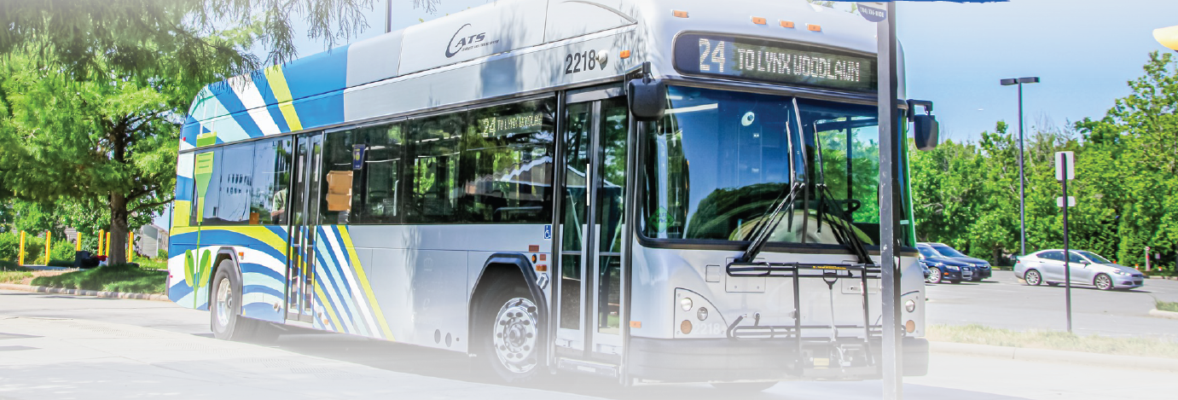

Transportation Plan for Sustained Regional Growth in Mecklenburg
Investing in Mobility, Equity, and Innovation

Slide 2

Why Now?
More People
More Traffic
More Urgency
    Charlotte adds 117 new residents every day
    More people means more congestion, longer commutes, and reduced quality of life
    We aim to:
      Ease congestion
      Support economic development
      Enhance access to jobs, services, and opportunity
    This plan unlocks access, sustains growth, and keeps Charlotte competitive

Slide 3
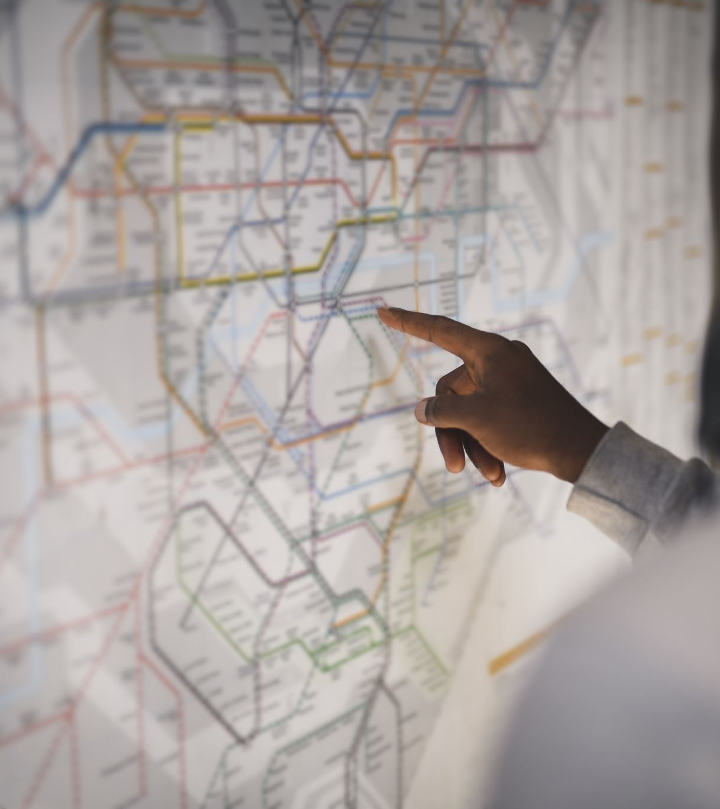
What this plan delivers
250,000 more people within ¼ mile of high-frequency transit (up from just 29K today)
320,000 more jobs accessible near high-frequency transit (up from 127K)
90% of the county will have transit access every 30 minutes or better

Slide 4
Every dollar creates results across the county
  $7.74 billion in roads money
  $7.74 billion for rail
  $3.9 billion for bus

Slide 5
Roads - $7.74 Billion
    Resources to the towns (funding amounts based on road miles and population)
      Cornelius: $325.9 million
      Davidson: $174.5 million
      Huntersville: $700.0 million
      Matthews: $307.0 million
      Mint Hill: $379.5 million
      Pineville: $87.3 million

Slide 6
Rail - $7.74 Billion
    Extending rail lines and adding a connection to the airport will enhance connectivity and provide an alternative to crowded roads.
    This plan includes the guarantee of the Red Line being built which would connect the northern towns of Mecklenburg to the business and entertainment district in uptown.

Slide 7
Bus -
$3.9 Billion
A 50 % increase in funding annually across the entire county
15 routes will offer 15-minute-or-better frequency, serving 60% of existing riders
On-demand, curb-to-curb service in 100 additional square miles
2,000 new or upgraded shelters, benches, and waiting pads.

Slide 8
Economic & Community Impact
Job access = economic growth: Transit access near jobs grows by 2.5x
Mobility = dignity: Easier access to healthcare, jobs, school, and opportunity
Quality of life = economic competitiveness: Companies want to locate where people can move freely and affordably
Serving underserved areas with new service and amenities

Slide 9
Budget and Strategic Investment
Our Goal:
Raise $3.0 million to drive the success of this campaign
Budget Allocation Overview:
Category | Investment | Purpose
Media & Voter Turnout | $2,653,250 | High-impact communications and community outreach
Administrative | $121,800 | Campaign consulting, compliance, and travel
Fundraising | $98,525 | Sustaining campaign momentum
Data & Analytics | $100,000 | Data modeling and tracking survey
Total Budget: $3,000,000
Note: Budget work in progress & subject to change

Slide 10
Why Your Support Matters
Investing in this campaign is investing in:
Regional growth
Transportation equity
Economic competitiveness
Quality of life for current and future residents
This is a once-in-a-generation opportunity to shape Charlotte’s future

