Slide 1
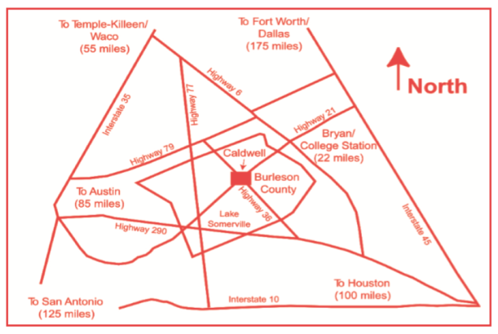
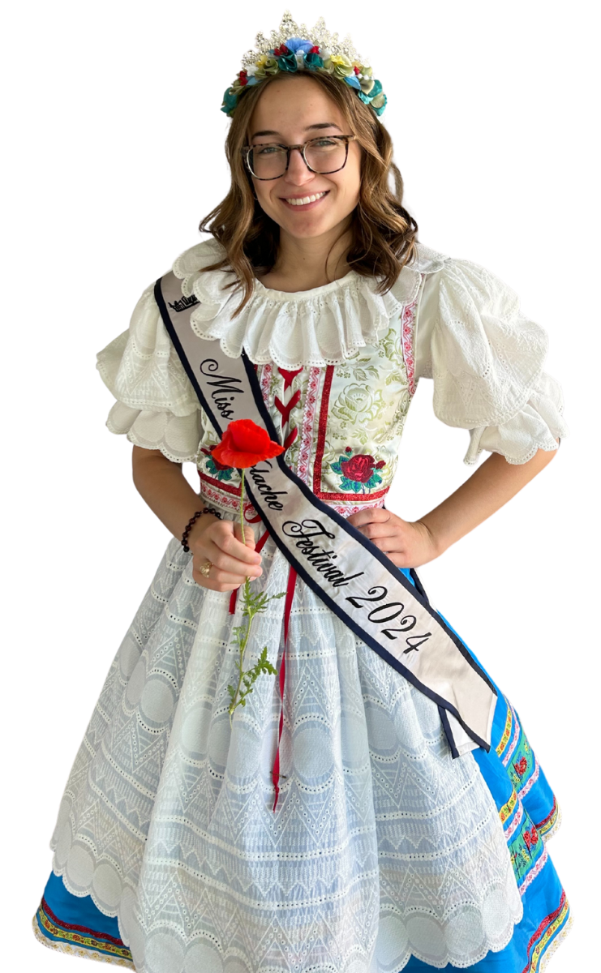

For more information on the Kolache Festival
Events, contact:
Burleson County Chamber of Commerce
301 N. Main St.
Caldwell, TX 77836
979-567-0000
contact@burlesoncountytx.com
BurlesonCountyTX.com/kolache-fest
KOLACHE FESTIVAL
SEPTEMBER 12, 2026
9AM-4PM
FREE ADMISSION
For Additional Information Contact:
Kolache Festival
Burleson County Chamber of Commerce
301 N. Main St.
Caldwell, TX 77836
979-567-0000
info@burlesoncountytx.com
BurlesonCountyTX.com/kolachefestival
FREE ADMISSION
FREE ADMISSION
Olivia Supak
Miss Kolache
Festival 2025
Lodging Guide
Hotels/Motels :
America’s Best Value Inn - 1108 SH21 West, Caldwell; (979) 567-3535
America’s Best Value Inn - 151 Ave B.; Somerville; (979) 596-3884
Somerville Inn & Suites - SH 36 S.; Somerville;
(979) 596-1000
Fort Half Moon, Somerville (979) 596-1234
Sunset Inn - SH 36 N.; Caldwell; (979) 567-4661
The Surrey Inn - SH 21 E.; Caldwell; (979) 567-3221
Camping Facilities:
Big Creek Cabins on Lake Somerville
(979) 596-1616
Brazos Valley RV Park 2190 St. HWY 21 E.,
Caldwell; (979) 200-3007
Lake Somerville Marina & Campground
505 Marina Dr.; Somerville (979) 289-2321
Texas State Parks - Birch Creek State Park
(512) 389-8900
U.S. Corps of Engineers (Rocky Creek & Yegua Creek)
(979) 596-1622 or (979) 444-6777
Welch Park, Lake Somerville; (979) 596-2286
Bed & Breakfast:
Land of Refuge Retreat Center, Caldwell;
(512) 560-0933
Rocking H, Caldwell; (979) 567-1727
Rosewood of New Tabor, Caldwell; (979) 272-8580
Seven Oaks, Caldwell; (979) 272-1952
For more, visit our website: burlesoncountytx.com
NAME ______________________________________ PHONE ____________________
Mailing Address__________________________________________________
Physical Address__________________________________________________
Age (if younger than 18) _______ Email Address _________________________________
KOLACHE DIVISION: Circle ONE (1 thru 4)
Youth
Non-Professional Burleson County
Non-Professional State
Professional
KOLACHE ROLL DIVISION (open to everyone)
Please circle the class entered. One entry
Per class. EACH ENTRY REQUIRES AN ENTRY FORM.
KR-CC. Cream Cheese
KR-E. Poppyseed
KR-L. Other: (specify filling)_________________
For additional information about guidelines or entries, contact the Texas A&M AgriLife Extension Service of Burleson County at 979-567-2308 or burleson-tx@ag.tamu.edu
Apple
Apricot
Cheese
Cherry
E. Peach
F. Poppyseed
G. Prune
H. Sausage (**Hot links ARE considered sausage)
I. Meat & Cheese Combo: (specify filling)______________
J. Other & Cheese Combo: (specify filling)_____________
K. Other Fruit: (specify filling)_____________
L. Other Meat: (specify filling)_____________
M. Other: (specify filling)_____________
2026 STATE OF TEXAS KOLACHE BAKE SHOW ENTRY FORM
Please circle the kolache class entered. One entry per class.
EACH ENTRY REQUIRES AN ENTRY FORM.
** ANY cheese combined with any other filling will be considered cheese combo and included in Class I or J.
BURLESON COUNTY CHAMBER OF COMMERCE
41st ANNUAL
KOLACHE
KOLACHE BAKE SHOW AWARDS
YOUTH
Grand Champion – Plaque & $300
Reserve Champion – Plaque & $100
NON-PROFESSIONAL
Burleson County Grand Champion – Plaque & $300
Burleson County Reserve Champion – Plaque & $100
State Grand Champion – Plaque & $300
State Reserve Champion – Plaque & $100
PROFESSIONAL
Grand Champion – Plaque & $300
Reserve Champion – Plaque & $100
KOLACHE ROLL
Grand Champion – Plaque & $300
Reserve Champion – Plaque & $100
FESTIVAL
September 12, 2026
DOWNTOWN CALDWELL
“ON THE SQUARE”
The Kolache Capital of Texas
979-567-0000
BurlesonCountyTX.com/kolache-fest

Slide 2

GREAT CZECH ENTERTAINMENT
Friday, September 11, 2026
Pre-Festival Dinner & Street Dance
Burleson County Czech Heritage Museum
Sponsored by
Burleson County Czech Heritage Museum
6 pm – Czech Meal
7:00 pm – 10 pm, Polka Music and Dance
Beer sold by New Tabor SPJST
Tickets sold in advance (limited tickets available day of event).
For more information call the Chamber at
979-567-0000 or contact a Czech Museum member.
SATURDAY, SEPTEMBER 12, 2026
9:00 am – 4:00 pm
KOLACHE FESTIVAL
Ahoj, join us in a fresh approach to kick off the 41st Annual Kolache Festival with a traditional kroje folk costume parade. The parade will start at 8:15 am, at the BC Czech Heritage Museum and will circle the square before heading to the pavilion. All ages are welcome to participate.
MAIN STAGE POLKA PAVILION - 202 W FOX
9:00 am: VITAM (WELCOME) Opening Prayer, Flag Ceremony, National Anthem, “Texas Our Texas” and “KDE DOMOV MUJ” (Czech National Anthem) Local, State and National Dignitaries. Crowning of Kolache Festival King & Queen of Burleson County.
9:30 am: SPJST Youth Beseda Dancers & Beseda Alumni Dancers
10:30 am-1:30 pm: The Shiner Hobo Band
12:00 pm: Performance by the Czech & Slovak Dancers of CHS (Czech Heritage Society)
12:30 pm: Kolache Eating Contest (Southside of the Courthouse)
1:30 pm: The Czechaholics (under the pavilion) and the Morarvians (under the Kolache Bake Shoppe tent on Main Street)
3:30 pm: State Championship Kolache Bake Show Awards & Ceremony
CELEBRATING CZECH HERITAGE
The Kolache Festival is more than a celebration—it's a tribute to the rich Czech heritage that helped shape our community. Each year, we honor the traditions, stories, and spirit of those who came before us while inspiring new generations to embrace their roots. From lively polka music and traditional dancing to authentic Czech cuisine, handcrafted art, and cultural experiences, the festival brings our heritage to life. Come celebrate the customs, flavors, and friendships that keep our Czech legacy thriving.
MUSEUM, HISTORY & SPECIAL FEATURES
State of Texas Kolache Bake Show
The Kolache Bake Shoppe
The Kraitchar House Museum &
Demonstrations
Burleson County Czech Heritage Museum
U.S. Texas Czech Flag Ceremony
“Kde Domov Muj” Czech National Anthem
Parade of Costumes
Creative Memories Guild Quilt Show
NEW location: Street Rod &
Classic Car Show
NEW location: Kids’ Adventureland
Antique Machinery & Tractor Show
Kolache Eating Contest
NEW - Art Show
Street Rod & Classic Car Show
NEW LOCATION
201 E Buck Street
Downtown – Registration at the Citizens State Bank Drive Thru
8:00 am - 2:00 pm
Quilt Show (Friday - Saturday)
Caldwell Civic & Visitors Center
9:00 am - 4:00 pm
ARTS & CRAFTS
& FOOD VENDORS
150+ VENDORS
All Day Shuttle Bus from Caldwell High School to Kraitchar House
NO PETS
VISIT THE BAKE SHOPPE
“Ceske Kolace”
A Block of Kolache Vendors
on Main Street
KOLACHE MAKING DEMONSTRATION
Friday, September 11, 2026
10 am – 2 pm
*Pre-Registration Required*
Will open on Aug. 10, 2026 at 9 a.m. https://forms.office.com/r/3WQ8V0neLA
The demonstration will include watching the baking from start to finish, giving
techniques on the best way to process the
dough so that the kolache will fit the criteria
that judges in the contest are wanting to
see, as well as making kolache for your family
and friend’s enjoyment.
Hosted by Bruno Shimek- 3-time State Champion & Kolache Bake Show Committee Member. Bruno will be assisted by Carolyn Brinkmann- 2-time State Champion & KBS Committee Member, Brian Estlund-KBS Committee Member, Lynette “Urbanovsky” Shimek- 2-time State Champion, & Stan Vitha.
For questions call (979) 567 2308 or
Burleson-tx@ag.tamu.edu
2026 STATE OF TEXAS
KOLACHE BAKE SHOW
Kolache, the original Czech wedding pastry, is a favorite national dessert throughout Czech Republic. The art of baking kolaches came with the early immigrants to Burleson County. Bakers have competed for 40 years to win the coveted title of Grand Champion Kolache Baker of Burleson County. Over the years, the bake show has grown to five divisions. It is open to adult and youth nonprofessional, professional, and champion bakers.
A kolache entry consists of 6 average size kolaches of the same filling and dough. These will be transferred by the baker to a plain disposable plate and box. A baker may enter one entry in each of the 13 classes: A. Apple, B. Apricot, C. Cheese, D. Cherry, E. Peach, F. Poppyseed, G. Prune, H. Sausage (**Hot links ARE considered sausage), I. Meat & Cheese Combo, J. Other & Cheese Combo, K. Other Fruit, L. Other Meat, and M. Other. **ANY cheese combined with any other filling will be considered cheese combo and included in Class I or J.
The Kolache Roll division is open to bakers of all ages, both non-professional and professional. A Kolache Roll must be made with kolache dough (yeast) of any filling. A baker may enter one entry in each of 3 classes: Cream Cheese, Poppyseed, and Other. An entry consists of 6 approximately 1- inch slices of the same filling and dough. (tea rings, strudels, or any other form of baked goods are not accepted.)
All Bake Show entries must be made by one person. Team entries are not accepted.
Registration will be from 8:00 am to 10:00 am on September 12, 2026.
Judging will begin promptly at 10:30 am.
After judging is complete, baked goods may be offered to the public for a donation to cover the cost of the event.
Grand Champions, Reserve Champions, and first place winners for each of the 4 Kolache divisions will be recognized, and 1 Grand Champion, 1 Reserve Champion, and 1st place class winners for the Kolache Roll division will be recognized at the Bake Show Awards ceremony at 3:30 pm at the Polka Pavilion (202 W. Fox Street).
Ribbons awarded for all entries will be given to participants immediately after the awards ceremony.
Decisions of the Kolache Bake Show Committee & Judges are final.
All Grand Champion winners of the 2025 Kolache Bake Show are not eligible to compete in 2026, but may compete in 2027. The Grand Champions of 2025 are invited to judge in the 2026 Kolache Bake Show.
For additional information about guidelines or entries, contact: Texas A&M AgriLife Extension Service Burleson County 1516 FM 166, Ste. 101 Caldwell, TX 77836
979-567-2308
burleson-tx@ag.tamu.edu
Texas A&M AgriLife Extension Service is an equal opportunity employer and program provider. Texas A&M AgriLife Extension Service provides equal opportunities in its programs and employment to all persons, regardless of race, color, sex, religion, national origin, disability, age, genetic information, veteran status, sexual orientation, or gender identity. The Texas A&M University System, U.S. Department of Agriculture, and the County Commissioners Courts of Texas Cooperating. Americans with Disabilities - Individuals with disabilities who require an auxiliary aid, service, or accommodations in order to participate in any Extension activities are encouraged to contact the County Extension Office at (979) 567-2308 14 days prior to event to determine how reasonable accommodations can be made.
Guidelines
Caldwell Methodist Church
306 W. Fox Street; Caldwell, Texas
The Kolache Bake Show is open to youth, adult non-professional, and professional bakers. Youth ages 9 through age 18, or still enrolled in high school as of January 1, 2026, may enter the Youth Division. Professionals are those individuals who have owned or been employed by a bakery and/or those who have received more than $1,000 in gross sales from sale of baked goods from their home or any other means. Once entered as professional, then always a professional. All others are considered adult non-professional or youth.
All Burleson County non-professional adults may enter in Burleson County or State Division. They may enter in only one division in any given year.
979-567-0000
burlesoncountytx.com/kolache-fest

