Slide 1
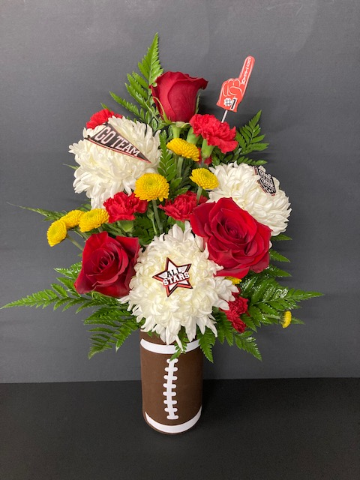
September
School Spirit
Cylinder Vase
Craft Paint (Espresso)
Clear Finish
White Vinyl
4 Leather Leaf
3 Freedom Rose
2 Mini Carnation Red
3 Football Mums White
3 Yellow Button Mums

Slide 2
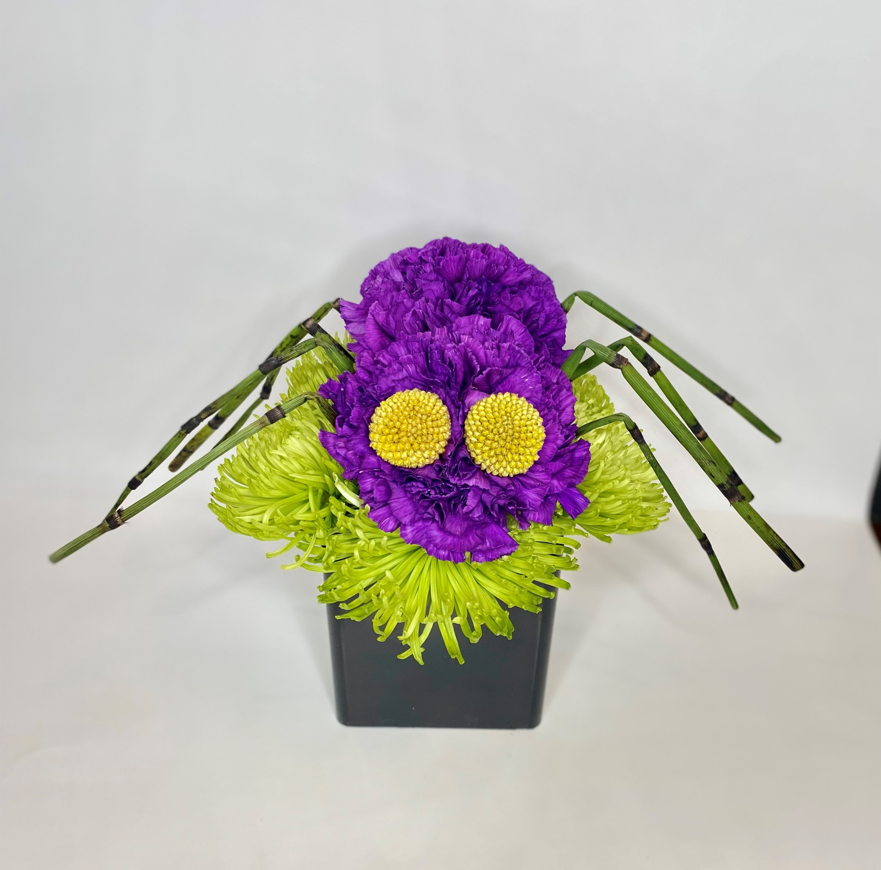
October
Creeping it Real
1/3 Block of Foam
Colored Cube Vase
9 Purple Carnations
5 Spider Mums Green
8 Equisetum (Horse Tail)

Slide 3
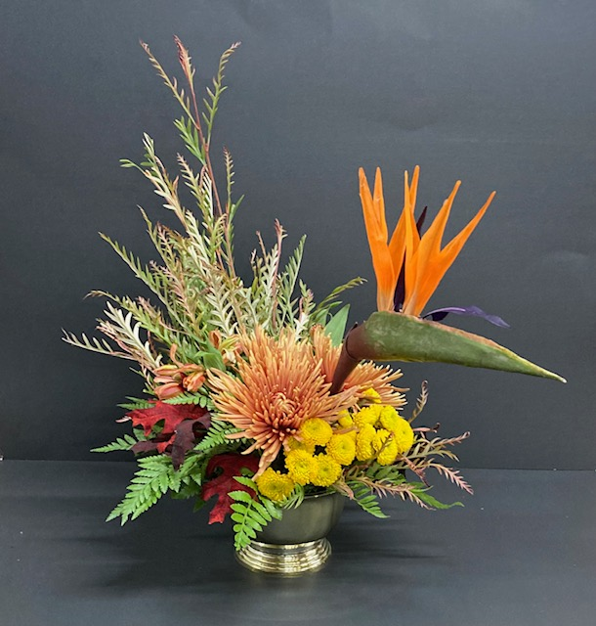
November
Tom the Turkey
Gold container
1/3 block of foam
3 button mum’s yellow
3 spider mum's bronze
1 birds of paradise
2 grevillea
2 leather leaf

Slide 4
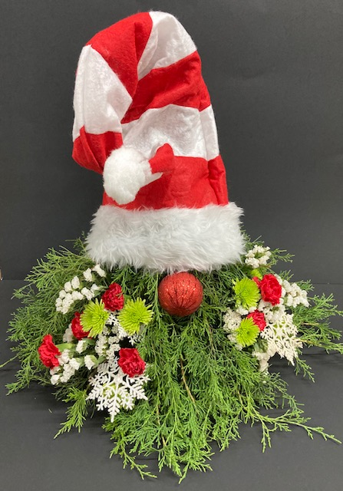
December
Jingle Jangles
1 block of foam
1 green or clear dish bowl
½ bunch of cedar
2 mini carnations red
1 green button mum
1/3 bunch statice white
Christmas hat
Christmas ornament for nose

Slide 5
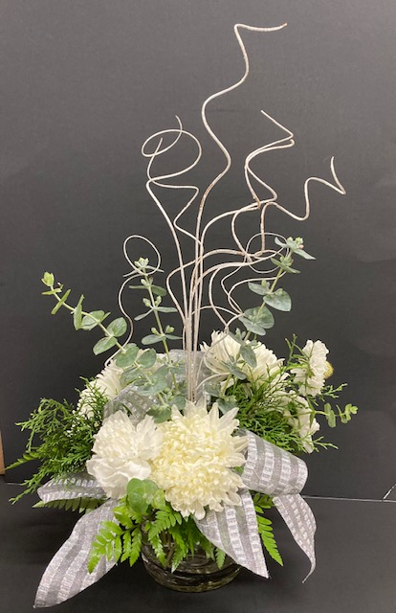
January
Winter Frost
Clear round cylinder
10 White ting
¼ clear tape for grid
2 yards ribbon
2 leather leaf
1 cedar
3 baby eucalyptus
3 football mum’s white
3 carnations white
3 Alstroemeria white

Slide 6
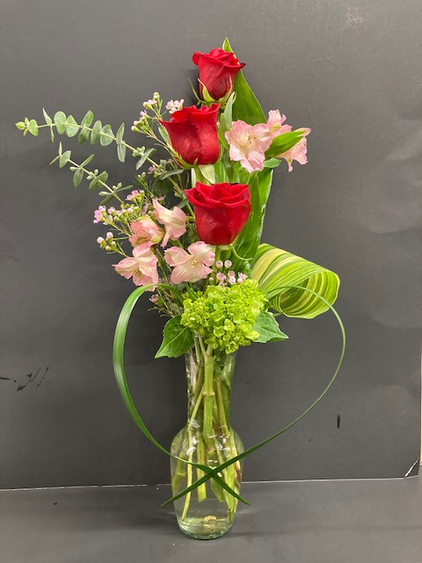
February
Love is in the Air
Multi stem bud vase
3 freedom rose red
1 stem baby eucalyptus
2 waxflower pink
1 mini green hydrangea
2 Aspidistra leaves
2 alstroemeria pink
2 leather leaf
2 lily grass

Slide 7
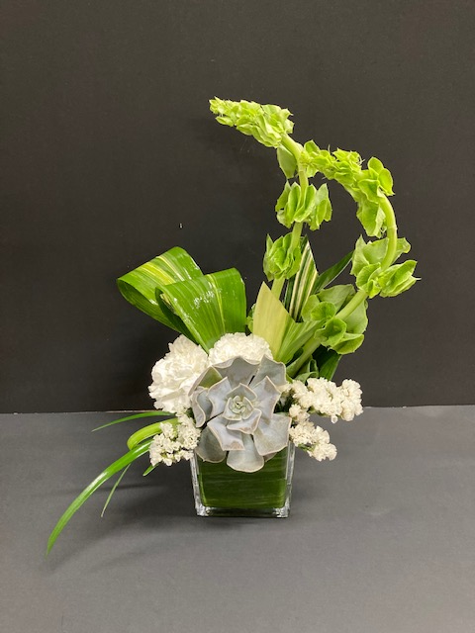
March
A little bit of luck
4x4 clear cube
1/3 block of foam
5 Aspidistra leaves
2 Bells of Ireland
3 carnations white
2 statice white
3 lily grass
1 succulent

Slide 8
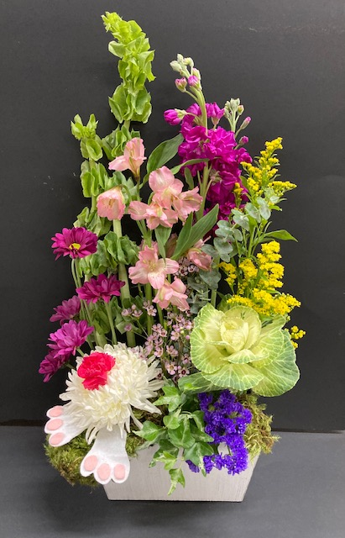
April
Mr. McGregor’s Garden
1 oblong container
Sheet moss
Felt for bunny feet
English ivy or plumosa
1 kale
2 stock fuchsia
2 alstroemeria pink
2 bell of Ireland
1 daisy purple
1 football mum white
2 solidago
1 status
1 waxflower lavender

Slide 9
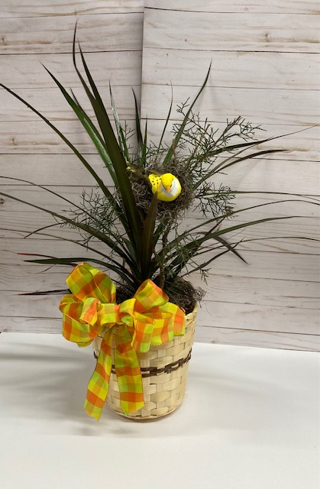
May
Birds Nest Basket
Basket
Potted plant
2 yards of ribbon
Bird
Moss for top of plant and nest
1 stem of cedar to hold nest

