Slide 1
PFAS and Other PENNVEST Federal Funding:
What You Need to Know to Apply & Comply
Presented by
Breana Sumners
April 7, 2026

Slide 2
Agenda – PFAS PENNVEST Funding
PFAS PENNVEST Funding Availability & Eligibility
Funding Compliance
PFAS-Specific Project Considerations Using Case Studies
Summary: Tips & Lessons Learned

Slide 3
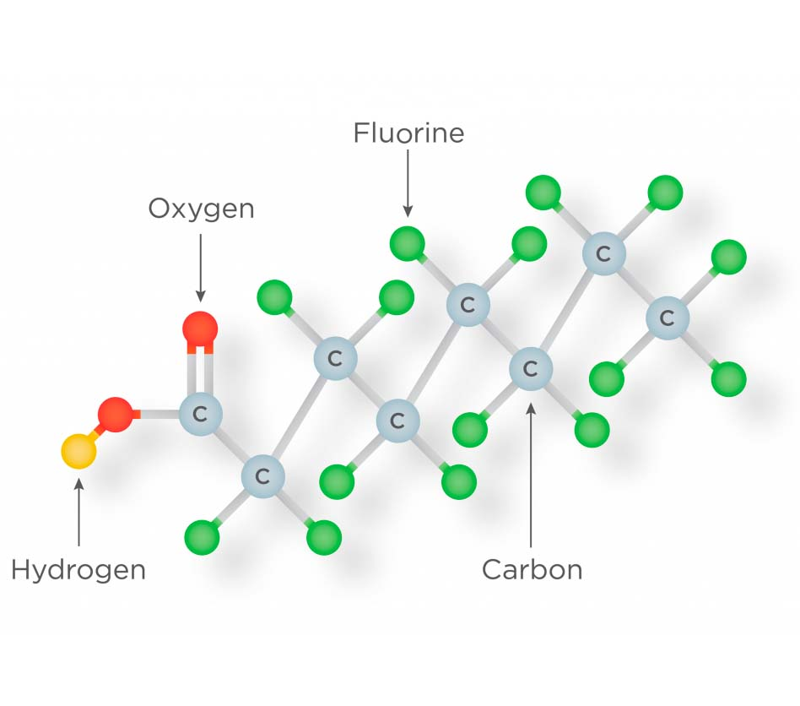

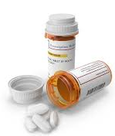
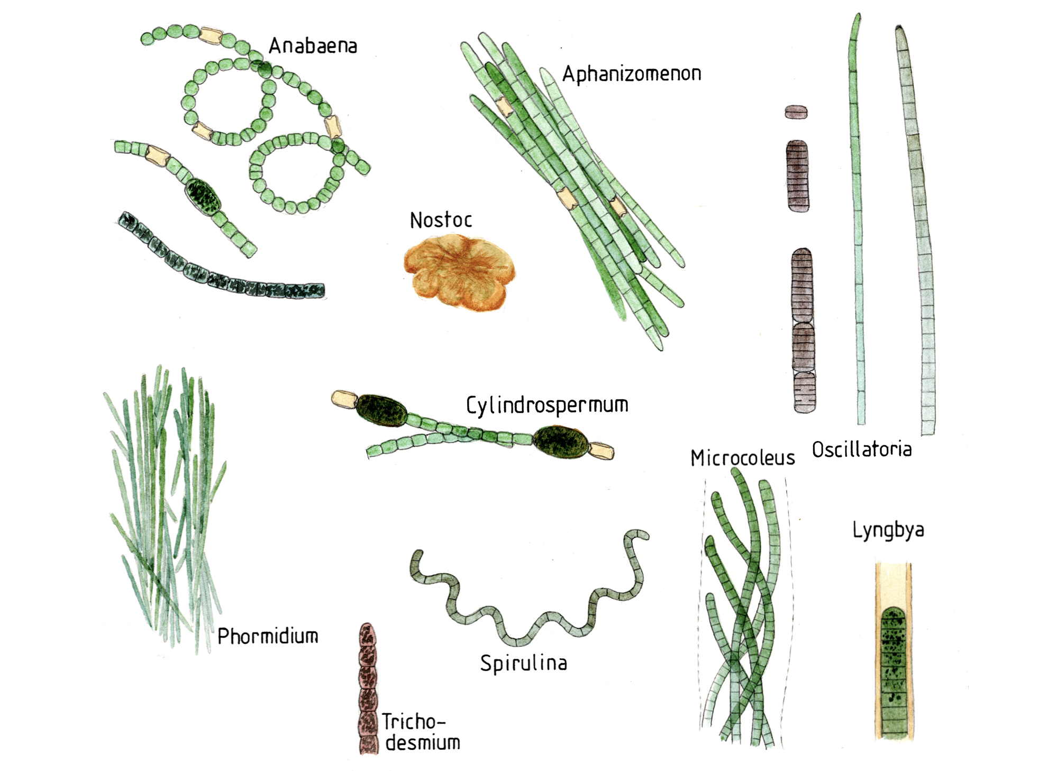
What is PFAS PENNVEST Funding?
Funding set aside through the Infrastructure Investment and Jobs Act (IIJA) to specifically address emerging contaminants (ECs) in water, wastewater, stormwater, and nonpoint source pollution.
Emerging Contaminants
Per- and Polyfluoroalkyl Substances (PFAS)
Pharmaceuticals and Personal Care Products
Microplastics/Nanoplastics
Antimicrobial-resistant Bacteria
6PPD-quinone
Harmful Algal Blooms (HABs)
EPA Contaminant Candidate Lists
  CCL1 – CCL6 (open for public comment)
  https://www.epa.gov/ccl
PFAS
Notes:
6PPD-quinone (6PPD-q) is a chemical formed when 6PPD, a chemical used in tires, reacts with ozone.

Slide 4
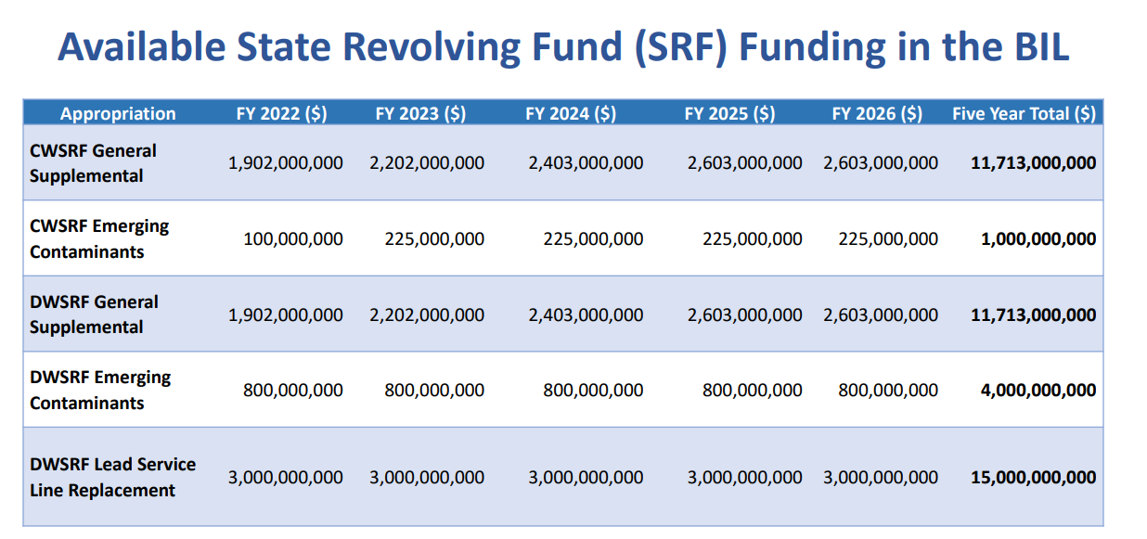
How Much is Available & When?
Mapping the Progress of IIJA Funding for Water Infrastructure
–
As of July 2025 PA was the only state to secure 100% of allotments.
National average of 68.8% with only 18% of total SRF appropriations reaching recipients via subawards
Notes:
IIJA established the emerging contaminate funding as an annual allocation from EPA to the States over five (5) years from FY2022 to 2026. We’re nearing the end of the availability of these funds. If you have an EC project – get it in now.

Slide 5

How Much is Available & When – for PA?
FY2025 Appropriations & Total Project Capital Based on the Intended Use Plan:
  $25.21M Drinking Water IIJA Emerging Contaminants
  $8.42M Clean Water IIJA Emerging Contaminants
Tentative Quarterly PENNVEST Application Cutoffs & Board Meetings
Application Cut-Off | Board Meeting
May 6, 2026 | July 15, 2026
July 29, 2026 | October 14, 2026
October 28, 2026 | January 21, 2027
February 3, 2027 | April 14, 2027
April 28, 2027 | TBD
Notes:
Plug for the PENNVEST program as a whole – PA made national news in January for a historic single round totaling almost $560M for 36 different projects across 25 counties.
The annual allotments for EC and the base program were released in May last year so we can expect to see the amounts for 2026 soon. Assume they will be similar but there are reallotments from prior years to consider.
$6.3M per PV Round Water
$2.21M per PV Round WW
For LSL, they updated the allotment formula so that it includes actual inventory data. The allotments were later this year, not announced until November. If we look at the same project capital numbers in the IUP we get $115.75M for FY 2025.
Announce the board meeting schedule on the 15th

Slide 6

What is Available - Grant vs. Low Interest Loans
Emerging Contaminant funding is issued as principal forgiveness (grant), regardless of financial status
HOWEVER….If requests exceed availability for a given evaluation round…
  Funding offer will be loan/grant split
  Offers pro-rated: Ratio =
Available Funds
Total All Requests
Notes:
Only for those specific design considerations that were made specific to emerging contaminants, which go above and beyond what would be needed with a normal end of life replacement. These “above and beyond” costs are what is included in the BIL percentage.
For example, filters being replaced at the end of their useful life but include air wash (backwashing at higher flow rates, contributes to a better clean which reduces the algal material left in the bed), backwash pumps and backwash handling (upgraded to accommodate increased backwash demands)

Slide 7

Eligible Applicants
Public Entities
Private Entities
Otherwise Eligible Applicants
Notes:
Otherwise Eligible – e.g. Counties,

Slide 8






Eligible Projects
This Photo s lCC BY-SA
Specifically address
>1 emerging contaminant
Result in water
quality benefit
Environmental
Permits In-hand
Design
Completed
Planning (water only)
Design, and Construction
Activities
Biddable Plans
& Specs
Notes:
PRIOR INFO FROM SLIDES:
Drinking Water IIJA Funding
Nonpoint Source Pollution Control
Water reuse
Source Water Protection
Groundwater and surface water protection and restoration
Clean Water IIJA Funding
Wastewater Treatment
Biosolids treatment/disposal
Septic-to-sewer connections
Stormwater Management and Treatment
Lagoon Improvements and Decommissioning
Landfill capping and leachate control
Cleanup of contaminated Sites

Slide 9
Funding Compliance

Slide 10

Associated Federal Requirements
Don’t Forget!
Applicable State Requirements
Still Apply:
Competitive Procurement
“Or-Equal” Provisions
PA Steel Products Procurement Act
PA Prevailing Wages
Federal Non- Equivalency Funded Projects
  American Iron and Steel (AIS)
  Davis-Bacon Wages
  Fiscal Sustainability Plan (CWSRF Only)
  Environmental Review
Federal Equivalency Funded Projects – Additional Requirements*
  Build America Buy America (BABA)
  Disadvantage Business Enterprise (DBE)
  Single Audit
  A/E Procurement Rules (CWSRF Only)
*Funding source identifying signage is no longer required on the project site.
Notes:
AIS is specific to SRF and USDA and has been around since 2014 so most of us have some comfortability. There’s a specific list of products made primarily of iron and steel that must comply.
BABA was new under BIL/IIJA but applies to all federal infrastructure projects (not just those under BIL/IIJA) so if anyone in the room has EPA WIIN grants or DOE or others they may have noticed BABA is required under those funding programs as well.
BABA has three categories - iron and steel, manufactured products (think control panels & meters), and construction material. Basically everything but cement and cementitious materials and aggregates.
IF BOTH AIS and BABA APPLY: Individual projects that are subject to both requirements will not be required to demonstrate compliance with AIS and BABA for the same product. EPA’s guidance indicates that either an AIS or BABA certification letter is acceptable for the iron and steel products.

Slide 11

PFAS-Specific Project Considerations
Borough of Emmaus PFAS Project

Slide 12
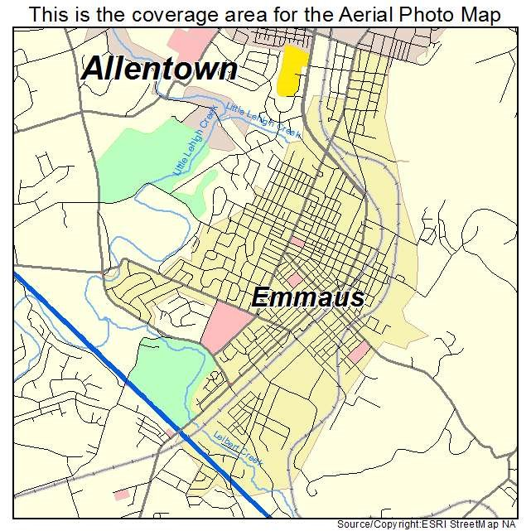
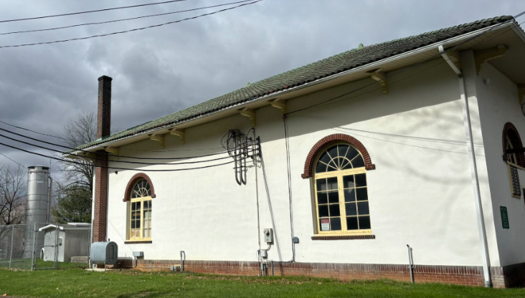
Borough of Emmaus PFAS Upgrades Project
The System
  Located 50 miles from Philadelphia
  Lehigh County
  4600 customers
  ADD = 1.3 mgd
  5 Wells – Cl Disinfection & Air Stripping for VOCs
  Elevated PFAS in Well Nos. 1 & 2
 | PFOA | PFOS
PA MCL | 14 ppt | 18 ppt
Future Federal MCL | 4 ppt | 4 ppt
Notes:
Well 1: PFOA 32 ppt; PFOS 200 ppt;
Well 2: PFOA 160 ppt; PFOS 1400 ppt;
Other 3 wells: right around regulatory limit
Proposed Changes to the Rule:
2029 compliance shift to 2031
Rescind other four PFAS (GenX, PFBs,
The Federal final rule requires:
Public water systems must monitor for these PFAS and have three years to complete initial monitoring (by 2027), followed by ongoing compliance monitoring. Water systems must also provide the public with information on the levels of these PFAS in their drinking water beginning in 2027.
Public water systems have five years (by 2029) to implement solutions that reduce these PFAS if monitoring shows that drinking water levels exceed these MCLs.
Beginning in five years (2029), public water systems that have PFAS in drinking water which violates one or more of these MCLs must take action to reduce levels of these PFAS in their drinking water and must provide notification to the public of the violation.

Slide 13
Borough of Emmaus PFAS Upgrades Project
2020: Elevated Levels of PFAS in 2 Wells
2021: Well 2 Removed from Service
2022-2023: Source Water Alternatives Study
2020: Consent Order and Agreement (CO&A)
2024: Amended CO&A
2024: Design of Treatment Facilities for Wells 1 and 2
Notes:
Once the study was completed we were able to layout the construction schedule, that was incorporated into the amended CO&A and design completed in 2024

Slide 14
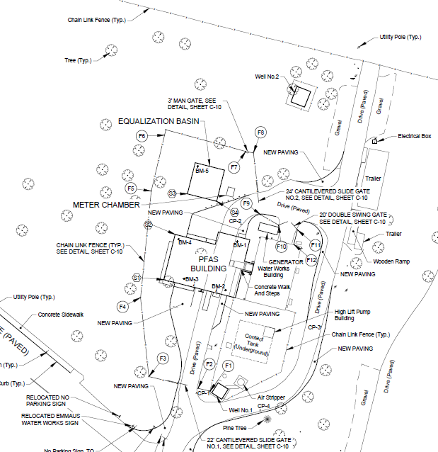
Borough of Emmaus PFAS Upgrades Project
The Project
  Update Treatment Process including:
    Building Addition
    PFAS Treatment: Two (2) lead/lag GAC trains
    Process Wastewater: below-grade equalization basin, discharge to sanitary system or pump/haul
    Sulfuric Acid Chemical Feed System (pH adjustment)
    Supporting chemical, electrical, instrumentation and control work
Project Costs & Funding
  Total: $9.40M
  PV Funding Offer: $7.52M Grant & $1.88M Loan
Notes:
PENNVEST - $7.52M Grant; $1.88M Loan (Initial Offer was $9.73M G/$2.48M L)
PFAS Vessels - $824k
Total Construction - $6.84M
Contractors – Worth, ($4.4M) Warko Group ($269k, $261k), North End Electric ($724k)

Slide 15
Important Project Considerations
Process Wastewater/Discharges
Permitting and approval requirements
Filter Vessels
Design specifics and long lead times
Notes:
Adding call out to costars related to design specific?

Slide 16
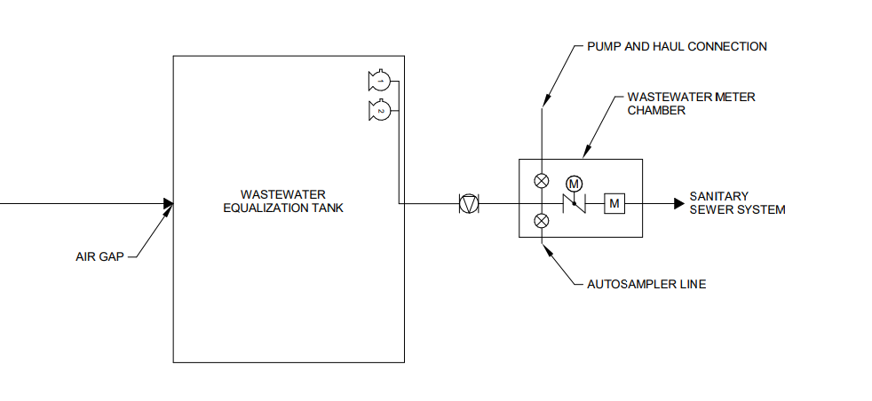
Process Wastewater/Discharges
Process Wastewater Equalization Tanks
  Check if Industrial Storage Tank Design Standards/Permitting/Approvals Required
Process Wastewater Disposal Method Options (bold/underlined = Emmaus)
  Hauled
    Receiving WWTP able to accept Industrial Flow?
  Discharge to Sanitary Sewer System
    Receiving WWTP able to accept Industrial Flow?
      Industrial Permit from WWTP System
    Planning Approvals Required?
      Act 537 Planning/Sewage Facilities Planning Module
        limitations on connections/EDUs (6 months for approval w/ available EDUs, greater if not available)
        Act 537 Planning identified property for use with on-lot system
  Infiltration Beds (Analyzer Discharge)
  Recycle to Head of WTP
Notes:
Typically need discharge method approval in hand before application but used hauling as backup based on extended approval times

Slide 17
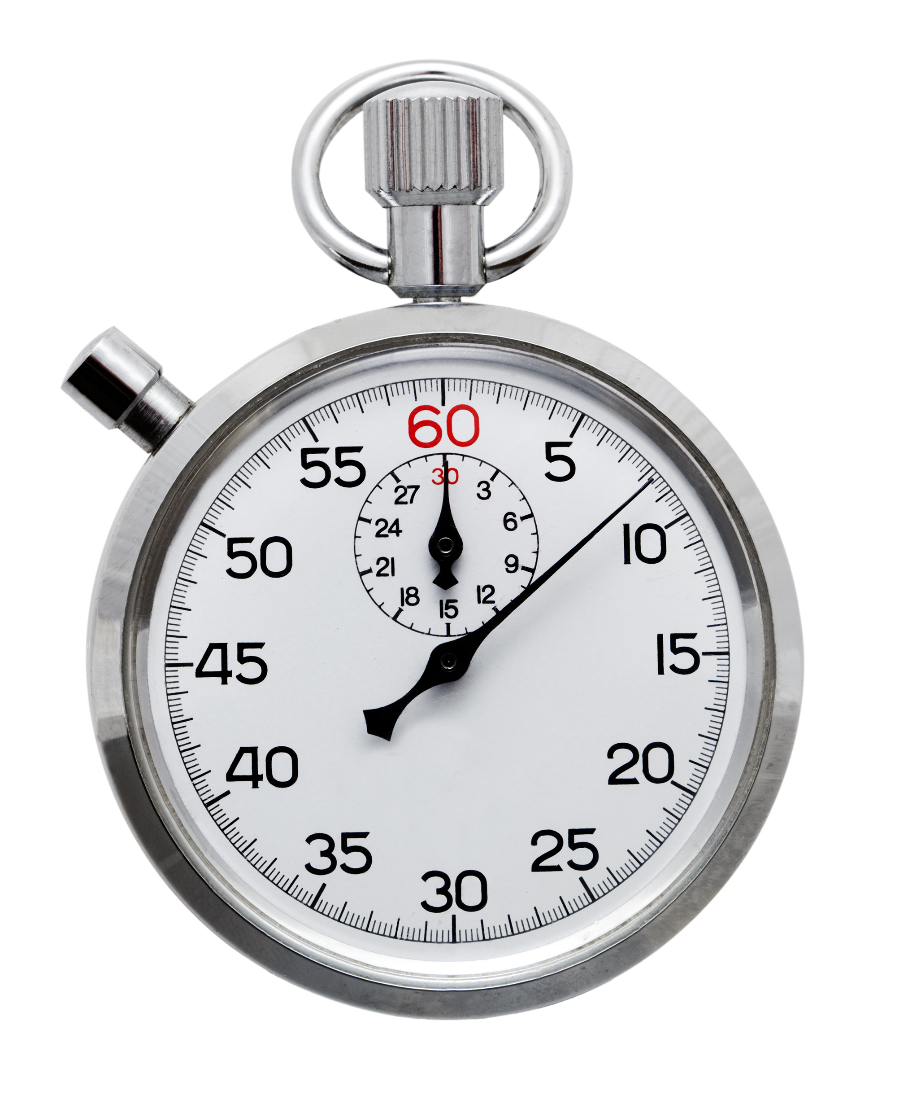
Filter Vessels
Design Considerations
  Unique Vessel Configurations
  Building Size
  Operations/Backwash Frequency/Volumes
Timeline
  6-9 month lead times
  Consent Order: 12 months in between Notice to Proceed and Certificate of Completion
Notes:
Different vendors stick with specific designs
Certificate of completion required per CO&A

Slide 18
Solution:
Pre-purchase of equipment

Slide 19
Solution Timeline
Approved pre-purchased equipment timeline
Equipment Delivery
Certificate of Completion Deadline
Design Completion
Bid Advertisement
Bid Opening
Notice to Proceed
PROJECT
PENNVEST
0 Months
2 months
3 months
4 months
6 months
18 months
Application Submission
Grant/Loan Offer
Settlement Date
Typically earliest opportunity to purchase equipment

Slide 20

Pre-Purchased Equipment Requirements
PADEP Planning Consultation
Equipment Only Acquisition Approval
  Letter of No Prejudice Form
  Reimbursement Resolution
  Interim Financing
Federal/State Regulations
  Procurement Rules (exception of COSTARS)
  DBE (COSTARS)
  Davis Bacon Wages
  BABA/AIS
DBE does NOT apply if self-funded
Notes:
Briefly highlight that original belief was that CoStars completed DBE solicitations and therefore using COSTARS covered DBE requirements
Note that these (Except DBE) requirements still apply even if pre-purchase equipment will not be reimbursed by PENNVEST
Last year or two determination that COSTARS was not completing DBE

Slide 21
Emmaus Pre-Purchase Timeline
March 2024:
Planning Consultation
October 2024:
Submit Request for Equipment Only Acquisition Approval
November 2024:
PENNVEST Application Submission
July 2024:
Design Outreach to Filter Manufacturers*
November 2024:
Received Equipment Only Acquisition Approval
December 2024:
Issued Purchase Order
  *Manufacturers were asked to confirm they were certified COSTARS at this time
Notes:
Point out purchase order was issued after approval and that equipment cannot be received or paid for prior to approval

Slide 22
Ensuring DBE Compliance
COSTARS
COSTARS still requires DBE solicitation (as of 10/2024)
  This project required a modified DBE submission
DBE for pre-purchased equipment will require
  Recipient Compliance Statement
  Certified Bid Tabulation
  DGS Searches
  Copies of First and Second Solicitation Letter
  Proof of Solicitation Emails and Responses
DBE Compliant
What this means for you:
- 30-Day Solicitation Period
- Solicit firms from DGS search + COSTARS or other
- Consider: Do you have to publicly bid?
*Pennbid is encouraged
Notes:
Our project was right in the middle of that so a modified DBE submission was used but moving forward….

Slide 23

Additional COSTARS Considerations
Which Party is COSTARS certified (Manufacturer or Vendor)?
  Manufacturer miscommunication
  Vendor involvement required to ensure COSTARS
  Negotiated no mark-up
Labor Involvement
  Contract Includes labor (i.e. delivery/installation)
  Davis Bacon Wages still apply
Notes:
If labor on project site by manufacturer then Davis Bacon

Slide 24
Current Project Status
November 2024:
Modified DBE Submission Approved
January 2025:
Bid Advertisement
February 2025:
Bid Opening/Submissions
January 2025:
Funding Offer was received
May 2025:
Funding Settlement
May 2025:
Issued Notice to Proceed
December 2025:
Pre-Purchased Equipment Delivered
Anticipated Completion:
August 2026

Slide 25


Summary: Tips/Lessons Learned
Layout Timeline Early
  Include Project Goals, Funding Requirements & Milestones, Consent Orders, Permitting, Material/Equipment Lead Times
  Consider temporary process waste solutions
  Consider pre-purchasing equipment
Highlight Compliance Items Throughout Process
  Include compliance requirements in Purchase Order
  Perform DBE Solicitations
Ensure Open Communication with Manufacturer/Vendor
  Avoid misunderstandings when ensuring compliance

Slide 26
THANK YOU!
Breana Sumners bsumners@gftinc.com

