Slide 1


Introduction to and Refresher on Water and Wastewater Utility
Leadership Management and Supervision
PA-AWWA
Prepared and presented by: Ralph E. Johnson, P.E., L.O.
Sr. Civil Engineer, Systems Design Engineering, Inc.
In collaboration with: Michael Bingham, PE.
Sr. Civil Engineer, Systems Design Engineering, Inc.

Slide 2
Introduction to and Refresher on Water and Wastewater Utility
Leadership Management and Supervision
PaDEP Course ID # 9684
3.0 Drinking Water CEHs and 3.0 wastewater CEHs
Must participate in the class and complete all assessments in order to receive credit for completing the course.

Slide 3
Table of Contents
Today’s Presentation
Overview of Leadership and Management
Leadership
Management
Supervision
Part 1 Exam
Special Topic: Asset Management

Slide 4

Intro to Leadership, Management, and Supervision
Introduction

Slide 5

Objectives
At the end of this training the participant will be able to:
Define the difference between operator responsibilities and duties compared to leadership, management and supervisor responsibilities and duties.
Apply the learned leadership, management and supervisor responsibilities and duties as a utility leader, manager and/or supervisor, or refine their existing skills.
Utilize the information in this presentation as a reference while fulfilling the responsibilities and implementing the basic practices of being a utilities leader, manager and/or supervisor.

Slide 6

Comparison of Operator Responsibilities to Leadership Responsibilities

Slide 7
List of Operator Duties and Responsibilities
Process control and troubleshooting
Operate processes, machinery, and equipment
Laboratory procedures and laboratory equipment calibration
Record keeping, data analysis, and report writing
Preventive, predictive, repair, and emergency maintenance.
Regulatory compliance and reporting
Create and implement Standard Operating Guidelines (SOGs) and maintenance management systems
Develop and implement safety programs, security measures, and emergency procedures
Operate and maintain sewer collection systems
Etc., etc., etc.
PaDEP certification, CDL licensing, Specific equipment authorization, Continuing Education Hours, Etc.

Slide 8
So, now that you’re a Leader, Manager, or Supervisor
Some of your thoughts might be:
Well, now what?
What does this mean?
Is the pay going to be worth it?
Am I going to get any guidance?
Who's going to answer my questions?
What is this presentation about, anyway?

Slide 9
How did you get this role?
Assigned to you (Voluntold)
Applied for the position (Volunteered)
Developed and mentored within the organization (Groomed)
Promoted by default (Not sure how you got here)

Slide 10

Did you, or do you, even want to be in this role?
Some of you probably do, and some of you probably do not.

Slide 11

Some other questions you might have
What are my next step(s)?
Will I like this new opportunity?
Will I succeed, struggle, or both?
Will I be accepted as the leader, manager, and/or supervisor?
Is the pay worth it?
Is the challenge something I’m going to enjoy?
Etc., etc., etc.

Slide 12
This presentation is designed to give you an awareness about what leadership, management and supervision is about.
what types of responsibilities, skills and duties are involved?
Do you have any additional thoughts, questions, comments and/or feedback?
let's get started!

Slide 13
Part I
Overview of Leadership and Management
Leadership
Management
Supervision

Slide 14
Objectives
Create an awareness that once one becomes a leader there are additional and somewhat different duties and responsibilities compared to operations and maintenance
Present a summarized list of typical leadership, management and supervisor topics that one needs to acknowledge and understand when involved in overseeing a utility
Present a brief overview on each topic presented to create the awareness of what knowledge, skills, and abilities are needed to be a leader, manager, and/or supervisor.

Slide 15

Overview of Leadership and Management

Slide 16

Pre-exercise A
At the end of this course you will be asked to list at least one item from each section of the course that you feel is a strength of yours.
  Overview of Leadership and Management
  Leadership
  Management
  Supervision

Slide 17

Overview of Leadership and Management (Cont.)
Evolution of Management
  Classical:
    Systematic
    Scientific
    Administrative
    Human Resources
    Bureaucratic

Slide 18

Overview of Leadership and Management (Cont.)
Evolution of Management
  Contemporary:
    Quantitative
      Uses mathematical data in models to determine future performance
    Organizational Behavior
      Looks at how people interact within a group to determine how to make the organization function more effectively

Slide 19
Overview of Leadership and Management (Cont.)
Evolution of Management
  Contemporary:
    Systems Theory and Contingency Perspective
      The systems theory focuses on the organization’s internal structure and behavior, and the contingency theory focuses on the impact these have on the external environment

Slide 20

Overview of Leadership and Management (Cont.)
Progression of Leadership and Management
  Find a “fit”
  Be “effective”
  Prepare a “successor”

Slide 21

Overview of Leadership and Management (Cont.)
Careers in Leadership and Management
  Management Careers have both opportunities for success as well as downsides

Slide 22
Overview of Leadership and Management (Cont.)
Careers in Leadership and Management
  Factors include:
    Education, knowledge, abilities, drive to be an influencer, motivated to manage, etc.

Slide 23
Overview of Leadership and Management (Cont.)
Careers in Leadership and Management
  When given opportunities:
    You must be a competent leader, perform well and capitalize to assure your future success

Slide 24

Overview of Leadership and Management (Cont.)
Careers in Leadership and Management
  Defining Success:
    Technical Expertise, Managerial Rank, Security, Autonomy, Creativity, etc.

Slide 25
Overview of Leadership and Management (Cont.)
Careers in Leadership and Management
  Understand the path(s) to leadership growth within your organization and pick one that fits you

Slide 26
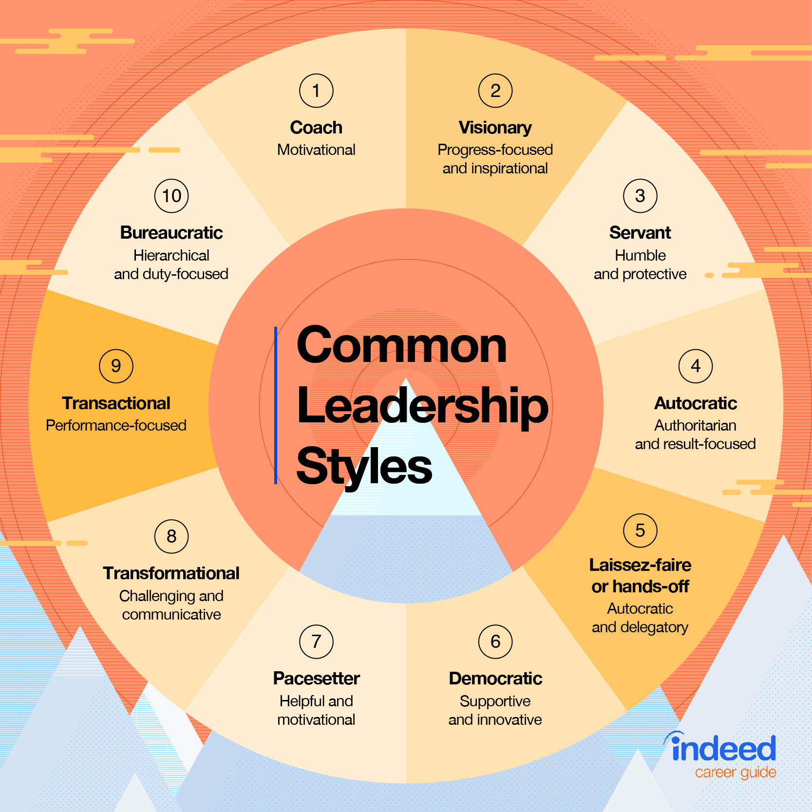
Overview of Leadership and Management (Cont.)
Managers as Leaders
  There are many leadership styles
  Styles range from laissez-faire, autocratic, and bureaucratic to transformational, visionary, coach and servant; with additional leadership styles in-between.

Slide 27
Overview of Leadership and Management (Cont.)
Managers as Leaders
  There are many leadership styles
  A style that uses different techniques with same person and/or different people, at different times and pending different situations is referenced as a situational leader

Slide 28

Overview of Leadership and Management (Cont.)
Managers as Leaders
  Levels of Leadership:
    Strategic
      Mission, Strategic Goals, Corporate Strategy, Business Strategy
    Tactical
      Business Strategy, Functional Strategies
    Operational
      Functional Strategies

Slide 29
Leader and Manager Resources and Sources of Information
Human
Financial
Physical
Informational
Energy
Technology

Slide 30

Characteristics of a Leader
Strong leadership skills
Action oriented
Having and sharing a company vision
Excellent communication and socialization skills
Self-confident

Slide 31
Characteristics of a Leader
Ability to take risks
Ability to motivate and generate loyalty
Creates a positive, synergistic, effective and efficient work environment
Develops managers and builds teams

Slide 32
Characteristics of a Leader
Has a continuous improvement mentality
Has a customer/client satisfaction focus
Emotional intelligence
Etc.

Slide 33
Factors Influencing Success
Knowledge and ability
Personality and behaviors
Motivations and integrity
Available paths and opportunities to growth
Barriers

Slide 34
Characteristics of an Effective Organization
Creating a company Culture
  How we treat each other
  How we treat the clients and customers we serve
  Shared ethics
  Comradery
  Level of transparency

Slide 35
Characteristics of an Effective Organization (Cont.)
Creating a company culture
  Working atmosphere
    Formal or informal, structured or unstructured, proactive or reactive

Slide 36
Characteristics of an Effective Organization (Cont.)
Creating a company culture
  The view toward customer service
  How continuous improvement is embraced
  How the competition is respected
  Public image
  Etc.

Slide 37
Characteristics of an Effective Organization (Cont.)
Mentoring program and career paths for young professionals are important
  Leadership Path
  Technical Path

Slide 38
Characteristics of an Effective Organization (Cont.)
Succession planning is important for continuity of quality service
  Senior team member mentors a young professional and documents their institutional knowledge

Slide 39

The Environments Leaders, Managers and Supervisors Work In
Business, and External Environment
  Financial Management
  Legal Issues
  Social and Political Issues
  Community, Customer and Developer Interactions
  Government and Regulatory
  Professional Consultants
  Vendors and Suppliers
  Business Development and Marketing

Slide 40
The Environments Leaders, Managers and Supervisors Work In
Internal Environment
  Decision Making
  Communication
  Human Resources
  Planning and Strategy
  Organizing and Staffing
  Change Management
  Team Building

Slide 41
List of Leader, Manager and Supervisor Duties and Responsibilities
Leadership functions and skills:
Effectiveness - Assures the right things are being done.
Empowerment - Creates an empowering culture, clarifies and shares the vision, creates cooperation through aligning others, motivates and inspires, delegates, role model and creates strategies for change.
Management functions and skills:
Efficiency - Assures things are being done the right way, Manages - writes job descriptions, ensures consistency, time management oriented, creates management systems, trains team members, controller, organizer, director, coordinator, continuous improvement, sets structure and procedures, supervises, conducts performance reviews and issues discipline

Slide 42
List of Leader, Manager and Supervisor Duties and Responsibilities (cont.)
An active leader that assures a positive environment that provides incentives and opportunities for high performance to occur while balancing the complexities of being a creative thinker, problem solver, decision maker and prioritizer.
Difference between leadership and management:
Leaders assure the right things are being done.
Managers assure things are being done the right way.
Both are necessary.
Combined Leadership and Management:

Slide 43
Quiz #1
Is the task below Leadership or is it Management?
Developing an emergency response manual
Assigning operator duties for the day
Presenting a monthly managers report
Determining what safety training to present
Updating a maintenance schedule
Responding to a customer complaint
Creating a computerized maintenance management system (CMMS)
Presenting a scheduled public information program
Developing standard operating guidelines (SOGs)
Performing an emergency system repair

Slide 44
Introduction to Leadership, Management, and Supervision
Leadership

Slide 45
Leadership
Leadership power versus control
  Motivating and the power of persuasion
    Accountability – Directing/Guiding/Coaching/Counseling performance
  Employee needs, expectancy, equity
    Motivators versus Satisfiers
  Goal setting
    Set SMART goals (Specific, Measurable, Achievable, Relevant, and Time-Bound)
    Outcomes, pros and cons and accountability issues if goals are not SMART

Slide 46
Leadership in Today’s Market

Slide 47

Managing Across Generations and Its Challenges
Aging and Shrinking Workforce
Changing required Work Skills and loss of Institutional Knowledge
Baby Boomers
  born 1946 to 1964
Generation X
  born 1965 to 1980
Millennials
  born 1981 to 2000
Generation Z
  born 2001 to 2020

Slide 48
Some of Today’s Current Topics
Situational leadership
Servant leadership
Customer centered leadership
Quality movement
Constant regulatory additions and Changes

Slide 49
Some of Additional Current Topics
Municipal Mergers, Privatization, and Contract Operations
Multitude of changing and new HR Initiatives where a Positive Culture and Inclusiveness are Expected
Younger workforce demanding higher integrity from Leaders

Slide 50

Some of Today’s Current Challenges
More Comprehensive & Complex Work Environment
Artificial intelligence
Personnel shortages, and skills shortage
Changing employee expectations
Remote work and hybrid work

Slide 51
Some of Today’s Current Challenges
Technology advances
Cyber security
World Turmoil
Climate Change, Pandemics
Failed Infrastructure, Deferred Maintenance
Political and Social unrest

Slide 52
Some of Today’s Current Challenges
Better Informed Customer base
Web information, both accurate and misleading
Social media, speed of communication, information overload
Recruiting and Retainage vs. Traditional hiring and Onboarding
Consumer inability or refusal to Pay what is Necessary

Slide 53

Other Current Challenges

Slide 54

Introduction to Leadership, Management and Supervision
Leadership
  Creating a positive, proactive company culture
Modifying organizational behavior
      Who Moved My Cheese?
      https://www.youtube.com/watch?v=OvYCLxqkfvY 12:08 minutes: seconds

Slide 55
Introduction to Leadership, Management and Supervision
Leadership
  Creating a positive, proactive company culture
Modifying organizational behavior
      Our Iceberg is Melting
      https://www.youtube.com/watch?v=hB-c3pJR0qU 9:56 minutes: seconds

Slide 56
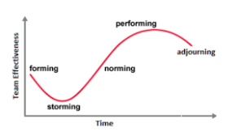
Introduction to Leadership, Management and Supervision
Leadership
  Creating a positive, proactive company culture
    Group formation and development, Tuckman’s Model, by Bruce Tuckman in 1965

Slide 57
Introduction to Leadership, Management and Supervision
Leadership
  Creating a positive, proactive company culture
    Programs and projects
      Effective work teams (Programs)
      Task teams (Projects)
    Informal teams

Slide 58
Introduction to Leadership, Management and Supervision
Management

Slide 59

Management Systems and Personal Development
Quality Movement
Relationships
Training
Health, Safety, and Security Programs
Computer and Record Keeping
Personal Development

Slide 60

Introduction to Leadership, Management and Supervision
Management
  Emotional Intelligence
    The capacity to be aware of, control, and express one's emotions, and to handle interpersonal relationships judiciously and empathetically.
    Emotional intelligence is the key to both personal and professional success
    Emotional Intelligence (EI) is the ability to manage both your own emotions and understand the emotions of people around you. There are five key elements to EI: self-awareness, self-regulation, motivation, empathy, and social skills

Slide 61
Introduction to Leadership, Management and Supervision
Management
  Time management
    Delegate Tasks.
      It is common for all of us to take on more tasks than we are capable of completing.
    Prioritize Work.
    Create a Schedule.
    Set up Deadlines.
    Overcome Procrastination.
    Deal With Stress Wisely.
    Multitasking.
      Multitasking has pros and cons.
    Start Early.
    Set short and long-term goals.

Slide 62
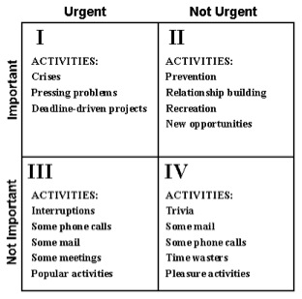
Introduction to Leadership, Management and Supervision
Management
  Time management
  https://youtu.be/zV3gMTOEWt8

Slide 63
Introduction to Leadership, Management and Supervision
Management
  Management programs
    Group project – create a list of management programs including assignments
    Initial audit of documents and list of potential management programs
  Developing and implementing Programs:
    Group project – create the following programs
      Mentoring program and career paths for young professionals
      Succession planning program for retiring professionals

Slide 64
Introduction to Leadership, Management and Supervision
Supervision

Slide 65
Examples of Supervision Topics
Enforcing company policies
Performance reviews and performance improvement plans
Issuing appropriate discipline
Progressive process unless an egregious violation has occurred
Dealing with Difficult People
Different types of difficult people take different types of management
Developing and implementing practices, procedures, SOGs/SOPs
The use of check charts
The 80/20 rule - 80% of results come from 20% of our effort.

Slide 66
Understanding Relationships
Fast Decision Making/Decisive
People Oriented/Energetic
Methodical/Fact Driven
Task/Data Oriented

Slide 67

DISC
Task Oriented?
People Oriented?
Outgoing and Active?
Reserved & Reflective?

Slide 68
Introduction to Leadership, Management and Supervision
Supervision
  Seven Habits of Highly Effective People, by Stephen Covey
    Dependence – Independence – Interdependence
  Delegation (Who’s got the Monkey?)
    https://youtu.be/UUhDlV34aDg 3:31 minutes:seconds

Slide 69
Introduction to Leadership, Management and Supervision
Supervision
  The Servant Leadership, by James C. Hunter
    Servant leadership is a leadership philosophy in which the goal of the leader is to serve. This is different from traditional leadership where the leader's main focus is the thriving of their company or organization. A servant leader shares power, puts the needs of the employees first and helps people develop and perform as highly as possible.
    Instead of the people working to serve the leader, the leader exists to serve the people.

Slide 70
Introduction to Leadership, Management and Supervision
Supervision
  Situational Leadership, by Ken Blanchard
    The situational theory of leadership refers to those leaders who adopt different leadership styles according to the situation and the development level of their team members. It is an effective way of leadership because it adapts to the team's needs and sets a beneficial balance for the whole organization.

Slide 71
Introduction to Leadership, Management and Supervision
Supervision
  Strengths Finders 2.0, Gallup and Tom Ruth, based on Don Clifton Strength Psychology
    The 34 Clifton Strengths Themes Explain Your Talent DNA
    Each of us has a unique combination of 34 Clifton Strengths themes.
    There are four distinct domains of strength emerge: Executing, Influencing, Relationship Building and Strategic Thinking.
    The 34 Clifton StrengthsFinder themes naturally cluster into these four domains of strength.
    The 34 themes explain a simple but profound element of human behavior: what's right with people.
    Individually, each theme gives you a way to describe what you naturally do best or what you might need help from others to accomplish.

Slide 72
Additional Topics to Consider as a Leader, Manager, Supervisor
Decision Making
Communication
Financial Management
Legal Issues
Business Development and Marketing

Slide 73
Additional Topics to Consider as a Leader, Manager, Supervisor
Planning and Strategy
Organizing and Staffing
Change Management
Team Building
Relationships

Slide 74
Additional Topics to Consider as a Leader, Manager, Supervisor
Training, Teaching, Mentoring, and Succession Planning
Management Systems
Health, Safety, and Security Programs
Computer and Record Keeping
Personal Development

Slide 75
Introduction to Leadership, Management and Supervision
Review of today’s course.
    Overview of Leadership and Management
    Leadership
    Management
    Supervision

Slide 76
Introduction to Leadership, Management and Supervision
Exercise A
  List at least one item from each section of this course that you think is a strength of yours.
    Overview of Leadership and Management
    Leadership
    Management
    Supervision

Slide 77
Quiz #2
Leadership is making sure you are doing the ________ thing.
Management is making sure you are doing things the ________ way.
SMART goals are specific, measurable, __________ , relevant, and time-bound.
Servant leadership is assuring you are _______ your team, as opposed them _______ you.
Time management needs to consider whether something is Important and/or _______.

Slide 78
Introduction to Leadership Management and Supervision
Special Topic: Asset Management

Slide 79
Importance of Asset Management Implementation as it Relates to Leadership

Slide 80
Asset Management
Asset management is one of the more critical component to addressing Today’s Topics of Leadership, Management and Supervision.
Therefore, we’ll spend a brief time on asset management today.
Please understand asset management is a presentation unto itself.

Slide 81
Asset Management (cont.)
Definition: (from Wikipedia)
Asset management is a systematic process of developing, operating, maintaining, upgrading, and disposing of assets in the most cost-effective manner.

Slide 82
Asset Management (cont.)
Asset management is a systematic approach to the governance and realization of all value for which a group or entity is responsible.
It applies to tangible assets (physical objects such as complex process or manufacturing plants, infrastructure, buildings or equipment).
It also applies to intangible assets (such as intellectual property, goodwill and financial assets).

Slide 83
Asset Management (cont.)
Asset management is a systematic process of:
  developing,
  operating,
  maintaining,
  upgrading,
  and disposing
of assets in the most cost-effective manner.
(Including all costs, risks, and performance attributes)

Slide 84
Asset Management (cont.)
Theory of asset management primarily deals with the periodic matter of improving, maintaining or in other circumstances assuring the economic and capital value of an asset over time.

Slide 85
Asset Management (cont.)
The term is commonly used in engineering, the business world, and public infrastructure sectors to ensure a coordinated approach to the optimization of costs, risks, service/performance, and sustainability. The term has traditionally been used in the financial sector to describe people and companies who manage investments on behalf of others.

Slide 86
Asset Management (cont.)
The ISO 55000 series of standards, developed by ISO TC 251, are the international standards for Asset Management. ISO 55000 provides an introduction and requirements specification for a management system for asset management.

Slide 87
Asset Management (cont.)
The ISO 55000 standard defines an asset as an "item, thing or entity that has potential or actual value to an organization". ISO 55001 specifies requirements for an asset management system within the context of the organization, and ISO 55002 gives guidelines for the application of an asset management system, in accordance with the requirements of ISO 55001.

Slide 88
Asset Management Examples
Physical and Infrastructure asset management
Public asset management
Financial asset management
Engineering asset management
Software asset management
International Standard series on Asset Management
Enterprise asset management
Intellectual and non-physical asset management

Slide 89
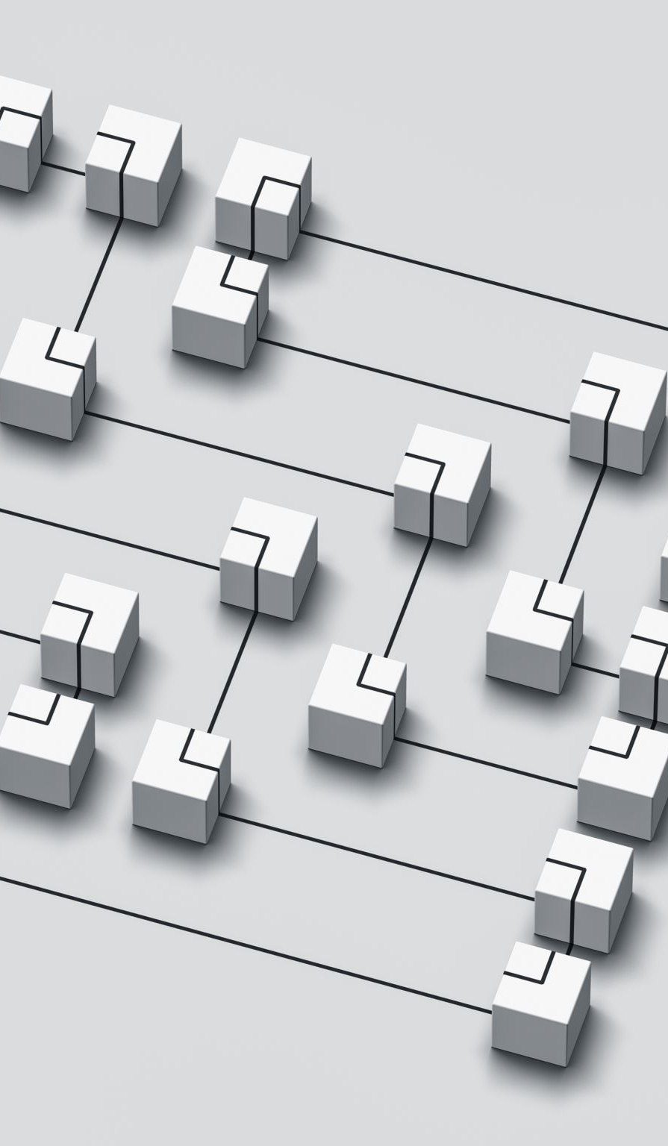
Asset Management Types
Intangible asset management
  Not covered in this presentation.
Tangible asset management - Physical and Infrastructure
  Asset management plans can be comprehensive and complex, or overarching and simplified
  Plan style depends on the intended use and the organization’s ability to prepare a plan

Slide 90

Tangible Asset Management
Plans shall include, but not be limited to:
  Labeling each asset
  Describing each asset
  Documenting the value of each asset
  Prioritizing the importance of each asset

Slide 91
Tangible Asset Management
Plans shall also include, but not be limited to:
  Determining the life expectancy of each asset
  Evaluating the present condition of each asset
  Considering disposal, rebuild or replacement options of each asset
  Schedule the expected due date for addressing each asset

Slide 92

Maintenance is a Key Component of Asset Management
Maintenance management systems are a necessary part of a maintenance program
  Computerized maintenance management systems (CMMS) are recommended
Asset inventory data base and documentation shall include:
  Property, grounds and buildings
  Machinery, equipment and supplies
  Vehicles, fleet and portable equipment
  Miscellaneous

Slide 93
Maintenance is a Key Component of Asset Management
Manuals, cut sheets and parts list shall be on record
Maintenance tools and equipment
Maintenance procedures and methods
Maintenance schedules, check lists and work orders
Predictive, preventive, inspection and testing program
Scheduled and repair program
Emergency maintenance program
Maintenance personnel skills development, training and safety program

Slide 94

Reliability-centered maintenance (RCM)
Reliability centered maintenance (RCM) is a maintenance strategy that is implemented to optimize the maintenance program.
It is the implementation of a maintenance strategy on each facility asset to optimize plant productivity through cost-effective maintenance techniques.

Slide 95
Reliability-centered maintenance (RCM)
Reliability centered maintenance (RCM) involves:
  Conducting Root Cause Analysis
Five Key Components of Reliability-centered maintenance are
  Function – Primary and Secondary
  Functional Failure – Total or Partial
  Failure Mode – Deterioration, Lack of lubrication, Dirt, Disassembled, Human error
  Failure Effect – What happened in context to the operation
  Failure Consequences – Qualitative analysis to determine the importance of the failure

Slide 96


Slide 97

Protecting and Maintaining Your System: Asset Management for Water & Wastewater Facilities
(PARTIAL)
Marc Neville
PA Dept. of Environmental Protection
&
Walter Higgins
U.S. Environmental Protection Agency
J O S H S H A P I R O G O V E R N O R
| J E S S I C A S H I R L E Y S E C R E T A R Y

Slide 98
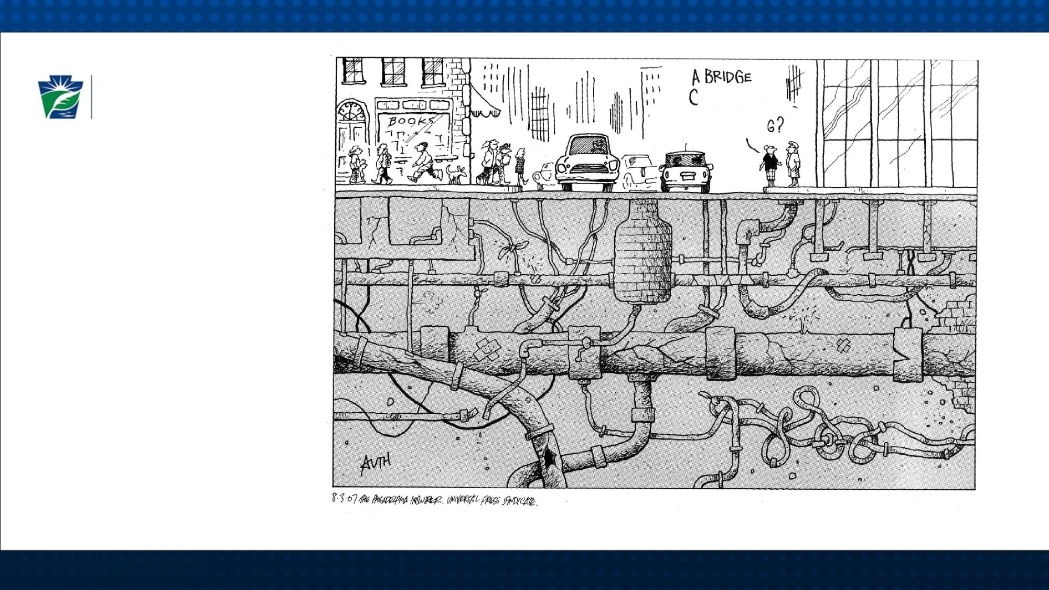



Department of
Environmental Protection
Pennsylvania
ALITHÖ 2007 The Philadelphie I cuire . Neonntecl e ith permission of UNIVERSAL PRESS SYNDICATE. AII rights _{ieserved.}

Slide 99
Topics
What is Asset Management?
Why Asset Management?
Review of Basic Asset Management Plan
Commercial Mapping Programs
Effective Communication

Slide 100

Challenges facing Wastewater Utilities
Maintaining aging structures and
equipment while…
…Providing a high level of service at a
reasonable cost
HOW CAN WE DO IT?
By Good Planning!

Slide 101
What is Asset Management?
Asset Management is a way to PLAN FOR REPAIR AND REPLACEMENT of your system's major components by evaluating them and determining WHEN and how much it will COST.
Asset management can ultimately save a system money by planning for repairs or replacements.
Knowing when your system will need to pay for major repairs or replacements can alleviate the cost of paying for "emergency" or unplanned projects.
- PA DEP Website

Slide 102
What is Asset Management?
Agencies (https://www.pa.gov/agencies/dep.html )
> Department of Environmental Protection
> Programs and Services
> Water
> Clean Water
> Wastewater Operations and Assistance
> Wastewater Operator Resources
OR
Agencies
> Department of Environmental Protection
> Programs and Services
> Water
> Safe Drinking Water
> Capability Enhancement Program
> Asset Management
Asset Management Information Sheet(opens in a new tab) (PDF)
Simplified Spreadsheet for Asset Management(opens in a new tab) (Excel).

Slide 103
Looking at:
Asset Condition (poor, new)
Asset Criticality (catastrophic, minor)
Cost of periodic maintenance ($$ vs. $$$$)
Cost of operating (energy)
Cost to replace (in kind, upgrade)
Annually determine:
  Let It Fail
  Maintain It
  Rehabilitate It
  Replace It

Slide 104
What is Asset Management ?
…in other words,
How do I budget for this Pump Station?
  for Maintenance, Rehab, AND/OR Replacement?
  and When?
  What is the risk and consequence of FAILS?
Outcomes:
  Regularly updated WRITTEN PLAN for O&M, Rehab, Replacement, Capital Improvement Plans
  Identifies future $$ needed

Slide 105
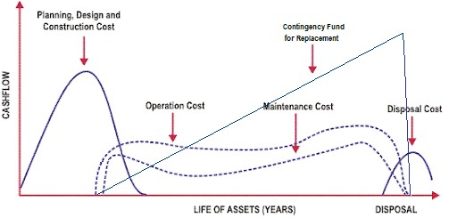
Puts Primary Focus upon
Long-term life-cycle costs and sustained performance; not
Short-term, day-to-day operation

Slide 106
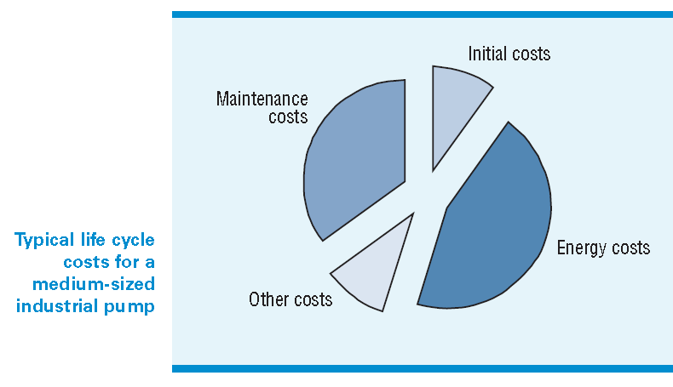
Why Asset Management?

Slide 107

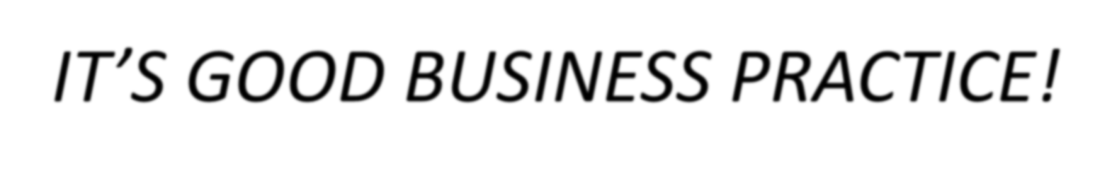
Why Asset Management?
Aging Infrastructure
Funding shortages
Aging workforce.
Compliance/Regulatory Pressure.
Business Financial Rating
End of this partial PaDEP Asset Presentation.

Slide 108
Review of
Today
Today’s Presentation
Overview of Leadership and Management
Leadership
Management
Supervision
Part 1 Exam
Special Topic: Asset Management

Slide 109

Question and Answer

Slide 110

Thank You!
Prepared and Presented by:
Ralph E. Johnson, P.E., L.O. - Sr. Civil Engineer, Systems Design Engineering, Inc. (SDE)
In collaboration with:
Michael J Bingham, P.E., - Principal, Systems Design Engineering, Inc. (SDE)

Slide 111
Summary of Key Contributors
Ralph E. Johnson, P.E., L.O.
  50 years in municipal management, public works, contract operations, consulting, and engineering
  Project management and design of public infrastructure projects
  Extensive experience in municipal management, project management, water and wastewater operations
  Graduate of Pennsylvania State University (A.S. Chemical Engineering Technology, 1981) and Alvernia College (B.A. Business Management and Administration, 1995)
  Licensed Professional Engineer in Pennsylvania (Reg. No. PE0787704)
  Certified PaDEP Water Operator (Certification No. W17282) and Wastewater Operator (Certification No. S7622)

Slide 112
Summary of Key Contributors
Michael J. Bingham, P.E.
  15+ years of experience in civil engineering, land development, and municipal infrastructure
  Expertise in site grading, stormwater management, zoning enforcement, and land development
  Comprehensive knowledge of NPDES permitting, erosion and sediment control, and roadway design
  Project management and design of municipal and private infrastructure projects
  Graduate of Clemson University (B.S. Civil Engineering)
  Recognized as one of Central Pennsylvania’s “40 under 40” for professional achievements and community contributions
  Licensed Professional Engineer in Pennsylvania, Delaware, New Jersey, and Maryland

Slide 113
Introduction to Leadership, Management and Supervision
End of Part I

Slide 114
Quiz #3
True or False
Asset management is a systematic process of developing, operating, maintaining, upgrading, and disposing of assets in the most cost-effective manner.
True or false
There are eight examples of asset management.
True or False
Tangible asset management shall include “labeling each asset”.
True or False
Tangible asset management shall include “considering disposal, rebuild or replacement options of each asset”.
True or False
Maintenance is a key component of asset management.

