Slide 1


Regulatory Update
EPA Region 3
Joint Conference of SE District - PA AWWA and the Eastern Section WWOAP
April 7, 2026
Patti Kay Wisniewski
Wisniewski.patti-kay@epa.gov
Notes:
Presentation is in Malvern, PA at Penn State Great Valley
Slides will be shared for posting to SE PA AWWA section webpage

Slide 2
CCL Determinations
March17, 2026, EPA final determination for nine contaminants on the Contaminant Candidate List (CCL).
Contaminants do not meet the criteria for regulation development because these are not commonly found in drinking water at levels and at a frequency of concern.
EPA will not develop regulations for: 2-aminotoluene, cylindrospermopsin, ethoprop, microcystins, molybdenum, permethrin, profenofos, tebuconazole, and tribufos.

Slide 3

What is EPA doing about PFAS?
On May 14, 2025, EPA announced its intent to keep the existing (MCLs) for PFOA and PFOS, while extending their compliance deadlines.
And, rescind the regulations and reconsider the regulatory determinations for PFHxS, PFNA, HFPO-DA (commonly known as GenX), and the hazard index mixture of these three plus PFBS, to ensure that the determinations and any resulting drinking water regulation follow the legal process laid out in the Safe Drinking Water Act.

Slide 4
What Does This Mean?
EPA plans to issue two proposed rules and aims to finalize these rulemakings in Spring 2026.
As of late March, these proposed regulations were with OMB for review. There will be a comment period once published in the Federal Register (usually 60 days).

Slide 5
PFAS OUTreach
EPA recently announced the new PFAS OUTreach Initiative (PFAS OUT).
Through PFAS OUT, EPA will share resources, tools, funding, and technical assistance opportunities to help drinking water systems address PFAS and protect public health.
The goal of PFAS OUT is to ensure that no community is left behind as we work to protect public health and position water systems for compliance with drinking water standards.
EPA anticipates releasing first set of PFAS OUT materials soon.

Slide 6
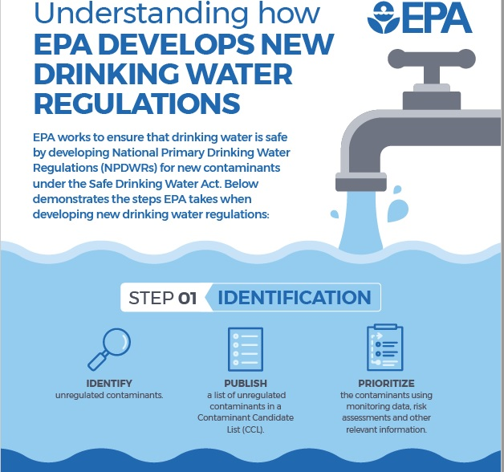
Plans to promulgate other Rules
Perchlorate:
P January 6, 2026
F May 2027
Revisions to MDBP:
P Summer 2027
F May 202?
Fluoride
UCMR6: finalize by December 2026 (statutory)

Slide 7
Perchlorate MCL
EPA proposed on January 6, 2026
Proposed MCLG at 0.02 mg/L (20 µg/L)
Proposed MCL at 0.02 mg/L (20 µg/L) and
Taking comment on setting the MCL at 0.04 mg/L (40 µg/L), or 0.08 mg/L (80 µg/L).
Community water systems (CWSs) and non-transient non-community water systems (NTNCWSs) will monitor for perchlorate where the monitoring frequency depends on the previous monitoring results.

Slide 8
What are the health effects of Perchlorate?
Perchlorate interferes with the normal functioning of a person’s thyroid gland by reducing iodide uptake, which can affect thyroid hormone production. Thyroid hormones help keep the metabolism working properly and are critical for growth and development, including brain development.
The EPA anticipates that very few regulated water systems—approximately one tenth of one percent—are likely to find perchlorate in drinking water above either the proposed enforceable limits or the MCLG.

Slide 9
Benefits of the Rule
The Administrator has determined that the benefits of this regulation would not justify the costs; however, the EPA is required to issue an NPDWR and MCLG for perchlorate in response to the D.C. Circuit's decision in NRDC v. Regan.

Slide 10
Fluoride Assessment Plan
On January 22, 2026, EPA announced the next step in the agency’s accelerated review of public health risks from fluoride in drinking water.
This fast-track effort marks a critical step in Administrator Zeldin’s April 2025 directive https://www.epa.gov/newsreleases/epa-will-expeditiously-review-new-science-fluoride-drinking-water to expedite EPA’s next fluoride health assessment under the Safe Drinking Water Act schedule rather than conducting a fluoride risk evaluation under the Toxic Substances Control Act (TSCA).

Slide 11
Fluoride Assessment Plan
EPA’s Preliminary Assessment Plan and Literature Survey is available for public comment in the Federal Register (docket #EPA-HQ-OW-2025-3823) (published 01/28/2026) until February 27, 2026.
EPA hosted a public informational webinar on January 28, 2026 to discuss the assessment plan as well as next steps. Fluoride Toxicity Assessment Preliminary Assessment Plan Webinar Slides (pdf)

Slide 12
Fluoride Assessment Plan
Objectives of the Assessment Plan
  describe the approach the EPA intends to follow to develop the fluoride toxicity assessment and present the results of the preliminary literature survey. The Assessment Plan is not a toxicity assessment;.
It does not contain conclusions regarding harmful human health effects of fluoride. Such conclusions about fluoride human health effects will be released as part of the forthcoming draft human health toxicity assessment.
The EPA’s toxicity assessment will be used to inform future decisions about potential revisions to the existing fluoride drinking water standard under the Safe Drinking Water Act (SDWA).

Slide 13
Fluoride - a few Reminders
SDWA prohibits EPA from requiring the addition of any substance to drinking water for any preventative health care purpose.
Health benefits of fluoride, such as cavity prevention, are not within the scope of EPA’s toxicity assessment.
The decision on whether or not to add fluoride to drinking water is made on a state or local basis. EPA does not make recommendations on adding fluoride to drinking water.
See https://www.epa.gov/sdwa/fluoride-drinking-water for factsheets about the assessment review.

Slide 14
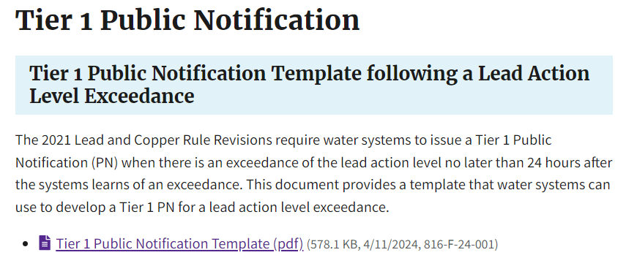
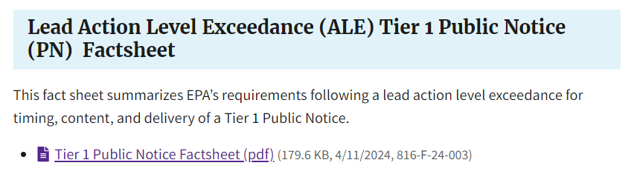
LCR Revisions
    Tier 1 PN - required for a lead ALE no later than 24 hours after the system learns of an exceedance.
    Use the template to assist with developing the notice.

Slide 15
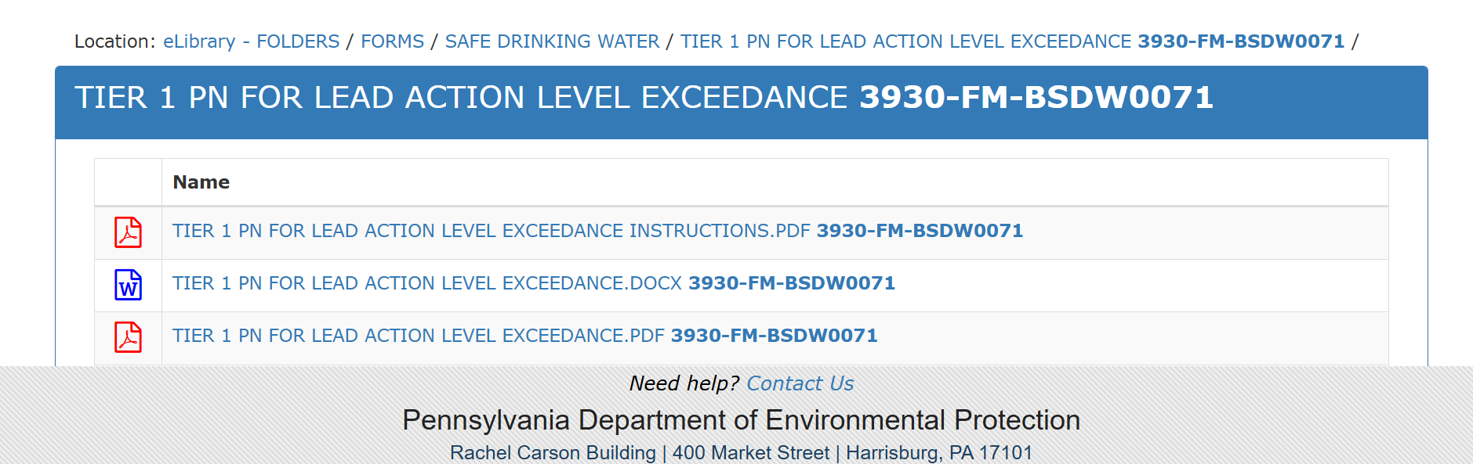
LCR Revisions
    Tier 1 PN - PADEP also has Templates

Slide 16
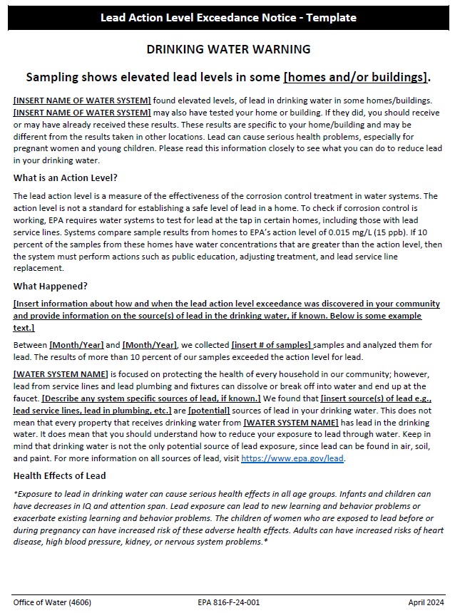
PN Timing/Content/Delivery
Within 24 hours of learning of lead ALE:
    Consult with PADEP
    Issue the PN to customers
    Send copy to PADEP and EPA (LeadALE@epa.gov)
Must include the required elements and mandatory health effects and statement to share the notice
Use appropriate forms of delivery
Consider non-English speaking customers

Slide 17
Important Reminder!
When a PWS has a lead ALE, and the system or state has not issued the Tier 1 PN, EPA will be issuing it.

Slide 18
LCRR/LCRI
All lead service line replacements, unless an exception has been granted, need to be completed by December 31, 2037.
In February 2025, the courts granted a request by the Department of Justice (DOJ), on behalf of EPA, to place the current litigation of the LCRI on hold (i.e., abeyance) in order to review the underlying rule.
On August 27, 2025, EPA requested the courts lift the abeyance and resume the litigation against the LCRI.
Following request to lift the abeyance, EPA released information to states to help them obtain primacy for the LCRI.

Slide 19
LCRR/LCRI
EPA will continue to develop new tools and information to support practical implementation flexibilities and regulatory clarity. There is currently a joint EPA/State national LCRI workgroup where some of these materials are being developed.
The Agency will announce next steps in the coming months.
Additionally, EPA’s free Water Technical Assistance program is available to help drinking water systems identify, plan for, and replace lead pipes in the communities they serve.
EPA’s funding and financing programs can help reduce the cost of lead pipe replacement projects and thereby reduce costs to families.

Slide 20
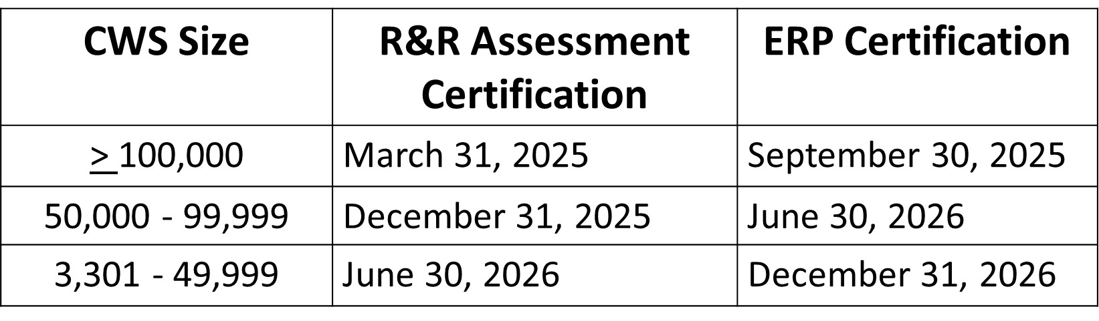
Reminders--AWIA aka SDWA Section 1433 Deadlines
100%
https://www.epa.gov/waterresilience/awia-section-2013
www.epa.gov/waterresilience

Slide 21
Be Aware of Threats/Act
Damage to electric grid impacting water and interdependencies
Cybersecurity
Mis-information (incorrect)
Dis-information (intentional to mislead, China during US disasters to further disrupt, fear)
Insider Threats / anything connected to your network
Wildfires / climate change impacts
CrowdStrike
Physical Tampering

Slide 22
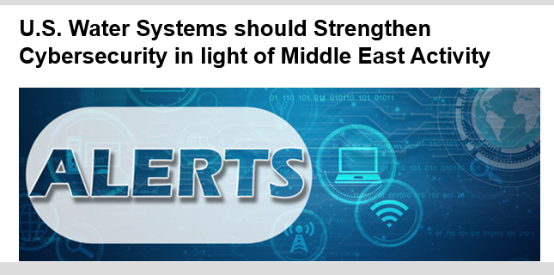
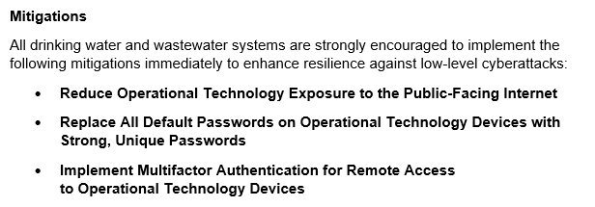
EPA issued 3/3/2026

Slide 23
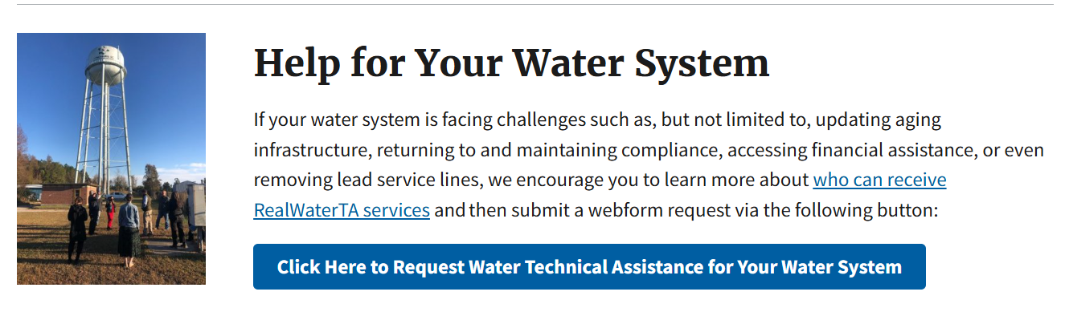
https://www.epa.gov/water-infrastructure/forms/real-water-technical-assistance-request-form
Patti Kay Wisniewski
Wisniewski.patti-kay@epa.gov
215.514.7893
Get on my email group to always hear the latest from EPA

