Slide 1
Housing Analysis for the Greater Newport Region
Year One Highlights Following the 2023 Study Release
June 2024

Slide 2
Greater Newport’s Housing Stock Is…
Growing in volume of total units, led by a surge in high-value owner-occupied units and a drop in lower-value renter-occupied units.
Consistently rising in value, with the median home price increasing by 60% in the last 5 years – and up 16% in the past year, making it harder for local earners to afford homes in their income bracket and contributing to population loss of workers age 30-54.
A lack of needed housing development is putting pressure on working-age population and those who want to age in place, leading to cost-burdened status of ⅓ of retirees and ¼ of working professionals.
A decline in working age population able to live in the region is being offset by increased workforce commuting into the region, this raises sustainability risks.
… with all of these trends accelerating

Slide 3
In this report you will find…
Median Home Price in RI and Greater Newport
Greater Newport Population
A concerning trend: Loss in prime age workers
A Mismatch Between Income and Housing Prices
Personas: Big Increase in the Gap Linking Occupations, Wages, and Housing Affordability
Workforce Projections
Future Workforce in Greater Newport
Changing Workforce & Housing Demand
10-Year Housing Demand Increase: 9,060 Units
Personas of the Future Workforce Linking Occupations, Wages, and Housing Affordability
If Housing Development Does Not Match Workforce Growth…
Recommendations

Slide 4
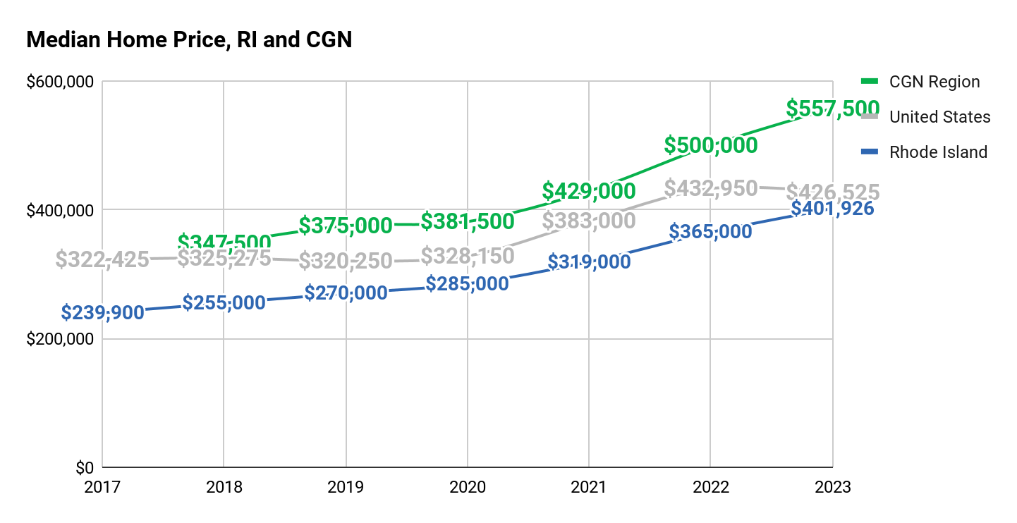
Median Home Price in RI and Greater Newport
The median home price for the CGN region increased by 60% from 2018 to 2023 – up by 14% from a year ago.
A typical owner in the CGN region now pays $155,000+ more than they would for the median RI home and $130,000+ more than US.
Median Home Price: HousingWorksRI, Housing Fact Book, 2017-2023;
US Median Home Price: Federal Reserve of St. Louis
Notes:
Source: https://docs.google.com/spreadsheets/d/1x7If-piNmxkB6OsJPc20dEJYrkZZLuKQjaXbVhm6W2M/edit#gid=432341965

Slide 5
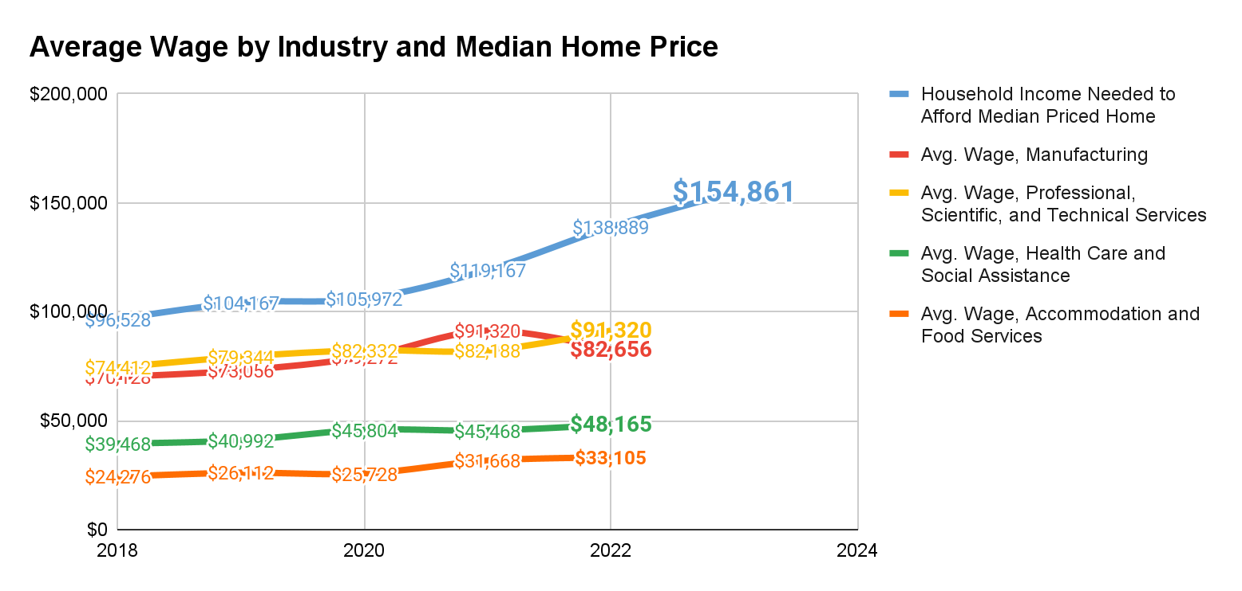
Widening Gap between Wages and Home Price
Wages have grown, but not enough to keep pace with increases in home price.
Household income needed to afford a median priced home increased by 60% over a five year period, while wages for Manufacturing rose 22%; PST 28%; Health Care 22%; and Accomodation and Food 43% – a widening gap for workers across industries.
Median Home Price: HousingWorksRI, Housing Fact Book, 2017-2023
Average Wage by Industry: Census Quarterly Workforce Indicators, 2017-2022
Notes:
Source: https://docs.google.com/spreadsheets/d/1gVuusdsA2xiYM_YhGzZyrmkVrybke10qVlUJzfI2_f4/edit#gid=1767678829
Healthcare
Accomodation and Food
Manufacturing
PST
5year

Slide 6
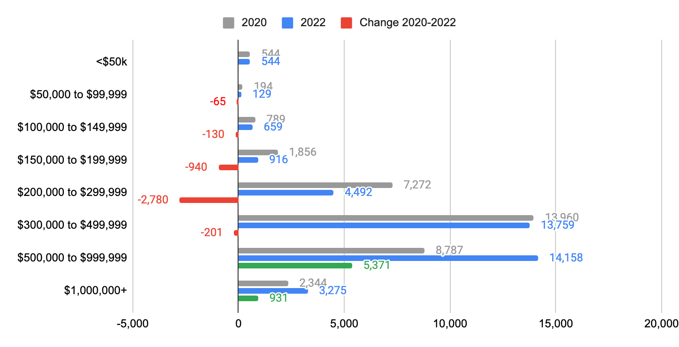
Home Values in Greater Newport
Home values are increasing in Greater Newport
Homes less than $300,000 decreased -37% from 2020 to 2022.
Homes greater than $500,000 increased +57% from 2020 to 2022.
Source: US Census Bureau | 2016-2020 & 2018-2022 ACS Estimates
=

Slide 7
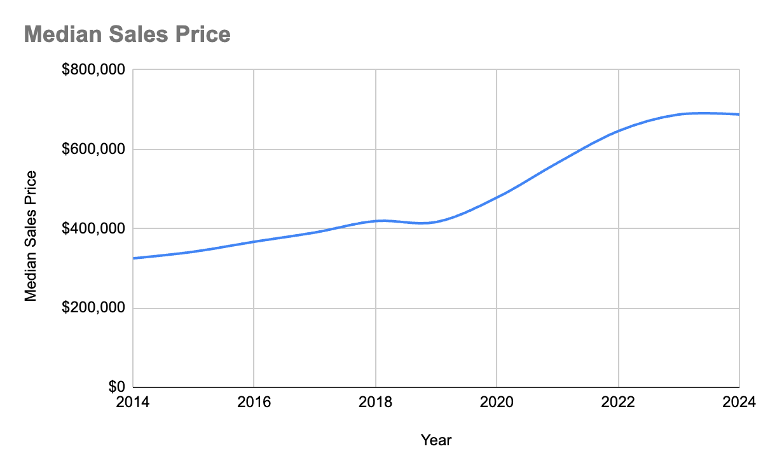
Historic Sales Price for Homes in Greater Newport
In the past decade, the median sales price of homes increased dramatically.
In 2014, the median sales price was $325K
In 2024, the median sales price is $688K
Source: Realtors data, 2014 to 2024
Notes:
Source: https://docs.google.com/spreadsheets/d/1MUD2yyZ4zHuXYIXpLwk5JUL-OJOkd2XWBQMVPfVGpRE/edit?gid=496242416#gid=496242416
Historically, there have been 1,175 homes sold annually (2018-2023) realtor data
Homes are selling faster, with sales volume holding steady, but active the number of active listings decreasing month over month

Slide 8
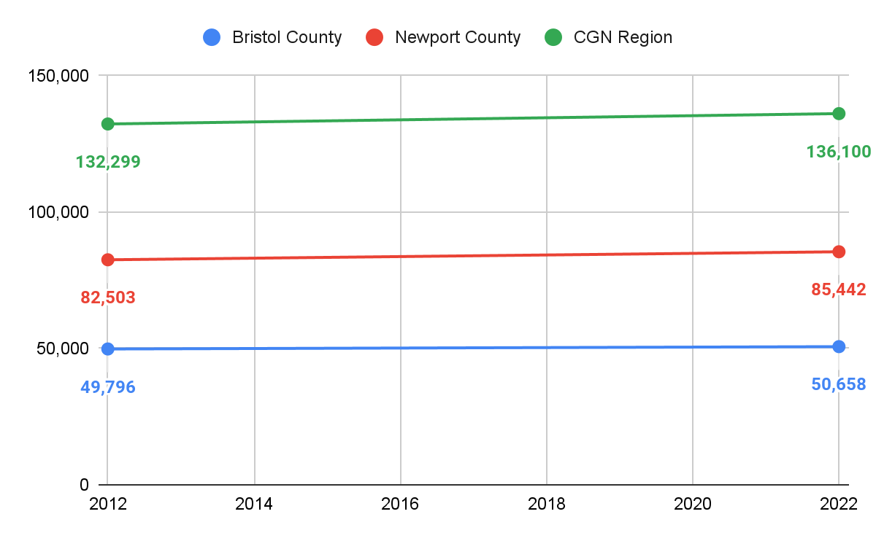
Greater Newport Population
In the past decade, the region grew by 3%, adding 3,801 residents.
Newport County grew by 4%, adding 2,939 residents.
Bristol County grew by 2%, adding 862 residents.
Source: US Census Bureau | 2012-2022 ACS Estimates
=
Notes:
Source: https://docs.google.com/spreadsheets/d/1gVuusdsA2xiYM_YhGzZyrmkVrybke10qVlUJzfI2_f4/edit#gid=155466607

Slide 9
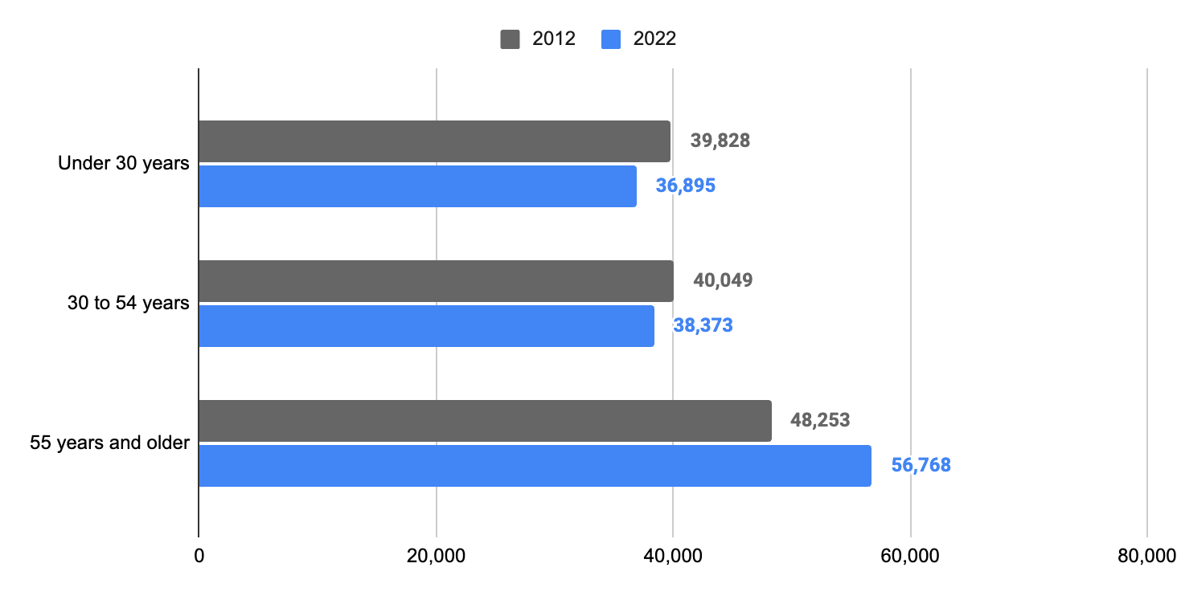
Greater Newport Population
Older adults and retirees are driving population growth.
The region grew population among adults age 55 years and older.
However, the region lost population for residents age 30 to 54 years and residents under 30 years old.
Source: US Census Bureau | 2012-2022 ACS Estimates
=
Notes:
Source: https://docs.google.com/spreadsheets/d/1gVuusdsA2xiYM_YhGzZyrmkVrybke10qVlUJzfI2_f4/edit#gid=155466607

Slide 10
A concerning trend: Loss in prime age workers
From 2010 to 2019, even as the overall population and workforce grew, the region lost 1,956 workers age 30 to 54.
At the same time, workers age 55 or older increased by 33%.
 | CGN, 2010 | CGN, 2021 | CGN Change, 2010 to 2021 | CGN %Change, 2010-2021 | RI %Change, 2010-2021 | US %Change, 2010-2019
Workers, Age 29 or younger | 10,124 | 9,432 | -692 | -7% | -6% | 13%
Workers, Age 30 to 54 | 22,164 | 20,208 | -1,956 | -9% | -7% | 6%
Workers, Age 55 or older | 9,455 | 12,583 | 3,128 | 33% | 36% | 45%
Total | 41,743 | 42,223 | 480 | 1% | 2% | 15%
Source: Census OnTheMap
=
Notes:
Source: https://docs.google.com/spreadsheets/d/1RiEAFLSVmWy01OMnmN43zXBOYmA1ZpoQ3I0eG9QHbrI/edit#gid=929738173
Across US, all age groups growing workers. The fastest growing group across the US, RI, and the CGN region is workers age 55 or older. Both CGN and RI as a whole experienced a loss of workers age 30 to 54. The CGN region has lost workers age 30 to 54 at twice the rate of the state.

Slide 11
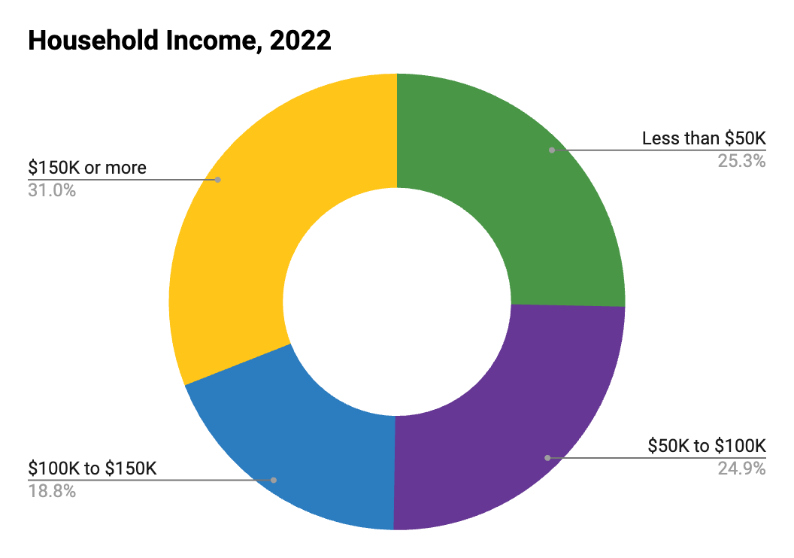
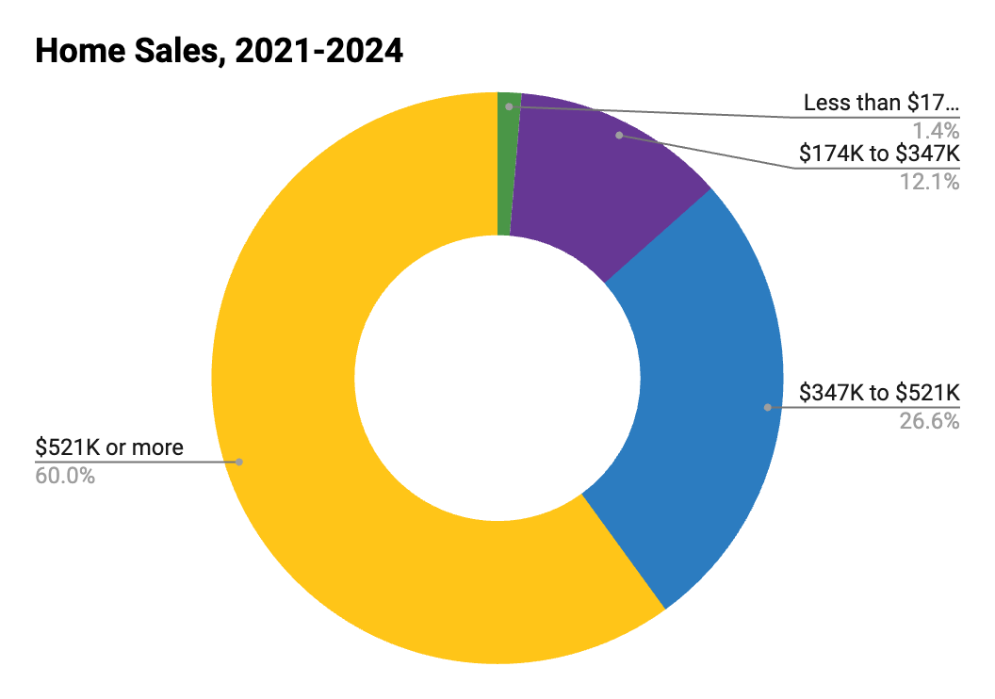
A Mismatch Between Income and Housing Prices
Home sales affordable to HH less than $100K (13%)
HH income
less than $100K
(50%)
Housing market access is an issue for many working families
Households earning less than $100K make up 50 of 100 households in Newport and Bristol Counties.
Homes affordable to households earning under $100K made up around 13 of 100 home sales in 2021-2024.
Household Income: Census ACS, 2022, 5-year estimates
Home Sales: Zillow, 2021-2024

Slide 12
Personas: Big Increase in the Gap
Linking Occupations, Wages, and Housing Affordability -
A Big Increase in the Housing Price Gap
Household Income | Less than $50K | $50K to $100K | $100K to $150K | $150K or more
Home Affordability | Less than $174K | $174K to $347K | $347K to $521K | $521K or more
Households | 13,925 | 13,685 | 10,329 | 17,020
Percent of Households | 25% | 25% | 19% | 31%
Homes Sold Per Year | 81 | 725 | 1,593 | 3,598
Percent of Sales | 1% | 12% | 27% | 60%
From 2021-2024, 60% of homes sold in the region were priced above $521K (only affordable to households making $150K or more in income)
For every home sold that was affordable to a household making $50K to $100K per year, there were 5 homes sold priced above $521K, only affordable to the highest income households.
Household Income: Census ACS, 2022, 5-year estimates
Home Sales: Zillow, 2021-2024

Slide 13
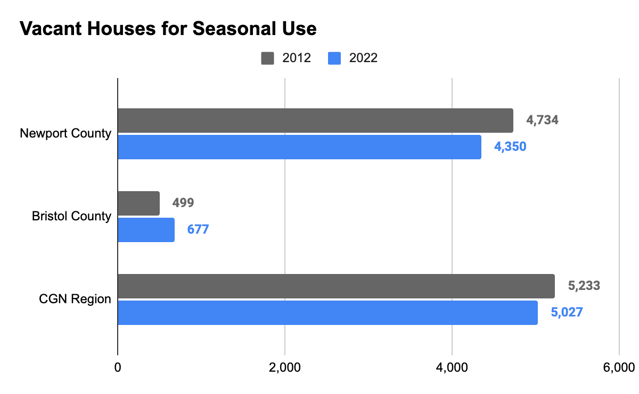
Second Homes in Greater Newport
The region has around 5,000 seasonal homes – a number that has remained relatively stable for a decade.
Seasonal homes account for 8% of the total housing stock of the region.
Source: US Census Bureau | 2018-2022 ACS Estimates
=
Notes:
Source: https://docs.google.com/spreadsheets/d/1gVuusdsA2xiYM_YhGzZyrmkVrybke10qVlUJzfI2_f4/edit?usp=sharing

Slide 14
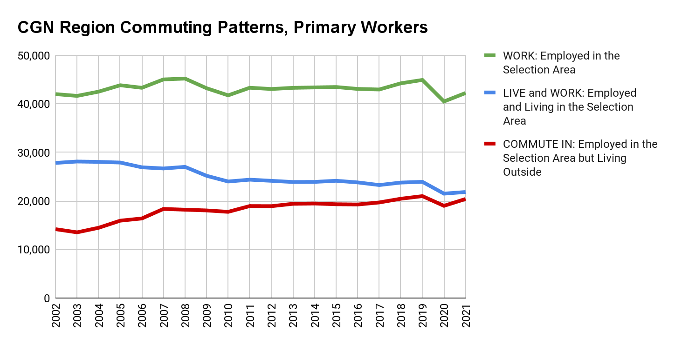
Commuting Patterns:
More Evidence Housing too Expensive for Workers
There is a decades-long trend of more workers having to commute in from outside of the region.
Even as the region added workers from 2010 to 2021, -2,167 fewer lived and worked in the region and 2,647 more commuted in from outside the region.
Note: this data is capturing pandemic era disruptions but the overall commuter trend has continued.
Source: Census OnTheMap
=
Notes:
Source: https://docs.google.com/spreadsheets/d/1RiEAFLSVmWy01OMnmN43zXBOYmA1ZpoQ3I0eG9QHbrI/edit#gid=929738173
The people who have to commute in – make less/essential workers – are the least likely to own
Real effect of worker retention on long commutes

Slide 15
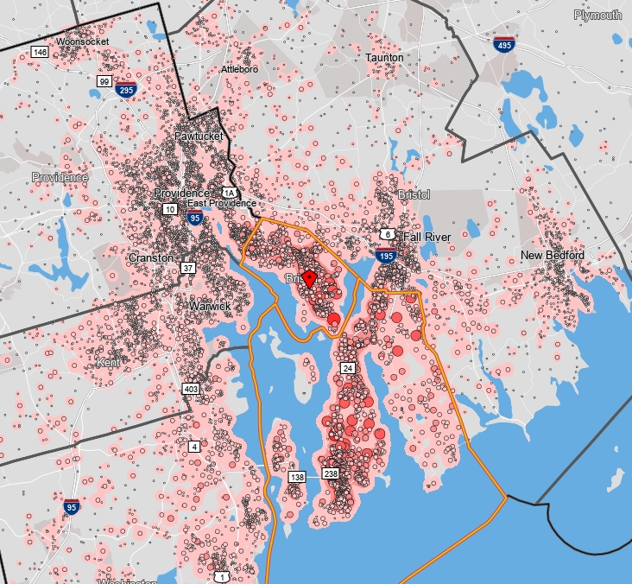
Commuting Patterns:
Where Workers Commute in from Outside the Region
 | Census Designated Place | Commuters
1 | Newport city, RI | 4,195
2 | Newport East CDP, RI | 2,545
3 | Fall River city, MA | 1,647
4 | Warwick city, RI | 1,546
5 | Providence city, RI | 1,493
6 | East Providence city, RI | 1,236
7 | Tiverton CDP, RI | 1,213
8 | Cranston city, RI | 967
9 | Pawtucket city, RI | 555
10 | New Bedford city, MA | 473
48% of workers commute in from outside the region for their primary job (totaling 20,394 workers) – with many workers traveling from Fall River or Providence. In Commuting is up from 34% in 2002 = 6,219 additional commuters.
Source: Census OnTheMap
=
Notes:
Source: https://docs.google.com/spreadsheets/d/1RiEAFLSVmWy01OMnmN43zXBOYmA1ZpoQ3I0eG9QHbrI/edit#gid=929738173
The people who have to commute in – make less/essential workers – are the least likely to own
Real effect of worker retention on long commutes
Yes -- map shows all commuting into the CGN region. The table is the top 10 places that people commute from who work in the region. In bold are places outside the CGN region which people live and commute into the CGN region for work.

Slide 16
The Original Study

Slide 17
Housing Analysis for the Greater Newport Region
April 2023

Slide 18
The State of Newport’s Housing Stock
Future Housing Needs
Workforce Projections
Housing Needs
Personas of the Future Workforce
Community Ramifications
Recommendations + Promising Practices
Notes:
We will cover 5 topic areas in today’s presentation.

Slide 19
The State of Greater Newport’s
Housing Stock
…Greater Newport = Bristol and Newport County, RI

Slide 20
Greater Newport’s Housing Stock Is…
Growing in volume of total units, led by a surge in high-value owner-occupied units and a drop in lower-value renter-occupied units.
Consistently rising in value, with the median home price increasing by 44% in the last 5 years, making it harder for local earners to afford homes in their income bracket and contributing to population loss of workers age 30-54.
A lack of needed housing development is putting pressure on working-age population and those who want to age in place, leading to cost-burdened status of ⅓ of retirees and ¼ of working professionals.
A decline in working age population able to live in the region is being offset by increased workforce commuting into the region, this raises sustainability risks.

Slide 21
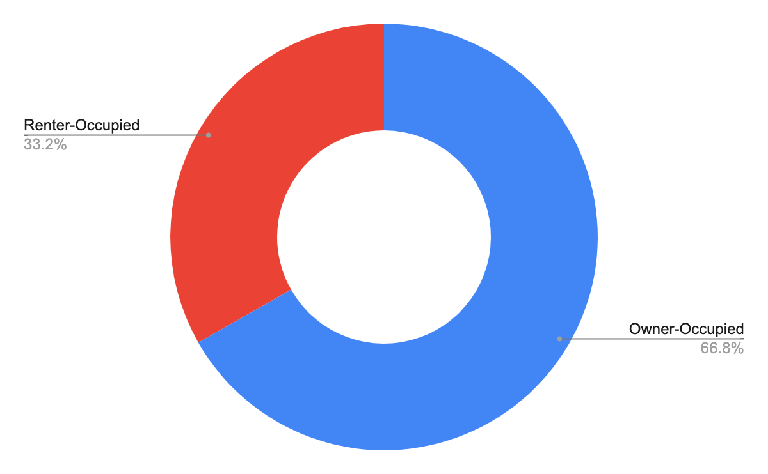
Occupied Units in Greater Newport
Between 2015 and 2020, there was an increase of +1,121 new housing units in Greater Newport. The majority of units are owner-occupied in Greater Newport which had 35,746 units in 2020.
Between 2015 and 2020, there has been a decrease of -1,092 in renter-occupied units, and an increase of +493 in owner-occupied units.
17,793
53,539
Occupied Units
35,746
Source: US Census Bureau | 2016-2020 ACS Estimates
=
Notes:
Source: https://docs.google.com/spreadsheets/d/1gVuusdsA2xiYM_YhGzZyrmkVrybke10qVlUJzfI2_f4/edit#gid=1583636727

Slide 22
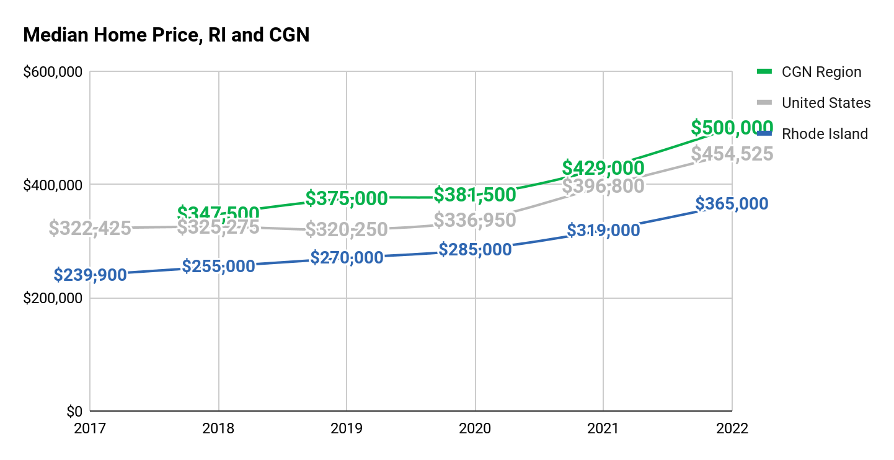
Median Home Price in RI and Greater Newport
The median home price for the CGN region increased by 44% from 2018 to 2022.
A typical owner in the CGN region now pays $135,000+ more than they would for the median RI home and $55,000+ more than US.
Median Home Price: HousingWorksRI, Housing Fact Book, 2017-2022;
US Median Home Price: Federal Reserve of St. Louis
Notes:
Source: https://docs.google.com/spreadsheets/d/1x7If-piNmxkB6OsJPc20dEJYrkZZLuKQjaXbVhm6W2M/edit#gid=432341965

Slide 23
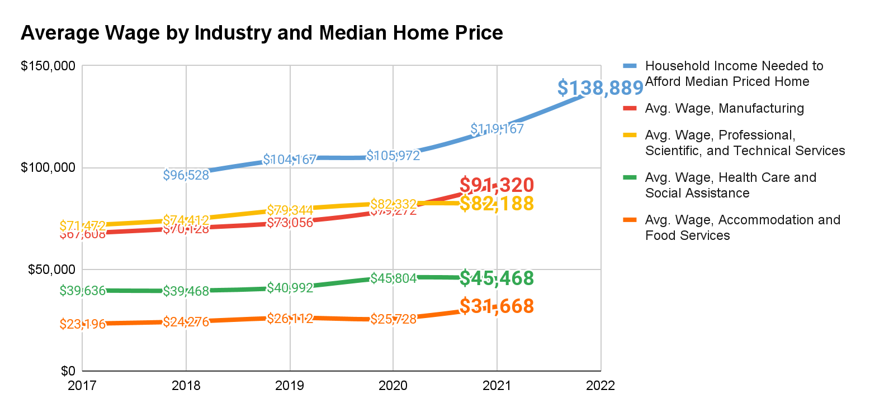
Widening Gap between Wages and Home Price
Wages have grown, but not enough to keep pace with increases in home price.
Household income needed to afford a median priced home increased by 44% over a five year period, while wages for Manufacturing rose 37%; PST 15%; Health Care 15%; and Accomodation and Food 35% – a widening gap for workers across industries.
Median Home Price: HousingWorksRI, Housing Fact Book, 2017-2022
Average Wage by Industry: Census Quarterly Workforce Indicators, 2017-2021
Notes:
Source: https://docs.google.com/spreadsheets/d/1gVuusdsA2xiYM_YhGzZyrmkVrybke10qVlUJzfI2_f4/edit#gid=1767678829
Healthcare
Accomodation and Food
Manufacturing
PST
5year

Slide 24
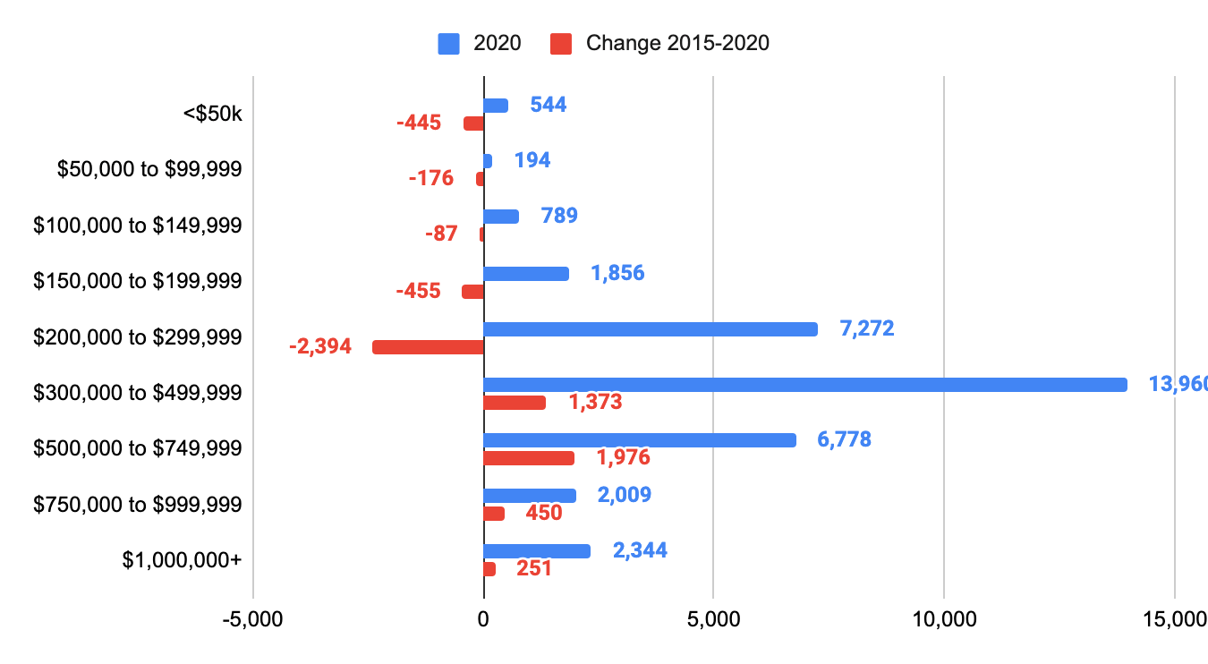
Home Values in Greater Newport
Home values are increasing in Greater Newport.
Homes less than $300,000 decreased -25% from 2015 to 2020.
Homes greater than $300,000 increased +19% from 2015 to 2020.
Source: US Census Bureau | 2016-2020 ACS Estimates
=

Slide 25
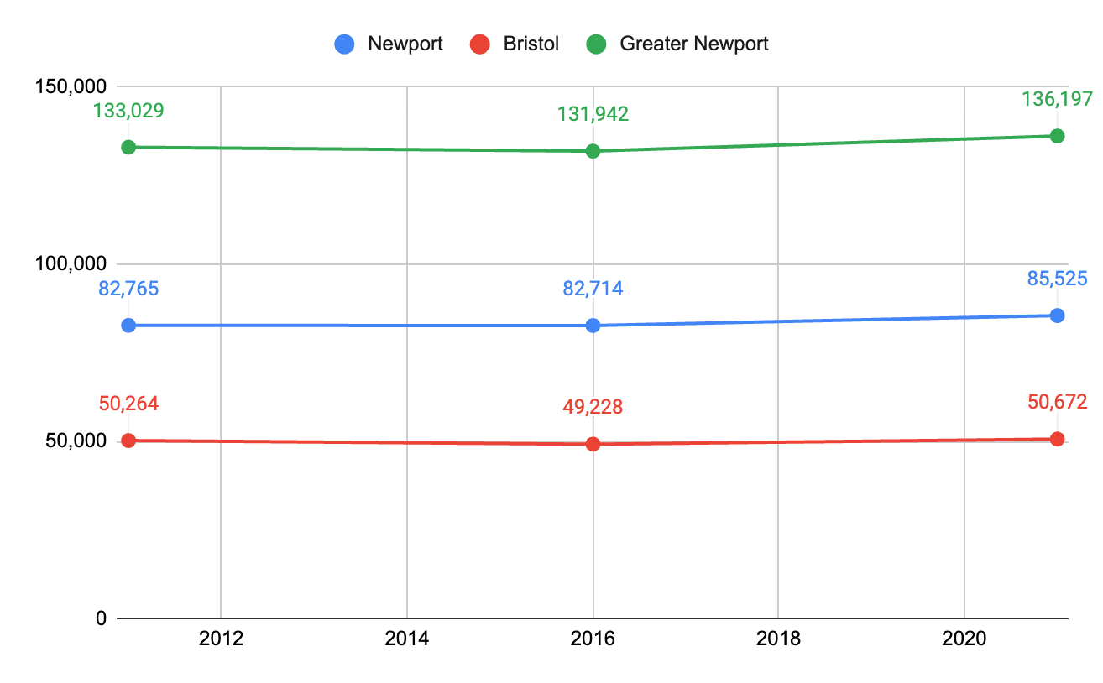
Greater Newport Population
Population in Greater Newport has increased by +3,168 from 2011 to 2021.
Population actually declined between 2011 and 2016, while increasing between 2017 and 2021.
Source: US Census Bureau | 2017-2021 ACS Estimates
=
Notes:
Source: https://docs.google.com/spreadsheets/d/1gVuusdsA2xiYM_YhGzZyrmkVrybke10qVlUJzfI2_f4/edit#gid=155466607

Slide 26
A concerning trend: Loss in prime age workers
 | CGN, 2010 | CGN, 2019 | CGN Change, 2010 to 2019 | CGN %Change, 2010-2019 | RI %Change, 2010-2019 | US %Change, 2010-2019
Age 29 or younger | 10,124 | 10,647 | 523 | 5% | 3% | 7%
Age 30 to 54 | 22,164 | 21,072 | -1,092 | -5% | -2% | 1%
Age 55 or older | 9,455 | 13,193 | 3,738 | 40% | 40% | 36%
Total | 41,743 | 44,912 | 3,169 | 8% | 8% | 9%
From 2010 to 2019, even as the overall population and workforce grew, the region lost 1,092 workers age 30 to 54. Residents Age 55 or older increased by 40%.
Source: Census OnTheMap
=
Notes:
Source: https://docs.google.com/spreadsheets/d/1RiEAFLSVmWy01OMnmN43zXBOYmA1ZpoQ3I0eG9QHbrI/edit#gid=929738173
Across US, all age groups growing workers. The fastest growing group across the US, RI, and the CGN region is workers age 55 or older. Both CGN and RI as a whole experienced a loss of workers age 30 to 54. The CGN region has lost workers age 30 to 54 at twice the rate of the state.

Slide 27
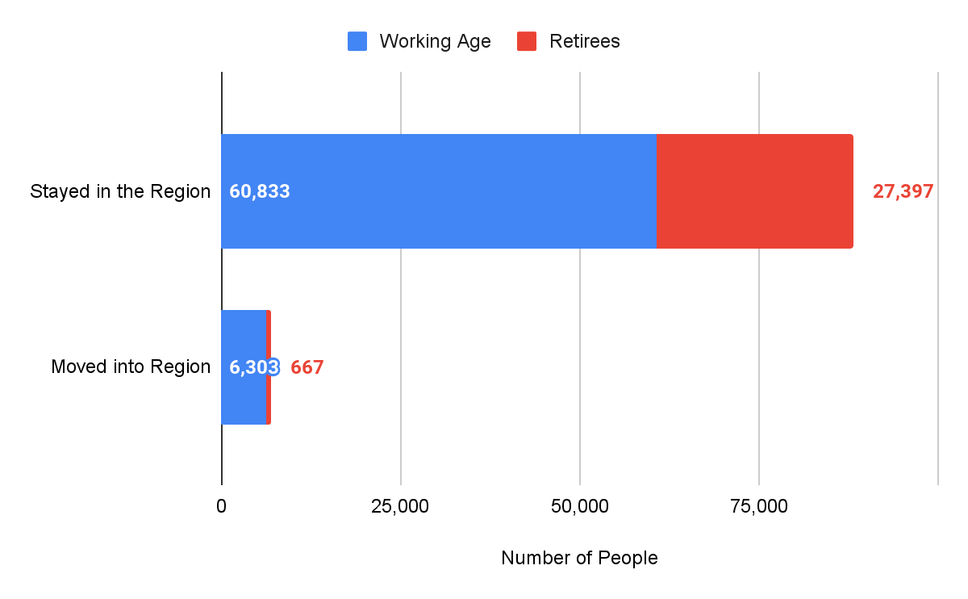
Geographic Mobility (2016-2020)
98% of retirees (65+) stayed in the region in the last year.
Nationally, 97% of retirees (65+) stayed in their respective regions in the last year.
Overall, CGN’s working age population shrank by -2% while the total retiree population grew by +15%.
Source: US Census Bureau | 2016-2020 ACS Estimates
=

Slide 28
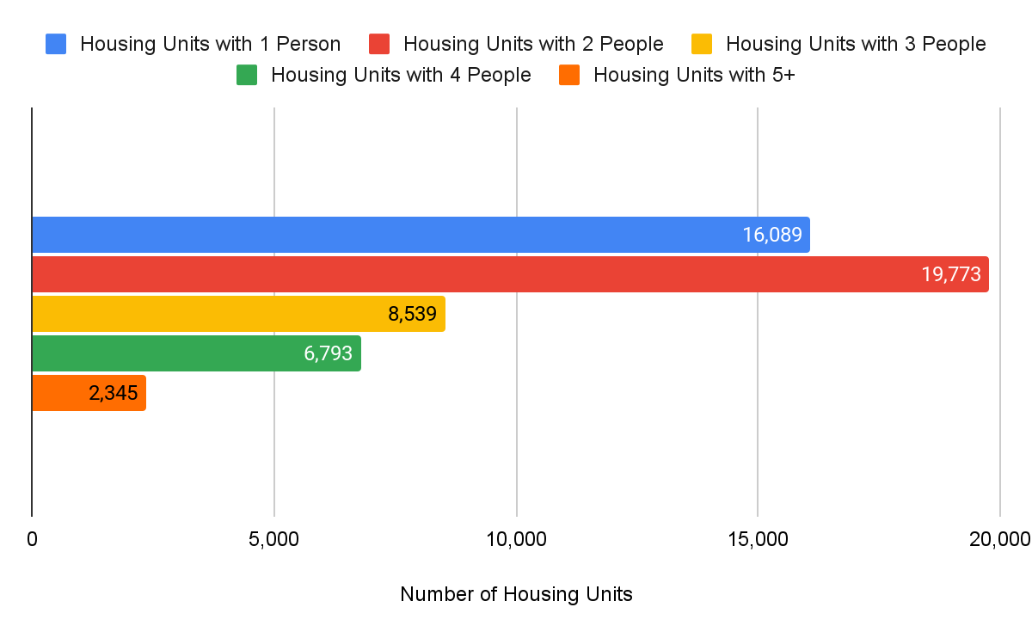
Number of People per Occupied Unit
Number of People per Occupied Unit
2 and 3-person units have grown the most, +2.5% and +6.6%, respectively (2016-2020).
Yet the majority of occupied units only have 1 or 2 people in them.
Source: US Census Bureau | 2016-2020 ACS Estimates
=

Slide 29
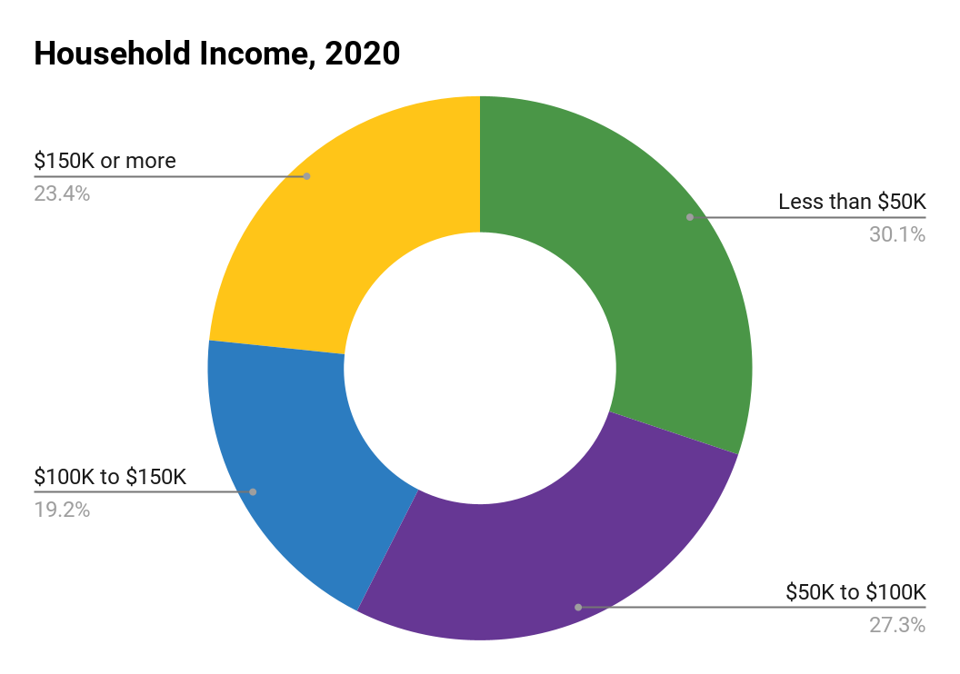
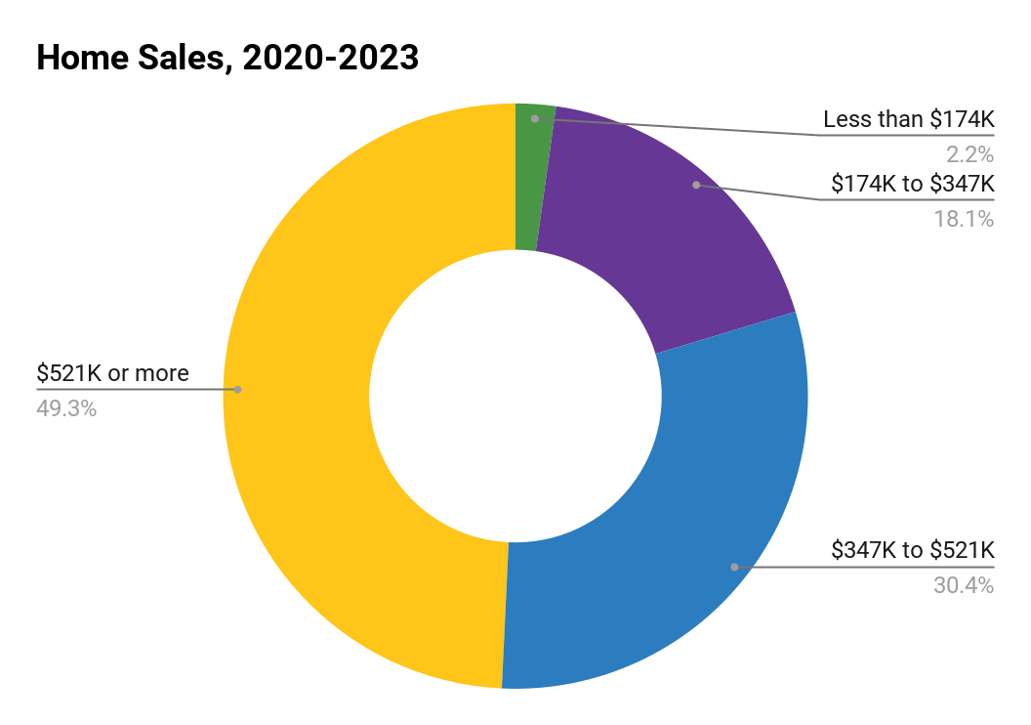
A Mismatch Between Income and Housing Prices
Home sales affordable to HH
less than $100K
(20%)
HH income
less than $100K
(57%)
Housing market access is an issue for many working families
Households earning less than $100K make up nearly 6 of 10 households in Newport and Bristol Counties.
Homes affordable to households earning under $100K made up 2 of 10 home sales in 2020-2022.
Household Income: Census ACS, 2020, 5-year estimates
Home Sales: Zillow, 2020-2022

Slide 30
Personas: Big Increase in the Gap
Linking Occupations, Wages, and Housing Affordability -
A Big Increase in the Housing Price Gap
Household Income | Less than $50K | $50K to $100K | $100K to $150K | $150K or more
Home Affordability | Less than $174K | $174K to $347K | $347K to $521K | $521K or more
Households | 16,139 | 14,635 | 10,273 | 12,508
Percent of Households | 30% | 27% | 19% | 23%
Homes Sold Per Year | 52 | 425 | 713 | 1,155
Percent of Sales | 2% | 18% | 30% | 49%
From 2020-2023, nearly 2.5 times as many homes sold for $521K+ than homes priced under $347K, despite 57% of total households seeking homes prices under $347k and only 23% seeking homes over $521k.
Household Income: Census ACS, 2020, 5-year estimates
Home Sales: Zillow, 2020-2022

Slide 31
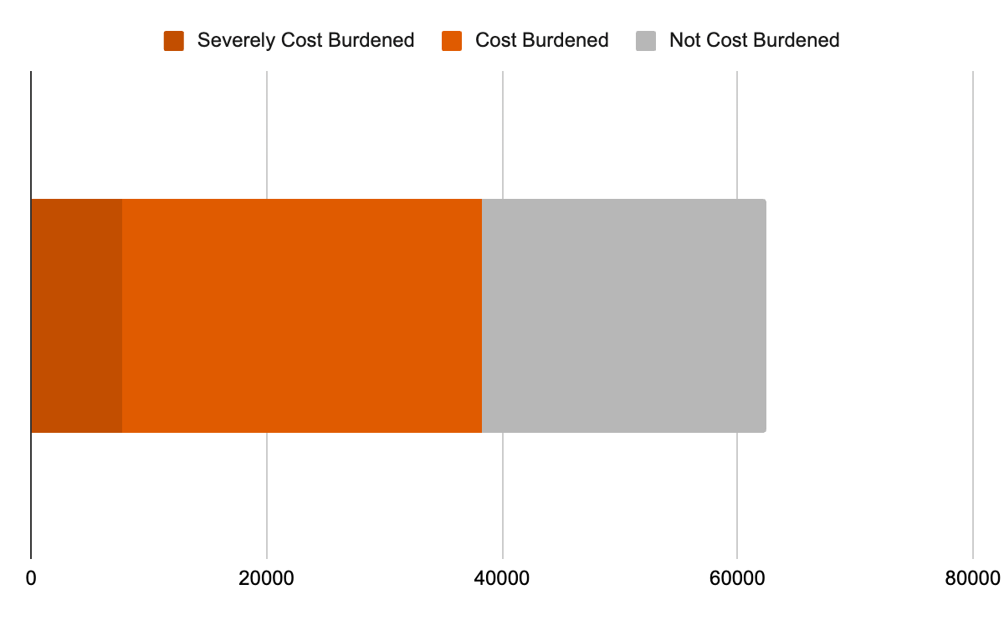
Owner Occupied and Renter: Cost Burdened Households in Greater Newport
7,796
Severely Cost Burdened Households
Paying 50% or more of their income on housing costs.
14%
56%
44%
30,542
Cost Burdened Households
Paying 30% or more of their income on housing costs. Across the state, 33% of households are cost burdened, and across the U.S, 30% of households are cost burdened.
Source: US Census Bureau | 2017-2021 ACS Estimates
=
Notes:
Source: https://docs.google.com/spreadsheets/d/1gVuusdsA2xiYM_YhGzZyrmkVrybke10qVlUJzfI2_f4/edit?usp=sharing

Slide 32
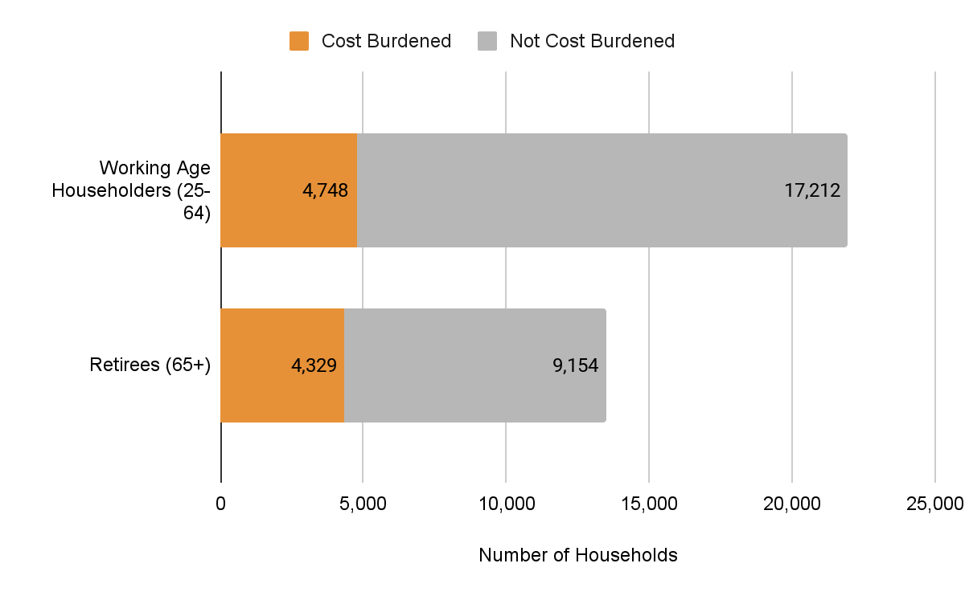
Cost Burden By Age
21.5% of Working Age Households are cost burdened while 32% of Retiree households are cost burdened.
Source: US Census Bureau | 2016-2020 ACS Estimates
=
Notes:
Occupied Units only

Slide 33
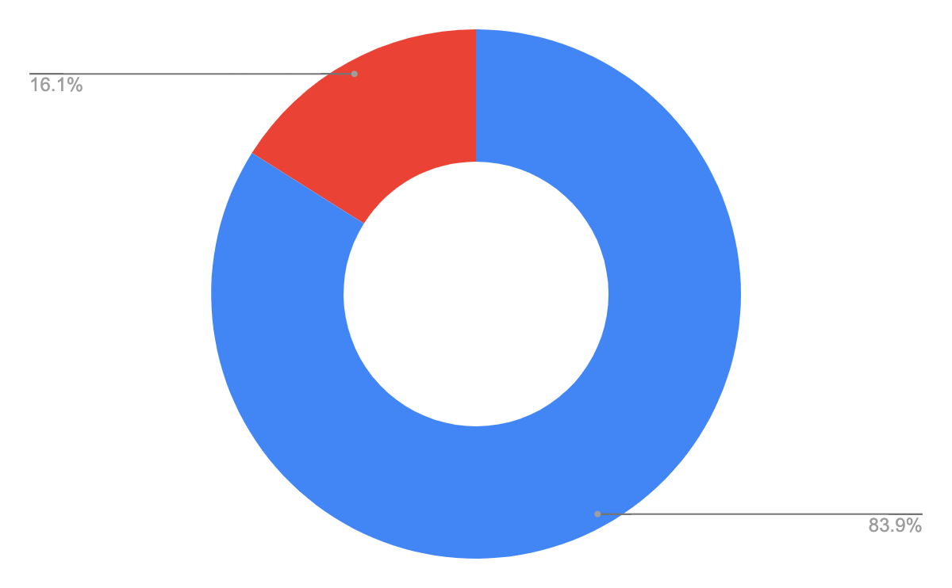
Vacancy in Greater Newport
Vacant Units
10,239
10,239
There has been an increase in both vacant and owner-occupied units.
Vacant units increased 20% between 2015 and 2020.
Increases in vacancy may be attributed to a high cost of living and an aging population.
63,778
Total Units
53,539
Occupied Units
Source: US Census Bureau | 2016-2020 ACS Estimates
=
Notes:
Source: https://docs.google.com/spreadsheets/d/1gVuusdsA2xiYM_YhGzZyrmkVrybke10qVlUJzfI2_f4/edit?usp=sharing

Slide 34
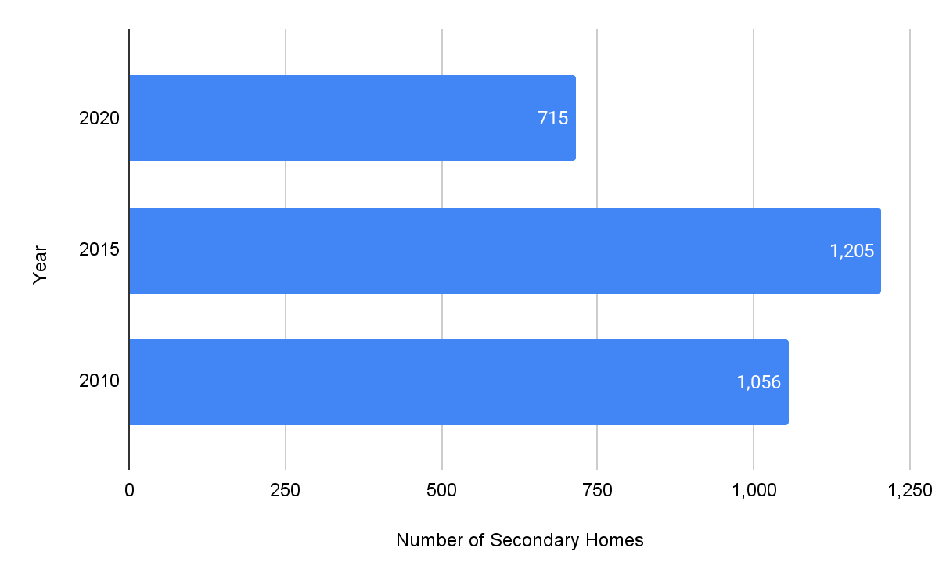
Second Homes in Greater Newport
7%
of vacant units are second homes – a statistic that has decreased 41% since 2015.
The majority of vacant homes in the area are Seasonal (49%) and Other Housing (22%), which includes homes under renovation, awaiting sale, or being used for storage.
Source: US Census Bureau | 2016-2020 ACS Estimates
=
Notes:
Source: https://docs.google.com/spreadsheets/d/1gVuusdsA2xiYM_YhGzZyrmkVrybke10qVlUJzfI2_f4/edit?usp=sharing

Slide 35
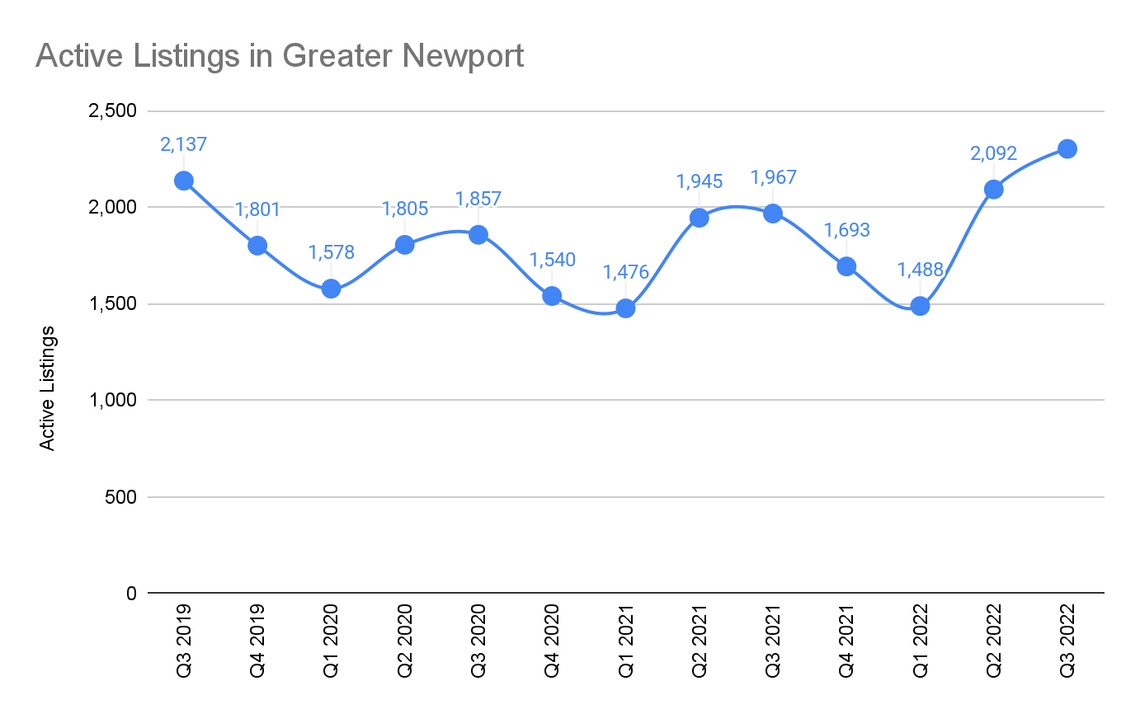
Short-term Rentals
Short-term Rentals
The volume of short-term rentals in the region has returned to pre-pandemic levels, driven primarily by Newport.
Location | Active Listings
Newport | 1,086
Middletown | 509
Jamestown | 162
Portsmouth | 156
Bristol | 132
Little Compton | 121
Tiverton | 63
Warren | 42
Barrington | 31
Source: AirDNA data compiled by Fourth Economy Consulting
Notes:
Source: https://docs.google.com/spreadsheets/d/1n1WTk_0c6bRfWlK-Nzn6S3UDqbhy66y604NexkTDcfI/edit?usp=sharing

Slide 36
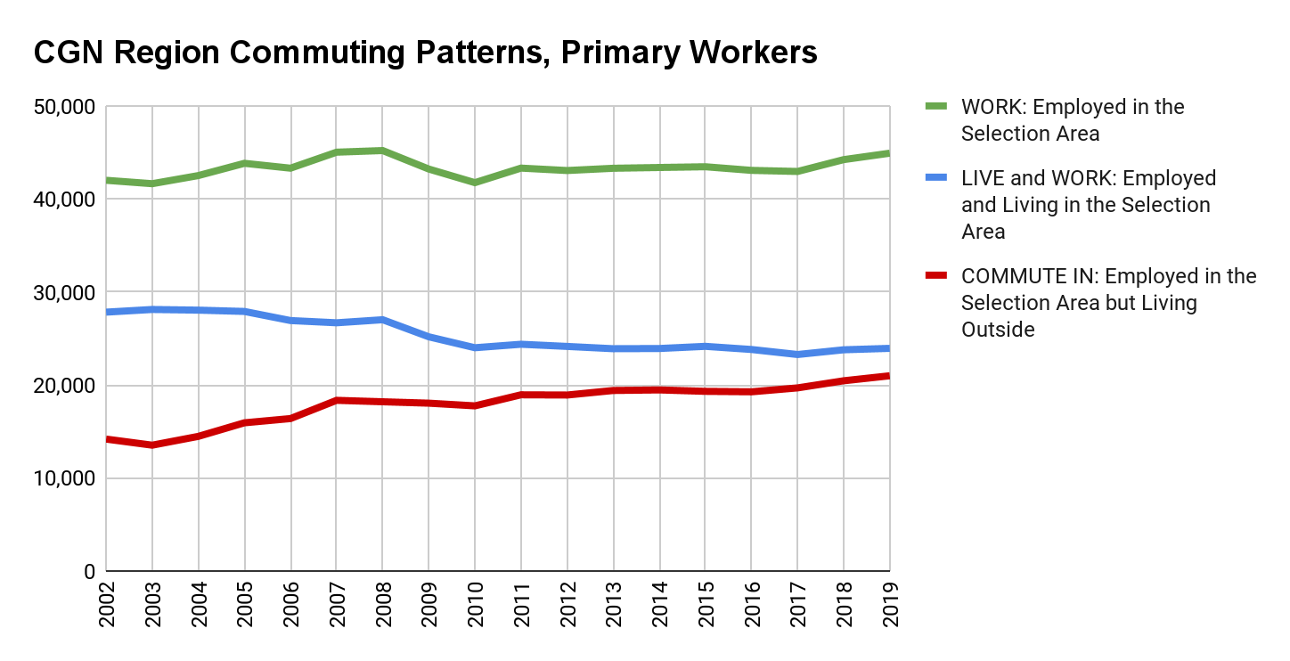
Commuting Patterns:
More Evidence Housing too Expensive for Workers
There is a decades-long trend of more workers having to commute in from outside of the region.
Even as the region added 3,169 workers from 2010 to 2019, 66 fewer lived and worked in the region and 3,235 more commuted in from outside the region.
Source: Census OnTheMap
=
Notes:
Source: https://docs.google.com/spreadsheets/d/1RiEAFLSVmWy01OMnmN43zXBOYmA1ZpoQ3I0eG9QHbrI/edit#gid=929738173
The people who have to commute in – make less/essential workers – are the least likely to own
Real effect of worker retention on long commutes

Slide 37
Commuting Patterns:
Where Workers Commute in from Outside the Region
 | Census Designated Place | In Commuters
1 | Newport city, RI | 4,648
2 | Newport East CDP, RI | 2,967
3 | Fall River city, MA | 1,704
4 | Warwick city, RI | 1,631
5 | Providence city, RI | 1,485
6 | East Providence city, RI | 1,296
7 | Tiverton CDP, RI | 1,246
8 | Cranston city, RI | 1,004
9 | Pawtucket city, RI | 536
10 | New Bedford city, MA | 455
47% of workers commute in from outside the region for their primary job (totaling 20,982 workers) – with many workers traveling from Fall River or Providence. In Commuting is up from 34% in 2002 = 6,000 additional commuters.
Source: Census OnTheMap
=
Notes:
Source: https://docs.google.com/spreadsheets/d/1RiEAFLSVmWy01OMnmN43zXBOYmA1ZpoQ3I0eG9QHbrI/edit#gid=929738173
The people who have to commute in – make less/essential workers – are the least likely to own
Real effect of worker retention on long commutes
Yes -- map shows all commuting into the CGN region. The table is the top 10 places that people commute from who work in the region. In bold are places outside the CGN region which people live and commute into the CGN region for work.

Slide 38
Future Housing
Needs
…Fourth Economy Analysis of data and interviews of regional employers

Slide 39
Workforce Projections
Greater Newport is projected to have a 15.6% increase in jobs in the next 10 years, led by Education and Health Services, Leisure and Hospitality, and Professional and Business Services.
This job growth will be outpaced by nearly 10,000 retirements from the current workforce, due primarily to an existing clustering of workers between ages 55-64. These roles will require significant backfilling to stabilize the regional workforce.

Slide 40
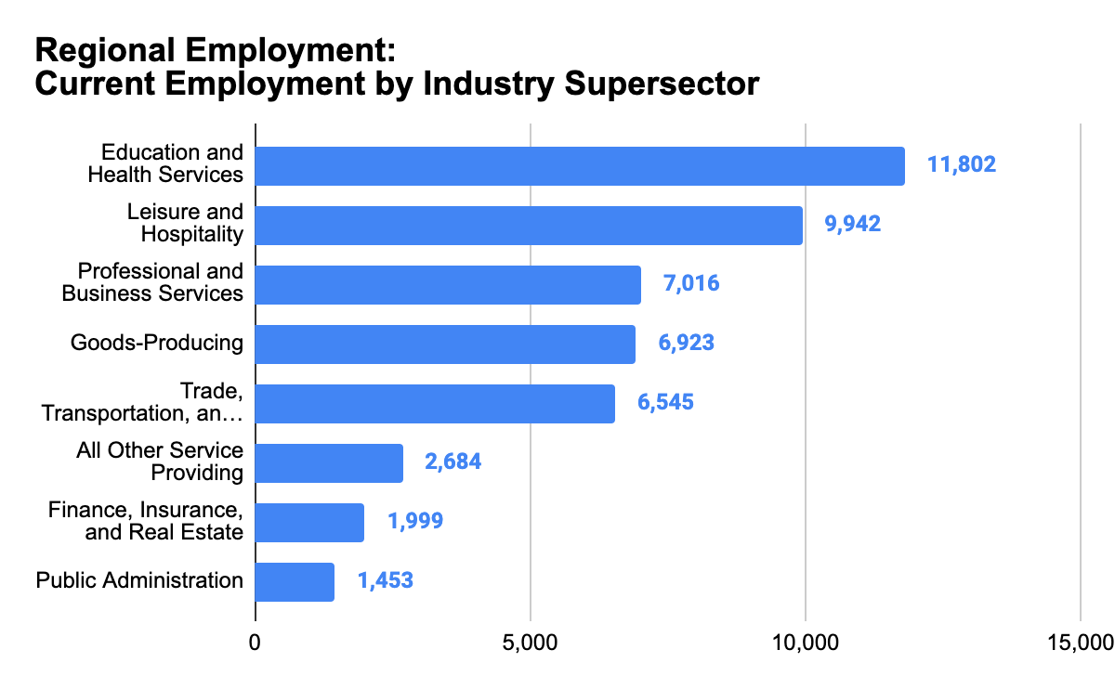
Current Workforce in Greater Newport
The Connect Greater Newport Region (Newport County and Bristol County) has a regional workforce of 48,364.
In the next decade, the economy is expected to add jobs, and experience a wave of retirements.
Sources: Quarterly Workforce Indicators, 2021-2022
Notes:
Source: https://docs.google.com/spreadsheets/d/1C6_o1Nlf3UVXxFCTJ7A3EajEA9nlvhjgJJNW3IEzIjo/edit#gid=0&range=F43

Slide 41
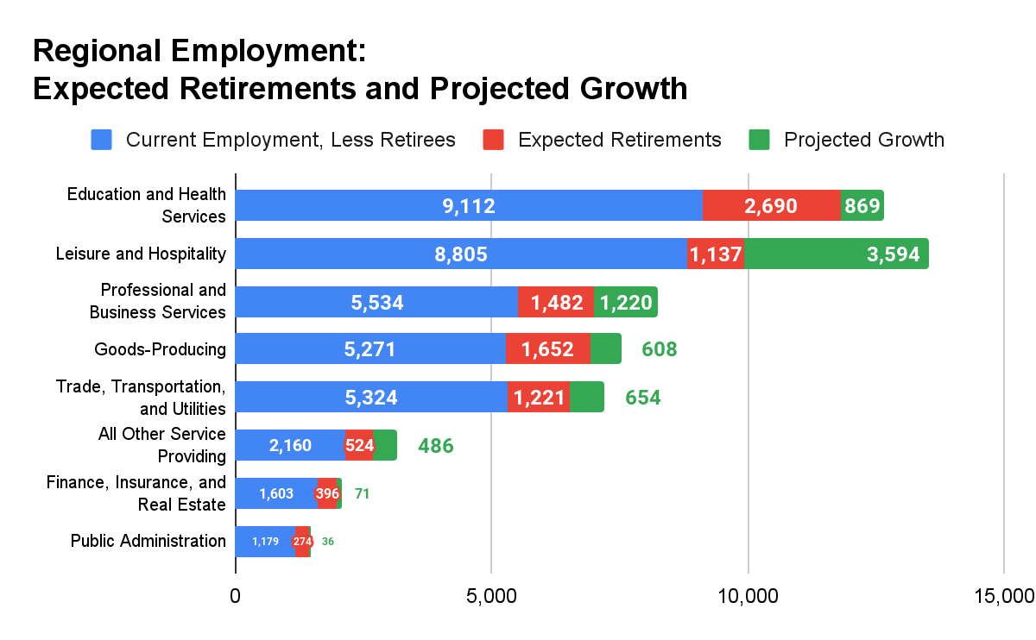
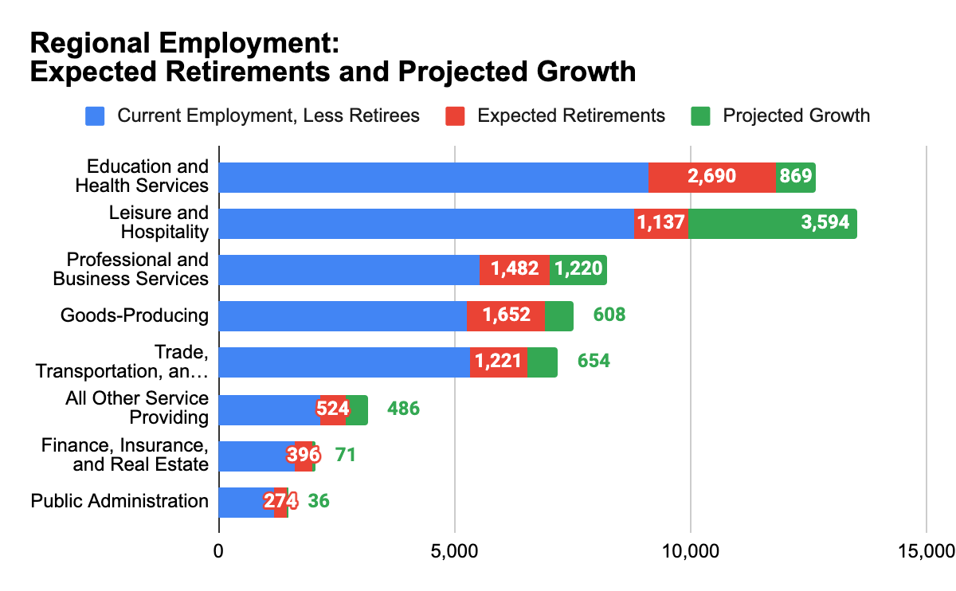
Future Workforce in Greater Newport
Overall, the region’s workforce is projected to increase in the next decade, adding 7,539 jobs from Projected Growth (15.6%).
Change in the composition of the regional workforce will also be driven by 9,376 Expected Retirements across the next decade (19.4% of workers are between the ages of 55 and 64).
Sources: Fourth Economy Analysis of Census Quarterly Workforce Indicators, 2021-2022, Rhode Island Department of Labor and Training Industry Projections, Interview responses
Notes:
Source: https://docs.google.com/spreadsheets/d/1C6_o1Nlf3UVXxFCTJ7A3EajEA9nlvhjgJJNW3IEzIjo/edit#gid=0&range=F43

Slide 42
NAICS Sector | Supersector | Current Employment | Current Avg. Wage | Projected Growth | Expected Retirements | Total New Workers
Health Care and Social Assistance | Education and Health Services | 6,165 | $45,252 | 573 | 1,309 | 1,882
Educational Services | Education and Health Services | 5,637 | $52,260 | 296 | 1,381 | 1,677
Accommodation and Food Services | Leisure and Hospitality | 8,224 | $31,680 | 2,906 | 874 | 3,780
Arts, Entertainment, and Recreation | Leisure and Hospitality | 1,718 | $40,464 | 688 | 263 | 951
Professional, Scientific, and Technical Services | Professional and Business Services | 4,676 | $82,620 | 985 | 1,002 | 1,987
Administration & Support, Waste Management and Remediation | Professional and Business Services | 1,792 | $48,060 | 197 | 342 | 539
Management of Companies and Enterprises | Professional and Business Services | 548 | $64,272 | 38 | 138 | 176
Manufacturing | Goods-Producing | 4,187 | $91,212 | 167 | 1,073 | 1,240
Construction | Goods-Producing | 2,570 | $59,592 | 417 | 546 | 963
Agriculture, Forestry, Fishing and Hunting | Goods-Producing | 160 | $38,328 | 24 | 32 | 56
Mining, Quarrying, and Oil and Gas Extraction | Goods-Producing | 6 | $61,800 | 0 | 1 | 1
Retail Trade | Trade, Transportation, and Utilities | 4,808 | $39,576 | 431 | 790 | 1,221
Wholesale Trade | Trade, Transportation, and Utilities | 1,047 | $99,744 | 90 | 247 | 337
Transportation and Warehousing | Trade, Transportation, and Utilities | 546 | $47,028 | 133 | 124 | 257
Utilities | Trade, Transportation, and Utilities | 144 | $64,644 | 0 | 60 | 60
Other Services (excluding Public Administration) | All Other Service Providing | 2,239 | $38,868 | 470 | 452 | 922
Information | All Other Service Providing | 445 | $135,948 | 16 | 72 | 88
Finance and Insurance | Finance, Insurance, and Real Estate | 1,381 | $112,536 | 43 | 262 | 305
Real Estate and Rental and Leasing | Finance, Insurance, and Real Estate | 618 | $58,848 | 27 | 134 | 161
Public Administration | Public Administration | 1,453 | $53,700 | 36 | 274 | 310
Total | Total | 48,364 | $47,325 | 7,539 | 9,376 | 16,915
Sources: Fourth Economy Analysis of Census Quarterly Workforce Indicators, 2021-2022, Rhode Island Department of Labor and Training Industry Projections

Slide 43
Greater Newport’s Housing Stock Will Need…
An increase of 9,000 units in the next decade to match projected workforce growth.
Further impacts the existing unmet need
At least 6,000 to if commuting patterns remain they are today
To match the needs of a new workforce concentrated in annual wages between $75,000 - $99,000, meaning:
A new supply of purchasable units priced under $400,000.
A new supply of rentable units priced under $1,249 per month.

Slide 44


Changing Workforce & Housing Demand
New Workers
New workers will be needed to fill new positions and positions vacated by retirees.
Retirees Some retirees will move from their homes, making them available to new workers. Other retirees will age in place.
Worker Household Formation
Some workers will form single earner households, while other workers will form two-earner households.

Slide 45
Model Methodology
The model takes changes in the workforce due to projected job growth and retirements and translates that into housing unit demand. The model articulates total additional housing demand needed over the next 10-years in terms of owner and renter units at different price points based on household incomes.
Workforce changes
Projected Job Growth: LMI Projections by Industry, State of Rhode Island, Department of Labor and Training
Projected Retirements: Quarterly Workforce Indicators, Share of Workers age 55-64 by Industry
Wages
Quarterly Workforce Indicators, Census
Household Composition
Forming one and two earner households. Source: U.S. Census Bureau, Current Population Survey, Annual Social and Economic Supplements (CPS ASEC).
Homeownership rate by household income. This input weights household income and is more likely to sort higher income households into owner units. Source: Census, American Community Survey
Housing stock is split between owners and renters. Source: Census, American Community Survey
Affordability
Rent affordability based on cost-burden threshold. Home affordability based on Decennial Census Data.
Notes:
https://docs.google.com/spreadsheets/d/1m4qlndxQ2uyUI4KkE8-7lUgMFL5ZyXYI3Gpi2nQvev8/edit#gid=0
Sources, assumptions, and inputs discussed in more detail within the spreadsheet model

Slide 46
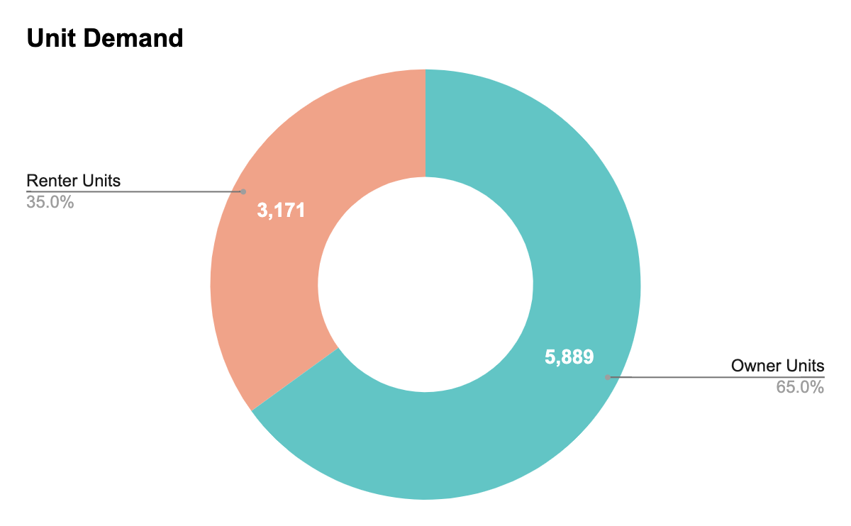
10-Year Housing Demand Increase: 9,060 Units
Housing Unit Demand Increase
Adding 7,539 jobs and backfilling positions for 9,376 retirees will increase overall housing unit demand in the region by 9,060 units in the next decade.
New units demand will be split between 5,889 Owner Units (65%) and 3,171 Renter Units (35%).
Sources: Fourth Economy Analysis of Census Quarterly Workforce Indicators, 2021-2022, Rhode Island Department of Labor and Training Industry Projections
Notes:
Source: https://docs.google.com/spreadsheets/d/1C6_o1Nlf3UVXxFCTJ7A3EajEA9nlvhjgJJNW3IEzIjo/edit#gid=1232577068

Slide 47
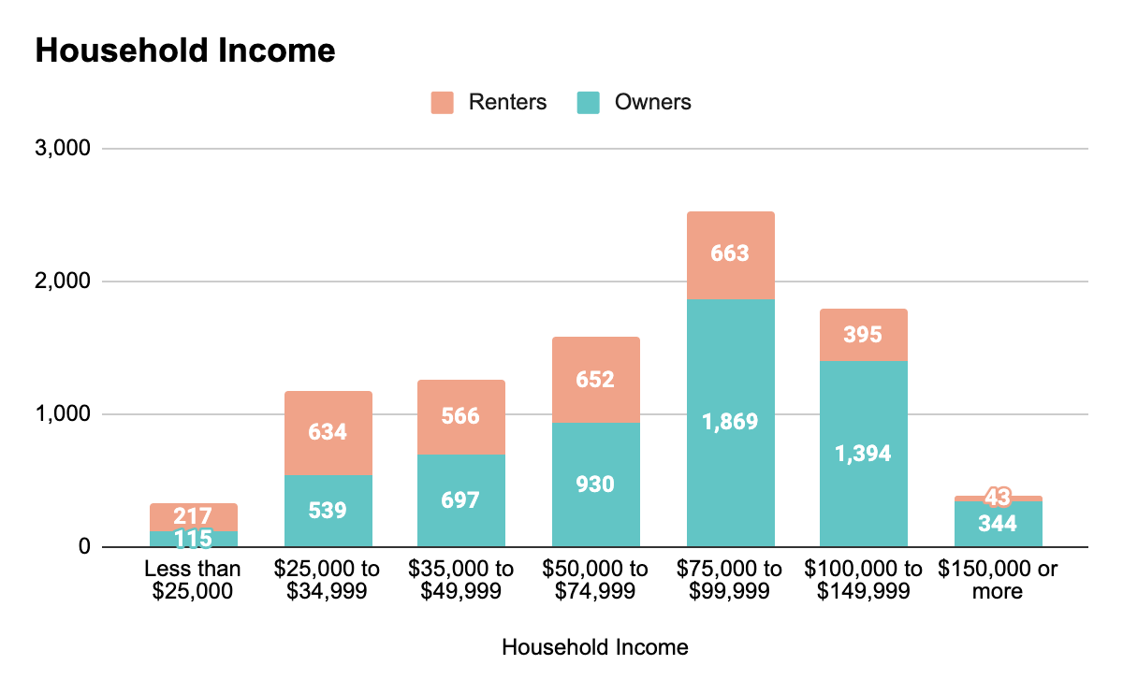
Income Levels of New Households
Household Income Levels
New households will generally make between $50,000 to $149,999, with many households earning between $75,000 to $99,999 per year.
Higher income households are more likely to be owners, while lower income households are more likely to rent.
Sources: Fourth Economy Analysis of Census Quarterly Workforce Indicators, 2021-2022, Rhode Island Department of Labor and Training Industry Projections
Notes:
Source: https://docs.google.com/spreadsheets/d/1C6_o1Nlf3UVXxFCTJ7A3EajEA9nlvhjgJJNW3IEzIjo/edit#gid=1232577068

Slide 48
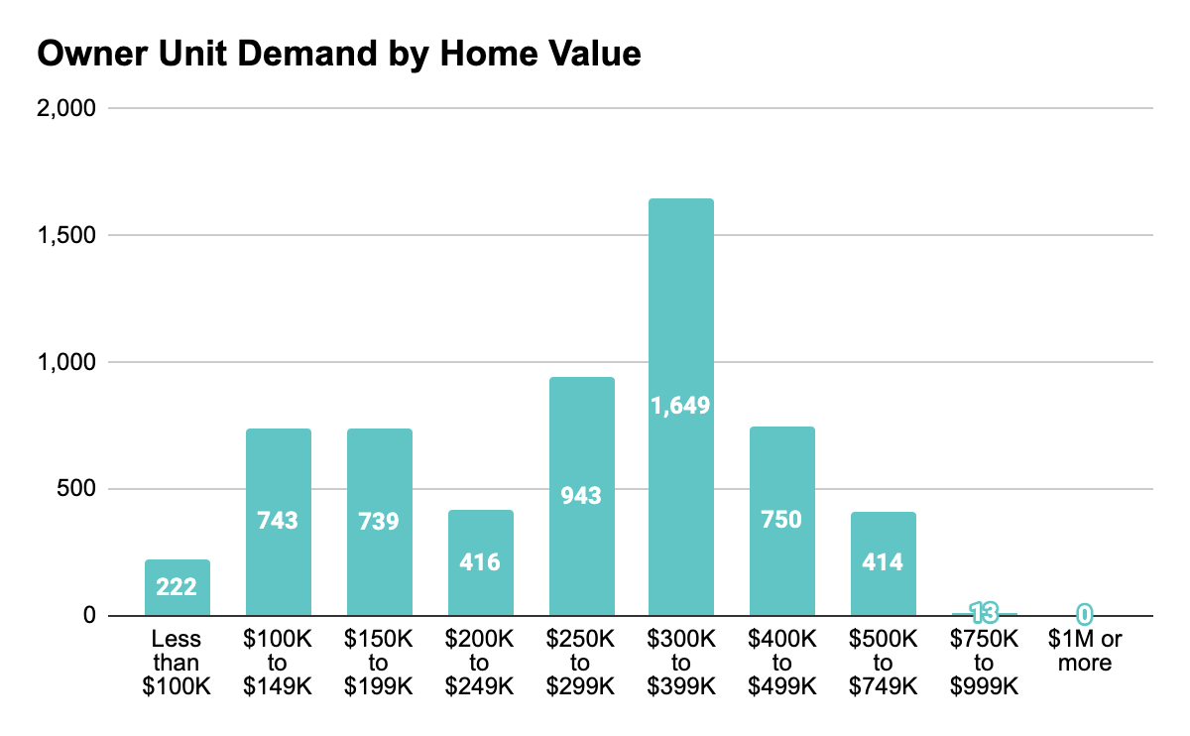
Home Unit Demand: 5,889 Owner Units
New Home Demand
New owner housing demand for the workforce is concentrated in homes priced below $400,000 – in stark contrast to the current availability of owner housing.
Sources: Fourth Economy Analysis of Census Quarterly Workforce Indicators, 2021-2022, Rhode Island Department of Labor and Training Industry Projections
Notes:
Source: https://docs.google.com/spreadsheets/d/1C6_o1Nlf3UVXxFCTJ7A3EajEA9nlvhjgJJNW3IEzIjo/edit#gid=1232577068

Slide 49
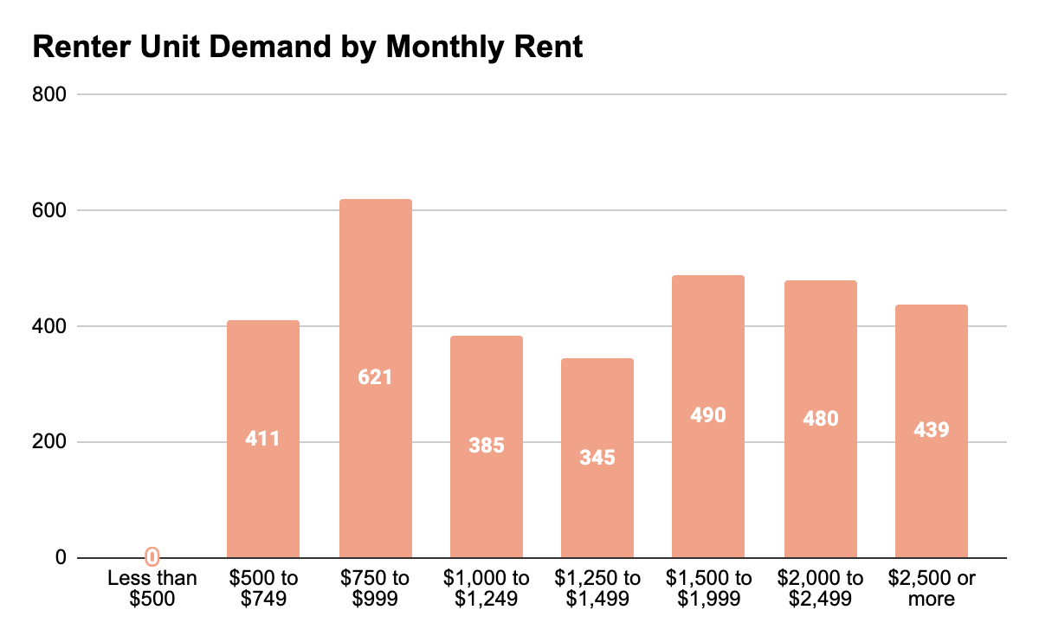
Rental Unit Demand: 3,171 Renter Units
New Rental Unit Demand
New rental unit demand is more evenly distributed, with demand at unit prices throughout the spectrum. A large concentration of rental demand is for units priced below $1,249 per month.
Sources: Fourth Economy Analysis of Census Quarterly Workforce Indicators, 2021-2022, Rhode Island Department of Labor and Training Industry Projections

Slide 50





Personas of the Future Workforce
Linking Occupations, Wages, and Housing Affordability
How do household income and housing affordability align?
Angela
28
Hair Stylist / Part-time Server
Alex / Jamie
36 / 32
Bartender / Software Engineer
Jim / Nancy
67 / 64
Retired “Empty Nesters”
Felix
46
Human Resources Consultant
Mateo / Susan
46
Structural Engineer / College Professor
<$50k
~$100k
>$150k
Annual Household Income
Notes:
Noun Project Jobs and Occupations by WiStudio
https://thenounproject.com/browse/collection-icon/jobs-and-occupations-71704/?p=1

Slide 51

Angela
Angela works at a salon in Middletown. She obtained an undergraduate degree from the University of Rhode Island, but decided to attend beauty school shortly thereafter. Angela has monthly student loan debt and, because she does not receive health insurance from her employer, pays out-of-pocket for health insurance. Angela works a few nights per week as a server at a local restaurant to make ends meet and save towards opening her own business. Homeownership feels like an unattainable goal for her and she assumes she’ll always be renting.
Impact on Greater Newport:
Lost sales tax revenue from the lack of workers living in the area
Loss of active residents of the local community
May move from the region over time to seek more stable housing
Causes churn for employers and limits their business growth
Housing opportunities in Greater Newport: 52 homes for sale per year on average within their price-point of under $174,000 (2.7% of homes).
Angela will likely: rent for several years and most likely be cost burdened due to the lack of rental units. She will do this until she decides that she wants to place roots down in a community. At that point she will most likely need to move out of the region.
Age: 28
Occupation: Hair Stylist, Part-time Server
Annual Household Income: <$50k
Notes:
Noun Project Jobs and Occupations by WiStudio
https://thenounproject.com/browse/collection-icon/jobs-and-occupations-71704/?p=1
Housing Affordability Assumptions
Affordability for owners and renters
3.6
- The rule of thumb is that the cost of your house should equal roughly 2.6 years of income. Source: Bloomberg City Lab
- In 2010, the nationwide price-to-income ratio was 3.6. Source: Clever, Decennial Census data
0.025
- Renter affordability assumption is that renters face cost burden when they spend more that 30% of their income on housing.
- Monthly rent affordability = Annual Income * 0.3 / 12 months = 0.025

Slide 52

Alex and Jamie
Alex and Jamie are a young married couple who dream of starting a family. Jamie works as a bartender at an upscale restaurant in Newport where he makes decent money in tips, especially during the tourist season. Alex recently started as a Software Coder at a tech firm in Barrington and commutes to the office two days during the week. Both love the community they’ve developed in Newport - but are having difficulty finding a home they can afford, even with help from Jamie’s parents.
Impact on Greater Newport:
Lost sales tax revenue from the lack of year-round workers living in the area
Less potential students for Greater Newport schools
Loss of potential active residents of the local community
May potentially try to get jobs closer to home
May potentially leave RI in general for more affordable, efficient live/work environment
Housing opportunities in Newport: 425 homes for sale on average each year within their price-point of $174k to $347k (20% of homes). This makes it difficult for them to find a place to the significant demand.
Chris and Jamie will likely: Move away after a few years to a community in Massachusetts that is seeing more development and lower cost housing.
Age: 36 / 32
Occupation: Bartender (Alex), Software Engineer (Jamie)
Annual Household Income:
$98k
Notes:
Noun Project Jobs and Occupations by WiStudio
https://thenounproject.com/browse/collection-icon/jobs-and-occupations-71704/?p=1

Slide 53

Felix
Felix rents a townhome in Providence, but has been looking to buy a home and has been considering properties in the Bristol/Newport area. He loves the slower pace and walkability of Bristol, but knows his dollar will go further in Fall River or Bedford, and likes that those areas are within an easy commuting distance to his job in Middletown,.
Impact on Greater Newport:
Lost sales tax revenue from the lack of year-round workers living in the area
Loss of potential active residents of the local community
May potentially try to get jobs closer to home
May potentially leave RI in general for more affordable, efficient live/work environment
Limits businesses ability to grow due to churn of labor force
Housing opportunities in Greater Newport: 713 homes for sale on average each year within their price-point of $347k to $521k (33% of homes).
Felix will likely:
Get frustrated with the long commutes and cost of doing so.
Look for opportunities outside the Greater Newport region that have for similar amenities but with lower housing costs.
Age: 46
Occupation: Human Resources Consultant
Annual Household Income:
$125k
Notes:
Noun Project Jobs and Occupations by WiStudio
https://thenounproject.com/browse/collection-icon/jobs-and-occupations-71704/?p=1

Slide 54

Mateo and Susan
Mateo works as a structural engineer at a firm in Kingston. Susan is a professor in the School for Marine Science and Technology at UMass Dartmouth. Susan and Mateo live in Warren as it’s a central location for both of their work and they like the restaurants and amenities Warren has to offer. Since the pandemic both Susan and Mateo have been working from home more often and could use more space.
Impact on Greater Newport:
Limits the income diversity in the community
Lack of lower cost housing limits front line services and education’s ability to retain workers
Will make selling their existing and finding a new home more difficult
Ability for these households to giver more back to the community through donations/ volunteering
Housing opportunities in Greater Newport: 1,155 homes for sale on average each year within their price-point of $521k+ (65% of homes). This is the household income, represents 23% of households and the level at which people will most be able to afford living and working in Greater Newport. .
Mateo and Susan will likely:
Remain in Greater Newport and try to increase their space through another purchase.
Age: 41 / 42
Occupation: Structural Engineer (Mateo), College Professor (Susan)
Annual Household Income: $175k+
Notes:
Noun Project Jobs and Occupations by WiStudio
https://thenounproject.com/browse/collection-icon/jobs-and-occupations-71704/?p=1

Slide 55

Jim and Nancy
Jim and Nancy have lived in Portsmouth for thirty-five years and raised three children with the last one just settled in their first home in Denver. Jim retired two years ago from his independent construction business two days after Nancy retired from her Nurses Aide position at the Hospital. They thought they planned well for retirement but inflation and the ups and downs of their investment portfolio have them worried. They would love to sell their 3-bedroom home and stay in the area but there are few options for senior active lifestyle housing.
Impact on Greater Newport:
Loss of community character
Fewer volunteers and charitable giving
Struggling households that defer maintenance
Increase in short-term rentals (legal and otherwise)
Inability for individuals to age in place and contribute
Housing opportunities in Greater Newport: 497 units sold per year on average within their price-point of below $347K.
Jim and Nancy will likely: Either stay in their home as long as they can because there are few options to sell and move into an smaller place. They may also start renting their home for short-term rentals as they stay with their oldest daughter during the summer. They are unsure about what’s next.
Age: 67 / 64
Occupation: Both retired
Annual Household Income: ~$75k
Notes:
Noun Project Jobs and Occupations by WiStudio
https://thenounproject.com/browse/collection-icon/jobs-and-occupations-71704/?p=1
Source for retirement data: https://docs.google.com/spreadsheets/d/1LhrRtyOtBY0r3CC2Wi04jd448C9P4UJ_mss8_WXdTRc/edit#gid=0

Slide 56

Personas of the Future Workforce
Linking Occupations, Wages, and Housing Affordability
How do household income and housing affordability align?
Household Income | Less than $50K | $50K to $100K | $100K to $150K | $150K or more
Home Affordability | Less than $174K | $174K to $347K | $347K to $521K | $521K or more
Rent Affordability | Less than $1,250 | Less than $2,500 | Less than $3,750 | $3,750 or more
Current HH Composition | 30% | 27% | 19% | 23%
Future HH Composition | 30% | 30% | 19% | 21%
Household Income: Census ACS, 2020, 5-year estimates
Home Affordability: HousingWorksRI, Housing Fact Book, 2017-2021
Notes:
Noun Project Jobs and Occupations by WiStudio
https://thenounproject.com/browse/collection-icon/jobs-and-occupations-71704/?p=1

Slide 57
Personas of the Future Workforce
Linking Occupations, Wages, and Housing Affordability
How do household income and housing affordability align?
 | Household 1 | Household 2 | Household 3 | Household 4
HH Income | Less than $50K | $50K to $100K | $100K to $150K | $150K or more
Ownership Threshold | <$174k | $174k - $347k | $347k - $521k | >$521k
% of Potential Units* | 23% | 48% | 24% | 6%
Rental Threshold | <$1,250 | <$2,500 | <$3,750 | >$3,750
% of Potential Units* | 45% | 41% | 12% | 1%
Household Income: Census ACS, 2020, 5-year estimates
Home Affordability: HousingWorksRI, Housing Fact Book, 2017-2021
*% of Potential Units – The percent of future units that would need to target this income bracket with their pricing.
Notes:
Source:
https://docs.google.com/spreadsheets/d/1x7If-piNmxkB6OsJPc20dEJYrkZZLuKQjaXbVhm6W2M/edit#gid=1101541874
Noun Project Jobs and Occupations by WiStudio
https://thenounproject.com/browse/collection-icon/jobs-and-occupations-71704/?p=1

Slide 58
Sample two-earner households
these workers are neighbors and colleagues!
 | Household 1 | Household 2 | Household 3 | Household 4
Worker 1 | Food Prep (entry wage) | Healthcare Support | Business and Finance | Management
Earnings | $24,050 | $36,590 | $79,330 | $125,690
Worker 2 | Personal Care (entry wage) | Office and Admin | Construction | Life Science
Earnings | $24,340 | $46,370 | $59,610 | $80,060
Total HH Income | $48,390 | $82,960 | $138,940 | $205,750
Ownership Threshold | <$174k | $174k - $347k | $347k - $521k | >$521k
% of Potential Units* | 23% | 48% | 24% | 6%
Rental Threshold | <$1,250 | <$2,500 | <$3,750 | >$3,750
% of Potential Units* | 45% | 41% | 12% | 1%
Occupation Data: BLS, May 2021 State Occupational Employment and Wage Estimates, Rhode Island
Notes:
Noun Project Jobs and Occupations by WiStudio
https://thenounproject.com/browse/collection-icon/jobs-and-occupations-71704/?p=1

Slide 59
If Housing Development Does Not Match Workforce Growth…
1
Greater Newport will lack a core cluster of essential workers able to live and work in the community.
Essential workers, such as teachers, electricians, and healthcare workers, will be priced out of the local housing market, forced to find housing outside of the Greater Newport Region. This trend will negatively impact population growth and regional density.
2
Workers may choose jobs that do not require making the long commute to Greater Newport.
Those who cannot afford to live in the region may seek new employment opportunities that do not require long commutes for equal pay, according to national workforce trends. This transition may take workers to other Rhode Island communities or elsewhere in the country.
3
Anchor institutions, such as education and medical centers, will miss out on critical revenue.
Entities that rely on a concentrated population for success, such as schools and hospitals, will miss out on key potential customers. This revenue loss will weaken key community institutions and the broader quality of life of Greater Newport
residents.

Slide 60
Recommendations

Slide 61
Recommendations for the Greater Newport Region
The CGN Region needs over 9,000 new units over the next decade to support the replacement of existing workforce and employment growth of organizations in the region.
Action: Create a workforce housing program that provide financial support for the construction of new housing targeted to sector of most significant need - healthcare and social assistance, educational services manufacturing and accommodation. Housing prices below $350k and rents below $3,000 should be prioritized. Model after RI Housing’s Workforce Housing Innovation Challenge.
Action: Support the development of smaller footprint and bedroom units to match population demographic trends of smaller households.
Action: Explore the feasibility of a regional or community-specific land trust that allows for the preservation of workforce housing.

Slide 62
Recommendations for the Greater Newport Region
Recognize the aging population of the region and address the desires for retirees to remain in the region while allowing some to downsize affordably.
Action: Support the development (zoning, financial support) of senior housing that meets a range of lifestyles and needs and allows retirees to downsize in an affordable way.
Action: Evaluate the impacts that the homestead exemption is having on housing access in the region. Consideration should be given to alternative models for supporting residents aging in place.
Action: Ensure there is broad awareness of the ability for RI residents to create accessible dwelling units (ADUs) on their property which are permitted by right.

Slide 63
Recommendations for the Greater Newport Region
Develop a strategy for supporting infrastructure required to limit the loss of working age population, while recognizing the need for increased commuting.
Action: Engage with municipalities, developers, and agencies to plan for housing development alongside other infrastructure improvements such as improved transportation resources, road or sidewalk improvements, broadband, water, and sewer expansions
Action: Create a program that requires housing investment offsets for any development that will create employment (see Telluride program)

Slide 64
Recommendations for the Greater Newport Region
Protect farm and forest land while increasing density in neighborhoods seeking development growth.
Action: Pursue a Transfer of Development Rights (TDR) program, a smart growth technique that allows legal manipulation of zoning to protect some parcels while permitting the development of others (Exeter and North Kingstown are currently authorized to use TDR)
Action: Establish Conservation Development zoning ordinances to ensure that development on green fields can preserve most of the open space within the development parcel (See Charlestown, RI as a model)

Slide 65
Recommendations for the Greater Newport Region
Increase multifamily housing development to help meet housing demand.
Action: Allow multifamily development by right in areas zoned commercial to facilitate conversion of the growing amount of vacant office and retail space into housing.
Action: Revisit provisions of local zoning ordinances that may pose unnecessary barriers to robust mixed use multifamily housing development, especially provisions that require more off street parking than may be necessary and unreasonably restrict building height, building uses and building density in built up neighborhoods
Action: Assess the benefits of adopting a version of Woonsocket’s zoning overlay district for its Downtown District, which has seen several new multifamily housing developments in part due to increased density allowed by the zoning reform becoming economically feasible
Action: Assess whether enhanced state funded infrastructure investment, e.g., water sewer, etc., through the State’s Municipal Infrastructure Grant Program would make it easier to complete significant multi family housing developments in neighborhoods where such development is a good fit

Slide 66
Recommendations for the Greater Newport Region
Prioritize affordable and equitable housing development and redevelopment at the local level.
Action: Seek out best practice information about Community Benefit Agreements to facilitate equitable development and redevelopment plans for the North End of Newport
Action: Use Rhode Island’s new Accessory Dwelling Unit law as a means of increasing the supply of affordable market rate housing
Action: Identify and seek to access existing sources of State technical assistance for local development efforts, including the municipal technical assistance authorized in the State’s Housing Incentives for Municipalities program
Action: Apply for a Super TIF district designation, a specific development district to budget a portion of the anticipated increases in State income and sales tax revenue as well as local property tax revenue towards physical improvements to enhance the district’s level and quality of development, including multifamily housing development

Slide 67
Recommendations for the Greater Newport Region
Maximize the feasibility of rehab and infill housing development, transit oriented development, and development on revitalized land to encourage increased housing units.
Action: Explore the availability of the State Historic Tax Credit (administered by the RI Division of Taxation and the RI Historic Preservation and Heritage Commission) and the Rebuild RI Tax Credit (administered by Commerce RI) to elevate the feasibility of potential rehab and infill housing
Action: Advocate for passage of Speaker Shekarchi ‘s Transit Oriented Development proposal and take advantage of its provisions for housing development incentives near transit stops and corridors
Action: Pursue State Brownfield cleanup funds (administered by the Rhode Island Department of Environmental Management) for any desirable development parcel that can only be redeveloped if thoroughly remediated

Slide 68
Promising Practices

Slide 69
Models: Housing Trust Fund
Regional leaders can establish an affordable housing trust fund that promotes preservation, construction, acquisition, loans, and operational support for affordable housing.
Housing trust funds can be supported through locally generated revenues such as increased fees on mortgage and deed recordings, property taxes, transfer taxes, TIF diversions, and linkage fees, as well as additional state and federal funding to support investments in affordable housing

Slide 70
Models: Land Trust
A community land trust is a nonprofit that purchases, manages, and retains land and/or property in trust on behalf of the community in order to maintain affordability of owner-occupied homes.
In Pennsylvania, the State College Community Land Trust has been promoting affordable home ownership for 25+ years. SCCLT buys and rehabilitates housing for code compliance and energy efficiency. It then sells to applicants meeting federal income guidelines and leases the land to the homeowner in a long-term agreement that saves the homeowner 30% in costs. Homeowners can sell the house in the future to other qualified buyers or back to SCCLT based on a resale formula that maintains affordability while allowing homeowners to build equity.
Community land trusts can be supported through grant funding, philanthropic contributions, and governmental sources.

Slide 71
Models: Deed Restrictions
Breckenridge (CO): Housing Helps program incentivizes homeowners and real estate investors to deed-restrict their property to help maintain and sustain affordable homes. The program provides funds to local homeowners and apartment developers to permanently deed-restrict their homes or units, incorporating workforce requirements and income caps. Under Housing Helps the Town will pay owners, buyers, sellers, businesses, and investors 15-30% to accept a deed restriction on homes that are currently unrestricted. The amount that will be paid for a deed restriction will vary depending on the market and how well the home meets current needs in the community. Recipients may use the funds for down payment, home repairs, special assessments, or any other purpose. In return, the recipients are required to execute a deed restriction that will insure the property is used for local housing.
Lease to Locals program, a partnership between the town and a private organization called Landing Locals, provides cash incentives to property managers and property owners to convert their short-term rentals into seasonal and long-term rentals. The cash incentives can range up to $20,000 per property depending on unit size and the length of the lease.

Slide 72
Models: Tie Housing Development to Job Growth
Telluride (CO): Housing Mitigation Program - The objective of the Town’s Housing Mitigation Program is to create housing for at least 40 percent of the new employees generated by new development in the Town. In exchange for complying with workforce housing requirements (see below), developers receive a density bonus, generally up to an increase of five thousand (5,000) cubic feet of above-grade density for each designated employee housing unit. Therefore, while the program is technically a mandatory program, there is a density exchange built into the policy. A formula define how many units must be created.
Developers can meet the requirement via:
Construction of units on-site, • Construction of units elsewhere within the Town (or Region as defined by the Telluride Master Plan), • Deed restricting existing market units within the Town, • Fee in lieu, or • Conveyance of land to the Town. (Typically the land conveyance happens as part of an annexation. The Town makes the land available through an RFP process to a developer to build workforce housing.)

Slide 73
Thank you.
Contact: Rich.Overmoyer@fourtheconomy.com or 412-251-1607

