Slide 1
Market & Competitor
Analysis & Tools

Slide 2
Our Panelists
Cindy Huang – Gemini Trust Company, Senior Corporate Counsel, Intellectual Property
Pete Mattei – Tenneco, Associate General Counsel – Innovation & Technology
Moderator: Stacy Fredrich – Rheem Manufacturing Co., Director, Global Intellectual Property

Slide 3
What do you want to achieve?
Purpose, scope, resources
Industry trends
Oppose third party patents
Type of information
Individual patents
Technology trends
Non-patent/business
Nature of results
Audience
Format
Freedom-to-operate
Potential tools

Slide 4
Competitor & Market Monitoring – Types
Patent Searching
Automated Patent Watches
Technical Publication Monitoring
Landscape & Whitespace Searching
Trend Analysis for Companies/Industries
Customized Patent Search Models/Tools
Non-patent information (e.g., business market information, Google alerts, newspaper)
Valuation Services

Slide 5
Dimensions of the Resources
Do It Yourself vs. Do It For Me
Manual vs. Automated
One-Off vs. Periodic Monitoring

Slide 6
Examples
Tool | DIY | Do It For Me | Manual | Automated | One-off | Periodic
Concur IP |  | X | X | X | X
IAMIP | X |  | X | X |  | X
PatentSight | X |  |  | X | X
Evalueserve |  | X | X |  | X

Slide 7
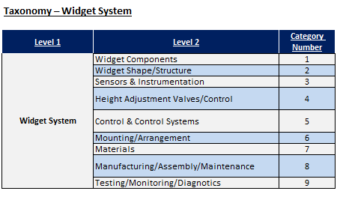
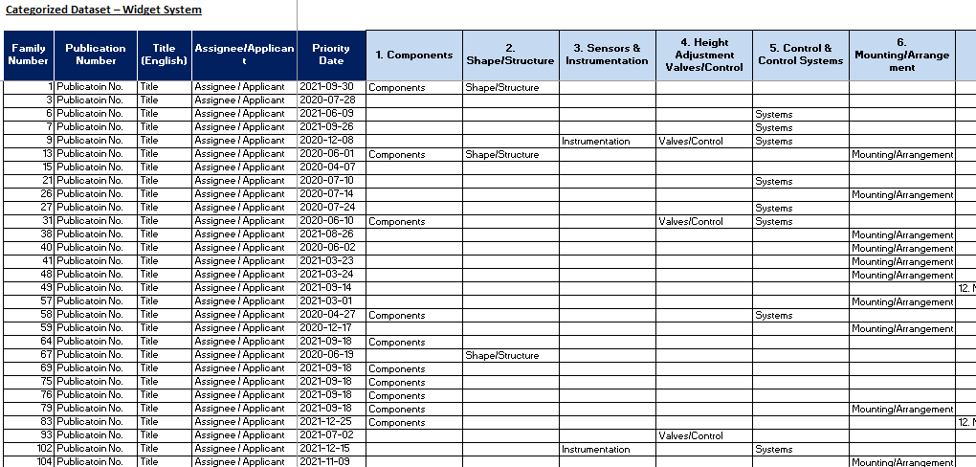
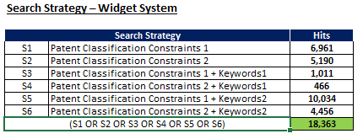
Concur IP (Do It For Me / Hybrid / One-Off)

Slide 8
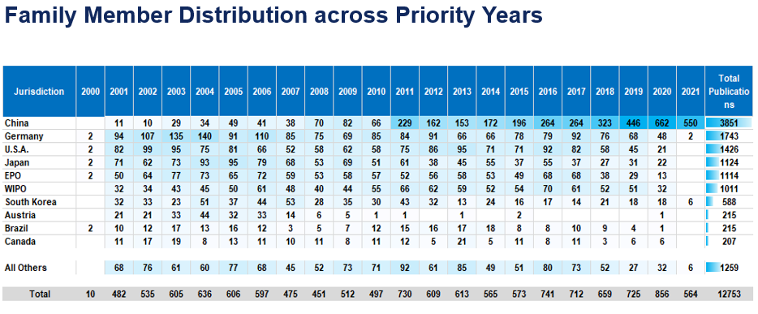
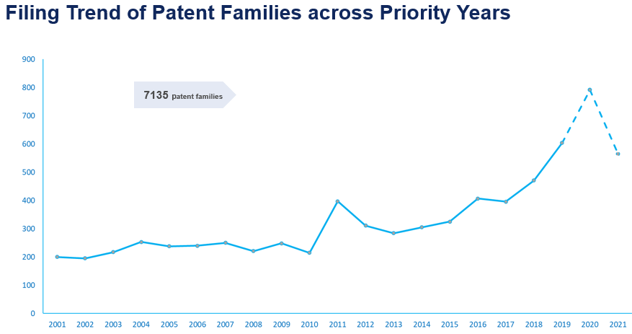
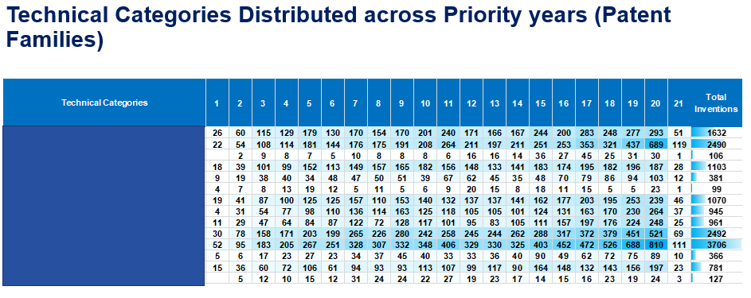
Notes:
(4) Analyze Data & Produce Visuals
Stacy: What’s the utility of this? What are your use cases?
Pete: this is a tool to tell a story, what is the narrative you want to tell?

Slide 9
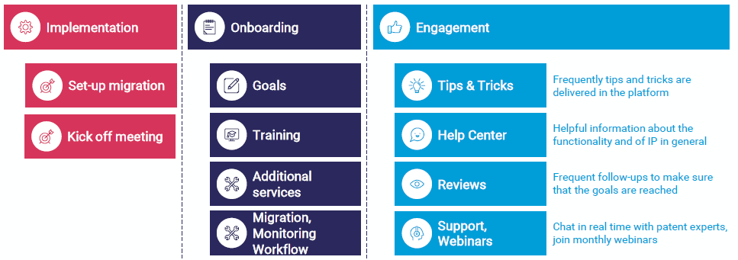
IAMIP (DIY / Hybrid / Periodic)

Slide 10
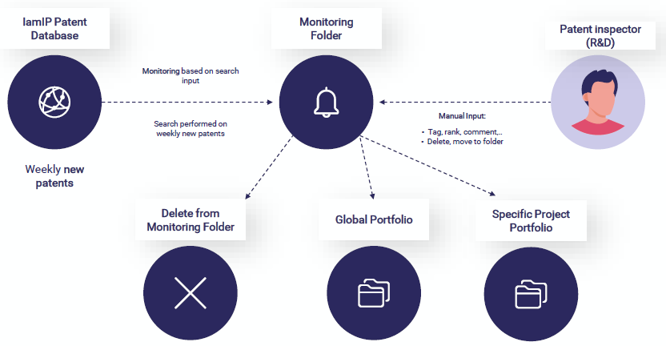

Slide 11
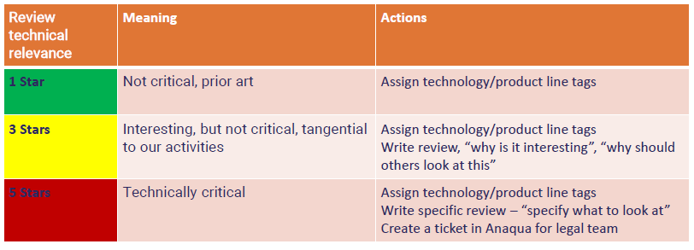

Slide 12
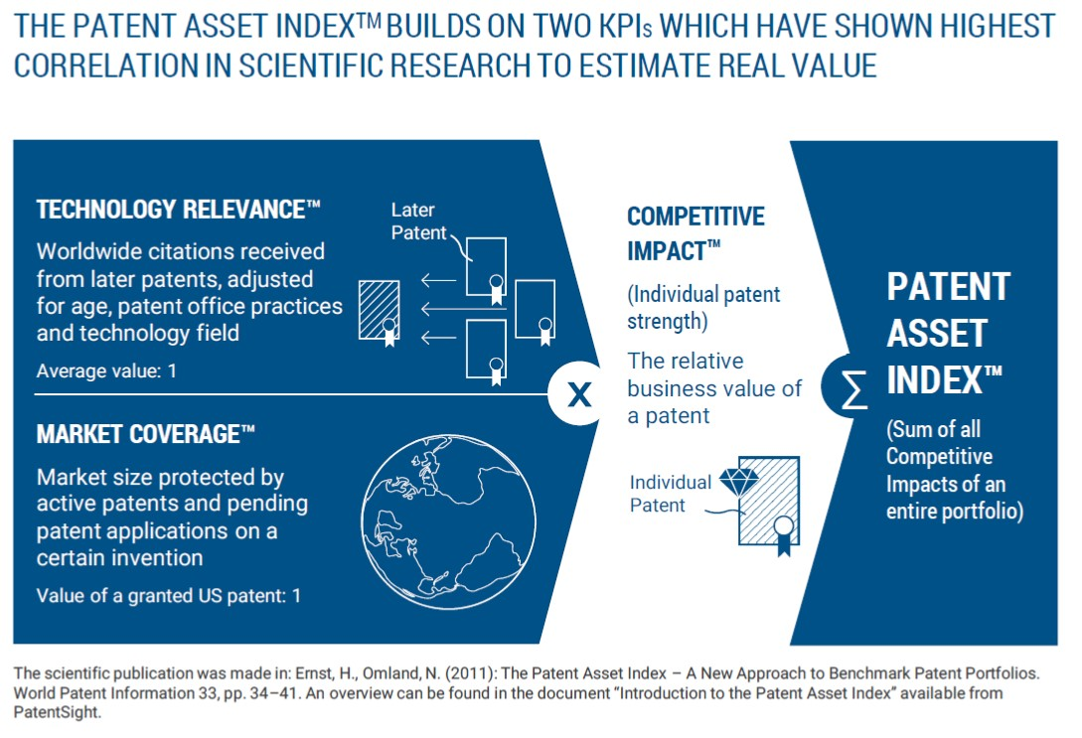
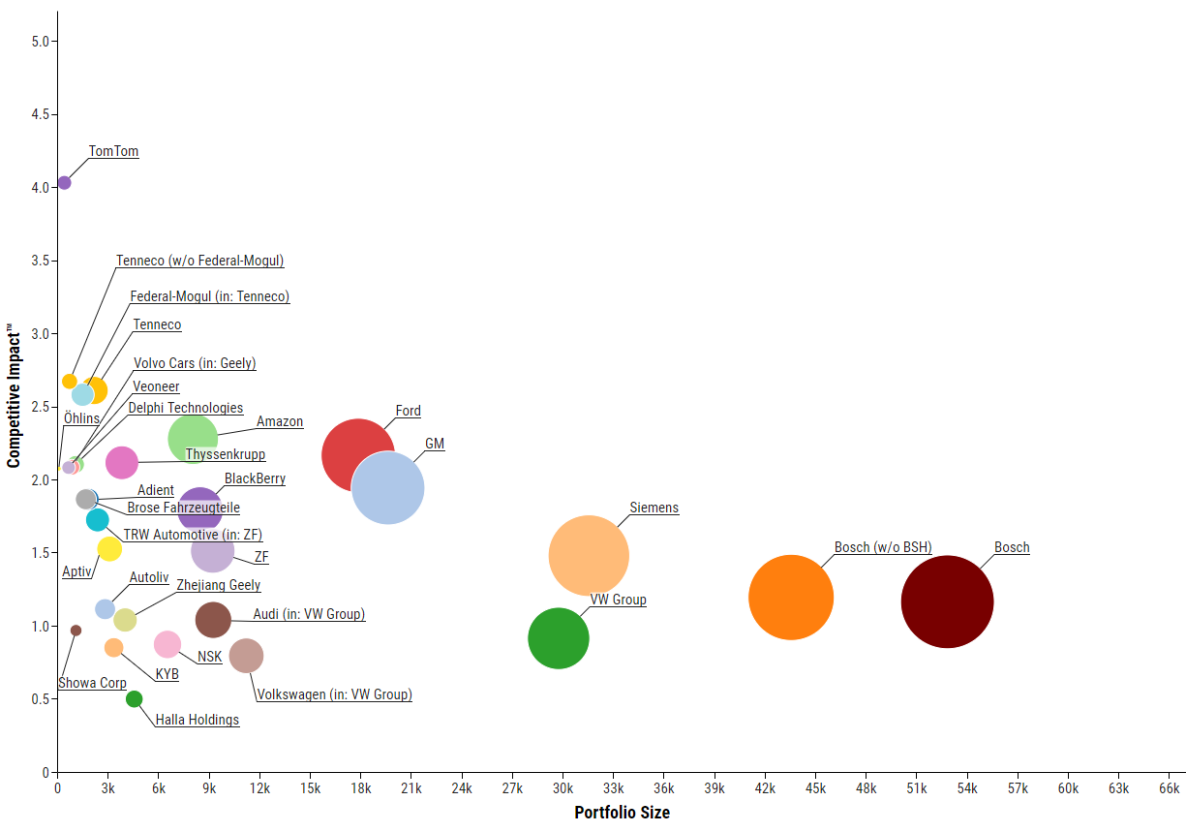
PatentSight (DIY / Automated / One-Off)
Grouped by: Owner / Bubble Area: Patent Asset IndexTM

Slide 13
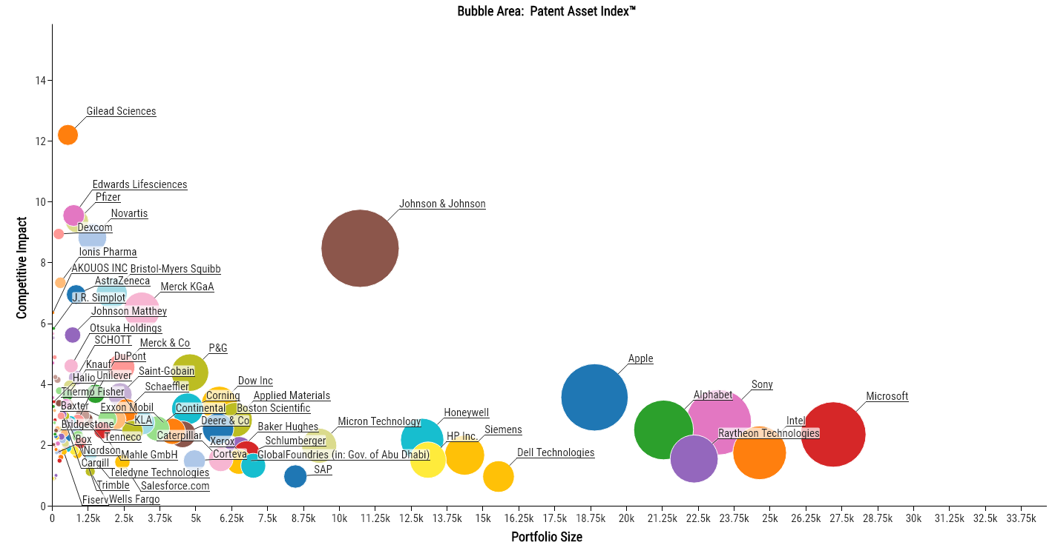

Slide 15
Evalueserve (Do It For Me / Manual / One-off)

Slide 16
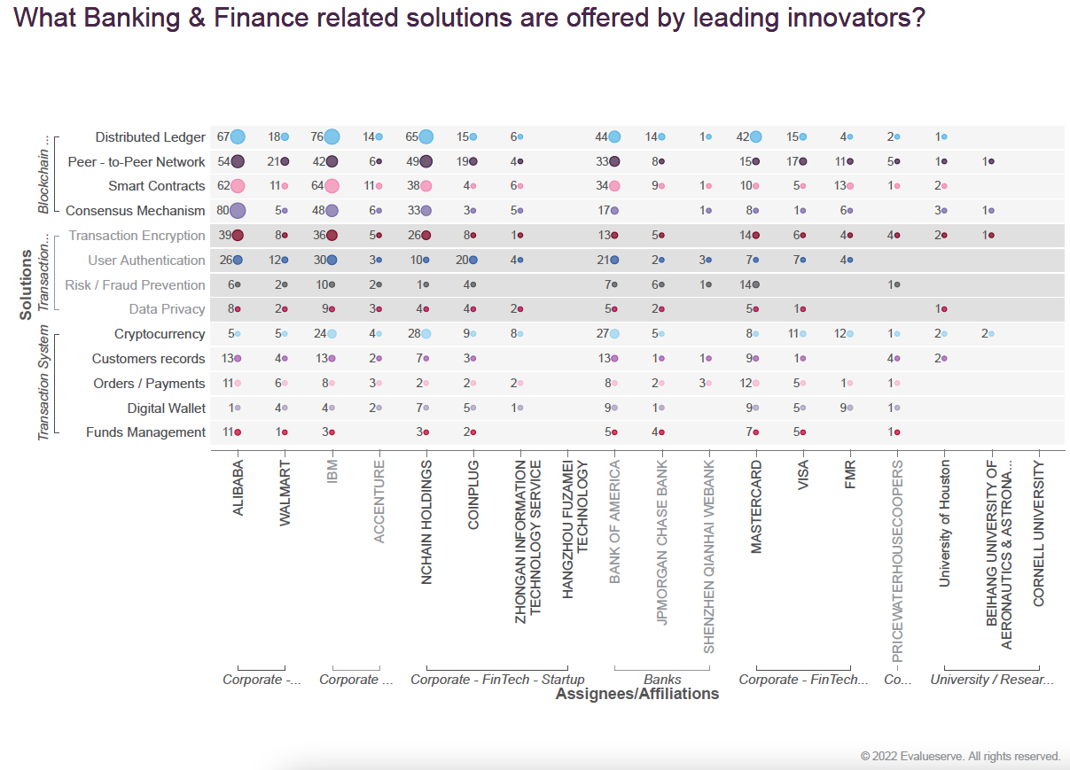

Slide 18
Limitations of Monitoring
Making effective use of the data
Patent data as a lagging indicator
Patent-only searching provides an incomplete view into a company’s activities
Aggregation of patent owner data
Identification of competitors as an input – who to include/exclude
Geographic limitations – competitors who file priority applications abroad
Limited bandwidth – how to prioritize searches
Balance of specificity v. volume
Scalability
Variable use of language
Layering of technologies

Slide 19
Audience Poll
Poll Question 1: Does your company use AI/ML tools for competitive IP analysis?
Poll Question 2: What tools or vendors have you found valuable for competitive analysis?
Live Question: Are there any types of monitoring, analysis or tools that we haven’t discussed that you have found effective? What are their benefits and limitations?

Slide 20
Poll Question #2 Results (as of Monday)
PatSnap
Innography
Orbit
Crayon
Lexis TotalPatent One
Global Technology Transfer
GooglePatents

Slide 21
Presenting Information to the Business
Mechanisms to consider:
Regular reporting & dashboards
Review patents with technical team
Industry trends and competitor information to leadership

Slide 22
Willfulness Concerns
See case law update handout on Willfulness and Willful Blindness
Practical considerations:
Industry risk profile
Human nature and accessibility of information
Business relationship with IP counsel

Slide 23
Questions

Slide 24
Appendix

Slide 25
Heat Map (DIY / Manual / Periodic)

Slide 27
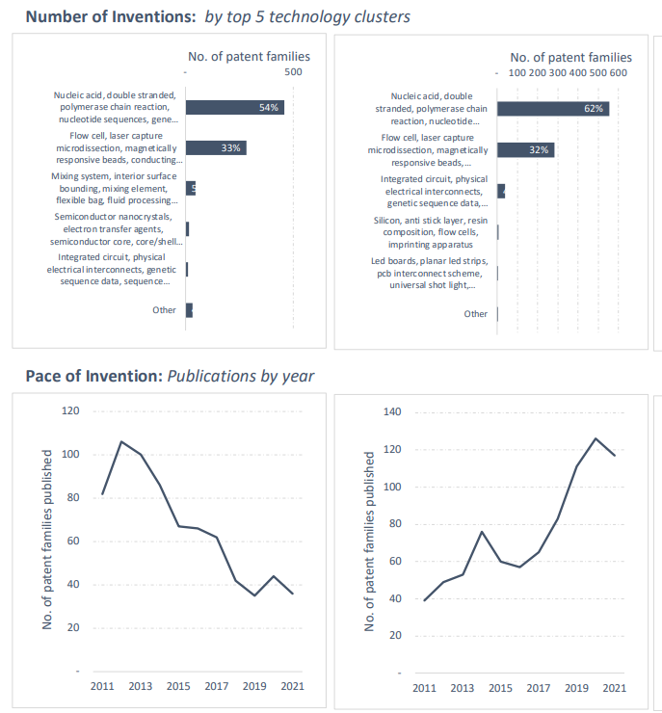
Cipher (Do It For Me or Hybrid / Hybrid / One-Off)

Slide 28
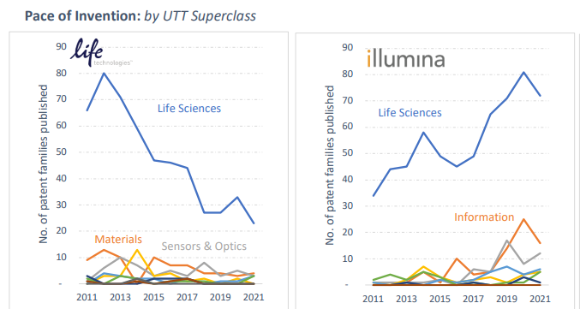
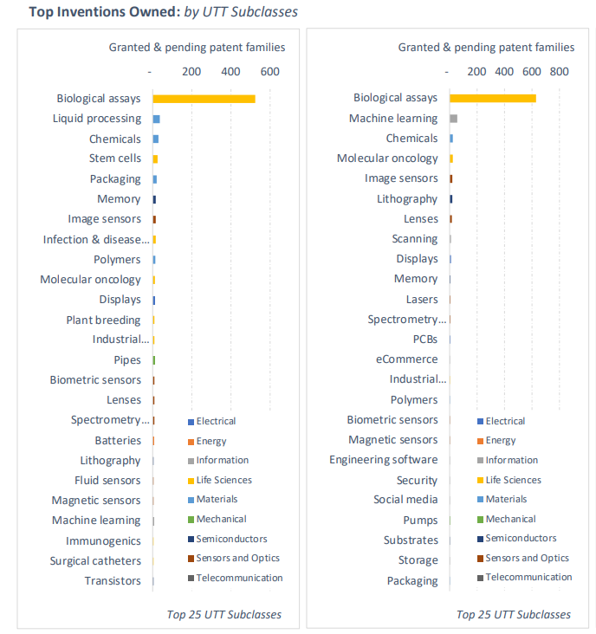

Slide 29
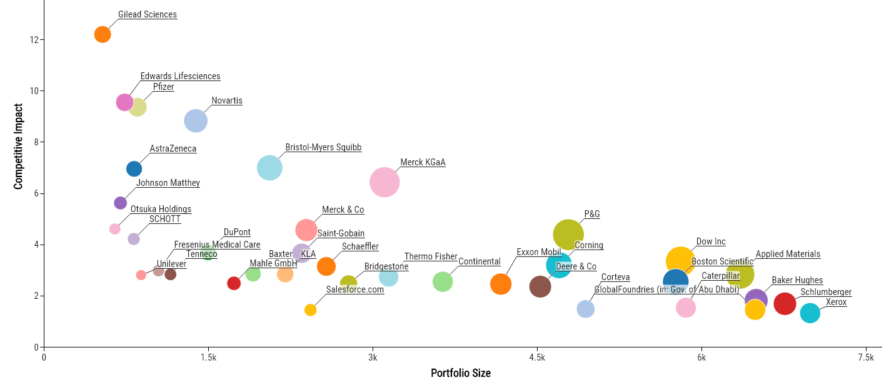
PatentSight (detail)

Slide 30
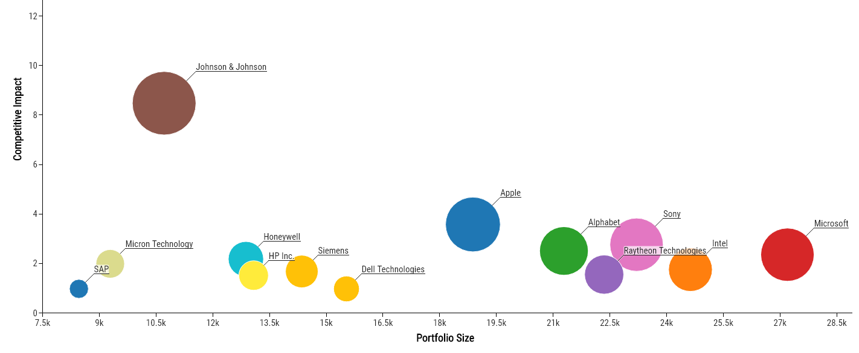
PatentSight (detail)

Slide 31
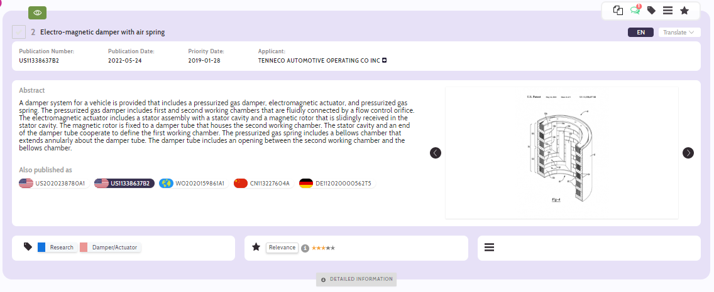
IAMIP (detail)

Slide 32
Evalueserve – Sample Report

Slide 34
