Slide 1

Update on Recent and Future Developments in the PCT System, and WIPO’s future plans
June 2022
ACPC Summer Meeting
Notes:
This presentation will explain briefly -
Who we are
What we do
How we do it

Slide 2
WIPO’s future plans

Slide 3

The Future of WIPO (1)
Vision
  A world where innovation and creativity from anywhere are supported by intellectual property, for the good of everyone
Mission
  lead the development of a balanced and effective global intellectual property ecosystem to promote innovation and creativity for a better and more sustainable future
New 5-year Medium Term Strategic Plan developed in 2021
  https://www.wipo.int/edocs/mdocs/govbody/en/wo_pbc_32/wo_pbc_32_3.pdf

Slide 4
The Future of WIPO (2)
What’s the Future
  Bring international community together to proactively address emerging issues and policy challenges relating to IP, innovation and creativity.
  Pursue international dialogue and co-operation on building respect for IP.
  Build effective interactions and partnerships with the UN, IGOs and NGOs in support of global goals to which IP can contribute.
What’s New
  New communications strategy – to deliver content in more dynamic, creative and exciting ways (inspiring IP stories, greater use of data analytics, leveraging Social Media)
  Engage with new users in all regions
    SMEs, Youth and Women
    Bring value and impact – use of IP as a powerful tool for economic growth, job creation, commercialization, financing and valuation
Notes:
Staff has been empowered to engage and communicate with our stakeholders. WIPO is providing staff with the requisite media and communications training to allow them to engage effectively.

Slide 5
The Future of WIPO (3)
What’s New (cont.)
  Engage with MS, IPOs and other governmental organizations
    Assist in developing national IP laws, regulations and administrative rules
    Regional and sub-regional approach (communities, enterprises and individuals)
    Build in-country IP skills and knowledge
      Greater use of WIPO Academy (education, coaching, mentoring, on-the-job training)
      Targeting entrepreneurs, enterprises including SMEs, universities and research institutions
  Train and empower staff – foundation of the organization
  Lead world-wide on IP and Gender issues
    Promote and encourage female engagement in IP
    Identify and create IP programs through education, research, capacity building
    Promote gender perspective in IP legislation, policy and programs
Notes:
Staff has been empowered to engage and communicate with our stakeholders. WIPO is providing staff with the requisite media and communications training to allow them to engage effectively.

Slide 6
The Future of WIPO (4)
Improve our services (PCT, Madrid, Hague, Lisbon, ADR)
  Strengthen customer service – transforming to applicant/client driven processes from application driven processes
  Enhance IT business solutions and quality management
    Digitalization of WIPO’s end-to-end business processes and new technologies
  Leverage MT and AI to increase quality and speed of translations
Continue multilateral work with norm setting and standards
  Administer 26 treaties, numerous non-binding international instruments and 54 technical standards
  Standing Committees and Work Groups
  Conversations (e.g., Trade Secrets, Standard Essential Patents and AI and other frontier technologies)
  Collaborate with UN Agencies, IGOs, specialist NGOs and experts
Notes:
Normative work - In recent years, collaboration on policy and substantive questions has become much more challenging. While there have been some successful outcomes, such as the Beijing and
Marrakesh treaties, WIPO’s normative agenda includes several negotiations that have been underway for a long time and in which outcomes remain elusive. Member States will be encouraged to develop flexible, dynamic and shorter-term outcomes that can be re-examined as circumstances and conditions change.

Slide 7
PCT status update

Slide 8
PCT Coverage Today

Slide 9
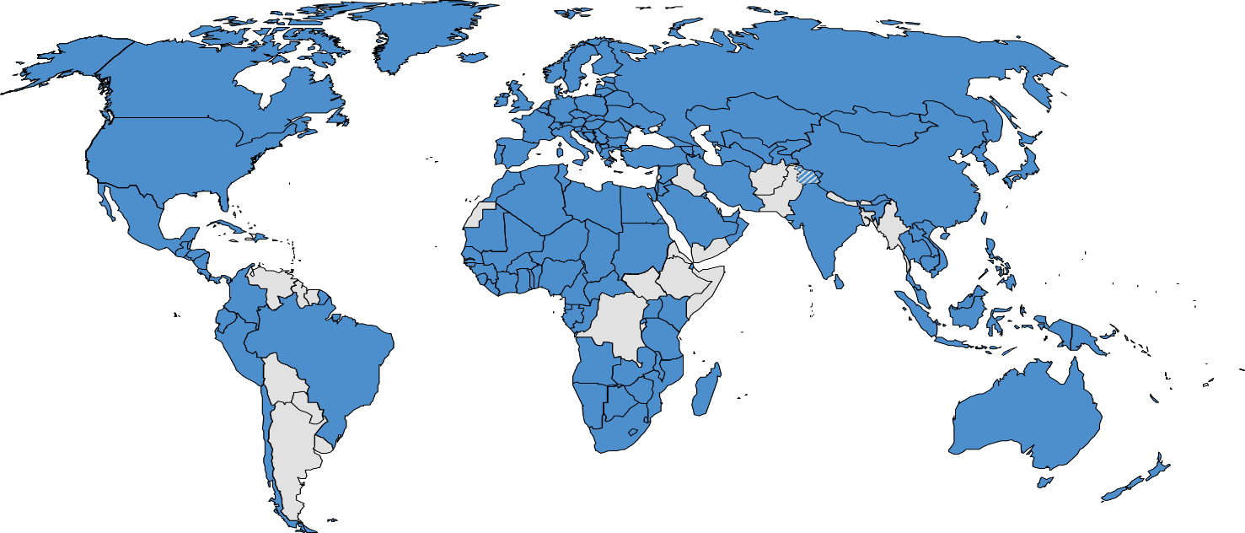
156 PCT States
=PCT
Albania
Algeria
Angola
Antigua and Barbuda
Armenia
Australia
Austria
Azerbaijan
Bahrain
Barbados
Belarus
Belgium
Belize
Benin
Bosnia and Herzegovina
Botswana
Brazil
Brunei Darussalam
Bulgaria
Burkina Faso
Cambodia
Cameroon
Canada
Cabo Verde (6 Jul 2022)
Central African Republic
Chad
Chile
China
Colombia
Comoros
Congo
Costa Rica
Côte d'Ivoire
Croatia
Cuba
Cyprus
Czech Republic
Democratic People's
Republic of Korea
Denmark
Djibouti
Dominica
Dominican Republic
Ecuador
Egypt
El Salvador
Equatorial Guinea
Estonia
Finland
France,
Gabon
Gambia
Georgia
Germany
Ghana
Greece
Grenada
Guatemala
Guinea
Malawi
Malaysia
Mali
Malta
Mauritania
Mexico
Monaco
Mongolia
Montenegro
Morocco
Mozambique
Namibia
Netherlands
New Zealand
Nicaragua
Niger
Nigeria
Norway
Oman
Panama
Papua New Guinea
Peru
Philippines
Guinea-Bissau
Honduras
Hungary
Iceland
India
Indonesia
Iran (Islamic Republic of)
Iraq (30 Apr 2022)
Ireland
Israel
Italy
Jamaica (10 Feb 2022)
Japan
Jordan
Kazakhstan
Kenya
Kuwait
Kyrgyzstan
Lao People’s Dem Rep.
Latvia
Lesotho
Liberia
Libya
Liechtenstein
Lithuania
Luxembourg
Madagascar
Poland
Portugal
Qatar
Republic of Korea
Republic of Moldova
Romania
Rwanda
Russian Federation
Saint Lucia
Saint Vincent and
the Grenadines
Samoa (2 Jan 2020)
San Marino
Sao Tomé e Principe
Saudi Arabia
Senegal
Serbia
Seychelles
Sierra Leone
Singapore
Slovakia
Slovenia
South Africa
Spain
Sri Lanka
Sudan
Swaziland
St. Kitts and Nevis
Sweden
Switzerland
Syrian Arab Republic
Tajikistan
Thailand
The former Yugoslav
Republic of Macedonia
Togo
Trinidad and Tobago
Tunisia
Turkey
Turkmenistan
Uganda
Ukraine
United Arab Emirates
United Kingdom
  United Republic of Tanzania
  United States of America
Uzbekistan
Viet Nam
Zambia
Zimbabwe
Notes:
When the PCT began accepting patent applications on June 1, 1978, there were 18 member countries. Since then, the number of member countries has steadily increased, and now 156 countries are members of the PCT, meaning that filing a patent application under the PCT system has the same effect as filing an application in 156 countries around the world. As for new member countries, Samoa joined the PCT the two years ago last,. This year, three countries joined the PCT: Jamaica (10 Feb.) in February, Iraq (30 Apr.) at the end of April, and Cape Verde will join the PCT in July (6 July).As you can see from this map, the PCT covers most of the countries in the world, including the United States, China, Southeast Asia, and Europe, which are the markets of Japanese

Slide 10
UN Member States not yet in PCT
Afghanistan
Andorra
Argentina
Bahamas
Bangladesh*
Bhutan
Bolivia
Burundi
Democratic Republic of Congo
Eritrea
Ethiopia
Fiji
Guyana
Haiti
Kiribati
Lebanon
Maldives
Marshall Islands
Mauritius*
Micronesia
Myanmar
Nauru
Nepal
Pakistan
Palau
Paraguay
Solomon Islands
Somalia
South Sudan
Suriname
Timor-Leste
Tonga
Tuvalu
Uruguay
Vanuatu
Venezuela
Yemen
(37)
*progress expected in the near future

Slide 11
Growth in PCT applications 1978-2021
277,500 filed in 2021 (+0.9%)
Notes:
This table presents the number of PCT applications since 1978.In 2021, there were approximately 280,000 applications, an increase of 0.9% over the previous year. Milestones over the past 40 years include. 1)The PCT route surpassed the Paris route filings in 2007. 2) Applications from Asia accounted for the majority (50.5%) of all PCT applications in 2018. As an overall trend, the number of applications has steadily increased, although the only drop in the number of applications occurred in 2009, when the Lehman Brothers bankruptcy became a global economic

Slide 12
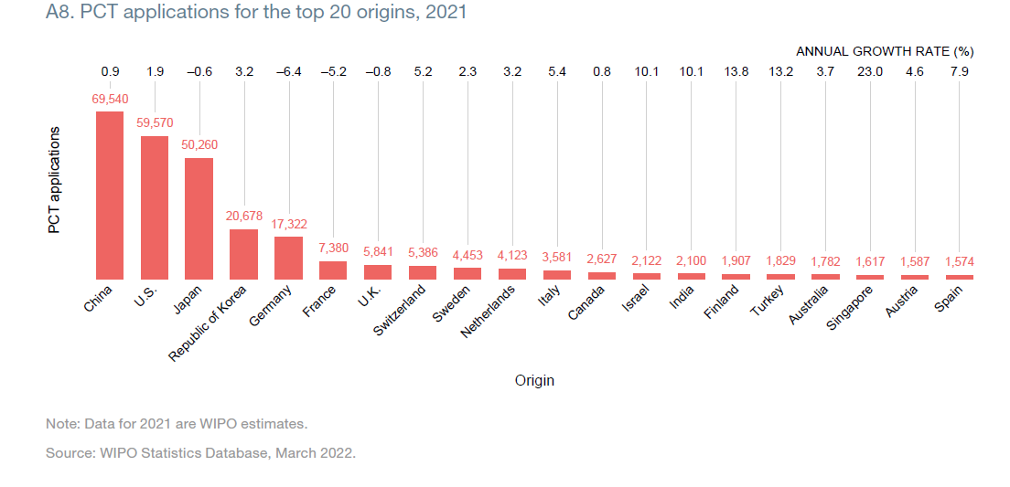

PCT applications received in 2021
Asia: 54.1%
North America: 22.4%
Europe: 22%
Source: PCT Yearly Review 2021, A8, based on WIPO statistics Database, March 2021
Notes:
This graph shows the trend for the top 20 countries in 2020.
Currently, the top five countries in terms of PCT applications are China, the U.S., Japan, Korea, and Germany, in that order, and these five countries will account for nearly 80% (78.7%) of all PCT applications in 2020.
Of the five countries, those that increased their applications last year were
The main growth came from China (+16.1%), Republic of Korea (+5.2%) and the U.S. (+3%).
Conversely, the main countries that saw a decrease in the number of applications were
Japan (-4.1%) and Germany (-3.7%)
The largest decreases between March and July 2020 were in computer technology, digital communication and semiconductors. The fields of biotechnology, medical technology, organic fine chemistry and pharmaceuticals increased rapidly, especially in China and the U.S.
In Japan, applications in the field of digital communication declined.
Decrease in pharmaceuticals in Germany

Slide 13
Top PCT applicants in 2021
Huawei Technologies—CN (6,952)
Qualcomm—US (3,931)
Samsung—KR (3,041)
LG Electronics—KR (2,885)
Mitsubishi Electric—JP (2,673)
Guang Dong Oppo Mobile Telecom—CN (2,208)
BOE Technology Group—CN (1,980)
Ericsson—SE (1,877)
Sony—JP (1,789)
Panasonic—JP (1,741)
Ping An Technology (Shenzhen) —CN (1,564)
Nippon Telegraph & Telephone—JP (1,508)
ZTE—CN (1,493)
Hewlett-Packard—US (1,485)
NEC —JP (1,350)
() of published
PCT applications
Notes:
To give you an alternative view (from a large PCT user), besides what you have already seen from Steve’s small company and the Nobel prize-winning inventor…
Huawei’s filing rate then is an average of just about 21 PCT applications per working day in 2020. Think of the R&D going on behind that…

Slide 14
Top PCT University applicants in 2021
University of California (US)
Zhejiang University (CN)
Massachusetts Institute of Technology (US)
Tsinghua University (CN)
Stanford University(US)
University of Texas (US)
South China University of Technology (CN)
National University of Singapore (SG)
Suzhou University (CN)
University of Tokyo (JP)
Dalian University of Technology (CN)
Shenzhen University (CN)
Qingdao Technological University (CN)
Korea University (KR)
Johns Hopkins University (US)
Notes:
To give you an alternative view (from a large PCT user), besides what you have already seen from Steve’s small company and the Nobel prize-winning inventor…

Slide 15
Top PCT Research Institution applicants in 2021
Fraunhofer Institute (DE)
Commissariat a l’Energie Atomique et aux Energies Alternatives (FR)
China Mobile Communication Ltd. Research Institute (CN)
Institut National de la Sante et de la Recherche Medicale (FR)
Centre National de la Recherche Scientifique (FR)
Agency for Science, Technology and Research (SG)
Chongqing Konka Photoelectric Technology Research Institute Co. Ltd (CN)
Korea Advanced Institute of Science and Technology (KR)
National Institute of Advanced Industrial Science and Technology (JP)
Nederlandse Organisatie Voor Toegepast-Natuurwetenschappelijk Onderzoek Tno (NL)
Korea Electronics Technology Institute (KR)
Consejo Superior de Investigaciones Científicas (ES)
Sloan-Kettering Institute for Cancer Research (US)
Dana-Farber Cancer Institute, Inc. (US)
U.S. Department of Health and Human Services (US)
Notes:
To give you an alternative view (from a large PCT user), besides what you have already seen from Steve’s small company and the Nobel prize-winning inventor…

Slide 16
PCT Applicants in 2021

Slide 17
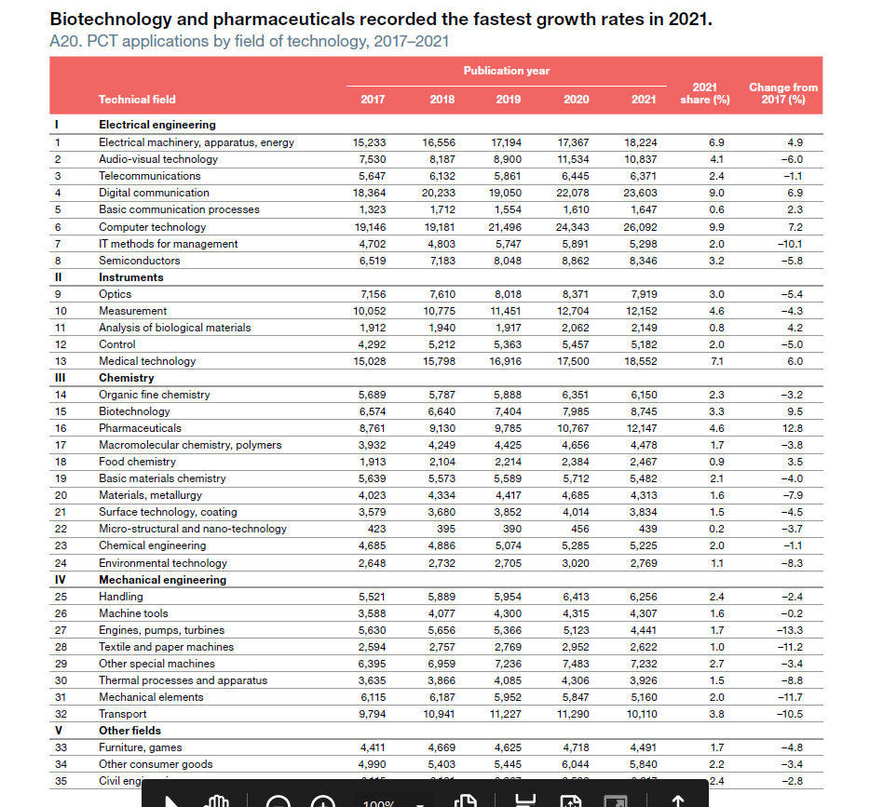

Slide 18
Recent PCT Developments

Slide 19
Recent PCT developments: new SL Standard
WIPO, together with Member States, has developed a new method and standard for filing sequence listings as part of PCT applications
  New WIPO Standard ST. 26 (Recommended Standard for the Presentation of Nucleotide and Amino Acid Sequence Listings Using XML)
WIPO has created:
  WIPO Sequence software tool (for applicants) (https://www.wipo.int/standards/en/sequence/index.html) to help author standard-compliant SLs, and
  WIPO Sequence Validator tool (for offices) to verify compliance
“Big bang” date for change to new standard by users and Offices: July 1, 2022

Slide 20
Recent PCT developments: legal
2021 PCT Assembly agreed:
  Necessary amendments for WIPO ST.26 implementation
  Amendments to Rule 82quater on extending PCT time limits (prompted by COVID experience)
    Add “epidemic” to Rule 82quater.1 as example of force majeure situation triggering excuse of delay in meeting time limits
    Add explicit legal basis in Rule 82quater.1(d) providing for ability to waive submission of evidence (which WIPO DG proposed for COVID-related disruptions in April 2020)
    82quater.3: PCT Offices/Authorities/IB may extend PCT time limits (not more than 2 months initially, but potentially extendible) when experiencing “general disruption” caused by force majeure event listed in 82quater.1(a) which affects office operations. Offices/Authorities so extending shall notify IB which will publish them.
No WG 2021 consensus on proposal (US/UK/JP/KR) to explicitly integrate PPH into the PCT

Slide 21
Recent PCT developments: electronic
PCT-SAFE software being decommissioned (no longer updated or supported) by IB as of July 1, 2022
  The International Bureau strongly encourages all current PCT-SAFE users to transition to the ePCT platform for preparing, filing and managing PCT applications which has a multitude of advantages over PCT-SAFE
ePCT
  Online PCT application filing and management service developed by WIPO which provides PCT online services for both applicants and IP Offices (https://pct.wipo.int)
    User interface available in all PCT publication languages
    Provides secure and direct interaction with PCT applications maintained by the International Bureau
    ePCT-Filing with 75 PCT receiving Offices
    ePCT allows applicants to conduct a number of electronic PCT international phase transactions (‘Actions’) with the IB and other participating IP Offices

Slide 22
Recent PCT developments: States/Offices/Authorities
PCT Assembly appointed Eurasian Patent Office (EAPO) as 24th ISA/IPEA

Slide 23
Recent PCT developments:
2021 PCT User Survey results
1,800 users in 80 countries
User satisfaction with WIPO’s PCT services rated as 90 out of 100 (improved from 88 in 2019) with 39% “very satisfied” and 51 “satisfied”
  processing of PCT applications by the IB of WIPO: 91
  functions of the ePCT services: 91
  contacting WIPO PCT services: 88
  PCT Information resources: 91
  PCT Information provided on the WIPO website: 91
  PCT trainings provided by WIPO: 91
  services provided by the most frequently used Receiving Office (USPTO #13 & RO/IB #6)
  services provided by the most frequently used ISA (USPTO #13)
  services provided by the most frequently used IPEA (USPTO #10)
  PCT international phase procedure added value to the processing of application in the national phase: 85
On WIPO shared Customer Satisfaction Index, PCT ranked as higher than other WIPO services

Slide 24
Future PCT Developments

Slide 25
Future PCT developments: quality
continue to work on report quality with Authorities (MIA Quality Subgroup), and related issues such as “standing behind” own ISA work as DO
International Bureau plans to monitor more closely the timeliness of actions by Offices & Authorities
continue to work with Authorities on development of quality metrics
continue to investigate potential for collaborative search and examination of PCT applications
Meeting of Quality Subgroup of the Meeting of International Authorities 2022: June 16-17
Meeting of International Authorities 2022: June 20-22
  https://www.wipo.int/meetings/en/details.jsp?meeting_id=69310

Slide 26
Future PCT developments: legal
legal framework is now quite mature so only make changes if truly necessary
look for opportunities to modernize the framework and remove anachronisms where possible
continue to encourage States to adapt national laws to make them PCT-compatible (to withdraw outstanding notifications of incompatibility (still 100+ country-specific incompatibilities))

Slide 27
Future PCT developments: electronic
ePCT further development
Promote the filing and exchange of full text and structured data in standardized formats
  Want more XML filings and ISA/IPEA reports
    IB will be revising Annex F of the Administrative Instructions under the PCT to allow the international phase processing of the application body in XML full text format as filed by the applicant or processed by Offices, which in turn will enable the transition to full-text international publication
    IB will make its DOCX converter and full-text comparison tools available to all IP Offices through web services, which will serve as a reference for implementation of processing applications filed in DOCX format and ensure consistency in the conversion from DOCX into XML
  Will enable improved automation of validation, processing, publication and delivery of high quality, standardized data and services to applicants, designated Offices and patent information users

Slide 28
Future PCT developments: data
Support and develop services for data exchange by the International Bureau, receiving Offices, International Searching/Preliminary Examining Authorities and designated/elected Offices to ensure timely, accurate, high quality and consistent results including translations, where possible using common or consistent tools
  the PCT system needs better compliance from designated Offices in their obligations under the PCT Regulations in order to be able to provide the data services member States want us to provide:
    Example: national phase entry data

Slide 29
Future PCT developments: States/Offices/Authorities
States/Offices/Authorities—almost certainly will have more Authorities, and look forward to welcoming and assisting additional Contracting States
  continue to coordinate training on search and examination, and provide PCT technical assistance

Slide 30
Future PCT developments: fees and payments
Reevaluate PCT fees, payment mechanisms and possibilities for targeted adjustments

Slide 31
Future PCT developments: International Bureau productivity
Improve productivity and service quality of PCT operations at the International Bureau through:
  further intelligent automation
  organizational transformation, and
  streamlining of processes and strengthening of management skills

Slide 32
PCT Challenges
Even while experiencing so much success, the PCT still faces a number of challenges:
  General/systemic
    Quality of international phase workproducts
    Quality of the processing of PCT applications by all Offices and Authorities
    Timeliness of actions by Offices and Authorities
    Uniformity of application/consistency/intended use
    Assisting developing and least developed countries
    Does not yet comprise all States of potential applicant interest
  Specific to International Bureau of WIPO
    Keeping the PCT system “healthy”
    Growth (filings and countries)
    Making financial and data flows more efficient and useful
    Helping users stay up to date on PCT legal and practical developments/demand for training
    Helping applicants and Offices transition to electronic filing, transmission and processing, and providing useful systems to support those actions
    Unscrupulous companies/individuals who want to mislead PCT applicants into paying unrelated and unnecessary fees

Slide 33
Conclusion
PCT:
  has been remarkably successful during its 44 years of operation, and continues to be an excellent example of concrete (generally non-politicized), ongoing multilateral cooperation in the intellectual property world
  continues to develop in all respects: legal, practical, electronic systems, data movement, payments/fees, Offices/Authorities
the participation and engagement of all of its stakeholders is greatly appreciated
And with that continuing, constructive cooperation, the PCT will:
  continue to improve its services, and
  continue to provide value to all of its users
Thank you for your use of the PCT system—please provide us with your feedback on your experience

Slide 34
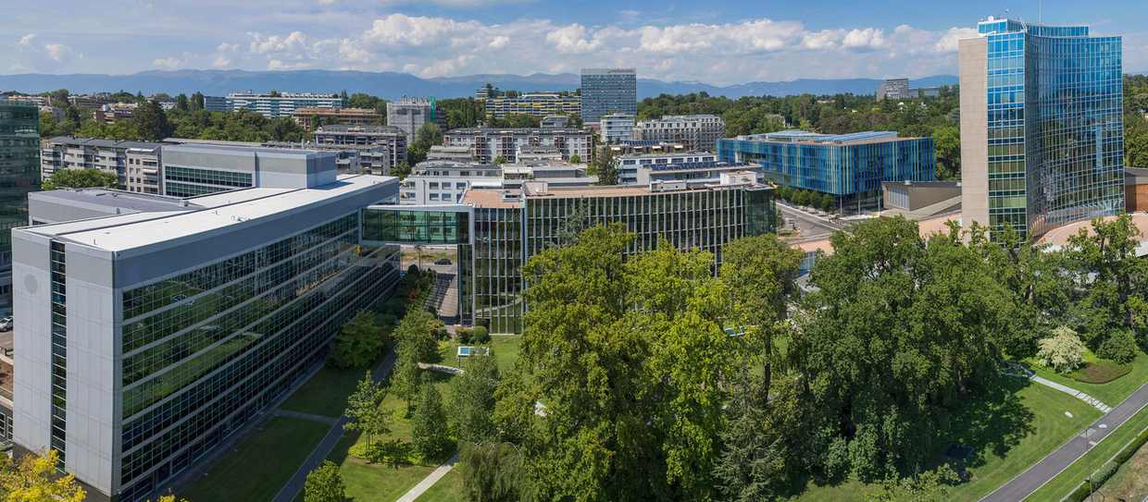
Thank you

