Slide 1

ACPC IP Metrics
2017 Survey
© 2017 Association of Corporate Patent Counsel

Slide 2
Terms of use:
This survey report was written and produced by Association of Corporate Patent Counsel (ACPC). This report is provided under controlled distribution and is not generally available to the public or to ACPC members that did not participate in the survey. No redistribution or sharing, either in whole or in part, is allowed without written permission from ACPC.
In exchange for receiving this survey report, you acknowledge and agree to these Terms of Use.
© 2017 Association of Corporate Patent Counsel

Slide 3

ACPC Benchmarking Survey
ACPC Executive Committee replaced salary survey with IP metrics survey in 2017
IP Metrics Survey Committee formed March 2017
Survey conducted May-June 2017
42 questions
IP metrics included: company size and industry, R&D function size and spend, innovative output, legal department size and spend, IP function size and spend, average costs by IP activity, outside counsel use
45 respondents
Results aggregated by ACPC staff
© 2017 Association of Corporate Patent Counsel

Slide 4

Special thanks to the IP Metrics Survey Committee
Tom Beall
John Cheek
Bernie Graves
Jason Houser
Dave Justmann
Ryan McQuade
Kevin Rhodes
Dennis Skarvan
Brian Suffredini
Roy Waldron
Special thanks:
Cheryl Muellner,
3M Manager of IP Operations & Data Analyst
ACPC Executive Office: Katie Fernstaedt
Miriam Feingold
© 2017 Association of Corporate Patent Counsel

Slide 5
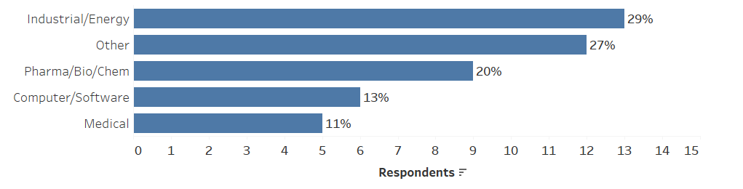
Survey respondents
45 companies responded to the survey
Consumer Products combined with Other category to preserve anonymity
© 2017 Association of Corporate Patent Counsel
Notes:
Q39. Please choose the category your company most identifies with:

Slide 6
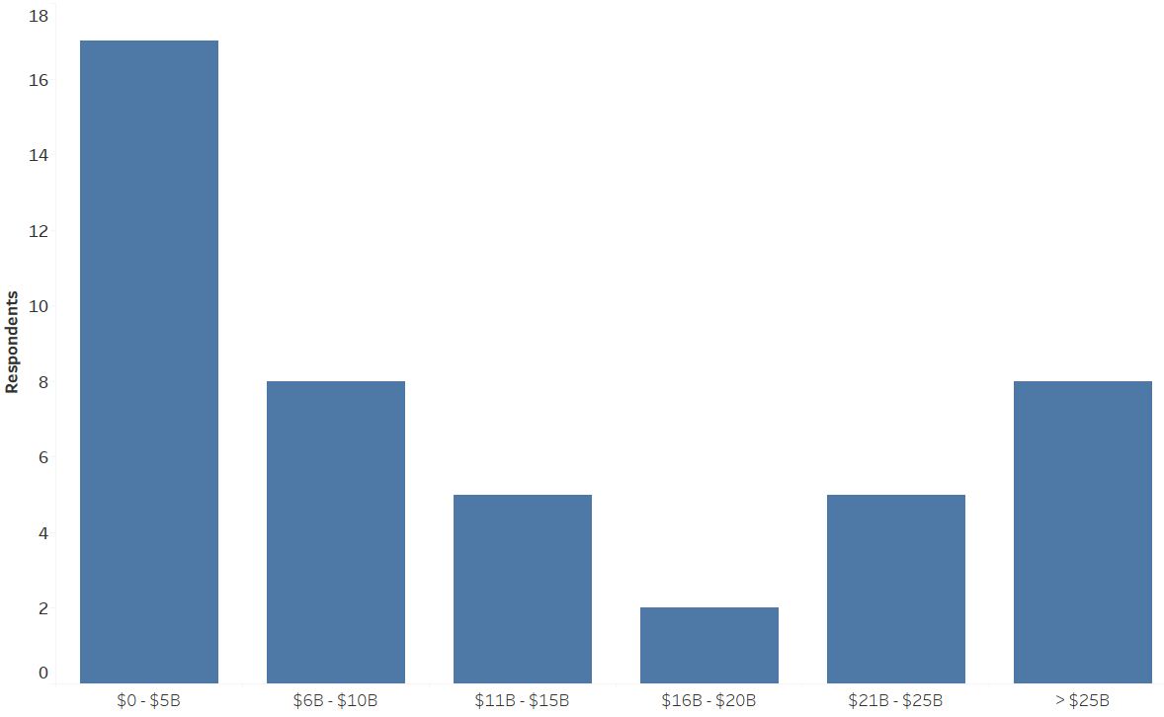
2016 revenue
Revenue
© 2017 Association of Corporate Patent Counsel
Notes:
Q2. Please list your company's total sales and revenue in US Dollars

Slide 7
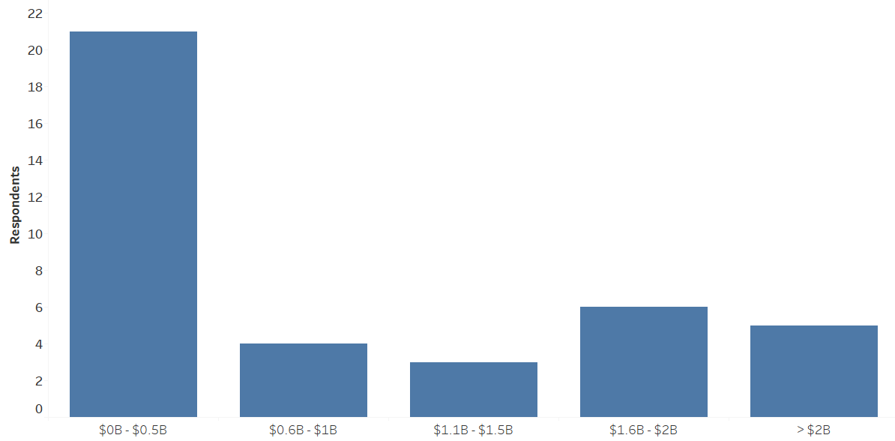
2016 R&D spend
R&D spend
© 2017 Association of Corporate Patent Counsel
Notes:
Q3. Please list your company's total research and development spend in US Dollars

Slide 8
2016 R&D spend as percentage of revenue
© 2017 Association of Corporate Patent Counsel
Notes:
Q2. Please list your company's total sales and revenue in US Dollars
Q3. Please list your company's total research and development spend in US Dollars

Slide 9
IP Teams, Roles & Responsibilities
© 2017 Association of Corporate Patent Counsel

Slide 10
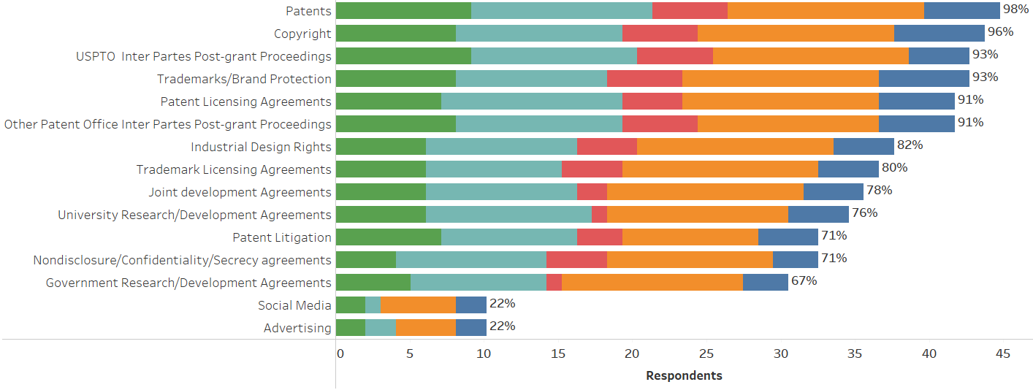
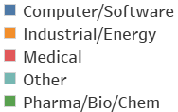
IP teams have primary responsibilities
© 2017 Association of Corporate Patent Counsel
Notes:
Q5. Which of the following substantive legal areas does the IP team have responsibility for within your company:
Q6. Does the IP team have lead/primary responsibility for patent-related litigation in District Courts or other judicial forums?
Q7. Does the IP team have primary responsibility for inter partes post-grant proceedings at the USPTO?
Q8. Does the IP team have primary responsibility for inter partes post-grant proceedings at other patent offices?

Slide 11
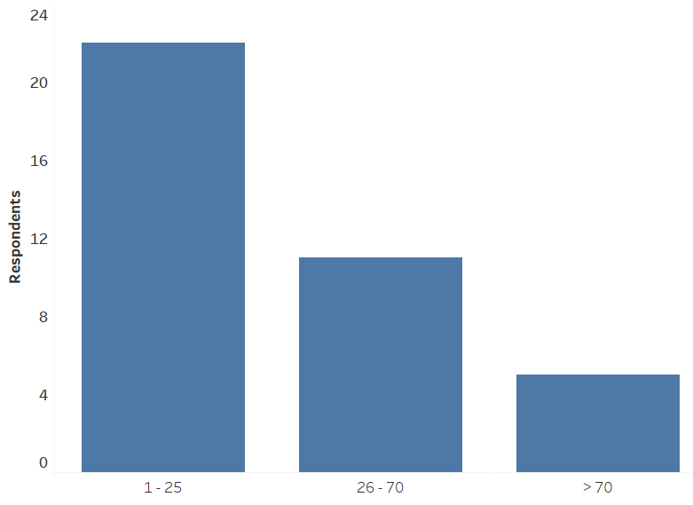
Size of IP team
IP team members
© 2017 Association of Corporate Patent Counsel
Notes:
Q11. Other staffing: Number of: Full-time equivalent (whole or fractional) employees in the IP team (any role, any location)

Slide 12
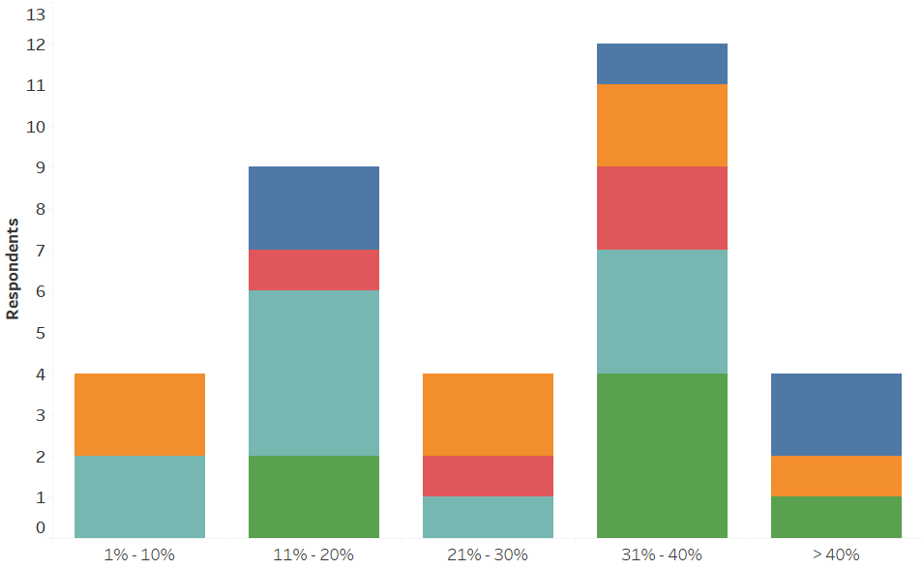
Size of IP team as percentage of total legal department
% of legal team
© 2017 Association of Corporate Patent Counsel
Notes:
Q11. Other staffing:
Number of: Full-time equivalent (whole or fractional) employees in the law department (any role, any location)
Number of: Full-time equivalent (whole or fractional) employees in the IP team (any role, any location)

Slide 13
Revenue ($M) per employee in IP team
© 2017 Association of Corporate Patent Counsel
Notes:
Q2. Please list your company's total sales and revenue in US Dollars
Q11. Other staffing: Number of: Full-time equivalent (whole or fractional) employees in the IP team (any role, any location)

Slide 14
R&D spend ($M) per employee in IP team
© 2017 Association of Corporate Patent Counsel
Notes:
Q3. Please list your company's total research and development spend in US Dollars
Q11. Other staffing: Number of: Full-time equivalent (whole or fractional) employees in the IP team (any role, any location)

Slide 15
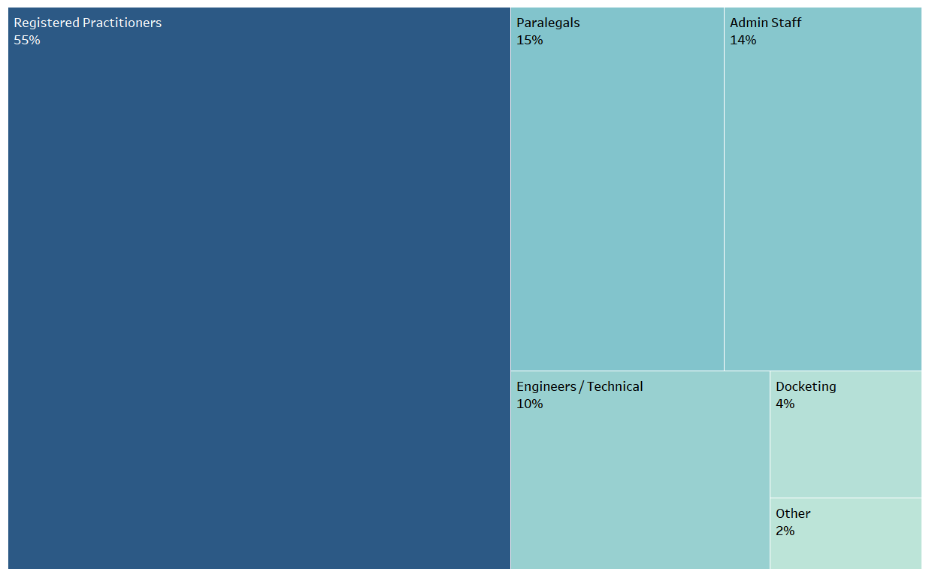
Patent related staff roles
© 2017 Association of Corporate Patent Counsel
Notes:
Q9. Patent Related Staffing:
Number Registered patent practitioners (patent attorneys, agents, or equivalents) in the IP team
Number of Patent paralegals
Number of Patent administrative support staff Number of Engineers, scientists, or technical support personnel
Number of Patent docketing staff (dedicated) Number of Other employees (not included above) in patent-related roles

Slide 16
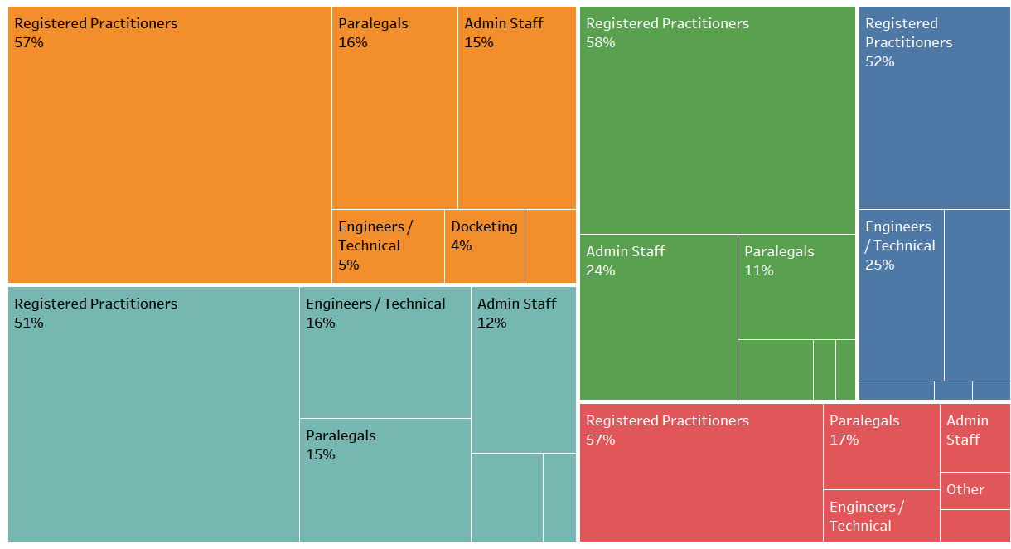
Patent related staff roles by industry
Other
3%
Paralegals
19%
Docketing
5%
Eng
1%
Oth
1%
Admin 2%
Dock 1%
Oth 1%
Docketing
4%
Other
2%
8%
4%
10%
Dock 4%
© 2017 Association of Corporate Patent Counsel
Notes:
Q9. Patent Related Staffing:
Number Registered patent practitioners (patent attorneys, agents, or equivalents) in the IP team
Number of Patent paralegals
Number of Patent administrative support staff Number of Engineers, scientists, or technical support personnel
Number of Patent docketing staff (dedicated) Number of Other employees (not included above) in patent-related roles

Slide 17
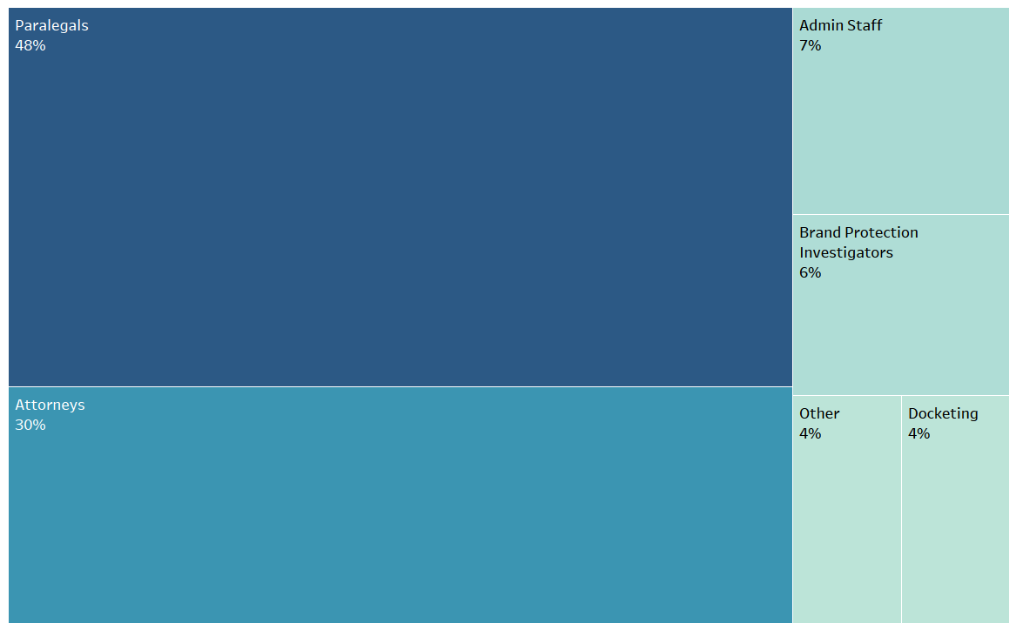
Trademark related staff roles
© 2017 Association of Corporate Patent Counsel
Notes:
Q10. Trademark Related Staffing:
Number of Trademark attorneys
Number of Trademark paralegals
Number of Trademark administrative support staff
Number of Brand protection investigators
Number of Trademark docketing staff (dedicated)
Number of other employees (not included above) in trademark-related roles

Slide 18
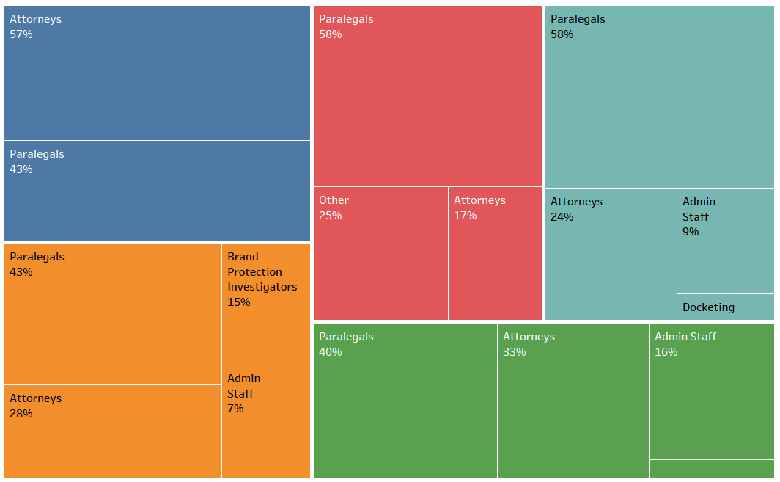
Trademark related staff roles by industry
Oth5%
4%
Dock 8%
Dock
6%
Other 1%
Other 3%
© 2017 Association of Corporate Patent Counsel
Notes:
Q10. Trademark Related Staffing:
Number of Trademark attorneys
Number of Trademark paralegals
Number of Trademark administrative support staff
Number of Brand protection investigators
Number of Trademark docketing staff (dedicated)
Number of other employees (not included above) in trademark-related roles

Slide 19
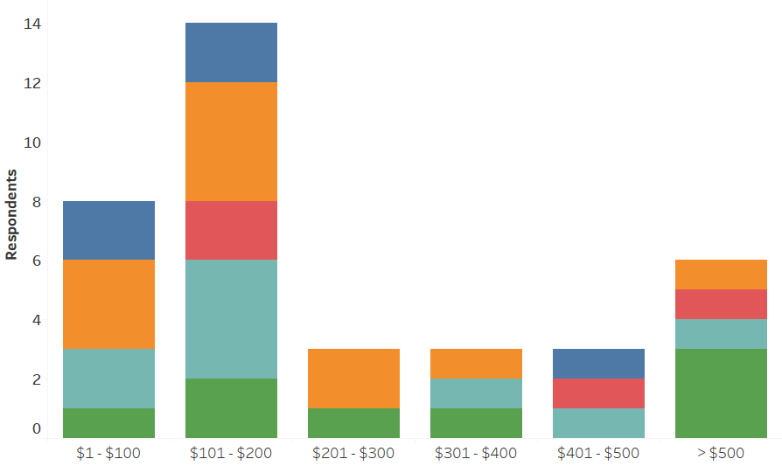
R&D spend ($000) per inventor
R&D spend ($000) per inventor
© 2017 Association of Corporate Patent Counsel
Notes:
Q3. Please list your company's total research and development spend in US Dollars
Q4. Please list the number of employees that are considered part of your core inventor population (i.e. engineers, scientists, technologists, or others in roles with reasonable opportunity to make a patentable invention)

Slide 20
Spending Metrics
© 2017 Association of Corporate Patent Counsel

Slide 21
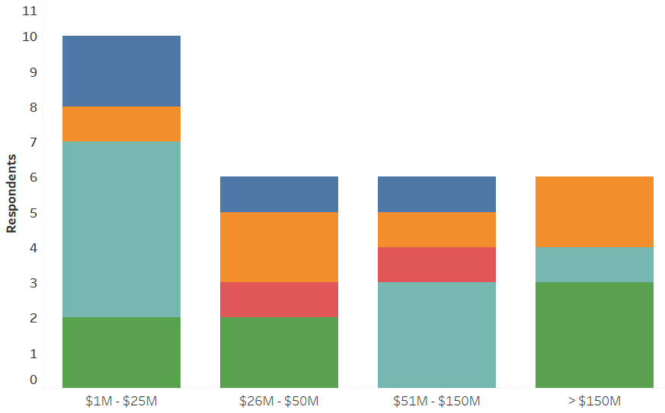
Total legal spend
Legal spend
© 2017 Association of Corporate Patent Counsel
Notes:
Q12. Total Spend in US Dollars:
Total Legal Department spend (all functions, labor and external spend)

Slide 22
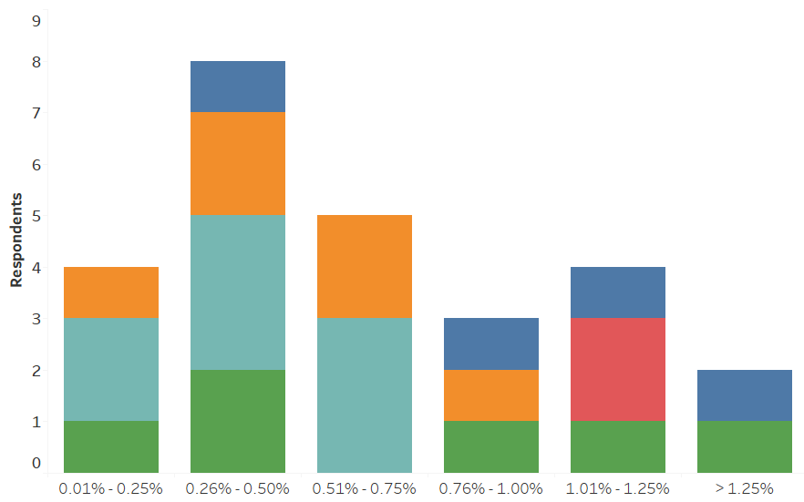
Legal spend as percentage of revenue
% of revenue
© 2017 Association of Corporate Patent Counsel
Notes:
Q2. Please list your company's total sales and revenue in US Dollars
Q12. Total Spend in US Dollars:
Total Legal Department spend (all functions, labor and external spend)

Slide 23
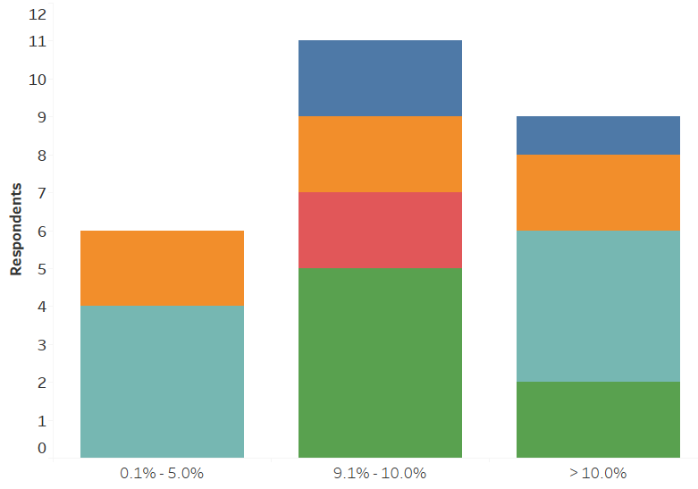
In-house IP spend as percentage of total legal spend
% of legal spend
© 2017 Association of Corporate Patent Counsel
Notes:
12. Total Spend in US Dollars:
Total Legal Department spend (all functions, labor and external spend)
13. Total IP team spend by category in US Dollars:
Labor

Slide 24
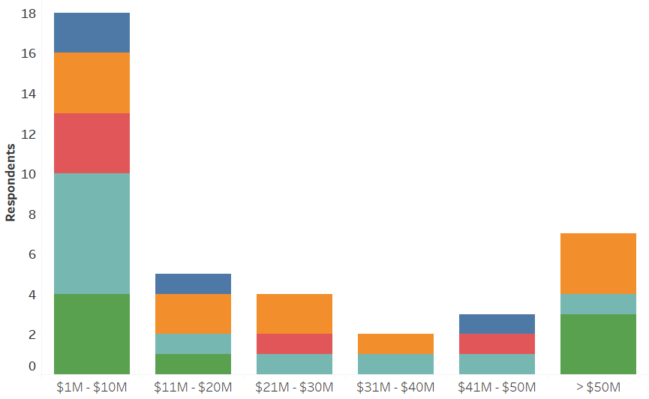
Total IP spend
IP spend
© 2017 Association of Corporate Patent Counsel
Notes:
Q12. Total Spend in US Dollars:
Total IP team spend (all functions, labor and external spend)

Slide 25
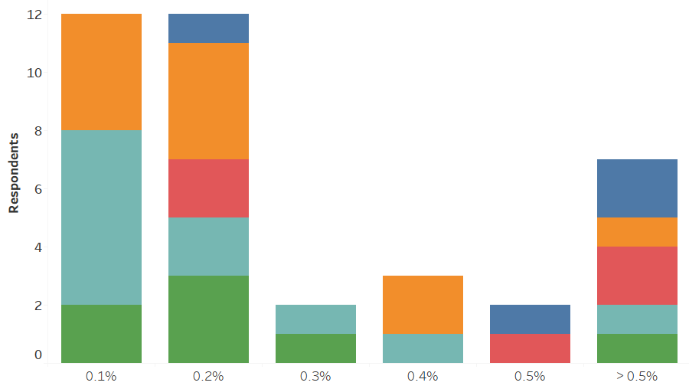
IP spend as percentage of revenue
% of revenue
© 2017 Association of Corporate Patent Counsel
Notes:
Q12. Total Spend in US Dollars:
Total IP team spend (all functions, labor and external spend)
Q2. Please list your company's total sales and revenue in US Dollars

Slide 26
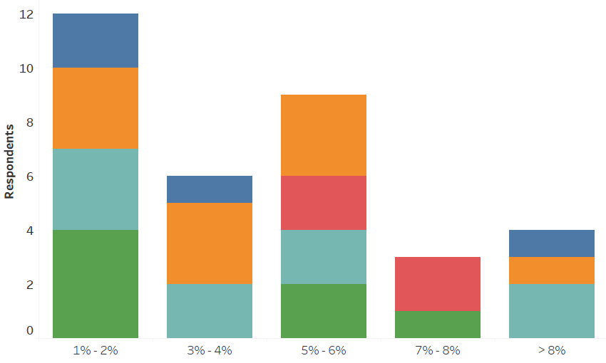
IP Spend as percentage of R&D spend
% of R&D spend
© 2017 Association of Corporate Patent Counsel
Notes:
Q3. Please list your company's total research and development spend in US Dollars
Q12. Total Spend in US Dollars: Total IP team spend (all functions, labor and external spend)

Slide 27
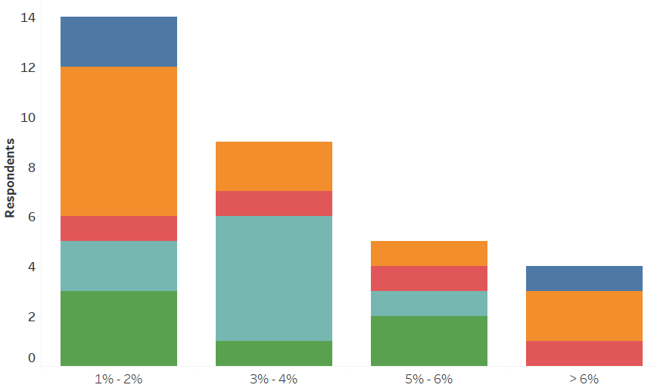
Patent Spend as percentage of R&D spend
% of R&D spend
© 2017 Association of Corporate Patent Counsel
Notes:
Q3. Please list your company's total research and development spend in US Dollars
Q14. Total patent-related team spend by category in US Dollars: Labor & External Spend

Slide 28
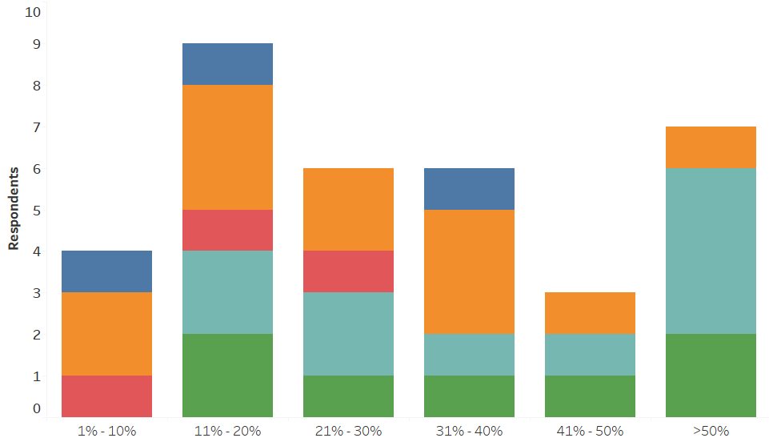
In-house IP spend as percentage of total IP spend
% of IP spend
© 2017 Association of Corporate Patent Counsel
Notes:
13. Total IP team spend by category in US Dollars:
Labor
External Spend

Slide 29
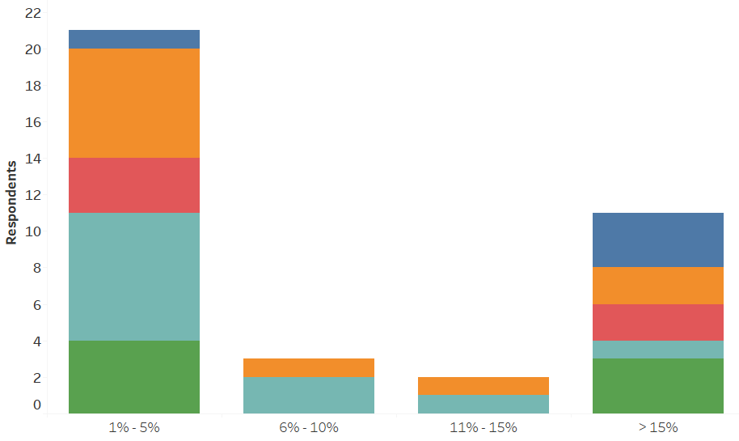
Patent litigation spend as percentage of total IP spend
% of IP spend
© 2017 Association of Corporate Patent Counsel
Notes:
Q12. Total Spend in US Dollars:
Total IP team spend (all functions, labor and external spend)
Total patent litigation spend (i.e. district court or other non patent office forums)

Slide 30
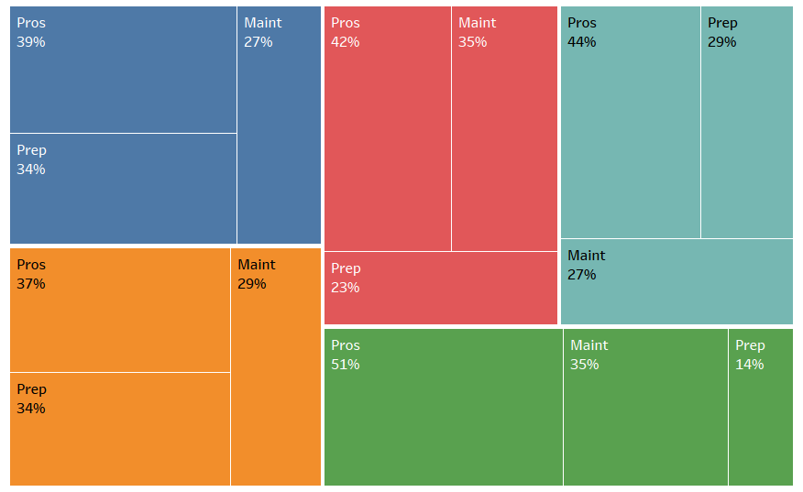
Patent portfolio spend
© 2017 Association of Corporate Patent Counsel
Notes:
15. Total patent portfolio spend in US Dollars: Preparation, Prosecution, Maintenance

Slide 31
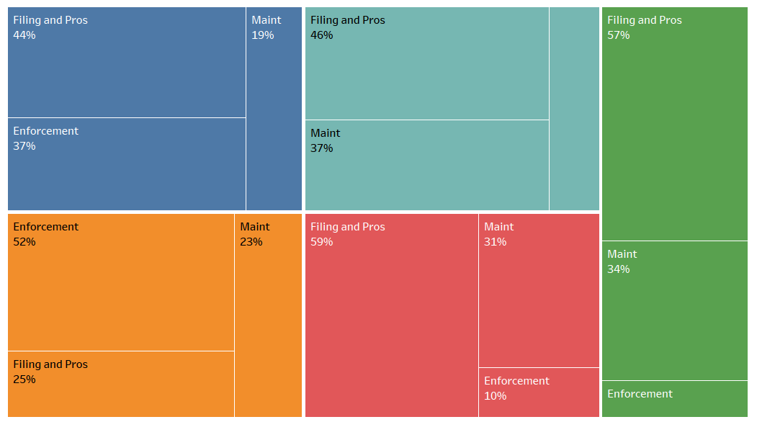
Trademark portfolio spend
Enforce 17%
9%
© 2017 Association of Corporate Patent Counsel
Notes:
16. Total trademark spend by category in US Dollars: Filing and Prosecution Maintenance Enforcement

Slide 32
Spend on patent post-grant proceedings
© 2017 Association of Corporate Patent Counsel
Notes:
Q12. Total Spend in US Dollars:
Total patent post-grant proceeding spend (i.e. USPTO or other patent office forums)

Slide 33
Spend on patent freedom to operate activities
© 2017 Association of Corporate Patent Counsel
Notes:
Q12. Total Spend in US Dollars:
Total patent risk management spend (i.e. clearance, freedom-to-operate, opinions of counsel)

Slide 34
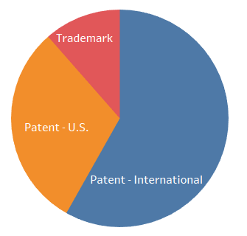
Outside counsel spend distribution by type
© 2017 Association of Corporate Patent Counsel
Notes:
Q12. Total Spend in US Dollars:
Total outside counsel patent portfolio spend (preparation, prosecution) (USA)(excluding any official fees paid through counsel)
Total outside counsel trademark spend (all activities)(excluding any official fees paid through counsel)
Total outside counsel patent portfolio spend (preparation, prosecution) (other than USA)(excluding any official fees paid through counsel)

Slide 35
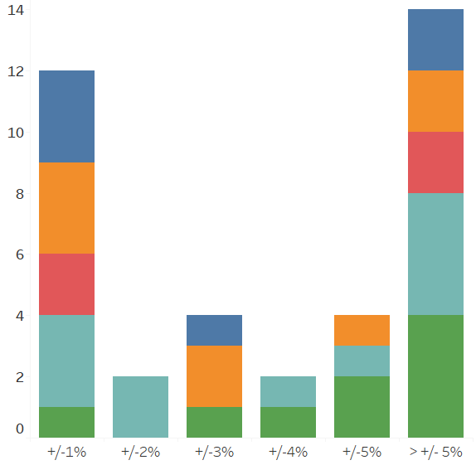
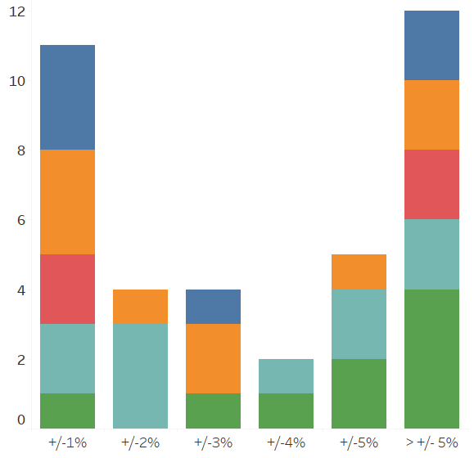
2016 external spend vs. plan
Total IP
Patent
Budget variance
Budget variance
© 2017 Association of Corporate Patent Counsel
Notes:
Q17. 2016 external IP spend vs 2016 external IP budget:
Q18. 2016 external patent-related spend vs 2016 external patent-related budget:

Slide 36
Portfolio Metrics
© 2017 Association of Corporate Patent Counsel

Slide 37
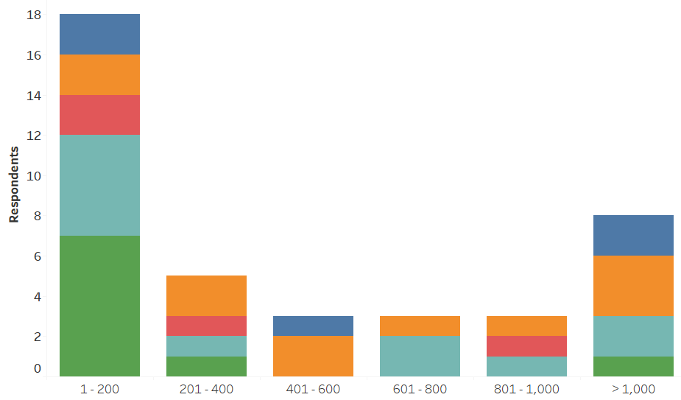
Invention disclosures in 2016
Invention disclosures
© 2017 Association of Corporate Patent Counsel
Notes:
Q19. IP Portfolio data: Total number of invention disclosures received in 2016

Slide 38
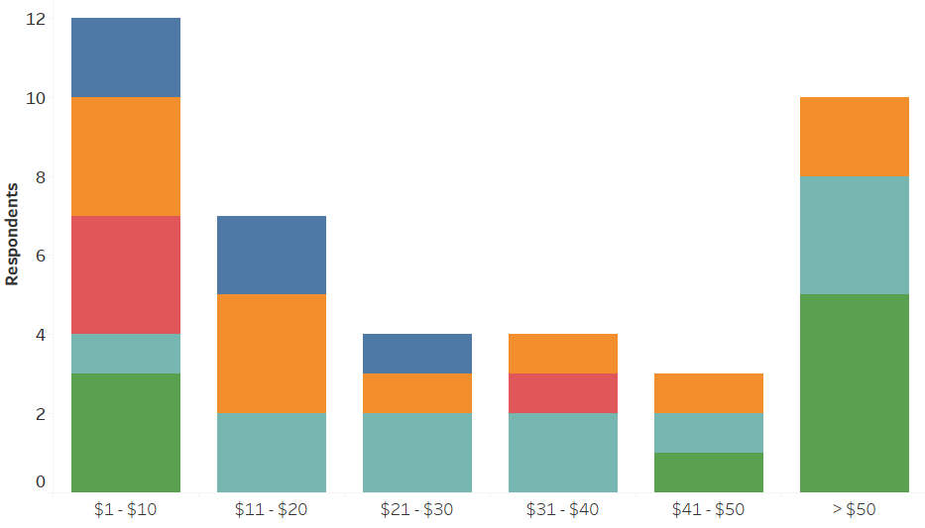

Revenue ($M) per invention disclosure
Revenue ($M) per invention disclosure
© 2017 Association of Corporate Patent Counsel
Notes:
Q2. Please list your company's total sales and revenue in US Dollars
Q19. IP Portfolio data: Total number of invention disclosures received in 2016

Slide 39
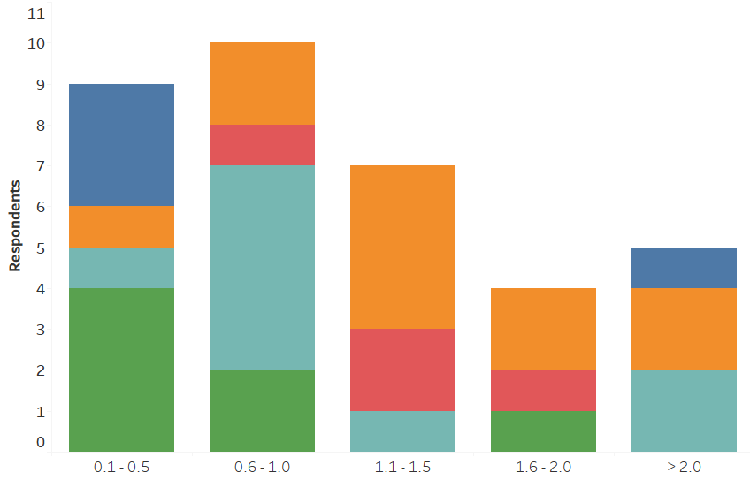
Invention disclosures per $M R&D spend
Invention disclosures
© 2017 Association of Corporate Patent Counsel
Notes:
Q3. Please list your company's total research and development spend in US Dollars
Q19. IP Portfolio data: Total number of invention disclosures received in 2016

Slide 40
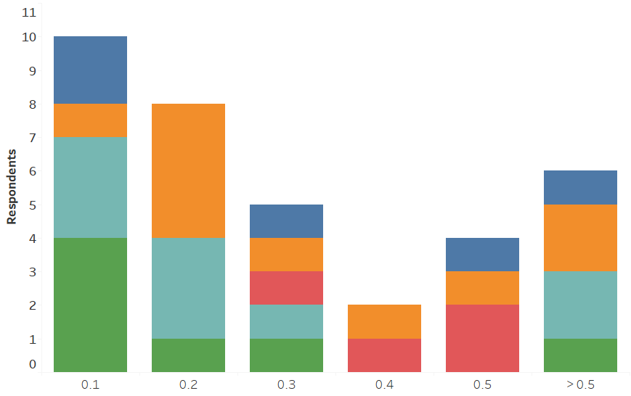
Invention disclosures per inventor
Invention disclosures
© 2017 Association of Corporate Patent Counsel
Notes:
Q19. IP Portfolio data: Total number of invention disclosures received in 2016
Q4. Please list the number of employees that are considered part of your core inventor population (i.e. engineers, scientists, technologists, or others in roles with reasonable opportunity to make a patentable invention)

Slide 41
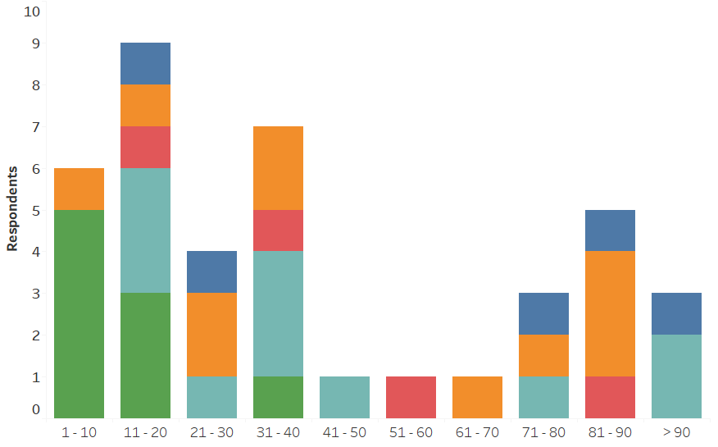
Invention disclosures per registered patent practitioner
Invention disclosures
© 2017 Association of Corporate Patent Counsel
Notes:
Q19. IP Portfolio data: Total number of invention disclosures received in 2016
Q9. Patent Related Staffing: Number Registered patent practitioners (patent attorneys, agents, or equivalents) in the IP team

Slide 42
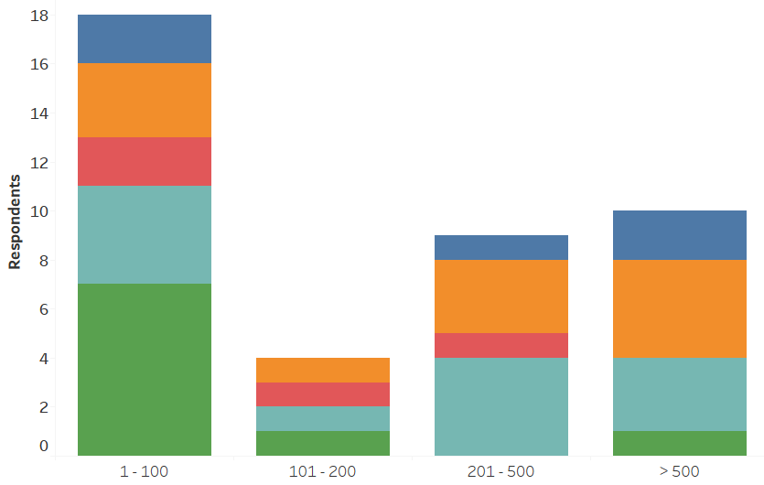
Priority patent filings in 2016
Priority patent filings
© 2017 Association of Corporate Patent Counsel
Notes:
19. IP Portfolio data: Total number of new/priority patent applications filed in 2016 (any country)

Slide 43
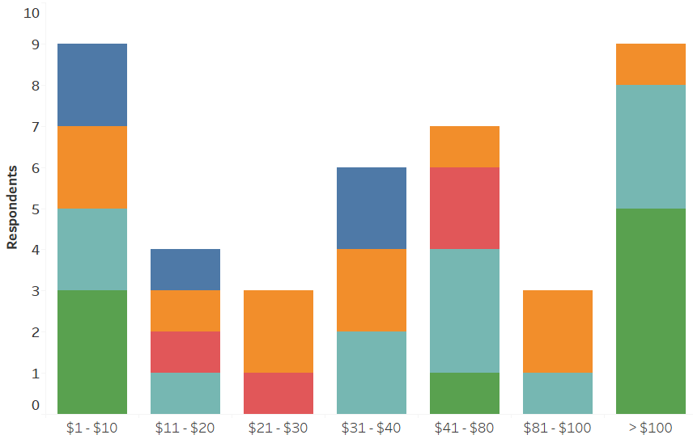
Revenue ($M) per priority patent filing
Revenue ($M) per priority patent filing
© 2017 Association of Corporate Patent Counsel
Notes:
Q2. Please list your company's total sales and revenue in US Dollars
19. IP Portfolio data: Total number of new/priority patent applications filed in 2016 (any country)

Slide 44
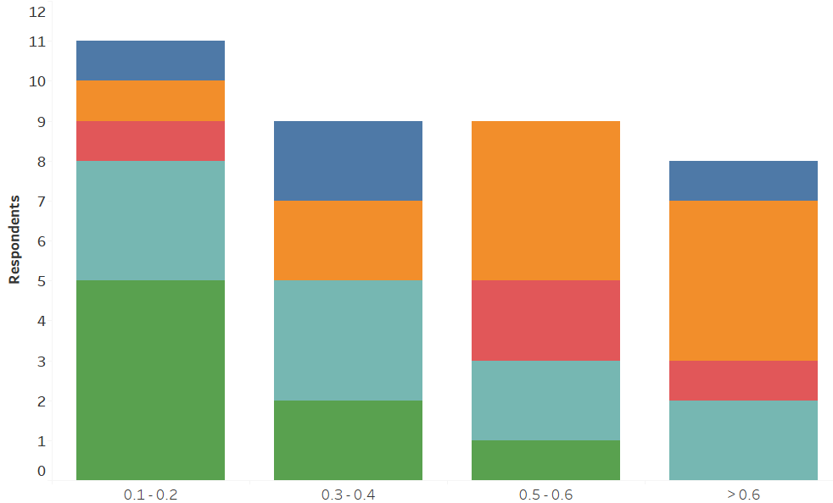
Priority patent filing per $M R&D spend
Priority patent filings
© 2017 Association of Corporate Patent Counsel
Notes:
Q3. Please list your company's total research and development spend in US Dollars
19. IP Portfolio data: Total number of new/priority patent applications filed in 2016 (any country)

Slide 45
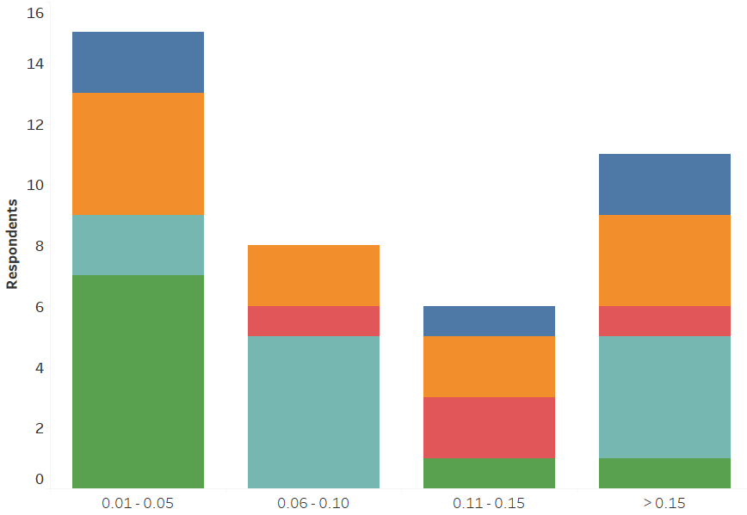
Priority patent filings per inventor
Priority patent filings
© 2017 Association of Corporate Patent Counsel
Notes:
19. IP Portfolio data: Total number of new/priority patent applications filed in 2016 (any country)
Q4. Please list the number of employees that are considered part of your core inventor population (i.e. engineers, scientists, technologists, or others in roles with reasonable opportunity to make a patentable invention)

Slide 46
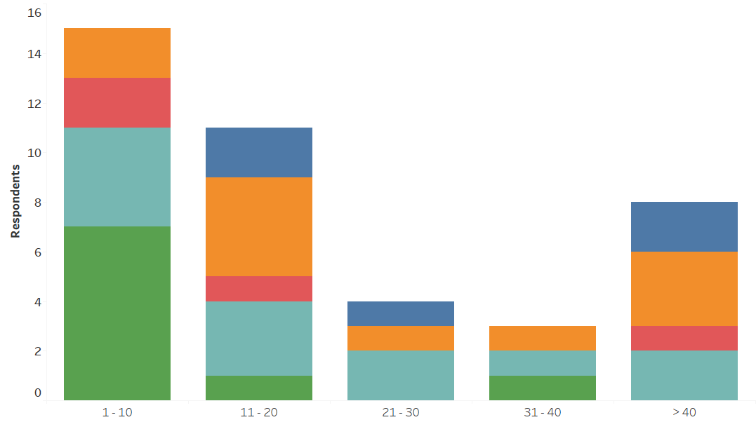
Priority patent filings per registered patent practitioner
Priority patent filings
© 2017 Association of Corporate Patent Counsel
Notes:
Q19. IP Portfolio data: Total number of new/priority patent applications filed in 2016 (any country)
Q9. Patent Related Staffing: Number Registered patent practitioners (patent attorneys, agents, or equivalents) in the IP team

Slide 47
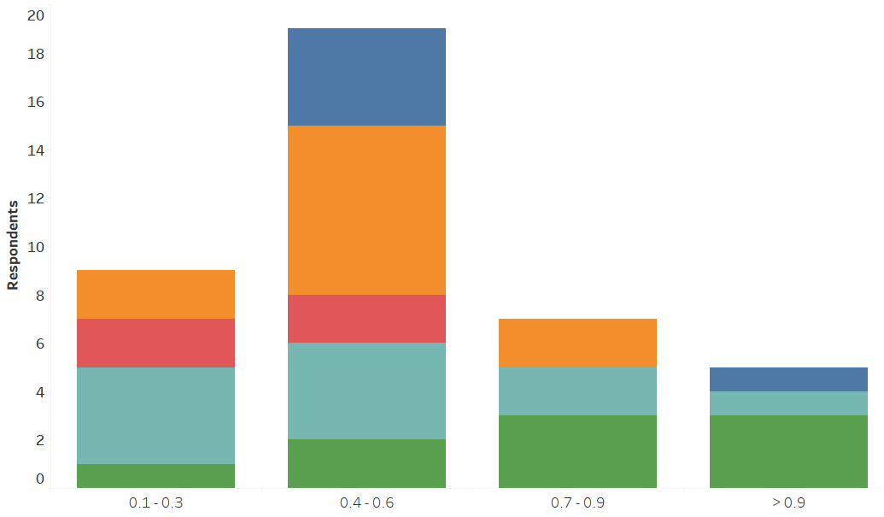
Priority patent filings per invention disclosure in 2016
Priority patent filings
© 2017 Association of Corporate Patent Counsel
Notes:
Q19. IP Portfolio data:
Total number of new/priority patent applications filed in 2016 (any country)
Total number of invention disclosures received in 2016

Slide 48
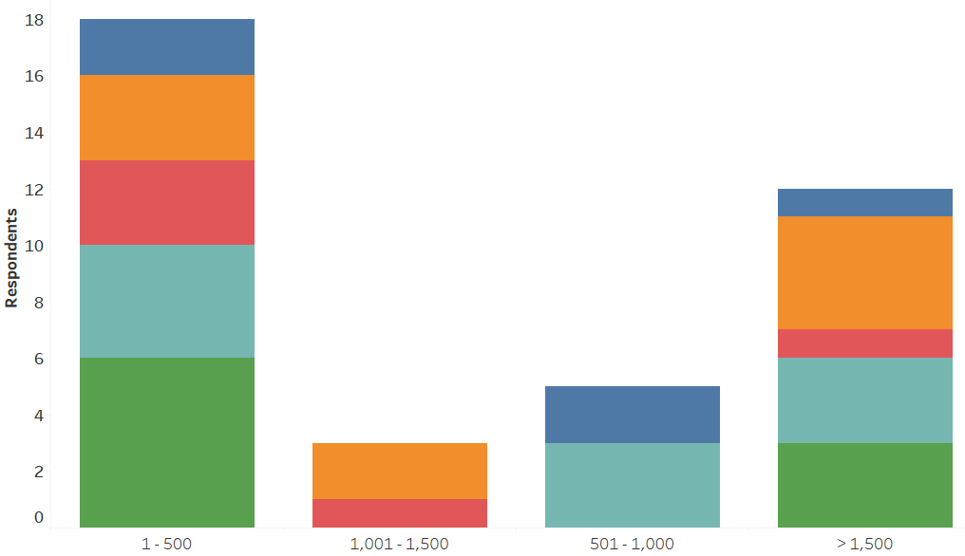
Patents granted in 2016
Patents granted
© 2017 Association of Corporate Patent Counsel
Notes:
Q19. IP Portfolio data: Total number of patents granted to the company in 2016 (any country)

Slide 49
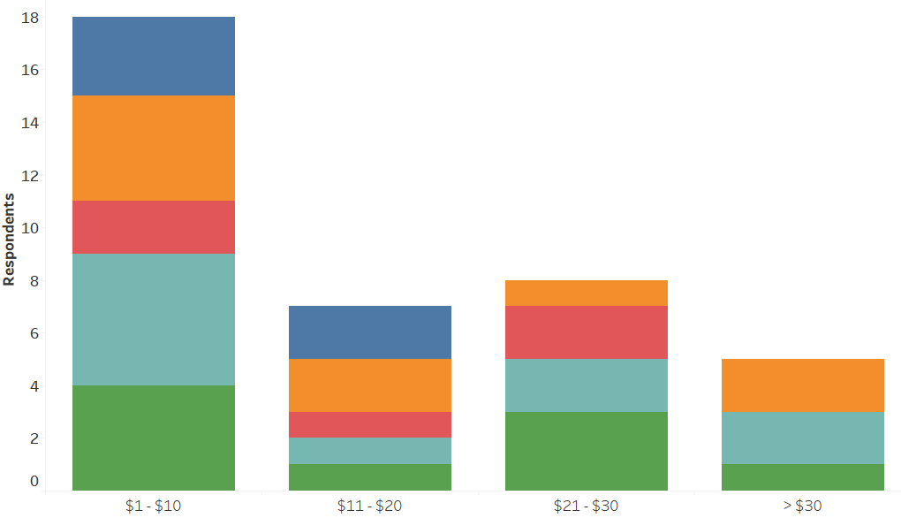
Revenue ($M) per patent granted in 2016
Revenue ($M) per granted patent in 2016
© 2017 Association of Corporate Patent Counsel
Notes:
Q2. Please list your company's total sales and revenue in US Dollars
Q19. IP Portfolio data: Total number of patents granted to the company in 2016 (any country)

Slide 50
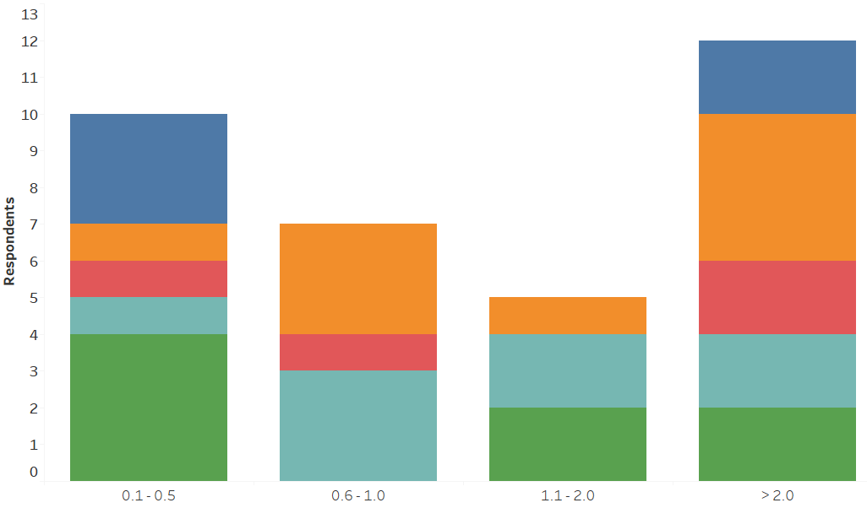
2016 Granted patent per $M R&D spend
Patents granted
© 2017 Association of Corporate Patent Counsel
Notes:
Q3. Please list your company's total research and development spend in US Dollars
Q19. IP Portfolio data: Total number of patents granted to the company in 2016 (any country)

Slide 51
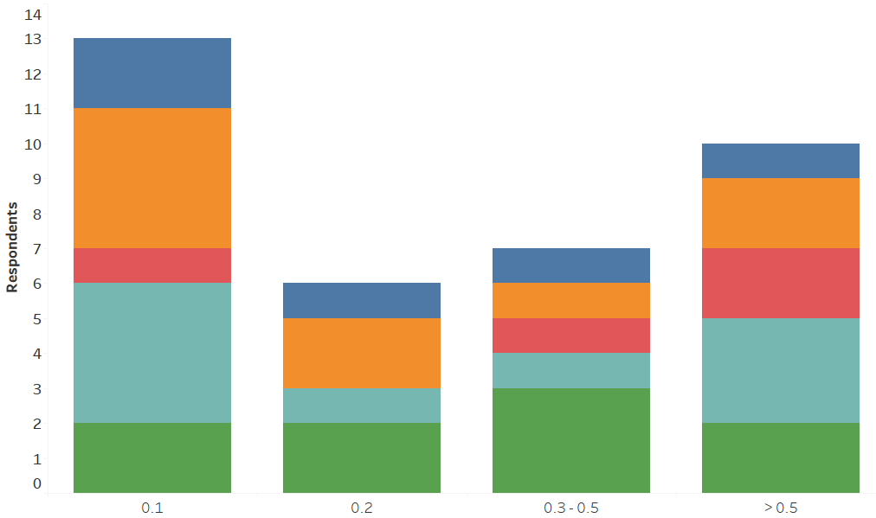
Patents granted per inventor in 2016
Patents granted
© 2017 Association of Corporate Patent Counsel
Notes:
Q19. IP Portfolio data: Total number of patents granted to the company in 2016 (any country)
Q4. Please list the number of employees that are considered part of your core inventor population (i.e. engineers, scientists, technologists, or others in roles with reasonable opportunity to make a patentable invention)

Slide 52
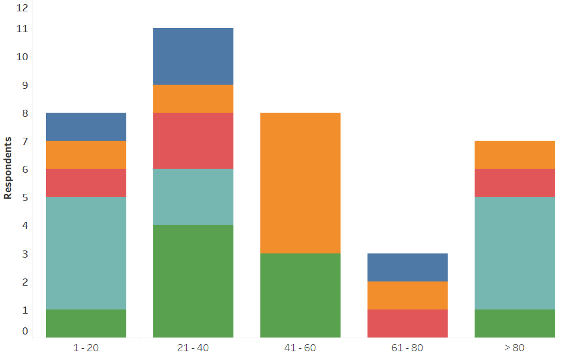
Patents granted per registered patent practitioner in 2016
Patents granted
© 2017 Association of Corporate Patent Counsel
Notes:
Q19. IP Portfolio data: Total number of patents granted to the company in 2016 (any country)
Q9. Patent Related Staffing: Number Registered patent practitioners (patent attorneys, agents, or equivalents) in the IP team

Slide 53
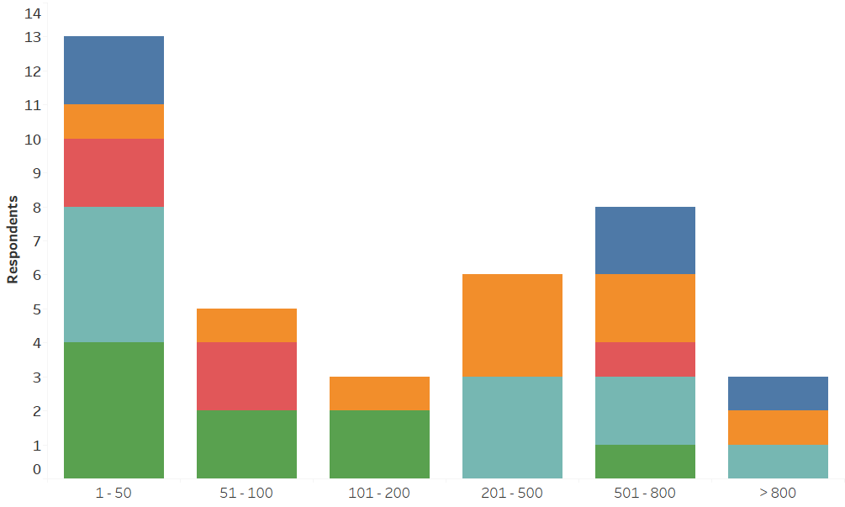
U.S. patents granted in 2016
U.S. patents granted
© 2017 Association of Corporate Patent Counsel
Notes:
Q19. IP Portfolio data: Total number of patents granted to the company in 2016 USA

Slide 54
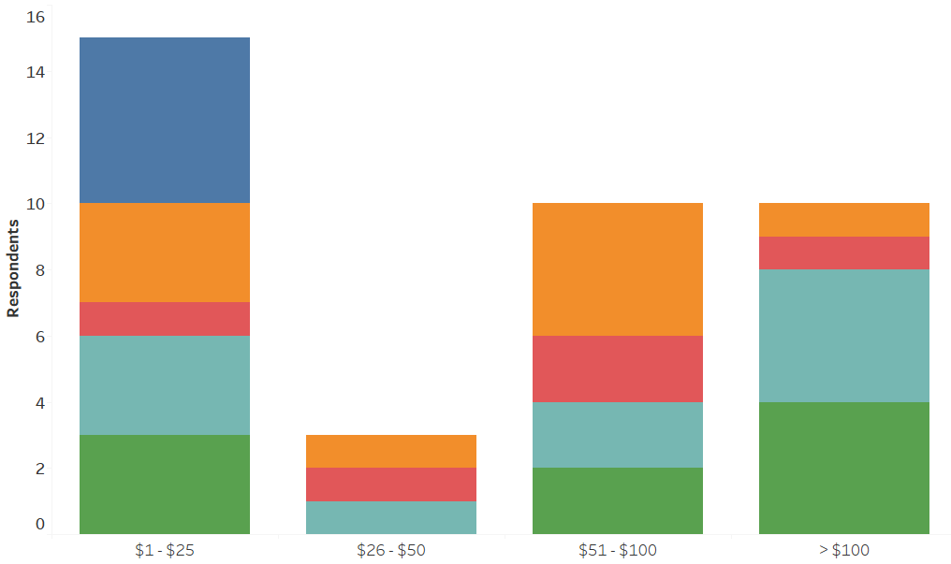
Revenue ($M) per U.S. patent granted in 2016
Revenue ($M) per U.S. patent granted in 2016
© 2017 Association of Corporate Patent Counsel
Notes:
Q2. Please list your company's total sales and revenue in US Dollars
Q19. IP Portfolio data: Total number of patents granted to the company in 2016 USA

Slide 55
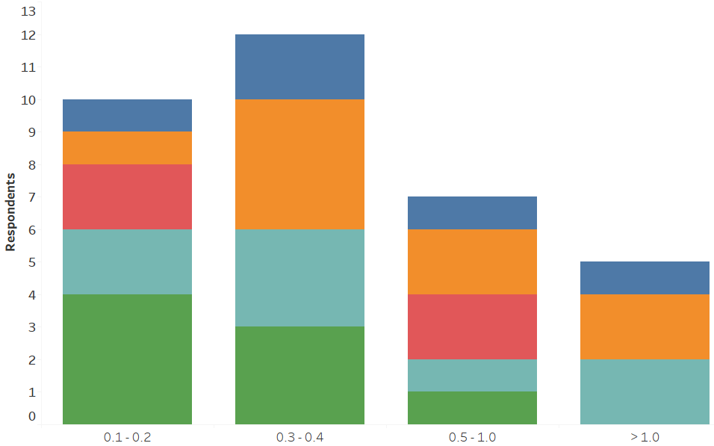
U.S. patent granted in 2016 per $M R&D spend
U.S. patents granted
© 2017 Association of Corporate Patent Counsel
Notes:
Q3. Please list your company's total research and development spend in US Dollars
Q19. IP Portfolio data: Total number of patents granted to the company in 2016 USA

Slide 56
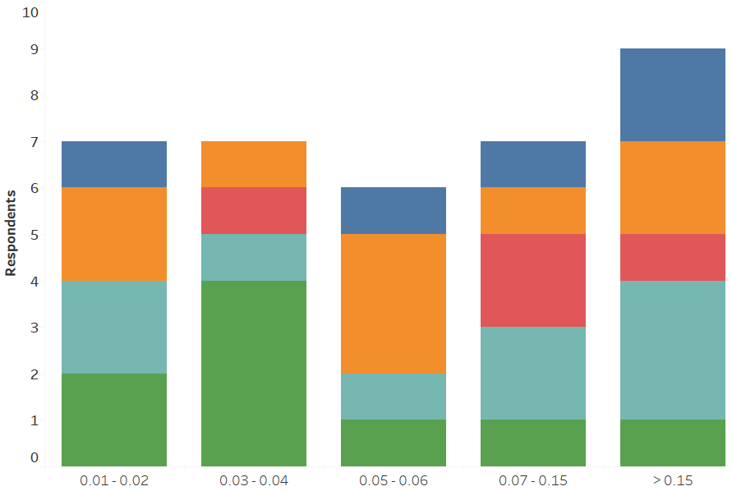
U.S. patents granted per inventor in 2016
U.S. patents granted
© 2017 Association of Corporate Patent Counsel
Notes:
Q19. IP Portfolio data: Total number of patents granted to the company in 2016 USA
Q4. Please list the number of employees that are considered part of your core inventor population (i.e. engineers, scientists, technologists, or others in roles with reasonable opportunity to make a patentable invention)

Slide 57
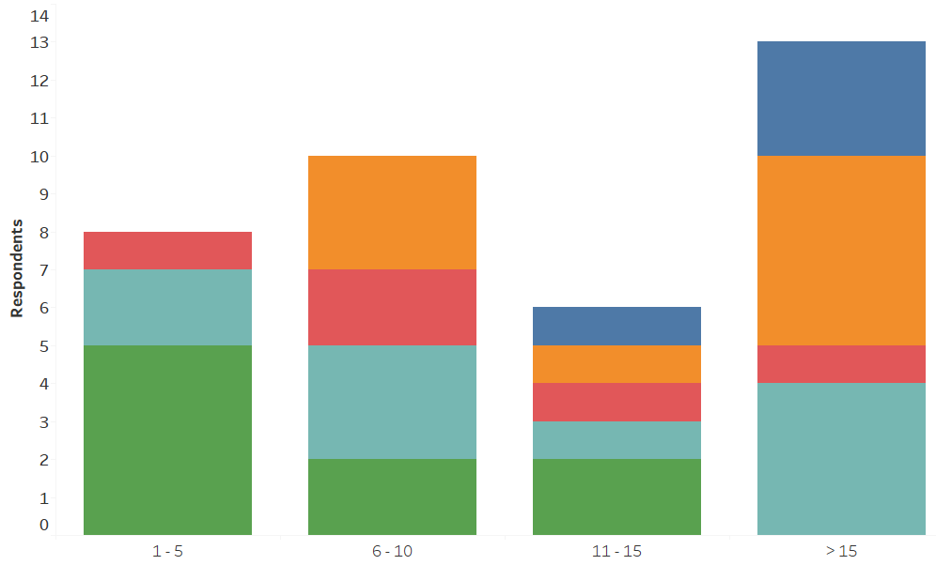
U.S. patents granted per registered patent practitioner in 2016
U.S. patents granted
© 2017 Association of Corporate Patent Counsel
Notes:
Q9. Patent Related Staffing: Number Registered patent practitioners (patent attorneys, agents, or equivalents) in the IP team
Q19. IP Portfolio data: Total number of patents granted to the company in 2016 USA

Slide 58
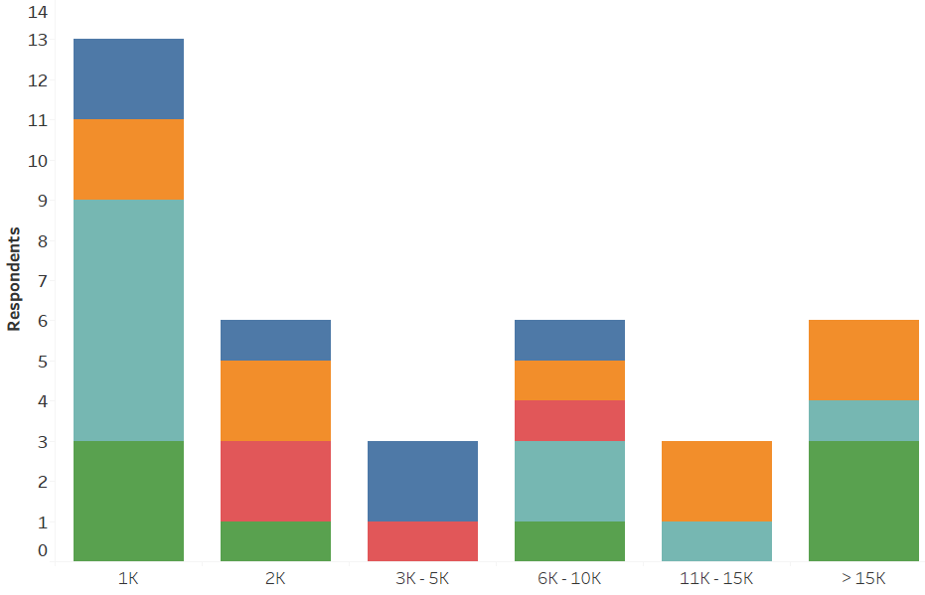
Trademark registrations
Trademark registrations
© 2017 Association of Corporate Patent Counsel
Notes:
Q19. IP Portfolio data: Total number of active trademark registrations (all countries)

Slide 59
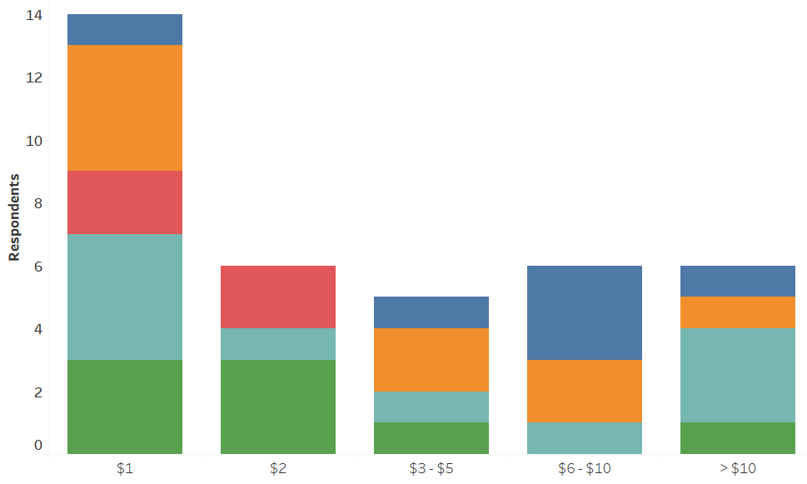
Revenue ($M) per trademark registration
Revenue ($M) per trademark registration
© 2017 Association of Corporate Patent Counsel
Notes:
Q2. Please list your company's total sales and revenue in US Dollars
Q19. IP Portfolio data: Total number of active trademark registrations (all countries)

Slide 60
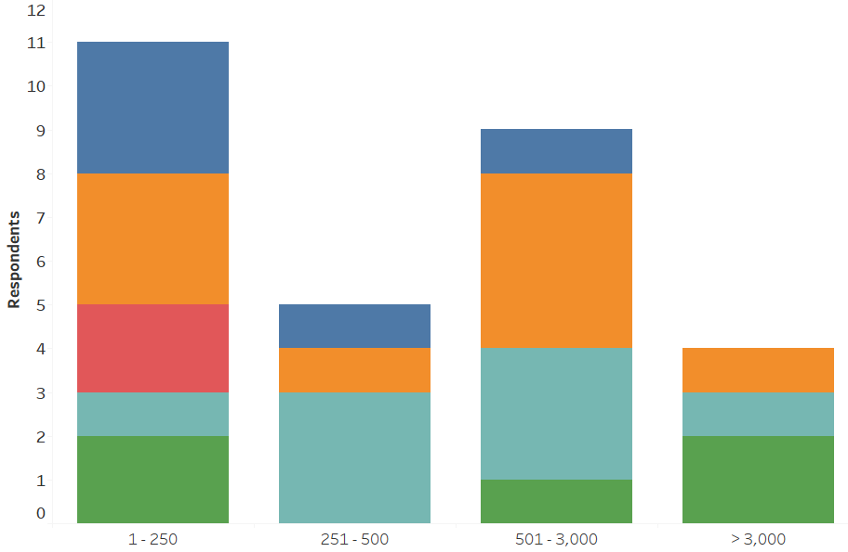
Domain name registrations
Domain name registrations
© 2017 Association of Corporate Patent Counsel
Notes:
Q19. IP Portfolio data: Total number of domain name registrations

Slide 61

Revenue ($M) per domain name registration
Revenue ($M) per domain name registration
© 2017 Association of Corporate Patent Counsel
Notes:
Q2. Please list your company's total sales and revenue in US Dollars
Q19. IP Portfolio data: Total number of domain name registrations

Slide 62

Active patent portfolio
Active patents
© 2017 Association of Corporate Patent Counsel
Notes:
Q19. IP Portfolio data: Total number of active granted patents (including design patents/registrations) (all countries)

Slide 63

Revenue ($M) per active patent
Revenue ($M) per active patent
© 2017 Association of Corporate Patent Counsel
Notes:
Q2. Please list your company's total sales and revenue in US Dollars
Q19. IP Portfolio data: Total number of active granted patents (including design patents/registrations) (all countries)

Slide 64

Active patent per $M R&D spend
Active patents
© 2017 Association of Corporate Patent Counsel
Notes:
Q3. Please list your company's total research and development spend in US Dollars
Q19. IP Portfolio data: Total number of active granted patents (including design patents/registrations) (all countries)

Slide 65

Active patents per inventor
Active patents
© 2017 Association of Corporate Patent Counsel
Notes:
Q19. IP Portfolio data: Total number of active granted patents (including design patents/registrations) (all countries)
Q4. Please list the number of employees that are considered part of your core inventor population (i.e. engineers, scientists, technologists, or others in roles with reasonable opportunity to make a patentable invention)

Slide 66

Active patents per registered patent practitioner
Active patents
© 2017 Association of Corporate Patent Counsel
Notes:
Q19. IP Portfolio data: Total number of active granted patents (including design patents/registrations) (all countries)
Q9. Patent Related Staffing: Number Registered patent practitioners (patent attorneys, agents, or equivalents) in the IP team

Slide 67

Revenue ($M) per pending patent application
Revenue ($M) per pending patent application
© 2017 Association of Corporate Patent Counsel
Notes:
Q2. Please list your company's total sales and revenue in US Dollars
Q19. IP Portfolio data: Total number of pending patent applications (all countries)

Slide 68

Pending patent application per $M R&D spend
Pending patent applications
© 2017 Association of Corporate Patent Counsel
Notes:
Q3. Please list your company's total research and development spend in US Dollars
Q19. IP Portfolio data: Total number of pending patent applications (all countries)

Slide 69

Pending patent applications per inventor
Pending patent applications
© 2017 Association of Corporate Patent Counsel
Notes:
Q4. Please list the number of employees that are considered part of your core inventor population (i.e. engineers, scientists, technologists, or others in roles with reasonable opportunity to make a patentable invention)
Q19. IP Portfolio data: Total number of pending patent applications (all countries)

Slide 70

Pending patent applications per registered patent practitioner
Pending patent applications
© 2017 Association of Corporate Patent Counsel
Notes:
Q9. Patent Related Staffing: Number Registered patent practitioners (patent attorneys, agents, or equivalents) in the IP team
Q19. IP Portfolio data: Total number of pending patent applications (all countries)

Slide 71

Registered patent practitioners $M per R&D spend
Registered patent practitioners
© 2017 Association of Corporate Patent Counsel
Notes:
Q3. Please list your company's total research and development spend in US Dollars
Q9. Patent Related Staffing: Number Registered patent practitioners (patent attorneys, agents, or equivalents) in the IP team

Slide 72

Geographic distribution of granted patent portfolio
© 2017 Association of Corporate Patent Counsel
Notes:
Q20. Percent of total number of granted patents in the following countries: USA Germany United Kingdom Other European Country Russia China India Other

Slide 73

Geographic distribution of pending patent applications
© 2017 Association of Corporate Patent Counsel
Notes:
Q21. Percent of total pending patent applications in the following countries: USA Germany United Kingdom Other European Country Russia China India Other

Slide 74
Patent Strategies & Portfolio Analyses
© 2017 Association of Corporate Patent Counsel

Slide 75

Patent strategies
70% of respondents (31) have a documented patent strategy
For those with a strategy, the strategy is based on
95% of documented strategies are approved by management outside the IP team
© 2017 Association of Corporate Patent Counsel
Notes:
Q25. Are patent strategies for the company documented in writing?
Q26. If you answered "Yes" to question 25: By which categories (select all that apply): Technologies Products Business Line Other
Q27. If you answered "Yes" to question 25: Are the documented strategies approved by management outside the IP team?

Slide 76


Patent ranking / Patent to product tracking
53%
55%
36%
© 2017 Association of Corporate Patent Counsel
Notes:
Q22. Do you keep records indicating the importance of each patent application/granted patent?
Q23. Do you keep records indicating whether each patent application/granted patent covers company products?
Q24. Do you keep records indicating whether each patent application/granted patent covers products in development?

Slide 77
Patent ranking / Patents to products correlation
Average percentage of patents that cover commercialized products:
43%
Average percentage of patents that cover products in development:
37%
Average percentage of patents considered to be highly important:
36%
© 2017 Association of Corporate Patent Counsel
Notes:
Q22. Do you keep records indicating the importance of each patent application/granted patent?
If yes, what percentage of your patent portfolio is considered to be highly important (e.g. high value, critical to business)?
Q23. Do you keep records indicating whether each patent application/granted patent covers company products?
If yes, what percentage of your patent portfolio covers company products?
Q24. Do you keep records indicating whether each patent application/granted patent covers products in development?
If yes, what percentage of your patent portfolio covers products in development?

Slide 78


Invention disclosure time to process targets
Invention disclosure to filing targets
Set by 40% of respondents
Average 132 days / Median 120 days
Filing decision to filing targets
Set by 51% of respondents
Average 85 days / Median 90 days
© 2017 Association of Corporate Patent Counsel
Notes:
Q36. Do you set an expected to target maximum time period for processing an invention disclosure from receipt to filing of a patent application (e.g. not more than 180 days from receipt to filing)?
Q37. Do you set an expected to target maximum time period for processing an invention disclosure from a filing decision to filing of a patent application?

Slide 79
IP Management Tools
© 2017 Association of Corporate Patent Counsel

Slide 80

Patent management systems
98% of respondents use a commercially available tool
© 2017 Association of Corporate Patent Counsel
Notes:
Q28. Do you use a commercially available tool for patent portfolio management?
Q29. If you answered "Yes" to question 28: By which tool (select all that apply):

Slide 81

Trademark management systems
82% of respondents use a commercially available tool
© 2017 Association of Corporate Patent Counsel
Notes:
Q30. Do you use a commercially available tool for trademark portfolio management?
Q31. If you answered "Yes" to question 30: By which tool (select all that apply):

Slide 82
Outside Counsel Activities & Fees
© 2017 Association of Corporate Patent Counsel

Slide 83
Outside counsel usage
84% respondents use outside counsel for drafting new priority filings
On average, 70% of new priority filings are drafted by outside counsel on a fixed fee basis
56% of respondents have fixed fee arrangements with outside counsel for prosecution
© 2017 Association of Corporate Patent Counsel
Notes:
Q34. Percent of:
New/priority patent applications prepared by external providers/outside counsel
Externally prepared new/priority patent applications paid primarily on a fixed/flat fee basis
External US patent prosecution (e.g. office actions, appeals) paid primarily on a fixed/flat fee basis (Y/N)

Slide 84


Use of outside counsel for all patent related activities
U.S.
International
© 2017 Association of Corporate Patent Counsel
Notes:
Q32. Percent of patent prosecution activity handled by external providers/outside counsel:
All countries
USA
Other than USA

Slide 85

Percentage of priority patent applications drafted by outside counsel
© 2017 Association of Corporate Patent Counsel
Notes:
Q34. Percent of: New/priority patent applications prepared by external providers/outside counsel

Slide 86

Percentage of priority patent applications drafted by outside counsel on a fixed fee basis
© 2017 Association of Corporate Patent Counsel
Notes:
Q34. Percent of: Externally prepared new/priority patent applications paid primarily on a fixed/flat fee basis

Slide 87

U.S. patent prosecution on a fixed fee basis
© 2017 Association of Corporate Patent Counsel
Notes:
Q34. Percent of: External US patent prosecution (e.g. office actions, appeals) paid primarily on a fixed/flat fee basis (Y/N)

Slide 88
Average Outside Counsel Fees
Preparation | Respondents | Average Cost
All utility patent fields | 33 | $8,323
Biotech | 2 | $11,250
Chemical non-pharma | 18 | $9,657
Design Drafting | 16 | $3,620
Electrical / Computer | 21 | $8,614
Mechanical / Electromechanical | 23 | $7,497
Prosecution | Respondents | Average Cost
US OA Response | 35 | $2,483
Other | Respondents | Average Cost
Invalidity opinion - US OC | 26 | $19,723
Non-infringement opinion - US OC | 25 | $15,580
Combined non-infringement and invalidity opinion - US OC | 21 | $25,381
© 2017 Association of Corporate Patent Counsel
Notes:
Q33. Average cost of preparing a non-provisional US or equivalent priority application: All utility patent fields, Mechanical/ Electromechanical, Electrical/Computer, Chemical non-pharma, Pharma, Biotech
Q35. Average cost of: Preparing a US or equivalent priority design application, Responding to a substantive office action in a US patent application, A non-infringement opinion by US counsel, An invalidity opinion by US counsel, A combined non-infringement and invalidity opinion by US counsel

