Slide 1
Trends in Collaboration Agreements
Rich Assmus – Mayer Brown
Mike Lee – Google
Heidi Martinez – Xerox Moderator: Shital Shah - Caterpillar

Slide 2
Agenda – Agreement Trends
Introductions
Overview
Topics
Collaboration Across Industry Boundaries
Data Rights & Ownership
Trade Secret Protections

Slide 3
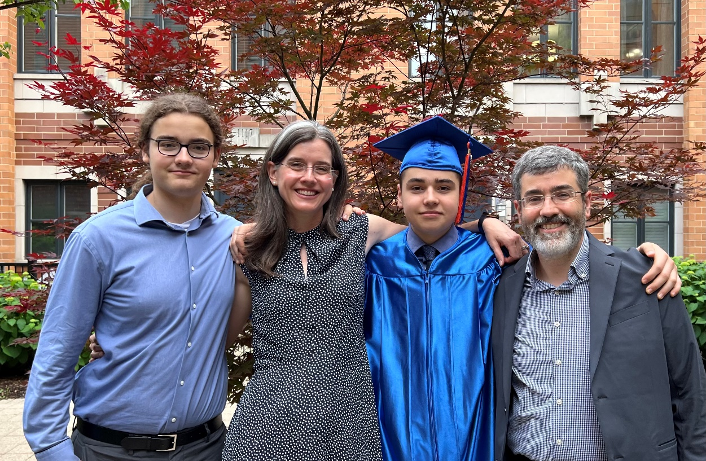
Richard M. Assmus – Mayer Brown
Partner in the Intellectual Property, Brand Management and Litigation practice and co-leads the Firm’s Technology and IP Transaction practice
Chicago, Illinois
B.S. Mathematics – University of Chicago
Family
J.D. – University of Michigan Law School

Slide 4
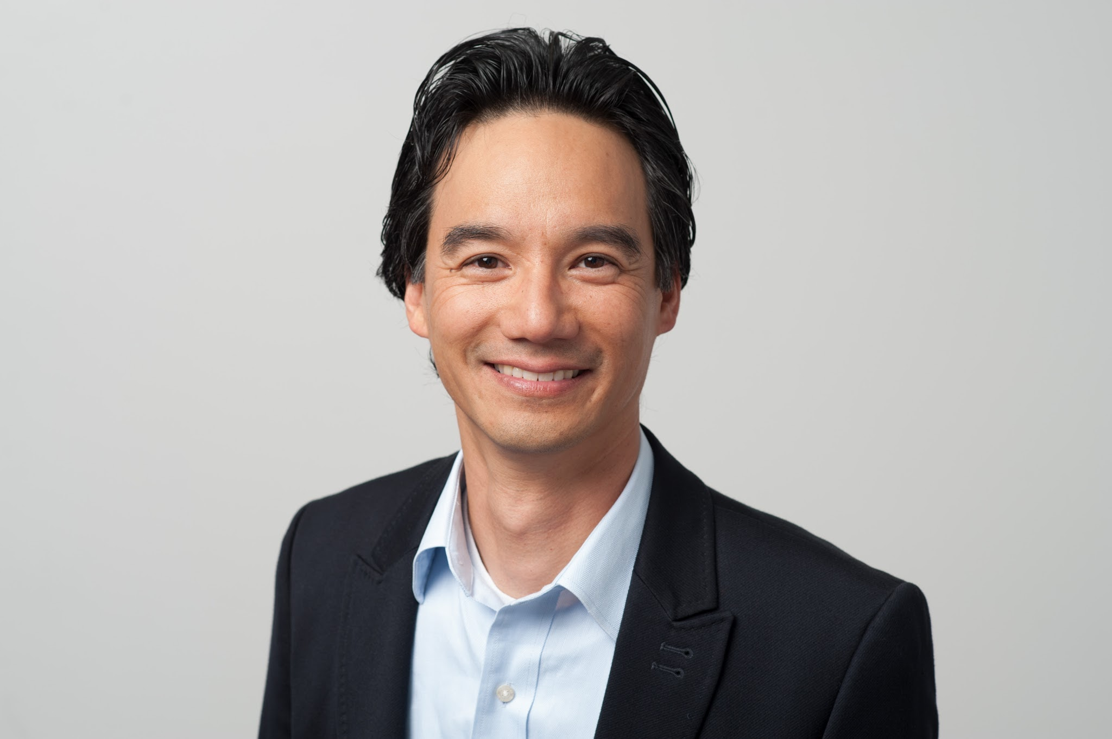
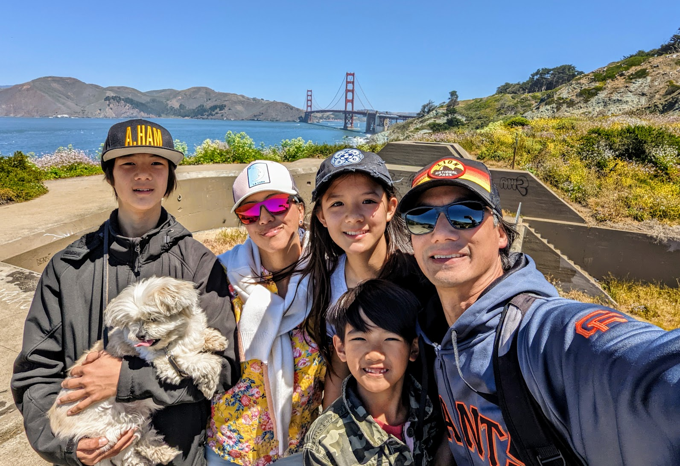
Mike Lee – Google LLC
Director, Head of Patents
Los Altos, California
B.S., Materials Science Eng, UC Berkeley
J.D., George Washington
Family

Slide 5
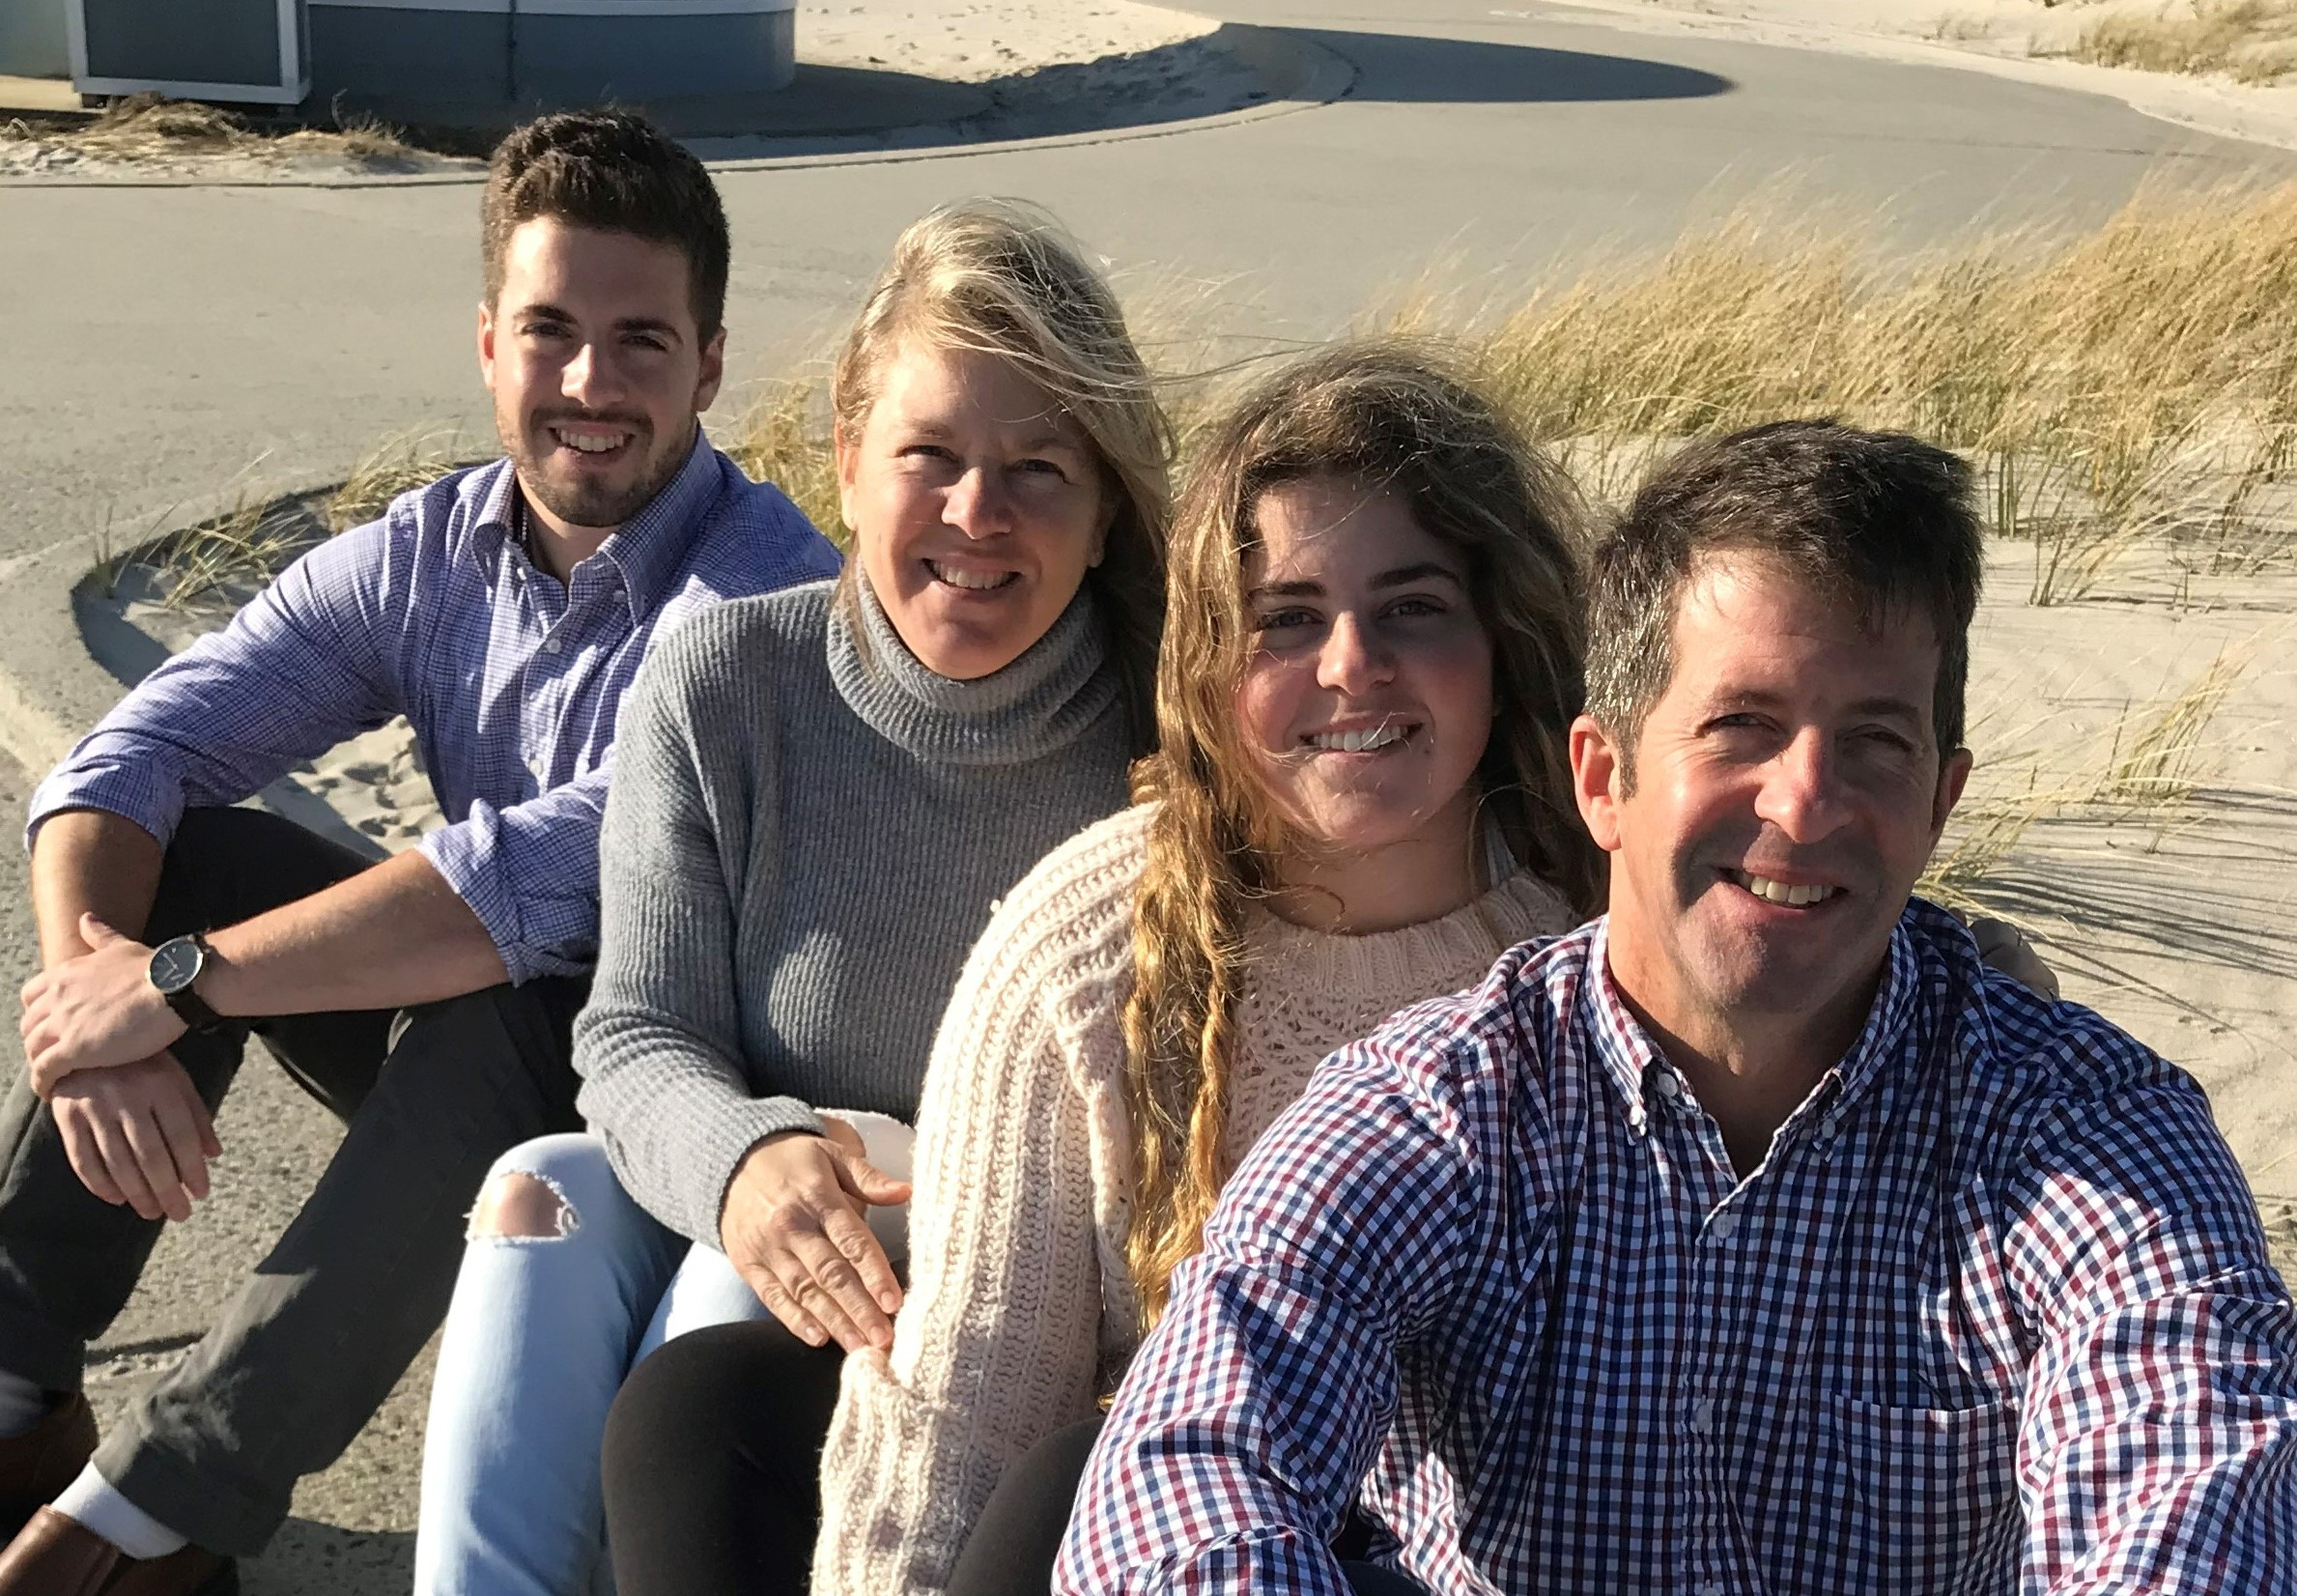
Heidi S. Martinez – Xerox Corporation
Chief IP Counsel, Associate General Counsel
Webster, New York
B.A. History – University of Rochester
Family
J.D. – Boston College Law School

Slide 6
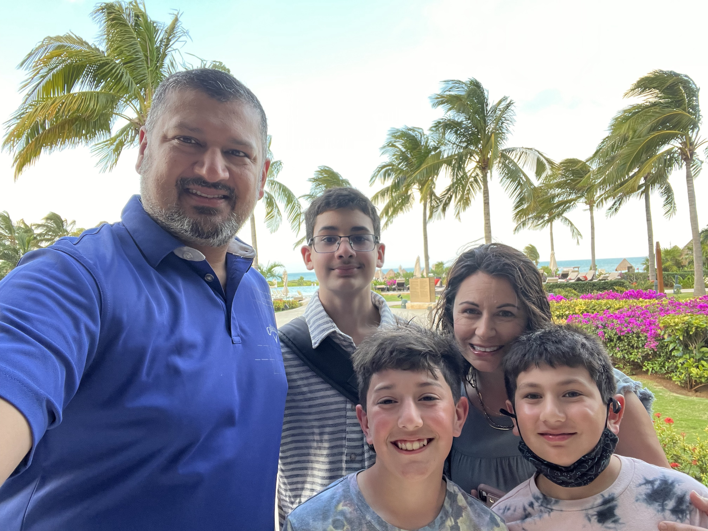
Shital A. Shah – Caterpillar Inc.
Associate General Counsel – Global Patent Strategy
Peoria, Illinois
B.S. Engineering Mechanics – Univ. of Cincinnati
Family
J.D. – University of Cincinnati

Slide 7
Collaboration Essentials
Become familiar with the other party to the agreement to properly structure the joint development
Understand the purpose of the joint development and what each party expects from the relationship
Understand what each party will or will not contribute to the joint development and how those contributions are protected
Due diligence related to contributed IP is important
Use representations to protect the JV from future disputes and issues
Whether contributed IP should be licensed or assigned to the JV and/or parties is fact-dependent and includes analysis of factors like the contributor’s need/desire to use the IP going forward

Slide 8
Collaboration Essentials
Define ownership, control, and maintenance of joint IP
Be very clear about what royalties or accounting will be due to the parties
Provide for termination and future of the joint development
Define what each party can do with any contributed or joint IP after the JV terminates

Slide 9
Poll Question #1 (please use the Whova App)
Has anyone participated in a significant collaboration agreement over the past year?
a. Yes
b. No

Slide 10
Poll Question #2 (please use the Whova App)
Has anyone participated in a cross-industry collaboration with any of the following:
(multiple answers okay)
a. US Government
b. Non-US Government
c. University
d. Start-Up
e. Venture Capital

Slide 11
Poll Question #3 (please use the Whova App)
Are you concerned about Data Rights use and ownership in agreements?
a. Yes
b. No

Slide 12
Poll Question #4 (please use the Whova App)
What aspect of data rights do you find most challenging when negotiating?
(multiple answers okay)
a. Ownership
b. Access
c. Use
d. Privacy
e. Data Rights Enforcement
f. All of the Above

