Slide 1
Building a High-Quality Patent Portfolio
ACPC 2023 Winter Meeting
Tonya Combs
Senior VP, Deputy General Patent Counsel
ELI LILLY and COMPANY
Olivia Tsai
Assistant General Counsel, Head of IP
CRUISE
Estelle Bakun
Assistant General Counsel of Technology and IP
EXXON MOBIL CORPORATION
Kirstin Stoll-DeBell
Partner
FAEGRE DRINKER BIDDLE & REATH
Notes:
To change the image on this slide, select the picture and delete it. Then click the Pictures icon in the placeholder to insert your own image.

Slide 2
WHAT DOES “HIGH-QUALITY” MEAN?

Slide 3
AUDIENCE QUESTION:
What is the MOST important aspect of a high-quality patent portfolio?
Size
Enforceability
Geographic Scope
Technical Breadth
Revenue generation
Blocks competitors
Alignment with business strategy
Other

Slide 4
PANEL QUESTION:
How do you define a
High-Quality patent portfolio
for your company?

Slide 5
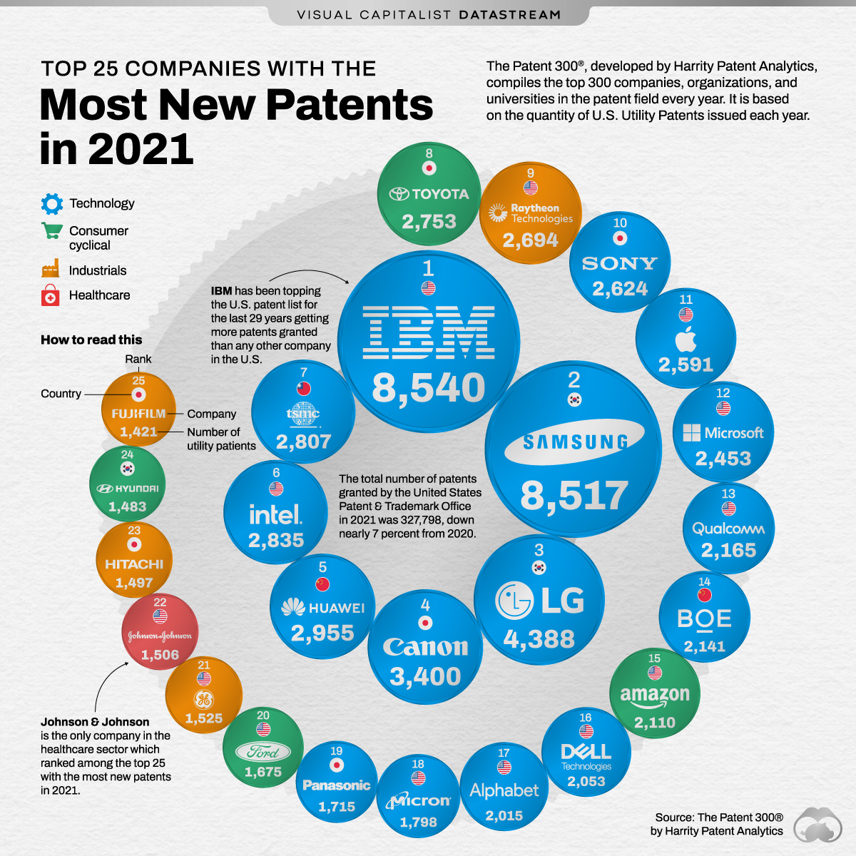
What is the Right SIZE Portfolio for your Company?
Are there benchmarks to use?
% of spend on R&D
% of spend by revenue
Competitor benchmarking
Alignment with business strategy and goals
Aggressive High Number:
Technology changes quickly
Groundbreaking discoveries
Young company or industry
Competitors are litigious
Conservative Low Number:
Technology is slow to change and/or is incremental
Mature company or industry
Majority of sales are for components
Patent litigation is rare

Slide 6
AUDIENCE QUESTION:
How many Total Active Issued U.S. Patents are in your company’s patent portfolio?
Less than 500
Between 500 and 1000
Between 1000 and 2500
Between 2500 and 5000
More than 5000

Slide 7
PANEL QUESTION:
What metrics do you use to determine the quality of your company’s patent portfolio?

Slide 8
How to Determine Patent Quality of a Portfolio?
Some Potential Metrics for Determining Quality
Efficiency:
Rounds of prosecution?
Time to issuance?
Does longer prosecution equal higher or lower quality?
Scope:
Number of columns in the specification and number of drawings?
Number of patent families and/or average number of members in a family?
Breadth of technology areas covered?
Your company’s products?
Competitor’s products?
SEPs?
Economic Value of products covered by patents?
Economic and Non-Economic Value
How much revenue is generated from licensing? Litigation? Selling? Pledging?
Impact on company’s reputation as an innovator?
Alignment with Business Strategies

Slide 9
PANEL QUESTION
Assuming you have a fixed budget to spend on patents, what are things you can do to maximize the quality of that spend?

Slide 10
AUDIENCE QUESTION:
Does the amount of legal spend impact the quality of a patent portfolio?
Yes – positively
Yes – negatively
Not at all

Slide 11
HOW TO BUILD “HIGH-QUALITY” PORTFOLIOS?

Slide 12
AUDIENCE QUESTION:
What is the MOST important goal for your company’s patent portfolio?
Licensing income?
Financial returns on R&D?
Disincentives for competitors to initiate suit against your company?
Inhibiting competitors’ R&D?
Showing value through a reputation for innovation?
Other?

Slide 13
PANEL QUESTION
What are the MOST important things your company should do to build a high-quality patent portfolio?

Slide 14
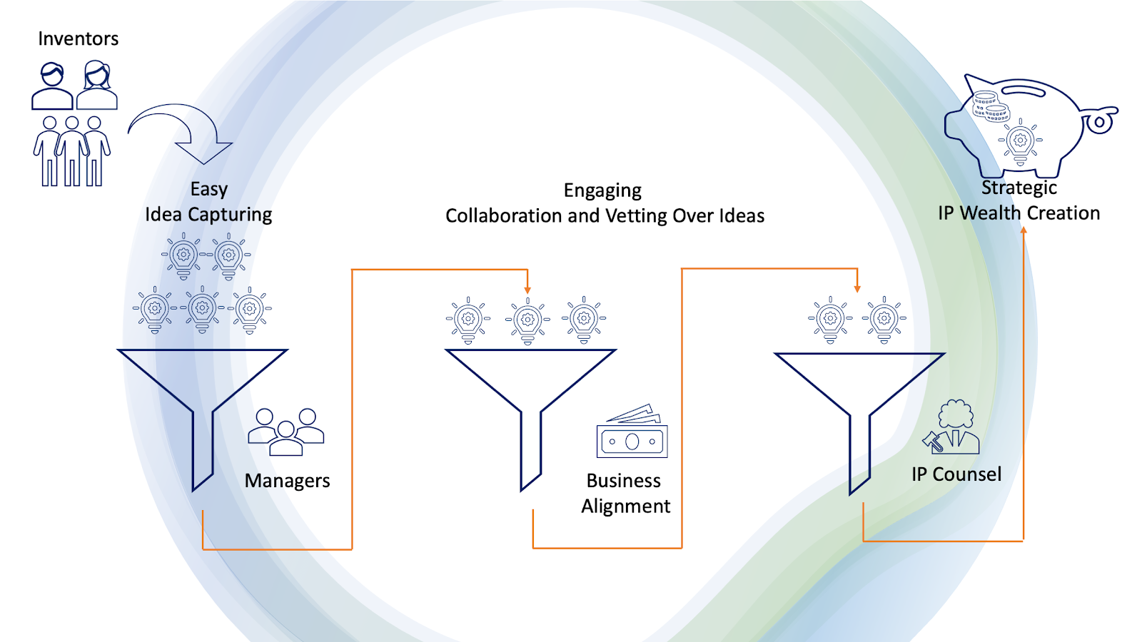
Strengthening your Portfolio Proactively

Slide 15
PANEL QUESTIONS:
Analysis of competitive patent landscape:
Do you recommend doing this?
Recommendations for efficiency?
How to minimize risk for willfulness and intent for indirect infringement?

Slide 16
PANEL QUESTION
How do you determine how much to budget for legal spend to build and maintain a high-quality patent portfolio?

