Slide 1

COMMUNITY DEVELOPMENT INSTITUTE
Effective Meeting Facilitation/Conflict Resolution
Presented by
JOVON B. RICHARDSON, Founder & Principal Consultant
Lagniappe Business Services LLC
www.jeauxbrumfield.com

Slide 2


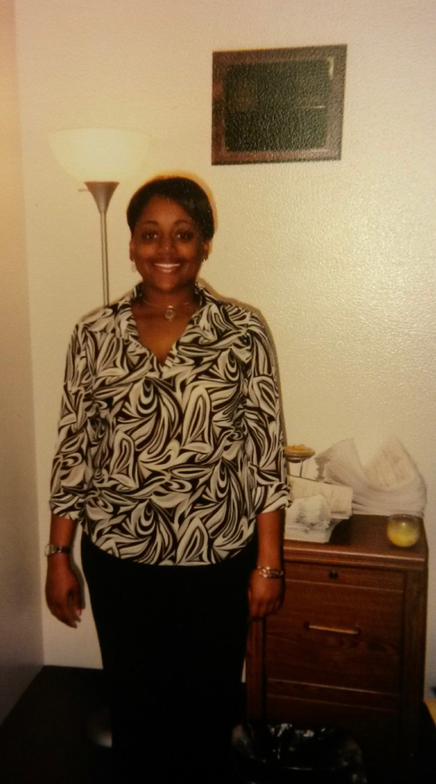
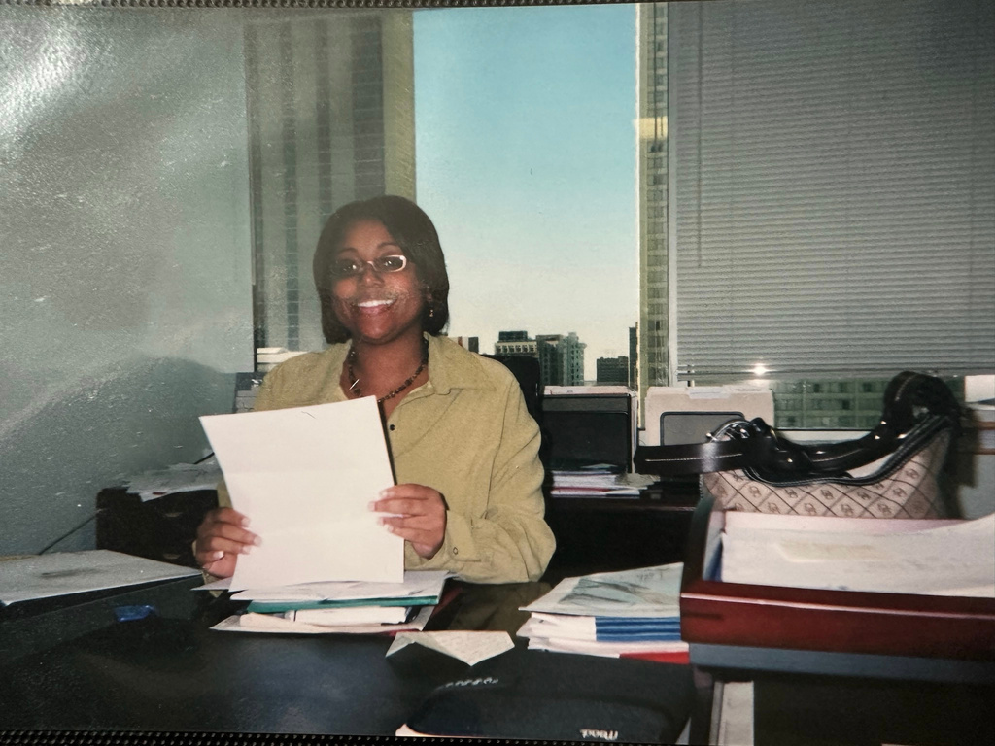
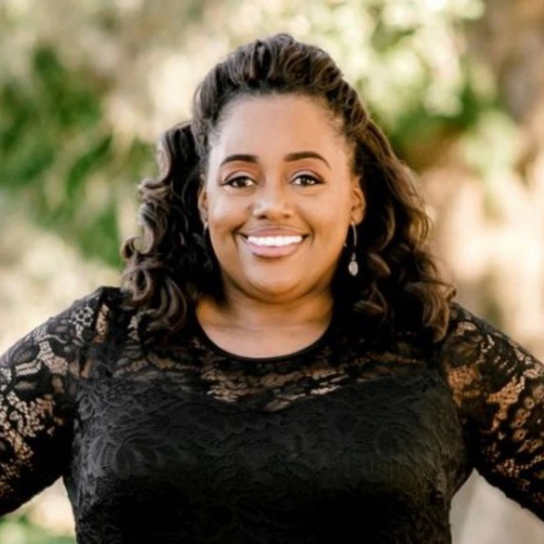
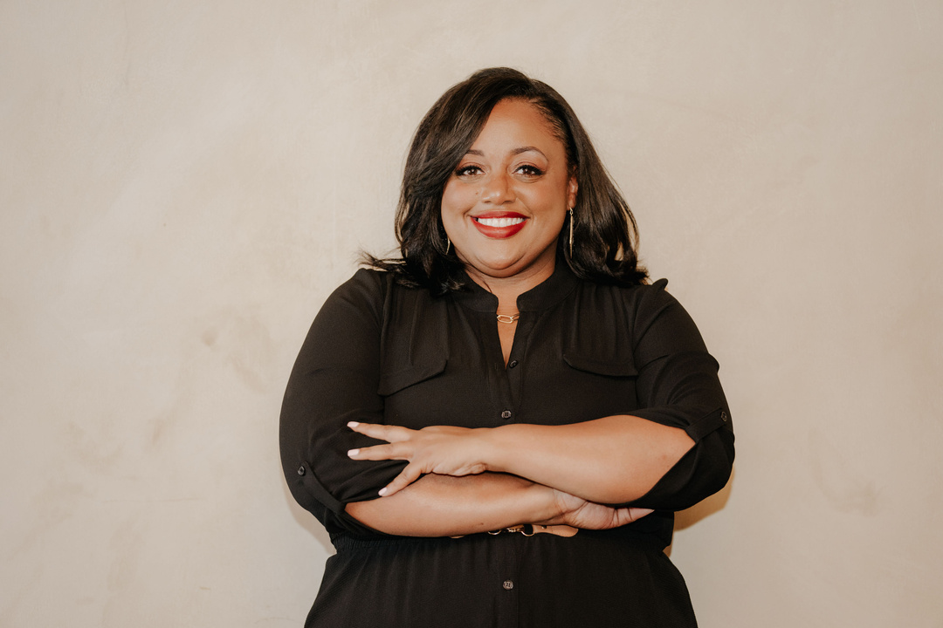
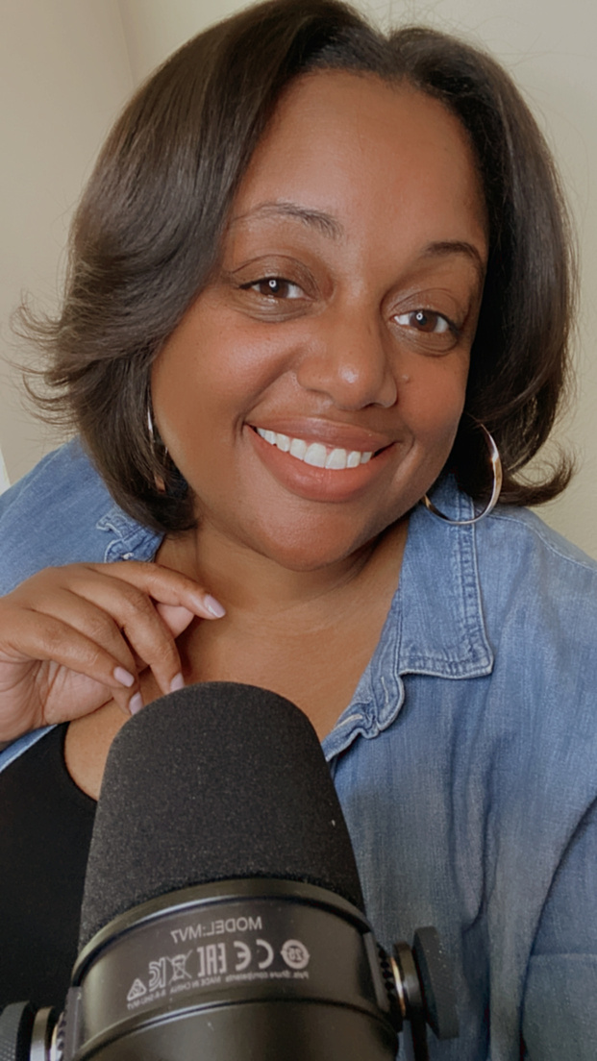
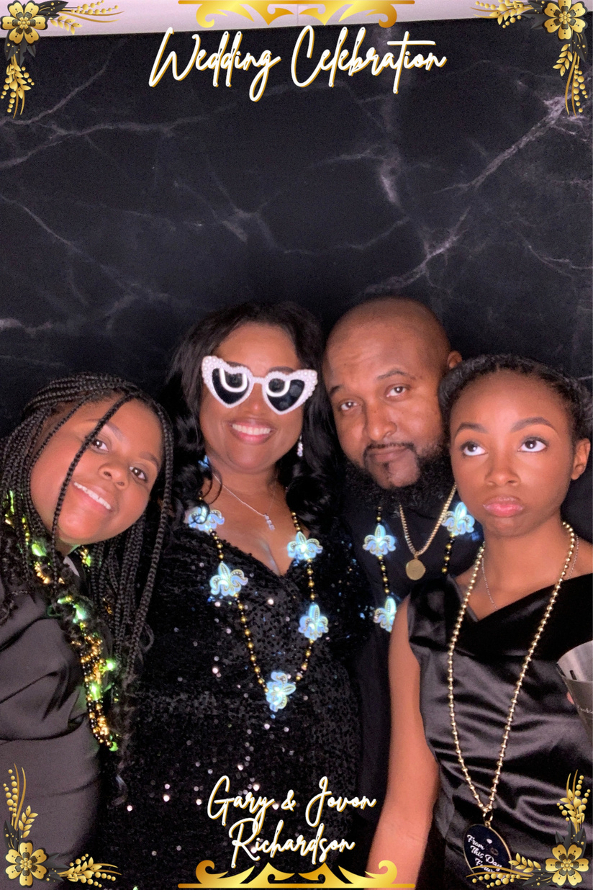
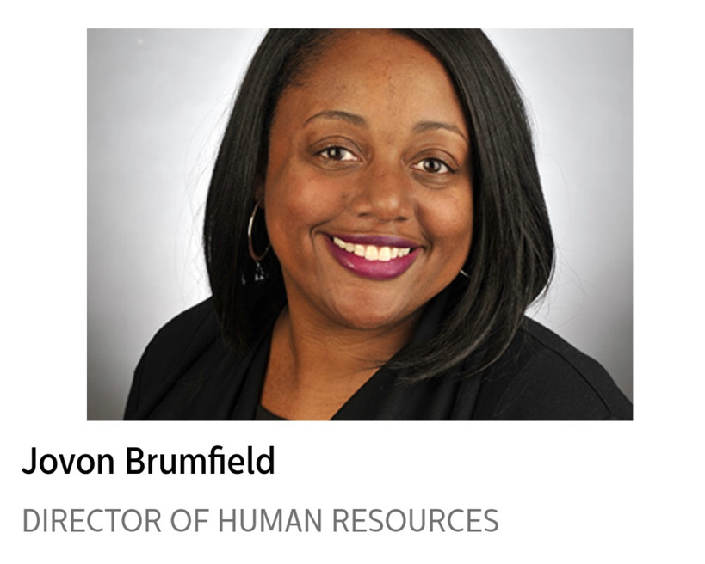
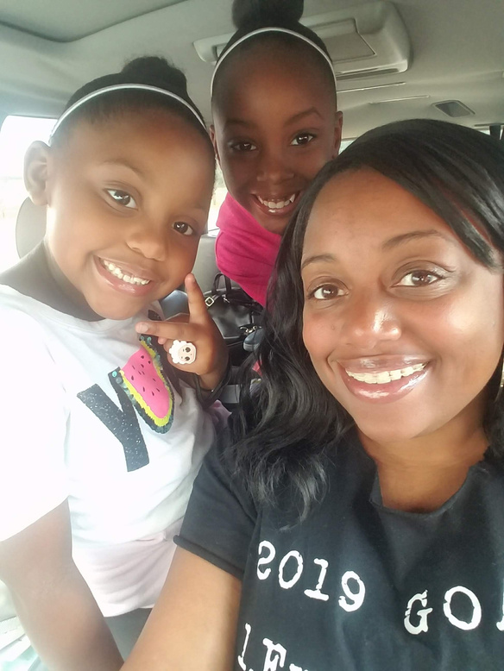

Slide 3
“Leadership
is
INFLUENCE.”

Slide 4



FOUNDATION OF EFFECTIVE LEADERSHIP
AWARENESS
COMMUNICATION
STRATEGY

Slide 5
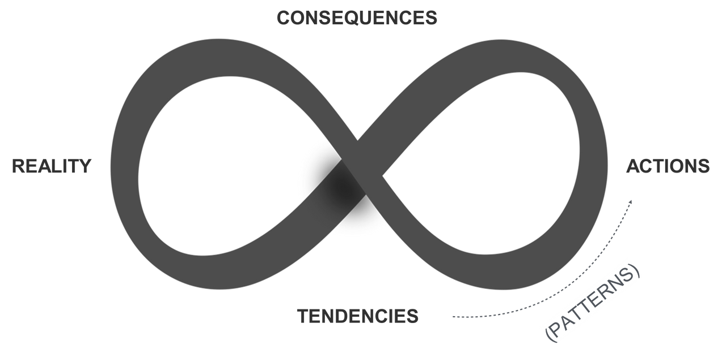

MAXIMIZE YOUR INFLUENCE
KNOW YOURSELF TO LEAD YOURSELF
AWARENESS

Slide 6
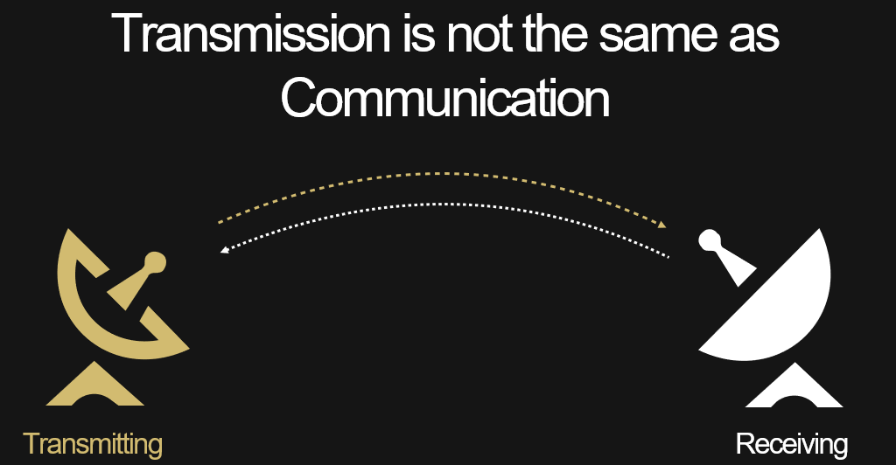
MAXIMIZE YOUR INFLUENCE
COMMUNICATION

Slide 7
MAXIMIZE YOUR INFLUENCE
Be
INTENTIONAL
STRATEGY

Slide 8


Slide 9
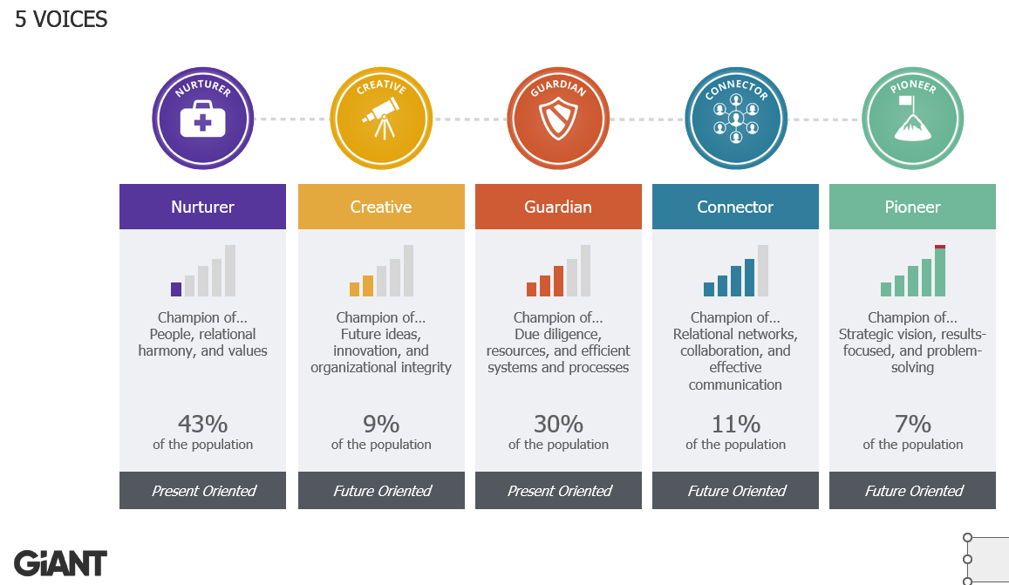

Slide 10
BEFORE THE MEETING

Slide 11
BEFORE THE MEETING
CONSIDER THE FOLLOWING:
  PURPOSE
    Do we need to meet?
    What are the intended outcomes?
    In-person vs. virtual?
  ATTENDEES & ROLES
    Who needs to be invited?
    What roles will they play? (Facilitator, note taker, timekeeper, etc.)
    How should attendees prepare?

Slide 12
BEFORE THE MEETING
  PREPARE THE AGENDA
    Items to consider
      Start/end times, as well as time for each agenda item
      Introductions
      Ground Rules/Meeting Purpose
      Celebration/Acknowledgements
      Review of previous meeting minutes
      Parking lot
      Review of action items and responsible party
        Start with a verb; specify the deliverable; assign an owner; establish a due date
      Schedule next meeting(s)
  INVITATIONS - Send invitation and agenda in advance

Slide 13
DURING THE MEETING

Slide 14
OVERCOMING CHALLENGES
  Stalled Conversations
  Sidebar Conversations
  Consensus vs. Compromise vs. Cooperation
What challenges
have you encountered in past meetings?
How did you handle them?

Slide 15
AFTER THE MEETING

Slide 16
AFTER THE MEETING
  FINISH JUST AS YOU STARTED - WITH INTENTION
    RECAP decisions, action items, deadlines
    Schedule next meeting(s)
  AFTER THE MEETING
    Email meeting minutes + action items
    Solicit feedback via polls and surveys
    Create and execute accountability plan for action items

Slide 17
Questions?
Key Takeaways?

Slide 18
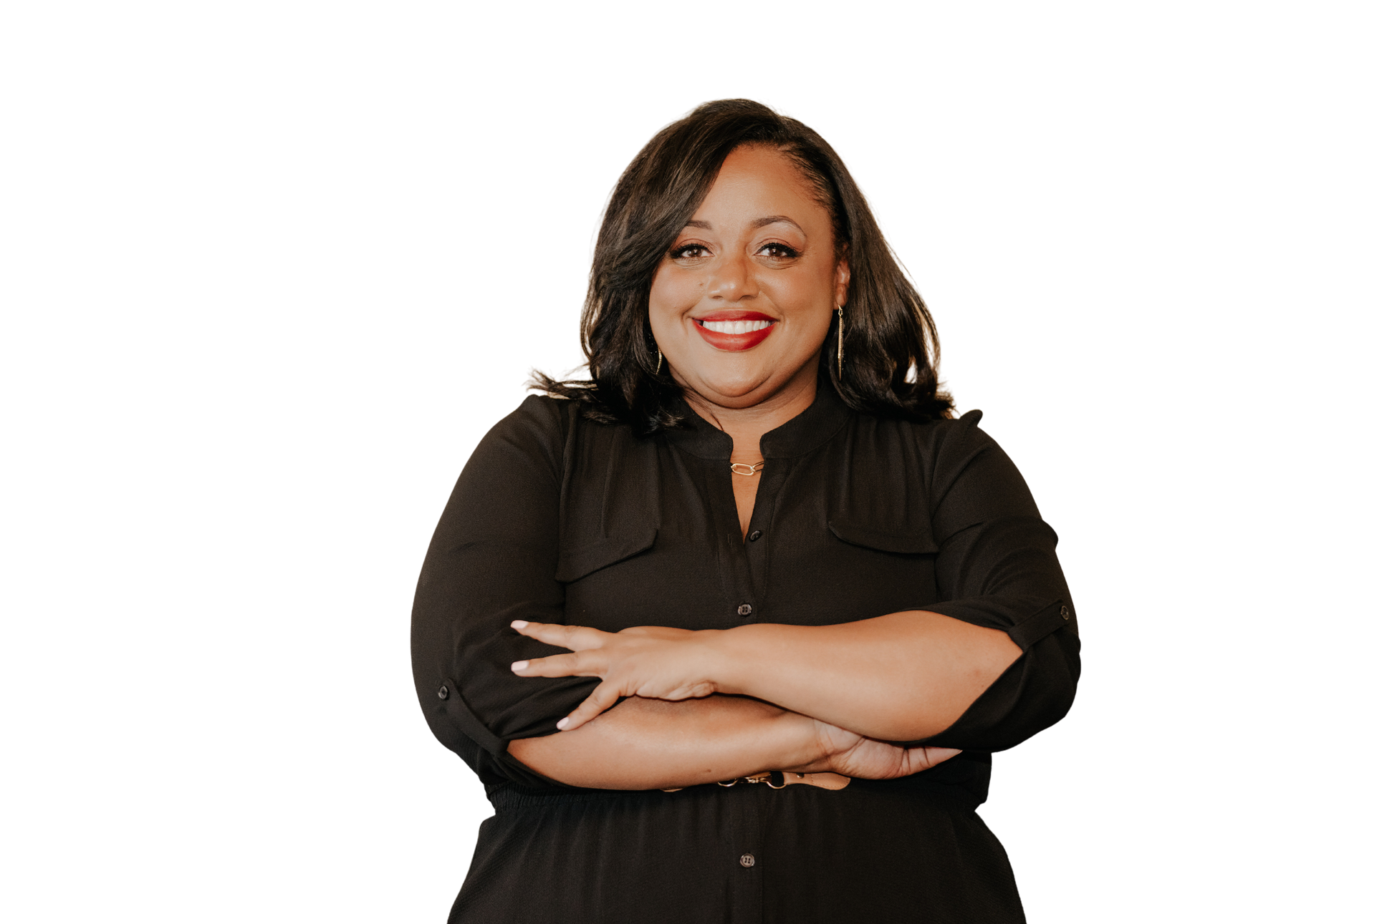
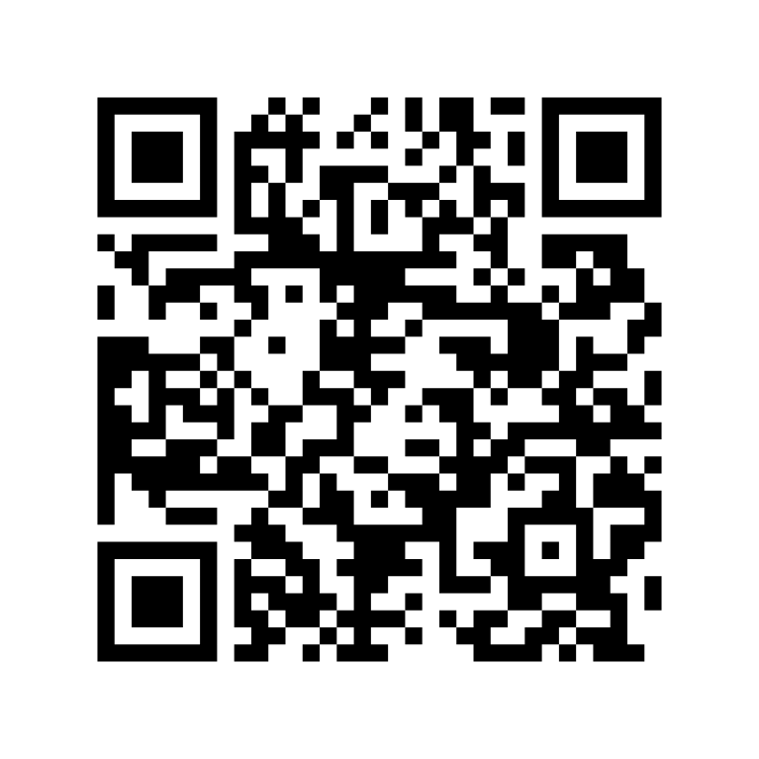
Let's stay
connected
THANK YOU!

