Slide 1
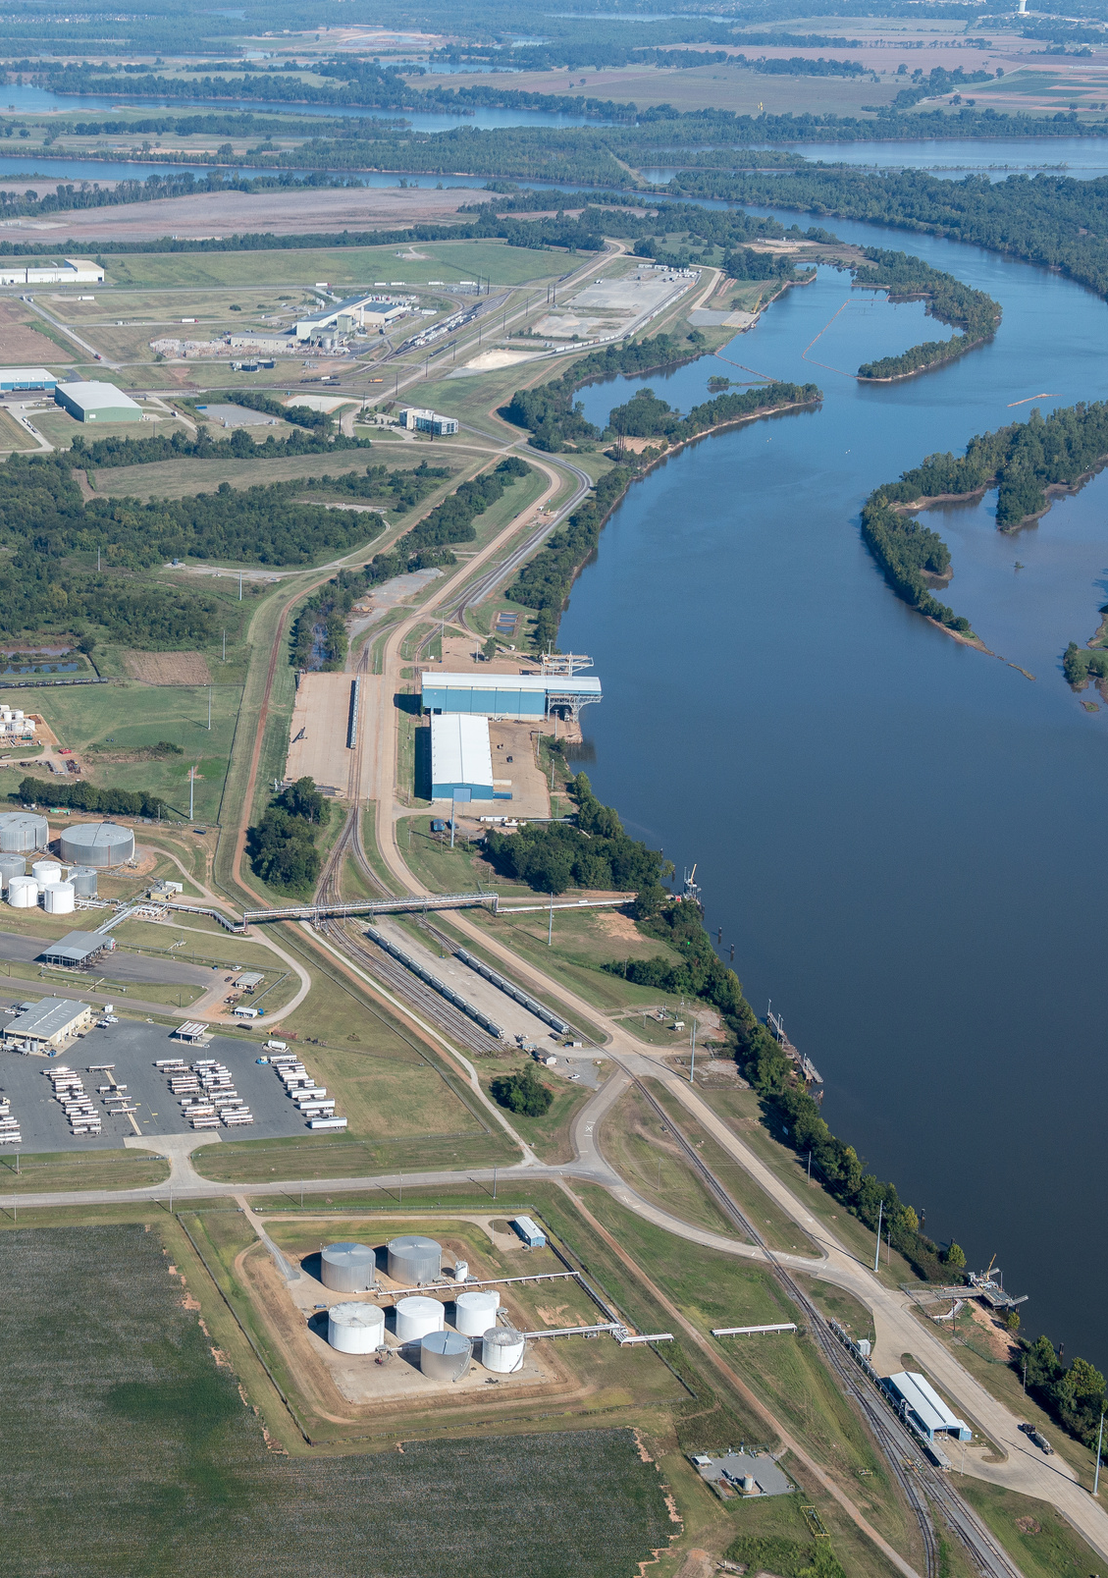

Business Attraction & Site Selection
Presented to CDI, Class of 2025
Angie White, CEcD
COO | NLEP
nlep.org

Slide 2
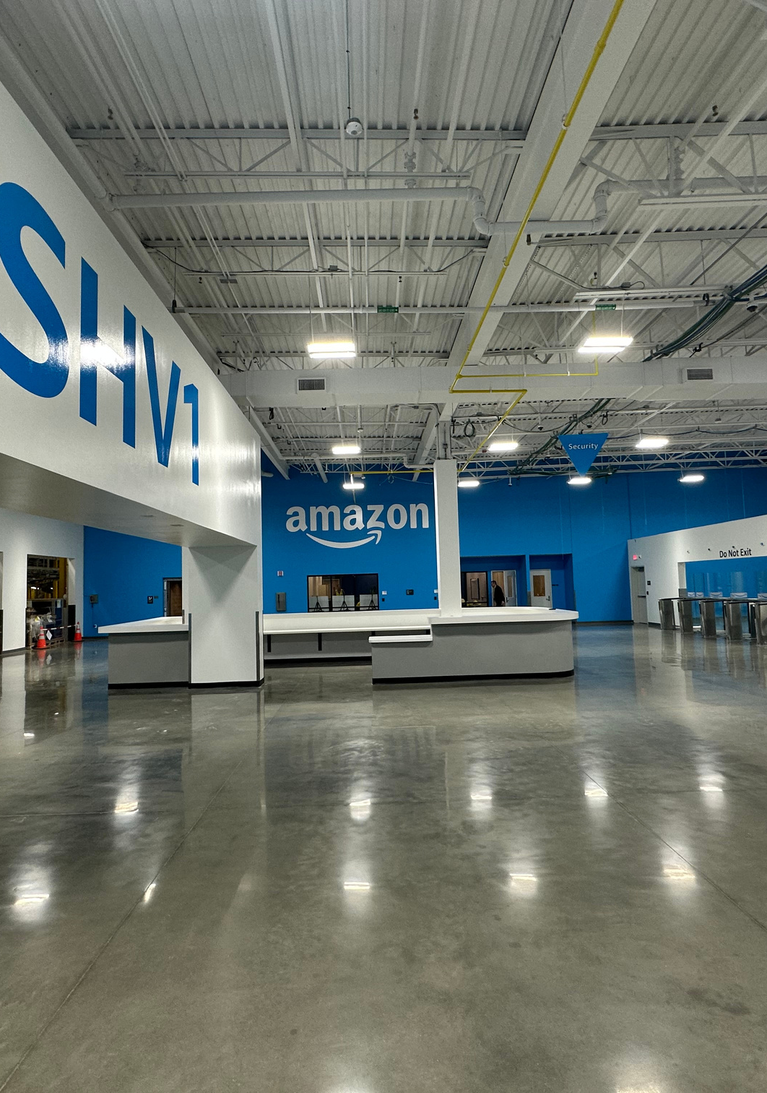










Agenda
About NLEP
What is Site Selection?
Managing the Site Selection Process to Win
Relationship Management for Future Opportunities
Q&A

Slide 3
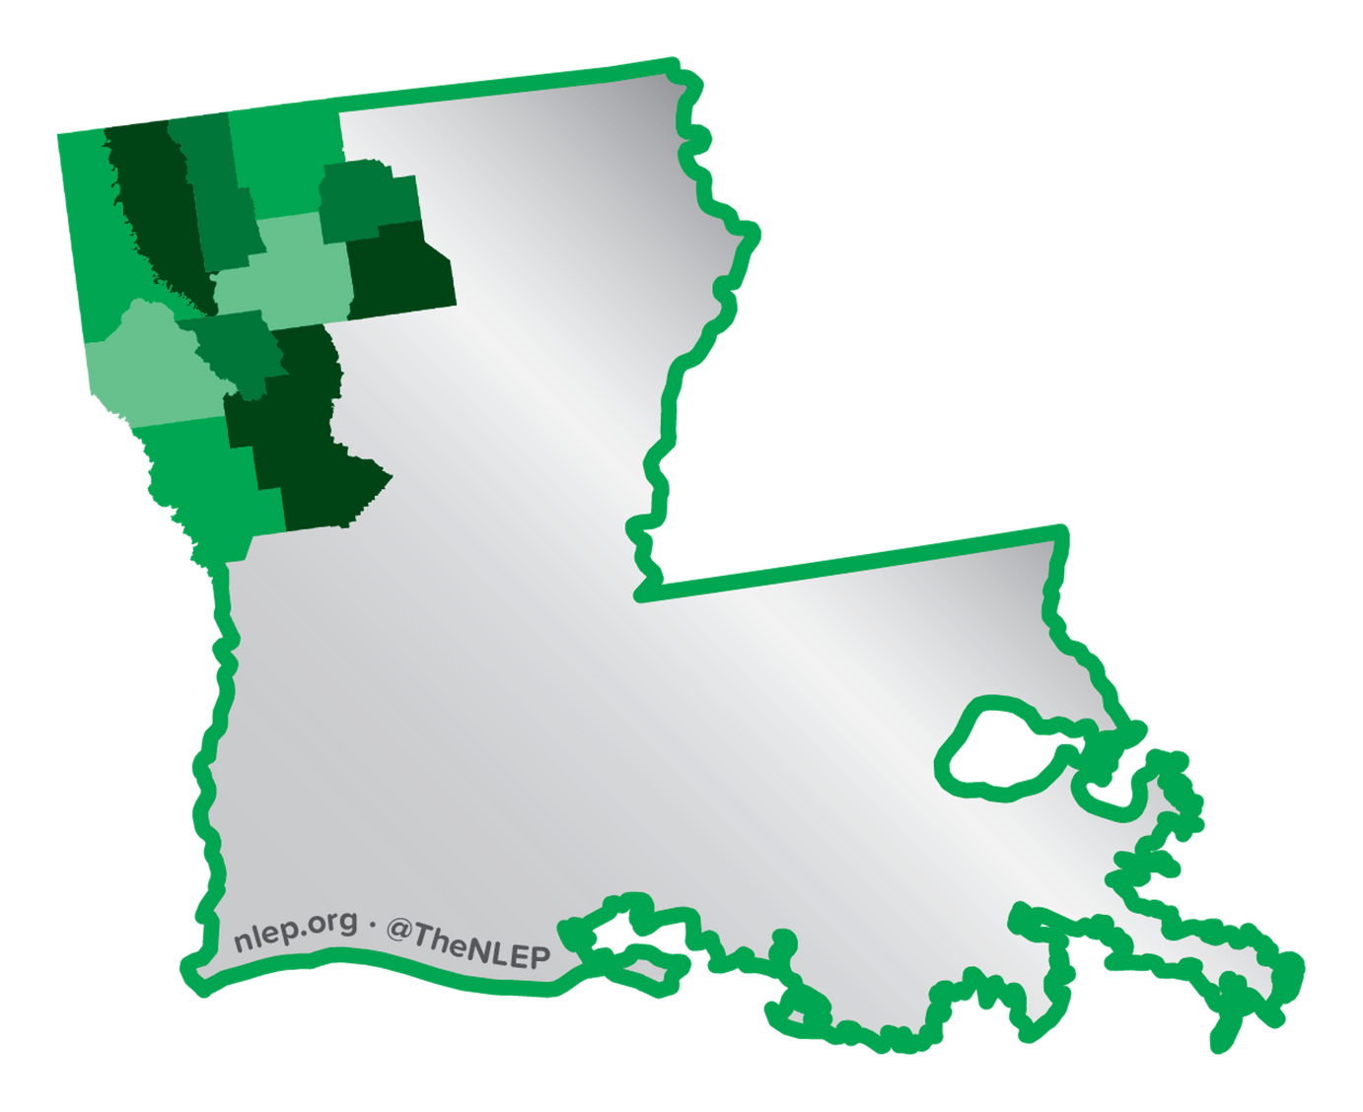
About NLEP
Private-Public Nonprofit Regional EDO (REDO)
150 Investors
1 of 80 Accredited EDOs
7 Staff Members
4 IEDC Excellence in Economic Development Awards
2 Certified Economic Developers
1 ED Finance Professional
1 Professional Community & Economic Developer
1 Certified Workforce Developer

Slide 4







Our Team
Justyn Dixon
President and CEO
Angie White
Chief Operating Officer
Sheena Bryant
V.P. of Business Development Strategy
Dean Baugh
Director of Existing Industry
Michele Riney
Director of Operations
Megan Delgado
Senior Project Manager
Lanier Thibodeaux
Director of Marketing

Slide 5

What is Site Selection?
Seeking specific data on communities to compare them and determine the most profitable location for a project (RFI)
Verifying the data submitted (site visit)
Comparing due diligence findings on eligible communities
Selecting the location of choice

Slide 6
Why Not Retail, Healthcare, Hospitality?
Depends on the EDO’s mission
For NLEP, focus is on traded sectors (goods/services mostly sold outside the market)
Business brings new income into the local economy rather than recirculating it
Job multiplier effects tend to be higher

Slide 7
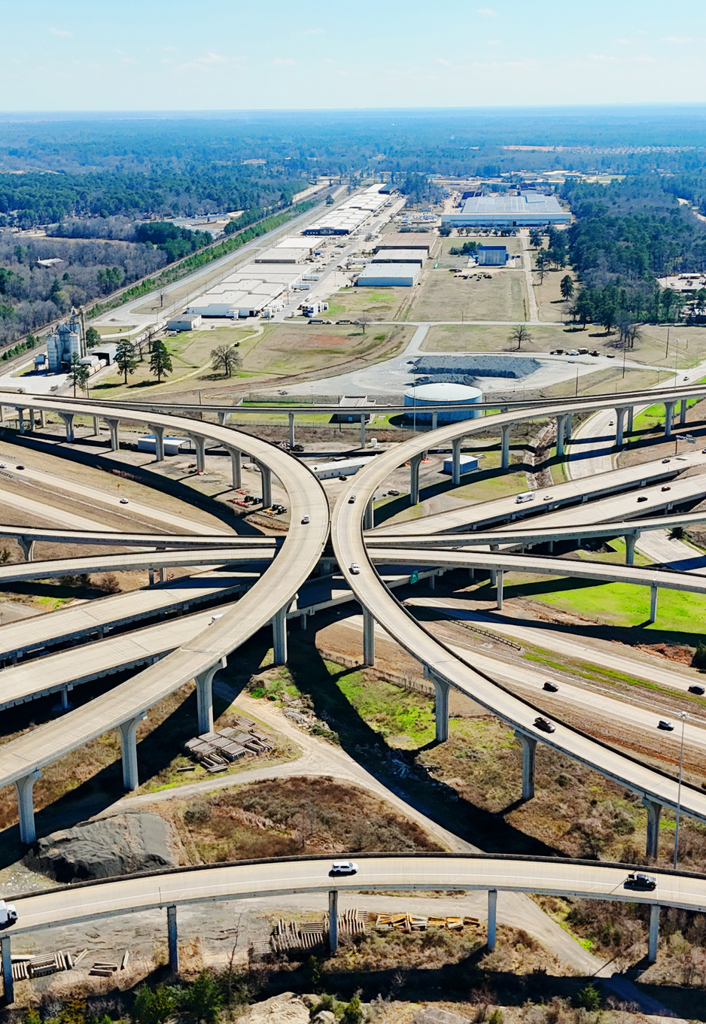
Reasons for Site Search
Growth of Existing Product or Service
New Product or Service
Need to Relocate
Quality of Life Concerns of Owner/Mgmt
Logistical Factors

Slide 8
Key Drivers of Site Selection
Physical facility / site needs
Geographic location requirements
Local market requirements

Slide 9
The Role of Incentives
Incentives should always be guided by the “but for” rule, except when they are not . . .

Slide 10
Types of EcDev Incentives
Statutory
Discretionary

Slide 11
Types of EcDev Incentives
Tax exemptions or reductions
Job creation credits
Special utility rates
Expedited permitting
Low-interest loans
Reduced price for land/building
Infrastructure development and site preparation
Labor training

Slide 12
Key Players:
Decision-Maker Side
Company CEO or other C-Suite Exec
Corporate Board
Division or Department
Committee/special leadership team
Site Location Consultants
Industrial/Commercial Real Estate Agents

Slide 13
Key Players:
Location Side
EDO (state, regional and/or local)
Utility Providers
Property owner/representative
Relevant government departments (state, local)
Workforce reps
Existing industry
Local business/elected leadership

Slide 14

Managing the Site Selection Process to Win
Speed
Cost
Risk

Slide 15

Managing the Site Selection Process to Win
Promptness
Thoroughness
Accuracy
Honesty
Confidentiality
Collaboration
Integrity

Slide 16
Relationship Mgmt for Future Opportunities: Site Selectors
Attend site selector-focused event
Attend target industry-focused events
Go visit them
Familiarization tours
Guest speaking opportunities
Share relevant news

Slide 17
Relationship Mgmt for Future Opportunities: Industry
Regular BRE visits
HQ visits
Be part of local business team to fight for investment
Be a solution provider
Be a resource connector

Slide 18




Questions
318.677.2559
awhite@nlep.org
nlep.org

