Slide 1
On The Horizon
Key Energy Trends
Midwest Energy Summit – Fargo, ND
November 7, 2024
Tony Clark

Slide 2
Four Key Trends
Rapid Demand Growth
Large-Scale Retirements of Dispatchable Generation
Carbon Constrained Policy Environment
No Easy Near-Term Zero Carbon Capacity Replacement

Slide 3
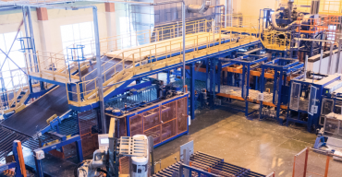
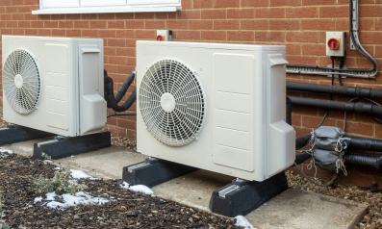
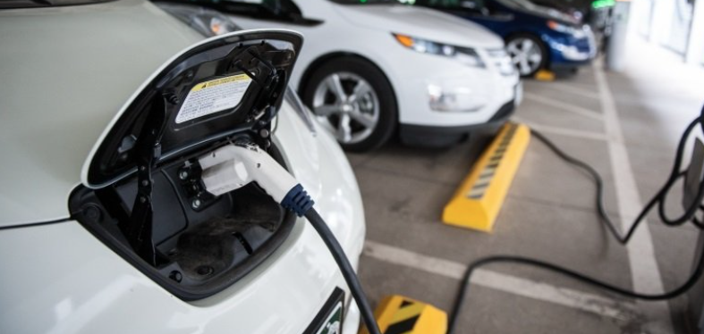
Rapid Demand Growth
Notes:
2022: 2.6% growth over next five years
2023: 4.7% growth over same period
2024: ICF says 9% growth by 2028
EPRI: Data Centers/AI alone could equal 9% of total demand
Evs: BofA: 8% 2024. 14% - 2027; 29% - 2030
Average EV usage: about 400 kwh/month
Average heat pump: 450 kwh/month

Slide 4
Large-Scale Retirements of Dispatchable Generation

Slide 5
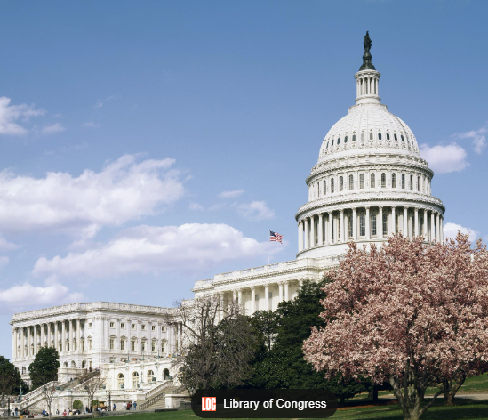
Carbon Constrained Policy Environment

Slide 6
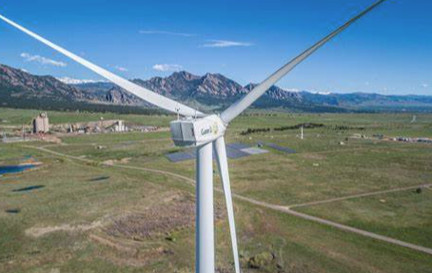
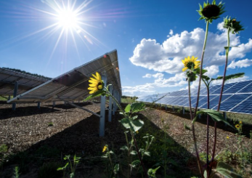
No Easy Near-Term Zero Carbon Capacity Replacement

Slide 7
Electricity Prices 2015 - Present

Slide 8
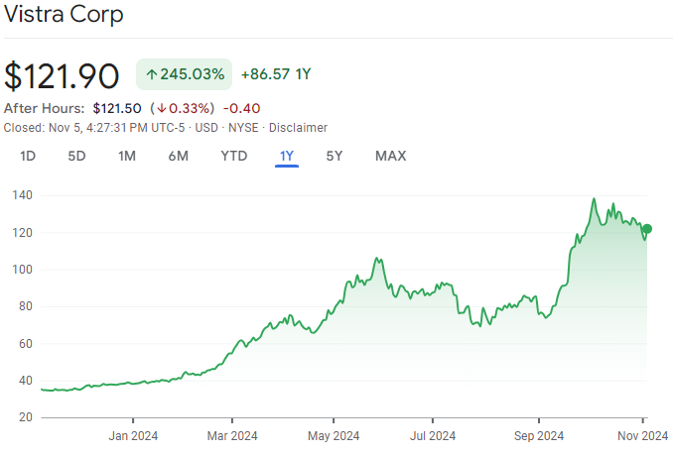
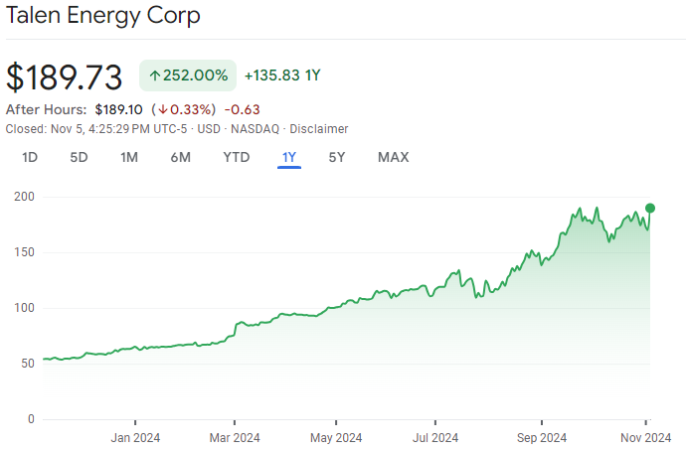
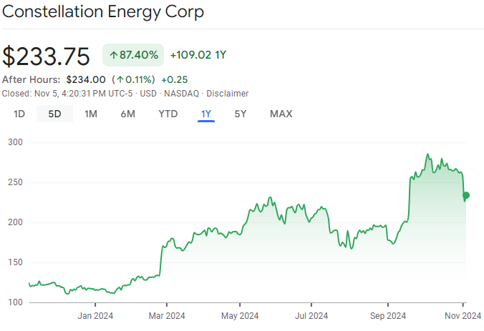
What Does Wall Street Think?

Slide 9
The Path Forward?
The Current Trajectory is Unsustainable
The Near Term is Uncertain – The Arc Less So
Impacts Will Vary by Region
Pragmatic Compromises Will Likely be Made
Regulations and Markets Will Need to Adapt
States Must Play a Vital Role

