Slide 1
Ag and Energy Nexus
Nancy Johnson
Executive Director North Dakota Soybean Growers Association

Slide 2
Where Did This Nexus Begin?
The U.S. Petroleum Crisis of 1979
In cities, it looked like this
In rural America, planters were stopped in fields due to lack of diesel fuel

Slide 3
How Did Ag and Energy Respond?
Farmers and ag engineers are problem solvers
About 3.5 million acres of sunflower were planted
Let’s solve this problem right here in N.D.
Traditional shallow drilling produced an oil boom and bust cycle in the ‘80s
Research was looking for a better answer as shallow horizontal drilling began in the ‘90s
Notes:
https://library.ndsu.edu/ir/bitstream/handle/10365/4667/farm_39_06_07.pdf?sequence=1&isAllowed=y
https://library.ndsu.edu/ir/bitstream/handle/10365/4663/farm_39_06_03.pdf?sequence=1&isAllowed=y
https://www.ndstudies.gov/energy/level2/module-2-petroleum-natural-gas/history-petroleum-and-natural-gas-north-Dakota
https://www.adm.com/en-us/news/news-releases/2007/10/adm-opens-biodiesel-production-facility-in-velva-nd/

Slide 4
How Did that Work Out?
At 100% sunflower oil, the droplets are about 3 times larger than petroleum diesel droplet
Coking the injectors wasn’t a great outcome since that affects engine performance
The focus changed and sunflower seeds now crushed for food oil
Notes:
https://www.upi.com/Archives/1984/08/20/National-Sun-Industries-the-worlds-largest-sunflower-processing-plant/4477461822400/

Slide 5
What are Biofuels?
The U.S. Energy Information Administration (EIA) publishes data on four major categories of biofuels that qualify for the federal Renewable Fuels Standard (RFS, 2005) Program:
Ethanol—an alcohol fuel blended with petroleum gasoline for vehicles; accounted for the largest share of U.S. biofuel production (82%) and of consumption (75%) in 2022
Biodiesel—a biofuel usually blended with petroleum diesel for consumption; accounted for the second-largest share of U.S. biofuel production (9%) and of consumption (9%) in 2022
Renewable diesel—a fuel chemically similar to petroleum diesel fuel used as a drop-in fuel or a petroleum diesel blend; percentage share of total U.S. biofuel production was about 8% and for consumption about 9% in 2022
Other biofuels—include renewable heating oil, renewable jet fuel (sustainable aviation fuel, alternative jet fuel, and biojet), renewable naphtha, renewable gasoline, and other emerging biofuels that are in various stages of development and commercialization
Energy Information Agency

Slide 6
Biomass – Renewable Energy
Renewable organic material that comes from plants and animals - feedstocks
5% of U.S. energy in 2023
Liquid transportation fuels is 36% of that

Slide 7
Diverse Oilseed Options for Farmers
Camelina was tried in 1999
Canola became another substantial oilseed crop
Several crushing operations came online in the region
Biodiesel production in North Dakota began in 2007
Relatively limited acres equals limited biofuels
Soybeans became a major row crop

Slide 8
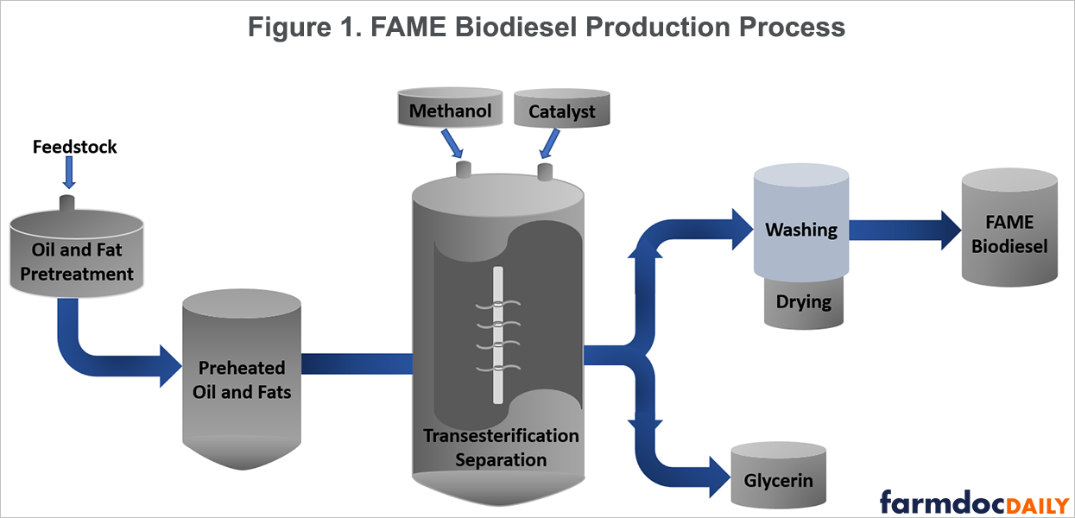
Biomass-Based Biodiesel
Produced by trans-esterification of vegetable oils and animal fats
Typically blended with petroleum diesel
Vegetable Oil
EIA
Notes:
Biodiesel is one of the first biofuels
Rudolf Diesel, the inventor of the diesel engine in 1897, experimented with using vegetable oil as fuel in his engines. The fuel made from vegetable oils and animal fats that we call biodiesel today is named after him because it is mostly used in diesel engines (as is petroleum diesel fuel). Biodiesel meets the ASTM specification D6751 and is approved for blending with petroleum diesel/distillate.
Biodiesel is produced by transesterification of vegetable oils and animal fats. In transesterification, the feedstock chemically reacts with an alcohol (usually methanol) in the presence of a catalyst, like lye. The products are glycerin and the biodiesel fuel or FAME (fatty acid methyl esters). Vegetable oils (mainly soybean oil) are the main feedstocks for U.S. biodiesel production. Other major U.S. biodiesel feedstocks include animal fats from meat processing plants and used (recycled) cooking oil and yellow grease from restaurants.
1 oil barrel is 42 gallons

Slide 9
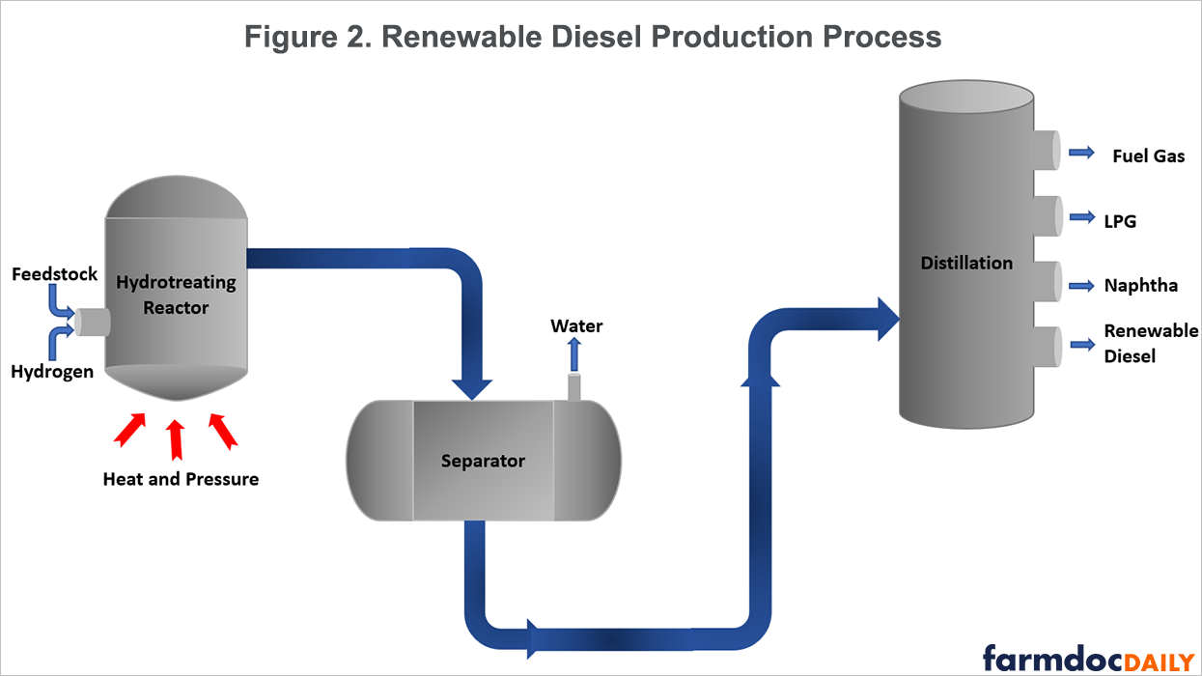
Renewable Diesel
Can be produced from nearly any biomass feedstock, through a variety of processes, such as hydrotreating
A hydrocarbon that is chemically equivalent to petroleum diesel and can be:
Used as a drop-in biofuel
Transported in petroleum pipelines
Sold at retail stations with or without blending with petroleum diesel
EIA
Notes:
Renewable diesel production uses a hydrogenation process rather than the esterification process used to produce biodiesel. Because renewable diesel is a drop-in fuel, it meets ASTM D975 specification for petroleum diesel and can be seamlessly blended and transported with petroleum diesel.
Most renewable diesel is hydrogenation-derived renewable diesel (HDRD) or hydroprocessed esters and fatty acids (HEFA) produced by hydrogenation of triglycerides, a similar process used for desulfurizing petroleum diesel. So, existing petroleum refineries can be converted to renewable diesel production with only modest changes. However, hydrotreating renewable feedstocks requires significantly more hydrogen than desulfurizing diesel, and the source of the hydrogen could affect whether or not the renewable diesel can meet national or state standards for biofuels. Other methods can be used for renewable diesel production, such as gasification and pyrolysis. Renewable heating oil is similar to renewable diesel fuel but meets ASTM D396 for fuel oils.

Slide 10
Soybean Crush Plants
Notes:
Figure 4. Soybean Oil Used for Renewable Diesel Production
This growing demand for soybean oil for biofuels is supporting an expansion of soybean crush facilities in the U.S. In 2023, the U.S. soybean crush industry processed 2.29 billion bushels of soybeans utilizing 90% of nameplate crush capacity in the U.S.Crush capacity is expected to increase to 2.7 billion bushels by the end of 2024 and to 3.23 billion bushels by the end of 2027. If annual utilization rates remain near 90% (downtime for repairs and maintenance) then crush in 2024 could approach 2.42 billion bushels, 2.7 billion bushels by the end of 2025, 2.81 billion bushels by the end of 2026, and 2.89 billion bushels by the end of 2027. Figure 5 shows where and when the new/expanded crush capacity is expected to be developed. Construction has already started on plants due to come online in 2024 and 2025. Planning is advancing for the plants due to come online in 2026 and 2027.

Slide 11
Feedstocks - 2022
Feedstock Inputs to U.S. Biodiesel, Renewable Diesel and Other Biofuels Production

Slide 12
Nexus
Notes:
Marathon is 12,500 bbl day, 18,900,000 gallons in 360 day year.
10 biodiesel plants in Iowa, 2 now owned by Chevron, 350million gallons year.

Slide 13
Diesel Markets Seeking Clean Fuels
Over-the-road
55 billion gallons per year diesel demand
Currently, biodiesel and renewable diesel meet 8% of U.S. on-road heavy-duty fuel demand
Aviation
26 billion gallons per year kerosene demand
Shipping/Marine
Domestic and international = 6.8 billion gallons per year
Home heating
4 billion gallons per year
Off-road (construction, farming)
4 billion gallons per year
Railroads
Passenger and freight = 3.8 billion gallons per year

Slide 14
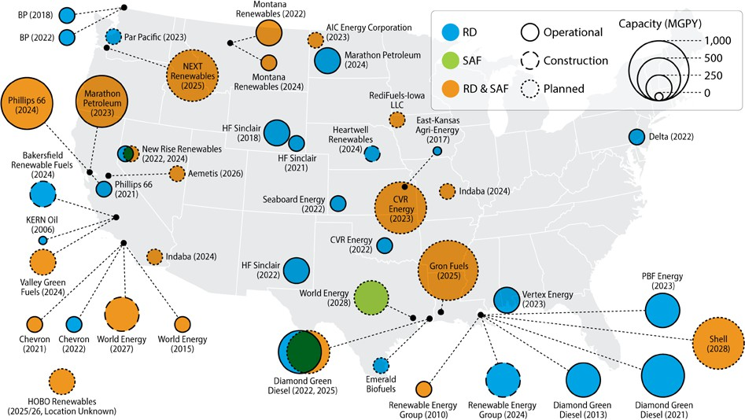
Planned RD and SAF Capacity
Location and capacity of HEFA SAF and RD facilities
Includes co-processing facilities
Announced total capacity for SAF is expected to reach 2 billion gallons by 2030, with the majority from HEFA
An additional billion gallons would be needed to meet the Grand Challenge
Source: NREL, Sustainable Aviation Fuel State-of-Industry Report: Hydroprocessed Esters and Fatty Acids Pathway, July 2024.
Notes:
HEFA Hydrotreated esters and fatty acids. RD, SAF
National Renewable Energy Lab.

Slide 15
Biodiesel, RD and SAF Growth
U.S. domestic production reached 4 billion gallons.
2024
Per Energy Information Administration, renewables meet 9% of U.S. distillate demand.
2023
2030
Per NREL, potential 9.6 billion gallons of capacity, including 2 billion gallons of SAF.
Renewable diesel capacity grew by 1.3 billion gallons.
Domestic production on pace for 4.5 billion gallons.
Source: EPA Moderated Transaction System, Oct. 2024

Slide 16
Use of All Feedstocks Increasing
In 2021, the U.S. exported 50% of collected used cooking oil (UCO)/ yellow grease and tallow
In 2023 and 2024, U.S. is a net importer of UCO, tallow, and canola
Use of soybean oil and distillers corn oil at record levels
Source: EIA Monthly Biofuels Capacity and Feedstocks Update, Sept. 2024.

Slide 17
§45Z Clean Fuel Production Credit
Producer tax credit
Replaces blender excise credit, which expires on December 31
Producer income credit based on lifecycle carbon score
Combination of feedstock and production technology, finished fuel and market changes
Waste oils – used cooking oil, distillers corn oil – have lower carbon scores so anticipate a higher credit
Timing
Oct. 1 press conference by Acting Assistant Secretary for Tax Policy Aviva Aron-Dine
“We continue to actively work on guidance for the section 45Z Clean Fuel Production Credit, which takes effect on January 1, 2025”
Heatmap interview with Deputy Treasury Secretary Wally Adeyemo
“Focusing on [clean hydrogen] means that there’s going to be clear trade-offs.”

Slide 18
Renewable Fuel Standard
The volumes for 2023-2025 “were set significantly lower than production trends” – Energy Information Administration
EIA significantly revised biodiesel and renewable diesel projections after 2020. EPA used inconsistent projections
EPA expects to propose 2026 volumes by March 2025 and finalize them by December
By statute, the volumes were due by Nov. 1, 2024
Biomass-based Diesel RFS Volumes
Billion Gallons | Volume EIA Projected | Volume EPA Set
2020 | 2.16 | 2.43
2021 | 2.08 | 2.43
2022 | 2.45 | 2.76
2023 | 4.48 | 2.82
2024 | 4.93 | 3.04
2025 | 4.73 | 3.35

Slide 19
Farm Bill
Advanced Biofuel Payment Program
Farm, Food, and National Security Act of 2024 (House version of Farm Bill) would reauthorize and provide mandatory funding at same level as 2018 farm bill
Direct USDA to update life cycle assessment for soy biodiesel and renewable diesel
Farm to Fly Act
Rep. Max Miller (R-OH) – enables Energy Title programs to support SAF - defines SAF to be consistent with 40B/45Z tax incentives
Some provisions included in House bill

Slide 20
Thank You

