Slide 1
State of Reliability in North America
Midwest Energy Summit Camilo Serna - Senior Vice President, Strategy and External Engagement
November 7, 2024

Slide 2
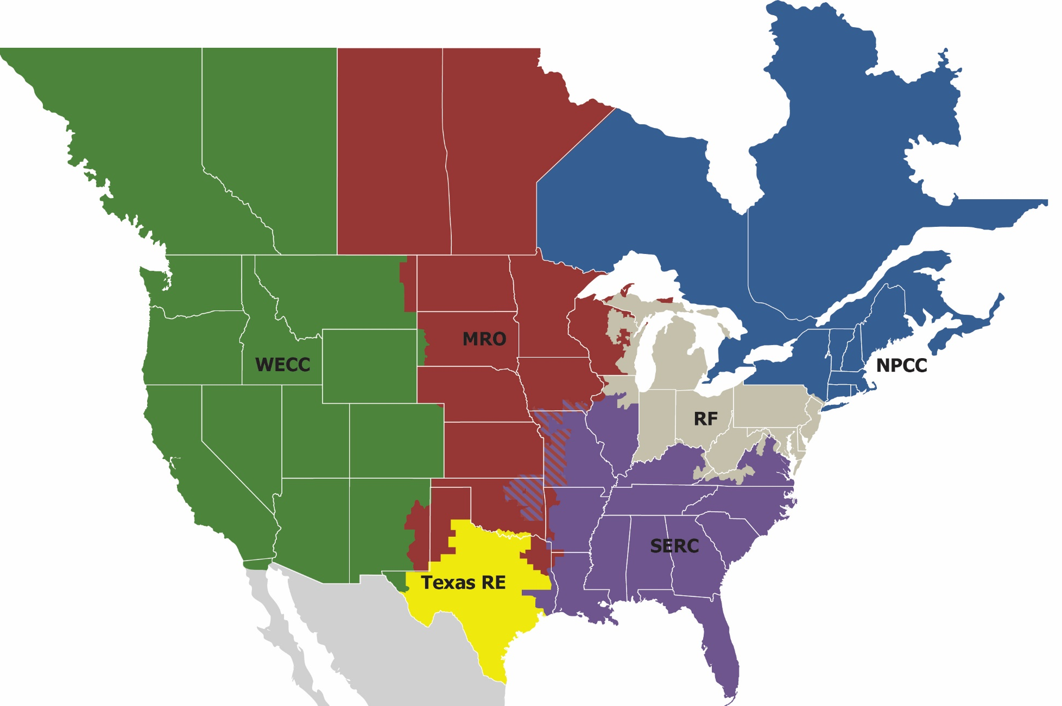
NERC and the ERO Enterprise
The vision for the ERO Enterprise, which is comprised of NERC and the six Regional Entities, is a highly reliable and secure North American Bulk Power System (BPS). Our mission is to assure the effective and efficient reduction of risks to the reliability and security of the grid.
Notes:
Evan to speak to regional entity background

Slide 3
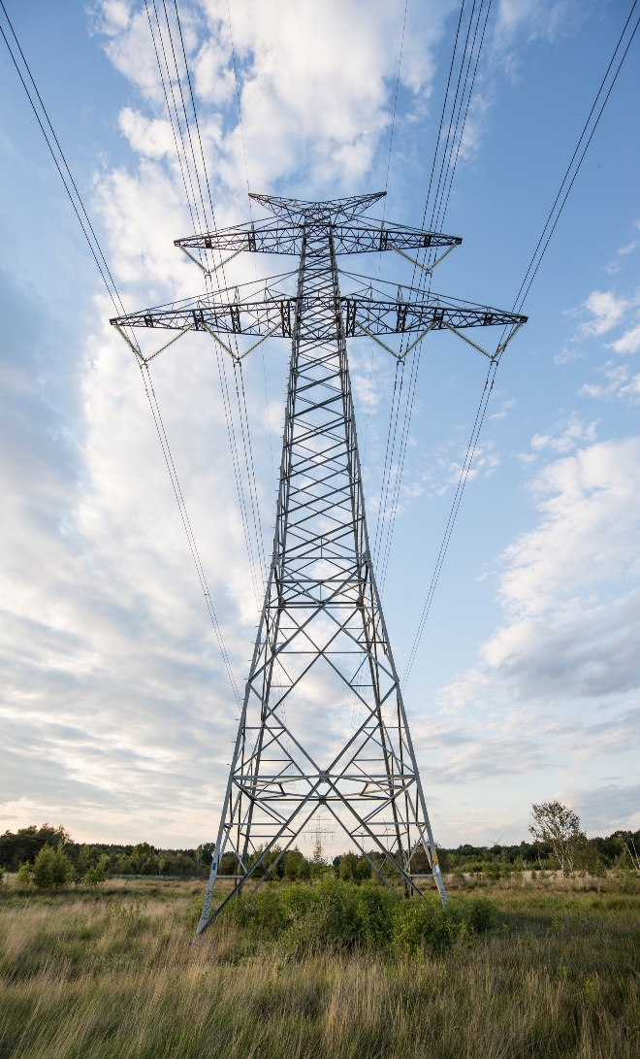
Hyper Complex Risk Environment
Rapidly Changing Resource Mix
Accelerating Demand Growth
Extreme Weather Complexities
Evolving Threat landscape

Slide 4
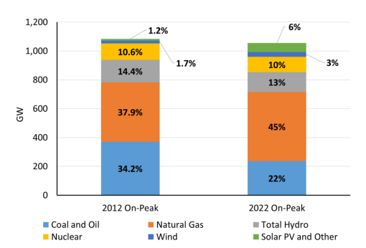
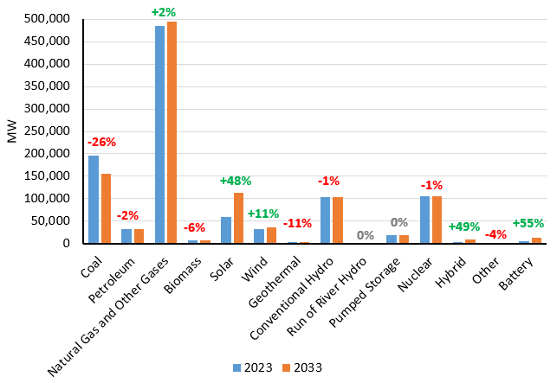
Rapidly Changing Resource Mix
NERC-Wide 2012 vs 2022 Peak Capacity Resource Mix
NERC-Wide On-Peak Capacity by Fuel Type

Slide 5
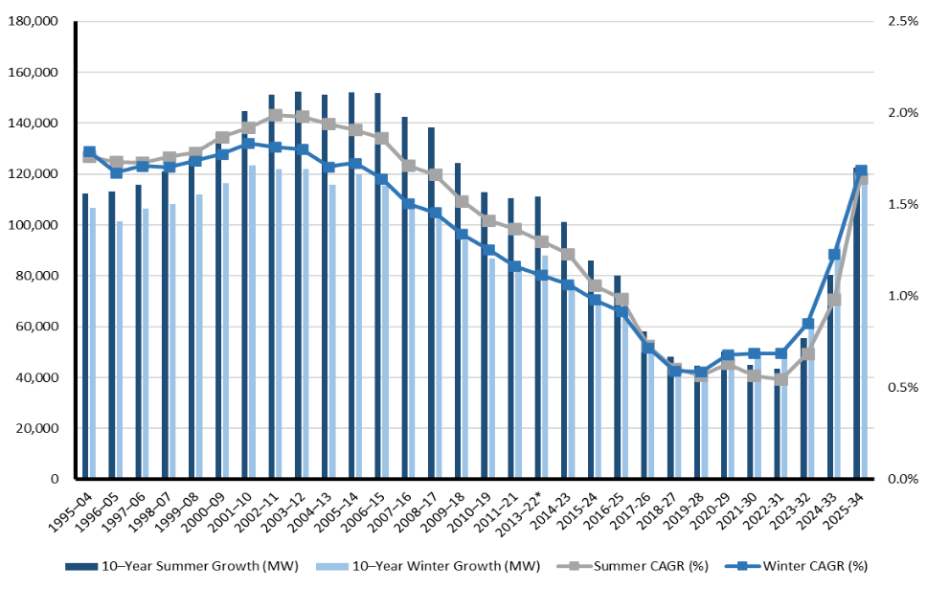
Accelerating Demand Growth
NERC Wide Projected Summer Peak Demand – 1995/2004 to 2025/2034 LTRA

Slide 6
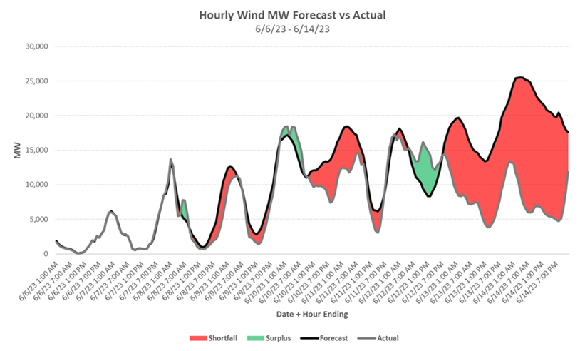
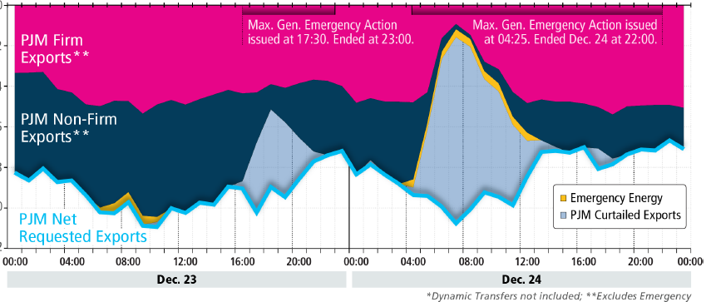
Extreme Weather Complexities
ERCOT Hourly Wind MW Forecast vs. Actual
Net Scheduled Export Interchange* (MWh, Thousands)
June 6, 2023: ERCOT, SPP, MISO: A “wind drought” caused 60 GW of installed wind capacity to generate 300 MW
December 24, 2022: PJM: Transmission system during extreme cold weather limited the ability to export to support southern neighbors

Slide 7
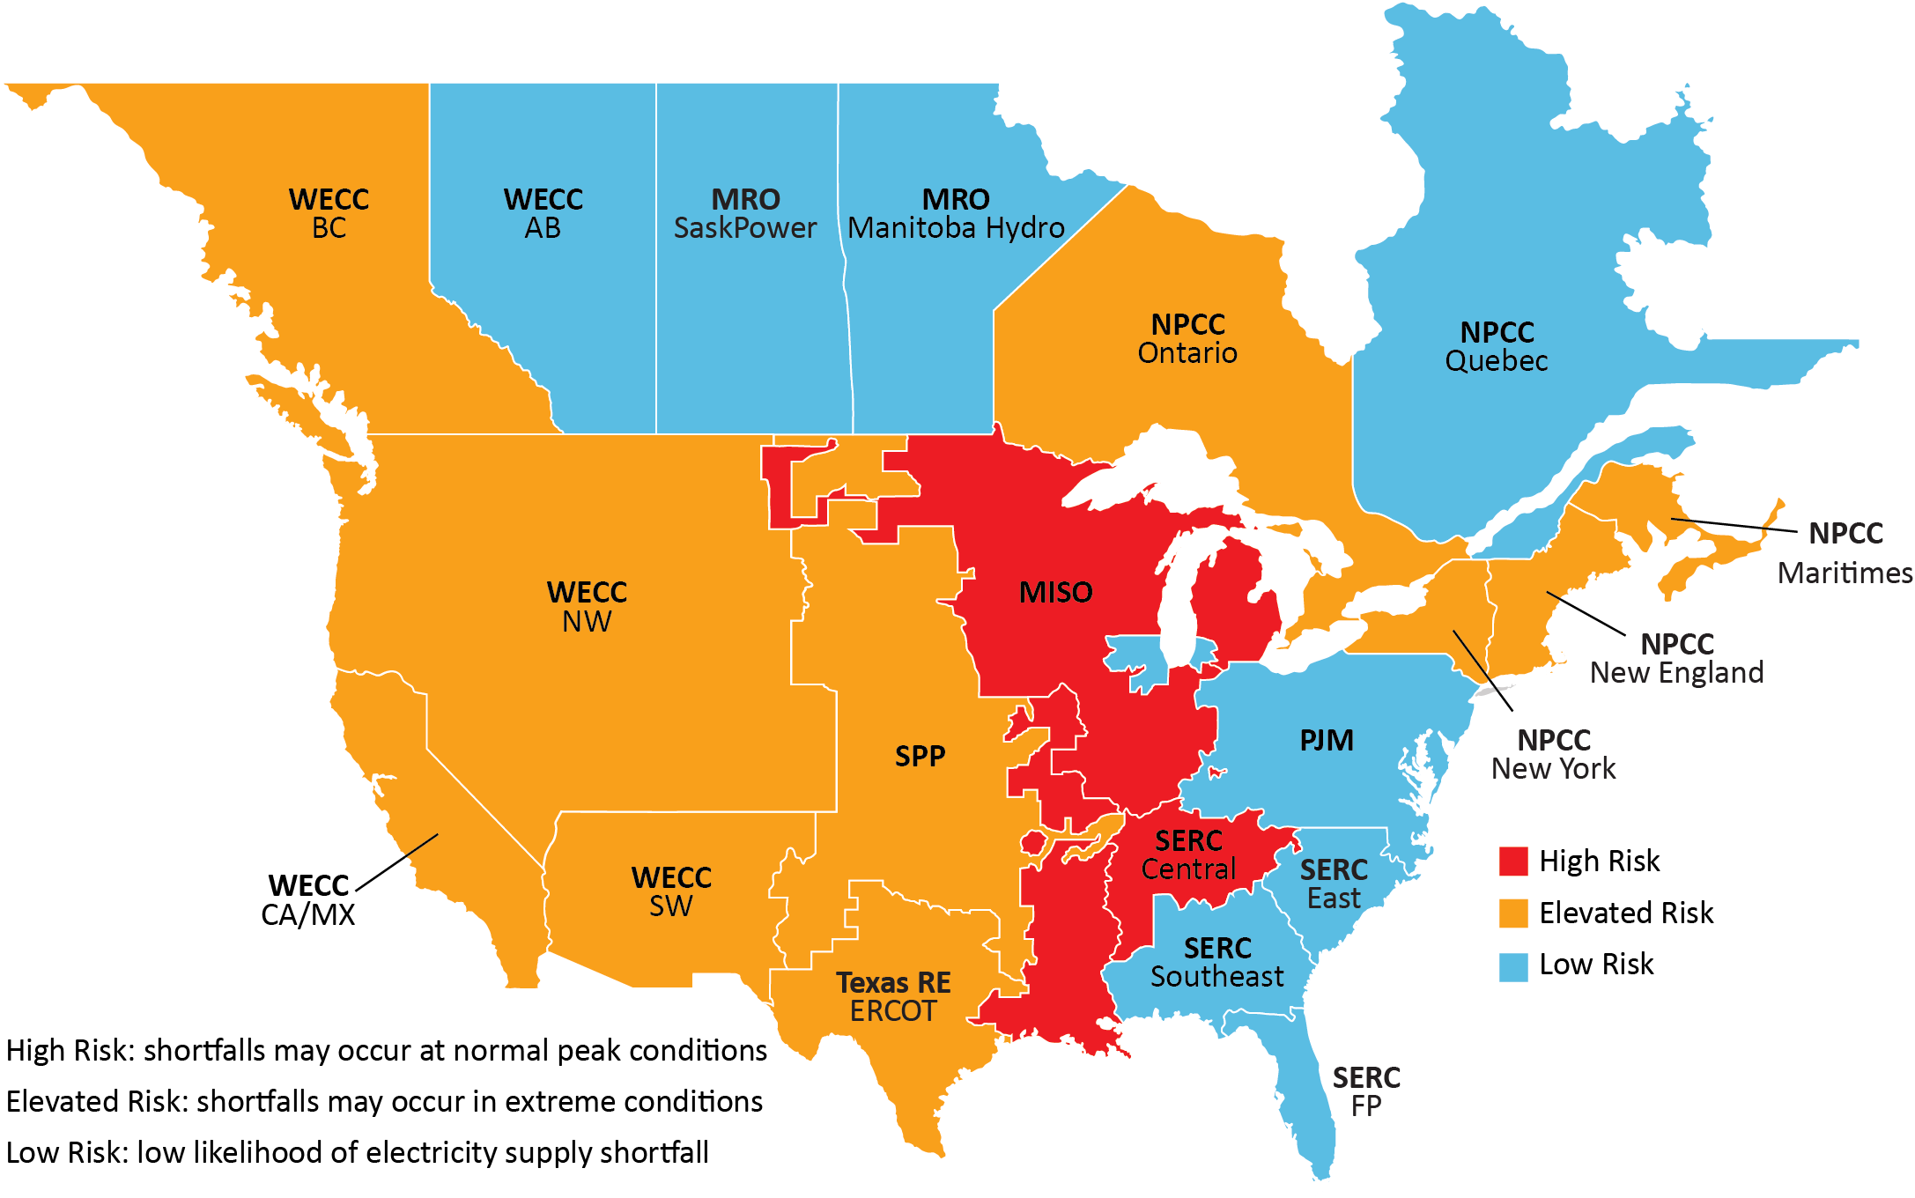
Long-Term Reliability Assessment
2023 - 2033 Long-Term Reliability Risk Area Summary

Slide 8
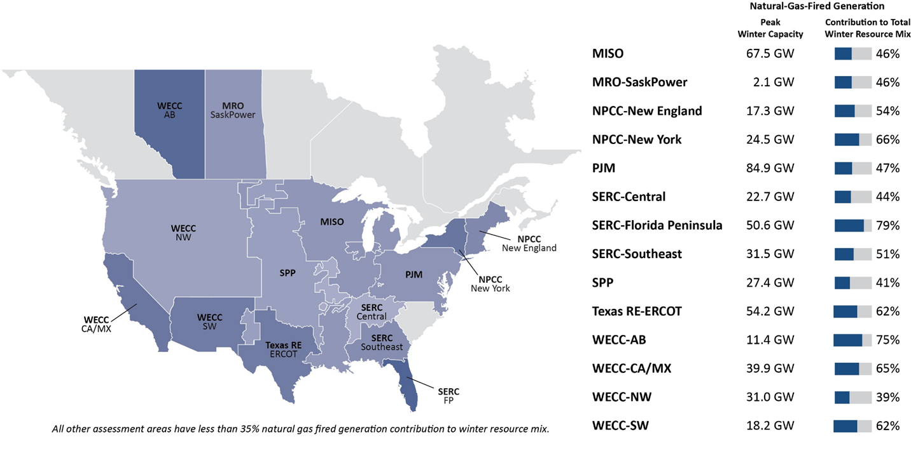
Increasing Dependence on Natural Gas
Natural-Gas-Fired Generation Capacity Contributions to 2023–2024 Winter Generation Mix

Slide 9
Reliability Priorities
Identify and deploy new resources to replace retiring generation that provide both sufficient energy and essential reliability services needed for stable grid operations (such as flexibility, voltage support, frequency response, and dispatchability)
Develop sufficient transmission, to integrate renewables and distribute them, make the system more resilient
Shift focus from planning for solely “capacity on peak” to “energy 24x7” due to the changing fuel mix
Address gas/electric interface through more gas infrastructure, increased information sharing, appropriate market-based incentives and consideration of accountability mechanisms (i.e., Gas Reliability Authority)
Ensure a robust energy supply chain for the balancing resources, with sufficient access to fuel and stored energy to withstand long-duration, wide-spread extreme weather events
Given potential significant increased demand due to electrification and large load development, planning for this growth must be calibrated with the reliability needs of the BPS

Slide 10
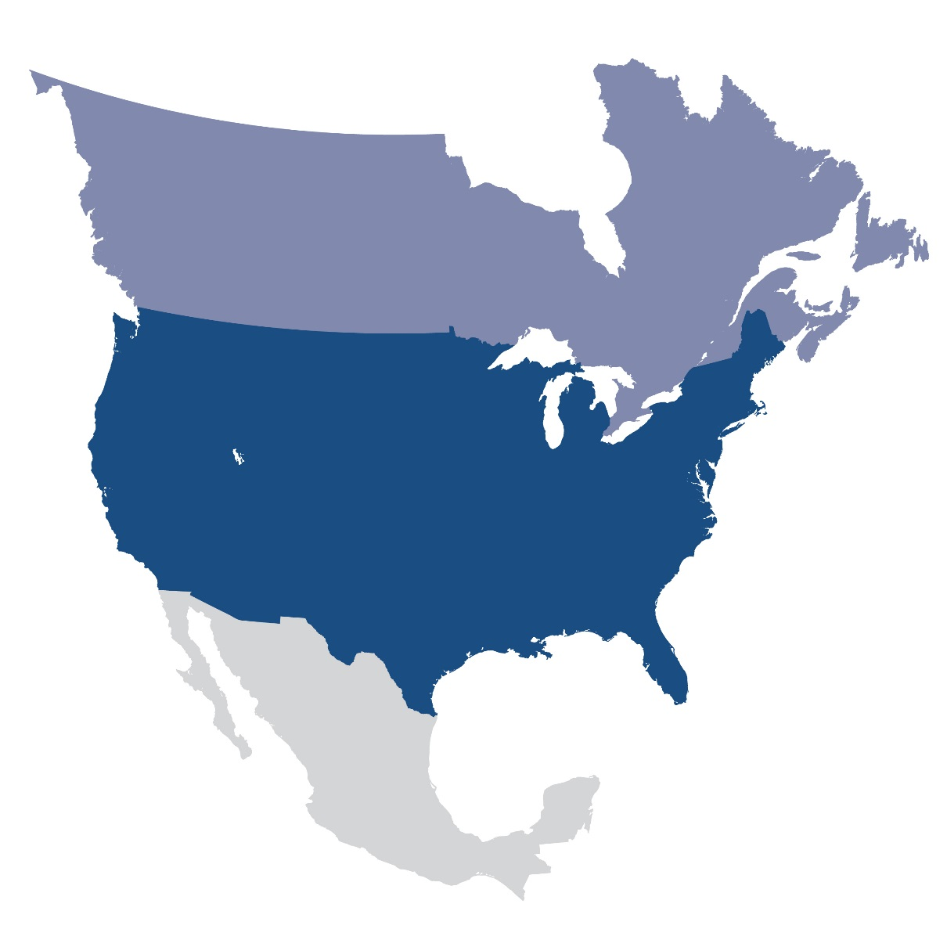
Feedback/Questions?

