Slide 1
I DON’T LIKE IT, SO YOU CAN’T HAVE IT!
SELF-SENSORSHIP IN THE LIBRARY
A PRESENTATION BY THE OHIO LIBRARY COUNCIL’S
INTELLECTUAL FREEDOM COMMITTEE

Slide 2
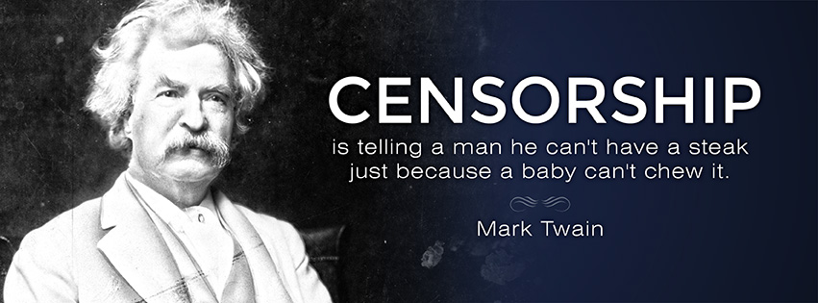

Slide 3

Why Self-Censorship Matters
It’s the NUMBER ONE way in which materials are censored within libraries!
Unlike externally imposed forms of censorship, it offers no review process. The only person/people who even know(s) the censorship took place is/are the librarian(s) involved.
It can dramatically alter the library collections, cost libraries patrons, and make collections feel less friendly to populations who are historically underserved already.

Slide 4
Never Have I Ever…
Opted not to order something controversial because “it won’t circulate.”
Told myself we didn’t need a book because “it’s poorly written.”
Reassured myself that I didn’t have to order a certain title because “we don’t have people like that in our library.”
Shied away from ordering something because “it will get stolen.”
Argued that I couldn’t afford to purchase something controversial because the “budget has been cut.”
Refused to make a purchase because of what it would say about me if I ordered it.
Decided not to purchase a book because it contained “unproven science.”
Let fear of a complaint or challenge guide my purchasing decisions.
Let myself avoid ordering a book because I knew other libraries would have it.
Notes:
Everyone STAND UP!
We’re going to play a game of “Never have I ever.” The rules are simple. When I read a sentence that you HAVE done, you sit down. Don’t be shy, don’t be ashamed, and don’t be in denial. The first step to fixing the self-censorship problem is acknowledging the many ways it exists. We can’t do that if we can’t recognize those actions when we, ourselves, take them.

Slide 5
Ordering the Materials Is Not Enough
Often, materials are censored even after they have made it through the libraries doors:
Intentionally poor displays that hide book covers or titles
Misleading or assumptive genre or subject headings
Intentional misplacement of books
Age limits on materials imposed by the library rather than the parents
Locking up controversial materials, or making patrons request them from staff
Claiming titles are checked out or missing if the librarian decides the material is not appropriate for the patron seeking it

Slide 6
Book Presentation
Displays: If you avoid creating certain displays, even if you know they are relevant, you are self-centering. If you intentionally place books so that they are “hiding” within the display you are self-censoring. Display space should, at varying times throughout the year, represent all library users.
Genre & subject headings: Be cognizant of who your genre and subject headings are excluding and including, and whether that inclusion is always a good thing.
Book placement in the collection: If the book is being marketed as a teen book, don’t place it in the adult section just because the content is controversial. It can no longer be found easily by the target audience and is unlikely to get much traffic via the audience you’ve forced it upon.
Notes:
Displays: LGBT theme displays during PRIDE month, for example
Genre & subject headings: Lumping all books about black people or by black authors into “Urban Lit” or “Street Lit” is a form of self-censorship, as it discourages people from outside this subgroup to read them. Calling a section that contains nothing but Christian-themed stories “Family Literature” implies that non-Christian stories are not family-friendly, or that non-Christian families are not as “wholesome.”
Book placement in the collection: This is most frequent with books on sex, sexuality, and transgender issues. These issues concern children and teens, so put these books where they belong!

Slide 7

Materials Access
Age Limits: If a parent wishes to impose age limits on certain material they may do so, either via age-restrictive library cards or (better yet) by being at the library and deciding, in person, what their child can take home.
Requesting materials: Controversial materials that are not expensive and/or are not needed for routine reference questions should not be locked up or kept behind a reference desk, as it discourages use.
I just don’t want to give it to them!: Refusal to provide requested materials that are available in the system is a dereliction of your duty as an information professional.
Notes:
Age Limits: It is NOT OUR JOB to impose age limits on material, no matter how old, or young, a patron is. Age-restrictive library cards should NOT restrict things based on topic or genre. They should restrict items based on DEPARTMENT. A child’s card will not work in the teen or adult dept, a teen card will not work in the adult dept.
Requesting materials: Rare materials, such as local history materials, yearbooks, or micro-film can absolutely be kept under lock & key, but access to them should not be denied arbitrarily. Those materials that are heavily used for reference questions should, when possible, have an easily accessible duplicate in the circulating collection.
I just don’t want to give it to them!: TOO BAD.

Slide 8

Preventing Self-Censorship
Know your biases
Avoid genres or subcategories with unwanted implications
Make sure you’re not actively trying to hide books because they make you uncomfortable
Always ask yourself “why” you’ve excluded certain books or authors
Have a formal complaint procedure that gets used EVERY TIME there is a materials challenge, no matter who the challenge comes from
Make sure librarians and collection developers are not punished for complaints!
Remember that it’s not your job to tell people what type of information they can have
Notes:
Know your biases: There are a number of tests you can take on-line that will help you assess your unconscious biases, the most well-known being out of Harvard. Project Implicit allows you to test a variety of known biases to see whether or not you hold any of them. An easy way to test your bias in the moment is to simply as yourself “why don’t I like ‘x’ or why does ‘x’ make me uncomfortable?” Whether ‘x’ is a person, a place, or a book, the answer may well tell you some of your biases.
Genres and subcategories: It’s less about the genre heading and more about how you use it. If the combination of genre heading and titles contained seem to imply that you are saying a particular type of patron should be drawn to this section (white, black, male, female, gay, straight, and so forth) you may want to rethink either the types of headings you are using, or how you are using them.
Don’t punish your people: In the event of a materials challenge, do NOT punish the librarian who ordered the item! They already feel awful enough and are already questioning their ordering capabilities and standards. Punishing them simply because a patron or another librarian disagreed with what they selected will only discourage them from doing their job.

Slide 9

The Complaint Process
In the event of a complaint, the following is an example
process a library could follow to ensure all parties are
treated fairly:
Ensure the library has a detailed complaint form. Present the aggrieved with this form and ask that they fill it out.
Gather a review panel.
Regardless of the outcome, a detailed explanation should be made available to all library staff who wish to read it. If the patron elected to be notified of the outcome, a form letter detailing the review panel outcome should be sent.
Notes:
Part of this form should contain a space for the collection developer or librarian’s ordering-thought-process. Why did they feel it was needed for the collection?
The review panel should be as varied as possible, with men & women, people of different colors, people of different ages, even people of varying work titles. If more than one panel is gathered in a six month time period, avoid having the exact same people each time, if possible.

Slide 10
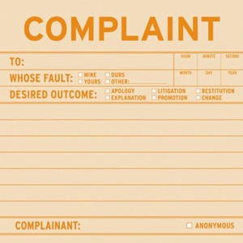
The Complaint Form
The Materials “Request for Reconsideration” form should contain, at a minimum, the following questions for the person making the request:
Item title, author, and format
Department item was found in
Nature of the complaint/reason for the request
Desired outcome
Notes:
Nature of the complain: Why are you asking that we reconsider this particular item? How or why has this item offended you?
Desired outcome: This is important because a lot of patrons who complain do not actually want the materials removed, they just want them moved off a display, to another department, etc. It may turn out that it is possible to satisfy the patron’s request without removing materials from the library.

Slide 11

The Review Panel
Any review panel gathered to process a request for reconsideration should consider the following questions, at a minimum:
What is the nature of the complaint? What is “wrong” with the material?
What is the desired outcome? Can this outcome be met without removing the item from the collection?
Is this a complaint that a reasonable person could pose?
Why did the staff member who ordered the material do so? What role or purpose did they foresee it having in the collection?
Can the complaint be mitigated without violating the intellectual freedom of other library users?
Notes:
Does the material contain too much sex? Violence? Etc.
What does the patron want from this? Can we give it to them and still keep library materials?
Consider the personality of the patron. Are they a patron with any obvious biases and, if so, is the complaint in line with the biases? Is the complaint one that you could foresee an average library user making, or does it seem like a complaint that stems from “hyper-sensitivity” to the topic at hand?
If the materials were ordered for a particular purpose- to attract a target audience or fill a hole in the collection, for instance- consider whether they are successfully doing that. If they are, keeping them in spite of the complaint is likely your best bet.
If the complaint cannot be mitigated without violating the intellectual freedom of other library users, then the complaint cannot be mitigated. Those who do not like library materials are welcome to avoid reading them. Violating another’s right to do so in order to appease the sensibilities of an offended patron should never be considered an acceptable outcome.

Slide 12

Oh, No! This patron is complaining! What now?
Possible patron complaints to look out for:
This book/DVD/item offends me!
Why did you order this?
Who ordered this? I demand to speak to them.
Please remove this item immediately.
Who is reading this garbage?
These items don’t belong in the library.
Notes:
Possible answers:
This book/DVD/item offends me!
“If you would like it removed, we have a request for reconsideration form that you can fill out. No item can or will be removed from the library collection until it has been properly considered by a review panel.”
If they continue fighting with you, it may be worthwhile to remind them that some of what they read likely offends other patrons. If they wish to have books of interest to them on the shelves, they may be required to tolerate books of interest to others.
Why did you order this?
“It filled a particular hole in the collection.”
“We have patrons who are interested in the topic.”
Don’t be afraid to pass the buck! “I’m uncertain. I did not order the title and I do not typically involve myself in collection development.”
Who ordered this? I demand to speak to them.
“It is not our policy to retain a record of which staff members ordered which items. I could not tell you that.
Please remove this item immediately.
This is one where the best answer is often to do as they ask, albeit it temporarily. Place the book behind the reference desk and, after the patron has left the premises, reshelf it.
Who is reading this garbage?
“We are not at liberty to discuss the reading habits of other patrons with you, just as we are not at liberty to discuss your reading habits with other patrons.”
These items don’t belong in the library.
- “If you would like it removed, we have a request for reconsideration form that you can fill out. No item can or will be removed from the library collection until it has been properly considered by a review panel.”

Slide 13
Questions?
Comments?
Complaints?
Stories and Examples?

Slide 14
For More Information:
The Ohio Library Council’s Intellectual Freedom Committee: http://olc.org/about-us/divisions/intellectual-freedom-committee/
The American Library Association’s Intellectual Freedom Committee: http://www.ala.org/advocacy/intfreedom

